Slide 1
CS5570 Architecture of Database Management Systems
Concurrency Control mechanisms
Kendall Bingham Computer Science Electrical Engineering University of Missouri-Kansas City Kansas City, MO, USA.

Slide 2
Concurrency Control Mechanisms (CCMs) Two-Phase Locking (2PL)
Introduction to CCMs
Transaction Properties Revisited
Two Phase Locking Approach
Correctness
Implementation
Limitations

Slide 3
DBMS Architecture

Slide 4
Transaction Properties Revisited
Atomicity (A): Implemented by Roll-back operation
Consistency (C): Implemented by consistency constraints.
Isolation (I): Implemented by the Scheduler
Durability (D): Implemented by recovery manager

Slide 5
Scheduler
Isolation
It guarantees that any time only one conflicting operation has access to a data item.
Definition: Let x be a data item. Isolation at time t_{i} between two conflict operations r_{j}[x] and w_{k}[x] and w_{j}[x] and w_{k}[x] exists
if r_{j}[x] exists then w_{k}[x] either does not exist or waits for x to become available
If w_{k}[x] exists then w_{j}[x] either does not exist or waits for x to become available
Isolation is required only when one of the operation is a write.

Slide 6
Scheduler
Isolation Solutions
If r_{j}[x] exists then w_{k}[x] does not exist represents an immediate roll-back scenario
If w_{k}[x] exists then w_{j}[x] waits for x to become available represent a blocking scenario
These two options are combined in a variety of ways to develop a number of conflict resolution policies. Each policy defines a unique concurrency control mechanism.

Slide 7
Types of Scheduler
We identify two categories of schedulers
Aggressive: Avoids delaying operations. The scheduler immediately resolves the conflict my rolling back one of the conflicting transaction. Thus, if T_{i} conflicts with T_{j} then either roll-back T_{i} or T_{j} using a set of predefined policies
Conservative: The scheduler forces one of the conflicting transactions to wait for the other transaction to complete or to reach at some execution point.
These two policies can be combined in a large number of ways. Some combination may not be meaningful from performance viewpoint in resolving a conflict.

Slide 8
Some Definitions
We define the following items for a transaction:
Holder (T_{h}) = T_{i} that has x for processing.
Requester (T_{r}) = T_{i} that request x for processing.
If T_{h} ∩ T_{r} ≠ ∅ then sooner or later they will conflict.
Read set (RS) = The set of data items T reads
Write set (WS) = The set of data items T writes
Usually RS(T_{i}) ∩ WS(T_{i}) ≠ ∅. In this case T_{i} applies r and w operations on x. If RS(T_{i}) ∩ WS(T_{i}) = ∅ then either T_{i} is a read transaction (no write operation) or it is a write transaction (no read operation).

Slide 9
Aggressive Vs. Conservative
An aggressive scheduler immediately resolves conflict by rolling-back T_{h} or T_{r}. The selection of T_{h} or T_{r} depends on the conflict resolution policy. This quick decision does reduce transaction waiting time but introduces the possibility of
Repeated roll-back: T_{h} or T_{r} may be rolled-back multiple times
Cascading
Rigid decision (inflexibility)
Violation of serializability

Slide 10
Aggressive Vs. Conservative
An conservative scheduler takes time to resolve a conflict. Usually it blocks T_{h} or T_{r} on the basis of a set of predefined criteria. This delayed decision does reduce transaction roll-backs but may introduces the possibility of
Deadlock
Number of blockings
Low level of concurrency (may degenerate to a serial execution)

Slide 11
Aggressive Vs. Conservative
All schedulers have an aggressive and conservative version (approaches). Since the data processing requirements varies with organization, type of data, temporal and spatial properties of data, transaction rate, workload, available resources, etc., it is hard to identify one scheme that could work efficiently in each situation. However, some mechanisms provide satisfactory performance in most cases.

Slide 12
Locking-Based Conflict Resolution Approach
We will begin our discussion on locking-based isolation approaches. We define the following two additional operations:
Lock_{i} (x) = l_{i}(x): T_{i} locks x for its use.
To manage conflicts (r-w and w-w) there are Share (Read) lock and Exclusive (Write) lock. Share (Read) lock or allows non-conflicting operations (r-r, inc-inc, dec-dec) to continue together (parallel or concurrently). An Exclusive lock cannot be shared.
unlock_{i} (x) = u_{i}(x): T_{i} unlocks x and releases it for T_{j}.
Read lock (x) = rl_{i} (x). Write lock (x) = wl_{i} (x)

Slide 13
Lock Table
A lock manager uses a lock table to record the status (locked or free) of a data item. A sample lock table is shown below:
Data structure of a lock table: A hash table. Usually data item id serves as a hash key.
Data Item | Operation | Transaction ID | T Status
x | r_{i} | T_{i} | Active
y | w_{i} | T_{i} | Active
x | w_{i} | T_{j} | Blocked by Ti

Slide 14
Lock Table
A lock is very frequently accessed by the scheduler so it is a hot data. Most frequently accessed part of the page table resides in RAM and other parts are paged in on demand.
Locking and unlocking cost: about a thousand instructions.
Lock table entries are reused when a data item is released.

Slide 15
Lock Conflict
Y = There is a conflict. N = There is no conflict.
rl_{i}(x) = T_{i} applies a read lock on x.
wl_{i}(x) = T_{i} applies a write lock on x.
ru_{i}(x) = Scheduler unlocks read lock on x for T_{i}.
wu_{i}(x) = Scheduler unlocks write lock on x for T_{i}.
Operation | rl_{j}(x) | wl_{j}(x)
rl_{i}(x) | N | Y
wl_{i}(x) | Y | Y
Notes:
TODO Grid needs updated

Slide 16
Two-Phase Locking (2PL) Policy
Concurrent operation must be managed correctly to resolve “dirty read”, “unrepeatable read”, and “Lost update.” 2PL policy states: Locking phase (growing phase) and Unlocking (releasing) phase must be mutually exclusive
Lock_{i} (x) = l_{i}(x): T_{i} locks x for its use.
To manage conflicts (r-w and w-w) there are share lock and exclusive lock. Share lock allows non-conflicting operations (r-r, inc-inc, dec-dec) to continue together (parallel or concurrently). An exclusive lock cannot be shared.
unlock_{i} (x) = u_{i}(x): T_{i} unlocks x and releases it for T_{j}.

Slide 17
Two-Phase Locking (2PL) Policy
A transaction must mutually exclude its locking and unlocking phases. This means that a transaction cannot release one of its locked data items and subsequently tries to lock a new data item.
If every transaction follows this 2PL policy then execution of concurrent transactions will preserve database consistency.
To understand the concept, working, and implementation of 2PL scheduler, we will proceed as follows:
Understand the concept and policy
Discuss its behavior
Proof its correctness (it produces SR history)

Slide 18
Basic 2PL Locking
There are many ways to enforce 2PL policy. We will discuss most of the variations and evaluate their behavior. We first discuss Basic 2PL concurrency control mechanism. Steps of Basic 2PL:
TM sends an operation p_{i}[x] of T_{i} to the scheduler. The scheduler checks if x is locked by T_{j} in a conflicting mode (q_{j}l[x]). If Yes then scheduler blocks T_{j} for x (T_{j} is blocked by T_{i}).
If x is free or locked by T_{j} in share mode then the scheduler applies p_{i}l[x] and sends p_{i}[x] to DM.
DM processes x for T_{i} and acknowledges this to the scheduler. The scheduler unlocks x and makes sure that T_{i} does not lock any more data items.

Slide 19
Basic 2PL Locking
Discussion
DM processes x for T_{i} and acknowledges this to the scheduler. The scheduler unlocks x and makes sure that T_{i} does not lock any more data items.
The successful acknowledge is necessary to maintain isolation properly. Let see how.
If the scheduler applies ui[x] before receiving the acknowledgement from DM then T_{j} may get the lock on x and the scheduler would send q_{j} [x] to DM. At this point, DM has p_{i}[x] and q_{j}[x]. There is no guarantee that DM will apply the operations in the order pi[x] < qj[x]. If the order q_{j}[x] < p_{i}[x] is applied then it will violate isolation. Thus, to force the order p_{i}[x] < q_{j} [x] acknowledgement is necessary.

Slide 20
Basic 2PL Locking
Discussion
DM processes x for T_{i} and acknowledges this to the scheduler. The scheduler unlocks x and makes sure that T_{i} does not lock any more data items.
This point also satisfies 2PL policy. It guarantees that all pairs of conflicting operations of T_{i} and T_{j} are applied in the same order p_{i}[x] < q_{j}[x] or q_{j}[x] < p_{i}[x]. We establish this as follows. Let T₁ : r₁[x] w₁[y] → c₁ and T₂ : w₂[x] w₂[y] → c₂. We have the following history:
H1 = rl₁[x] r₁[x] ru₁[x] wl₂[x] w₂[x] wl₂[y] w₂[y] wu₂[x] wu₂[y] c₂ wl₁[y] w₁[y] wu₁[y] c₁
The SG(H1) is cyclic, i.e., T1 → T2 → T1 so it is not serializable. It occurs because the execution violates 2PL (lock → unlock → lock → unlock).

Slide 21
Basic 2PL Locking
If the locking→ unlocking → locking by a transaction is changed to
Lock →..→ .. Lock → Unlock ..→.. Unlock
then H1 can become a SR. For H1 to be SR, the execution steps must be revised. Note that changing lock and unlock order does not alter the order of the execution of reads and writes. The following order generates a SR history.

Slide 22
Basic 2PL Locking
Initially T₁ and T₂ have no locks.
Scheduler sets rl₁[x] and submits r₁[x] to DM. DM acknowledges the processing of r₁[x].
Scheduler receives w₂[x] but wl₂[x] cannot be set so T₂ is blocked.
Scheduler receives w₁[y] and wl₁[y] is successfully applied. DM acknowledges the processing of w₁[y].
The scheduler receives c₁ which is sent to DM. DM acknowledges the processing of c1 and all locks applied for T₁ are released. The locking and execution of T₂ operations follows. The following serial (therefore serializable) history is produced.
H₂ = rl₁[x] r₁[x] wl₁[y] w₁[y] c₁ ru₁[x] wu₁[y] wl₂[x] w₂[x] wl₂[y] w₂[y] c₂ wu₂[x] wu₂[y]

Slide 23
Basic 2PL Locking Problem
A transaction’s execution life is composed of three phases: Lock → Process → Unlock. These can be combined in following ways:
All locks → Process → All Unlock.
(Locks + Process) → All Unlock.
All Locks → (Process + Unlock).
(Locks + Process) → (Process + Unlock).
Each of these ways satisfy 2PL locking policy. Each ways has a set of inherent problems.

Slide 24
Basic 2PL Locking Problem
Question and Answer

Slide 25
Basic 2PL Locking Problem
Redundant locking
All locks → Process → All Unlock.
Consider the following code segment:
BT
r(x);
if (x > 0) then read (y) else r(z)
ET
The code refers to data items x, y, and z but the transaction will use only two. This method will lock x, y, and z which means one of the locks (y or z) is redundant. This will increase number of blockings leading to higher wait time.

Slide 26
Basic 2PL Locking Problem
No redundant locking but Deadlock
(Locks + Process) → All Unlock.
In this process a data item is locked and processed then the next data item will be locked if it is required. When a conflict occurs then the requester will be blocked. This is likely to generate a deadlock (a cycle in the schedule).

Slide 27
Basic 2PL Locking Problem
No deadlock but redundant locking and cascade roll-back.
All Locks → (Process + Unlock).
As soon as T_{h} (holder) has processed x, it releases it (note that it cannot lock any data item if it has released one). This creates the problem cascade roll-back because releasing a data item before commit generates “reads from” relationship which introduces cascading in the schedule.

Slide 28
Basic 2PL Locking Problem
Deadlock and Cascade Roll-backs.
(Locks + Process) → (Process + Unlock).
Locks + Process generates deadlock.
Process + Unlock generates cascading.
Task: Investigate issues related to each of these 2PL locking methods.

Slide 29
Basic 2PL Locking Problem
Lock Conversion (Lock Upgrade or Downgrade)
Lock Upgrade: rl[x] → wl[x]
Lock Downgrade: wl[x] → rl[x]
A transaction may need to upgrade or downgrade its locks to complete the execution. For example, a transaction may read a number of data items (read lock) and depending upon the value of a data item may want to upgrade its lock on the data item.

Slide 30
Basic 2PL Locking Problem
A lock conversion may create a cycle among two or more transactions. Consider the following scenario:
T₄ : r₄[x] w₄[x] c₄ T₅ : r₅[x] w₅[x] c₅
The scheduler applies rl₄[x] and sends r₄[x] to the DM.
The scheduler applies rl₅[x] and sends r₅[x] to the DM.
T4 wants to upgrade its lock to wl₄[x] but it cannot because rl₅[x] and wl₄[x] conflicts.
T4 wants to upgrade its lock to wl₅[x] but it cannot because rl₄[x] and wl₅[x] conflicts.

Slide 31
Correctness of 2PL
Correctness of a 2PL scheduler is established by proving that in all situations the scheduler produces a serializable history. We show this by analyzing the order of conflicting operations. We begin with ordering of locks and operations.
An entity must be locked before applying r or w. Thus, ol_{i}[x] < o_{i}[x].
The lock is released only when DM acknowledges the processing of o. Thus, o_{i}[x] < ou_{i}[x].
If Ti is committed then we have: ol_{i}[x] < o_{i}[x] < ou_{i}[x].
Proposition 1: If o_{i}[x] ∈ C(H) then ol_{i}[x] < o_{i}[x] < ou_{i}[x] ∈ C(H)

Slide 32
Correctness of 2PL
Question and Answer

Slide 33
Correctness of 2PL
Let p_{i}[x] and q_{j}[x] be two conflicting operation. This implies that their corresponding locks pl_{i}[x] and ql_{j}[x] will conflict. If there is a C(H) then it must have pu_{i}[x] < ql_{j}[x] or qu_{j} [x] < pl_{i}[x].
Proposition 2: If p_{i}[x] and q_{j}[x] are conflicting operations ∈ H then either pu_{i}[x] < ql_{j}[x]∈ C(H) or qu_{j}[x] < pl_{i}[x]∈ C(H)

Slide 34
Correctness of 2PL
The 2PL rule says that all lock operations must happen before all unlock operations in a transaction. Thus, pl_{i}[x] < pu_{i}[x] will persists in the transaction.
Proposition 3: In a complete history H of a 2PL scheduler, if p_{i}[x] and q_{i}[y] ∈ H then pl_{i}[x] < pu_{i}[x] ∈ C(H) and ql_{j}[y] < qu_{j}[y]∈ C(H) implies that either pl_{i}[x] < qu_{j}[y] or ql_{j}[y] < pu_{i}[x]
Finally, we need to show that the serialization graph (SG) of all 2PL histories are acyclic. We use these propositions to establish this.

Slide 35
Correctness of 2PL
Let T_{i} and T_{j} be two transactions at least one of their lock conflicts. Their SG of a complete 2PL history H will contain T_{i} → T_{j} ∈ SG(H). This means all locks of T_{i} will come before all locks of T_{j} and all unlocks of T_{i} will come before all unlocks of T_{j}.
This confirms that T_{i} must have released all locks before T_{j} applied any of its lock.

Slide 36
Correctness of 2PL
Consider a SG(H): T_{i} → T_{j} → T_{k}. This means T_{i} must have released all its locks before T_{j} applied all its locks and Tj must have released all its locks before T_{k} applied all its locks. Transitively, T_{i} must have released all its locks before T_{k} applied all its locks. Note that there may not be any conflicting operation between T_{i} and T_{k} but the transitive relationship creates a conflicting scenario. This lock and unlock precedence will persists in any SG(H) which is produced by a 2PL scheduler
This confirms that in T₁ → T₂ → … → T_{n}, T₁ must have released all locks before T_{n} applied any lock.

Slide 37
Correctness of 2PL
We now want to establish that there is no cycle in SG(H) produced by a 2PL scheduler. We use proof by contradiction
Suppose a 2PL scheduler generated a SG(H) as T₁ → T₂ → … → T_{n} → T₁. Using our earlier discussions, this SG(H) indicates that T₁ released its locks and then T₁ applied its locks. This is a violation of 2PL rule and cannot be produced by a 2PL scheduler. This contradicts our assumption implying that a 2PL always produces a SR history.

Slide 38
Correctness of 2PL
The following lemmas formalize our discussion on SG(H) and ordering of conflicting operations.
Lemma 3.4: If T_{i} → T_{j} in SG(H) then for some conflicting operations p_{i}[x] and q_{j}[x] in H, pu_{i}[x]] < ql_{j}[x].
Proof: T_{i} → T_{j} indicates that there must be at least one conflicting operation in T_{i} and T_{j} such that pi[x] < qj[x]. In this case (from proposition 1: If o_{i}[x] ∈ C(H) then ol_{i}[x] < o_{i}[x] < ou_{i}[x] ∈ C(H)) we have,
1. pl_{i}[x] < p_{i}[x] < pu_{i}[x], and 2. ql_{j}[x] < q_{j}[x] < qul_{j}[x]
By proposition 2, either pu_{i}[x] < ql_{j}[x] or qu_{j}[x] < pl_{i}[x]. If qu_{j}[x] < pl_{i}[x] exists then from the relationships 1 and 2 above we will have q_{j}[x] < p_{i}[x] but this contradicts our SG(H): T_{i} → T_{j}. Thus, pu_{i}[x] < ql_{j}[x] ∈ C(H).

Slide 39
Correctness of 2PL
Task: Study and understand Lemma 3.5 and Theorem 3.6: Every 2PL history H is serializable.

Slide 40
Isolation Levels
Read Uncommitted – Transaction is allowed to read uncommitted writes.
Read Committed – Any data read is committed
Repeatable Read – Other transactions cannot change values the transaction has read.
Serializable – Highest isolation level, guarantees complete serializability of transactions.

Slide 41
Isolation Levels
Isolation Levels | Dirty Reads | Non-Repeatable Reads | Phantom Insertions
Read Uncommitted | YES | YES | YES
Read Committed | NO | YES | YES
Repeatable Read | NO | NO | YES
Serializable | NO | NO | NO

Slide 42
How do we change 2PL for each of these?
Read Uncommitted
Read Committed
Repeatable Read
Serializable

Slide 43
Deadlock
Strategies
Timeout
Wait for Graph (WFG)

Slide 44
Deadlock
How one or more deadlocks can set in.

Slide 45
Deadlock
To discover a deadlock: Use Wait For Graph (WFG)
To resolve a deadlock a victim (transaction) must be selected for rolling it back. Some of the possible options are:
The amount of effort (CPU, I/O cost, etc.) used so far by a transaction.
The cost of rolling-back a transaction. (The cost of forwarding processing is nearly the same as the cost of rolling-back the transaction).
The cost needed to finish the transaction
The degree of cascading
A few more can be identified.

Slide 46
Variation of 2PL Schemes
Conservative 2PL
This scheduler prevents deadlock, as a result, no transaction is rolled-back. As we discussed earlier, its locking, execution, and release phases are atomic. Ti locks all data items if there is no data conflict with Tj. If Ti encounters a conflict during locking phase then Ti does not lock any. If a WFG is maintained then it will never have a cycle.
Class Task: Prove that the SG(H) of a conservative scheduler has no cycle in WGF.

Slide 47
Variation of 2PL Schemes
Strict 2PL
This scheduler allows deadlock, as a result, some scheme must be used to resolve the cycle. This scheduler’s release phase is atomic. Ti locks data items incrementally and a transaction is blocked on a conflict. This creates a deadlock situation and if a deadlock happens then it must be discovered in a WFG.
Class Task: Prove that the SG(H) of a strict scheduler may create a deadlock.

Slide 48
Variation of 2PL Schemes
Cautious Waiting (CW)
CW resolves a conflict by rolling-back or by blocking one of the conflicting transactions. When T_{r} conflicts with T_{h} then T_{r} is rolled-back only if T_{h} is blocked. If T_{h} is running then the T_{r} is blocked and resumes its execution when the T_{h} commits or rolled-back. If the T_{h} is subsequently blocked then the T_{r} remains blocked.
Suppose T_{h}1: r1(x) w1(y) ch. T_{r} 2: r2(y) w2(x) cr.
T_{h}1 has x and T_{r} 2 has y and conflicts then
If T_{h} is running then block T_{r} else if T_{h} is blocked then roll-back T_{r}.
If T_{h}1 makes a request for y (T_{h}1 is now a requester and T_{r} 2 is a holder) then T_{h}1 will be rolled-back.

Slide 49
Variation of 2PL Schemes ( Add other Methods )
Cautious Wait
Never wait

Slide 50
Implementation Issues
Lock Manager
It manages lock and unlock operations. These operations are invoked very frequently so their code must be highly optimized (should not use more than a few hundred machine code instructions). A lock table is implemented as a hash table. The locking time and unlocking time are reduced as follows:
All rl’s and wl’s of a transaction are linked in two different links in a lock table.
A read lock may be released (a) after all modifications are done and (b) just before commit is issued. But a write lock must be released after commit.

Slide 51
Implementation Issues
Fair Scheduling
Consider the following scenario:
Since there are many lock requests and cannot be processed immediately, they have to be queued. Consider the following lock request queue: rl₂[x] (head of the queue), rl₃[x], wl₄[x], rl₅[x] waiting for wu₁[x]. When wu₁[x] is executed, the lock manager can set rl₂[x] and rl₃[x] and also rl₅[x]. This would be unfair to wl₄[x] and it may never be scheduled if there is a stream of reads.
A number of scheduler policies can be implemented.
Class Task: please suggest a few policies that are fair and feasible.

Slide 52
Blocking and Aborting Transactions
Messaging
Process

Slide 53
Atomicity of Reads and Writes
OS synchronization
Semaphores
Monitors
Lockable units and disk block sizes
Notes:
A write would be a read on disk block then right.

Slide 54
The Phantom Problem
Phantom: A non-existing lockable unit. The unit appears and then disappears.
Problem: A phantom has to be locked to serialize the execution of transactions. For example, if a new account is opened then this new record is locked before it can be entered in the database.
Origin: In a database that grows and shrink such as airline reservation, bank account, etc.

Slide 55
The Phantom Problem
We illustrate this problem with the following set of relations:
Accounts Assets
Account # | Location | Balance |  | Location | Total
339 | Marlboro | 750 |  | Marlboro | 750
914 | Tyngsboro | 2308 |  | Tyngsboro | 3858
22 | Tyngsboro | 1550
Lockable unit: A tuple. Thus, to insert a tuple lock is applied on this tuple.

Slide 56
The Phantom Problem
T₁: Reads all Tyngsboro accounts from Account relation, adds up their balances, and compares the sum to the total assets in Assets relation.
T₂ : Adds a new account [99, Tyngsboro, 50] in Account relation, adds the balance of that account to the Total in Assets relation.
Conflicts (T₁ and T₂): At Total attribute in Assets relation and in Accounts at tuple insertion.
Accounts Assets

Slide 57
The Phantom Problem
T₁ and T₂ are executed concurrently and one of the schedules is as follows (we ignore the locking part):
r₁ [tuples accounts(339), accounts(914), accounts(22) ⇒ 3858
(must read all tuples to select Tyngsboro tuples)
Insert₂ [tuple accounts(99, Tyngsboro, 50)];
r₂ [tuples assets(Tyngsboro)]; ⇒ 3858 Interference
w₂ [tuple assets(Tyngsboro)]; ⇒ 3908
r₁ [tuple assets(Tyngsboro)]; ⇒ 3908

Slide 58
The Phantom Problem
Execution:
T₁ locks all three tuples of Account and finds Tyngsboro tuples.
T₂ locks and inserts the new record, locks Tyngsboro tuple in Assets, updates the value and releases these tuples. (Note: this is an interference since T₁ has not committed yet.)
T₁ locks Tyngsboro tuples in Assets, reads the total and commits.
This execution is not serializable because of the interference from T₂. (Execute T₁ and T₂ serially and check the order of conflicting operation)

Slide 59
The Phantom Problem
The problem is caused by the new tuple (accounts(99, Tyngsboro, 50) which acts like a phantom (appear for a transaction and disappears for another transaction).
If T₂ is not allowed to lock the phantom tuple then this interference can be avoided. This will produce a serializable schedule. Under this lockable unit, something else has to be used to avoid this interference.
Every relation (file) has a special location where control information (metadata) is stored. If T₁ locks this control information and then locks the tuples, T₂ cannot lock and insert the phantom tuple.

Slide 60
Index Locking
Every relation (file) has a special location where control information (metadata) is stored. If T₁ locks this control information before locking the tuples then T₂ cannot lock and insert the phantom tuple.
The control information can be used as an index to Accounts relation. T₁ can isolate T₂ by locking the index.
This can be implemented by creating an index (could be virtual) on “Location” attribute of “Accounts” and “Assets.” If a transaction, say T₃ does not conflicts with T₁ or T₂ then it can continue by locking non-conflicting index.

Slide 61
Index Locking
This defines the concept of predicate locking. Thus, if a predicate such as Location = Tyngsboro or
This can be implemented by creating an index (could be virtual) on “Location” attribute of “Accounts” and “Assets.” If a transaction, say T₃ does not conflicts with T₁ or T₂ then it can continue by locking non-conflicting index.

Slide 62
Locking Granularity
Lock granularity defines the size of a data item that is locked by a lock command. A lock operation lock It can be an,.
Lock granularity: Fine or Coarse.
Fine: A set of tuples of a relation, a set of columns of a relation, a set of attributes, etc.
Coarse: Entire database, a set of relations, etc.

Slide 63
Locking Granularity Vs. Throughput
Fine: A tuple, a column, etc.
Good points: Degree of concurrency high, Low waiting time, and higher throughput.
Bad points: Higher transaction blocking and/or roll-backs, too many locks, higher I/O overhead, higher paging traffic, etc.
Coarse: Entire database, a set of relations, etc.
Good points: Low locking overhead, lower I/O overhead, lower number of locks, lower paging traffic, etc.
Bad points: Lower degree of concurrency, higher waiting time, low throughput but better response, etc.
Compromise: A set of relations.

Slide 64
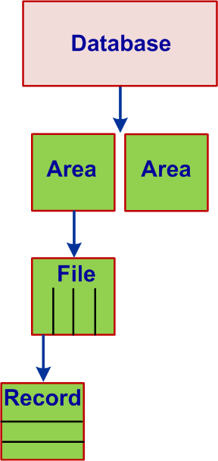
Multigranularity Locking
Concurrency can be increased (without affecting consistency) by defining lockable granularity of different sizes. This can create a lock granularity hierarchy and can be represented as:

Slide 65
Multigranularity Locking
The hierarchical presentation of a database defines multiple granularities. Transaction behavior can be defined as follows:
T_{i} intends to read a data item (not actually read it)
T_{i} intends to write a data item (not actually write it).
T_{i} reads a data item and intends to write it
T_{i} reads a data item
T_{i} writes a data item
Various combinations of these modes are possible. These are operation so under 2PL we must define lock types to manage these operations.

Slide 66
Multigranularity Operations
T_{i} intends to read a data item (not actually read it) - ir
T_{i} intends to write a data item (not actually write it) - iw
T_{i} reads a data item and intends to write it - riw
T_{i} reads a data item - r
T_{i} writes a data item - w
Various combinations of these modes are possible. These are operation so under 2PL we must define lock types to manage these operations.
Operations | r | w | ir | iw | riw
r | y | n | y | n | n
w | n | n | n | n | n
ir | y | n | y | y | y
iw | n | n | y | y | n
riw | n | n | y | n | n

Slide 67
Multigranularity Locking
Lock Instance Graph (G)
A hierarchical arrangement of granularity is illustrated in the following figure. It is called a lock instance graph. Each node of this graph (tree) represents a lockable unit.
A Lock Instance Graph = G
Notes:
TODO : Add in lock escalation

Slide 68
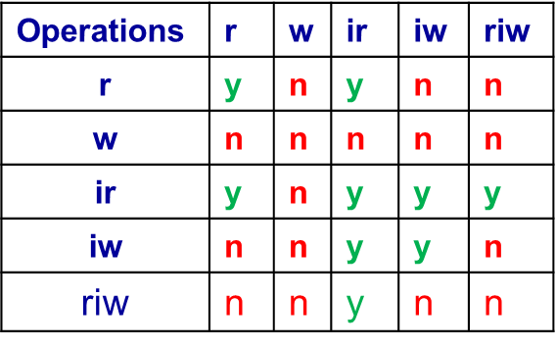
Multigranularity Locking
Lock Instance Graph (G)
T1 wants to read R1.1 rl1(1.1)
T2 wants to write R5.3 wl2(5.3)
Notes:
TODO Add slide somewhere for the rules and order. TODO Change image R3.1 and R3.1

Slide 69
Multigranularity Locking
Lock Instance Graph
Explicit lock: A lock that is applied by the lock manager.
Ex: Lock manager applies a read or write lock on DB1.
Implicit lock: As a result of an explicit lock the children of the locked node (i.e., DB1) assumed to be locked. The lock manager does not lock them.
If LM applies a read lock (explicitly) on DB1 then all its children (A1 through R5.3) assumed to be locked (implicitly) in a read mode. Similarly if DB1 is locked explicitly in irl then all its descendants are assumed to get locked (implicitly) in irl.

Slide 70
Multigranularity Locking
Rules for applying lock types on a lockable unit
Ancestors to Descendants: If an ancestor is locked explicitly then descendants are locked implicitly. Thus, to lock an ancestor (DB1 or A1 or F1) in r or w mode just lock the ancestor in that mode.
Descendants to Ancestors: To lock a descendant in a r or w mode, all its ancestors must be locked in ir or iw mode. Thus, if R1.1 is needed to be locked in w mode, all its ancestors (DB1, A1, and F1, F2, and F3) must be locked in iw mode in that order. This avoids r-w conflict.

Slide 71
Multigranularity Locking
Steps for applying lock types on a lockable unit
G: A lock instance graph.
If x is not the root of G, then to set rl_{i}[x] or irl_{i}[x]. T_{i} must have an ir or iw lock on x’s parent.
If x is not the root of G, then to set wl_{i}[x] or iwl_{i}[x] T_{i} must have an iw lock on x’s parent.
To read (or write) x, T_{i} must own an r or w (or iw) lock on some ancestor of x. A lock on x itself is an explicit lock for x; a lock on a proper ancestor of x is an implicit lock for x.
T_{i} may not release an intention lock on x, if it is currently holding a lock on any child of x.

Slide 72
Multigranularity Locking
An example. G: A lock instance graph.
Suppose T₁ wants to set rl₁[F3].
irl₁[DB1] → irl₁[A1] → rl₁[F3]
Check
Suppose T₂ tries to set wl₂[R3.2]. It must first set iwl₂[DB1], then iwl₂[A1] and finally iwl₂[F3]. It can obtain the first two locks but not the last one because it conflicts with the explicit lock (rl₁[F3]). After T₁ releases rl₁[F3], T₂ can set its locks iwl₂[F3] and wl₂[R3.2]. If T₃ comes along and tries to set rl₃[A1] then it must first set irl₃[DB1]. It can set this lock followed by rl₃[A1]] before T₂ releases.

Slide 73
Multigranularity Locking
Correctness
Theorem 3.7: In multigranularity locking, if a transaction owns an explicit or implicit lock on a node of G, then no other transaction can own an explicit or implicit conflicting lock on that node.
Proof: Since modification is done to a leaf node(s) after intention locks on its ancestors are applied, it is enough to proof that no conflicting locks can be applied on a leaf node. Suppose T_{i} and T_{j} hold a conflicting lock leaf x. We have the following seven cases to consider:

Slide 74
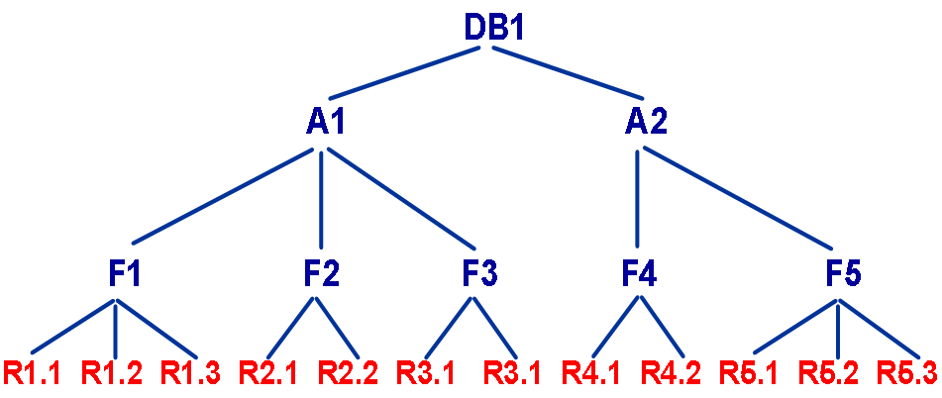
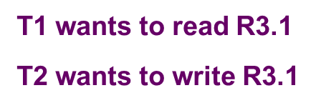
Multigranularity Locking
T_{i} T_{j} Answer
Implicit r lock explicit w lock T F
Implicit r lock implicit w lock T F
explicit r lock explicit w lock T F
explicit r lock implicit w lock T F
Implicit w lock explicit w lock T F
Implicit w lock implicit w lock T F
explicit w lock explicit w lock T F
Notes:
Case 1. By rule (3) of the MGL protocol, Ti owns rl;[y] for some ancestor y of X. By rule (2) of the MGL protocol (and induction), Tj must own an iw lock on every ancestor of X. In particular, it owns iw&[y], which is impossible because the lock types iw and r conflict. Case 2. By rule (3) of the MGL protocol, Ti owns rl;[y] for some ancestor y of x, and Tj owns Wlj[y’] for some ancestor y’ of X. There are three subcases: (a) y = y’, (b) y is an ancestor of y’, and (c) y’ is an ancestor of y. Case (a) is impossible, because Ti and Tj are holding conflicting read and write locks (respectively) on y = y’. Case (b) is impossible because Tj must own iwljy], which conflicts with rli[y]. And case (c) is impossible because Ti must own irlJy’], which conflicts with wl,[y’]. Thus, the assumed conflict is impossible. Cases (3) and (7) are obviously impossible. Cases (4) and (5) foIlow the same argument as case (I), and (6) follows the argument of (2)

Slide 75
Multigranularity Locking
Class discussion
Questions for discussion
Does MGL expands 2PL capability? If yes then how, if no then why not?
What intention lock mode would be required if a transaction wants to write (w is not a function of r) to a few records and then read some new records?
T₁ and T₂ has iw on DB1. T₂ wants to delete A1. Can it be done? T₁ and T₂ has iw on F1. T₁ wants to change DB1. Can it be done?

Slide 76
Multigranularity Locking
Implementation Issues – Lock conversion
We have now five lock modes that make lock conversion quite complex. We define “lock strength” to for a general lock conversion policy.
Lock strength: defines how many conflicts a lock type generates. For example, if a lock type p generates more number of conflicts than a lock type q then p is more stronger than q.
Definition: Lock type p is stronger than lock type q if for every lock type o, ol_{i}[x] conflicts with ql_{j}[x] implies that ol_{i}[x] conflicts with pl_{j}[x].

Slide 77
Multigranularity Locking
Examples – Lock conversion
Lock type riw is stronger than lock type r
Implied
conflict conflicts
lock type wl
Lock type r is stronger than lock type iw
Implied
conflict conflicts
lock type ?

Slide 78
Lock Conversion
Old Lock Type
Requested Lock Type
 | ir | iw | r | riw | w
ir | ir | iw | r | riw | w
iw | iw | iw | riw | riw | w
r | r | riw | r | riw | w
riw | riw | riw | riw | riw | w
w | w | w | w | w | w

Slide 79
Lock Escalation
How does a TM know what granularity to select?
Analyzing the program.
High level SQL
Past history
We’ve read x records from this relation. We should read lock the entire relation.
Deadlocks can occur from lock escalation
Instead of lock escalation, abort and retry transaction with escalated locks.

Slide 80
Variation of 2PL Schemes (Optimistic Method)
Optimistic Method of Concurrency Control. Issues with 2PL locking schemes:
Lock maintenance overhead because of (a) read-only transactions use locking (not necessary because they do not threatens consistency) and (b) deadlock management cost.
There are no general-purpose deadlock-free locking protocols for databases that always provide high concurrency.
Since large parts of the database are on secondary memory, concurrency is significantly lowered in the presence of high paging traffic.
Locks cannot be released until the end of the transaction. This may again significantly lower concurrency.

Slide 81
Optimistic Method
Optimistic Method of Concurrency Control claims to eliminate a few of these issues. The idea behind this optimistic approach is quite simple:
Since in most cases reading a data value can never cause a loss of integrity, reads are completely unrestricted.
Writes are severely restricted, all writes take place on local copies of the data to be modified. If it is established that the transaction’s changes will not cause a loss of integrity, the local copies are made global in the write phase. In the case of a read-only transaction, it must be determined that the result it would return is correct. The step in which it is determined that the transaction will not cause a loss of integrity (or that it will return the correct result) is called validation.

Slide 82
Optimistic Method
Optimistic Method of Concurrency Control mechanisms are also called certifiers. They can be based on 2PL or Timestamp-based policy. 2PL-based certifiers works as follows:
A 2PL certifiers immediately .
Writes are severely restricted, all writes take place on local copies of the data to be modified. If it is established that the transaction’s changes will not cause a loss of integrity, the local copies are made global in the write phase. In the case of a read-only transaction, it must be determined that the result it would return is correct. The step in which it is determined that the transaction will not cause a loss of integrity (or that it will return the correct result) is called validation.

Slide 83
Optimistic Method
A 2PL certifier works as follows:
T₁ requests a lock (read or write) on x and the scheduler grants it. X may be locked by T₂ in a conflicting mode or free.
T₁ and T₂ continue to execute. Suppose T₁ sends c₁ to the certifier.
The certifier checks if there is any operation of T₁ that conflicts with an operation of T₂. If there is one then the certifier rejects c₁ and aborts T₁ otherwise it commits T₁.

Slide 84
Optimistic Method
Implementation
Data structures: A list of active transactions, a list of readset of a transaction – r-scheduled[T_{i}] and a list of writeset of a transaction – w-scheduled[T_{i}]. So r-scheduled[T_{i}] contains all data items T_{i} has read and w-scheduled[T_{i}] contains all data items T_{i} has written to. w-scheduled[T_{i}] ∩ r-scheduled[T_{i}] ≠ {} (could be = {}). The certifier receives c_{i}, it performs the following operations with all active transactions:
r-scheduled[T_{i}] ∩ w-scheduled[T_{j}]
w-scheduled[T_{i}] ∩ r-scheduled[T_{j}]
w-scheduled[T_{i}] ∩ w-scheduled[T_{j}]
If any result is ≠ {} T_{i} is rolled-back.

Slide 85
Optimistic Method
Class discussion
Task: Prove “The 2PL certifier produces SR history.”

Slide 86
Timestamp
A timestamp is monotonically increasing integer. The upper bound is 2⁶⁴-1. It can be used for
identifying the order of arrive of events (transaction arrival, processing resource requests, etc.)
assigning execution priority to concurrent processes
resolving conflicts
We use timestamp with locking to develop integrated schedulers and non-locking timestamp-based schedulers. It is used to define transaction arrival as follows:
The scheduler assigns the current timestamp to T₁ when it arrives and the value of timestamp is incremented. T₂ gets the next timestamp and so on.

Slide 87
Timestamp
The scheduler assigns the current timestamp to T₁ when it arrives and the value of timestamp is incremented. T₂ gets the next timestamp and so on. Under this scheme we have:
If timestamp (T₁) < timestamp (T₂) then T₁ arrived before T₂ or T₁ is older than T₂ in the event order. Note that this is true for the scheduler. It does not reflect the order of user initiation of T₁ and T₂. User may have issues T₂ before T₁.
A conflict between T_{i} and T_{j} can be resolved if they are executed in their timestamps order. There is no blocking so one of the transactions has to be rolled-back.

Slide 88
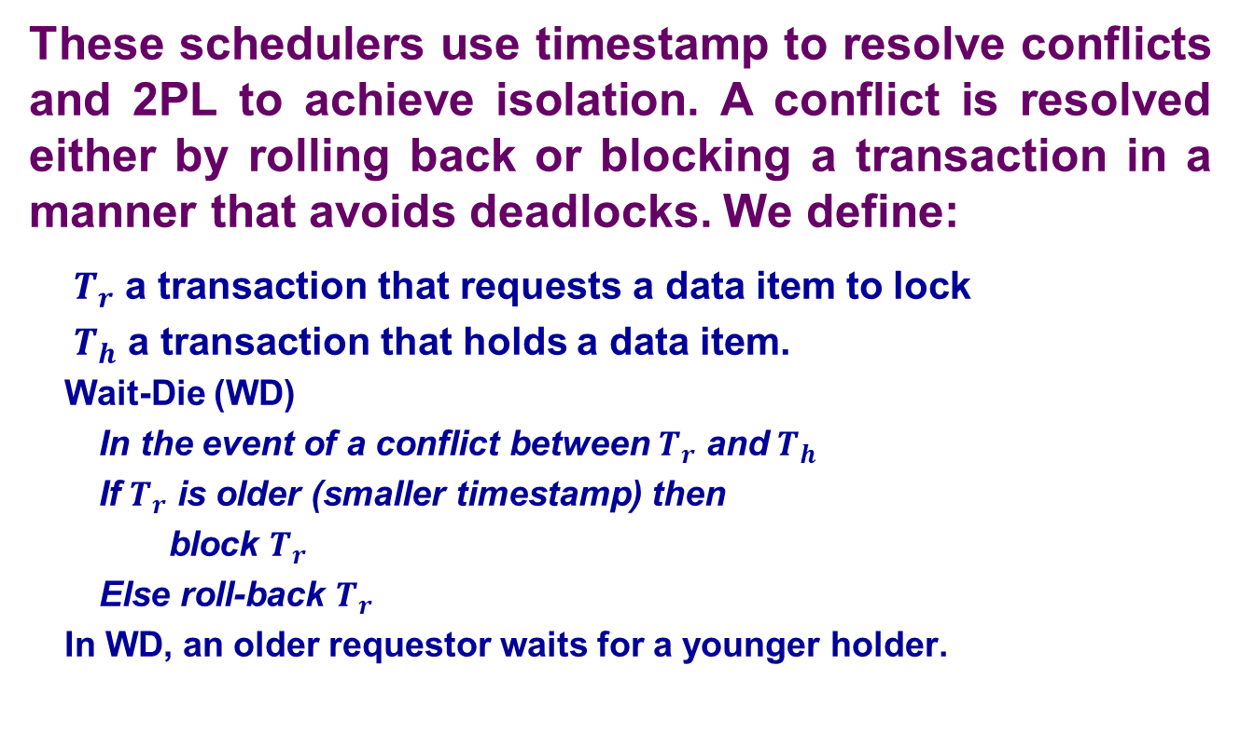
Wait-Die (WD) and Wound-Wait (WW) schedulers
These schedulers use timestamp to resolve conflicts and 2PL to achieve isolation. A conflict is resolved either by rolling back or blocking a transaction in a manner that avoids deadlocks. We define:
$T_{r}$ a transaction that requests a data item to lock
$T_{h}$ a transaction that holds a data item.
Wait-Die (WD)
In the event of a conflict between $T_{r}$ and $T_{h}$
If $T_{r}$ is older (smaller timestamp) then
block $T_{r}$
Else roll-back $T_{r}$
In WD, an older requestor waits for a younger holder.

Slide 89
Wait-Die (WD) schedulers
Class discussion
Task: Proof that WD is a deadlock-free scheduler.

Slide 90
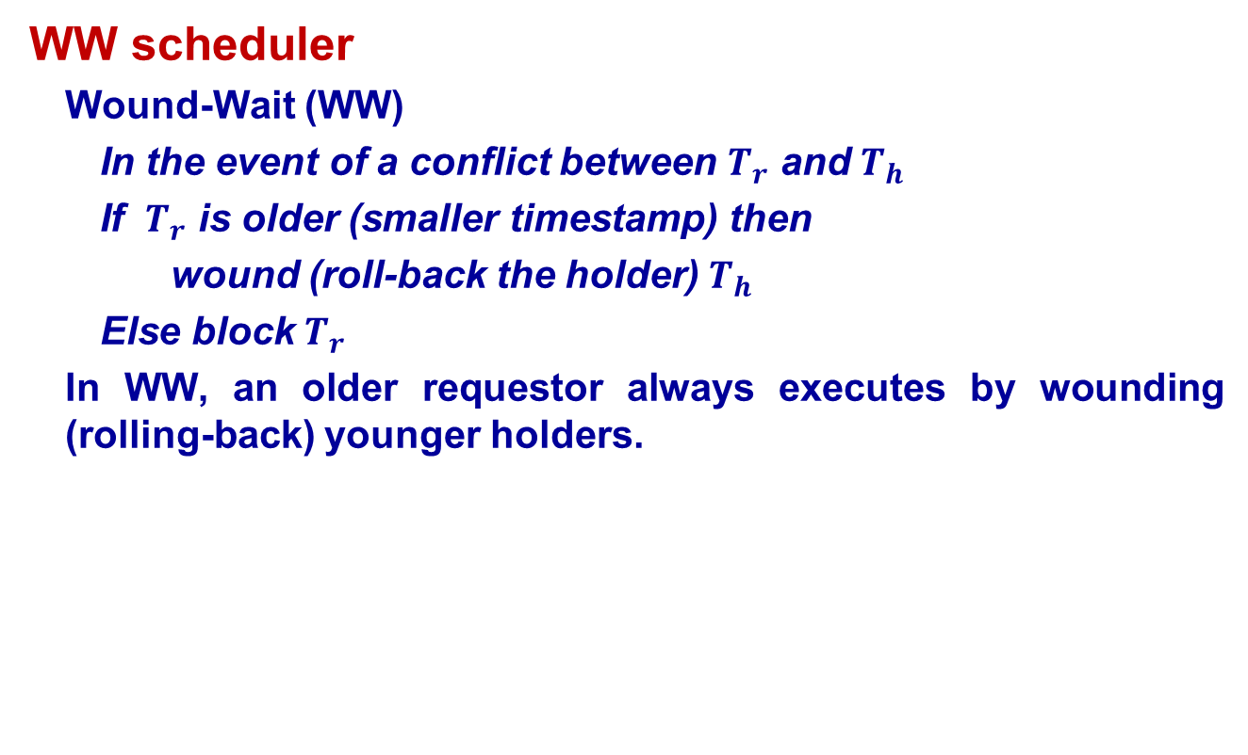
Wound-Wait (WW) schedulers
WW scheduler
Wound-Wait (WW)
In the event of a conflict between $T_{r}$ and $T_{h}$
If $T_{r}$ is older (smaller timestamp) then
wound (roll-back the holder) $T_{h}$
Else block $T_{r}$
In WW, an older requestor always executes by wounding (rolling-back) younger holders.

Slide 91
Wound-Wait (WW) schedulers
Class Discussion
Task: Proof that WW is a deadlock-free scheduler

Slide 92
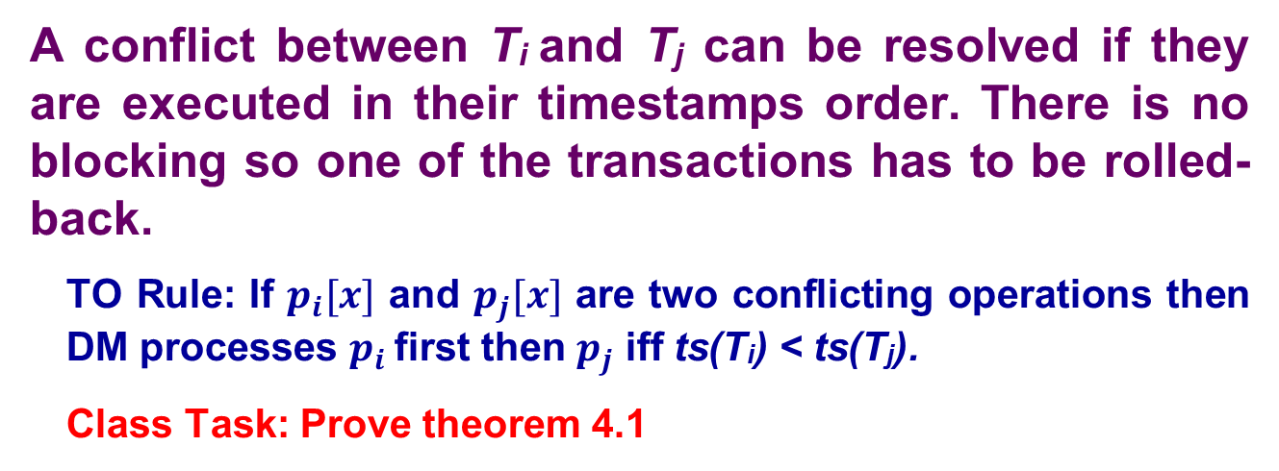
Timestamp
A conflict between T_{i} and T_{j} can be resolved if they are executed in their timestamps order. There is no blocking so one of the transactions has to be rolled-back.
TO Rule: If $p_{i}[x]$ and $p_{j}[x]$ are two conflicting operations then DM processes $p_{i}$ first then $p_{j}$ iff ts(T_{i}) < ts(T_{j}).
Class Task: Prove theorem 4.1

Slide 93
Basic Timestamp Ordering (TO)
First we discuss “too late” arrival of a conflicting operation p_{i}.
An operation p_{i} is too late if the DM has already processed p_{j} where ts(T_{i}) < ts(T_{j}). This implies that the event (e.g., T_{i}) that is older than T_{j} is trying to become a younger event than T_{j}. This violates serial execution rule so T_{i} is aborted. It is possible that T_{j} may also be aborted (cascading). If T_{i} must be executed then it can be scheduled with a new timestamp.

Slide 94



Simple TO Scheduler
Implementation
A simple TO scheduler works similar to a 2PL scheduler. T_{i} must be able to access its timestamp and the timestamp of T_{j} that accessed x to know if there is a conflict. To do so, every data item is associated with the timestamp of the transaction that processed it last.
Data item representation: Instance:
ts(T_{i} ) = i and ts(T_{j}) = j. ts(T_{i} ) < ts(T_{j}) = j
T_{j} applies r_{j}[x] and the result is

Slide 95
Simple TO Scheduler
Algorithm
Tj wants to access x.
If ts(x) < ts(Tj) then
Tj accesses and modifies x;
overwrite ts(x) with ts(Tj) //ts(x) is now j
else
roll-back Tj;
Problem: Tj will be rolled back even if it wants to read x because simple TO cannot identify r-w and w-w conflicts.
Solution: Basic TO and Thomas Write Rule (TWR)

Slide 96

Basic TO Scheduler
Basic TO scheme identifies r-w and w-w conflicts to avoid unnecessary roll-back of transaction.
In a basic TO scheduler a data item has two time stamps (a) a read time stamp and (b) a write timestamp.
Read timestamp (rts): used to discover r-w and w-r conflicts.
Write timestamp (wts): used to discover r-w w-r, and w-w conflicts.

Slide 97
Basic TO Scheduler
Algorithm: r is managed by rts and a w by wts.
Read operation
If wts(x) < ts(T_{i}) then
overwrite rts by the larger of the ts(T_{i}) and rts(x);
execute read
else
roll-back the transaction;
Write operation
If rts(x) < ts(T_{i}) and wts(x) < ts(T_{i}) then
overwrite wts by ts
execute write
else
roll-back the transaction;

Slide 98
Basic Timestamp Ordering (TO)
Data structures:
max-r-scheduled[x] – denotes maximum timestamps of r on x that is sent to the DM.
max-w-scheduled[x] – denotes maximum timestamps of w on x that is sent to the DM.
r-in-transit[x] – denotes the number of reads have been sent to DM but have not been acknowledged.
w-in-transit[x] – denotes the number of writes have been sent to DM but have not been acknowledged.
queue[x] – holds transaction that can be scheduled according to TO policy but waiting for acknowledgement from DM for operations submitted earlier.

Slide 99
Basic Timestamp Ordering (TO)
Initially
max-r-scheduled[x] = 0, r-in-transit[x] = 0, and queue[x] = empty
max-w-scheduled[x] = 0, w-in-transit[x]=0
Execution
The scheduler receives r₁[x], it dispatches it to DM, sets max-r-scheduled[x] = 1 and r-in-transit[x] = 1.
The scheduler receives w₂[x]. It can be
Scheduled according to TO rule but since
r-in-transit[x] = 1, the scheduler must wait until it receives ack(r1[x]). It, therefore, appends w₂[x] to queue[x]. (w-in-transit[x] is unaffected).

Slide 100
Basic Timestamp Ordering (TO)
Execution
The scheduler receives r₄[x] and although
r₄[x] can be scheduled (TO rule), the
scheduler must wait until it receives
ack(w₂[x]). It, therefore, appends r₄[x] to queue[x] (after w₂[x]). (r-in-transit[x] is unaffected.)
The scheduler receives r₃[x] and
although r₃[x] can be scheduled
(TO rule), the scheduler must wait until it receives ack(w₂[x]). It, therefore, appends r₃[x] to queue[x] (after r₄[x]). (r-in-transit[x] is unaffected.)

Slide 101
Basic Timestamp Ordering (TO)
Execution
The scheduler receives ack(r₁[x]) from DM.
It sets r-in-transit[x] = 0. It removes w₂[x] from
queue[x], sends it to DM, and sets
max-w-scheduled[x] = 2 and w-in-transit[x] = 1.
It cannot dispatch r₃[x] and r₄[x] because w-in-transit[x] > 0. This indicates that the DM has not yet acknowledged some conflicting w.
ack(w₂[x]) arrives. The scheduler makes
w-in-transit[x] = 0, sends r₃[x] and r₄[x]),
max-w-scheduled[x] = 4 and r-in-transit[x] = 2.

Slide 102
Basic Timestamp Ordering (TO)
Strict TO
Consider the following schedule generated by a TO scheduler of T₁ and T₂ where ts(T₁) = 1 and ts(T₂) = 2:
w₁[x] r₂[x] w₂[y] c₂
It is serializable (conflicting operations appear in timestamp order) but not recoverable. We need a schedule that is serializable and recoverable. To make it recoverable, we need to enforce a further constraints: “do not set w-in-transit[x] = 0 when DM acknowledges the processing of w_{i}[x] until the scheduler receives c_{i} or a_{i}. This eliminates dependency relationship “younger transaction is dependent on older transaction.” This may create a situation where a younger transactions waits for an older transaction but this does not create a cyclic wait situation so there no deadlock.

Slide 103
Basic Timestamp Ordering (TO)
TO Vs. 2PL
w-in-transit[x] acts as a lock on a data item. In spite of this similarity, a TO scheduler is not a 2PL scheduler because some serializable TO schedules cannot be produced by a 2PL scheduler (such as):
H1 = r₂[x] w₃[x] c₃ w₁[y] c₁ r₂[y] w₂[z] c₂
Question: Which one is a correct serialization graph of H1?
Serialization graph Your answer
SG(H1) = T₂ → T₃ → T₁ True False
SG(H1) = T₁ → T₃ → T₂ True False
SG(H1) = T₃ → T₁ → T₂ True False
SG(H1) = T₂ → T₁ → T₃ True False
SG(H1) = T₃ → T₂ → T₁ True False
SG(H1) = T₁ → T₂ → T₃ True False

Slide 104
Basic Timestamp Ordering (TO)
Class Discussion
TO Vs. 2PL
H1 = r₂[x] w₃[x] c₃ w₁[y] c₁ r₂[y] w₂[z] c₂
Question 1: Why H1 cannot be produced by a 2PL scheduler?
Question 2: How T₁, T₂, and T₃ can run under 2PL to produce the same serialization graph as H1?

Slide 105
Basic TO Scheduler
Algorithm: r is managed by rts and a w by wts.
Two consecutive writes
Compare wts(x) and ts(T_{i})
If wt < ts then
begin modify the data item; overwrite wts(x) with ts(T_{i}) end
else roll-back the transaction;

Slide 106
Thomas Write Rule (TWR)
If w_{i}[x] is performed and then w_{j}[x] (no write is a function of a read) then w_{i}[x] can be ignored and T_{i} is not rolled-back.
Example: Suppose on Saturday you moved to 1020 Troost and then on Sunday you moved to 5100 Rockhill. Suppose UMKC sends your address change transactions T_{Troost} to the system and then sends T_{Rockhill} when T_{Troost} is still running. T_{Rockhill} modifies the address to 5100 Rockhill. T_{Troost} finds that a younger transaction (T_{Rockhill}) has changed the value to 5100 Rockhill, T_{Troost} must roll-back according to TO. But since no write is a function of read, T_{Troost} is not rolled-back but ignored.
This is a case of ww synchronization. Thus, if a write arrives too late (e.g., T_{Troost}) and its write is not a function of a read then its write is not sent to DM (ignored) for processing.

Slide 107
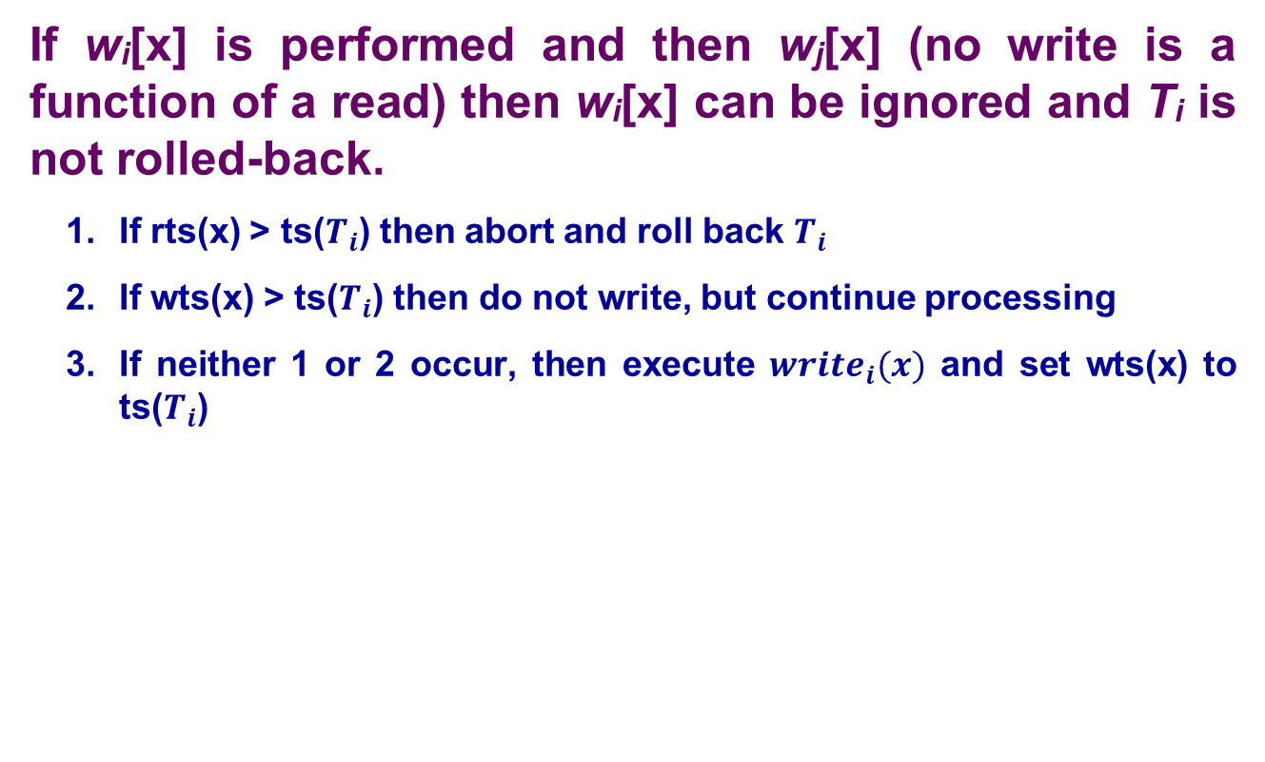
Thomas Write Rule (TWR)
If w_{i}[x] is performed and then w_{j}[x] (no write is a function of a read) then w_{i}[x] can be ignored and T_{i} is not rolled-back.
If rts(x) > ts($T_{i}$) then abort and roll back $T_{i}$
If wts(x) > ts($T_{i}$) then do not write, but continue processing
If neither 1 or 2 occur, then execute $write_{i}(x)$ and set wts(x) to ts($T_{i}$)

Slide 108

Timestamp Management
How much space is needed for Timestamps?
Valid Timestamps in range : $t−δ$

Slide 109
Summary
We have covered in detail serializability theory and discussed a number of schedulers. In particular we discussed 2PL, timestamping and mixed schemes. In practice, strict 2PL is most commonly used in all commercial database systems. Every system implements some variation of 2PL scheduler. No commercial database system maintains a wait-for-graph for resolving deadlock, rather they assume that a deadlock has occurred if a transaction remains in a blocked state for “x” amount of time.

