Slide 1
CS5570 Architecture of Database Management Systems
Datawarehousing
Kendall Bingham Computer Science Electrical Engineering University of Missouri-Kansas City Kansas City, MO, USA.

Slide 2
Data Warehouse
Introduction
Architecture
Views and Schema
View Management

Slide 3
Data Warehouse Introduction
Conventional database systems stores mainly historical data such as employee records, medical histories, sales history, etc. Transactions are initiated to find answers of queries that need such data. Thus, database systems are basically suited for:
robust and efficient On-Line Transaction Processing (OLTP) on operational data
maximize transaction throughput and response time

Slide 4
Data Warehouse Introduction
Most organizations not only process queries but they need to make intelligent decisions and predict the future activities. To do so, they require additional information that conventional database systems cannot provide. For example, it is not easy (but not impossible) for a database system to answer the
following query:
Query: What are the supply patterns of “toy” product in California in 1997 and how were they different from last year?
Such queries need large volume of data from multiple data sources and to incorporate this feature the data access capability of conventional database systems needs further expansion.

Slide 5
Data Warehouse Introduction
Database systems use a logical model for representing the information they contain. Relational
data model has been the most commonly used data model to represent and manage an organization’s day-to-day data processing needs. However, it fails to capture the decision support requirements of the power users within an organization because such requirements are multi-dimensional.

Slide 6
Data Warehouse Introduction
An organization need multidimensional data to (a) manage efficiently its day-to-day activities, (b) make effective marketing strategies, and (c) make efficient and intelligent decisions.
To capture and get relevant information for the above tasks we need to be able to analyze the data before and after processing. This way of processing the data is called On-Line Analytical Processing (OLAP).
OLAP must access data from a separate repository, which is commonly referred to as Data Warehouse (DW).

Slide 7
Data Warehouse Introduction
Definition
A DW is a subject-oriented, integrated, time-varying, and non-volatile databases.
Subject-oriented: The data is arranged by the common subject area of a company, such as sales, marketing, finance.
Integrated data: DW integrates data derived from various functional systems in the organizations, and provides a unified and consistent view of the overall organization.
Time-variant data: DW data is able to represent the flow of data through time, and queries are based on time range.
Non-volatile data: Data is always added (and rarely deleted) to DW for maintaining the company’s entire history.

Slide 8
Data Warehouse Introduction
View
A DW system stores highly aggregated and summarized data for complex data analysis and decision support activities, such as data mining, comparisons of historical data and trends analysis. The data storage template is referred to as a view.
The essential characteristics of DW:
should be accurate, complete, consistent, integrated, well-defined, and time stamped for informational purposes,
should follow business rules, and satisfy integrity constraints, including primary/foreign keys, referential integrity and data dependencies,
the user should be satisfied with the quality of data and information derived from DW.

Slide 9
Data Warehouse Queries
Examples of DW queries for network outages:
Find the number of network outages per geographical region
If the number of outages per region > threshold then find the vendors that defaulted
Drill down the query to further granularize the region (Drill-down = decreasing the level of aggregation)
View the result set in temporal dimensions

Slide 10
Data Warehouse Queries
Examples of DW queries for network outages:
Find the number of network outages per geographical region
If the number of outages per region > threshold then find the vendors that defaulted
Drill down the query to further granularize the region (Drill-down = decreasing the level of aggregation)
View the result set in temporal dimensions

Slide 11
Data Warehouse Architecture
An intuitive architecture of a DW.
DS1, DS2, …, DSn are base systems such as Oracle, Informix, File systems, etc.

Slide 12
Data Warehouse System Architecture
A conceptual DW system architecture

Slide 13
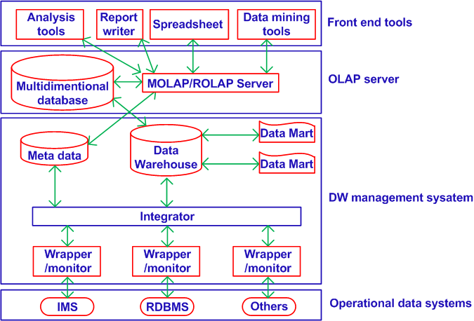
Data Warehouse Architecture
A reference architecture of DW system

Slide 14
Data Warehouse Architecture
A DW is composed of databases and file systems. They are processed differently. This may create inconsistency is DW. To manage the formatting problem (file system and database system), the following components are added:
Wrapper-Monitor: It detects the changes that take place at the data source and propagates them to the integrator in a predefined or known format.
Integrator: It identifies the set of MVs affected by a change in a data source. Additional information from other data sources may be required to incorporate the change in the relevant MVs. The integrator queries relevant data sources to get the additional information and composes view updates.

Slide 15
Data Warehouse Architecture
Data Mart
A part of the DW that stores information about a specific topic or entity. For example, a data mart for sales data, a data mart for medical data, and so on. It is created to
Minimize search time
Reduce update overhead
Improve query response time
Improve concurrency.

Slide 16
Data Warehouse Architecture
A DW is modeled as a set of materialized views (MV).
Materialized View
A materialized view is like a base relation of a database. An MV is a stored consistent version of a view. Updates to DW are installed in the set of relevant MVs.
Definition
The DW is modeled as a set of m materialized views {MV₁, MV₂, ..., MV_{m}} over n data sources {DS₁, DS₂, ..., DS_{n}}, which could be heterogeneous and autonomous.

Slide 17
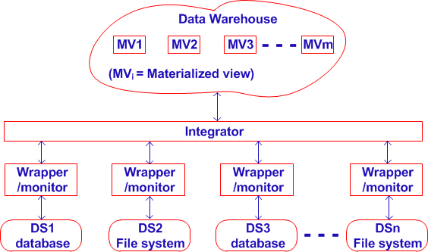
Data Warehouse Logical Architecture
A DW has two basic logical components:
DW and Integrator
Data source and Wrapper/monitor

Slide 18
Data Warehouse Logical Architecture
A DW has three basic logical components:
Integrator: It identifies the set of MVs affected by the particular change at the data source.
Wrapper/monitor: It detects the changes that take place at a data source and propagates them to the integrator in a predefined or known format.
Data sources: Different types of databases, File systems, etc. Thus, to establish the correspondence between the data source and the data warehouse data structure, each data source is associated with a Wrapper-Monitor.

Slide 19
Data Models for Data Warehouse
Conventional two-domensional (files, relations, etc.) data models are not well-suited for processing complex queries. DW queries are ad-hoc and usually refer to spatial and temporal parameters on multiple dimensions. So a DW needs multidimensional data models (i.e., a cube see below)

Slide 20
Data Cube Representation
A data cube is representation in terms of relations Using:
Fact Table: It records facts
Dimension Table: it provides multidimensional view of the data (facts)
Example
Fact Table: Research. The data about this activity is stored in multiple dimensions
Dimension Table: Major area, Minor area, Location, Time, etc.

Slide 21
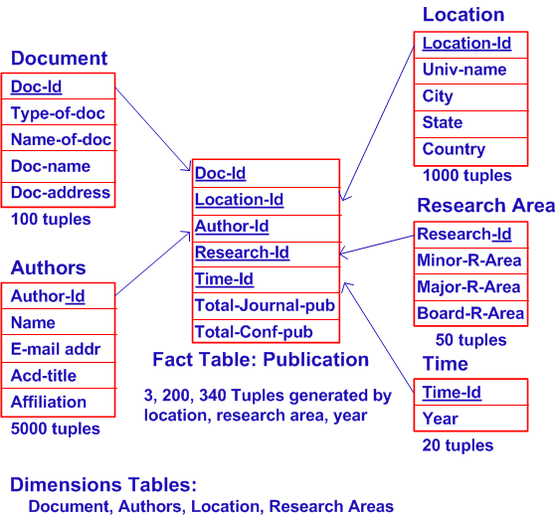
Data Cube Representation: Start Schema
A data cube is representation in terms of relations Using:

Slide 22
Data Cube Representation: Snowflake Schema
In star schema, the dimension tables are denormalized and therefore, it does not capture hierarchies (i.e. dependencies among attributes) directly.
This is captured in snowflake schema. Here, the dimension tables are normalized for simplifying the data selecting operations related to the dimensions, and thereby, capture attribute hierarchies. In this schema, the multiple fact tables are created for different aggregate levels by pre-computing aggregate values. This schema projects better semantic representation of business dimensions.

Slide 23
Data Cube Representation: Start Schema
A Multidimensional Database is a collection of n hypercubes {H1, H2,..., Hn}, where each hypercube Hi is a set of relations {D1, D2,..., Dm, F} such that
Each Dj is a dimension table, i.e., a relation characterized by its unique identifier dj (dimension) that uniquely identifies each tuple in Dj and provides the granularity for representing facts along the axis of the hypercube.
F is a fact table, i.e., a relation connecting all dimension tables D1, ..., Dm on the dimension attribute dj in each table; the identifier of F is given by the foreign keys d1, ..., dm of all the dimension tables it connects; the schema of F contains a set of additional attributes M called measure attributes on which the aggregate functions are computed; the aggregate functions on M form the solution space of the hypercube.

Slide 24
Data Cube Representation: Start Schema
The process of designing a warehouse database is iterative and consists of the following steps:
Identify user requirements and problem domain.
Develop subject area data model (one at a time; bottom-up design), including an ER diagram and associated metadata, e.g., marketing information, sales information, product information.
Develop a logical data model from the subject area data model.
Define warehouse architecture, schema and views.
Design the physical data model; data partitioning, placement, storage structure, and access methods.
Design and develop metadata repository.
Identify data sources; operational, legacy, others.
Develop or buy software tools for selecting, filtering, transforming, integrating and loading data to the warehouse.
Propagate the data into warehouse storage.
Build data warehouse applications.
Administer the performance of data warehouse.

Slide 25
View Maintenance
A DW stores integrated information from multiple data sources in materialized views (MV) over the source data. When the data in any source (base data) changes, the MVs at the DW need to be updated accordingly. The process of updating a materialized view in response to the changes in the underlying source data is called View Maintenance. View maintenance in a distributed environment gives rise to inconsistencies since there is a finite unpredictable amount of time required for (a) propagating changes from the DS to the DW and (b) computing view updates in response to these changes. Data consistency can be maintained at the data warehouse by performing the following steps:

Slide 26
View Maintenance
Propagate changes from the data sources (ST1 – current state of the data sources at the time of propagation of these changes) to the data warehouse to ensure that each view reflects a consistent state of the base data.
Compute view updates in response to these changes using the state ST1 of the data sources.
Install the view updates at the data warehouse in the same order as the changes have occurred at the data sources.

Slide 27
View Maintenance
The inconsistencies at the data warehouse occur since the changes that take place at the data sources are random and dynamic. Before the data warehouse is able to compute the view update for the old changes, the new changes change the state of the data sources from ST1 to ST2. This violates the consistency criterion. Making MVs at the data warehouse self-maintainable decimates inconsistency problems by eliminating the finite unpredictable time required to query the data source for computing the view updates.

Slide 28
Self View Maintenance
Consider a MV defined over a set of base relations R = {R1, R2, ..., Rn}. MV stores a preprocessed query at the data warehouse. The set R may reside in one data source or in multiple (heterogenous) data sources. A change ΔRi made to the relation R_{i} might affect MV.
MV is defined to be self-maintainable if a change ΔMV in MV, in response to the change ΔRi, can be computed using only the MV and the update ΔRi. But DW might need some additional information from other relations of R to compute the view update ΔMV. Since the underlying data sources are decoupled from DW, this requires a finite computation time. Also the random changes at the data sources can give rise to inconsistencies at DW. Some data sources may not support database functionalities and querying such sources to compute the view updates may be an impossible task. Because of these problems, the preprocessed query that is materialized at the warehouse needs to be maintained without access to the base relations.

Slide 29
Self View Maintenance Approaches
Replicate all base data in its entirety at DW so that the maintenance of the MV becomes local to the data warehouse.
Problems:
As more and more data is added to the warehouse, it increases the space complexity and gives rise to information redundancy which might lead to inconsistencies.
Overlooks the point that the base tuples might be present in the view itself, so the view instance, the base update and a subset of the base relations might be sufficient to achieve self-maintainability in the case of SPJ (Select-Project-Join) views.
Question: But how can the subset of the base relations that is needed to compute the view updates be stored at DW?

Slide 30
Self View Maintenance Approaches
Answer: Maintain a set of minimal auxiliary views (AVs) to materialize that are sufficient to make a view self-maintainable.
Issues in this approach:
It is not possible to maintain the required set of AVs at DW for view materialization. Thus, in some approaches, a set of AV are stored at DW along with the set of MVs such that together MV∪AV is self-maintainable (to some extent).
The research challenge lies in finding the most economical AVs in terms of space complexity and computational costs.

Slide 31
Self View Maintenance Approaches
Use update filtering. Such filter will check if a change at a base data would change any portion of MVs at DW. If no then materialization will not be initiated. This would require checking of distributed integrity constraints at a single site. As many changes as possible can be filtered at the sources and only the changes that result in view updates may be propagated to DW. The update filtering will reduce the size of the maintenance transactions at DW, thus minimizing the time required to make DW consistent with the data sources.

Slide 32
Self View Maintenance Approaches
Issues in this approach:
Side effect: We need to make our data sources (and the wrapper/monitor) components more intelligent. They need to know about their participation in DW and in its configuration so that the updates can be checked against the constraint set before propagating them.
To be able to realize this, the data sources cannot be decoupled from DW anymore. This would give rise to new problems like configuration management i.e., if there is a change in the schema at any data source or at DW, all participating entities need to be informed of this change so that they can modify the constraint set to reflect this change. The view maintenance strategies would now be based on the constraint set and any change to the constraint set would warrant a change in the existing view maintenance transaction.

Slide 33
Self View Maintenance Approaches
Incremental View Maintenance: Materialize MVs as soon as ΔRi appears. Incremental view maintenance which updates DW instantaneously in response to every change at the data source is expensive and gives rise to inconsistent.
Batch View Maintenance: Queue a large number of updates and propagate them to DW as a batch update.
In current commercial systems, a batch update is periodically sent to DW and view updates are computed and installed. This transaction is called the maintenance transaction. A user typically issues read-only queries at DW and a long-running sequence of user queries is called a reader session. The batch.

Slide 34
Self View Maintenance Approaches
Issues in current approach:
A maintenance transaction is typically large and blocks DW from all reader sessions for the duration of the maintenance transaction.
The maintenance transaction typically runs at night. The 24−hour shop concept is what most companies are striving for and DW to be online 24 hours to allow the company to be competitive in its strategies. results during the same reader session. An update from the data source will change the results a user might see over a sequence of queries.

Slide 35
Self View Maintenance Approaches
Some solution:
An integration with self maintenance techniques, where auxiliary views can be used to answer queries during maintenance transactions.

Slide 36
View Maintenance Problems
Unpredictable amount of time required for (a) propogating updates from the DS to DW (Data Warehouse) and (b) computing the view update to be installed at the DW. These may affect the correct order of installing the updates leading to inconsistencies at the DW.
Inconsistency at the DW may also occur when a DS uses its recently updated tuple to compute a query issued by the DW. Since the DS is decoupled from the DW, it simply propagates its changes to the DW and responds to queries sent by the DW.
We illustrate these problems with the following examples.

Slide 37
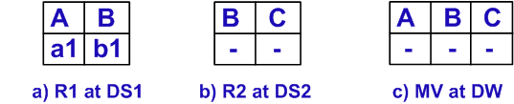
View Maintenance Problems
Insertion Anomaly Example
Consider two relations R1(A, B) and R2(B, C) in DS1 and DS2 respectively. The DW stores R1 and R2 in a view with schema MV such that MV = R1 R2. Initially MV is empty.
Table 1: State of the tables before insert (R2,< b1, c1 >)
DS2 executes I1 = insert (R2, <b1, c1>) and sends I1 to DW
Table 2: State of the tables after insert (R2,< b1, c1 >)

Slide 38
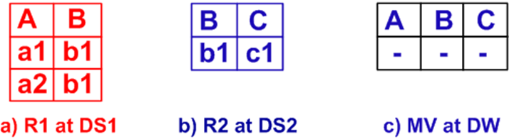
View Maintenance Problems
Insertion Anomaly Example
DW receives I1 and sends Q1 = (R1 <b1, c1>) to DS1 for computing view update information (required from R1 at DS1). In the meantime:
DS1 executes I2 = insert (R1, <a2, b1>) and sends I2 to DW
Table 3: State of the tables after insert (R1,< a2, b1 >)

Slide 39
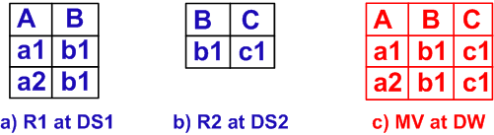
View Maintenance Problems
Insertion Anomaly Example
DW receives I2 and sends Q2 = (R2 <a2, b1>) to DS2 for computing view update information (required from R2 at DS2).
DS1 receives Q1, evaluates it and generates the answer
A1 = a1, b1, c1
a2, b1, c1
A1 is sent to the DW.
DW receives A1 and updates MV to MV ∪ A1
Table 4: State of the tables after view update: A1 reaches MV

Slide 40
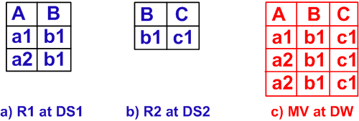
View Maintenance Problems
Insertion Anomaly Example
DS2 receives Q2, evaluates it and generates the answer
A2 = {a2, b1, c1} which is sent to the DW.
DW receives A2 and updates MV to
MV ∪ A2 = a1, b1, c1
a2, b1, c1
a2, b1, c1
Table 5: State of the tables after view update (MV ∪ A2 )

Slide 41
View Maintenance Problems
Insertion Anomaly Example
End Result
MV has duplicate tuples. It is identified as Distributed Incremental View Maintenance Anomaly that is shown in Tables 1-5. This occurs because DW attempts to update a view while the base data at a source which participates in this view is changing. The decoupling of DS1, DS2 and DW allows DS1 and DS2 to update the base data that affects the view update at DW.

Slide 42
View Maintenance Problems
Deletion Anomaly Example
We need to understand how deletions are handled in partially self maintainable views before we discuss deletion anomaly.
When a base tuple is deleted at a DS, the deletion is propagated to the DW. The DW identifies the MVs that may be affected by this change and deletes that base tuple from there by using the key of the base relation that is also a part of the MVs. This deletion can give rise to anomalies.
Deletion anomaly example:
Consider three base relations
R1(A, B) at DS1
R2(B, C) at DS2
R3(C, D) at DS3
The DW stores an MV = R1 R2 R3.

Slide 43
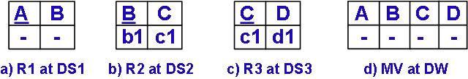
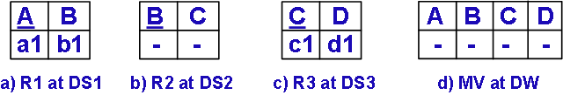
View Maintenance Problems
Deletion Anomaly Example
Table 6. State of the tables before insert (R1,<a1, b1>)
First: Execute insert (R1,<a1, b1>) at DS1
Next: Execute delete (R2, <b1, c1>) from DS2
Note: These insert and delete could happen in parallel
Table 7: State of the tables after these insert and delete

Slide 44
View Maintenance Problems
Deletion Anomaly Example
Results of insert and delete propagated to DW
DS1 executes I1 = insert(R1,< a1, b1 >) and sends I1 to DW.
DW receives I1 and sends Q1 = (R2 <a1, b1>) to R2 at DS2 to get the information (value of C attribute) required for view update.

Slide 45
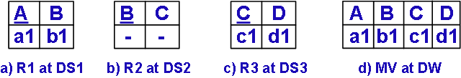
View Maintenance Problems
Deletion Anomaly Example
DS2 receives Q1, evaluates it and generates A1 = {a1, b1, c1}. A1 is sent to the DW.
DS2 executes D1 = delete(R2,< b1, c1 >) and sends D1 to DW.
DW receives A1 and sends Q2 = R3 A1 to DS3. {for computing view update information is required (value of attribute D from R3 at DS3}
DW receives D1 and executes delete (MV,<x, b1, c1, y>). MV is an empty table now.
DS3 receives Q2, evaluates it and generates A2 = {a1, b1, c1, d1}. A2 is sent to the DW.
DW receives A2 and updates MV to MV ∪ A2 = {a1, b1, c1, d1}.
Table 8: State of the tables after update A2 is in DW

Slide 46
View Maintenance Problems
Deletion Anomaly Example
Thus, there exists an incorrect tuple in MV. If the delete in MV would occur after this tuple was installed, then the tuple would have been deleted and the result would be consistent with the base data. We identify this inconsistency as the Deletion Anomaly, illustrated in Tables 6-8. This anomaly occurs if any of the base tuples that participate in a view update to be installed at the DW is deleted.

Slide 47
View Maintenance Problems
In the data warehousing scenario, accessing base relations can be difficult because:
they are distributed across different sources
data sources may be unavailable
communication cost is high
An approach where view materialization is achieved without frequently accessing base relations directly is required. This approach is referred to as self-maintainable.
Consider a materialized view MV at the data warehouse defined over a set of base relations R = {R1, R2, ..., Rn}. The set of base relations R may reside in one data source or in multiple, heterogenous data sources. A change ΔRi made to the relation Ri might affect MV.
Denition: MV is defined to be strictly self-maintainable if a change ΔMV in MV, in response to a change ΔRi can be computed using only the MV and the update ΔRi.

Slide 48
View Maintenance Problems
The data warehousing approach of integrating and summarizing data from multiple sources in views makes strict self-maintenance difficult to achieve.
We relax some of the requirements of strict self-maintenance and define weak self-maintainability. This can be achieved in a cost-effective manner.
Denition: MV is defined to be weakly self-maintainable if a change ΔMV in MV, in response to a change ΔRi can be computed using the MV, the update ΔRi and some additional information stored at warehouse.

Slide 49
Weak self-Maintenance Approach
This scheme stores some additional information in Auxiliary
Views (AVs) materialized at the DW and also at the DS to apply multiple updates at the DW in a consistency preserving manner. This additional information stored in AVs allows us to issue compensating queries to eliminate duplicate tuples (insertion anomaly) and enforces an order to eliminate the deletion anomaly. The deletion anomaly takes place because the base tuples that participate in an MV update, changes before that update is installed in the MV. We categorize the data modifications at the source in terms of data as follows:
Recently Inserted tuples.
Recently Deleted tuples.
Participating tuples (currently participating in some MV update that is yet to be installed at the DW.
Non Participating tuples (none of the above).

Slide 50
A View Maintenance Scheme
AV: A temporary (buffer) storage at DW.
The AV stores recently inserted, participating and recently deleted base data temporarily. Whenever a new tuple is inserted in a base table, it is propagated to the AV.
DW identifies the affected MVs.
DW issues queries to compute the view update that needs to be installed at the MV. The tuples that participate in the view update are also stored temporarily in an AV. Any update (delete or insert to a base table that are also stored in the AV) is corrected at AV and then applied to the MV.

Slide 51
A View Maintenance Scheme Steps
Example 1: Correcting Insertion Anomaly
We assume the same insertion anomaly scenario. We store auxiliary views AVR1 and AVR2 at the DW. We modify the execution pattern to give the correct result:
DS2 executes I1 = insert (R2,<b1, c1>) and sends I1 to DW.
DW receives I1, inserts (AVR2,<b1, c1>) and sends Q1 = R1 <b1, c1> to DS1.
DS1 executes I2 = insert (R1,<a2, b1>) and sends I2 to DW.
DW receives I2, inserts(AVR1,<a2, b1>) and sends
Q2 = (R2 <a2, b1>) - (AVR1 AVR2) to DS2.
DS1 receives Q1, evaluates it and generates the answer A1 = {a1, b1, c1, a2, b1, c1}. A1 is sent to the DW.

Slide 52
A View Maintenance Scheme Steps
Example 1: Correcting Insertion Anomaly
We assume the same insertion anomaly scenario. We store auxiliary views AVR1 and AVR2 at the DW. We modify the execution pattern to give the correct result:
DS2 executes I1 = insert (R2,<b1, c1>) and sends I1 to DW.
DW receives I1, inserts (AVR2,<b1, c1>) and sends
Q1 = R1 <b1, c1> to DS1.
DS1 executes I2 = insert (R1,<a2, b1>) and sends I2 to DW.
DW receives I2, inserts(AVR1,<a2, b1>) and sends
Q2 = (R2 <a2, b1>) - (AVR1 AVR2) to DS2 =
DS1 receives Q1, evaluates it and generates the answer A1 = {a1, b1, c1, a2, b1, c1}. A1 is sent to the DW.

Slide 53
A View Maintenance Scheme Steps
Example 1: Correcting Insertion Anomaly
DW receives A1, deletes(AVR2,<b1, c1>) and updates MV to MV ∪ A1 = {a1, b1, c1, a2, b1, c1}.
DS2 receives Q2, evaluates it and generates the answer A2 = { } which is sent to DW.
DW receives A2, deletes(AVR1,<a2, b1 >) and updates MV to MV ∪ A2 = {a1, b1, c1, a2, b1, c1}.
Thus the data (recent insert in DS) stored in AVs allows the DW to issue compensating queries to undo the effect of Insertion Anomaly. Also, the data is stored in the AV till the answer of the query is not installed in the DW. If the answer of the query needs to be joined with some other base relation, the data is not deleted from the AV .

Slide 54
A View Maintenance Scheme Steps
Example 1: Correcting Deletion Anomaly
We materialize at DW, auxiliary views AV_{R1.ins}, AV_{R2.ins} and AV_{R3.ins} that store recently inserted base tuples.
We materialize at DW, AV_{R1.del}, AV_{R2.del} and AV_{R3.del} that store the recently deleted base tuples and AV_{R1.par}, AV_{R2.par} and AV_{R3.par} to store the currently participating base tuples.

Slide 55
A View Maintenance Scheme Steps
Example 1: Correcting Deletion Anomaly
The steps which the DW and the DS take to perform View Maintenance are:
DS1 executes I1 = insert(R1,<a1, b1>) and sends I1 to DW.
DW receives I1, inserts (AV_{R1.ins},<a1, b1>) and sends
Q1 = R2 <a1, b1> to DS2.
DS2 receives Q1 and evaluates it.
The answer A1 = {< a1, b1, c1>} is sent to the DW.
DS2 executes D1 = delete (R2,<b1, c1>) and sends D1 to DW.
DW receives A1, inserts (AV_{R2.par},<b1, c1>) and sends Q2 = R3 A1 to DS3.
DW receives D1, executes τ = (AV_{R2.par} ∪ AV_{R2.ins}) ∩ < b1, c1>.
If τ = {ϕ} then DW deletes (MV,<x, b1, c1, y>) else DW inserts (AV_{R2.del},<b1, c1>).

Slide 56
A View Maintenance Scheme Steps
Example 1: Correcting Deletion Anomaly
DS3 receives Q2 and evaluates it.
The answer A2 = {< a1, b1, c1, d1 >} is sent to the DW.
DW receives A2 and updates MV to MV ∪ A2 = {<a1, b1, c1, d1>}.
DW executes τ′ = < a1, b1 > ∪ AV_{R1.de}l and τ′′ = < b1, c1 > ∪ AV_{R2.del}.
DW executes delete (AV_{R2.del},<b1, c1>) and executes delete (MV,<x, b1, c1, y>). {τ′′ = < b1, c1 >}
DW executes delete(AV_{R2.par},<b1, c1>) and executes delete (AV_{R1.ins},<a1, b1>).
The MV contains {ϕ} which is the desired result. This is achieved by delaying the delete from the MV till the update is installed in the MV. We refer to this as Lazy Delete approach.

