Slide 1
LLM Benchmarks and Evaluation
Plaban Kumar Bhowmick
TA : Trishita Mukherjee
Department of AI
plaban@ai.iitkgp.ac.in

Slide 2
Contents
Need for Benchmarks
Properties of Benchmarks
Representative LLM datasets across four dimensions
Prominent Evaluation metrics
LLM Capabilities

Slide 3
What are LLM Benchmarks?
LLM benchmarks are standardized frameworks for assessing the performance of LLMs.
Benchmarks consist of sample data, a set of questions or tasks to test LLMs on specific skills, metrics for evaluating performance and a scoring mechanism.
Assess reasoning, knowledge, language understanding, etc.
Important for comparing model performance.

Slide 4
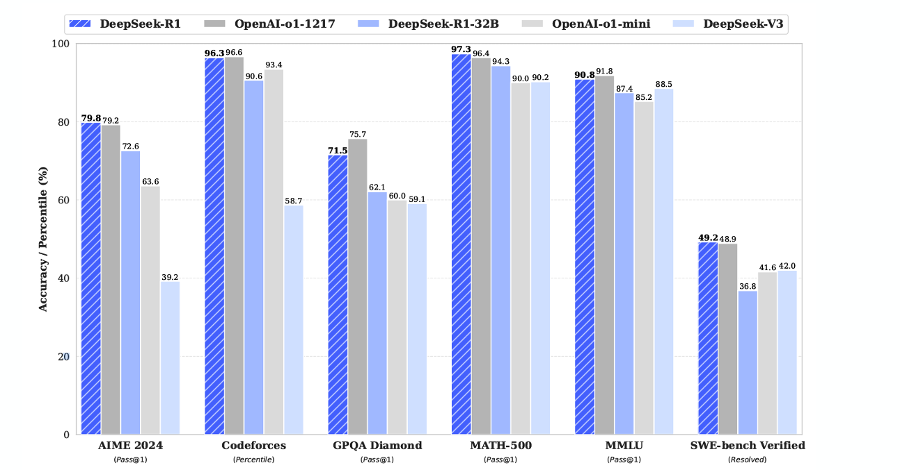
Need for Benchmarks
To track progress by comparing the performance.
Given two models, model A and model B , which model is better?
Guo, D., Yang, D., Zhang, H., Song, J., Zhang, R., Xu, R., Zhu, Q., Ma, S., Wang, P., Bi, X. and Zhang, X., 2025. Deepseek-r1: Incentivizing reasoning capability in llms via reinforcement learning. arXiv preprint arXiv:2501.12948.

Slide 5
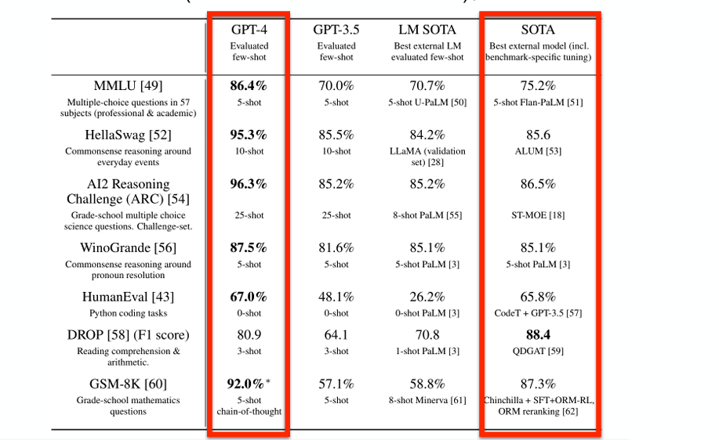
Need for Benchmarks
To track progress by comparing performance.
Given two models, model A and model B, which model is better?
Achiam, J., Adler, S., Agarwal, S., Ahmad, L., Akkaya, I., Aleman, F.L., Almeida, D., Altenschmidt, J., Altman, S., Anadkat, S. and Avila, R., 2023. Gpt-4 technical report. arXiv preprint arXiv:2303.08774.

Slide 6
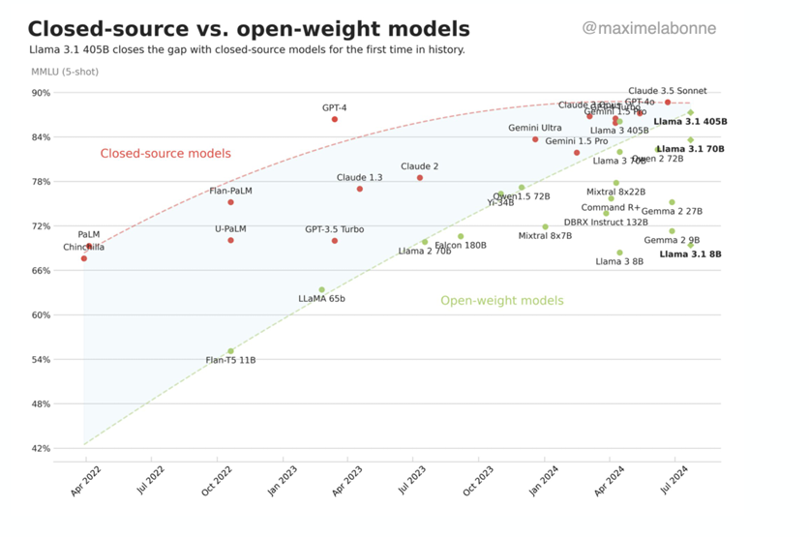
Need for Benchmarks
Comparison of closed-source LLMs compared to open-weight LLMs?

Slide 7
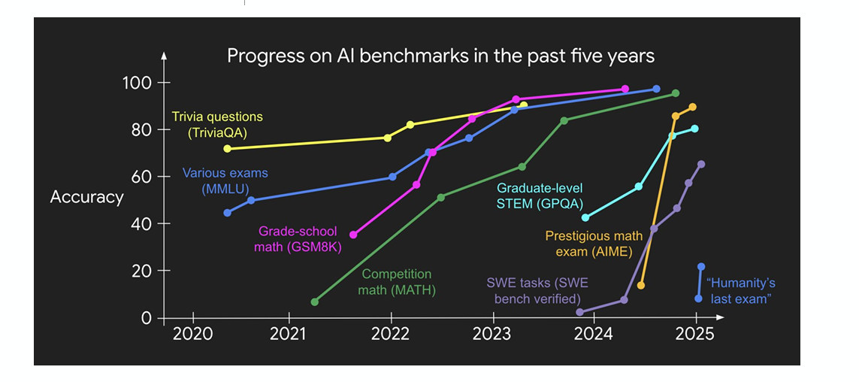
Core Properties of Good LLM Benchmarks
Difficulty : Are the problems challenging enough to distinguish between capable and not so capable models?
https://x.com/_jasonwei/status/1889096555254456397

Slide 8
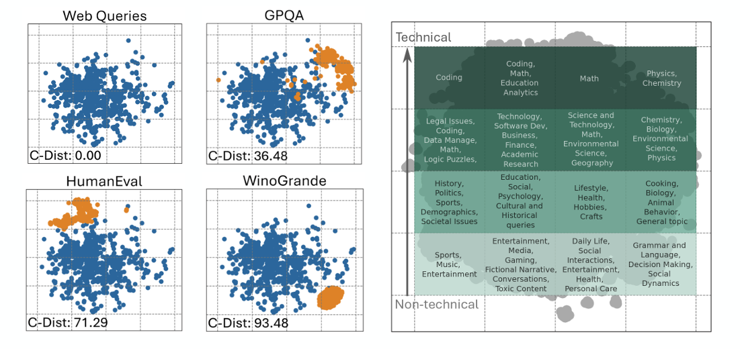
Core Properties of Good LLM Benchmarks
Diversity: Do the problems is diverse enough to evaluate the model’s ability to handle a broad range of queries?
Ni, J., Xue, F., Yue, X., Deng, Y., Shah, M., Jain, K., Neubig, G. and You, Y., 2024. MixEval: Deriving Wisdom of the Crowd from LLM Benchmark Mixtures. arXiv preprint arXiv:2406.06565

Slide 9
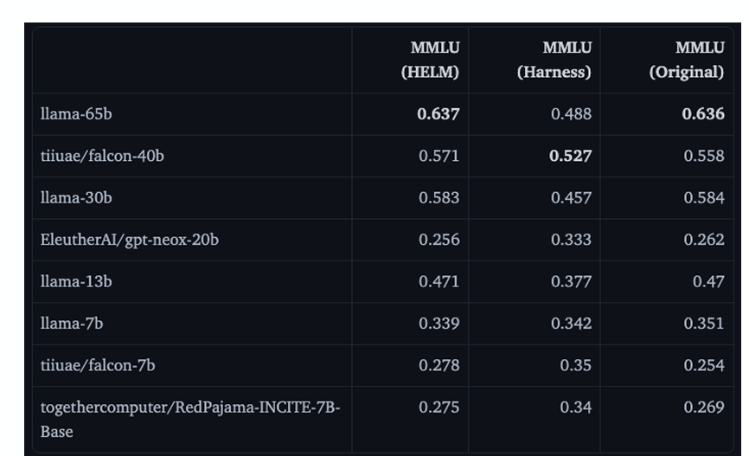
Core Properties of Good LLM Benchmarks
Reproducibility: Is the model able to consistently achieve similar scores across multiple test runs, allowing for fair comparisons between different models?
https://huggingface.co/blog/open-llm-leaderboard-mmlu#1001-flavors-of-mmlu

Slide 10
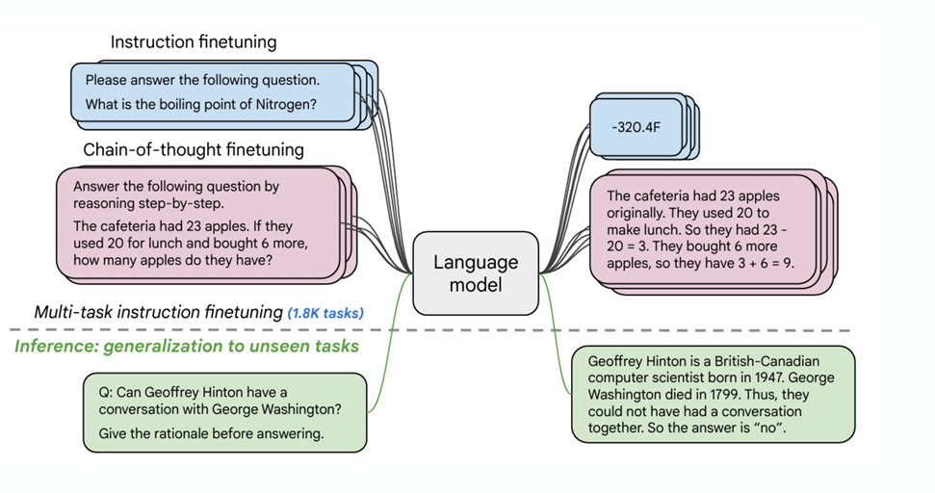
Core Properties of Good LLM Benchmarks
Data Contamination: LLMs are trained on a vast amount of information during pre-training and a wide range of tasks during post-training.
Chung, H.W., Hou, L., Longpre, S., Zoph, B., Tay, Y., Fedus, W., Li, Y., Wang, X., Dehghani, M., Brahma, S. and Webson, A., 2024. Scaling instruction finetuned language models. Journal of Machine Learning Research, 25(70), pp.1-53.

Slide 11
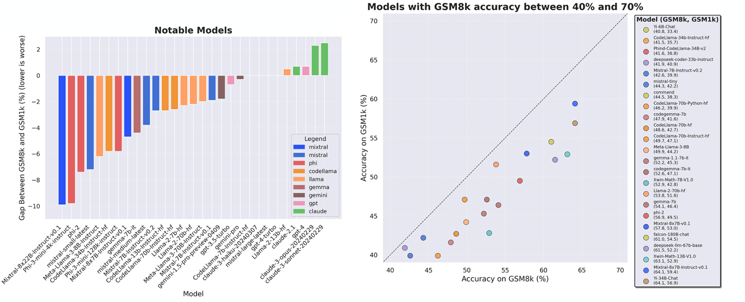
Core Properties of Good LLM Benchmarks
Data Contamination:How can we ensure that the evaluation reflects their ability to generalize to unseen novel tasks rather than relying on memorization of similar problems encountered during training?
Zhang, H., Da, J., Lee, D., Robinson, V., Wu, C., Song, W., Zhao, T., Raja, P., Slack, D., Lyu, Q. and Hendryx, S., 2024. A careful examination of large language model performance on grade school arithmetic. arXiv preprint arXiv:2405.00332.

Slide 12
Representative LLM datasets across four dimensions
Pre-training corpora
Instruction fine-tuning datasets
Preference datasets
Evaluation datasets

Slide 13
Pre-training corpora
The pre-training corpora are large collections of text data used during the pre-training process of LLMs.
In the pre-training phase, LLMs learn extensive knowledge from massive amounts of unlabeled text data, which is then stored in its model parameters.
It enables LLMs to possess a certain level of language understanding and generation capabilities.
Pre-training corpora, can be divided into two types: general pre-training corpora and domain-specific pre-training corpora.

Slide 14
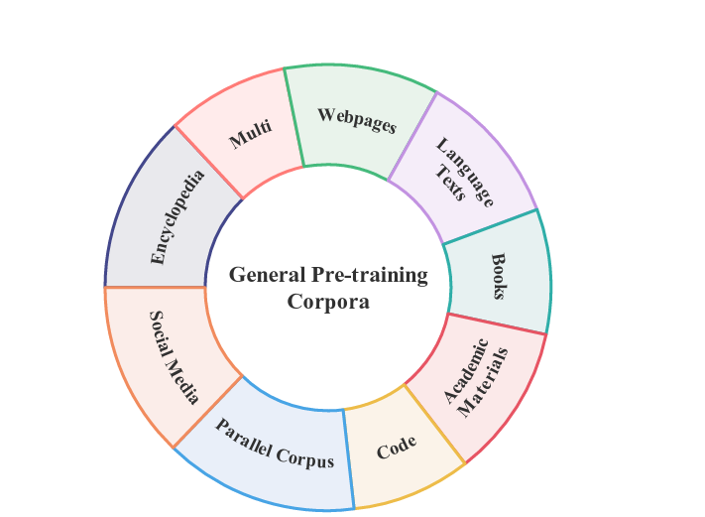
General Pre-training Corpora

Slide 15
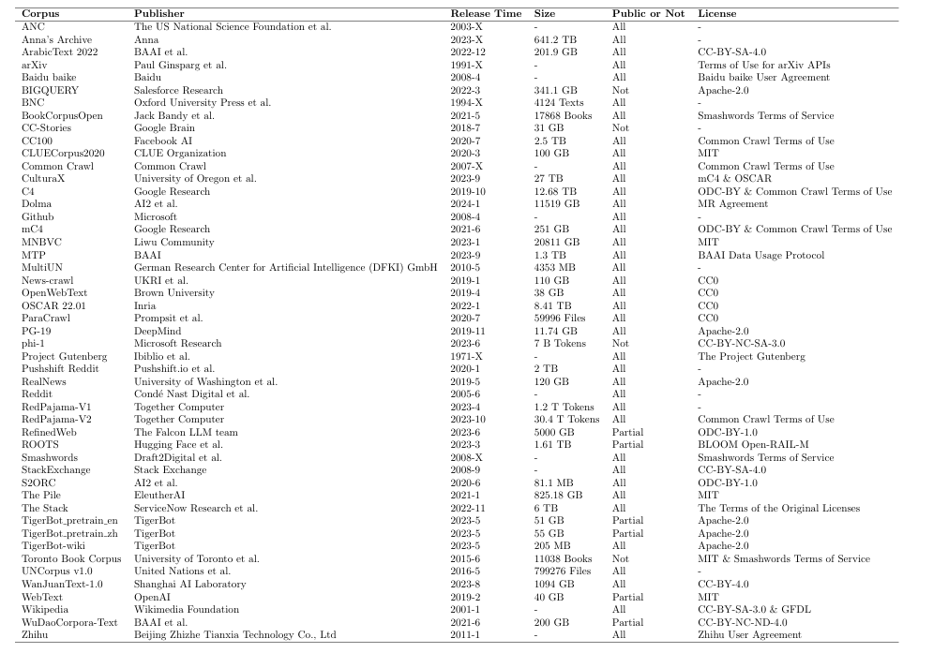
General Pre-training Corpora
Summary of General Pre-training Corpora Information PartI. Release Time:“X”indicates unknown month. Public or Not:“All” Indicates full opensource; “Partial” indicates partially opensource; “Not” indicates not open source.“License” indicates the corpus follows a certain protocol.

Slide 16
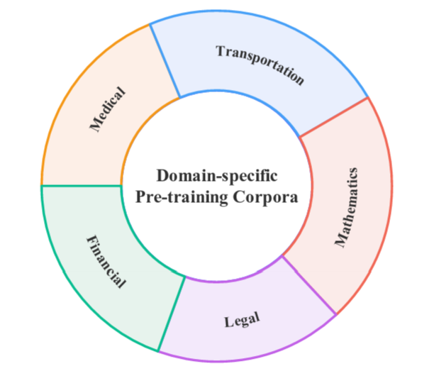
Domain Specific Pre-training Corpora
Domain-specific pre-training corpora tailored for specific fields or topics.

Slide 17
Domain Specific Pre-training Corpora
Financial Domain: BBT-FinCorpus, FinCorpus, Fin-GLM, Tiger-Bot Research
Medical Domain: Medical-pt, Pub-med central
Legal Domain: Tiger-Bot Law
Transportation Domain: TransGPT
Mathematics Domain: Proof-Pile-2

Slide 18
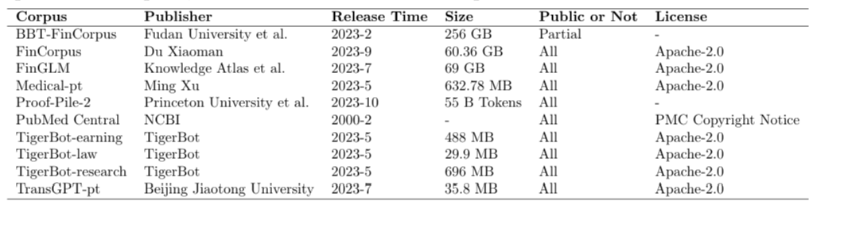
Domain Specific Pre-training Corpora
Summary of Domain-specific Pre-training Corpora Information. Public or Not:“All” indicates full open source; “Partial” indicates partially open source. “License” indicates the corpus follows a certain protocol.

Slide 19
Instruction Fine-tuning Datasets
The instruction fine-tuning datasets consists of a series of text pairs comprising “instruction inputs” and “answer outputs.”
“Instruction inputs” represent requests made by humans to the model, encompassing various types such as classification, summarization, paraphrasing, and more.
“Answer outputs” are the responses generated by the model following the instruction, aligning with human expectations.

Slide 20
Instruction Fine-tuning Datasets
Four ways to construct the instruction fine-tuning datasets:
manual creation
model generation, for example, using the Self-Instruct method (Wang et al, 2023f)
collection and improvement of existing open-source datasets
a combination of the above aforementioned methods.
The instruction fine-tuning datasets can be divided into two main categories: general instruction fine-tuning datasets and domain-specific instruction fine-tuning datasets.

Slide 21
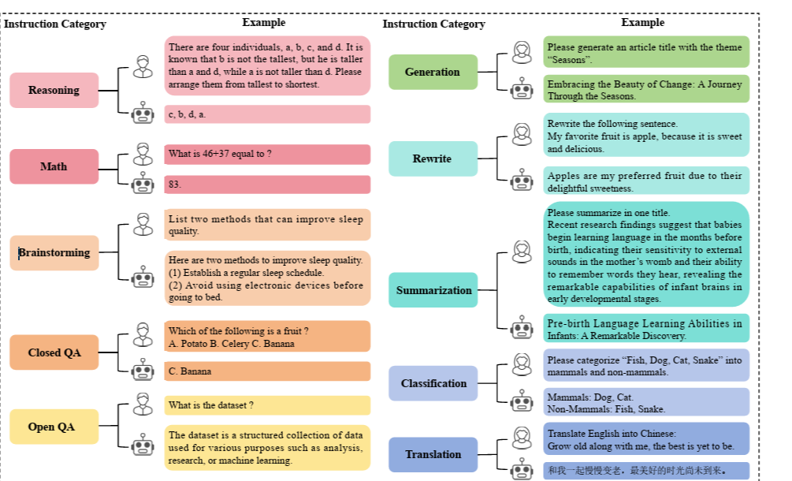
Summary of Instruction Categories

Slide 22
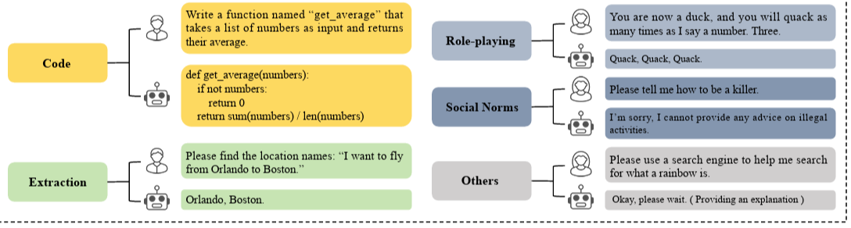
Summary of Instruction Categories

Slide 23
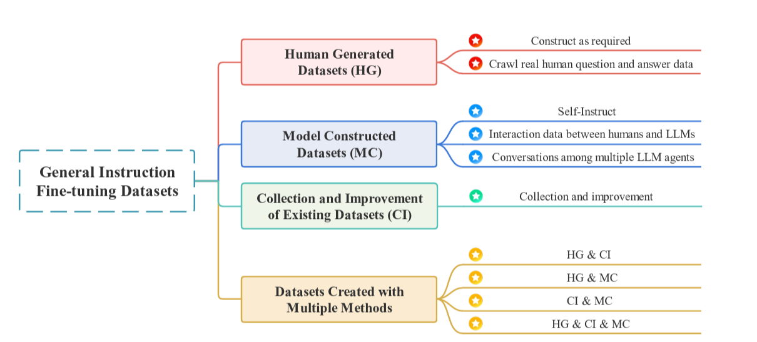
General Instruction Fine-tuning Datasets

Slide 24
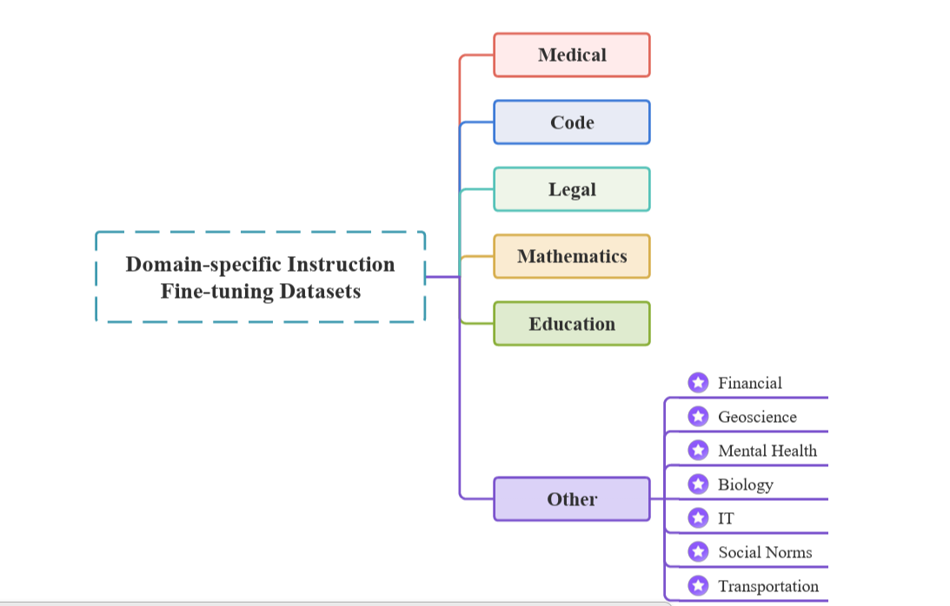
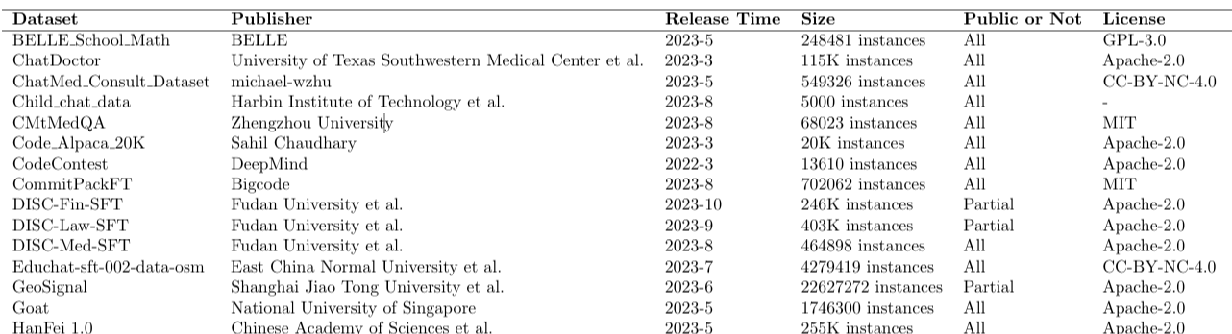
Domain-Specific Instruction Fine-tuning Datasets

Slide 25
Domain-Specific Instruction Fine-tuning Datasets

Slide 26
Preference Datasets
Preference datasets are collections of instructions that provide preference evaluations for multiple responses to the same instruction input.
They consist of pairs of instructions with different responses, along with feedback from humans or other models.

Slide 27
Preference Datasets
Preference datasets are primarily utilized during the alignment phase of large language models.
To assist in aligning the model’s outputs more closely with human preferences and expectations.
The alignment with human preferences is manifested in three main aspects: utility (possessing the ability to follow instructions) , honesty (avoiding fabrications) and safety, (refraining from generating illegal or harmful information) (Zhaoetal,2023).

Slide 28
Preference Datasets : An Example
Prompt: "Explain quantum computing in simple terms."
✅ Response A (Chosen): Quantum computing uses qubits that can be both 0 and 1 at the same time, enabling powerful computations.
❌ Response B (Rejected): Quantum computing is about very fast computers.

Slide 29
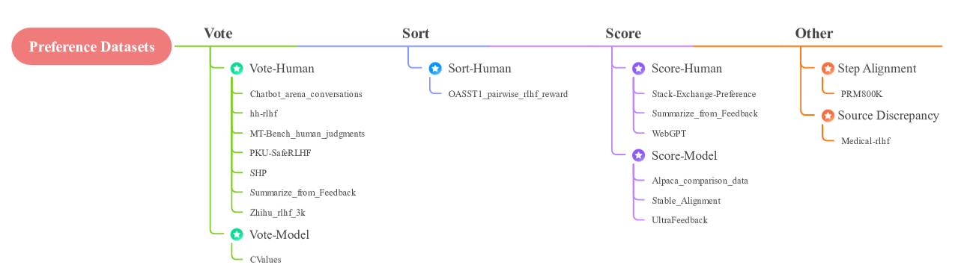
Preference Datasets
Different preference datasets corresponding to various preference evaluation methods

Slide 30
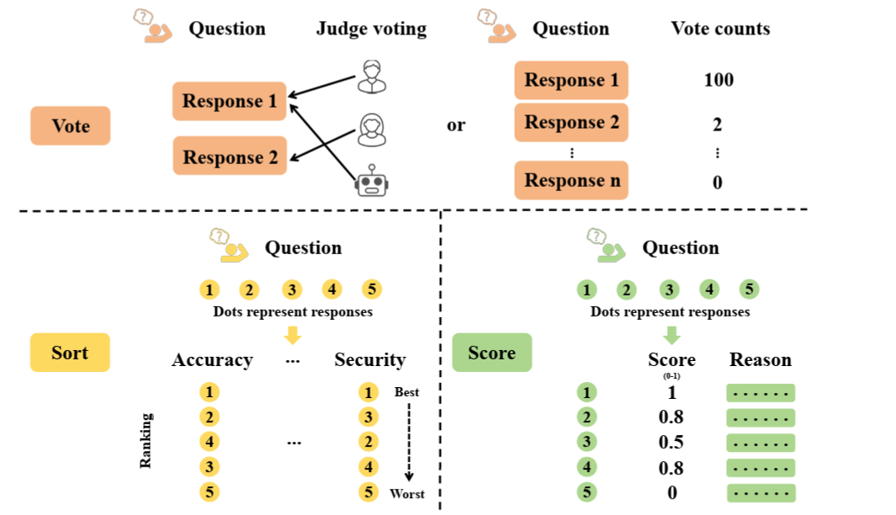
Preference Evaluation Methods

Slide 31
Evaluation Datasets
Evaluation datasets are a carefully curated and annotated set of data samples used to assess the performance of LLMs across various tasks.
Different evaluation datasets focus on different evaluation aspects, providing an objective measure of different models.

Slide 32
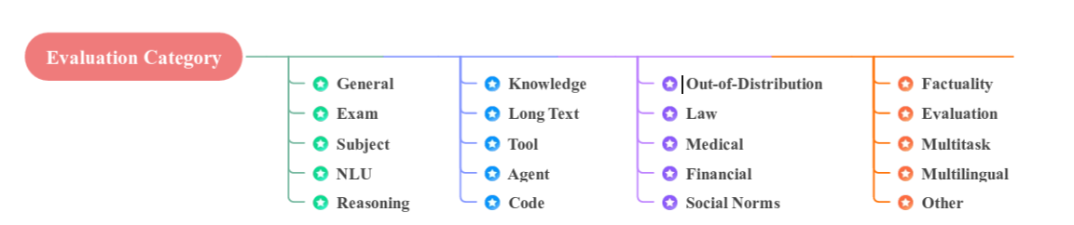
Evaluation categories of Evaluation Datasets

Slide 33
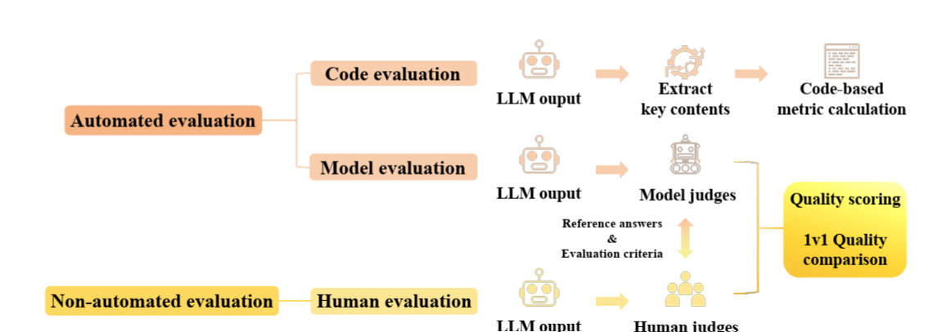
Evaluation Methods

Slide 34
Prominent Evaluation Metrics
F1 score
BLEU (Papineni et al, 2002)
ROUGE (Lin, 2004)
BertScore
Pearson correlation coefficient

Slide 35
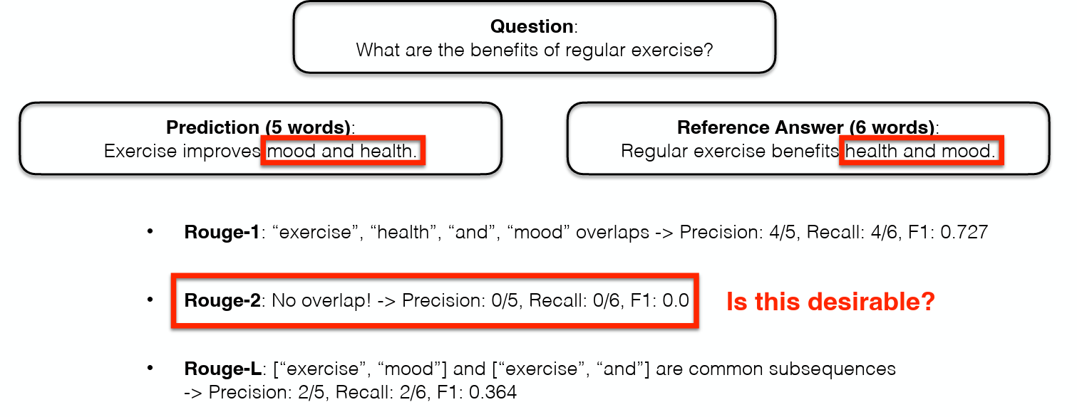
ROUGE Metric
Count the word overlap between the prediction and reference answer.
Lin, C.Y., 2004, July. Rouge: A package for automatic evaluation of summaries. In Text summarization branches out (pp. 74-81)

Slide 36
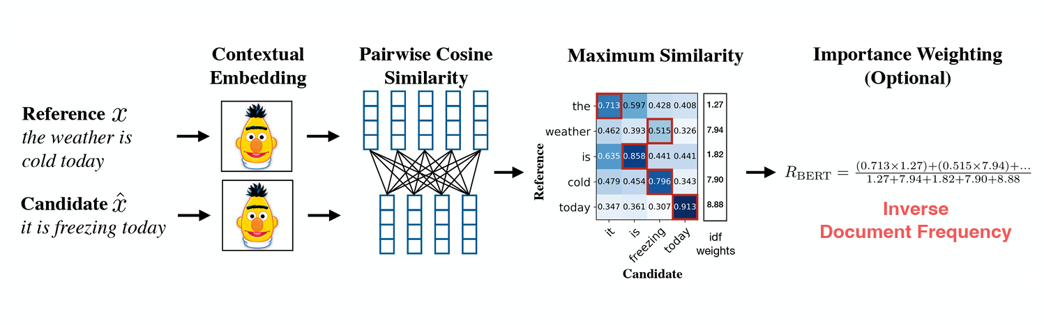
BertScore Metric
Compute the embedding similarity between the prediction & reference answer.
Zhang, T., Kishore, V., Wu, F., Weinberger, K.Q. and Artzi, Y., BERTScore: Evaluating Text Generation with BERT. In International Conference on Learning Representations.

Slide 37
LLM Capabilities
Knowledge and Language Understanding
Reasoning Capabilities
Multi-turn Open Ended Conversations
Grounding and Abstractive summarization
Content moderation and Narrative control
Coding Capabilities
LLM-Assisted evaluation

Slide 38
Benchmarks for Knowledge and Language Understanding
Benchmarks | Description | Purpose | Relevance | Resource
Massive Multitask Language Understanding (MMLU) | Measures general knowledge across 57 different subjects, ranging from STEM to social sciences. | To assess the LLM's understanding and reasoning in a wide range of subject areas. | Ideal for multifaceted AI systems that require extensive world knowledge and problem-solving ability. | https://arxiv.org/abs/2009.03300
AI2 Reasoning Challenge (ARC) | Tests LLMs on grade-school science questions, requiring both deep general knowledge and reasoning abilities. | To evaluate the ability to answer complex science questions that require logical reasoning. | Useful for educational AI applications, automated tutoring systems, and general knowledge assessments. | https://arxiv.org/abs/1803.05457

Slide 39
Benchmarks for Knowledge and Language Understanding
Benchmarks | Description | Purpose | Relevance | Resource
General Language Understanding Evaluation (GLUE) | A collection of various language tasks from multiple datasets, designed to measure overall language understanding. | To provide a comprehensive assessment of language understanding abilities in different contexts. | Crucial for applications requiring advanced language processing, such as chatbots and content analysis. | https://arxiv.org/abs/1804.07461
LAnguage Modelling Broadened to Account for Discourse Aspects (LAMBADA) | A collection of passages testing the ability of language models to understand and predict text based on long-range context. | To assess the models' comprehension of narratives and their predictive abilities in text generation. | Important for AI applications in narrative analysis, content creation, and long-form text understanding. | https://arxiv.org/abs/1606.06031

Slide 40
Benchmarks for Knowledge and Language Understanding
Benchmarks | Description | Purpose | Relevance | Resource
HellaSwag | Tests natural language inference by requiring LLMs to complete passages in a way that requires understanding intricate details. | To evaluate the model's ability to generate contextually appropriate text continuations. | Useful in content creation, dialogue systems, and applications requiring advanced text generation capabilities. | https://arxiv.org/abs/1905.07830
Multi-Genre Natural Language Inference (MultiNLI) | A benchmark consisting of 433K sentence pairs across various genres of English data, testing natural language inference. | To assess the ability of LLMs to assign correct labels to hypothesis statements based on premises. | Vital for systems requiring advanced text comprehension and inference, such as automated reasoning and text analytics tools. | https://arxiv.org/abs/1704.05426

Slide 41
Benchmarks for Knowledge and Language Understanding
Benchmarks | Description | Purpose | Relevance | Resource
SuperGlue | An advanced version of the GLUE benchmark, comprising more challenging and diverse language tasks. | To evaluate deeper aspects of language understanding and reasoning. | Important for sophisticated AI systems requiring advanced language processing capabilities. | https://arxiv.org/abs/1905.00537
TriviaQA | A reading comprehension test with questions from sources like Wikipedia, demanding contextual analysis. | To assess the ability to shift through context and find accurate answers in complex texts. | Suitable for AI systems in knowledge extraction, research, and detailed content analysis. | https://arxiv.org/abs/1705.03551

Slide 42
Benchmarks for Reasoning Capabilities
Benchmark | Description | Purpose | Relevance | Resource
GSM8K | A set of 8.5K grade-school math problems that require basic to intermediate math operations. | To test LLMs’ ability to work through multistep math problems. | Useful for assessing AI’s capability in solving basic mathematical problems, valuable in educational contexts. | https://arxiv.org/abs/2110.14168
Discrete Reasoning Over Paragraphs (DROP) | An adversarially-created reading comprehension benchmark requiring models to navigate through references and execute operations like addition or sorting. | To evaluate the ability of models to understand complex texts and perform discrete operations. | Useful in advanced educational tools and text analysis systems requiring logical reasoning. | https://arxiv.org/abs/1903.00161

Slide 43
Benchmarks for Reasoning Capabilities
Benchmark | Description | Purpose | Relevance | Resource
Counterfactual Reasoning Assessment(CRASS) | Evaluates counterfactual reasoning abilities of LLMs, focusing on "what if" scenarios. | To assess models' ability to understand and reason about alternate scenarios based on given data. | Important for AI applications in strategic planning, decision-making, and scenario analysis. | https://arxiv.org/abs/2112.11941
Large-scale ReAding Comprehension Dataset From Examinations (RACE) | A set of reading comprehension questions derived from English exams given to Chinese students. | To test LLMs' understanding of complex reading material and their ability to answer examination-level questions. | Useful in language learning applications and educational systems for exam preparation. | https://arxiv.org/abs/1704.04683

Slide 44
Benchmarks for Reasoning Capabilities
Benchmark | Description | Purpose | Relevance | Resource
Big-Bench Hard (BBH) | A subset of BIG-Bench focusing on the most challenging tasks requiring multi-step reasoning. | To challenge LLMs with complex tasks demanding advanced reasoning skills. | Important for evaluating the upper limits of AI capabilities in complex reasoning and problem-solving. | https://arxiv.org/abs/2210.09261
AGIEval | A collection of standardized tests, including GRE, GMAT, SAT, LSAT, and civil service exams. | To evaluate LLMs' reasoning abilities and problem-solving skills across various academic and professional scenarios. | Useful for assessing AI capabilities in standardized testing and professional qualification contexts. | https://arxiv.org/abs/2304.06364

Slide 45
Benchmarks for Multi Turn Open Ended Conversations
Benchmark | Description | Purpose | Relevance | Resource
MT-bench | Tailored for evaluating the proficiency of chat assistants in sustaining multi-turn conversations. | To test the ability of models to engage in coherent and contextually relevant dialogues over multiple turns. | Essential for developing sophisticated conversational agents and chatbots. | https://arxiv.org/abs/2306.05685
Question Answering in Context (QuAC) | Features 14,000 dialogues with 100,000 question-answer pairs, simulating student-teacher interactions. | To challenge LLMs with context-dependent, sometimes unanswerable questions within dialogues. | Useful for conversational AI, educational software, and context-aware information systems. | https://arxiv.org/abs/1808.07036

Slide 46
Benchmarks for Grounding and Abstractive Summarizations
Benchmark | Description | Purpose | Relevance | Resource
Ambient Clinical Intelligence Benchmark (ACI-BENCH) | Contains full doctor-patient conversations and associated clinical notes from various medical domains. | To challenge models to accurately generate clinical notes based on conversational data. | Vital for AI applications in healthcare, especially in automated documentation and medical analysis. | https://arxiv.org/abs/2306.02022
MAchine Reading COmprehension Dataset (MS-MARCO) | A large-scale collection of natural language questions and answers derived from real web queries. | To test the ability of models to accurately understand and respond to real-world queries. | Crucial for search engines, question-answering systems, and other consumer-facing AI applications. | https://arxiv.org/abs/1611.09268

Slide 47
Benchmarks for Grounding and Abstractive Summarizations
Benchmark | Description | Purpose | Relevance | Resource
Query-based Multi-domain Meeting Summarization (QMSum) | A benchmark for summarizing relevant spans of meetings in response to specific queries. | To evaluate the ability of models to extract and summarize important information from meeting content. | Useful for business intelligence tools, meeting analysis applications, and automated summarization systems. | https://arxiv.org/abs/2104.05938
Physical Interaction: Question Answering (PIQA) | Tests knowledge and understanding of the physical world through hypothetical scenarios and solutions. | To measure the model’s capability in handling physical interaction scenarios. | Important for AI applications in robotics, physical simulations, and practical problem-solving systems. | https://arxiv.org/abs/1911.11641

Slide 48
Benchmarks for Content Moderation and Narrative Control
Benchmark | Description | Purpose | Relevance | Resource
ToxiGen | A dataset of toxic and benign statements about minority groups, focusing on implicit hate speech. | To test a model's ability to both identify and avoid generating toxic content. | Crucial for content moderation systems, community management, and AI ethics research. | https://arxiv.org/abs/2203.09509
Helpfulness, Honesty, Harmlessness (HHH) | Evaluates language models' alignment with ethical standards such as helpfulness, honesty, and harmlessness. | To assess the ethical responses of models in interaction scenarios. | Vital for ensuring AI systems promote positive interactions and adhere to ethical standards. | https://arxiv.org/abs/2112.00861

Slide 49
Benchmarks for Content Moderation and Narrative Control
Benchmark | Description | Purpose | Relevance | Resource
TruthfulQA | A benchmark for evaluating the truthfulness of LLMs in generating answers to questions prone to false beliefs and biases. | To test the ability of models to provide accurate and unbiased information. | Important for AI systems where delivering accurate and unbiased information is critical, such as in educational or advisory roles. | https://arxiv.org/abs/2109.07958v2
Responsible AI (RAI) | A framework for evaluating the safety of chat-optimized models in conversational settings. | To assess potential harmful content, IP leakage, and security breaches in AI-driven conversations. | Crucial for developing safe and secure conversational AI applications, particularly in sensitive domains. | https://arxiv.org/abs/2310.17750

Slide 50
Benchmarks for Coding Capabilities
Benchmark | Description | Purpose | Relevance | Resource
CodeXGLUE | Evaluates LLMs' ability to understand and work with code across various tasks like code completion and translation. | To assess code intelligence, including understanding, fixing, and explaining code. | Essential for applications in software development, code analysis, and technical documentation. | https://arxiv.org/abs/2102.04664
HumanEval | Contains programming challenges for evaluating LLMs' ability to write functional code based on instructions. | To test the generation of correct and efficient code from given requirements. | Important for automated code generation tools, programming assistants, and coding education platforms. | https://arxiv.org/abs/2107.03374

Slide 51
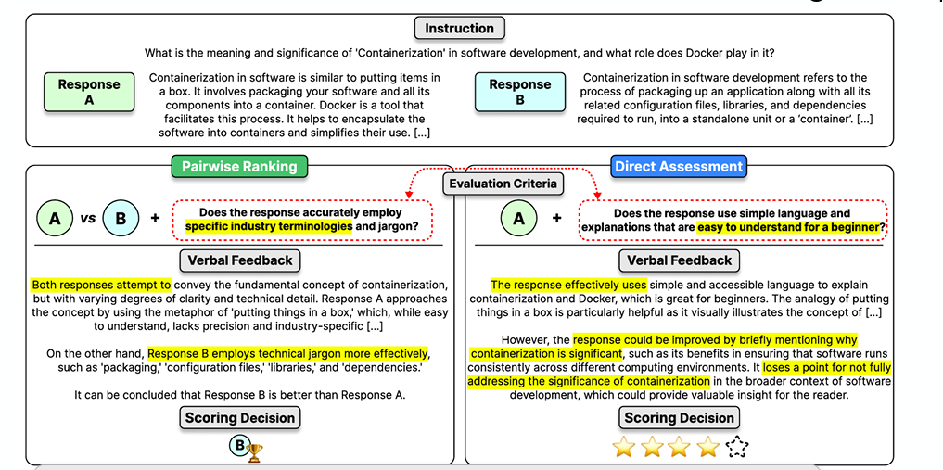
Benchmarks for LLM-Assisted Evaluation
LLM-As-A-Judge: Prompt LLM to provide judgement (e.g., “4 out of 5”, “A is better than B”)
Evaluation criteria can be decided while assessing the response!

Slide 52
Resources
Datasets for Large Language Models: A Comprehensive Survey (https://arxiv.org/pdf/2402.18041)
I acknowledge all the images taken from the respective resources.

