Slide 1
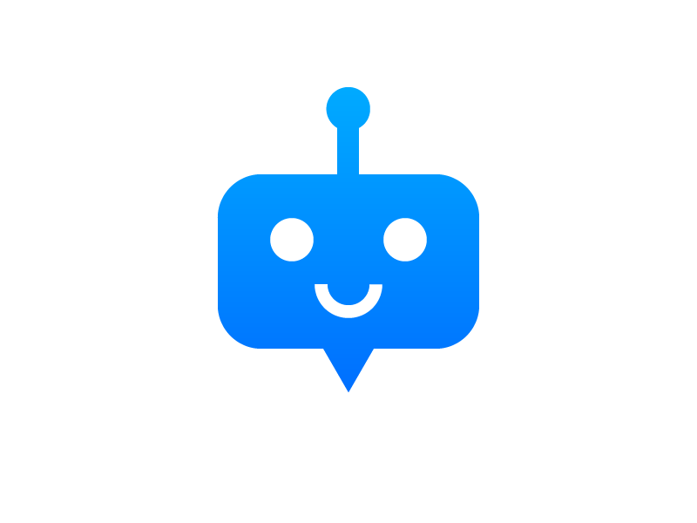
ChatBot
Make your own ☺

Slide 2
What actually is a ChatBot?
A subset of AI with NLP, or simply a computer program which is cable of making a conversation via text or speech.

Slide 3
Also known as:
Smart bots
Talkbots
Chatterbot
Bot
IM Bots
Interactive Agent
Conversational Interface
Artificial Conversational Entity

Slide 4
Application
Many companies chatbots run on messaging apps for B2C Customer Service, Sales and Marketting like :
FaceBook Messenger( since 2016)
WeChat ( since 2013 )
Whatsapp
Livechat
Kik
Slack
Line
Telegram

Slide 5
Some High Level AI – NLP based ChatBots :
Alexa
Siri
Google Assistant
Cortana

Slide 6
Our requirements to build a Simple ChatBot:
Basic Python Knowledge : For Simple Coding.
Anaconda : As a platform to open Jupyter Notebook.
Jupyter Notebook : To code and build a ChatBot
Chatterbot Package
Chatterbot Corpus
‘Patience’ : to train our ChatBot :P

Slide 7
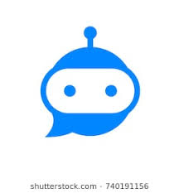
Thank You

