Slide 1
Analyzing Median House Prices and School Ratings for Scarborough Canada for Immigrants
Applied Data Science Capstone
IBM Data Science Professional Certificate

Slide 2
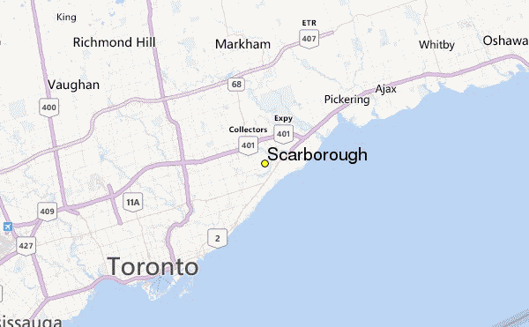

Slide 3
Part 1: Problem Description
Many people migrating to various states of Canada require search of a good housing prices as well as good rating schools for their children. The projects aim to create an analysis of features for a neighborhood as a comparative analysis between neighborhoods. The features include median house price and school ratings and recreational facilities. This would help people to get awareness of the places before moving to a new country, state, city or place for their work or to start a new life

Slide 4
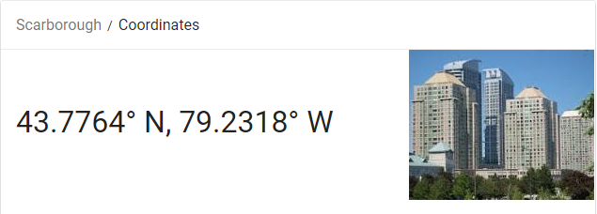
Part 2: Data We Need
Longitude and Latitude Data:
We will need geo-locational information about that specific borough and the neighborhoods in that borough. It is "Scarborough" in Toronto.
For the Toronto neighborhood data, a Wikipedia page exists that has all the information. The page can be found at: https://en.wikipedia.org/wiki/List_of_postal_codes_of_Canada:_M
Data was scraped and saved as a csv file. It can be found at: https://github.com/plabondutta/Coursera_Capstone/blob/master/postal_data_canada_with_lat_long.csv
Dataset comprising latitude and longitude, zipcodes is already available through the previous notebook. The location of Scarborough would be filtered using the same:
https://github.com/plabondutta/Coursera_Capstone/blob/master/ScrapPostalDataUsingBS4.ipynb

Slide 5
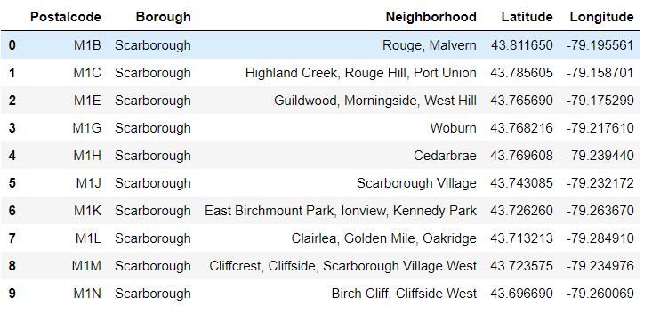

Slide 6
Foursquare API
Connecting to Foursquare and Retrieving Locational Data for Each Venue in Every Neighborhood
After finding the list of neighborhoods, we then connect to the Foursquare API to gather information about venues inside each and every neighborhood. For each neighborhood, we have chosen the radius to be 100 meter.

Slide 7
Data Preprocessing
Processing the Retrieved Data and Creating a DataFrome for All the Venues inside the Scarborough
When the data is completely gathered, we will perform processing on that raw data to find our desirable features for each venue. Our main feature is the category of that venue. After this stage, the column "Venue's Category" will be One-hot encoded and different venues will have different feature-columns.

Slide 8
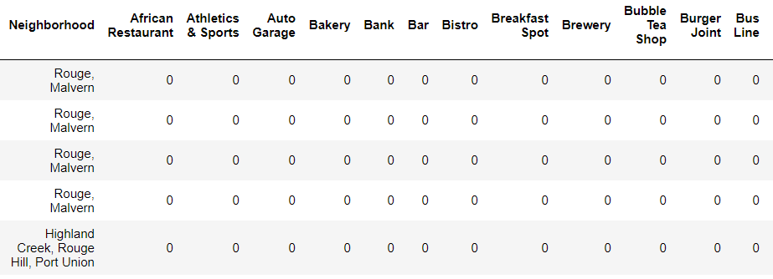
Creating a DataFrome
Processing the Retrieved Data and Creating a DataFrome for All the Venues inside the Scarborough

Slide 9
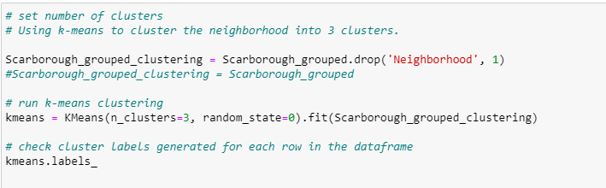
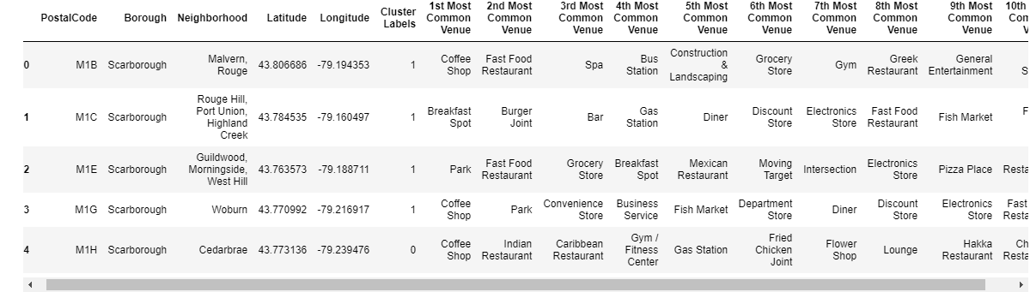
Main Article
Part 4: Applying one of Machine Learning Techniques (K-Means Clustering)

Slide 10
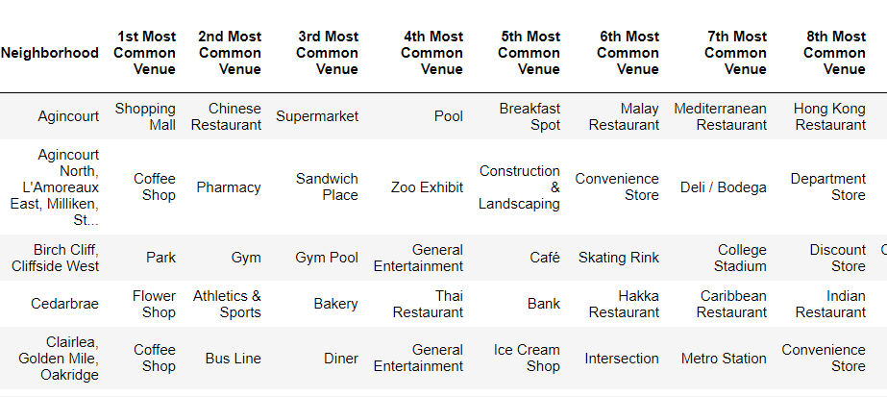
Finding Most Common Venues

Slide 11
Decision Making and Reporting Results
Now, we focus on the centers of clusters and compare them for their "Total Restaurants" and their "Total Joints". The group which its center has the highest "Total Sum" will be our best recommendation to the contractor. {Note: Total Sum = Total Restaurants + Total Joints.} This algorithm although is pretty straightforward yet is strongly powerful.

Slide 12
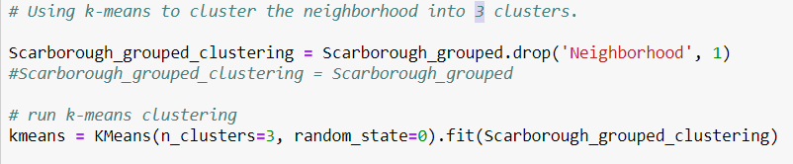
Clustering

Slide 13
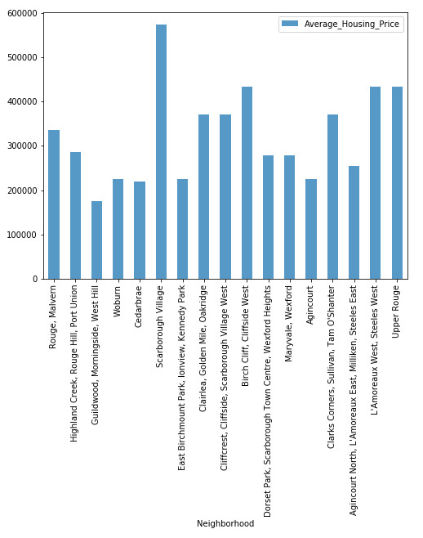
NEIGHBORHOOD MEDIAN HOUSING PRICES

Slide 14
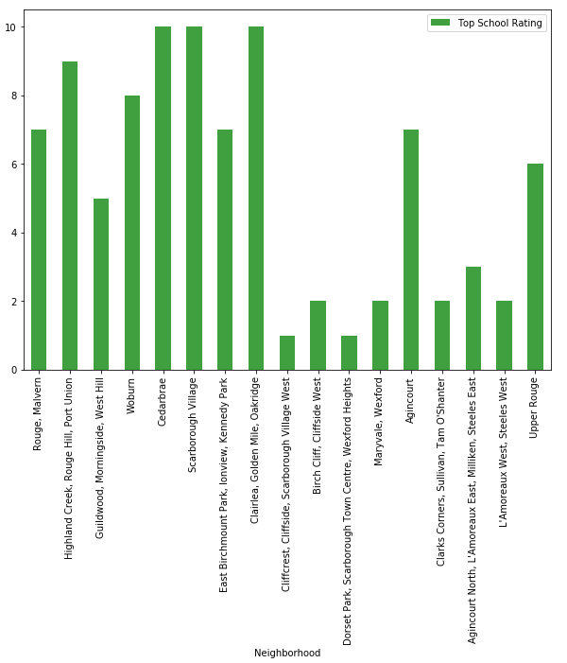
NEIGHBORHOOD SCHOOL RATINGS

Slide 15
Conclusion:
In this project, through a k-means cluster algorithm we separate the neighborhood into 03 clusters, which have similar neighborhoods around them. Using the charts above decision leading to a particular neighborhood based on average house prices and school rating can be made

Slide 16
THANKS

