Slide 1
An Algorithm for Multi-Criteria Optimization in CSPs
Marco Gavanelli
University of Ferrara
Italy
15th ECAI: July 21-26 2002, Lyon, France

Slide 2
Outline
Constraint Optimization Problems
Multi-criteria Optimization Problems
Current Approaches
New Method
Case studies
  Multi-Knapsack
  Randomly generated problems

Slide 3
Constraint Optimization Problem
A COP a CSP (X,D,C) with a cost function f to maximize
f:D₁ x ... x D_{N} → S_{t}
where (S_{t}, ≤) is a total order
An assignment A is an optimal solution to a COP iff it is a solution of the CSP and ¬∃A’ s.t. f(A’) > f(A)
Total order among solutions:
  Only the best assignment satisfying constraints is considered solution of the COP

Slide 4
Branch & Bound
Method for solving COPs
Translates a COP into a sequence of CSP
1. repeat
2. find a feasible assignment
for CSP: A
3. let f* = f(A)
4. impose f > f*
5. until search successful
Can be considered as a
set of NoGoods
Def. A nogood is a (partial) assignment A such that there is no unenumerated solution containing A

Slide 5
B&B as NoGood learning
The function f can be considered as a variable of the CSP linked with a constraint to other variables
E.g. A,B :: 0..4, f(A,B) = A+B
can be considered as
F :: 0..8, F = A+B
if we know a feasible assignment
(A→1,B →0), we can infer the nogoods:
{F→0},{F→1}

Slide 6
Multi-criteria Optimization Problems
A MOP is a CSP (X,D,C) with functions
f ≡ f₁,f₂,...,f_{n}, that “should be optimized at the same time”
The user is not able to synthesize the functions into only one
  usually, tradeoff solutions are considered more interesting, extreme solutions are seldom accepted
In most cases there is not only one optimal point

Slide 7
Non-Dominated Frontier
In a MOP, the concept of better solution turns into the concept of Domination:
X ≤_{d} Y ⇔ ∀ k=1..n, X_{k} ≤ Y_{k}
A Solution of the CSP is Pareto-Optimal or Non-Dominated iff
¬∃A’ s.t. f(A) <_{d} f(A’)
Only points in the nondominated frontier are interesting to the user
f₁
Criterion Space
f₂

Slide 8
Current Approaches: Models
Transform Partial Order into Total Order introducing assumptions:
  Hierarchies
  Linear Combinations
  Distance from the ideal point
  Interactive Methods
(MP) Methods that require properties of the problem structure:
  linear problems
  continuous/differentiable constraints/functions

Slide 9
Current Approaches: Methods
Incomplete Methods: Tabu Search, Genetic Algorithms, ...
van Wassenhove-Gelders [WS80]: Split the criterion space into strips and optimize only one function.
1. repeat
2. B&B: maximize f1 -> Δ
3. NoGood: f2 > f2(Δ)
4. until search successful
Notes:
ARTICLE{WG,
author = "L.N. van~Wassenhove and L.F.~Gelders",
title = "Solving a bicriterion scheduling problem",
journal = "European Journal of Operational Research",
year = "1980",
volume = "4",
pages = "42 -- 48",
}

Slide 10
van Wassenhove-Gelders
Search Tree
max(f₁)
f₁
f₂

Slide 11
van Wassenhove-Gelders: restart
Search Tree
max(f₁)
f₁
f₂

Slide 12
van Wassenhove-Gelders: restart 3
Search Tree
max(f₁)
f₁
f₂

Slide 13
van Wassenhove-Gelders: restart 3
Search Tree
max(f₁)
f₁
f₂

Slide 14
van Wassenhove-Gelders: Limitations
 2 Objective functions
 Restarts the search for each non-dominated solution found
 Complete (finds the whole non-dominated frontier)
 General (no assumptions on the problem structure)

Slide 15
Multi-B&B
Search Tree
f₁
f₂

Slide 16
Optimization NoGood
Extension of the concept of NoGood for Multi-Criteria Optimization
Def. An Optimization NoGood is an assignment {F₁ →v₁,…, F_{k} →v_{k}} such that ∀u₁≤ v₁,…, u_{k}≤ v_{k}, {F₁ →u₁,…, F_{k} →u_{k}} is a nogood
f₁
(v₁ ,v₂)
f₂

Slide 17
Propagation of optimization nogoods
f₁
f₂

Slide 18
Propagation of nogoods
Each time the check of optimization nogoods is activated, up to N of the recorded nogoods can reduce domains
The problem reduces to finding if N points are in the forbidden area
Use efficient, spatial data structures

Slide 19
Point Quad-Trees

Slide 20
Point Quad-Trees: Features
 Access in O(log(#Opt NoGoods))
 Easily extendable to N dimensions (Oct-Trees, ...)
 Insertion of new points in
O(log(#Opt NoGoods))
Drawbacks:
 Elimination of one point implies re-insertion of some of its children
 Efficiency depends on the balancing of the tree

Slide 21
Point Quad-Trees for MOP
Points that dominate the node are searched in one of the children
Dominated area is one of the children
We only delete points if they become dominated, i.e., if we insert another point

Slide 22
2D Quad-Trees for MOP
In general, deleting a point means:
Finding a new root for the sub-tree
re-arranging the children
In our case
The new root is the inserted point
The children that need re-arrangement are dominated

Slide 23
Case Study: Multi-Knapsack Problem
p_{i,j}: profit of object j according to knapsack i
w_{i,j}: weight of object j according to knapsack i
c_{i}: capacity of knapsack i
∀i, Σ_{j} x_{j}w_{i,j} ≤ c_{i}
x_{j} ∈{0,1}
max(f₁,...,f_{N}): f_{i}= Σ_{j} x_{j}p_{i,j}

Slide 24
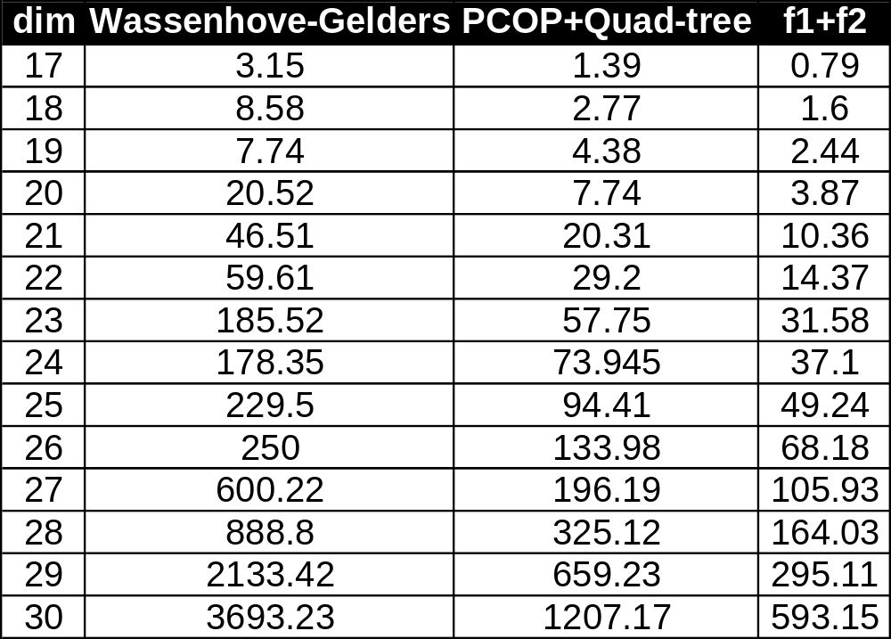
Multi-Knapsack Problem

Slide 25
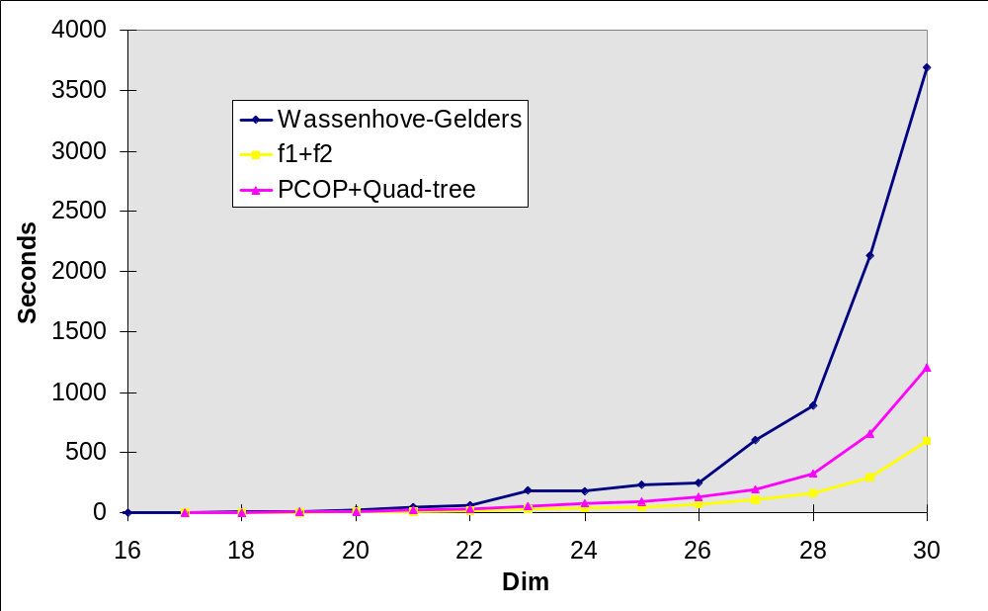
Multi-Knapsack

Slide 26
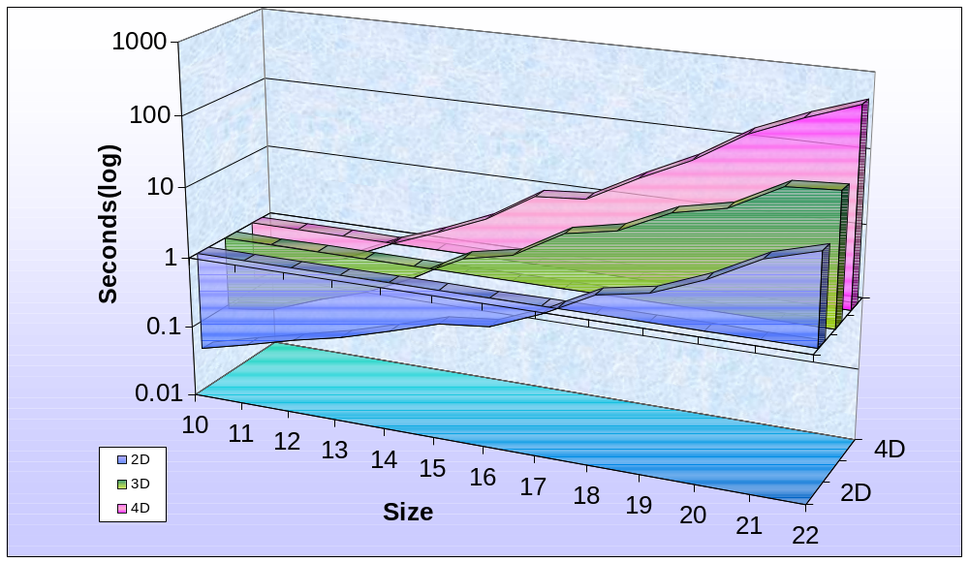
Multi-Knapsack > 2D

Slide 27
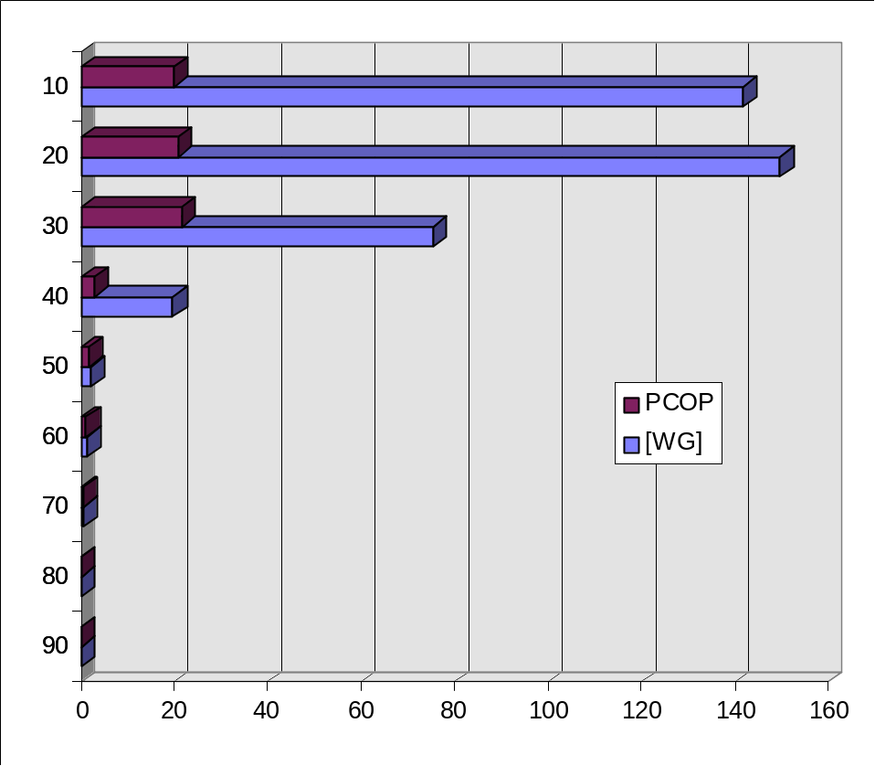
Randomly Generated Problems
Problems generated with parameters:
N=10, D=15, P = 50%, Q =10% .. 90%
Linear functions with random weights. Average of 10 problems each
Tightness [WG] PCOP
90 0.07 0.079
80 0.282 0.287
70 0.4922 0.4977
60 1.22 1.16
50 2.184 1.658
40 19.81 2.879
30 75.463 21.454
20 149.57 20.766
10 141.57 20.122
Notes:
Problems generated with parameters:
Number of variables: N=10
Size of domains: D=15
Constraint density: P = 50%
Constraint Tightness: Q varying from 10% to 90%
Linear functions with random weights

Slide 28
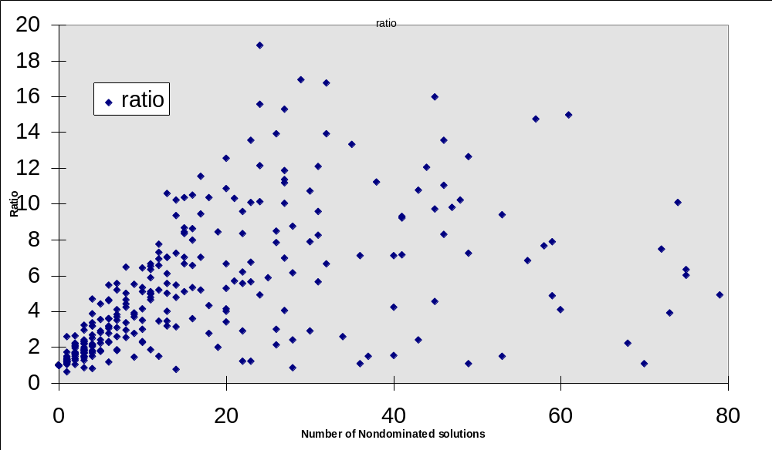
Randomly-Generated Problems
Ratio = Number of nondominated solutions ~ number of restarts
Equal computation time

Slide 29
Conclusions & Future Work
Extension of B&B for multicriteria with Quad-Trees in CSP
  complete (finds all the nondominated frontier)
  general (no assumptions on the functions, constraints, ...)
  N criteria
Future Work:
  Hybridization with methods in MP, local search, genetic algorithms, ...

Slide 30
Thanks for listening
Thank you!
Marco Gavanelli

