Slide 1
Integration of a Multicriteria Decision Model in Constraint Programming
F. Le Huédé
M. Grabisch
C. Labreuche
P. Savéant

Slide 2
Objective
Integrate
in
in order to solve
Multicriteria Combinatorial Optimization Problems.
Preference Modeling
with fuzzy measures and the Choquet integral
Constraint Programming
Notes:
The aim of our study is to integrate a multicriteria objective function in a CP solver in order to be able to find quickly, in a solution space described by finite domain variables and constraints, an optimal solution with respect to an objective function that is an accurate models of a decision maker preferences.
OUTLINE:
First I will introduce preference modeling with fuzzy measures and the Choquet Integral.
In the second part we will see how this model can be integrated in a CP solver,
and finally we will see a method to propagate the Choquet integral.

Slide 3
Why These Approaches?
Why CP?
    For the software engineering aspect of CP.
    For the modelling capacities of CP languages and the models flexibility.
    For the efficiency of the combination between search and constraints propagation.
Why a multicriteria model based on an aggregation function?
    In an Automated Decision context, decisions are taken by the software or an embedded system.
      The algorithm must return a unique solution of good quality.
      Preferences must be modelled « a priori » precisely.

Slide 4
Why the Choquet Integral?
The Choquet integral allows to model:
  the importance of a criterion,
  interactions between criteria.
  Many different behaviors.
Criterion 2
C
D
4 solutions to compare:
A
B
Criterion 1
C2
C2
C2
C
D
C
D
C
D
A
B
A
B
A
B
C1
C1
C1
Tolerance
Redundant criteria
Intolerance
Complementary criteria
Independence
Notes:
But before we start it may be important to tell a few words about the techniques we choosed to achieve multicriteria optimization.
First, why choosing the Choquet integral? Because the Choquet integral extends the wheighted sum and allows to model interactions between criteria and therefore its is able to represent many different behaviors.
For example, consider a choice between 4 solutions whose degrees of satisfaction on 2 criteria of the same importance as described on the graph.
Clearly, D is preferred to A
We can distinguish 3 completely different ways of comparing these solutions (also called alternatives):
A=B=C<D.
A<B=C=D.
A<B=C<D
These three ways are extreme, prototypical. More subtle ways of reasoning are possible.
However the fuzzy measure and the Choquet integral allow to model any of these kind of behavior as well as intemediate ones.

Slide 5
Main Issue
To find a good multicriteria solution
within a satisfying time.
How can we model and propagate the multicriteria model in CP?
How can we guide the search towards good solutions?

Slide 6
The Multicriteria Examination Timetabling Problem
Data:
  A set of exams to plan.
  A set of rooms of given capacities.
  A set of students, each enrolled to a set of exams.
  A set of periods.
Objective: To give each examination a period number and a room.
Constraints:
  Disjunction constraints: two exams followed by a same student can’t be planned on the same period.
  Room capacity: the number of students having an exam in a room on a given period can’t exceed the capacity of this room.
Criteria:
  Examination duration.
  Number of used rooms.
  Spreading of the exams.

Slide 7
Outline
The MCDM Model
Modelling a Multicriteria Model in CP
The Search of Solutions for Multicriteria Optimisation Problems

Slide 8
Components of the Multicriteria Model
Formalizing criteria
Modeling interactions between criteria
Aggregating
Utility functions
Fuzzy measure
Choquet Integral
Notes:
The multicriteria model is composed of 3 main components:
The criteria formalization is realized thanks to utility functions and it allows to establish the commensurability between the criteria.
The fuzzy measure is a set set function that is build in order to model importances and interactions between the criteria.
Finally the Choquet integral establish the overall evaluation. It computes a kind of average value of the utilities taking into account the importance and interactions between the criteria.
In the following part of the presentation we will give more details of this methodology.

Slide 9
MCDM Methodlogy: Criteria Formalization
Overall
Evaluation
1
C1
C3
C2
Construction of an
interval scale
over each criterion
Aggregation
0
Criterion
Definition of reference levels
u₁
u₂
u₃
Utility
1
1
1
Attribute
0
0
0
a₁
Hierarchical organization
of criteria
a₂
a₃
Construction of utility functions
Notes:
The criteria formalization starts with the identification of the attributes that account in the evaluation of the quality of a solution. That is to say, in our case, the identification of the objective functions.
Then, depending on the number of attributes and the connections between the se attributes, we try to establish a criteria hierarchy that gives us a cognitive map of the criteria.
The second steps aims to make the criteria comparable. Because these attributes we have identified are generally not measured on a common scale. We identify some reference levels on each attribute that correspond to common degrees of satisfaction for each criteria. That gives us what we call commensurable criteria.
Then we build an interval scale by evaluating the differences of satisfactions between several values of an attribute (for example: makespan).
Finaly this methodology, based on a questioning of the decision maker, allows us to build utility functions that give the degree of satisfaction of a criteria according to the value of an attribute (or objective function).

Slide 10
Utility function
Utility =
Degree of
satisfaction of
the criteria:
Minimise
the duration
1
0
LB
α₁.LB
α₂.LB
α₃.LB
max
Attribute: Duration of the exams

Slide 11
Fuzzy measures
Define a weight, not only for each criterion but also for each criteria coalition.
N: criteria set
A⊂ N : criteria coalition
µ(A) : weight of coalition A
Definition: A fuzzy measure µ on N is a function
µ: P(N) → [0,1], such that:
    µ(∅)=0, µ(N)=1
    A⊂ B ⇒ µ(A)≤ µ(B).
Notes:
The fuzzy measure is our tool to express the importance of a criterion or the interactions between two or more criteria.
It is a set function that defines a weight for each subset of the set of the criteria.

Slide 12
The Choquet integral
u = (u₁, u₂, u₃) : satisfaction degrees of a solution a.
Choquet integral of u with respect to µ:
u₍₃₎
u₍₂₎
_{n}
C_{µ}(u)=∑ u_{(i)}×[µ({(i),...,(n)}) - µ({(i+1),...,(n)})]
C_{µ}(u₁, u₂, u₃)
_{i=1}
u₍₁₎
where (.) indicate that the indices have been permuted so that:
u₍₁₎ ≤ u₍₂₎ ≤ u₍₃₎ and µ({(n+1)}) = 0
µ({(1),(2),(3)})
µ({(2),(3)})
µ({(3)})
Notes:
Finally the aggregation function establish the overall evaluation of a solution.
We use the Choquet integral that computes an average value of the utilities taking account of the interaction and the importance of the criteria.
Diverses formules de l'intégrale de Choquet sont possibles. Voici une autre formule qui correspond à un découpage différent, plus proche de la somme pndérée.

Slide 13
Graphical representations of the Choquet integral
u₁
C_{µ}(u₁,u₂)=z₁
u₁
u₁=u₂
u₁=u₂
C_{µ}(u₁,u₂)=z₂
u₂
u₂
Complementary criteria
Redundant criteria
Notes:
Encore quelques exemples de représentation graphique de l'intégrale de Choquet où l'on voit qu'il est possible d'atteindre certaines solutions non supportées de meilleur compromis.

Slide 14
Outline
The MCDM Model
Modelling a Multicriteria Model in CP
The Search of Solutions for Multicriteria Optimisation Problems

Slide 15
Integration in a CP solver
y
Overall evaluation
Choquet Constraint: y = C_{µ}(u₁, u₂, u₃ )
[0,1]
u₁
u₂
u₃
Utilities / scores
Affine
Constraint
u₁=U₁(a₁), u₂=U₂(a₂)
u₃=U₃(a₃)
a₁
a₂
a₃
Attributes
a₁=f₁(x₁,…,x_{m}),
a₂=f₂(x₁,…,x_{m}),
a₃=f₃(x₁,…,x_{m})
FD
Objective
functions
x₁, x₂, ....................., x_{m}
Problem
variables and
constraints
Notes:
La question qui se pose ensuite est comment intégrer la modélisation multicritère présentée dans un solveur de contraintes. On propose le schémas suivant:
En PPC, le problème combinatoire est modélisé à l'aide de variables et de contraintes sur lesquels on défini les attributs à l'aide de fonctions objectifs telles que la somme, le min ou le max.
Ensuite, les fonctions d'utilité sont modélisées principalement à l'aide de contraintes affine,
finalement, l'évaluation globale doit

Slide 16
The Choquet constraint
Objective :
    Establish the relation : y = C_{µ}(u₁, ..., u_{n})
    During the search, propagate domain reductions between the variables y, u₁, ..., u_{n}.
Notes:
La majeure partie des problèmes ont été étudiés. (des solutions ont été proposées.
Résoudre le problème de l'intégration de l'intégrale de Choquet en Contraintes.
-> pouvoir chercher la solution qui maximise y.

Slide 17
Constraint Propagation
The CP resolution process alternates :
    construction of a search tree,
    constraint propagation at each node of the tree.
Propagation = enforcing a consistency level for each constraint:
  Arc consistency : A constraint propagation technique enforces arc-consistency on a constraint c(x₁ ... x_{m}), if and only if when propagation stops the following statement holds:
for every variable x_{i}
      for every value val_{i} in the domain of x_{i}
        there are values val₁ ... val_{i-1} val_{i+1} ... val_{m}
        in the domains of x₁ ... x_{i-1} x_{i+1} ... x_{m}
        such that val₁ ... val_{i-1} val_{i} val_{i+1} ... val_{m} satisfy c
  Bound consistency techniques: consistency checks are done only on the bounds of the domains.
Notes:
Considering a constraint as a sub-problem, arc-consistency consists of removing all the values that do not belong to any solution of the sub-problem

Slide 18
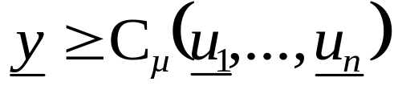
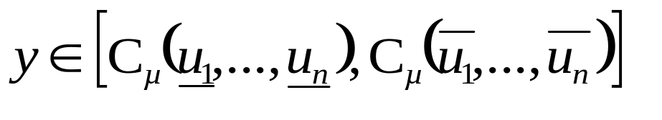
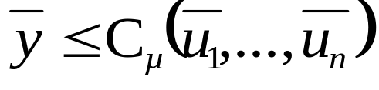

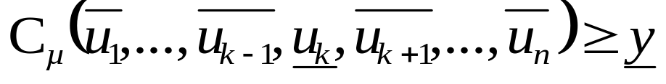
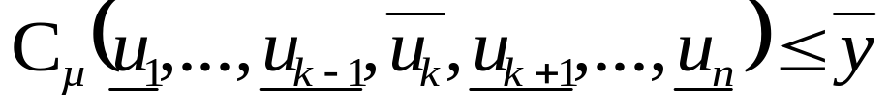
Propagation of the Choquet constraint
Consider a constraint that maintains the relation y = C_{µ}(u₁,...,u_{n}), it is bound-consistent iff conditions 1,2,3 and 4 hold:
1
2
3
How can we deduce some
new bounds for u_{k} ?
4
Notes:
On écrit les conditions pour l'intégrale de Choquet. Pour les utiliser pour calculer de nouvelles bornes :
Pour 1 et 2 : pas de problème, on dispose de l'expression analytique de l'intégrale de Choquet qui nous donne les bornes.
Par contre pour 3 et 4... impossible de séparer les termes de l'intégrale à cause de la permutation qui dépend de l'ordre des utilités.
=> Un algo pour déterminer la nouvelle borne.

Slide 19
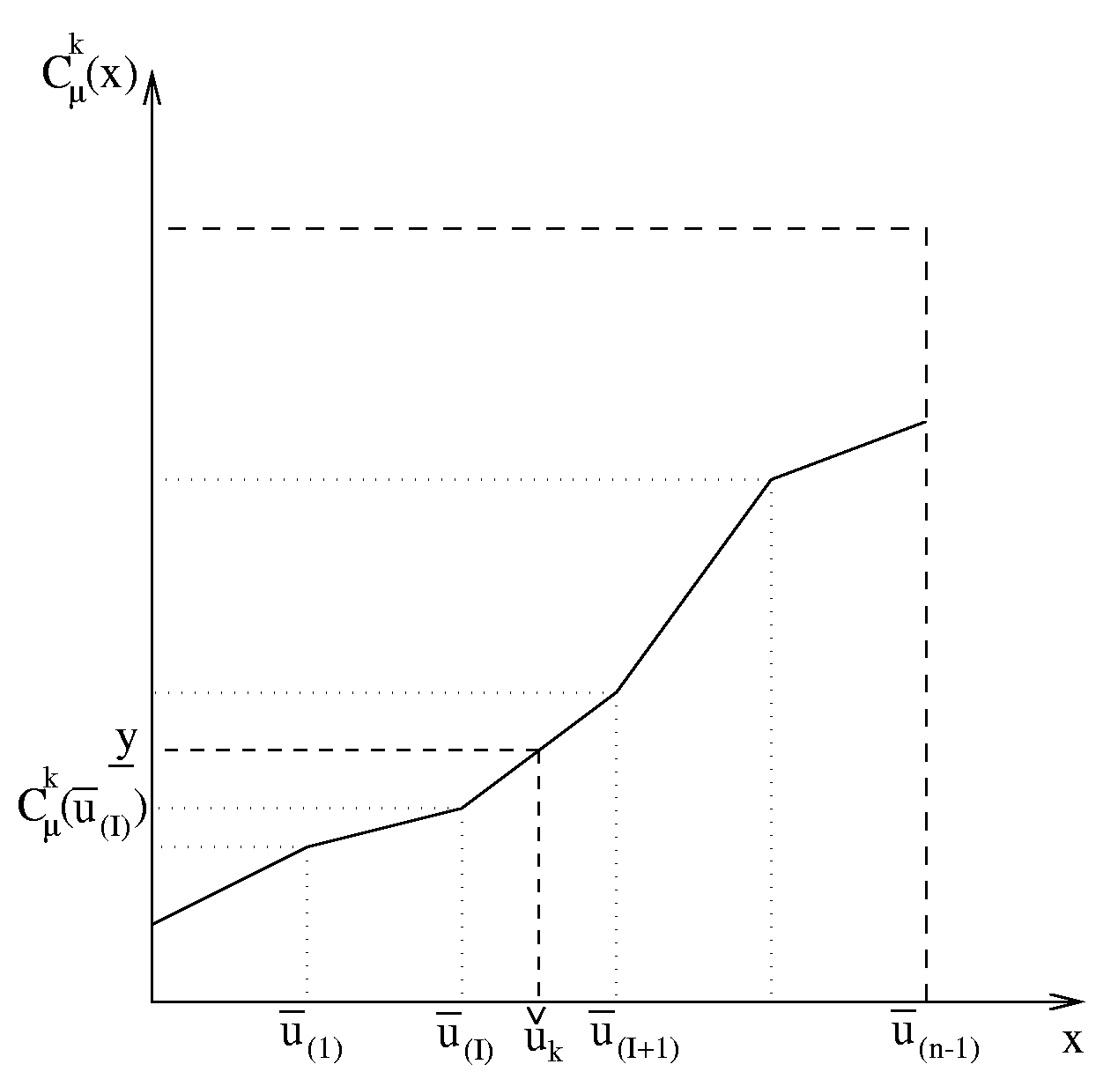
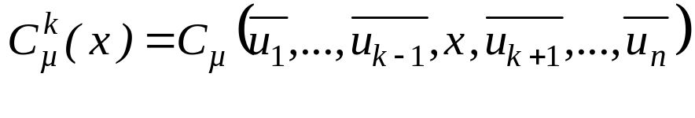

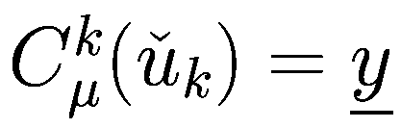

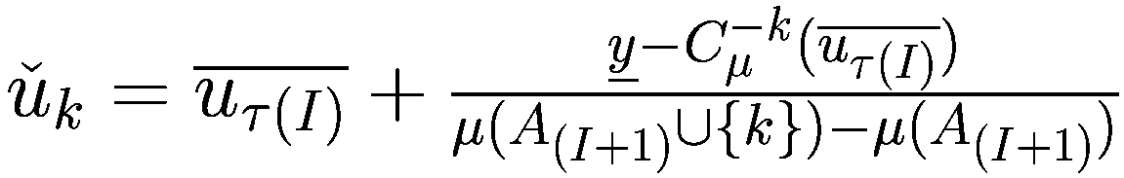
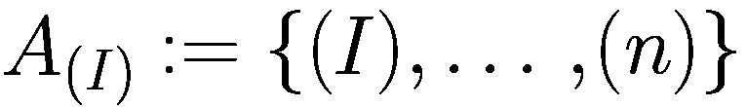
Computing a new lower bound for u_{k}
Notation :
Find the smallest value,,
such that:
Determine on which piece of the
function is located
1
Compute
2
Notes:
Calcul à partir de la condition 3 : borne inf d'un score.
1: Fonction : affine par morceau, non convexe, points de non continuité: bornes sup des autres variables.
-> trouver I, l'indice qui détermine sur quel segment de courbe se trouve la solution.
2: Calcul sur la partie linéaire.

Slide 20
The Choquet constraint propagation: Example
y = C_{µ}(u₁,u₂,u₃)
µ₀ = 0
µ₁ = 0.1 µ₂ = 0.4 µ₃ = 0.1
µ₁₂ = 0.5 µ₁₃ = 0.2 µ₂₃ = 0.6
µ₁₂₃ = 1
y ∈ [0.4,1] y ∈ [0.4,0.44]
u₁ ∈ [0,0.2] u₁ ∈ [0.1,0.2]
u₂ ∈ [0,0.8] u₂ ∈ [0.7,0.8]
u₃ ∈ [0,0.2] u₃ ∈ [0.12,0.2]
Notes:
Quelques propriétés pour limiter les calcul dans un schémas de propagation global.

Slide 21
The Choquet constraint propagation: Results
Results for a model with redundant criteria
 | Without Propagation |  | With Propagation
 | Nb. Btk | ms | Nb. Btk | ms
Sc. 6 | 602 | 50 | 136 | 40
Sc. 15 | 40741 | 4920 | 9106 | 1570
Sc. 20 | 374943 | 55460 | 37931 | 8820
Sc. 23 | 30885518 | 2569 s | 12266735 | 790 s
Results for a model with independant criteria
 | Without Propagation |  | With Propagation
 | Nb. Btk | ms | Nb. Btk | ms
Sc. 6 | 1501 | 130 | 419 | 70
Sc. 15 | 23801 | 2820 | 3908 | 840
Sc. 20 | 738869 | 106100 | 51786 | 16120
Sc. 23 | 29816827 | 1234 s | 24700990 | 1179 s
Notes:
Quelques propriétés pour limiter les calcul dans un schémas de propagation global.

Slide 22
Outline
The MCDM Model
Modelling a Multicriteria Model in CP
The Search of Solutions for Multicriteria Optimisation Problems

Slide 23
Main Issue: Guiding the Search
Objective:
To define a search strategy able to guide the search quickly towards good solutions.
Difficult due to:
  Conflicting criteria
  Compensation phenomena
A strategy that is good for optimising
a criteria is often inefficient for another
Good solutions offer a trade-off
between the criteria
u₁
u₁=u₂
C_{µ}(u₁,u₂)=z₁
u₂

Slide 24
Guiding the Search in Multicriteria Optimisation: Related Papers
Focacci-Godard CP-AI-OR’02 :
Definition of a partial search algorithm for a three objectives job shop aggregated by a weighted sum.
At each solution, bounding constraints are set on the objectives of the problem to speed-up the finding of good solutions.
The best algorithm alternates several searches with different configurations of bounding constraints.
  A practical and dedicated approach.
  Incomplete search.
Junker CP-AI-OR’02 : « Preference Based Search »
A simple formalism allows to express some preferences between the criteria.
The PBS algorithm performs successive mono-objective optimisations to find the set of non-dominated solutions.
A suitable labelling strategy is selected for each mono-objective optimisation depending on the criterion to optimise.
The model returns a set of solutions.
The whole set of non-dominated solutions is hard to find in large size optimisation problems.

Slide 25
So What Do We Need?
A general approach for the search of solutions
to multicriteria combinatorial optimisation problems
in an automated decision context.

Slide 26
Suggested Approach: The MCS Algorithm (1)
General principle:
to alternate searches on the problem criteria
in order to find solutions of increasing quality.
  A search on a criterion uses a dedicated mono-criterion strategy that allows to find quickly solutions of good quality on this criterion.
  After a search on a criterion, the criterion choice heuristic dynamically chooses the criterion that will guide the next search.
  The algorithm ends when a user-defined stopping condition is verified.
  Before a mono-criterion search, an improvement on a criterion can be explicitly imposed thanks to local constraints.

Slide 27
Suggested Approach: The MCS Algorithm (2)
<getNextCriterion>(s*)
MCS( y,
list<Var>(u1,…,un),
list<HybridSearch>(S1,…,Sn),
<getNextCriterion>,
<setLocalConstraints>,
<checkTermination>
)
Criterion choice heuristic
c
<setLocalConstraints>(s*,c)
Local constraints addition
c,b
Search(u_{c},y,getStrategy(c))
Solutions search
s*
<checkTermination>(s*,b)
Stopping Condition
false
true

Slide 28
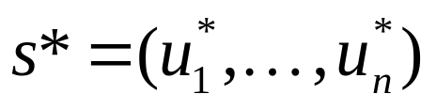
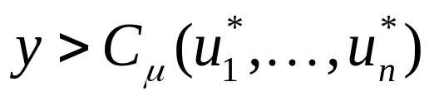
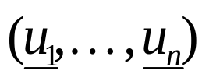
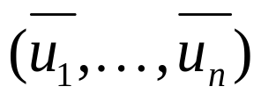
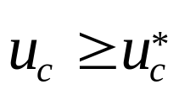
Instantiating MCS: An Example
Search for a first solution on criterion 1; old_c := 1
Set constraint
  propagate bounds and
Select the criterion c that maximises:
If ( c = old_c) set local constraint ; local := true
Search for a solution on criterion c
or nil
Terminate if (local ≠ true) and (s = nil)
else old_c := c

Slide 29
MCS Components: n Mono-Criterion Search Strategies
<getNextCriterion>(s*)
c
<setLocalConstraints>(s*,c)
c,b
Search(u_{c},y,getStrategy(c))
s*
<checkTermination>(s*,b)
false
true

Slide 30
MCS Components: n Mono-Criterion Search Strategies
MCS(y,(u1,…,un),(S1,…,Sn),<getNextCriterion>,<setLocalConstraints>,<checkTermination>)
Many kinds of search strategies can be defined easily with dedicated search pattern libraries such as ToOLS© :
  Definition of the search tree:
    Variable choice heuristic ;
    Labelling strategy.
  Specification of the maximum number of solutions per search.
  Specification of complete or partial search strategies.
  A library of hybrid methods that combine tree search and local search.
  Definition of an overall time limit and of a time limit per search.

Slide 31
MCS Components: The Criterion Choice Heuristic
<getNextCriterion>(s*)
c
<setLocalConstraints>(s*,c)
c,b
Search(uc,y,getStrategy(c))
s*
<checkTermination>(s*,b)
false
true

Slide 32


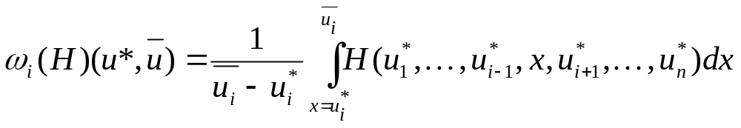
MCS Components: The Criterion Choice Heuristic
MCS(y,(u1,…,un),(S1,…,Sn),<getNextCriterion>,<setLocalConstraints>,<checkTermination>)
Indicates the criterion on which it is the most interesting to get an improvement with respect to:
    The last found solution (we denote its performances on the problem criteria).
    The aggregation function coefficients.
    The upper bounds of utility variables (denoted ).
Some criterion choice heuristics:
    Choose the criterion that maximises the maximum improvement indicator :
    Choose the criterion that maximises the average improvement indicator :

Slide 33
MCS components: Local Constraints
<getNextCriterion>(s*)
c
<setLocalConstraints>(s*,c)
c,b
Search(uc,y,getStrategy(c))
s*
<checkTermination>(s*,b)
false
true

Slide 34
MCS Components: Local Constraints
MCS(y,(u1,…,un),(S1,…,Sn),<getNextCriterion>,<setLocalConstraints>,<checkTermination>)
  <setLocalConstraints>(s*,c) allows to add some constraints on the criteria (u_{c} > u*_{c})
  A local constraint is valid during only one search.
  When a function posts a local constraint, it notifies the whole algorithm by returning true.
  Advantages: makes the search more efficient for the search of a solution of better quality on a selected criterion (if such a solution exists).
  Drawbacks: can make the search incomplete and take time for the search of a solution that does not exist.
Examples :
    systematicImprovement(s*,c): systematically add the constraint u_{c} > u*_{c} .
    consecutiveImprovement(s*,c): add the constraint u_{c} > u*_{c} when criterion c had been selected for the guiding of the previous search.

Slide 35
MCS components: The algorithm Stopping Condition
<getNextCriterion>(s*)
c
<setLocalConstraints>(s*,c)
c,b
Search(uc,y,getStrategy(c))
s*
<checkTermination>(s*,b)
false
true

Slide 36
MCS Components: The Algorithm Stopping Condition
MCS(y,(u1,…,un),(S1,…,Sn),<getNextCriterion>,<setLocalConstraints>,<checkTermination>)
<checkTermination> realises two kinds of operations:
    The termination of the algorithm (e.g., when a search can’t find any solution).
    The use of information returned by a search to reinforce the model.
optimalityCondition(local,s*,s,u,c)
if (getOverallValue(s*) = y.sup)
return true
else if (s = ∅) \\ the last search did not find any solution
if (local) \\ A local constraint was used
setConstraint(u[c] ≤ getValue(s*,c)),
return false
else return true
else return false
end

Slide 37
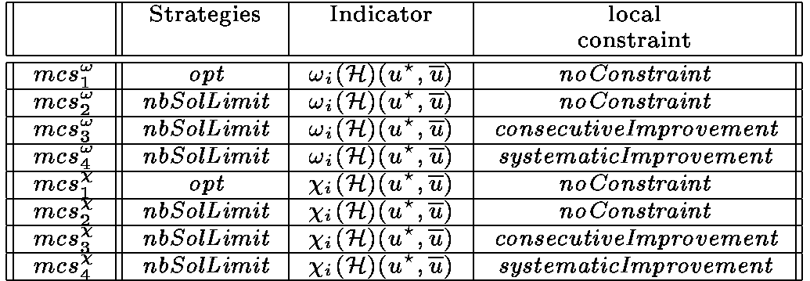
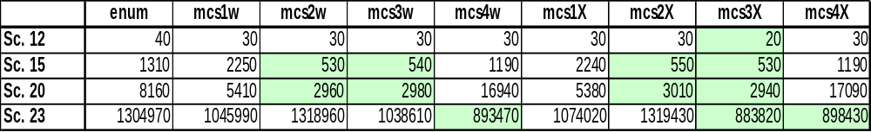
Some Instances of MCS for Complete Search
MCS Instances
Results on the examination timetabling problem

Slide 38
Conclusion and Future Work
Contributions:
  Integration of an MCDM model in CP.
  The MCS algorithm, dedicated to the search of solutions to multicriteria optimisation problems.
    The criterion choice heuristic.
    The definition of MCS components to achieve complete search.
  Implementation of these results in the Eclair© solver.
On going work:
  Instantiation of the MCS algorithm for partial search.
  Large combinatorial optimisation problems.

