Slide 1
Structure and Randomization: Common Themes in AI/OR
Carla Pedro Gomes
Cornell University gomes@cs.cornell.edu www.cs.cornell.edu/gomes
Invited Talk
AAAI 2000

Slide 2
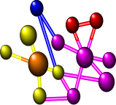



Integration of Artificial Intelligence & Operations Research Techniques
Planning
AI
Representations
Constraint Languages
Logic Formalisms
Bayesian Nets
Rule Based Systems
• • •
Tools
Constraint Propagation
Systematic Search
Stochastic Search
• • •
Pros / Cons
Rich Representations
Computational Complexity
OR
Representations
Mathematical
Modeling Languages
Linear & Non-linear
(In)Equalities
• • •
Tools
Linear Programming
Mixed-Integer Prog.
Non-linear Models
• • •
Pros / Cons
More Tractable (LP)
Primarily Complete Info
Limited Representations
Scheduling
Start
Goal
Quasigroup
ROME LABORATORY OUTAGE MANAGER (ROMAN)
Parameters Load Run
Parameters Load Run
31 - 45: ACPOWER? 0 NUM-UNAV-RESS 1
UNAV-RES-MAP (DIV2 D24BUS-3 D24-2 D24-1) (ACPLOSS D24BUS-3 D24-2
AC-POWER
0 10 20 30 40 50 60 70 80 90
(A or B) and (D or E or not A) ...
Status
AC Power
DIV1
DIV2
DIV3
DIV4
Satisfiability
Protein Folding
Reasoning
Verification
Routing
THE CHALLENGE
AI OR
COMBINE APPROACHES
EXPLOIT PROBLEM STRUCTURE
INCREASE ROBUSTNESS
SCALE UP SOLUTIONS
EXPLOIT RANDOMIZATION and UNCERTAINTY
HANDLE COMPLEXITY
of PRACTICAL TASKS
FRAGILE

Slide 3
Outline
I Motivational Problem Domains
II Capturing Structure in LP & CSP Based Methods
III Randomization
IV Conclusions
Notes:
In this talk I will compare and contrast the different views of AI and OR
on structure and randomization, highlighting potential synergistic benefits.

Slide 4
Motivational Problem Domains
Notes:
I’ll start by describing several problem domains that I’ll use throughout the talk. I will focus on domains that are not necessarily very traditional for the AI and OR communities.

Slide 5
Fiber Optic Networks
Wavelength Division Multiplexing (WDM) is the most promising technology for the next generation of wide-area backbone networks.
WDM networks use the large bandwidth available in optical fibers by partitioning it into several channels, each at a different wavelength.
  (Barry and Humblet 92, 93; Chen and Banerjee 95; Kumar et al. 1999)

Slide 6
Fiber Optic Networks
Nodes
connect point to point
fiber optic links

Slide 7
Fiber Optic Networks
Nodes
connect point to point
fiber optic links
Each fiber optic link supports a
large number of wavelengths
Nodes are capable of photonic switching
--dynamic wavelength routing --
which involves the setting of the wavelengths.

Slide 8
Routing in Fiber Optic Networks
preassigned channels
Input Ports
Output Ports
1
1
2
2
3
3
4
4
Routing Node
How can we achieve conflict-free routing in each node of the network?
Dynamic wavelength routing is an NP-hard problem.

Slide 9
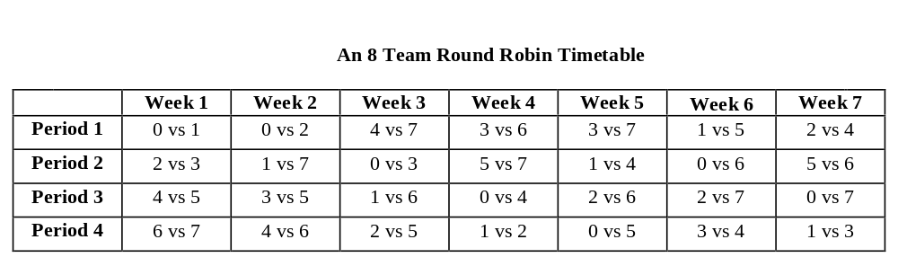
Timetabling
The problem of generating schedules with complex
constraints (in this case for sports teams).
  (Gomes et al. 1998, McAloon & Tretkoff 97, Nemhauser & Trick 1997, Régin 1999)

Slide 10
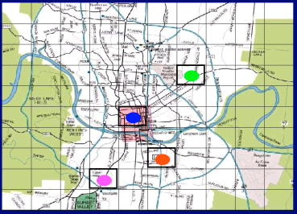
Paramedic Crew Assignment
(Austin, Texas)
Paramedic crew assignment is the problem of assigning paramedic crews
from different stations to cover a given region, given several resource constraints.

Slide 11
Decoding in Communication Systems
Voice waveform, binary digits
from a CD, output of a set of
sensors in a space probe, etc.
Telephone line, a storage
medium, a space communication
link, etc.
usually subject to NOISE
Source
Encoder
Channel
Decoder
Destination
Processing prior to transmission,
e.g., insertion of redundancy to
combat the channel noise.
Processing of the channel output with the
objective of producing at the destination
an acceptable replica of the source output.
Decoding in communication systems is NP-hard.
(Berlekamp, McEliece, and van Tilborg 1978, Barg 1998)

Slide 12
Quasigroups or Latin Squares:
An Abstraction for Real World Applications
Given an N X N matrix, and given N colors, a quasigroup of order N is a colored matrix, such that:
-all cells are colored.
- each color occurs exactly once in each row.
- each color occurs exactly once in each column.
Quasigroup or Latin Square
(Order 4)
Notes:
Finally, during this talk I will also use the domain of quasigroups or latin squares. This is a problem from combinatorial design. Interestingly, it is a good abstraction for real world problems. I’ll come back to this point but, first I’ll define the concept of quasigroup.

Slide 13
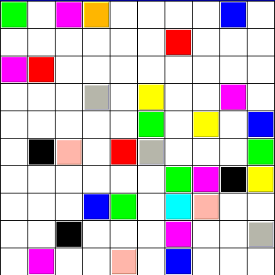
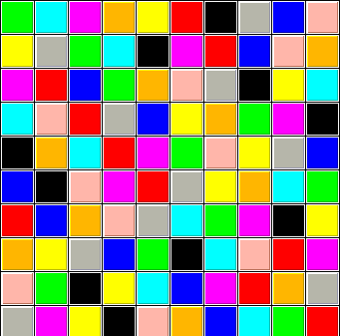
Quasigroup Completion Problem (QCP)
Given a partial assignment of colors (10 colors in this case), can the partial quasigroup (latin square) be completed so we obtain a full quasigroup?
Example:
32% preassignment
(Gomes & Selman 97)

Slide 14
Quasigroup Completion Problem
A Framework for Studying Search
NP-Complete.
Has a structure not found in random instances,
such as random K-SAT.
Leads to interesting search problems when structure is perturbed (more about it later).
(Anderson 85, Colbourn 83, 84, Denes & Keedwell 94, Fujita et al. 93, Gent et al. 99, Gomes & Selman 97, Gomes et al. 98, Meseguer & Walsh 98, Stergiou and Walsh 99, Shaw et al. 98, Stickel 99, Walsh 99 )
Notes:
As I mentioned before, the QCP is also a good abstraction for real world problems; let’s see how we can use this domain to model routers in fiber optic networks.

Slide 15
QCP Example Use: Routers in Fiber Optic Networks
Dynamic wavelength routing in Fiber Optic Networks can be
directly mapped into the Quasigroup Completion Problem.
  each channel cannot be repeated in the same input port (row constraints);
  each channel cannot be repeated in the same output port (column constraints);
Output ports
Input Port
Output Port
1
1
2
2
3
Input ports
3
4
4
CONFLICT FREE
LATIN ROUTER
(Barry and Humblet 93, Cheung et al. 90, Green 92, Kumar et al. 99)

Slide 16
Outline
I Motivational Problem Domains
II Capturing Structure in LP & CSP Based Methods
LP Based Methods
III Randomization
IV Conclusions
Notes:
I’ll now move on to the next part of my talk, in which I’ll talk about capturing structure in LP and CSP based methods.

Slide 17
  The ability to capture and exploit structure is of central importance --- a way of “taming” computational complexity;
  The Operations Research (OR) community
  has identified several problem classes
  with very interesting, tractable structure,
  namely:
  Linear Programming (LP)
  Network Flow Problems

Slide 18
Complexity of Linear Programming
Simplex Method (Dantzig 1947)
Worst-case --- exponential (very rare)
Practice (average case) --- good performance
Ellipsoid Method (Khachian 1979)
Worst-case --- (high order) polynomial
Practice --- poor performance
(Kantorovich 39, Klee and Minty 72)

Slide 19
Complexity of Linear Programming
Interior Point Method (Karmarkar 1984)
Worst-case --- polynomial
Practice --- good performance
Despite its worst case exponential time complexity, the simplex method is usually the method of choice since it provides tools for sensitivity analysis and its performance is very competitive in practice.

Slide 20
Beyond Linear Constraints
In general, in real-world problems we have to deal with more complex constraints, namely integrality constraints and other constraints.
In OR, Mixed Integer Programming (MIP) formulations allow us to model such problems.
In AI, these problems are attacked as Constraint Satisfaction Problems.
The overriding idea in each case is to limit search.

Slide 21
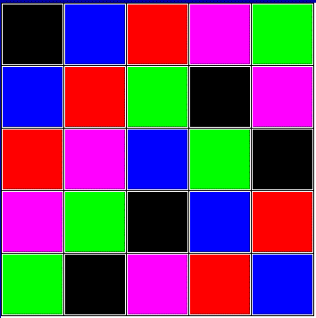
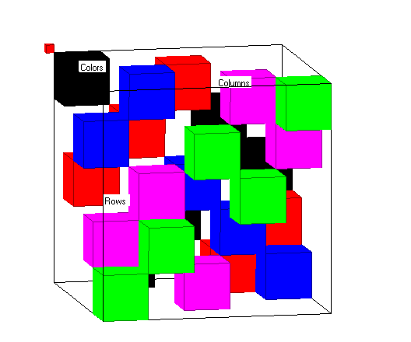
QCP as MIP
Rows
Colors
Columns
Cubic representation of QCP
Notes:
Here we show a 3D representation of the QCP.
The third dimension is the color.
Note in this representation, each line of the cube has a single block.
I’m going to project the cube onto its row/column plane and we’ll see how it maps into the 2D representation.

Slide 22

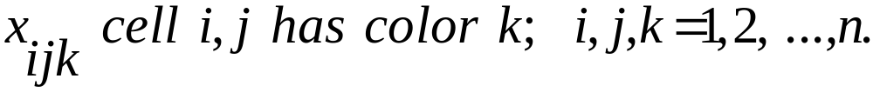
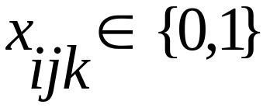

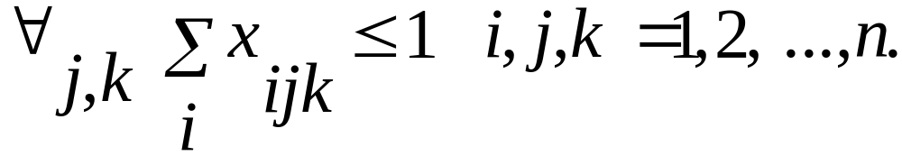
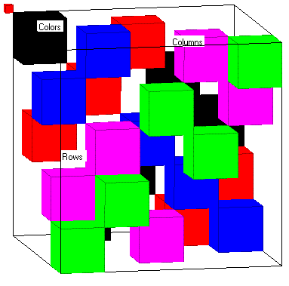
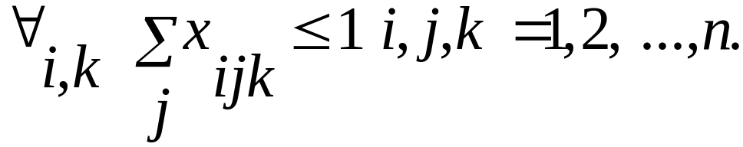
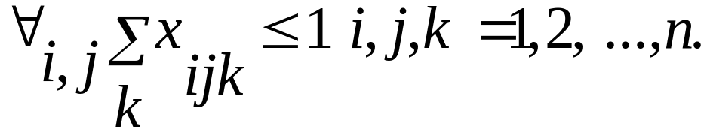
QCP as an MIP
Variables -
Constraints -
Row/color line
Column/color line
Row/column line
Notes:
Notice that the constraints of this problem are linear - what transforms this problem into an integer problem.
Note this problem is hard because of the 0/1 variables

Slide 23
Branch-&- Bound for MIPs
Standard OR approach for solving MIPs.
Backtrack search procedure:
  At each node, we solve a linear relaxation of MIP (drop 0/1 constraint on variables).
  Branch on the variables for which the solution of the LP relaxation is not integer.
  When an integer solution is found, its objective value can be used to prune other nodes, whose relaxations have worse values.

Slide 24
Branch & Bound
Depth First vs. Best bound
Critical in performance of Branch & Bound: the way in which the next node to be expanded is selected.
Best-bound - select the node with the best
LP bound (standard OR approach) --->
this case is equivalent to A*, the LP
relaxation provides an admissible
search heuristics
Depth-first - often quickly reaches an integer
solution (may take longer to produce an
overall optimal value)

Slide 25
Cutting Planes
Cuts - are redundant constraints for the MIP model but not redundant for the linear relaxation, leading to tighter relaxations.
Cuts are derived automatically. OR takes advantage of the mathematical structure of specific classes of problems (e.g., polyhedral structure) to identify strong cutting planes (TSP, JSSP, set covering, set packing, etc.).
Integer Vertex
(Balas et al. 93, Gomory 58 and 63, Jeroslow 80, Lovasz and Schrijver 91, Nemhauser & Wolsey 88, Wolsey 98)

Slide 26
OR has a long tradition in exploiting structure.
OR emphasizes the identification of special problem classes (or components of problems) with special structure.
Network Flow Problems
  Remarkable examples of exploiting the special structure found in certain IP problems leading to highly efficient solution techniques.

Slide 27
OR Based Approaches
Summary
OR based approaches have been applied to solve large problems in areas as diverse as transportation, production, resource allocation, and scheduling problems, etc.
OR based models also have played an important role in the development of approximation algorithms (e.g., 50% approx. for optimization version of QCP).

Slide 28
Outline
I Motivational Problem Domains
II Capturing Structure in LP & CSP Based Methods
LP Based Methods
CSP Based Methods
III Randomization
IV Conclusions
Notes:
I will now go on with CSP based Methods

Slide 29
Mathematical Basis of Constraint Programming (CP)
The Constraint Satisfaction Problem (CSP):
  A finite set of variables is given and with each variable is associated a non-empty finite domain.
  A constraint on k variables X₁,…,X_{k} is a relation R(X₁,…,X_{k}) ⊆ D₁ x …x D_{k}.
  A solution to a CSP is an assignment of values to all the variables, satisfying all the constraints.
(Dechter 86, Freuder 82, Mackworth 77, Tsang 93, van Beek and Dechter 97)

Slide 30
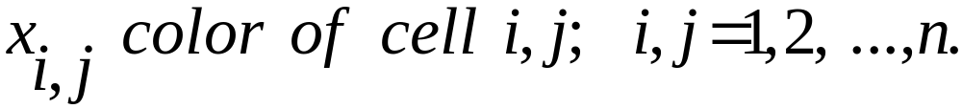
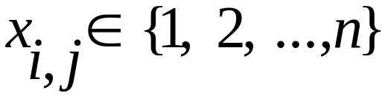

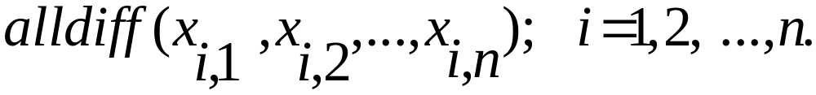
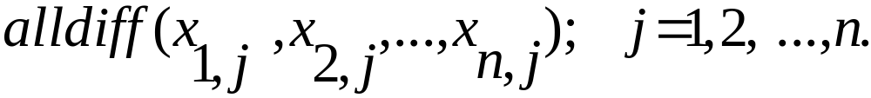
QCP as a CSP
[ vs. for MIP]
Variables -
Constraints -
[ vs. for MIP]
row
column

Slide 31
Domain Reduction and Constraint Propagation
In CP, each constraint of a CSP is considered as a subproblem.
With each constraint we associate domain reduction techniques.
Constraint propagation links the constraints through their shared variables triggering additional domain reduction.

Slide 32
Domain Reduction in QCP
Forward Checking
Arc Consistency

Slide 33
Exploiting Structure for Domain Reduction
A very successful strategy for domain reduction in CSP is to exploit the structure of groups of constraints and treat them as global constraints.
  Example using Network Flow Algorithms:
  All-different constraints
(Caseau and Laburthe 94, Focacci, Lodi, & Milano 99, Nuijten & Aarts 95, Ottososon & Thorsteinsson 00, Refalo 99, Régin 94 )

Slide 34
Exploiting Structure in QCP
ALLDIFF as Global Constraint
Matching on
a Bipartite graph
Two solutions:
All-different constraint
we can update the
domains of the column
variables
Analogously, we can
update the domains
of the other variables
(Berge 70, Régin 94, Shaw et al. 98 )

Slide 35


Exploiting Structure
Arc Consistency vs. All Diff
Arc Consistency
Solves up to order 20
Size search
space
AllDiff
Solves up to order 40
Size search
space

Slide 36

Global Constraints in Timetabling
Cardinality Constraints: each team plays no more than 2 times
in the same slot
All Different Constraints
LP Based
10 teams
CP Based (no AllDiff)
14 teams
All Different Constraints
CP Based (AllDiff)
40 teams
  (Gomes et al. 98, McAloon & Tretkoff 97, Nemhauser & Trick 97, Régin 99)

Slide 37
Constraint-Based Approaches
Summary
CSP based approaches provide a framework suitable to capture the richness of real world domains;
CSP combines domain reductions algorithms with constraint propagation - this is a very modular setup and independent of the particular structure of the individual constraints.
CSP methods allow for strategies that exploit tractable substructure with propagation.

Slide 38
MIP vs. CSP
Modeling:
  CSP representations are more expressive and more compact than MIP representations. However MIP formulations handle numerical information more naturally.
Search:
  Both approaches use backtrack search methods.
  MIP -> Best-bound search;
  CSP -> Depth-first search;
Inference (exploiting structure at each node of search tree):
  MIP uses LP relaxations and cutting planes;
  CSP - domain reduction, constraint propagation and redundant constraints.

Slide 39
Hybrid Solvers
OR + CSP Based Approaches
An emerging and very active research area combines OR based approaches with CSP based approaches - Hybrid Solvers.
(Bacchus and van Beek 98, Beringer and de Backer 95, Bockmayr and
Kasper 98, Caseau and Laburthe 98, Clements, Crawford, Joslin, Nemhauser,
Puttlitz, and Savelsbergh 97, Dixon and Ginsberg 00, Focacci, Lodi, Milano 99,
Kautz and Walser 00, Manquinho and Silva 00, McAloon & Tretkoff 97,
Hooker, Ottosson, Thorsteinsson, Kim 00, Refalo 99, Ottoson andThorsteinsson 99,
Puget 98, Régin 99, Rodosek , Wallace, and Hajian 97, Vossen, Ball, Lotem, Nau 00,
van Hentenryck 99, Walser 99, and more.)

Slide 40
Outline
I Motivational Problem Domains
II Capturing Structure in LP & CSP Based Methods
LP Based Methods
CSP Based Methods
Structure and Problem Hardness
III Randomization
IV Conclusions

Slide 41
Problem Class vs. Problem Instance
So far I’ve talked about general inference methods to exploit structure within a problem class:
LP Based methods use LP relaxations and cuts.
CSP based methods use domain reduction algorithms and propagation
I’ll talk now about structural differences between instances of the same problem class.

Slide 42
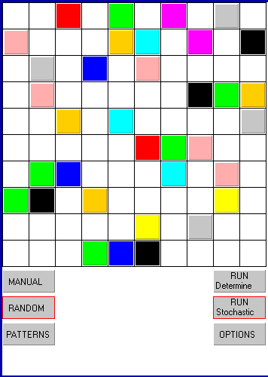
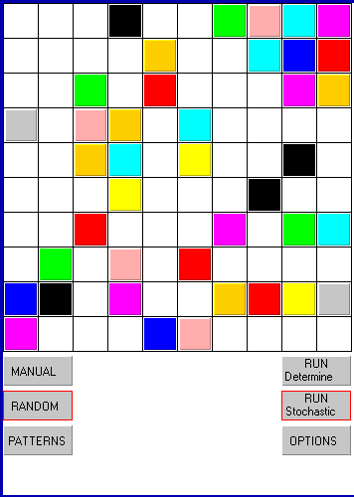
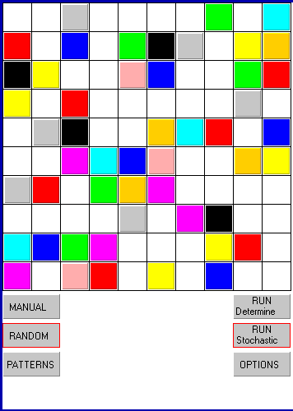
Are all the Quasigroup Instances
(of same size) Equally Difficult?
Time performance:
150
1820
165
What is the fundamental difference between instances?

Slide 43
Are all the Quasigroup Instances
Equally Difficult?
Time performance:
150
1820
165
Fraction of preassignment:
35%
40%
50%

Slide 44
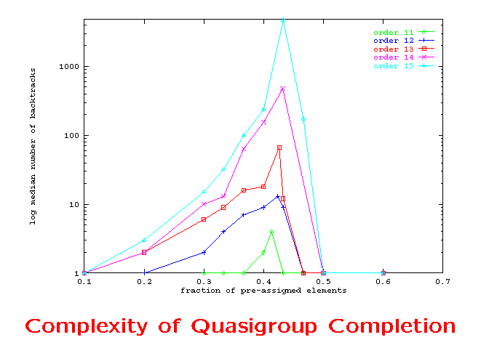
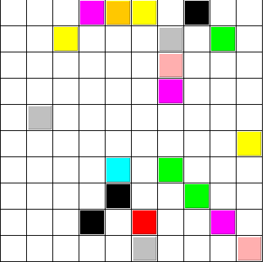
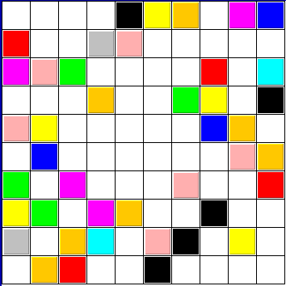
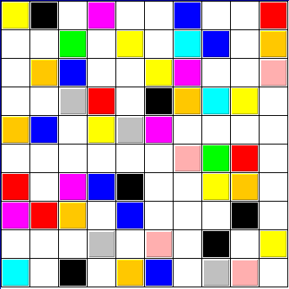
Complexity of Quasigroup Completion
Critically constrained area
Median Runtime (log scale)
Underconstrained
area
Overconstrained area
20%
42%
50%
Fraction of pre-assignment

Slide 45
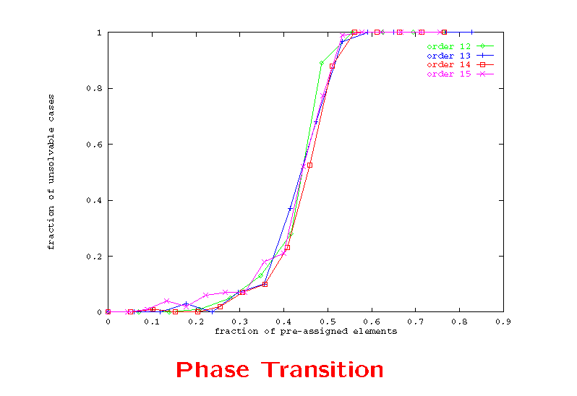
Phase Transition
Complexity Graph
Phase transition
from almost all solvable
to almost all unsolvable
Almost all solvable
area
Almost all unsolvable
area
Fraction of unsolvable cases
Fraction of pre-assignment

Slide 46
These results for the QCP - a structured domain, nicely complement previous results on phase transition and computational complexity for random instances such as SAT, Graph Coloring, etc.
(Broder et al. 93; Clearwater and Hogg 96, Cheeseman et al. 91, Cook and Mitchell 98, Crawford and Auton 93, Crawford and Baker 94, Dubois 90, Frank et al. 98, Frost and Dechter 1994, Gent and Walsh 95, Hogg et al. 96, Mitchell et al. 1992, Kirkpatrick and Selman 94, Monasson et 99, Motwani et al. 1994, Pemberton and Zhang 96, Prosser 96, Schrag and Crawford 96, Selman and Kirkpatrick 97, Smith and Grant 1994, Smith and Dyer 96, Zhang and Korf 96, and more)

Slide 47
Structural features of instances provide insights into their hardness namely:
  I - Constrainedness
  II - Backbone

Slide 48
I - Constrainedness
The constrainedness of combinatorial problems is an important notion to differentiate instances of problems.
  Fraction of pre-assigned colors (QCP);
  Ratio of clauses to variables (SAT);
  Ratio of nodes to edges (Graph Coloring);
(Gent, MacIntyre, Prosser, & Walsh 96, Williams and Hogg 94, Smith & Dyer 96 )

Slide 49


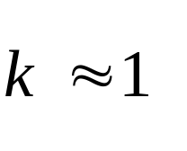
Domain Independent Measure of Constrainedness
- is a domain independent measure of the constrainedness of an ensemble of instances, a function of the number of solutions and the size of the search space.
critically constrained instances
(Gent, MacIntyre, Prosser, & Walsh 96, Williams and Hogg 94, Smith & Dyer 96 )

Slide 50
Constrainedness Knife-edge
As search progresses:
Underconstrained problems tend to become more underconstrained until solution is found.
Overconstrained problems tend to become more overconstrained until inconsistency is proved.
Critically constrained problems remain critically constrained until solution is found or inconsistency is proved.

Slide 51
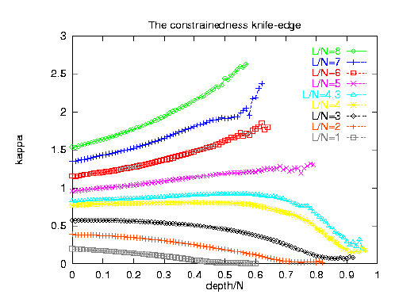
The Constrainedness Knife-edge in Satisfiability
Constrainedness
KAPPA
(Walsh 99)
Fraction of Assigned Variables

Slide 52
II - Backbone
Backbone is the shared structure of all the
solutions to a given instance.
This instance has
4 solutions:
Backbone
Total number of backbone variables: 2

Slide 53
Phase Transition in the Backbone
We have observed a transition in the backbone from a phase where the size of the backbone is around 0% to a phase with backbone of size close to 100%.
The phase transition in the backbone is sudden and it coincides with the hardest problem instances.
(Achlioptas, Gomes, Kautz, Selman 00, Monasson et al. 99)

Slide 54
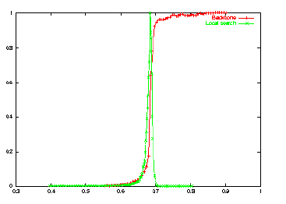
New Phase Transition in Backbone
QCP (satisfiable instances only)
% Backbone
Sudden phase transition in Backbone
% of Backbone
Computational
cost
Fraction of preassigned cells

Slide 55
Phase Transitions, Backbone, Constrainedness
Summary
The understanding of the structural properties of problem instances based on notions such as phase transitions, backbone, and constrainedness provides new insights into the practical complexity of many computational tasks.
Active research area with fruitful interactions between computer science, physics (approaches
from statistical mechanics), and mathematics (combinatorics / random structures).

Slide 56
Outline
I Motivational Problem Domains
II Capturing Structure in LP & CSP Based Methods
III Randomization
IV Conclusions

Slide 57
Local Search
Stochastic strategies have been very successful
in the area of local search.
  Simulated annealing
  Genetic algorithms
  Tabu Search
  GSAT and variants.
Limitation: inherent incomplete nature of local search methods.

Slide 58
Randomized Backtrack Search
Goal: explore the addition of a stochastic element to
a systematic search procedure without losing
completeness.
We introduce randomness in a backtrack search method by randomly breaking ties in variable and/or value selection.
Compare with standard lexicographic tie-breaking.

Slide 59
Distributions of Randomized Backtrack Search
Key Properties:
I Erratic behavior of mean
II Distributions have “heavy tails”.

Slide 60
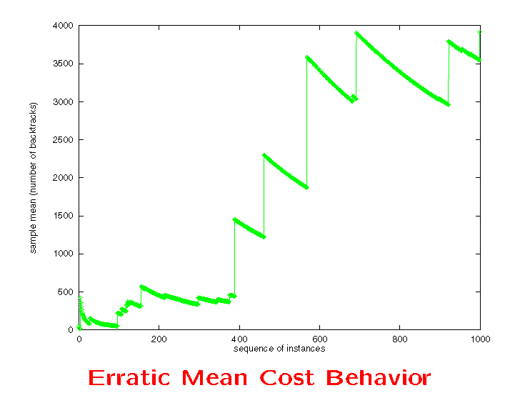
Erratic Behavior of Search Cost
Quasigroup Completion Problem
3500!
sample
mean
2000
Median = 1!
500
number of runs

Slide 61
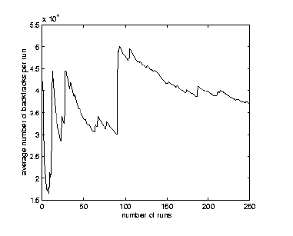
Erratic Behavior of Search Cost
Sequential Decoding
sample
mean
number of runs

Slide 62
Heavy-Tailed Distributions
… infinite variance … infinite mean
Introduced by Pareto in the 1920’s
--- “probabilistic curiosity.”
Mandelbrot established the use of heavy-tailed distributions to model real-world fractal phenomena.
Examples: stock-market, earth-quakes, weather,...

Slide 63

Decay of Distributions
Standard --- Exponential Decay
e.g. Normal:
Heavy-Tailed --- Power Law Decay
e.g. Pareto-Levy:

Slide 64
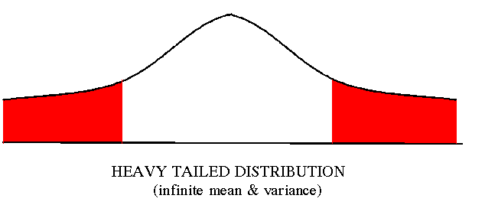
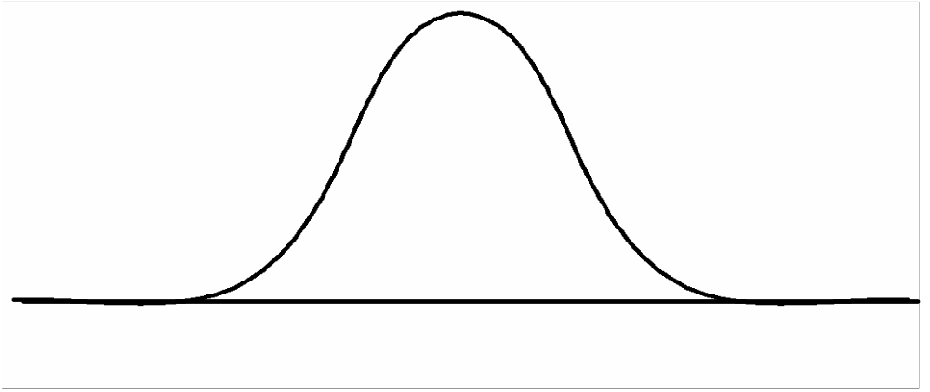
Power Law Decay
Exponential Decay
Standard Distribution
(finite mean & variance)

Slide 65



How to Check for “Heavy Tails”?
Log-Log plot of tail of distribution
should be approximately linear.
Slope gives value of
infinite mean and infinite variance
infinite variance

Slide 66
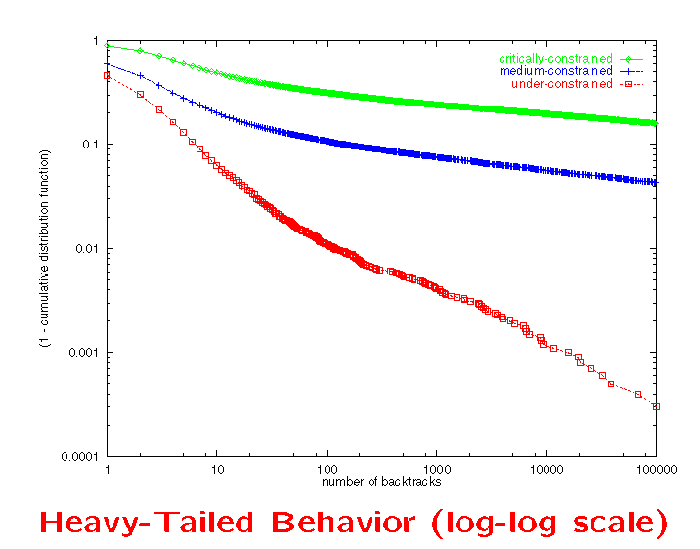
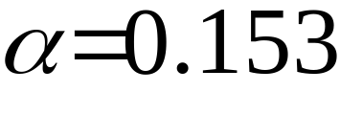
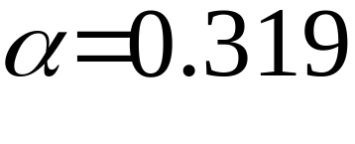
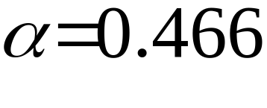
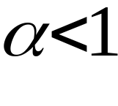
Heavy-Tailed Behavior in QCP Domain
18% unsolved
(1-F(x))(log)
Unsolved fraction
=> Infinite mean
0.002% unsolved
Number of backtracks (log)

Slide 67
Exploiting Heavy-Tailed Behavior
Heavy Tailed behavior has been observed in several domains: QCP, Graph Coloring, Planning, Scheduling, Circuit synthesis, Decoding, etc.
Consequence for algorithm design:
Use restarts or parallel / interleaved runs to exploit the extreme variance performance.
Restarts provably eliminate
heavy-tailed behavior.
(Gomes et al. 97, Hoos 99, Horvitz 99, Huberman, Lukose and Hogg 97, Karp et al. 96, Luby et al. 93, Rish et al. 97)

Slide 68
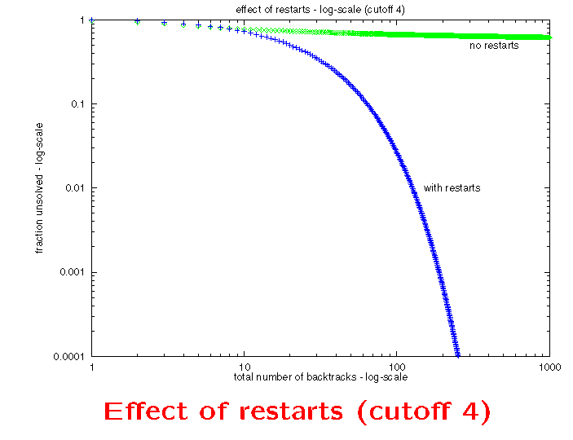
Restarts
70%
unsolved
no restarts
1-F(x)
Unsolved fraction
restart every 4 backtracks
0.001%
unsolved
250 (62 restarts)
Number of backtracks (log)

Slide 69
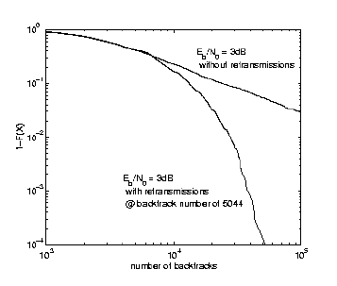
Retransmissions in Sequential Decoding
without retransmissions
1-F(x)
Unsolved fraction
with retransmissions
Number backtracks (log)

Slide 70
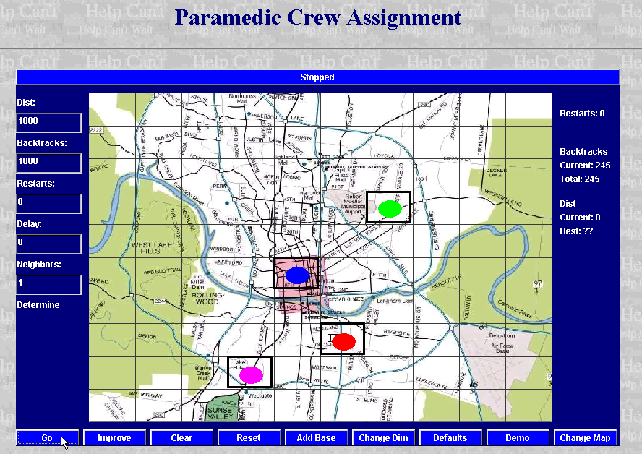
Deterministic Search
Austin, Texas

Slide 71
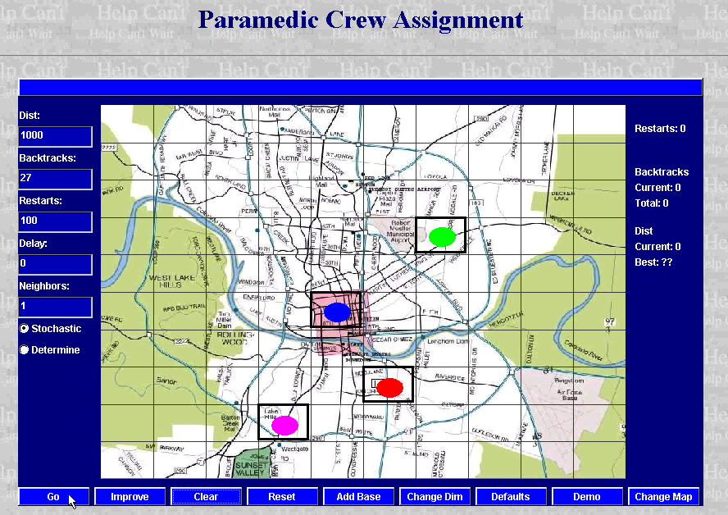
Restarts
Austin, Texas

Slide 72
Portfolio of Algorithms
A portfolio of algorithms is a collection of algorithms running interleaved or on different processors.
Goal: to improve the performance of the different algorithms in terms of:
  expected runtime
  “risk” (variance)
Efficient Set or Pareto set: set of portfolios that are best in terms of expected value and risk.
(Gomes and Selman 97, Huberman, Lukose, Hogg 97 )

Slide 73
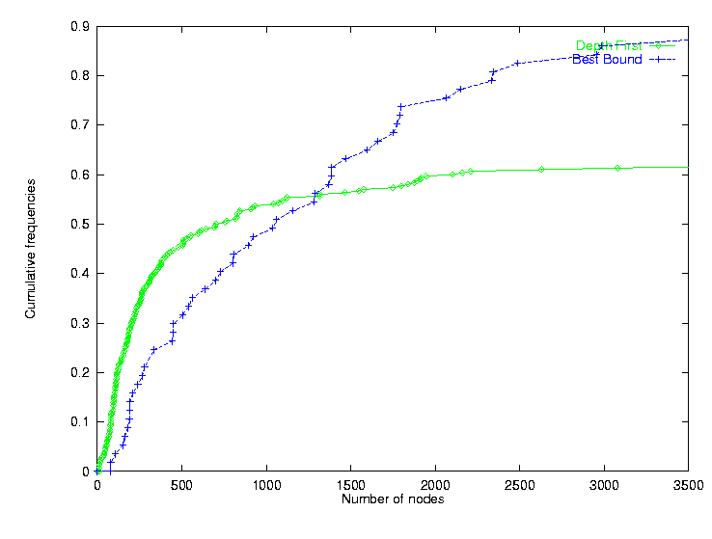
Branch & Bound for MIP
Depth-first vs. Best-bound
Optimal strategy: Best-Bound
Best-Bound: Average-1400 nodes; St. Dev.- 1300
Depth-first
45%
Cumulative Frequencies
Best-bound
30%
Depth-First: Average - 18000;St. Dev. 30000
Number of nodes

Slide 74
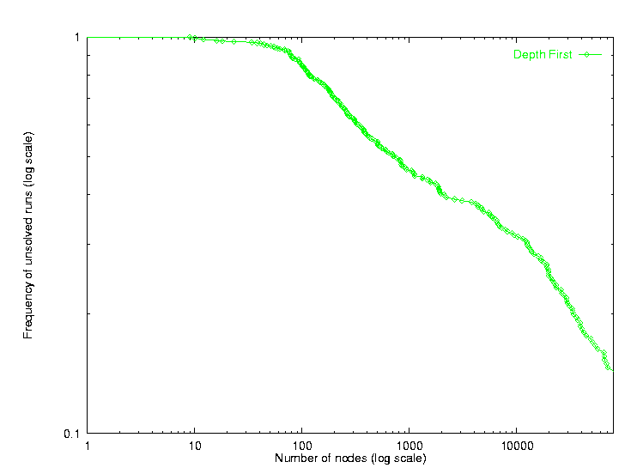
Heavy-tailed behavior of Depth-first

Slide 75
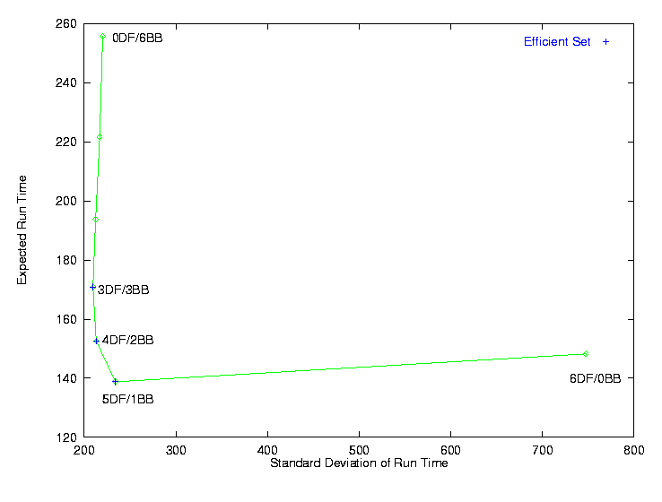
Portfolio for 6 processors
0 DF / 6 BB
Expected run time of portfolios
3 DF / 3 BB
Efficient set
4 DF / 2 BB
6 DF / 0BB
5 DF / 1BB
Standard deviation of run time of portfolios

Slide 76
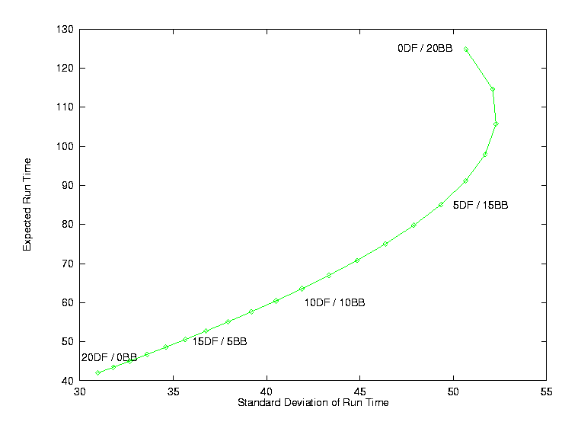
Portfolio for 20 processors
0 DF / 20 BB
The optimal strategy is to run
Depth-First on the 20 processors!
Expected run time of portfolios
Optimal collective behavior emerges
from suboptimal individual behavior.
20 DF / 0 BB
Standard deviation of run time of portfolios

Slide 77
Compute Clusters and Distributed Agents
With the increasing popularity of compute clusters and distributed problem solving / agent paradigms, portfolios of algorithms --- and flexible computation in general --- are rapidly expanding research areas.
(Baptista and Silva 00, Boddy & Dean 95, Bayardo 99, Davenport 00, Hogg 00,
Horvitz 96, Matsuo 00, Steinberg 00, Russell 95, Santos 99, Welman 99. Zilberstein 99)

Slide 78
Randomization
Summary
Stochastic search methods (complete and incomplete) have been shown very effective.
Restart strategies and portfolio approaches can lead to substantial improvements in the expected runtime and variance, especially in the presence of heavy-tailed phenomena.
Randomization is therefore a tool to improve algorithmic performance and robustness.

Slide 79
Outline
I Motivational Problem Domains
II Capturing Structure in LP & CSP Based Methods
III Randomization
IV Conclusions

Slide 80
Exploiting Structure: Common Theme in AI and OR Methods
CSP
Methods
Backtrack Style Global Search
combined with sophisticated
inference at each node:
LP relaxations + Cuts
and Domain Reduction +
Constraint Propagation
MIP
Methods
Challenge:
Balance Search (#nodes)
& Inference (per node)
Notes:
Exploiting structure is a common theme in OR and AI – methods.

Slide 81
Randomization: Bridging Complete and Local Methods
Complete
Methods
Randomization
exploits variance,
increasing performance
and robustness
Challenge:
Expected Performance
vs. Variance (risk)
Local
Methods
Notes:
Exploiting randomization is also becoming a common theme in complete and local search or metaheuristics

Slide 82
Exploiting Structure:
Tractable Components
Transition Aware Systems
(phase transition
constrainedness
backbone resources)
Randomization
Exploits variance
to improve robustness
and performance
General Solution
Methods
Real World
Problems
Notes:
Finally exploiting structure and randomization are common themes in OR and AI bridging the gap between general solutions methods and real world problems.

Slide 83
Demos, papers, etc. www.cs.cornell.edu/gomes

