Slide 1
PGM 2000/01 Tirgul7
Foundations of Decision Theory
(mostly from Pearl)

Slide 2
Introduction
I’m planning a party and having a hard time to decide whether to stage it indoors or outdoors. In despair, I summarize what I can say in a table:
indoors dry (0.7) = regret
indoors wet (0.3) = relief
outdoors dry (0.7) = perfect
outdoors wet (0.3) = disaster
It is clear I prefer perfect to regret, but is it enough to make a decision? Probabilities quantify the likely-hood of events. We are looking for a measure which will quantify desirability and will be the basis of all decision making.

Slide 3
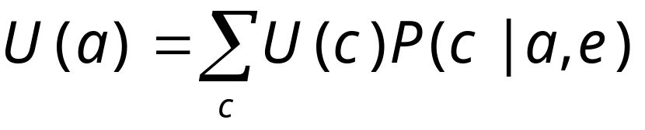
Utilities, consequences and MEU
Given some evidence, we are given a set of actions that we can take. Each action has several consequences. For each consequence c we assign a utility (or desirability) measure U(c). The expected utility of the action is then:
Following the Bayesian approach, we want to maximize this expected utilitiy (MEU)

Slide 4
Lotteries
At each stage of the decision process, we are faced with a dilemma of which action to take. Each action has a payoff or a loss. Thus, much like gambling we are faced with a lottery situation. Lotteries are defined as pairs of consequences and probabilities L(C,P).
C₁ = 1 month
p₁=0.60
Project completion time lottery L
p₂=0.30
C₂ = 2 months
p₃=0.10
C₃ = 3 months

Slide 5
Lotteries (cont.)
When trying to assess the desirability of a lottery, we encounter several problems:
What is a good calibration commodity? Is money stable enough? Does the commodity depend on time and circumstances?
Once a commodity is found, we need to be able to deduce complex lotteries from simpler ones (or deal with infinitely many possibilities).

Slide 6
Calibrating a Lottery
Solution: calibrate a lottery against a standard best/worst lottery which is equivalent in desirability to ours (calibrate a lottery using it’s inherent uncertainty).
p₁=0.60
p_{s}
C₁ = 1 month
C₁ = 1 week
L_{s}
p₂=0.30
L
C₂ = 2 months
C₃ = 3 months
1-p_{s}
C₃ = 1 year
p₃=0.10

Slide 7
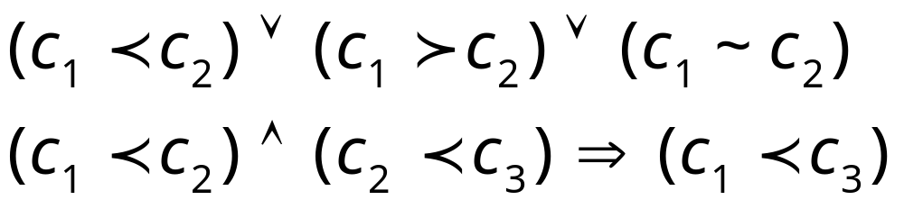
Axioms of Utility Theory
We are still left with the problem of how to define our preference over different consequences. We want a preference pattern that will allow us to prefer one lottery over another in a consistent way. The following axioms define some constraints on what kind of preference we are allowed to use as a basis for making decisions.
Axiom 1 - Orderability: A linear and transitive preference relation must exist between the prizes. In simpler words, an agent must know what he wants:

Slide 8
Axioms of Utility Theory (cont.)
Axiom 2 - Continuity: If C₂ is in between C₁ and C₃ then we could compare C₂ to some lottery with only C₁ and C₃:
Axiom 3 - Substitutability: If two things look equivalent, they will also be equivalent in a larger context:

Slide 9
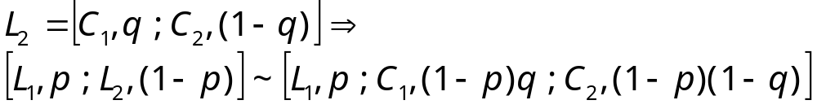
Axioms of Utility Theory (cont.)
Axiom 4 - Monotonicity: We prefer a better prize with higher probability:
Axiom 5 - Decomposability: there is no fun in gambling (just the outcome matters):

Slide 10
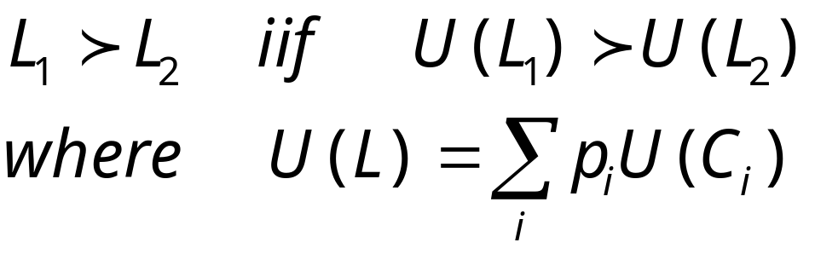
Constructing Utilities
Theorem: If a preference pattern obeys axioms 1-5 then by specifying the utility measure of each consequence we can faithfully prefer one lottery to another using:
This allows us to do just what we set out for: defining desirability for elementary consequences and then using the MEU principle to evaluate complex lotteries.

Slide 11
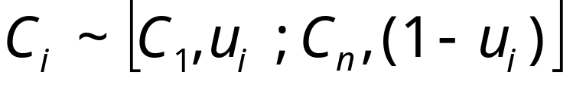
Proof
“Surprisingly”, the essence of the proof rests on exactly the essence of the axioms: the ability to reduce complex lotteries to simple ones and that compare these simple two prize lotteries to each other. The outline of the proof follows:
Let’s us examine two lotteries L₁ and L₂ that we want to compare with a joint set of prizes C₁…C_{n} (ordered from best prize to worst using axiom 1). Using substitution (axiom 3) we can write both lotteries in terms of all prizes (with probability 0 where needed).
⇒
Since any prize is between C₁ and C_{n}, using continuity (axiom 2):
and we can now substitute (axiom 3) and get:

Slide 12
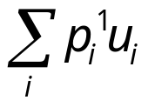
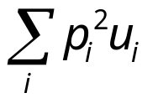
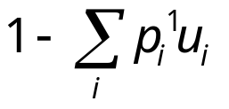
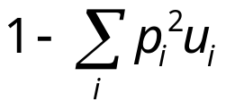
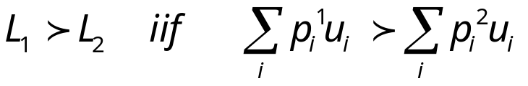
Proof (cont.)
u₁
C₁
p₁
C₁
p₁
...
~
...
1-u₁
L₁
L₁
C_{n}
p_{n}
u_{n}
C₁
p_{n}
C_{n}
1-u_{n}
C_{n}
Now, applying decomposability, we can present our lotteries in the following equivalent way:
Using monotonicity (axiom 4), since C₁>C_{n}, the preference between L₁ and L₂ is determined by the probability assigned to C₁. Thus:
C₁
C₁
L₁
L₂
C_{n}
C_{n}

Slide 13
Real-life Utilities
Given all the axioms of decision theory, we are still left with the actual problem of assigning utilities to consequences. In fact, any utility we come up with is only as unique as a linear transformation of it.
Can we use monetary values as utilities?
Do you prefer $3,000,000 for sure or $4,000,000 with 80% chance?
This just means that our utilities is not money directly. If, we assign a utlity of 12 to the case of adding $3,000,000 to our bank account and 10 to that of adding $4,000,000 than our choice makes sense.

Slide 14
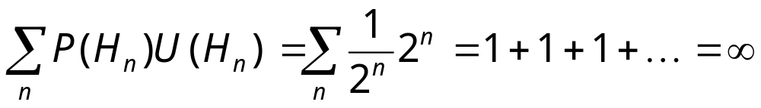
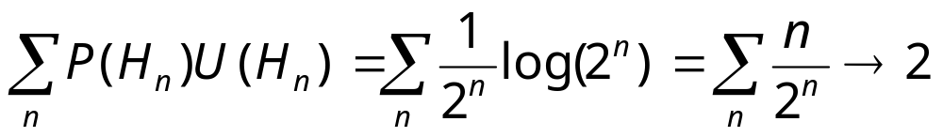
Utility of Money
St. Petersburg paradox (by Bernoulli): in the game you toss a coin until it comes up as heads. If the head appeared on the nth toss you get $2n. How much are you willing to pay to participate?
The expected winnings are:
if the utility of money is logarithmic then:

Slide 15
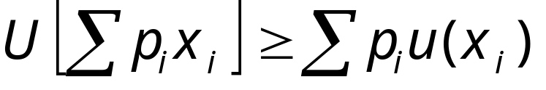
Attitudes towards risk
The shape of the utility curve describes a person’s attitude towards risk. A risk-averse person will prefer a sure thing to a gamble with the same payoff. That is:
and the sum of p_{i}x_{i} is the expected monetary value (EMV) offered by the lottery. A risk averse curve will be convex:
and $100 is the
insurance premium
people will be willing
to pay
U
U(lottery)
$400
$500
$reward

Slide 16
Attitudes towards risk (cont.)
A risk seeking person will prefer the lottery to certainty. In fact, state lotteries and casinos make a lot of money just by utilizing this attitude in all of us.
Thinking the above examples, we are all both risk averse and risk seeking. How can that be? The answer lies in that our utility function is not the same for all circumstances. A person with a $10,000,000 debt will take ridiculous risks to erase the debt because the situation is hopeless any ways. We feel strongly about “being lucky” in a Poker game but have a hard time seeing insurance claims as prizes in a game...

Slide 17
Rationality
Finally, we hope that at least we are rational compared to some utility function (decision theory gives us freedom in choosing the function). Unfortunately we are all irrational:
Test 1: Do you prefer a lottery A where you get $4,000,000 with 20% chance or B where you get $3,000,000 with 25% chance.
Test 2: Do you prefer C where you get $4,000,000 with 80% chance or D where you get $3,000,000 for sure?

Slide 18
Decision Trees
When we want to make optimal decisions, we need to plan. We will ultimately merge Bayesian networks and decisions into influence diagrams. Let’s start with a model which represent all possible scenarios:
A decision tree has two types of nodes: decision and chance. The leaves of the tree carry the utility associated with the scenario at that leaf.
We will find an optimal strategy by starting with the leaves and propagating towards the root:
  a chance node receives the expected utility
  a decision node is assigned the best utility (MEU) and
  the corresponding branch is marked.

Slide 19
Decision Trees: An example
The buyer of a used car can decide to carry out two tests. t₁ at the cost of $50 and t₂ at the cost of $20. There are two candidate cars c₁ costs $1500 and its market value is $2000 but will cost $700 to repair if the car is bad. c₂ costs $1150 with a market value of $1400 but a repair cost of only $150.
The buyer needs to buy a car and has time for one test. From experience, c₁ has 70% chance of being good while c₂ has 80% chance of being good (as an ex., verify that using no test, it is better to buy c₁ with EMV of $290).
Test t₁ checks car c₁. If the car is good there is a 90% chance that the test will confirm. If it is bad, the test will discover it in 65% of the cases.
Test t₂ checks car c₂. If will confirm good quality with 25% probability and discover flaws with 70% probability.

Slide 20
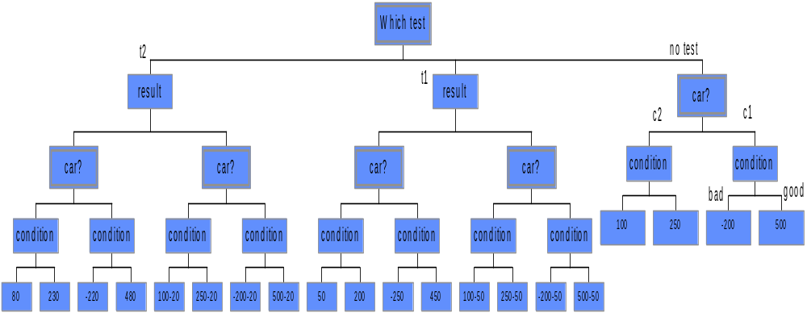
Decision Trees: An example (cont.)
Plugging in the probabilities and propagating for optimal plan, we find that we should do t₁. If it passes we should buy c₁ and if it fails we should buy c₂. Over all, we expect a utility of 303.77

Slide 21
Direction of Probabilities
Often, we are more comfortable in specifying probabilities in other directions than the ones needed. This is because causality does not necessarily follow the order in which we have to make decisions.
For example, it is more natural to assess what is the probability that a test will pass/fail based on the condition of the car. We then use Bayes rule to calculate the needed probabilities for the decision tree.

