Slide 1

Workshop IBM ILOG CPLEX CP Optimizer
OPL Studio Survival Kit
CP Optimizer Development Team
Nov. 7-9, 2012
This is not an OPL Training!

Slide 2
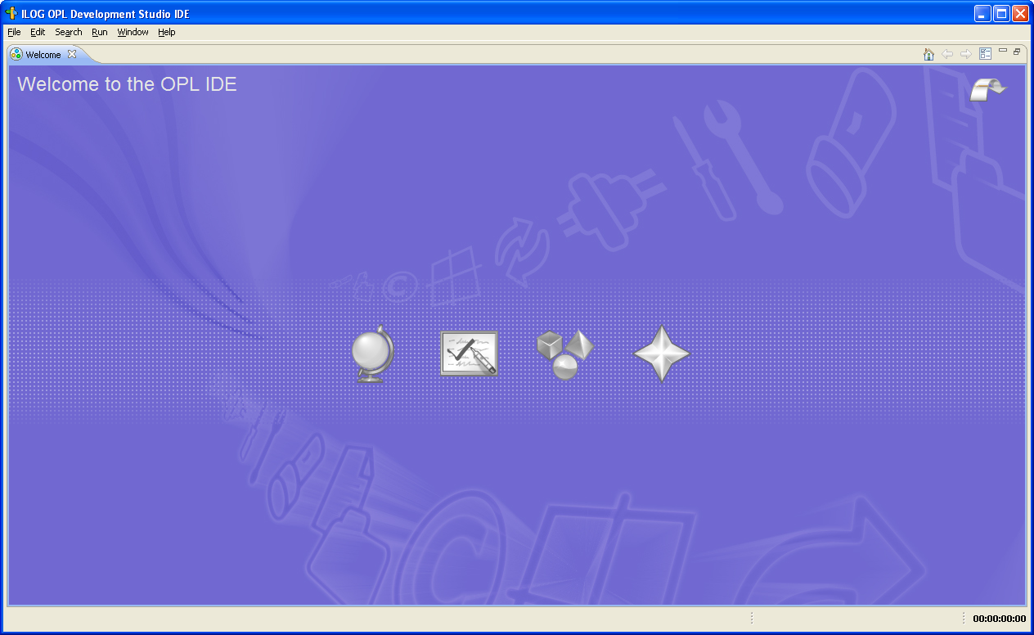

Slide 3
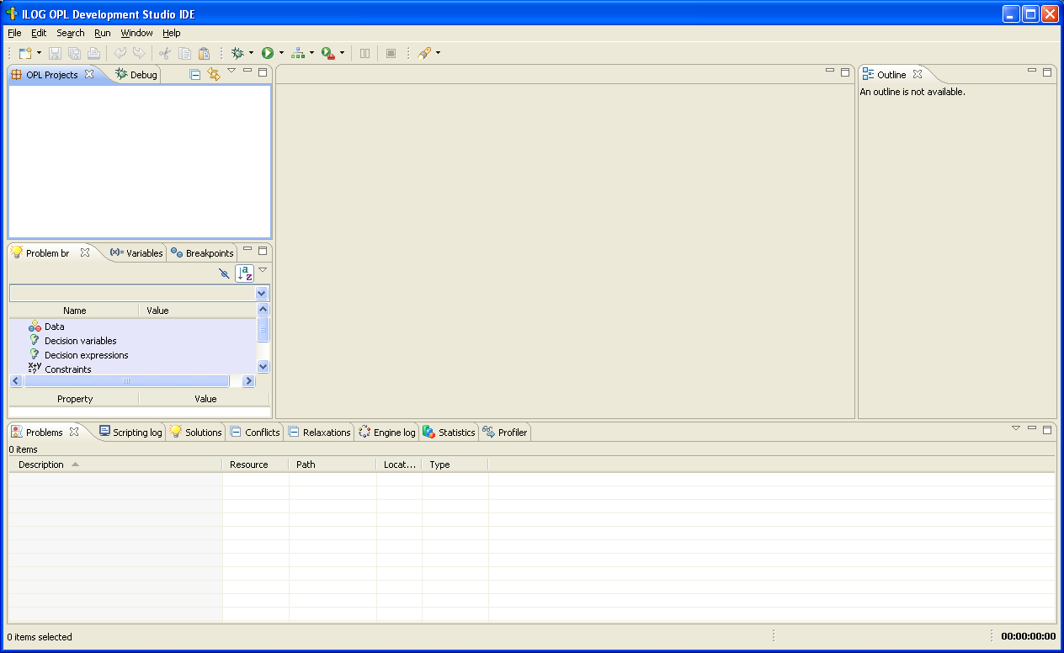
Import  Existing OPL projects

Slide 4
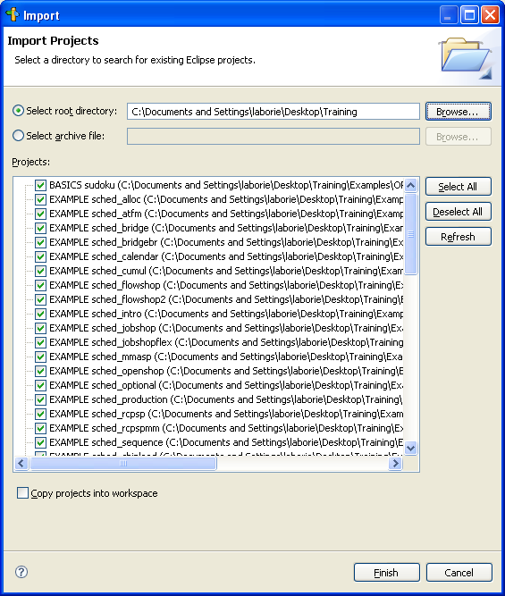

Slide 5
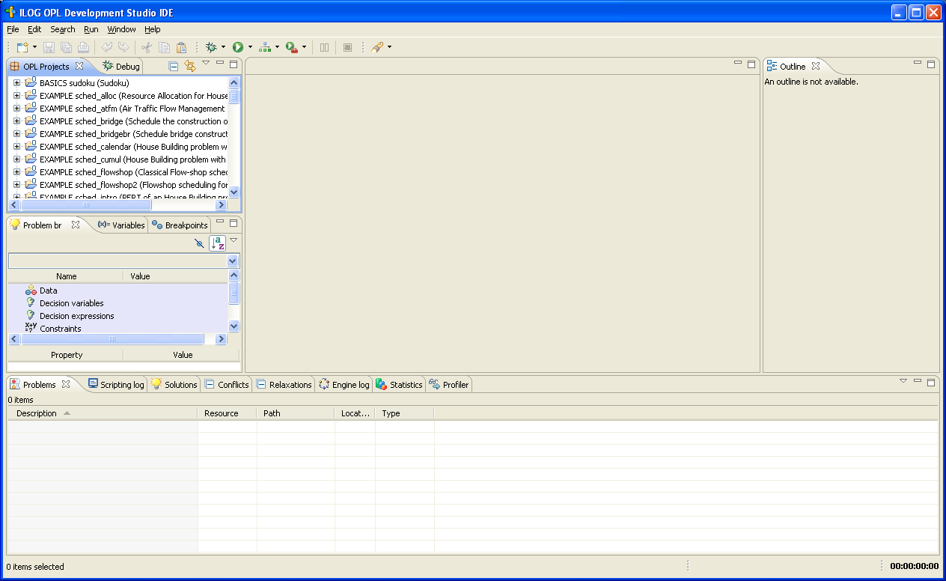
Browse projects

Slide 6
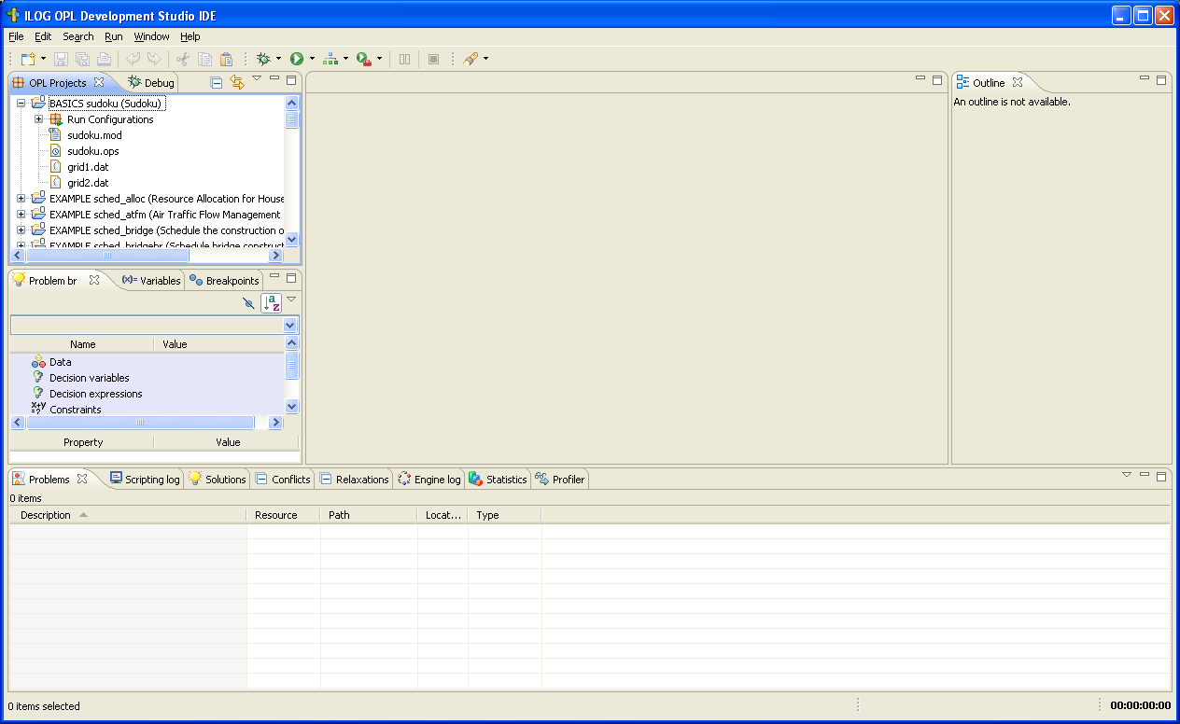
A project =
- a set of model files (.mod)
- a set of data files (.dat)
- a set of settings files (.ops)
- other files (e.g. .xls files …)
- a set of run configurations

Slide 7
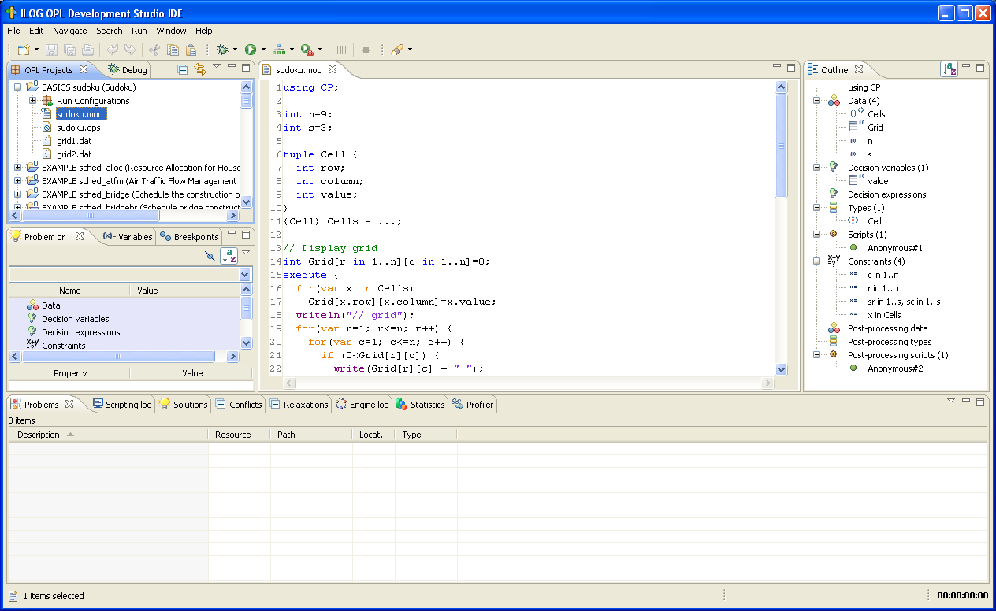
Model edition:
- data manipulation
- expression
- objective
- constraint
- script for pre- and
post-processing
- use Help→Dynamic
Help for information
on keywords

Slide 8
Double-click for full-size window

Slide 9
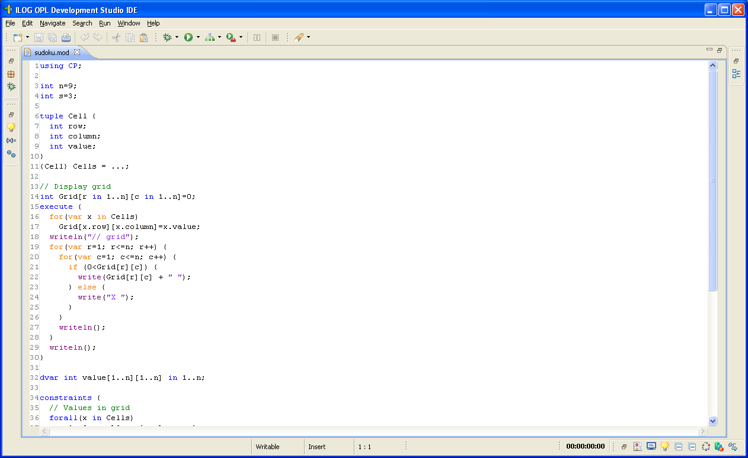
CP Optimizer model

Slide 10
Data structures and
data reading
Here, read input grid

Slide 11
Preprocessing
Here: display grid

Slide 12
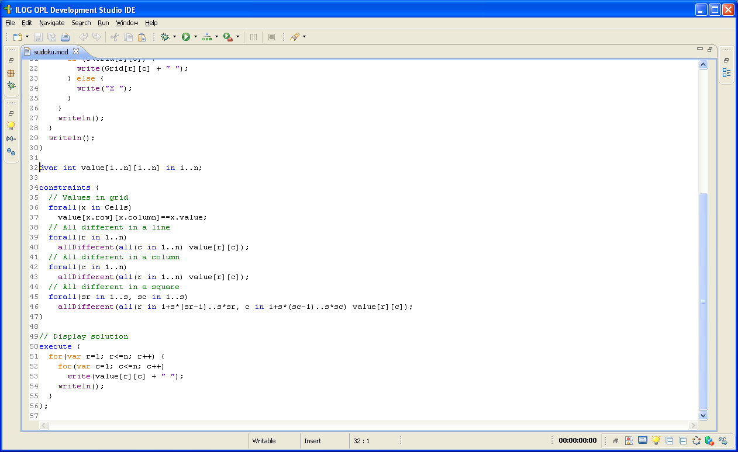
Model:
Variables
Expressions
Objective
Constraints

Slide 13
Postprocessing
Here: display solution grid

Slide 14
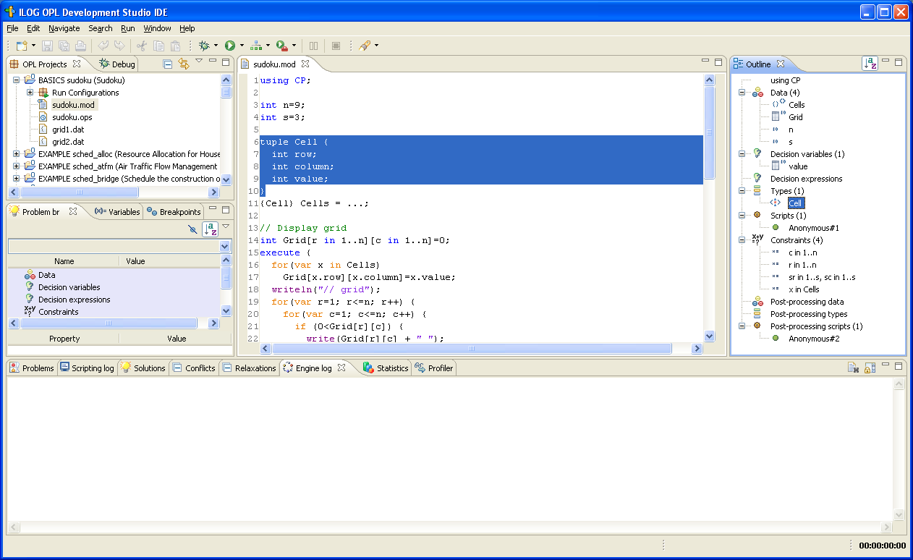
Model navigation

Slide 15
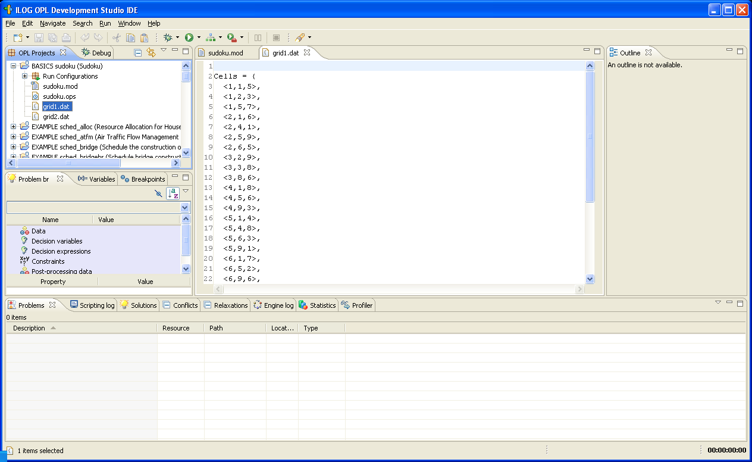
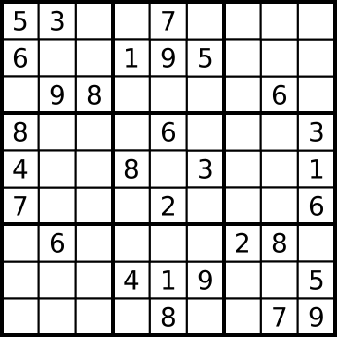
Data file:
- explicit data
- connection to:
* databases
* Excel worksheets

Slide 16
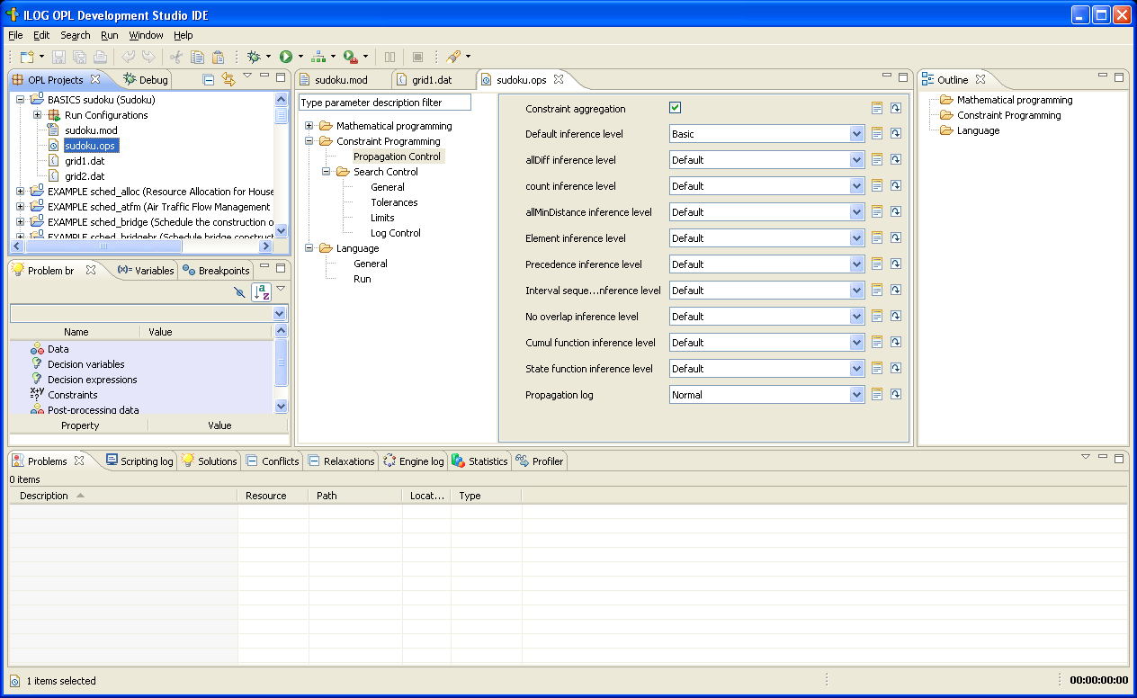
Settings file:
- language options
- engines parameters

Slide 17
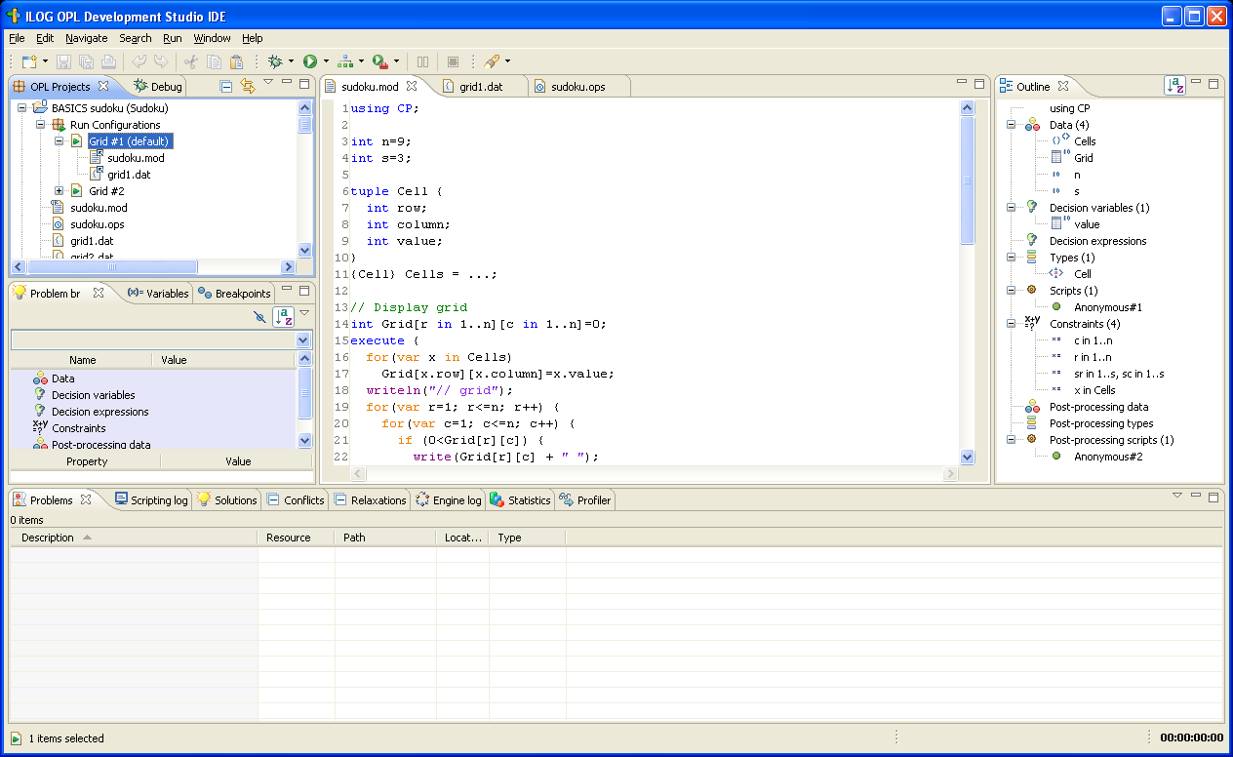
A run configuration = A variation of a project for execution purpose:
- at least one model file (.mod)
- a set of data files (.dat)
- a set of settings files (.ops)

Slide 18
Running a configuration:
Right-click  Run this

Slide 19
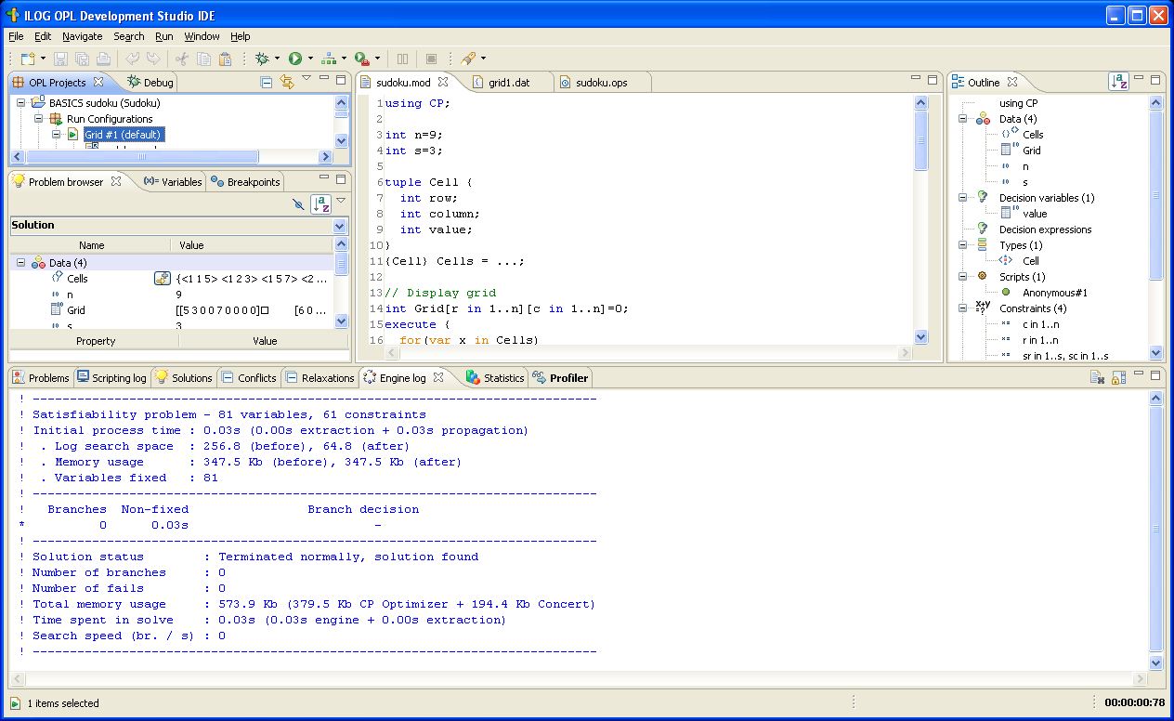
Engine log

Slide 20
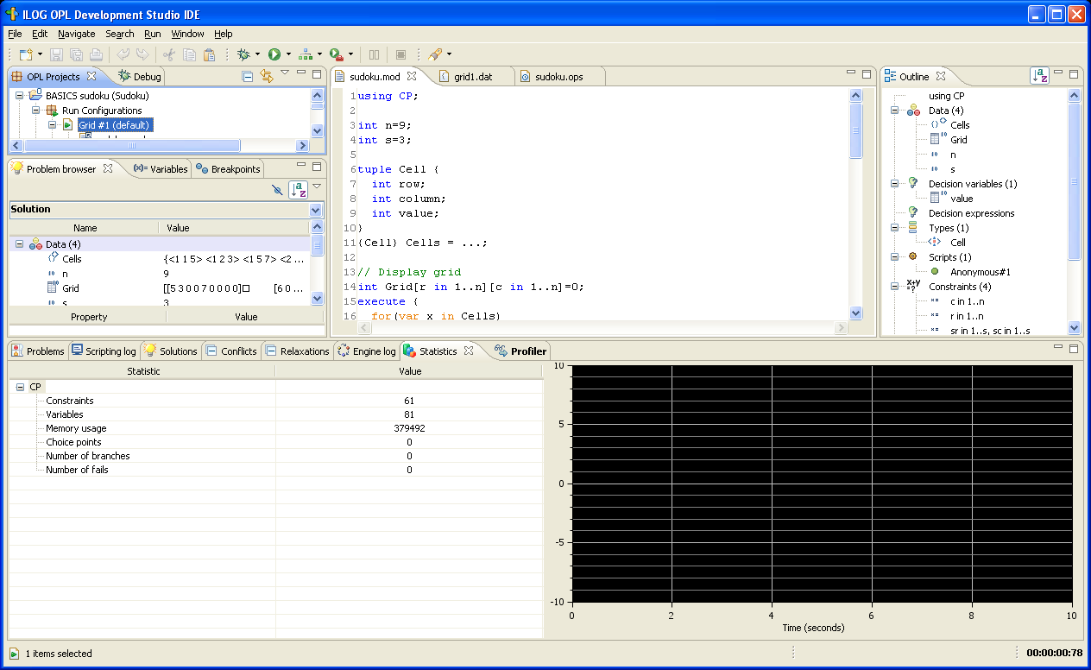
Engine statistics for performance analysis

Slide 21
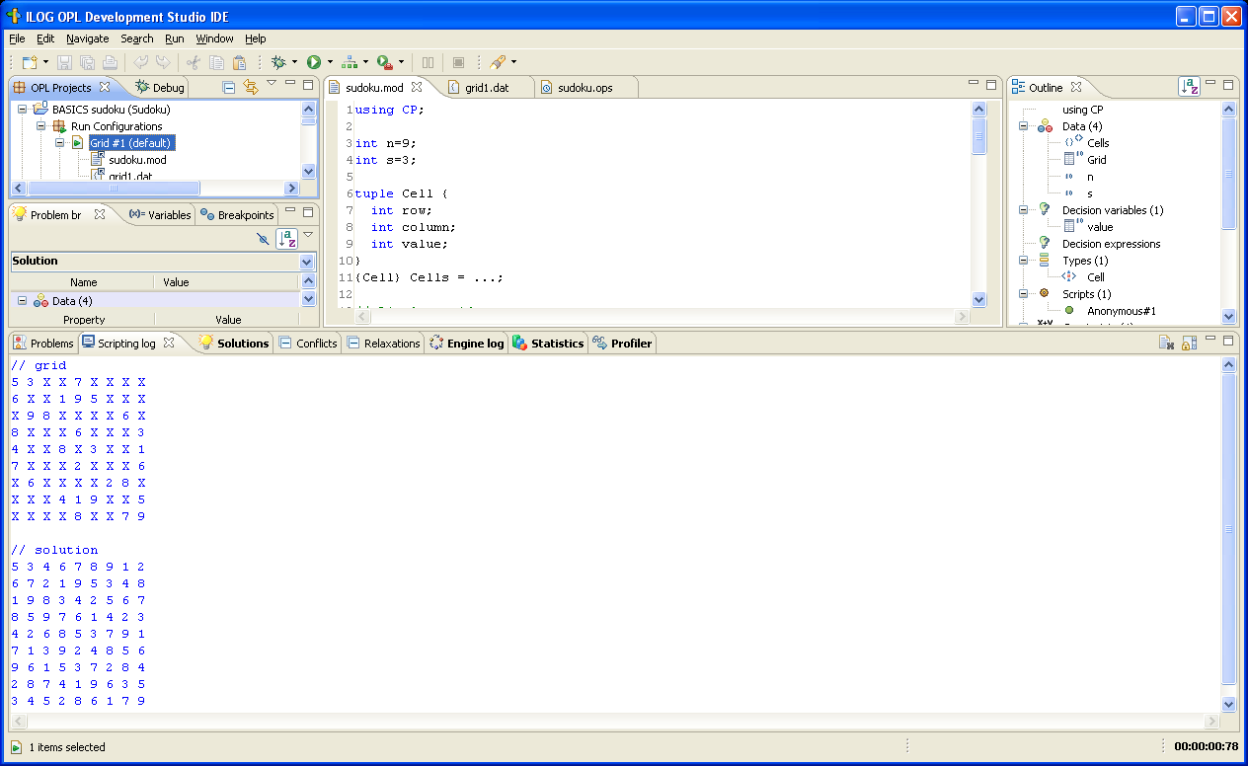
Script output

Slide 22
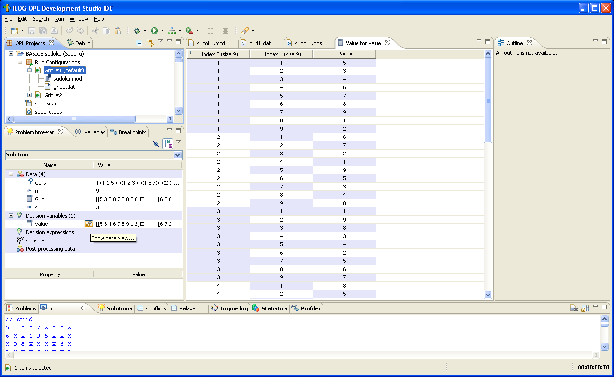
Solution and data inspection

Slide 23
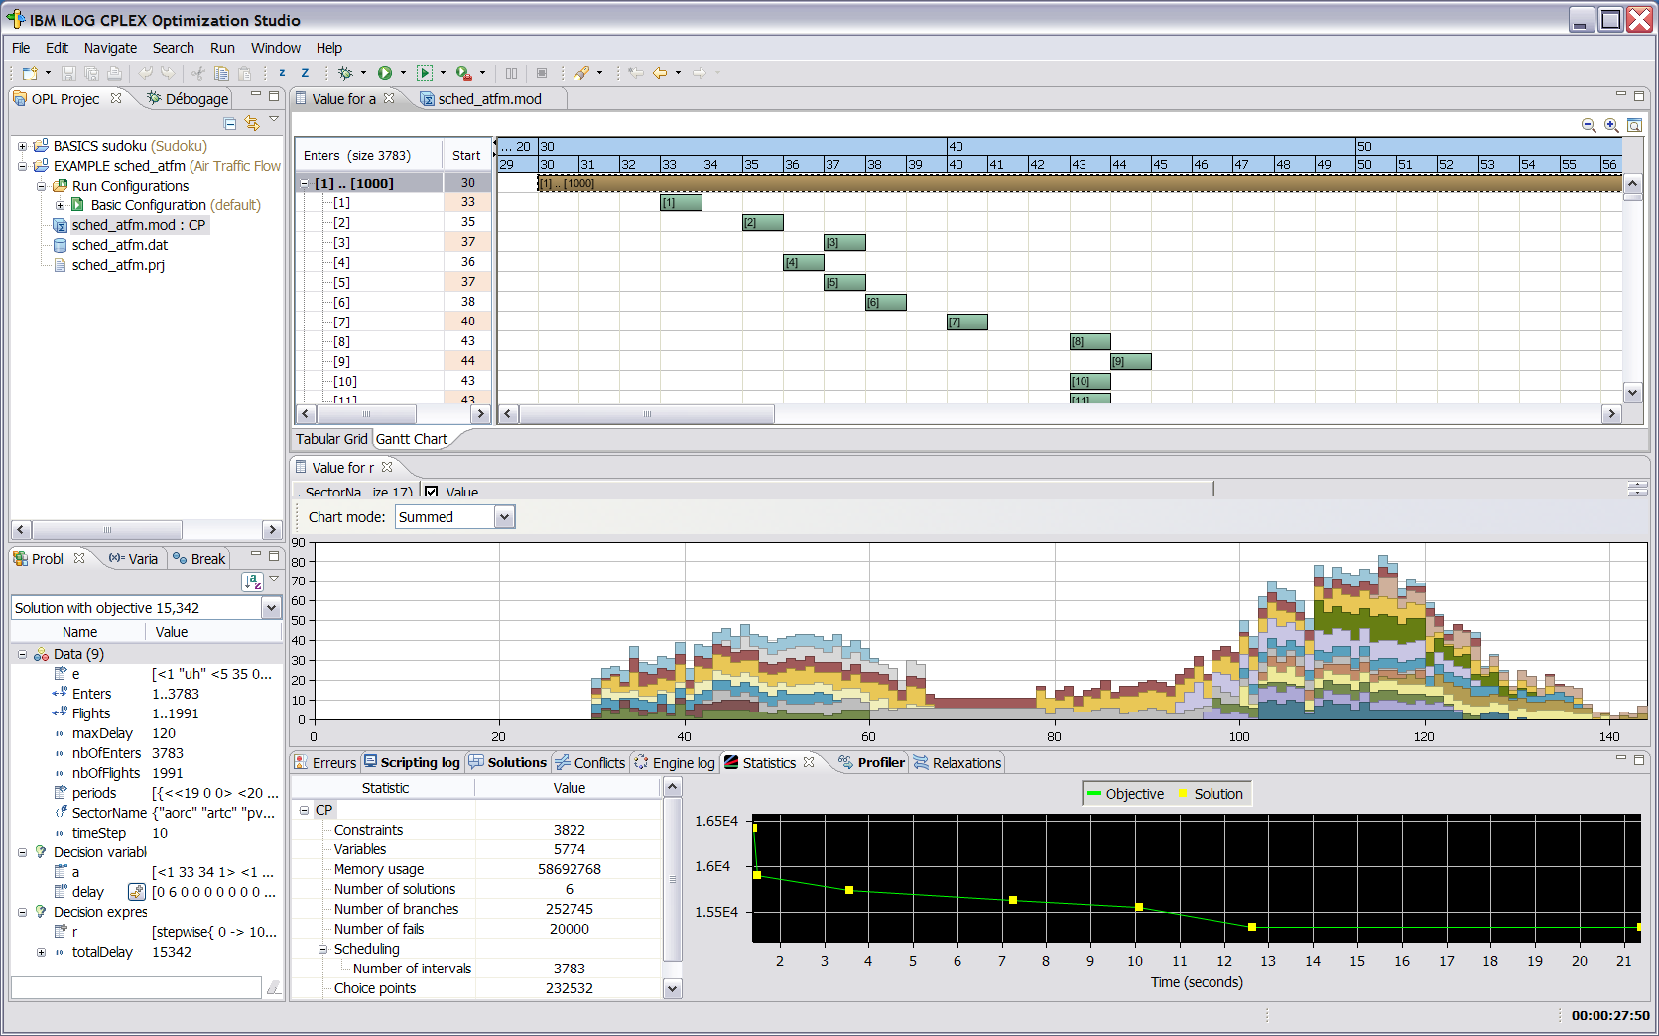
Solution and data inspection

