Slide 1
Workshop IBM ILOG CPLEX CP Optimizer
Search and Inference (propagation) Control
CP Optimizer Development Team
Nov. 7-9, 2012

Slide 2
Launching the Search
Two ways of solving
  Standard solve (nothing to say in OPL)
    Runs until a (optimal) solution found or until a limit is reached
  startNewSearch / next
    Produces (improving) solutions for processing one by one
  execute {
  cp.startNewSearch();
  while (cp.next()) {
  // do something
  }
  }

Slide 3
Types of search available
All methods vary according to the presence or not of interval variables
  By default, intervals take priority over integers
Restart
  Method of choice
Multi-point
  Alternative to restart (sometimes superior)
Depth-first
  Useful for debugging or counting solutions

Slide 4
Restart
Search is restarted frequently following different heuristics:
  Domain-based heuristics (e.g. chronological)
  Learned heuristics (e.g. impacts)
  Heuristic following an already found solution
  Randomized heuristics
Feedback learning approaches ensure that the best approaches are used most

Slide 5
Multipoint
Multiple (partial) solutions to the problem are maintained
These are specified via some pre-assignments before a completion method completes the pre-assignment
A population is maintained which balances objective value with the sizes of the partial assignment

Slide 6
Depth-First
Seldom the method to use for solving an optimization problem.
Most useful for:
  Debugging or investigating a model
  Producing all solutions to a decision problem
  Proving that there is no solution to a problem

Slide 7
Search parallelism
By default, the automatic search of CP Optimizer uses parallelism with one worker per core
Information EffectiveWorkers returns the number of workers used:
execute {
writeln("Using ", cp.info.EffectiveWorkers, " worker(s).");
}
Parameter Workers can be used to change this default value
Example: single worker
execute {
cp.param.Workers = 1;
}

Slide 8
Temporal Relaxation
For models containing interval variables, a linear relaxation is solved with CPLEX
Many different expressions over intervals
  including earliness and tardiness costs
  costs of presence / absence
Relaxation is solved at each restart and is used in the heuristic
  Can be turned off with a parameter:
execute {
cp.param.TemporalRelaxation = “Off”;
}

Slide 9
Interpreting the search log
Top
  Information on model dimensions
  Information on non-default parameter values
  Information on the initial propagation
  ! -------------------------------------------------------------------------
  ! Minimization problem - 5774 variables, 3822 constraints
  ! FailLimit = 20000
  ! Initial process time : 0,03s (0,00s extraction + 0,03s propagation)
  ! . Log search space : 58737,6 (before), 27774,2 (after)
  ! . Memory usage : 10,1 MB (before), 12,4 MB (after)
  ! Using parallel search with 2 workers.
  ! -------------------------------------------------------------------------

Slide 10
Interpreting the search log
Middle
  Incumbent value, Number of branches, new solution (via “*”), worker
  Decision at the current branch (“F” = branch failed)
  Smallest # of non-fixed variables since last display
  ! Best Branches Non-fixed W Branch decision
  * 16422 4345 0,76s 1 -
  * 15908 4351 0,81s 2 -
  15908 10000 5458 1 on a#416
  15908 10000 1879 2 on a#1029
  * 15742 18892 1,89s 2 -
  15742 20000 5251 1 on a#609
  15742 20000 4248 2 on a#1500
  15742 30000 1823 2 on a#3621
  15742 30000 3699 1 on a#2009
  * 15634 31575 5,85s 1 -
  15634 40001 1846 1 on a#3694
  15634 40000 1655 2 8 = delay#586
  * 15558 40621 8,71s 2 -
  * 15342 47670 11,48s 2 -
  15342 50000 2253 2 on a#3443
  15342 50000 1899 1 on a#1768

Slide 11
Interpreting the search log
Middle
  Incumbent value, Number of branches, new solution (via “*”), worker
  Decision at the current branch (“F” = branch failed)
  Smallest # of non-fixed variables since last display
  ! Best Branches Non-fixed W Branch decision
  * 16422 4345 0,76s 1 -
  * 15908 4351 0,81s 2 -
  15908 10000 5458 1 on a#416
  15908 10000 1879 2 on a#1029
  * 15742 18892 1,89s 2 -
  15742 20000 5251 1 on a#609
  15742 20000 4248 2 on a#1500
  15742 30000 1823 2 on a#3621
  15742 30000 3699 1 on a#2009
  * 15634 31575 5,85s 1 -
  15634 40001 1846 1 on a#3694
  15634 40000 1655 2 8 = delay#586
  * 15558 40621 8,71s 2 -
  * 15342 47670 11,48s 2 -
  15342 50000 2253 2 on a#3443
  15342 50000 1899 1 on a#1768

Slide 12
Interpreting the search log
Bottom
  Reason for termination, solution status
  Measures of effort (branches, fails, time)
  Memory usage
  Branch rate
  ! -------------------------------------------------------------------------
  ! Search terminated by limit, 6 solutions found.
  ! Best objective : 15342
  ! Number of branches : 253022
  ! Number of fails : 20000
  ! Total memory usage : 60,2 MB (58,7 MB CP Optimizer + 1,5 MB Concert)
  ! Time spent in solve : 15,29s (15,29s engine + 0,00s extraction)
  ! Search speed (br. / s) : 16540,8
  ! -------------------------------------------------------------------------

Slide 13
Search log control parameters
LogVerbosity
  Quiet: turn off the log
  Terse, Normal, Verbose: all do the same for now
LogPeriod
  Regularity of the display in the middle section
  In particular, setting to 1 shows each decision

Slide 14
Stopping Conditions
TimeLimit
  Stop after spending the time limit
  Two modes:
    TimeMode = CPUTime (default)
    TimeMode = ElapsedTime (solution of choice when deploying an application)
BranchLimit, FailLimit
  Stop after spending the limit
SolutionLimit
  Stop after producing the given number of solutions
ObjectiveLimit
  Stop when getting to/crossing the given value
RelativeOptimalityTolerance, OptimalityTolerance
  Limit to be proved for claiming optimality

Slide 15
Search Phases
Search phases are a means to specify, in a high-level manner, a technique for instantiating variables. In particular:
  To specify a (partial) order of instantiation
  To (optionally) specify further variable and value selection mechanisms
Example:
  cp.setSearchPhases(cp.factory.searchPhase(x),
  cp.factory.searchPhase(y));

Slide 16
Search Phases
General forms:
var p1 = cp.factory.searchPhase(
dvar int[] [, var-chooser, val-chooser]
);
var p2 = cp.factory.searchPhase(dvar sequence);
var q = cp.factory.searchPhase(dvar sequence[]);
var p3 = cp.factory.searchPhase(dvar interval[]);
cp.setSearchPhases(p1, p2, p3);

Slide 17
Search Phases: semantics
cp.setSearchPhases(p1, p2, p3);
Phases are considered in order
When p1 is complete, all variables mentioned in phase p1 will be fixed
  Any variables not fixed by the phases will be handled by an automatic mechanism afterwards
If variable and value choosers are used, then those will use to select a variable from within the phase, and the value of the variable.
  Can be user-defined in APIs

Slide 18
Search Phases: selecting variables
Variable selectors
  selectMin(variable-eval)
  selectMax(variable-eval)
  selectRandomVar()
Variable evaluators
  domainSize: size of domain
  domainMin, domainMax: min and max of domain
  varImpact: learned impact of variable
  explicitVarEval: associate an explicit evaluation

Slide 19
Search Phases: selecting values
Value selectors
  selectMin(value-eval)
  selectMax(value-eval)
  selectRandomValue()
Variable evaluators
  value: the evaluation is the value itself
  explicitValueEval: associate an explicit evaluation

Slide 20

Search Phases
OPL
Examples
  sched_square
  sports
  PPP

Slide 21
Constraint propagation
In general, constraints communicate through domain reductions, and not directly with each other
Constraint
Constraint
Variable
Domains
Constraint
Constraint
Constraint
Constraint

Slide 22
Constraint propagation
There are exceptions to this for certain specific constraint types
Certain constraints are aggregated
Constraint
Constraint
Variable
Domains
Constraint
Constraint
Constraint
Constraint

Slide 23
Constraint Aggregation
Certain groups of related constraint are aggregated by CP Optimizer. This is to:
  Increase constraint propagation
  Increase propagation speed
  Decrease memory usage
This happens automatically. You don’t have to worry about it
Examples
  Cliques of difference to all-different constraints
  All precedence constraints to the temporal network
  All binary constraints like presenceOf(a)=>presenceOf(b)

Slide 24
Constraint propagation control
The strength of propagation of certain constraint types can be controlled via parameters
A global parameter, DefaultInferenceLevel, selects the default level for all constraint types
One parameter per constraint type is also available: e.g. CountInferenceLevel
Reserved levels are
  Default, Low, Basic, Medium, Extended
  Higher levels may take more time or memory but lead to more domain reduction

Slide 25
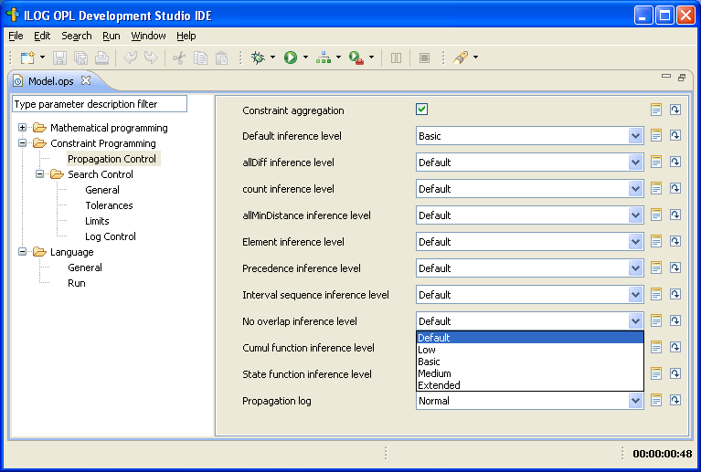
Inference Level Parameters

Slide 26
Inference Level parameters
Alternatively, parameters can be set using scripting before the constraint block
  execute {
  cp.param.DefaultInferenceLevel = “Extended”;
  }

Slide 27
Constraint propagation
The quality of a model will depend on the ability of the constraints to reduce domains and communicate
This also applies to the objective
Constraint
Constraint
Variable
Domains
Constraint
Constraint
Constraint
Constraint

Slide 28
Arithmetic and relational constraints
Only bounds are updated
  x + y ≤ 7
    before: dom(x) = {2, 3, 4, 5, 6}, dom(y) = {2, 4, 6, 8}
    after: dom(x) = {2, 3, 4, 5}, dom(y) = {2, 4}
  x + y == 7
    before: dom(x) = {2, 3, 4, 5, 6}, dom(y) = {2, 4, 6, 8}
    after: dom(x) = {3, 4, 5} dom(y) = {2, 4}
    best: dom(x) = {3, 5} dom(y) = {2, 4}
Bounds prop. is normally the best compromise
Specialized constraints can be considered if extra propagation is thought useful

Slide 29
Logical constraints
True / false values are propagated when known by examination of current domains
  x < 5 || y == 3
    before: dom(x) = {2, 3, 4, 5, 6}, dom(y) = {2, 4, 6, 8}
    after: dom(x) = {2, 3, 4}, dom(y) = {2, 4, 6, 8}
  (x == 3) → (y == 3)
    before: dom(x) = {2, 3, 4, 5, 6}, dom(y) = {2, 4, 6, 8}
    after: dom(x) = {2, 4, 5, 6}, dom(y) = {2, 4, 6, 8}
Weakness: multiple variable occurrences
  (x < 5) → (x == 3 || y == 3)
  CPO does not find that x cannot be 4 even if y != 3

Slide 30
Element expression
All domain values are considered for filtering
  a = [6, 2, 1, 9, 4]
  y = a[x]
    before: dom(x) = {0, 2, 3}, dom(y) = {5..10}
    after: dom(x) = {0, 3} dom(y) = {6, 9}
  a = [2, 0, 1, 0, 2, 2, 0, 1, 2, 1]
  a[x] < 2
    before: dom(x) = {0..9}
    after: dom(x) = {1, 2, 3, 6, 7, 9};

Slide 31
Generalized element expression
All index values are considered for filtering
By default, only the bounds of the array elements and of the result are updated and used for updating the index
  a[x] = 4
    before: dom(a) = [{3,5,7,9}, {5..7}, {2..6}], dom(x) = {0..2},
    after: dom(a) = [{3,5,7,9}, {5..7}, {2..6}], dom(x) = {0, 2},
  y = a[x] (y unconstrained)
    before: dom(a) = [{3,5,7,9}, {5..7}, {2..6}], dom(x) = {0, 2},
    after: dom(y) = {2..9};

Slide 32
Generalized element expression
All domain values of all variables and of the result can be considered for filtering using a parameter
  ElementInferenceLevel at “Medium” or “Extended”
  a[x] = 4
    before: dom(a) = [{3,5,7,9}, {5..7}, {2..6}], dom(x) = {0..2}
    after: dom(a) = [{3,5,7,9}, {5..7}, {4}], dom(x) = {2},
  y = a[x] (y unconstrained)
    before: dom(a) = [{3,5,7,9}, {5..7}, {2..6}], dom(x) = {0, 2}
    after: dom(y) = {2,3,4,5,6,7,9}

Slide 33
Allowed Assignments
All domain values of all variables are considered for filtering
  allowedAssignments(M, x, y)
    M = {<0,7>,<1,6>,<2,5>,<3,4>,<4,3>,<5,2>,<6,1>,<7,0>}
    before: dom(x) = {2, 3, 4, 5, 6}, dom(y) = {2, 4, 6, 8}
    after: dom(x) = {3, 5} dom(y) = {2, 4}
Can be used to make up for a lack of propagation in arithmetic expressions
  Classic: z = n * x + y when dom(y) = {0..n-1}
  See the “sports” example

Slide 34
Cardinality-based Constraints
All Different
  Three inference levels (AllDiffInferenceLevel)
  Initial Domain
    [{1}, {1,2,3,4,5}, {1,2,4}, {2,4}, {2,3,4}]
  Reasoning on values of fixed variables: Basic
    [{1}, {2,3,4,5}, {2,4}, {2,4}, {2,3,4}]
  Reasoning on bounds of variables: Medium
    [{1}, {5}, {2,4}, {2,4}, {2,3,4}]
  Reasoning on all possible values: Extended
    [{1}, {5}, {2,4}, {2,4}, {3}]

Slide 35
Cardinality-based Constraints
Inverse
  Propagation is the same as the all-different at the Basic level
  Plus a little bit of reasoning on the fact that each value must be taken exactly once
  Before propagation of inverse(x, y)
    dom(x) = [{0,1,2}, {0,2}, {0,2}], dom(y) = [{0..2}, {0..2}, {0..2}]
  After propagation
    dom(x) = [{1}, {0,2}, {0,2}], dom(y) = [{1..2}, {0}, {1..2}]
  To get more propagation add an all-different constraint at the Extended level on x or y

Slide 36
Cardinality-based Constraints
Count
  Count constraints are aggregated to distribute constraints
  Propagation levels are equivalent

Slide 37
Cardinality-based Constraints
Pack
  Sophisticated algorithms based on OR methods
  Use of dynamic programming techniques to eliminate or commit particular items
  Generalized version of Martello and Toth lower bound on number of containers
  Can result in a lot of domain reduction of the problems is very constrained (very little slack)

Slide 38
Interval Variables
Interval variable domain representation: tuple of ranges:
  [x_{min},x_{max}]⊆[0,1]: current execution status
  [s_{min},s_{max}]⊆ ℤ: conditional domain of start would the interval be present
  [e_{min},e_{max}]⊆ ℤ: conditional domain of end would the interval be present
  [l_{min},l_{max}]⊆ ℤ⁺: conditional domain of length would the interval be present
Notes:
Purpose: Describe how interval variables are represented in the engine
Conclusion:

Slide 39
Logical network
Logical constraints are aggregated in an implication graph: all 2-SAT logical constraints [¬]x(a) ∨ [¬]x(b) are translated as implications ( ¬[¬]x(a) ⇒ [¬]x(b) )
Incremental transitive closure of the implication graph allows detecting infeasibilities and querying in O(1) whether x(a) ⇒ x(b) for any (a,b)
Notes:
Purpose: Present the logical network
Conclusion:

Slide 40
Temporal network
Precedence constraints are aggregated in a temporal network
Conditional reasoning:
Propagation on the conditional bounds of a (would a be present) can assume that b will be present too, thus:
e_{max}(a) ← min(e_{max}(a), s_{max}(b))
Bounds are propagated even on interval variables with still undecided presence status
From logical network
x(a)⇒x(b)
a
b
endBeforeStart(a,b)
Notes:
Purpose: Present the temporal network
Conclusion:

Slide 41
Constraint Propagation: Simple example
Inspired from [Barták&Čepek 2007]
BuyTube (40)
CollectMaterial (1)
CollectKit (1)
MakeTube
GetTube
SawRod (10)
AssembleKit (5)
XOR
ClearRod (2)
SawTube (30)
ClearTube (20)
WeldTube (15)
WeldRod (15)
AssemblePiston (5)
ShipPiston (0)
Deadline=70
Notes:
Purpose: Illustrate propagation on the example
Conclusion:

Slide 42
Constraint Propagation: Simple example
Inspired from [Barták&Čepek 2007]
BuyTube (40)
CollectMaterial (1)
CollectKit (1)
BuyTube (40)
MakeTube
GetTube
SawRod (10)
AssembleKit (5)
XOR
ClearRod (2)
SawTube (30)
ClearTube (20)
WeldTube (15)
WeldRod (15)
AssemblePiston (5)
ShipPiston (0)
Deadline=70
Notes:
Purpose: Illustrate propagation on the example
Conclusion:

Slide 43
Sequence Variable Structures
“Light” precedence
  Maintain only ranked intervals at left and right and those which can be scheduled (or not) as the next left or next right
Full precedence
  Full graph is maintained but more costly to maintain and uses more memory (n time more, where n is the number of intervals in the sequence)

Slide 44
Types of propagation over intervals
Timetable
  (Compressed) representation of the level of a function over time. Propagation disallows intervals from regions where there is not enough capacity
Disjunctive
  Tests each pair of intervals to see if they must occur in a certain order
Edge-finding
  Uses energetic reasoning to discover that an interval must be to the left (or right) of a set of intervals

Slide 45
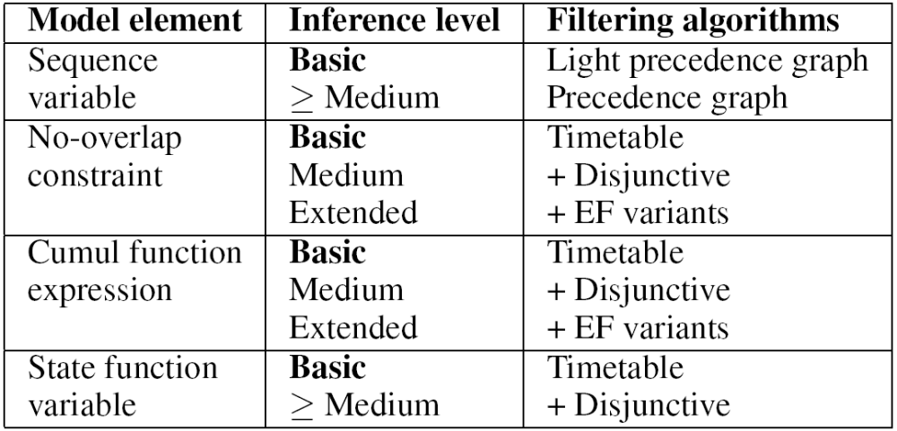
Search Parameters

