Slide 1
Conditional interval variables
A powerful concept for modeling and solving complex scheduling problems
Philippe Laborie – Principal Scientist, Developer IBM ILOG CPLEX Optimization Studio – 20 Aug. 2012 – ISMP 2012

Slide 2
Agenda
Conditional interval variables
What is it for ?
What is it ?
How is it used ?
How does it work ?
How can I go further ?

Slide 3
Scheduling is not only about deciding start and end times for a predefined set of activities
Conditional interval variables : What is it for ?
Real-world scheduling problems often involve:
Optional activities or sub-projects (oversubscribed problems)
Resource or mode allocation
Alternative paths / recipes
Activity splitting (pre-emptive)
Activities / Intervals of time defined by some conditions :
  A given resource is used / idle
  An inventory is below a given level
  Equipment setup / maintenance activities
The notion of a conditional interval variable (in short: interval variable) makes it possible/easier to capture those real-world features in an optimization model

Slide 4
Scheduling is not only about deciding start and end times for a predefined set of activities
Conditional interval variables : What is it for ?
The notion of a conditional interval variable (in short: interval variable) makes it possible/easier to capture those real-world features in an optimization model
An interval variable is a kind of 2-dimensional decision variable :
  Logical dimension: decision on a 0/1 presence value
  (condition for the presence of the interval)
  Temporal dimension: decision on interval start and end values
Interval variables were introduced in [1,2]. They form the foundation of the new generation of scheduling model and algorithms provided in IBM ILOG CPLEX Optimization Studio (CP Optimizer engine).
[1] Reasoning with Conditional Time-intervals. FLAIRS-2008.
[2] Reasoning with Conditional Time-intervals, Part II: an Algebraical Model for Resources. FLAIRS-2009.

Slide 5
Agenda
Conditional interval variables
What is it for ?
What is it ?
How is it used ?
How does it work ?
How can I go further ?

Slide 6
Formal definition
Conditional interval variables : What is it ?
An interval variable is a new type of decision variable (just like floating point variables in LP or integer variables in MIP/CP):
The domain of possible values for an interval variable a is of the form:
Domain(a) ⊆ {⊥} ∪ { [s,e) | s,e∈Ζ, s≤e }
Let a be a fixed interval variable:
  If a=⊥ we say that a is absent
  Otherwise (a is present), a=[s,e) and
  s (resp. e) denote the start (resp. end) value of a.
  e-s is the length of interval a.

Slide 7
First example: (optional) activities
Conditional interval variables : What is it ?
Examples in this presentation are illustrated on small CPLEX Optimization Studio OPL models.
The following interval variable a could model an activity of processing time 10 to be executed in a time-window [30,60).
Domain(a) = { [s,e) | 30≤s, e≤60, e-s=10 }
The following interval variable b could model an optional activity of processing time 10 that, if executed, must be executed in a time-window [30,60).
Domain(a) = {⊥} ∪ { [s,e) | 30≤s, e≤60, e-s=10 }

Slide 8
Overview of the other modeling concepts
Conditional interval variables : What is it ?
IBM ILOG CPLEX Optimization Studio provides the notion of interval variable together with a set of expressions and constraints over them:
  Intervals variables a,b,c,…
  Integer expressions startOf(a, absVal), startEval(f, a, absVal), …
  Logical constraints presenceOf(a) => presenceOf(b)
  Precedence constraints endBeforeStart(a, b, delay)
  Decomposition constraints span(a, {b1,…bn})
  Alternative constraints alternative(a, {b1,…bn})
  No-overlap constraints noOverlap({b1,…,bn})
  Cumul functions sum(i in 1..n) pulse(bi,qi) <= Q
  State functions alwaysEqual(stateFunction, a, stateValue)
We will see some of them in the examples …

Slide 9
Agenda
Conditional interval variables
What is it for ?
What is it ?
How is it used ?
How does it work ?
How can I go further ?

Slide 10
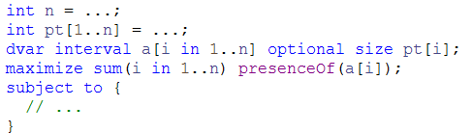
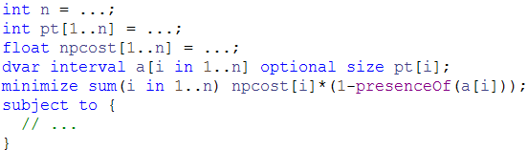
Oversubscribed scheduling problems
Conditional interval variables : How is it used ?
Schedule as many activities as possible
Minimize cost of non-processed activities

Slide 11
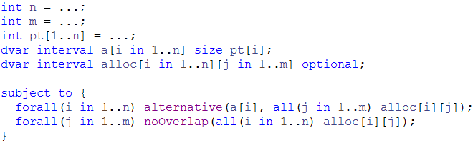
Alternative resources
Conditional interval variables : How is it used ?
Resource allocation: activity a[i] needs one resource to be selected among m ones

Slide 12
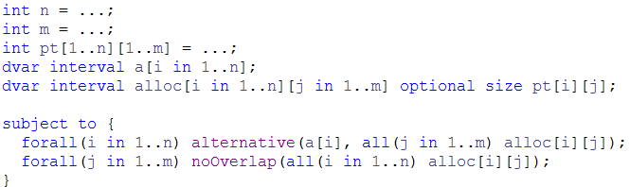
Alternative resources
Conditional interval variables : How is it used ?
Resource allocation: activity a[i] needs one resource to be selected among m ones
Conditional interval variables make it easy to specify :
  Activity duration that depends on the allocated resource

Slide 13
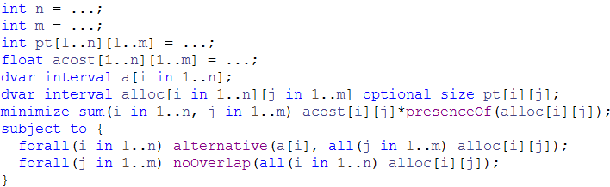
Alternative resources
Conditional interval variables : How is it used ?
Resource allocation: activity a[i] needs one resource to be selected among m ones
Conditional interval variables make it easy to specify :
  Activity duration that depends on the allocated resource
  Allocation costs

Slide 14
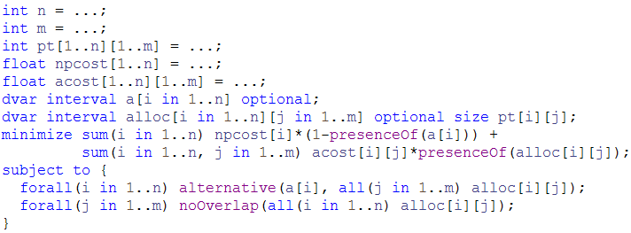
Alternative resources
Conditional interval variables : How is it used ?
Resource allocation: activity a[i] needs one resource to be selected among m ones
Conditional interval variables make it easy to specify :
  Activity duration that depends on the allocated resource
  Allocation costs
  Optional activities with non-processing cost

Slide 15
Alternative modes / recipes / projects
Conditional interval variables : How is it used ?
Optional interval variables used to represent an alternative way of executing an activity are not restricted to use a single resource, they can represent a much more complex process …
  Alternative resources
  Alternative modes
  Alternative recipes/projects
  Alternatives in work breakdown structures
a[i]
alternative
alt[i][1]
alt[i][2]
alt[i][m]
R1
R2
R3

Slide 16
Alternative modes / recipes / projects
Conditional interval variables : How is it used ?
Optional interval variables used to represent an alternative way of executing an activity are not restricted to use a single resource, they can represent a much more complex process …
  Alternative resources
  Alternative modes
  Alternative recipes/projects
  Alternatives in work breakdown structures
a[i]
alternative
alt[i][1]
alt[i][2]
alt[i][m]
R1
R2
R3
R4
R1

Slide 17
Alternative modes / recipes / projects
Conditional interval variables : How is it used ?
Optional interval variables used to represent an alternative way of executing an activity are not restricted to use a single resource, they can represent a much more complex process …
  Alternative resources
  Alternative modes
  Alternative recipes/projects
  Alternatives in work breakdown structures
a[i]
alternative
alt[i][1]
alt[i][2]
alt[i][m]
R1
R2
R1
R3
R1
R2
R4
R3

Slide 18
Alternative modes / recipes / projects
Conditional interval variables : How is it used ?
Optional interval variables used to represent an alternative way of executing an activity are not restricted to use a single resource, they can represent a much more complex process …
  Alternative resources
  Alternative modes
  Alternative recipes/projects
  Hierarchical alternatives (work breakdown structures)
alternative
a[i]
b[i]
c[i]
alternative
alternative
alt[i][1]
alt[i][2]
alt[i][m]
R1
R2
R1
R1
R1
R3
R2
R3
R1
R3
R2
R3
R4

Slide 19
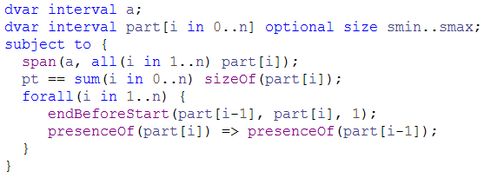
Preemptable activities
Conditional interval variables : How is it used ?
Activity can be preempted at most n times, activity parts should last at most smin
a
part[0]
part[1]
part[2]
part[n]

Slide 20
Other use-cases
Conditional interval variables : How is it used ?
Maintenance activities executed when some conditions are met (e.g. need to clean after a certain amount of production Q)
Setup activities on resources
…
level ≤ Q
level
prod
prod
prod
prod
prod
prod
prod
level+=q_{i}
clean[0]
clean[1]
clean[2]
level-=[1..Q]

Slide 21
Agenda
Conditional interval variables
What is it for ?
What is it ?
How is it used ?
How does it work ?
How can I go further ?

Slide 22
Search
Conditional interval variables : How does it work ?
Constrained-Based Scheduling resolution methods are extended to handle conditional interval variables:
  Constraint propagation
    Strong propagation on conditional bounds of interval variables
    Extension of classical Constrained-Based Scheduling propagation algorithms (timetabling, edge-finding, …)
  Branching scheme and branching strategies in tree search
    Mixing fixation of presence status and start/end values of interval variables
    Linear relaxation to compute indicative presence statuses / start, end values
  Large-Neighborhood Search
    LNS Fragments based on topology of the logical constraint network

Slide 23
Search
Conditional interval variables : How does it work ?
Constrained-Based Scheduling resolution methods are extended to handle conditional interval variables:
  Constraint propagation
    Strong propagation on conditional bounds of interval variables
    Extension of classical Constrained-Based Scheduling propagation algorithms (timetabling, edge-finding, …)
  Branching scheme and branching strategies in tree search
    Mixing fixation of presence status and start/end values of interval variables
    Linear relaxation to compute indicative presence statuses / start, end values
  Large-Neighborhood Search
    LNS Fragments based on topology of the logical constraint network

Slide 24
Constraint propagation
Conditional interval variables : How does it work ?
Conditional interval variable domain representation: tuple of ranges:
  [xmin,xmax] ⊆ [0,1]: current presence status
  [smin,smax] ⊆ ℤ: conditional domain of start value would the interval be present
  [emin,emax] ⊆ ℤ: conditional domain of end value would the interval be present
  [dmin,dmax] ⊆ ℤ⁺: conditional domain of size value would the interval be present

Slide 25
Constraint propagation
Conditional interval variables : How does it work ?
Logical constraints network :
  Logical constraints are aggregated in an implication graph: all 2-SAT logical constraints [¬] presenceOf(a) ∨ [¬] presenceOf(b) are translated as implications
  ( ¬[¬] presenceOf(a) ⇒ [¬] presenceOf(b) )
  Incremental transitive closure of the implication graph allows detecting infeasibilities and querying in O(1) whether presenceOf(a)⇒presenceOf(b) for any (a,b)

Slide 26
Constraint propagation
Conditional interval variables : How does it work ?
Precedence constraints network :
  Precedence constraints are aggregated in a temporal network
  Conditional reasoning:
  Propagation on the conditional bounds of a (would a be present) can assume that b will be present too, thus: emax(a) ← min(emax(a), smax(b))
  Bounds are propagated even on interval variables with still undecided execution status !
From logical network
presenceOf(a)⇒presenceOf(b)
a
b
endBeforeStart(a,b)
0
smin=0
emax=H
smin=10
emax=H
smin=20
emax=H
smin=10*n
emax=H
H
a[0]
a[1]
a[2]
a[n]
lmin=10
lmin=10
lmin=10
lmin=10

Slide 27
Implementation in IBM ILOG CPLEX Optimization Studio
Conditional interval variables : How does it work ?
Conditional interval variables are the foundation of the constraint-based scheduling model provided in CP Optimizer.
This powerful modeling language is associated with an efficient automatic search (Model & Solve paradigm)
First version with conditional interval variables was released in 2008
Since then, 6 versions have been released with continuous improvements
  Improvement of automatic search performance & robustness
  Small API extensions when necessary (new expressions or constraints)
Used in numerous industrial scheduling applications
Current version: V12.4

Slide 28
Agenda
Conditional interval variables
What is it for ?
What is it ?
How is it used ?
How does it work ?
How can I go further ?

Slide 29
If you decide to go further …
Conditional interval variables: How can I go further ?
With the concepts and the model:
  P. Laborie & J. Rogerie. Reasoning with Conditional Time-intervals. Proc. FLAIRS-2008.
  P. Laborie, J. Rogerie. P. Shaw & P. Vilím. Reasoning with Conditional Time-intervals,
  Part II: an Algebraical Model for Resources. Proc. FLAIRS-2009
With the solving techniques:
  Attend Paul Shaw’s presentation tomorrow :
  Cluster: Implementations and software, Tuesday, August 21st
  13:15 - 14:45, room: H 1058, Software for constraint programming
  Automatic search in CP Optimizer
  P. Laborie & D. Godard. Self-Adapting Large Neighborhood Search: Application to Single-mode Scheduling Problems. Proc. MISTA-2007.
With some more complex models:
  P. Laborie. IBM ILOG CP Optimizer for Detailed Scheduling Illustrated on Three Problems. Proc. CPAIOR-2009.
With IBM ILOG CPLEX Optimization Studio:
  http://www-01.ibm.com/software/integration/optimization/cplex-optimization-studio/
  Optimization Forum: search for “IBM Optimization Forum”

