Slide 1
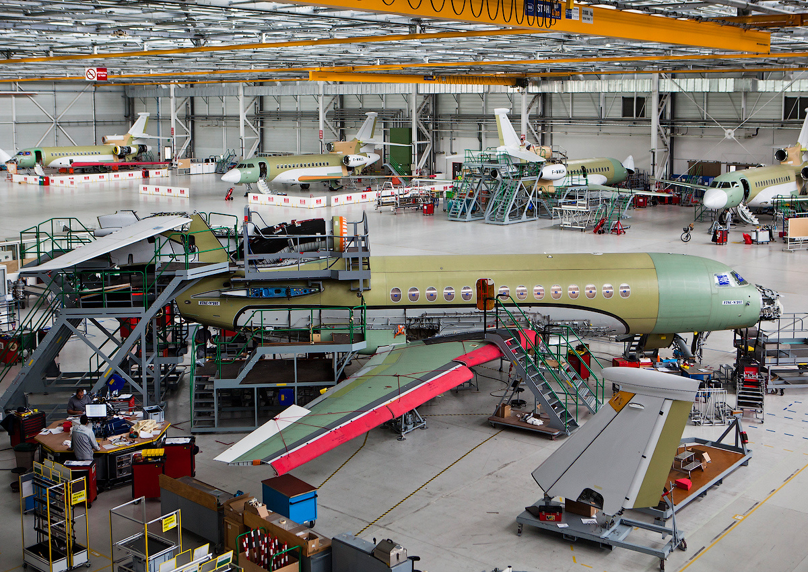

Combinatorial Optimization,
Constraint Programming,
Scheduling
From theory to practice
Philippe Laborie, IBM laborie@fr.ibm.com

Slide 2

About me
Defended a PhD in Artificial Intelligence more than 20 years before the A.I. hype
Working at IBM in Paris, in a team that develops IBM CPLEX Optimization Studio (CPLEX, CP Optimizer), a tool for solving Combinatorial Optimization problems for our customers
My job mainly consists in:
  Proposing and implementing improvements in our
problem solver
  Contributing to the state-of-the-art in Combinatorial
Optimization (publishing scientific papers, giving talks
in conferences, …)
  Helping our customers to formulate and solve their
problems using our tool

