Slide 1


Combinatorial Optimization,
Constraint Programming,
Scheduling
From theory to practice
Philippe Laborie, IBM laborie@fr.ibm.com
1

Slide 2
Overview
Combinatorial Optimization Problems:
definition, complexity

Slide 3
Overview
Combinatorial Optimization Problems:
definition, complexity
Scheduling Problems:
definition, complexity,
classification

Slide 4
Overview
Combinatorial Optimization Problems:
definition, complexity
Scheduling Problems:
definition, complexity,
classification
Constraint
Programming
(CP)
Resolution approaches

Slide 5
Overview
Combinatorial Optimization Problems:
definition, complexity
CP for
Scheduling
CP Optimizer
Scheduling Problems:
definition, complexity,
classification
Constraint
Programming
(CP)
Resolution approaches

Slide 6
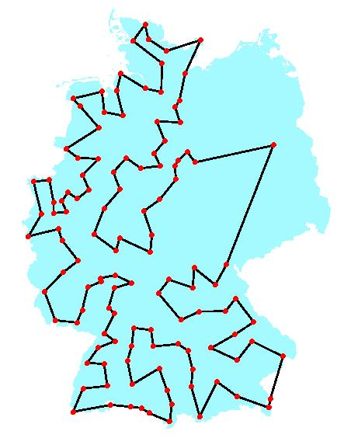
Combinatorial Optimization Problems
Combinatorial optimization searches for an optimal object in a finite, but usually large, collection of objects
Example: Traveling Salesman Problem (TSP)
  Given a list of n cities and the distances between each pair of cities, what is the shortest possible route that visits each city and returns to the origin city?
  Number of possible routes: (n-1)!

Slide 7
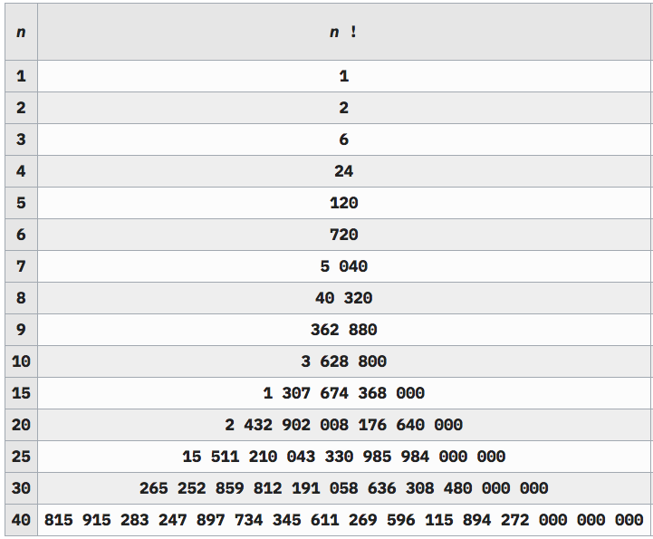
Combinatorial Optimization Problems
Example: Traveling Salesman Problem
  Number of possible routes: (n-1)!

Slide 8

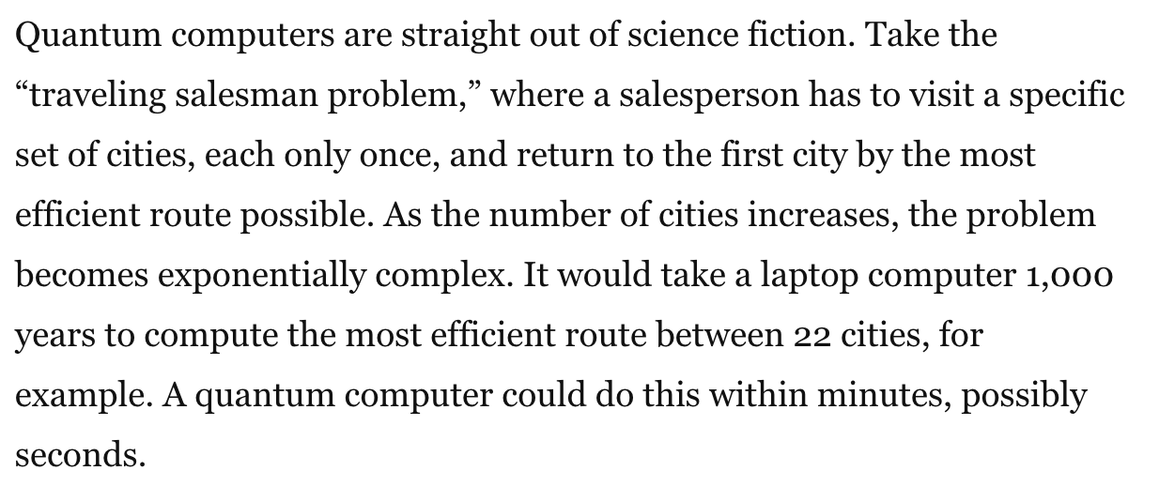
Combinatorial Optimization Problems
Example: Traveling Salesman Problem
21! = 51.090.942.171.709.440.000
Feb. 5, 2018

Slide 9
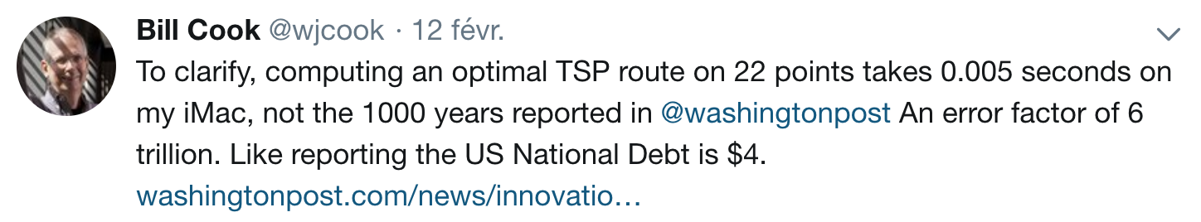
Combinatorial Optimization Problems
Example: Traveling Salesman Problem
21! = 51.090.942.171.709.440.000
Feb. 5, 2018

Slide 10
Combinatorial Optimization Problems
Example: Traveling Salesman Problem
  Number of possible routes: (n-1)!
  Largest TSP solved: n=85900, n! is 386527 digits long

Slide 11
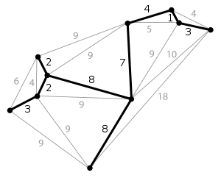
Combinatorial Optimization Problems
Don’t be too impressed:
  Even if the number of solutions is huge, some COPs are easy!
Example: Minimum Spanning Tree
  Even for the hardest COPs, the resolution does not have to explicitly go through all solutions !
Number of possible spanning trees: n^{n-2}

Slide 12
Combinatorial Optimization Problems
How to describe a COP ?
How to characterize the complexity of a COP ?
How to solve a COP ?

Slide 13
Combinatorial Optimization Problems - Description
How to describe a COP ?
  Input data
  Formal description of the problem:
    Decision variables
    Function to be minimized/maximized (objective function)
    Constraints defining the collection of feasible solutions
TSP Example
  Input data:
    Set V={v₁,v₂,…,v_{n}} of cities,
    Distance d(v_{i},v_{j})∈ for each pair of cities v_{i},v_{j} ∈ V
  Formal description of the problem:
    Find a tour of V i.e. a permutation π =(v_{π(1)},v_{π(2)},…,v_{π(n)}) of V that minimizes L = Σ_{i=1..n-1} d(v_{π(i)},v_{π(i+1)}) +d(v_{π(n)},v_{π(1)})

Slide 14
Combinatorial Optimization Problems - Description
How to describe a COP ?
  Input data
  Formal description of the problem:
    Decision variables
    Function to be minimized/maximized (objective function)
    Constraints defining the collection of feasible solutions
General formulation
  Given input data D and decision variable vector X=(x₁,x₂,…,x_{n})
  Find a value for each decision variable in X
    that minimizes F(D, X)
F: function with value in
    and is such that C(D, X) is true
C: function with value in {true,false}

Slide 15
Combinatorial Optimization Problems - Description
General formulation
  Given input data D and decision variable vector X=(x₁,x₂,…,x_{n})
  Find a value for each decision variable in X
    that minimizes F(D, X)
    and is such that C(D, X) is true
Example (Linear Program)
  Minimize x₁ + 2*x₂ + 3*x₃
  Subject to:
    x₁ + x₂ + x₃ ≥ 10
    3*x₁ + 2*x₂ ≤ 7
    x₁ ≥ 0, x₂ ≥ 0, x₃ ≥0

Slide 16
Combinatorial Optimization Problems - Description
General formulation
  Given input data D and decision variable vector X=(x₁,x₂,…,x_{n})
  Find a value for each decision variable in X
    that minimizes F(D, X)
    and is such that C(D, X) is true
Vocabulary:
  Solution: a combination of values for variables in X such that C(D, X) is true
  Optimal solution: a solution (see above) that minimizes F(D, X)
A COP may have:
  No solution (infeasible problem, example: x<y, y<x)
  Several optimal solutions (minimize x² such that |x|≥1)
  No objective function F(D,X), only constraints C(D,X)

Slide 17
Combinatorial Optimization Problems - Description
General formulation
  Given input data D and decision variable vector X=(x₁,x₂,…,x_{n})
  Find a value for each decision variable in X
    that minimizes F(D, X)
    and is such that C(D, X) is true
Example (Linear Program)
  Minimize x₁ + 2*x₂ + 3*x₃
  Subject to:
    x₁ + x₂ + x₃ ≥ 10
    3*x₁ + 2*x₂ ≤ 7
    x₁ ≥ 0, x₂ ≥ 0, x₃ ≥0
Example of solution: x₁=0, x₂=0, x₃=10
An optimal solution is: x₁=2, x₂=0, x₃=8

Slide 18
Combinatorial Optimization Problems - Complexity
How to characterize the complexity of a COP ?
Optimization Problem:
find a solution X that minimizes F(D,X) such that C(D,X) is true
Problem size s(D)
Input data D
Resolution
algorithm
Optimal
solution
Problem description
Resolution time
t=R(D)

Slide 19
Combinatorial Optimization Problems - Complexity
How to characterize the complexity of a COP ?
Decision Problem:
given B, is there a solution X such that F(D,X)≤B and C(D,X) is true
Problem size s(D)
Input data D
Resolution
algorithm
Yes/No
answer
Problem description
Resolution time
t=R(D)

Slide 20
Combinatorial Optimization Problems - Complexity
A decision problem is said to belong to class P if all its instances can be solved in polynomial time
More formally it means that there exists a resolution algorithm such that:
∃k∈N, ∀D, R(D) ≤ s(D)^{k}
Example: Minimum Spanning Tree problem
  If the data D is the input graph with n vertices and m edges, input size is something like s(D)=n+m
  This problem belongs to class P because there exists a resolution algorithm (known as Prim’s algorithm) whose worst case complexity is m.log(n)≤ s(D)²

Slide 21
Combinatorial Optimization Problems - Complexity
A decision problem is said to belong to class NP (Nondeterministic Polynomial time) if checking that a given vector X is a solution or not can be solved in polynomial time
Note the main difference with class P: here we suppose the vector X is given and we do not have to find it !
Of course if a problem is in P (so if we can find a solution X in polynomial time), then we can also check a vector X in polynomial time so we have:
P ⊆ NP
The decision version of most of the COPs belong to class NP
Example: The TSP clearly belongs to class NP: if you are given a tour, it is very easy to compute its length and check whether it is smaller than B

Slide 22
Combinatorial Optimization Problems - Complexity
There has been extensive effort to find polynomial time algorithms for solving problems in NP and, until now, a large number of these problems defy these attempts
Informally speaking, a decision problem in NP is NP-Complete if it is among the hardest ones in NP. If there exist a polynomial time algorithm for even one of the NP-Complete problems it means that all problems in NP can be solved in polynomial time
P=NP ?
So far, nobody knows …
The decision version of many COPs (including the TSP) are NP-Complete

Slide 23
Combinatorial Optimization Problems - Complexity
This is the theory of complexity
But always keep in mind that in practice :
  An instance of problem in P may take very long to solve (for instance if it has a time complexity in n¹²)
  An instance of NP-Complete problem (even if very large) can be easy: the theory is about worst-case complexity so it is pessimistic

Slide 24
Combinatorial Optimization Problems - Resolution
There are 3 main types of approaches:
  Exact: will produce a feasible solution that has been proved to be optimal
  Approximation: will produce a solution and some guarantee on its distance with respect to an optimal solution (for instance that its cost cannot be more than 1.2 worse than the optimal cost)
  Heuristic: will produce an (hopefully good) feasible solution with no optimality guarantee
Orthogonally, one can also distinguish between:
  Generic approaches that can solve a large class of different COPs (SAT, Integer Linear Programming, Constraint Programming)
  Problem specific approaches dedicated to a particular problem (for instance Prim’s algorithm for Minimal Spanning Tree, or Concorde for solving the TSP)

Slide 25
Combinatorial Optimization Problems - Resolution
Two generic exact methods
  ILP : Integer Linear Programming
  CP : Constraint Programming

Slide 26
Combinatorial Optimization Problems - Resolution
ILP : Integer Linear Programming
  Decision variables are integer variables. Ex: x₁, x₂, x₃, …, x_{n}
  Constraints are linear inequalities. Ex: 2.1 x₁ – 7.11 x₃ ≤ 9.3
  Objective function is a linear combination of variables
Example (Quiz):
  Minimize x₁ + 2*x₂ + 3*x₃
  Subject to:
    x₁ + x₂ + x₃ ≥ 10
    3*x₁ + 2*x₂ ≤ 7
    x₁ ≥ 0, x₂ ≥ 0, x₃ ≥0

Slide 27
Combinatorial Optimization Problems - Resolution
ILP : Integer Linear Programming
  Decision variables are integer variables. Ex: x₁, x₂, x₃, …, x_{n}
  Constraints are linear inequalities. Ex: 2.1 x₁ – 7.11 x₃ ≤ 9.3
  Objective function is a linear combination of variables
Example (Quiz):
  Minimize x₁ + 2*x₂ + 3*x₃
  Subject to:
    x₁ + x₂ + x₃ ≥ 10
    3*x₁ + 2*x₂ ≤ 7
    x₁ ≥ 0, x₂ ≥ 0, x₃ ≥0
An optimal solution is x₁=2, x₂=0, x₃=8

Slide 28
Combinatorial Optimization Problems - Resolution
ILP : Integer Linear Programming
  ILP is NP-Complete
  There exists many efficient ILP Solvers (including IBM CPLEX) that can solve problems with up to several 100.000 of variables.
  Some applications:
    Production planning
    Financial portfolio optimization
    Network design
  More info: https://en.wikipedia.org/wiki/Integer_programming

Slide 29
Combinatorial Optimization Problems – CP
CP : Constraint Programming
  Decision variables are in general integer variables.
Ex: x₁, x₂, x₃, …, x_{n}
  Rich variety of constraints an expressions :
    Linear inequalities. Ex: 2.1 x₁ – 7.11 x₃ ≤ 9.3
    Logical constraints. Ex: (max(x₁,x₂)==x₃) ⇒ (x₂* x₃ ≥5)
    Global constraints:
      Table compatibility constraints (CSP)
      AllDifferent(x₁, x₂, x₃, …, x_{n})
      Global constraint catalogue with 423 global constraints! http://sofdem.github.io/gccat/
  Objective function is any expression : Ex: log(x₁)/(1+2*x₂*x₃)
Example: Sudoku

Slide 30
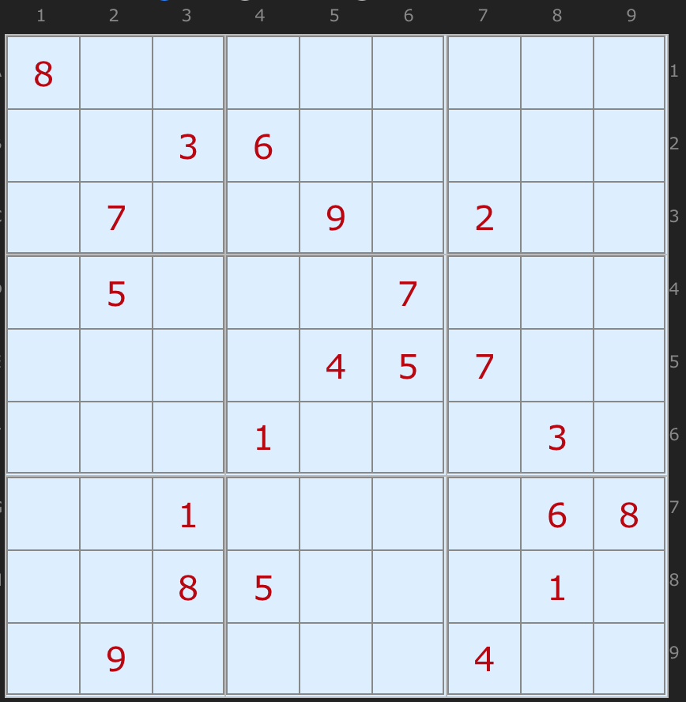
Combinatorial Optimization Problems - CP
CP : Constraint Programming
Example: Sudoku
Arto Inkala’s grid, 2012

Slide 31
Combinatorial Optimization Problems - CP
CP : Constraint Programming
Example: Sudoku
Variables:
∀ r,c ∈[1,9], x_{rc}∈[1,9] # value at row r column c
Constraints:
# input grid :
x₁₁==8, x₂₃==3, x₂₄==6, …
# all rows different :
∀r∈[1,9], all_different(x_{rc}, ∀c ∈[1,9])
# all columns different :
∀c∈[1,9], all_different(x_{rc}, ∀r ∈[1,9])
# all sub-squares different :
∀sr∈[0,2],∀sc∈[0,2],
all_different(x_{rc}, ∀r ∈[3sr+1,3sr+3],∀c ∈[3sc+1,3sc+3])
Arto Inkala’s grid, 2012

Slide 32
Combinatorial Optimization Problems - CP
CP : Constraint Programming
Example: Sudoku
Variables:
∀ r,c ∈[1,9], x_{rc}∈[1,9] # value at row r column c
Constraints:
# input grid :
x₁₁==8, x₂₃==3, x₂₄==6, …
# all rows different :
∀r∈[1,9], all_different(x_{rc}, ∀c ∈[1,9])
# all columns different :
∀c∈[1,9], all_different(x_{rc}, ∀r ∈[1,9])
# all sub-squares different :
∀sr∈[0,2],∀sc∈[0,2],
all_different(x_{rc}, ∀r ∈[3sr+1,3sr+3],∀c ∈[3sc+1,3sc+3])
Arto Inkala’s grid, 2012
See Python Notebook using CP Optimizer

Slide 33
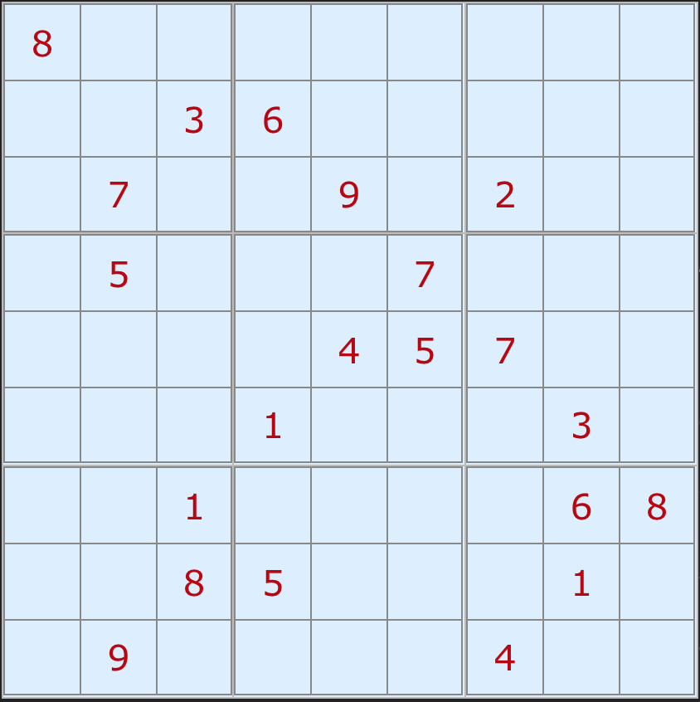
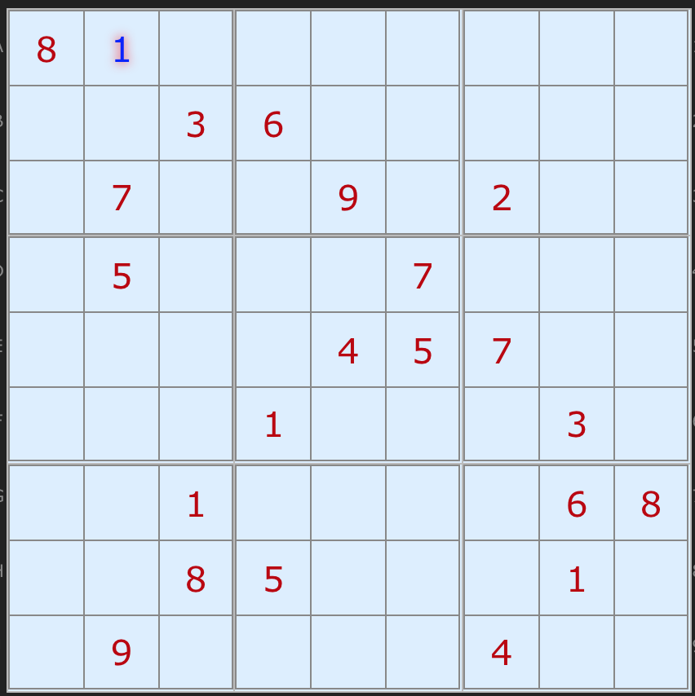
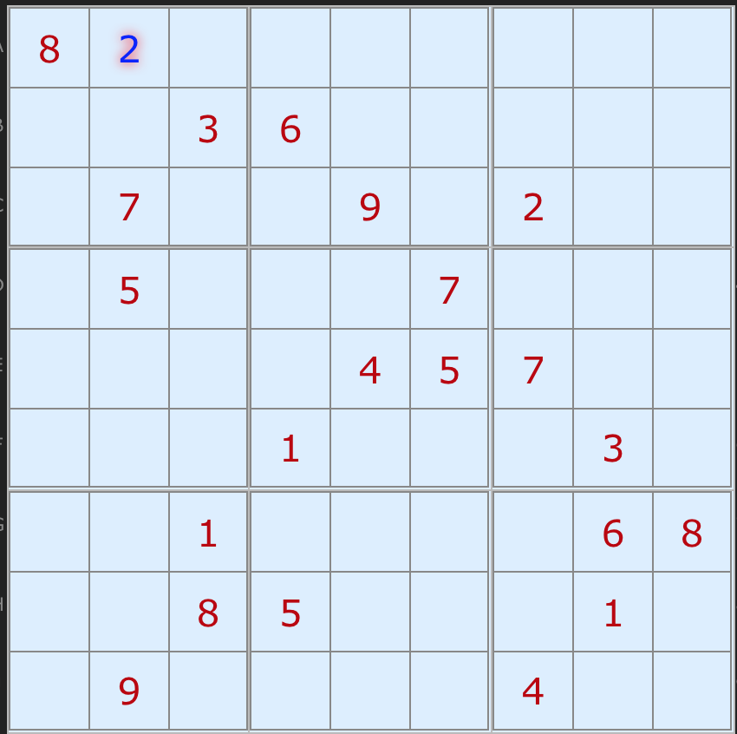
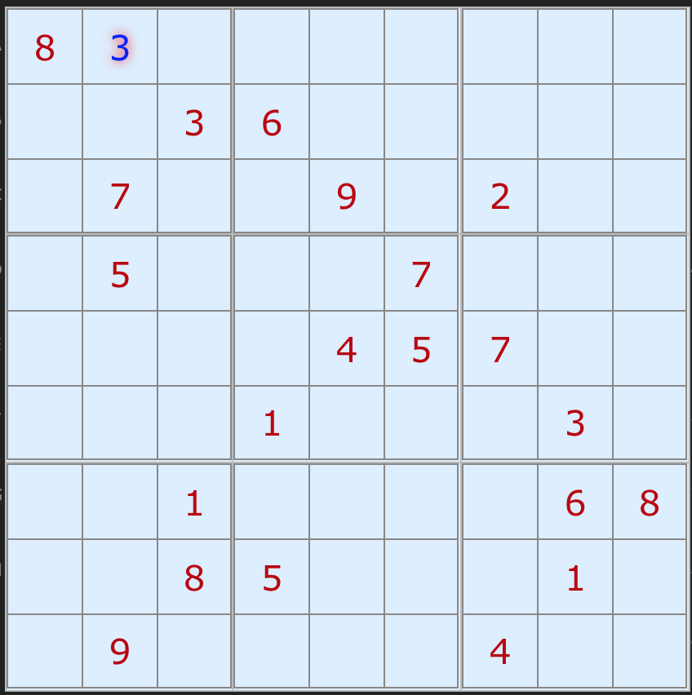
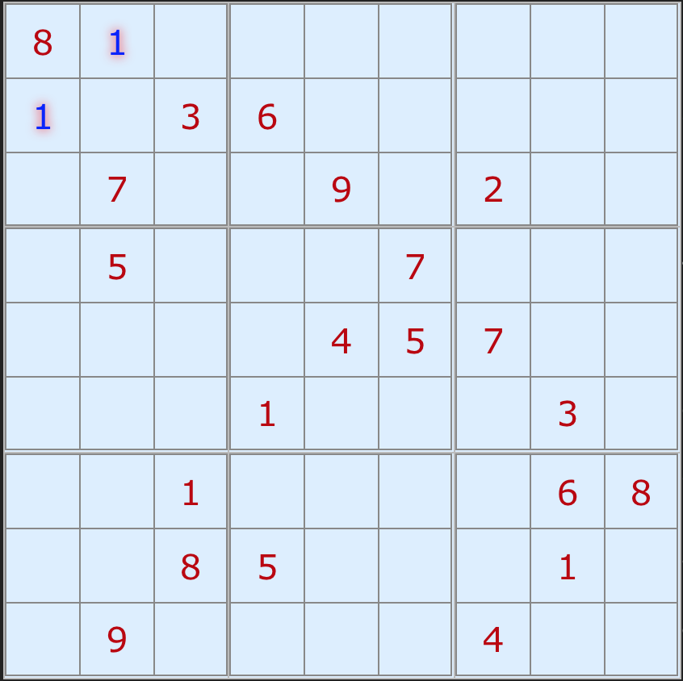
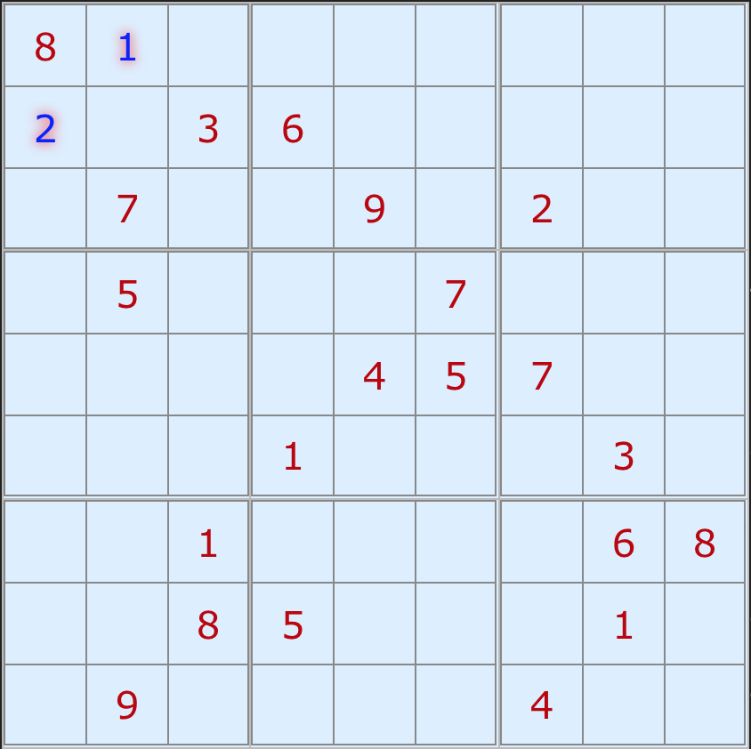
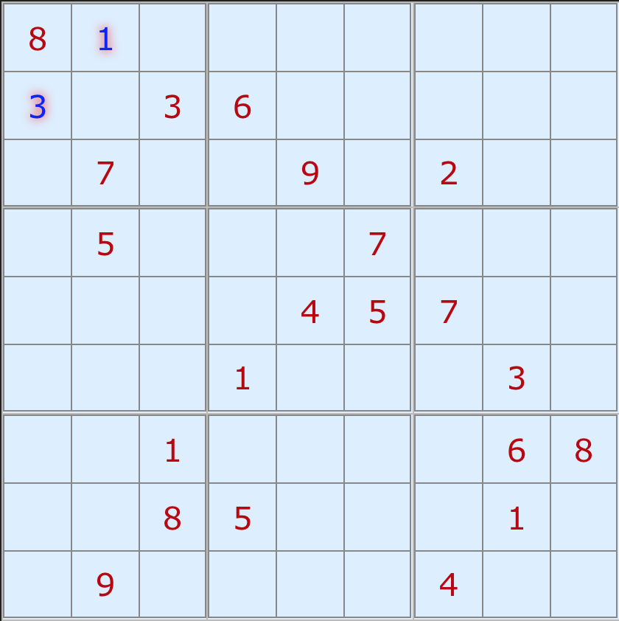
Combinatorial Optimization Problems - CP
CP : Constraint Programming
Example: Sudoku
First ingredient:
Tree search
...
...
Arto Inkala’s grid, 2012
...

Slide 34
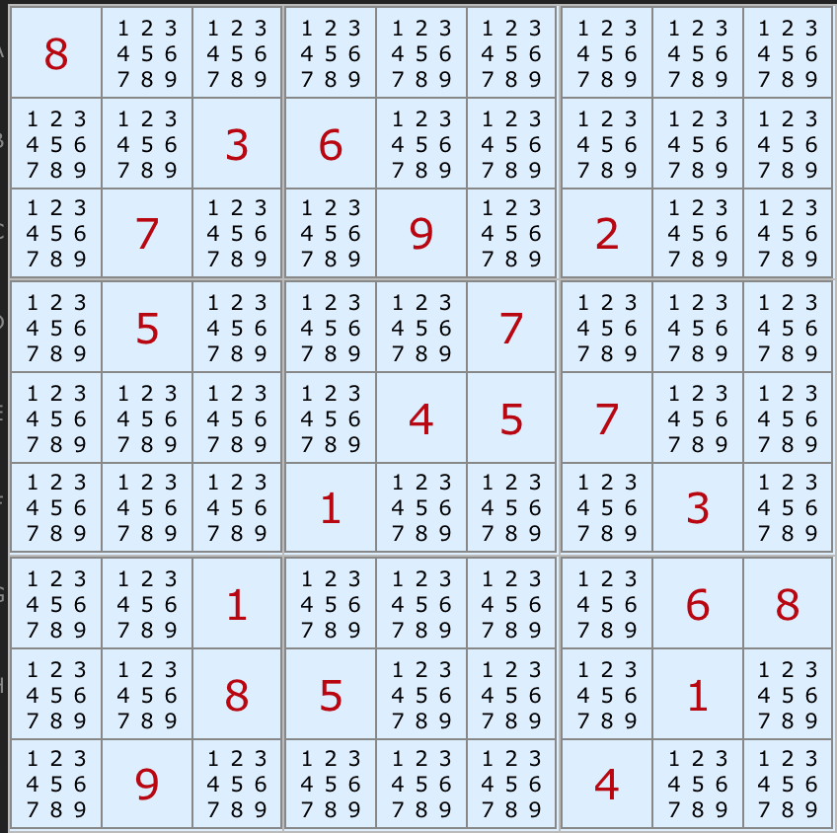
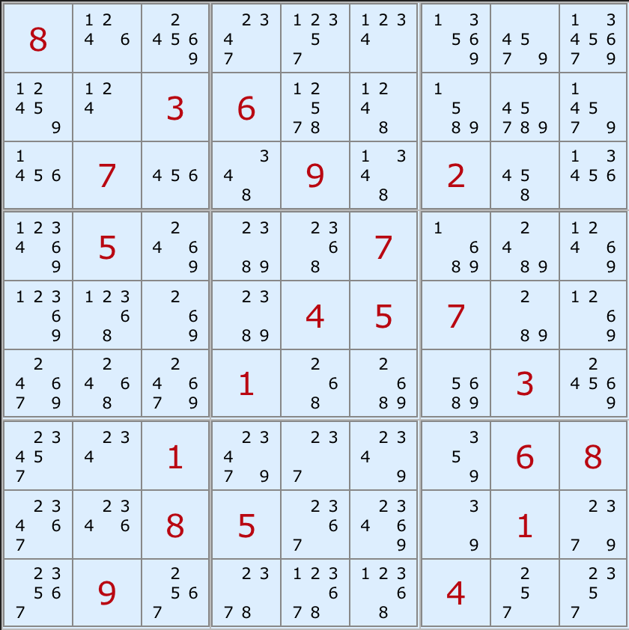
Combinatorial Optimization Problems - CP
CP : Constraint Programming
Example: Sudoku
Second ingredient:
Domain filtering
Arto Inkala’s grid, 2012

Slide 35
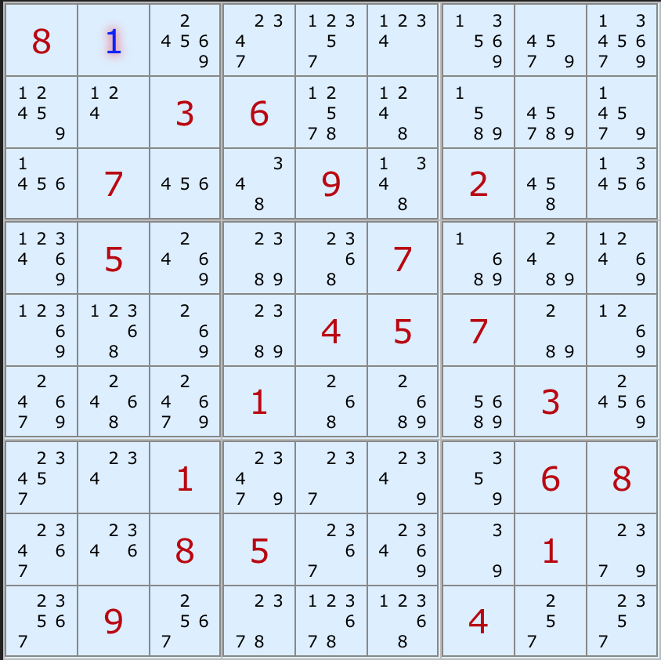
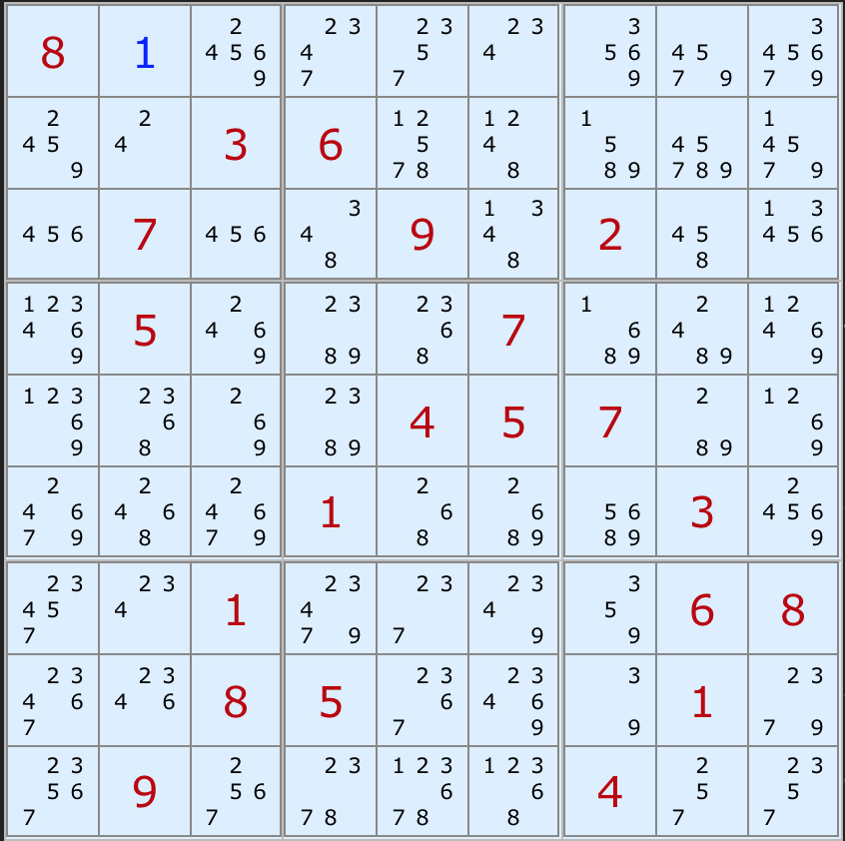
Combinatorial Optimization Problems - CP
CP : Constraint Programming
Example: Sudoku
Second ingredient:
Domain filtering
Arto Inkala’s grid, 2012

Slide 36
Combinatorial Optimization Problems - CP
How Constraint Programming works
  CP is a constructive approach
  Values are assigned to variables one at a time to extend a partial solution to a complete solution
  At a point, it may be useless to further extend a partial solution as at least one constraint is already violated by the partial solution
    The solver backtracks and tries a different value for a previously assigned variable
    All possible assignments of values to variables can be examined in this way

Slide 37
Combinatorial Optimization Problems - CP
How Constraint Programming works
  In CP, the basic search behavior is tree search
  Including search space reduction via domain filtering
  Domain filtering
    Before each value-variable assignment, domain filtering occurs
    Each value of a variable which cannot be used in a solution (given the current partial assignment) can be removed
    Each constraint type has a specialized algorithm which filters domains

Slide 38
Combinatorial Optimization Problems - CP
Domain filtering (specific algorithm for each constraint type)
  x < y
2
3
4
5
1
2
4
5
x y

Slide 39
Combinatorial Optimization Problems - CP
Domain filtering (specific algorithm for each constraint type)
  x < y
2
3
4
5
1
2
4
5
x y

Slide 40
Combinatorial Optimization Problems - CP
Domain filtering (specific algorithm for each constraint type)
  all_different(v,w,x,y,z)
1
2
3
4
5
2
4
2
3
4
4
5
2
4
5
v w x y z

Slide 41
Combinatorial Optimization Problems - CP
Domain filtering (specific algorithm for each constraint type)
  all_different(v,w,x,y,z)
1
2
3
4
5
2
4
2
3
4
4
5
2
4
5
v w x y z
Uses matching theory

Slide 42
Combinatorial Optimization Problems - CP
Domain filtering (specific algorithm for each constraint type)
  all_different(v,w,x,y,z)
1
3
2
4
3
4
5
2
4
5
v w x y z
Uses matching theory

Slide 43
Combinatorial Optimization Problems - CP
Some other ingredients of CP
  Variable selection strategy
  Value selection strategy
  Objective cut

Slide 44
Combinatorial Optimization Problems - CP
Some other ingredients of CP
  Variable selection strategy : select variable with smallest index
  Value selection strategy : select smallest value in domain
  Objective cut
Example:
  minimize x₁+2x₂
  subject to |x₁-x₂|≤2, x₁≠x₂, x₁,x₂ ∈[0,3]

Slide 45
Combinatorial Optimization Problems - CP
Some other ingredients of CP
  Variable selection strategy : select variable with smallest index
  Value selection strategy : select smallest value in domain
  Objective cut
Example:
  minimize x₁+2x₂
  subject to |x₁-x₂|≤2, x₁≠x₂, x₁,x₂ ∈[0,3]
x₁∈[0,3]

Slide 46
Combinatorial Optimization Problems - CP
Some other ingredients of CP
  Variable selection strategy : select variable with smallest index
  Value selection strategy : select smallest value in domain
  Objective cut
Example:
  minimize x₁+2x₂
  subject to |x₁-x₂|≤2, x₁≠x₂, x₁,x₂ ∈[0,3]
x₁∈[0,3]
x₁=0
x₂∈[1,2]

Slide 47
Combinatorial Optimization Problems - CP
Some other ingredients of CP
  Variable selection strategy : select variable with smallest index
  Value selection strategy : select smallest value in domain
  Objective cut
Example:
  minimize x₁+2x₂
  subject to |x₁-x₂|≤2, x₁≠x₂, x₁,x₂ ∈[0,3]
x₁∈[0,3]
x₁=0
x₂∈[1,2]
x₂=1
obj=2

Slide 48
Combinatorial Optimization Problems - CP
Some other ingredients of CP
  Variable selection strategy : select variable with smallest index
  Value selection strategy : select smallest value in domain
  Objective cut
Example:
  minimize x₁+2x₂
  subject to |x₁-x₂|≤2, x₁≠x₂, x₁,x₂ ∈[0,3]
x₁∈[0,3]
x₁=0
x₂∈[1,2]
x₂=1
obj=2
obj<2

Slide 49
Combinatorial Optimization Problems - CP
Some other ingredients of CP
  Variable selection strategy : select variable with smallest index
  Value selection strategy : select smallest value in domain
  Objective cut
Example:
  minimize x₁+2x₂
  subject to |x₁-x₂|≤2, x₁≠x₂, x₁,x₂ ∈[0,3] , obj<2
x₁∈[0,3]
x₁=0
x₂∈[1,2]
x₂=1
obj=2
obj<2

Slide 50
Combinatorial Optimization Problems - CP
Some other ingredients of CP
  Variable selection strategy : select variable with smallest index
  Value selection strategy : select smallest value in domain
  Objective cut
Example:
  minimize x₁+2x₂
  subject to |x₁-x₂|≤2, x₁≠x₂, x₁,x₂ ∈[0,3] , obj<2
x₁∈[0,3]
x₁=0
x₂∈[1]
x₂=1
obj=2
obj<2

Slide 51
Combinatorial Optimization Problems - CP
Some other ingredients of CP
  Variable selection strategy : select variable with smallest index
  Value selection strategy : select smallest value in domain
  Objective cut
Example:
  minimize x₁+2x₂
  subject to |x₁-x₂|≤2, x₁≠x₂, x₁,x₂ ∈[0,3] , obj<2
x₁∈[0,3]
x₁=0
x₂∈[1]
x₂=1
obj=2
obj<2

Slide 52
Combinatorial Optimization Problems - CP
Some other ingredients of CP
  Variable selection strategy : select variable with smallest index
  Value selection strategy : select smallest value in domain
  Objective cut
Example:
  minimize x₁+2x₂
  subject to |x₁-x₂|≤2, x₁≠x₂, x₁,x₂ ∈[0,3] , obj<2
x₁∈[0,1]
x₁=0
x₂∈[1]
x₂=1
obj=2
obj<2

Slide 53
Combinatorial Optimization Problems - CP
Some other ingredients of CP
  Variable selection strategy : select variable with smallest index
  Value selection strategy : select smallest value in domain
  Objective cut
Example:
  minimize x₁+2x₂
  subject to |x₁-x₂|≤2, x₁≠x₂, x₁,x₂ ∈[0,3] , obj<2
x₁∈[0,1]
x₁=0
x₁=1
x₂∈[1]
x₂∈[0]
x₂=1
obj=2
obj<2

Slide 54
Combinatorial Optimization Problems - CP
Some other ingredients of CP
  Variable selection strategy : select variable with smallest index
  Value selection strategy : select smallest value in domain
  Objective cut
Example:
  minimize x₁+2x₂
  subject to |x₁-x₂|≤2, x₁≠x₂, x₁,x₂ ∈[0,3] , obj<2
x₁∈[0,1]
x₁=0
x₁=1
x₂∈[1]
x₂∈[0]
x₂=1
obj=1
obj=2
obj<2

Slide 55
Combinatorial Optimization Problems - CP
Some other ingredients of CP
  Variable selection strategy : select variable with smallest index
  Value selection strategy : select smallest value in domain
  Objective cut
Example:
  minimize x₁+2x₂
  subject to |x₁-x₂|≤2, x₁≠x₂, x₁,x₂ ∈[0,3] , obj<1
x₁∈[0,1]
x₁=0
x₁=1
x₂∈[1]
x₂∈[0]
x₂=1
obj=1
obj<1
obj=2

Slide 56
Combinatorial Optimization Problems - CP
Some other ingredients of CP
  Variable selection strategy : select variable with smallest index
  Value selection strategy : select smallest value in domain
  Objective cut
Example:
  minimize x₁+2x₂
  subject to |x₁-x₂|≤2, x₁≠x₂, x₁,x₂ ∈[0,3] , obj<1
x₁∈[0,1]
x₁=0
x₁=1
x₂∈[1]
x₂∈[0]
x₂=1
obj=1
obj<1
obj=2

Slide 57
Combinatorial Optimization Problems - CP
Some other ingredients of CP
  Variable selection strategy : select variable with smallest index
  Value selection strategy : select smallest value in domain
  Objective cut
Example:
  minimize x₁+2x₂
  subject to |x₁-x₂|≤2, x₁≠x₂, x₁,x₂ ∈[0,3] , obj<1
x₁∈[0], x₂∈[0]
x₁=0
x₁=1
x₂∈[1]
x₂∈[0]
x₂=1
obj=1
obj<1
obj=2

Slide 58
Combinatorial Optimization Problems - CP
Some other ingredients of CP
  Variable selection strategy : select variable with smallest index
  Value selection strategy : select smallest value in domain
  Objective cut
Example:
  minimize x₁+2x₂
  subject to |x₁-x₂|≤2, x₁≠x₂, x₁,x₂ ∈[0,3] , obj<1
x₁∈[0], x₂∈[0]
Optimal solution: x₁=1, x₂=0
Objective value: 1
x₁=0
x₁=1
x₂∈[1]
x₂∈[0]
x₂=1
obj=1
obj<1
obj=2

Slide 59
Combinatorial Optimization Problems - CP
Yet some other ingredients of CP:
  Randomized restarts:
    Add noise to the heuristic branching (variable choice) function
    Cutoff and restart search after a fixed number of backtracks
  No-good learning:
    Learn some redundant constraints to avoid re-exploring the same sub-tree in the sequel of the search
  Large Neighborhood Search (LNS):
    Freeze values of a subset of the variables
    Re-optimize unfrozen variables
  Portfolios of strategies:
    Use a set of different strategies and learn the most efficient ones while solving the problem
Restart
Search tree
No-goods

