Slide 1


Combinatorial Optimization,
Constraint Programming,
Scheduling
From theory to practice
Philippe Laborie, IBM laborie@fr.ibm.com
1

Slide 2
Overview
Combinatorial Optimization Problems:
definition, complexity

Slide 3
Overview
Combinatorial Optimization Problems:
definition, complexity
Scheduling Problems:
definition, complexity,
classification

Slide 4
Overview
Combinatorial Optimization Problems:
definition, complexity
Scheduling Problems:
definition, complexity,
classification
Constraint
Programming
(CP)
Resolution approaches

Slide 5
Overview
Combinatorial Optimization Problems:
definition, complexity
CP for
Scheduling
CP Optimizer
Scheduling Problems:
definition, complexity,
classification
Constraint
Programming
(CP)
Resolution approaches

Slide 6
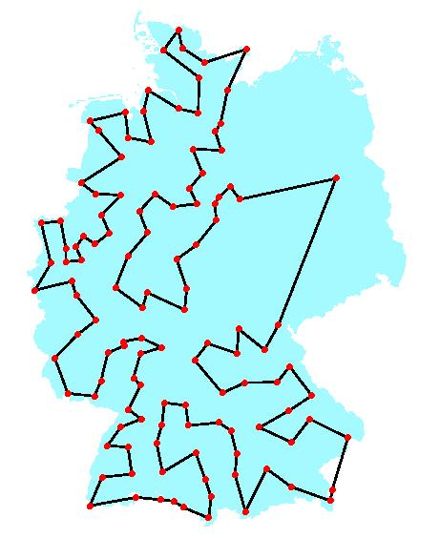
Combinatorial Optimization Problems
Combinatorial optimization searches for an optimal object in a finite, but usually large, collection of objects
Example: Traveling Salesman Problem (TSP)
  Given a list of n cities and the distances between each pair of cities, what is the shortest possible route that visits each city and returns to the origin city?
  Number of possible routes: (n-1)!

Slide 7
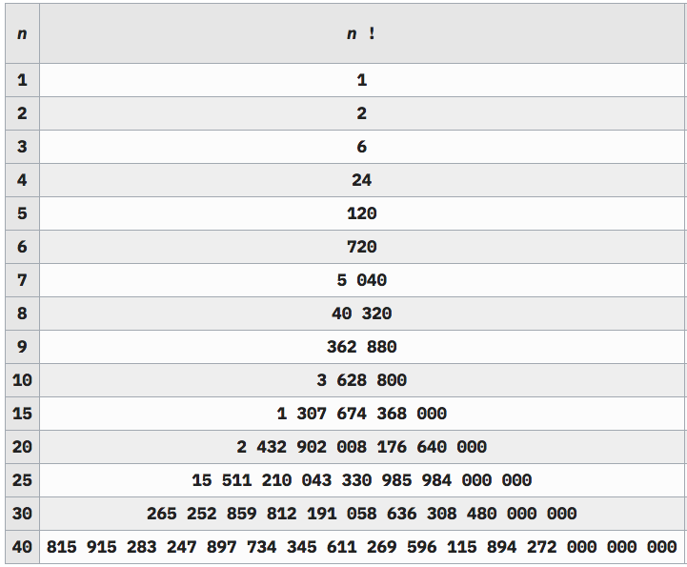
Combinatorial Optimization Problems
Example: Traveling Salesman Problem
  Number of possible routes: (n-1)!

Slide 8

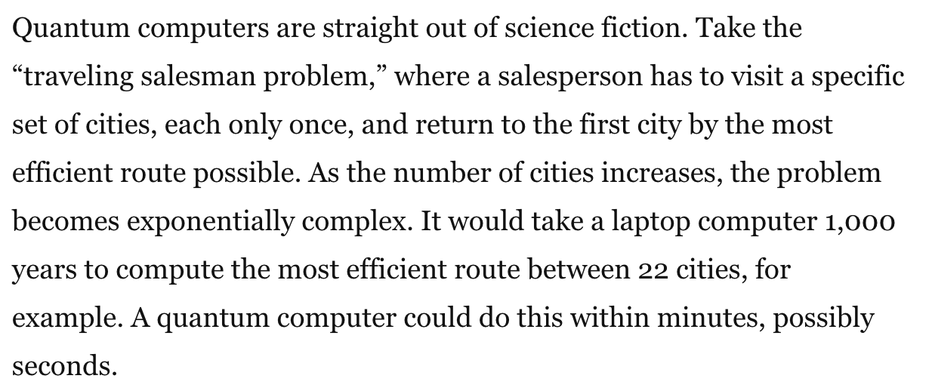
Combinatorial Optimization Problems
Example: Traveling Salesman Problem
21! = 51.090.942.171.709.440.000
Feb. 5, 2018

Slide 9
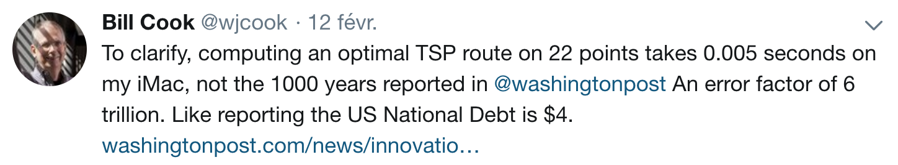
Combinatorial Optimization Problems
Example: Traveling Salesman Problem
21! = 51.090.942.171.709.440.000
Feb. 5, 2018

Slide 10
Combinatorial Optimization Problems
Example: Traveling Salesman Problem
  Number of possible routes: (n-1)!
  Largest TSP solved: n=85900, n! is 386527 digits long

Slide 11
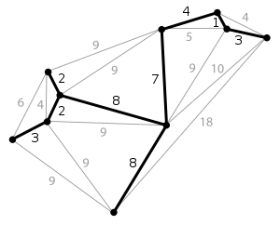
Combinatorial Optimization Problems
Don’t be too impressed:
  Even if the number of solutions is huge, some COPs are easy!
Example: Minimum Spanning Tree
  Even for the hardest COPs, the resolution does not have to explicitly go through all solutions !
Number of possible spanning trees: n^{n-2}

Slide 12
Combinatorial Optimization Problems
How to describe a COP ?
How to characterize the complexity of a COP ?
How to solve a COP ?

Slide 13
Combinatorial Optimization Problems - Description
How to describe a COP ?
  Input data
  Formal description of the problem:
    Decision variables
    Function to be minimized/maximized (objective function)
    Constraints defining the collection of feasible solutions
TSP Example
  Input data:
    Set V={v₁,v₂,…,v_{n}} of cities,
    Distance d(v_{i},v_{j})∈ for each pair of cities v_{i},v_{j} ∈ V
  Formal description of the problem:
    Find a tour of V i.e. a permutation π =(v_{π(1)},v_{π(2)},…,v_{π(n)}) of V that minimizes L = Σ_{i=1..n-1} d(v_{π(i)},v_{π(i+1)}) +d(v_{π(n)},v_{π(1)})

Slide 14
Combinatorial Optimization Problems - Description
How to describe a COP ?
  Input data
  Formal description of the problem:
    Decision variables
    Function to be minimized/maximized (objective function)
    Constraints defining the collection of feasible solutions
General formulation
  Given input data D and decision variable vector X=(x₁,x₂,…,x_{n})
  Find a value for each decision variable in X
    that minimizes F(D, X)
F: function with value in
    and is such that C(D, X) is true
C: function with value in {true,false}

Slide 15
Combinatorial Optimization Problems - Description
General formulation
  Given input data D and decision variable vector X=(x₁,x₂,…,x_{n})
  Find a value for each decision variable in X
    that minimizes F(D, X)
    and is such that C(D, X) is true
Example (Linear Program)
  Minimize x₁ + 2*x₂ + 3*x₃
  Subject to:
    x₁ + x₂ + x₃ ≥ 10
    3*x₁ + 2*x₂ ≤ 7
    x₁ ≥ 0, x₂ ≥ 0, x₃ ≥0

Slide 16
Combinatorial Optimization Problems - Description
General formulation
  Given input data D and decision variable vector X=(x₁,x₂,…,x_{n})
  Find a value for each decision variable in X
    that minimizes F(D, X)
    and is such that C(D, X) is true
Vocabulary:
  Solution: a combination of values for variables in X such that C(D, X) is true
  Optimal solution: a solution (see above) that minimizes F(D, X)
A COP may have:
  No solution (infeasible problem, example: x<y, y<x)
  Several optimal solutions (minimize x² such that |x|≥1)
  No objective function F(D,X), only constraints C(D,X)

Slide 17
Combinatorial Optimization Problems - Description
General formulation
  Given input data D and decision variable vector X=(x₁,x₂,…,x_{n})
  Find a value for each decision variable in X
    that minimizes F(D, X)
    and is such that C(D, X) is true
Example (Linear Program)
  Minimize x₁ + 2*x₂ + 3*x₃
  Subject to:
    x₁ + x₂ + x₃ ≥ 10
    3*x₁ + 2*x₂ ≤ 7
    x₁ ≥ 0, x₂ ≥ 0, x₃ ≥0
Example of solution: x₁=0, x₂=0, x₃=10
An optimal solution is: x₁=2, x₂=0, x₃=8

Slide 18
Combinatorial Optimization Problems - Complexity
How to characterize the complexity of a COP ?
Optimization Problem:
find a solution X that minimizes F(D,X) such that C(D,X) is true
Problem size s(D)
Input data D
Resolution
algorithm
Optimal
solution
Problem description
Resolution time
t=R(D)

Slide 19
Combinatorial Optimization Problems - Complexity
How to characterize the complexity of a COP ?
Decision Problem:
given B, is there a solution X such that F(D,X)≤B and C(D,X) is true
Problem size s(D)
Input data D
Resolution
algorithm
Yes/No
answer
Problem description
Resolution time
t=R(D)

Slide 20
Combinatorial Optimization Problems - Complexity
A decision problem is said to belong to class P if all its instances can be solved in polynomial time
More formally it means that there exists a resolution algorithm such that:
∃k∈N, ∀D, R(D) ≤ s(D)^{k}
Example: Minimum Spanning Tree problem
  If the data D is the input graph with n vertices and m edges, input size is something like s(D)=n+m
  This problem belongs to class P because there exists a resolution algorithm (known as Prim’s algorithm) whose worst case complexity is m.log(n)≤ s(D)²

Slide 21
Combinatorial Optimization Problems - Complexity
A decision problem is said to belong to class NP (Nondeterministic Polynomial time) if checking that a given vector X is a solution or not can be solved in polynomial time
Note the main difference with class P: here we suppose the vector X is given and we do not have to find it !
Of course if a problem is in P (so if we can find a solution X in polynomial time), then we can also check a vector X in polynomial time so we have:
P ⊆ NP
The decision version of most of the COPs belong to class NP
Example: The TSP clearly belongs to class NP: if you are given a tour, it is very easy to compute its length and check whether it is smaller than B

Slide 22
Combinatorial Optimization Problems - Complexity
There has been extensive effort to find polynomial time algorithms for solving problems in NP and, until now, a large number of these problems defy these attempts
Informally speaking, a decision problem in NP is NP-Complete if it is among the hardest ones in NP. If there exist a polynomial time algorithm for even one of the NP-Complete problems it means that all problems in NP can be solved in polynomial time
P=NP ?
So far, nobody knows …
The decision version of many COPs (including the TSP) are NP-Complete

Slide 23
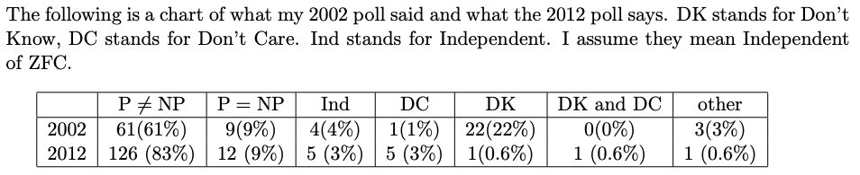
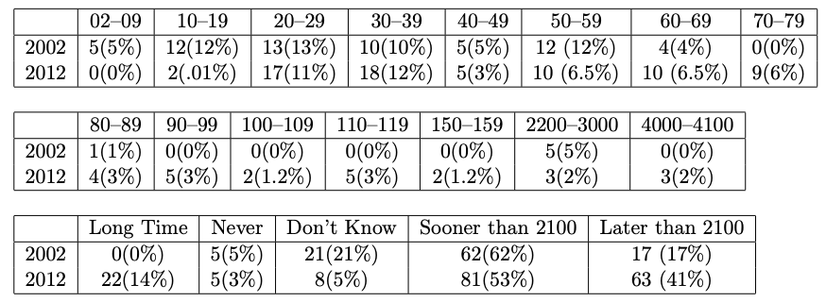
Combinatorial Optimization Problems - Complexity
B. Gasarch’s polls (2002, 2012)
  Does P=NP ?
  When will P vs. NP be resolved ?

Slide 24
Combinatorial Optimization Problems - Complexity
This is the theory of complexity
But always keep in mind that in practice :
  An instance of problem in P may take very long to solve (for instance if it has a time complexity in n¹²)
  An instance of NP-Complete problem (even if very large) can be easy: the theory is about worst-case complexity so it is pessimistic

Slide 25
Combinatorial Optimization Problems - Resolution
There are 3 main types of approaches:
  Exact: will produce a feasible solution that has been proved to be optimal
  Approximation: will produce a solution and some guarantee on its distance with respect to an optimal solution (for instance that its cost cannot be more than 1.2 worse than the optimal cost)
  Heuristic: will produce an (hopefully good) feasible solution with no optimality guarantee
Orthogonally, one can also distinguish between:
  Generic approaches that can solve a large class of different COPs (SAT, Integer Linear Programming, Constraint Programming)
  Problem specific approaches dedicated to a particular problem (for instance Prim’s algorithm for Minimal Spanning Tree, or Concorde for solving the TSP)

Slide 26
Combinatorial Optimization Problems - Resolution
Three generic exact methods
  SAT : Boolean SATisfiability
  ILP : Integer Linear Programming
  CP : Constraint Programming

Slide 27
Combinatorial Optimization Problems - Resolution
SAT : Boolean SATisfiability
  Decision variables are Boolean variable with values in “true”, “false”. Ex: x₁, x₂, x₃, …, x_{n}
  A literal is a boolean variable or its negation. Ex: x₁, x₂
  A clause is a disjunction of literals. Ex: x₁ ∨ x₂ ∨ x₃
  A Boolean satisfiability problem is a conjunction of clauses
Example (Quiz):
  Find x₁, x₂, x₃ such that :
  x₁ ∨ x₂ ∨ x₃ and x₁ ∨ x₃

Slide 28
Combinatorial Optimization Problems - Resolution
SAT : Boolean SATisfiability
  Decision variables are Boolean variable with values in “true”, “false”. Ex: x₁, x₂, x₃, …, x_{n}
  A literal is a boolean variable or its negation. Ex: x₁, x₂
  A clause is a disjunction of literals. Ex: x₁ ∨ x₂ ∨ x₃
  A Boolean satisfiability problem is a conjunction of clauses
Example (Quiz):
  Find x₁, x₂, x₃ such that :
  x₁ ∨ x₂ ∨ x₃ and x₁ ∨ x₃
x₁=true, x₂=true, x₃=true is not a solution

Slide 29
Combinatorial Optimization Problems - Resolution
SAT : Boolean SATisfiability
  Decision variables are Boolean variable with values in “true”, “false”. Ex: x₁, x₂, x₃, …, x_{n}
  A literal is a boolean variable or its negation. Ex: x₁, x₂
  A clause is a disjunction of literals. Ex: x₁ ∨ x₂ ∨ x₃
  A Boolean satisfiability problem is a conjunction of clauses
Example (Quiz):
  Find x₁, x₂, x₃ such that :
  x₁ ∨ x₂ ∨ x₃ and x₁ ∨ x₃
x₁=true, x₂=true, x₃=true is not a solution
x₁=true, x₂=true, x₃=false is a solution

Slide 30
Combinatorial Optimization Problems - Resolution
SAT : Boolean SATisfiability
  Boolean satisfiability problems are NP-Complete
  Remains NP-Complete even when only clauses with 3 literals (3-SAT)
  SAT is the first problem that was proven to be NP-complete in 1971 (Cook–Levin theorem)
  Nowadays there exists very efficient SAT Solvers that can handle Boolean satisfiability problems with more than one million of boolean variables
  Some applications:
    Model checking (hardware/software verification)
    Classical Planning
  More info: https://en.wikipedia.org/wiki/Boolean_satisfiability_problem

Slide 31
Combinatorial Optimization Problems - Resolution
ILP : Integer Linear Programming
  Decision variables are integer variables. Ex: x₁, x₂, x₃, …, x_{n}
  Constraints are linear inequalities. Ex: 2.1 x₁ – 7.11 x₃ ≤ 9.3
  Objective function is a linear combination of variables
Example (Quiz):
  Minimize x₁ + 2*x₂ + 3*x₃
  Subject to:
    x₁ + x₂ + x₃ ≥ 10
    3*x₁ + 2*x₂ ≤ 7
    x₁ ≥ 0, x₂ ≥ 0, x₃ ≥0

Slide 32
Combinatorial Optimization Problems - Resolution
ILP : Integer Linear Programming
  Decision variables are integer variables. Ex: x₁, x₂, x₃, …, x_{n}
  Constraints are linear inequalities. Ex: 2.1 x₁ – 7.11 x₃ ≤ 9.3
  Objective function is a linear combination of variables
Example (Quiz):
  Minimize x₁ + 2*x₂ + 3*x₃
  Subject to:
    x₁ + x₂ + x₃ ≥ 10
    3*x₁ + 2*x₂ ≤ 7
    x₁ ≥ 0, x₂ ≥ 0, x₃ ≥0
An optimal solution is x₁=2, x₂=0, x₃=8

Slide 33
Combinatorial Optimization Problems - Resolution
ILP : Integer Linear Programming
  ILP is NP-Complete
  ILP is more general than SAT: A SAT problem can easily be modeled as an ILP with integer variables in domain {0,1}
Example:
  Find x₁, x₂, x₃ such that :
  x₁ ∨ x₂ ∨ x₃ and x₁ ∨ x₃
Reformulation as an ILP:
  x₁ + (1-x₂) + x₃ ≥ 1
  (1-x₁) + (1-x₃) ≥ 1

Slide 34
Combinatorial Optimization Problems - Resolution
ILP : Integer Linear Programming
  There exists many efficient ILP Solvers (including IBM CPLEX) that can solve problems with up to several 100.000 of variables.
  Some applications:
    Production planning
    Financial portfolio optimization
    Network design
  More info: https://en.wikipedia.org/wiki/Integer_programming

Slide 35
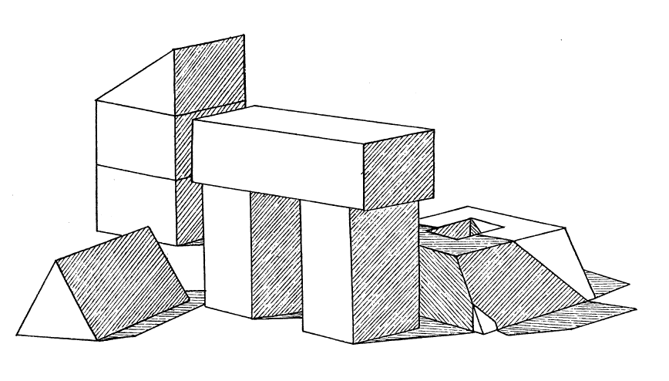
Combinatorial Optimization Problems – CP
CP : Constraint Programming
One of the earliest use of CP: Computer vision
  David L. Waltz. Generating Semantic Descriptions From Drawings of Scenes With Shadows. 1972.
  Problem: obtain a 3D model of a scene given a 2D drawing with shadows
  3D model = consistent labeling of the edges, junctions and regions

Slide 36
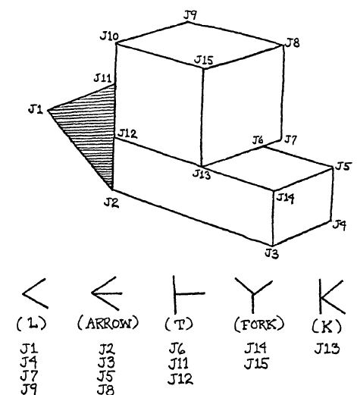

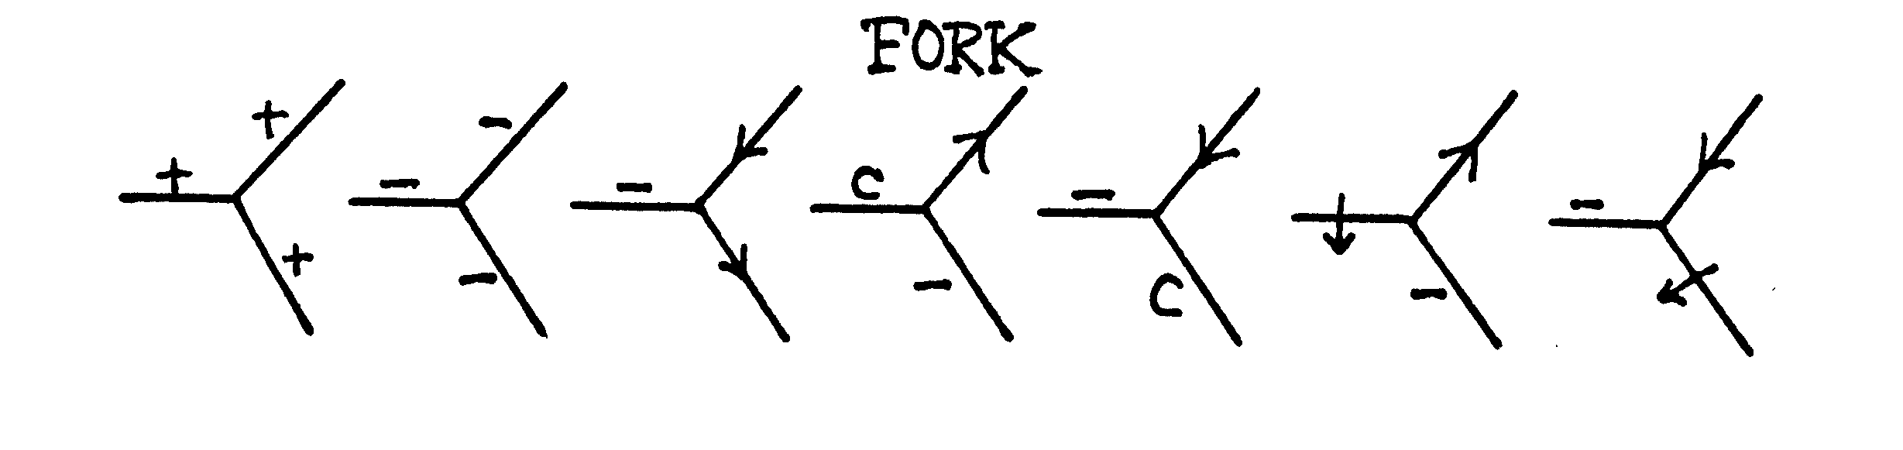
Combinatorial Optimization Problems – CP
CP : Constraint Programming
One of the earliest use of CP: Computer vision
  Possible edge labels: Convex (“+”), “Concave (“-”), Shadow (→), Obscuring (↑), Crack(“c”)
  Junction types: “L”, “Arrow”, “T”, “Fork”, “K”
  Each type of junction imposes particular
consistency rules (constraints) between
the label of its adjacent edges
{+,-,→,↑,c}
{+,-,→,↑,c}
{+,-,→,↑,c}

Slide 37
Combinatorial Optimization Problems – CP
CP : Constraint Programming
One of the earliest use of CP: Computer vision
  Method:
    Start with all possible edge labels
    Remove labels that are inconsistent (filter)
    Propagate the filtering to neighboring
edges of the image
    Filter edge labels, continue propagation
    Repeat the process until no more
reductions are possible

Slide 38
Combinatorial Optimization Problems – CP
CP : Constraint Programming
Constraint Satisfaction Problems
  Set of discrete decision variables
Example: x₁, x₂…, x_{n} ∈ D = {+,-,→,↑,c}
  Set of tables representing compatible values for a given subset of variables
Example:
x₄ x₇ x₁₁
+ + +
- - -
- → →
c → -
- → c
↑ → -
- → ↑
  Find a variable assignment that satisfies all table constraints

Slide 39
Combinatorial Optimization Problems – CP
CP : Constraint Programming
Constraint Satisfaction Problems
  Set of discrete decision variables
Example: x₁, x₂…, x_{n} ∈ D = {1,2,3,4,5}
  Set of tables representing compatible values for a given subset of variables
Example:
x₄ x₇ x₁₁
1 1 1
2 2 2
2 3 3
5 3 2
2 3 5
4 3 2
2 3 4
  Find a variable assignment that satisfies all table constraints

Slide 40
Combinatorial Optimization Problems – CP
CP : Constraint Programming
  Decision variables are in general integer variables.
Ex: x₁, x₂, x₃, …, x_{n}
  Rich variety of constraints an expressions :
    Linear inequalities. Ex: 2.1 x₁ – 7.11 x₃ ≤ 9.3
    Logical constraints. Ex: (max(x₁,x₂)==x₃) ⇒ (x₂* x₃ ≥5)
    Global constraints:
      Table compatibility constraints (CSP)
      AllDifferent(x₁, x₂, x₃, …, x_{n})
      Global constraint catalogue with 423 global constraints! http://sofdem.github.io/gccat/
  Objective function is any expression : Ex: log(x₁)/(1+2*x₂*x₃)
Example: Sudoku

Slide 41
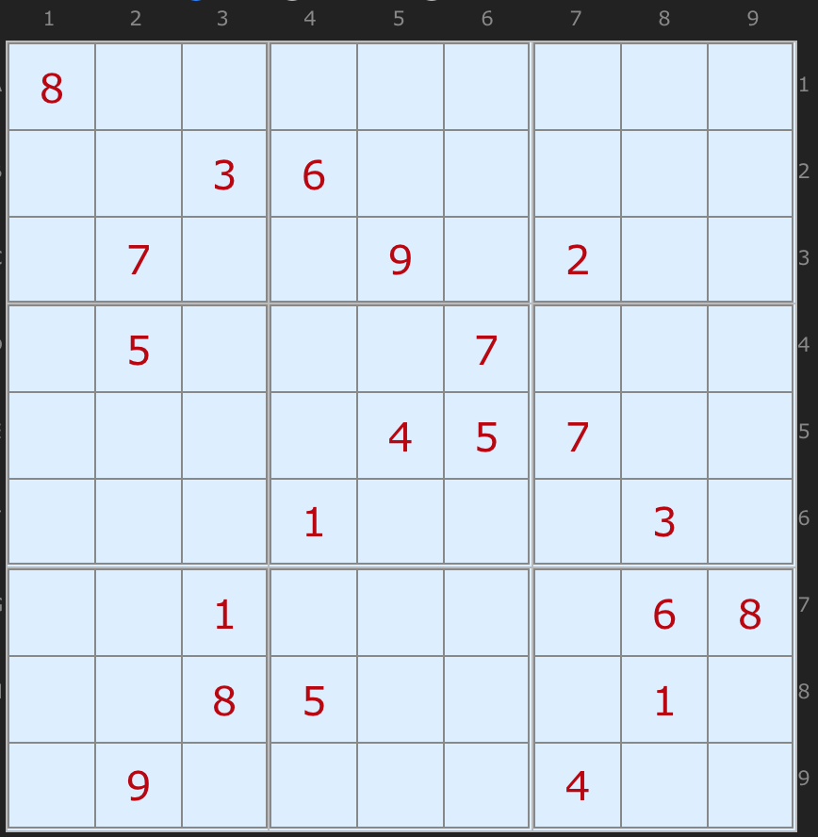
Combinatorial Optimization Problems - CP
CP : Constraint Programming
Example: Sudoku
Arto Inkala’s grid, 2012

Slide 42
Combinatorial Optimization Problems - CP
CP : Constraint Programming
Example: Sudoku
Variables:
∀ r,c ∈[1,9], x_{rc}∈[1,9] # value at row r column c
Constraints:
# input grid :
x₁₁==8, x₂₃==3, x₂₄==6, …
# all rows different :
∀r∈[1,9], all_different(x_{rc}, ∀c ∈[1,9])
# all columns different :
∀c∈[1,9], all_different(x_{rc}, ∀r ∈[1,9])
# all sub-squares different :
∀sr∈[0,2],∀sc∈[0,2],
all_different(x_{rc}, ∀r ∈[3sr+1,3sr+3],∀c ∈[3sc+1,3sc+3])
Arto Inkala’s grid, 2012

Slide 43
Combinatorial Optimization Problems - CP
CP : Constraint Programming
Example: Sudoku
Variables:
∀ r,c ∈[1,9], x_{rc}∈[1,9] # value at row r column c
Constraints:
# input grid :
x₁₁==8, x₂₃==3, x₂₄==6, …
# all rows different :
∀r∈[1,9], all_different(x_{rc}, ∀c ∈[1,9])
# all columns different :
∀c∈[1,9], all_different(x_{rc}, ∀r ∈[1,9])
# all sub-squares different :
∀sr∈[0,2],∀sc∈[0,2],
all_different(x_{rc}, ∀r ∈[3sr+1,3sr+3],∀c ∈[3sc+1,3sc+3])
Arto Inkala’s grid, 2012
See Python Notebook using CP Optimizer

Slide 44
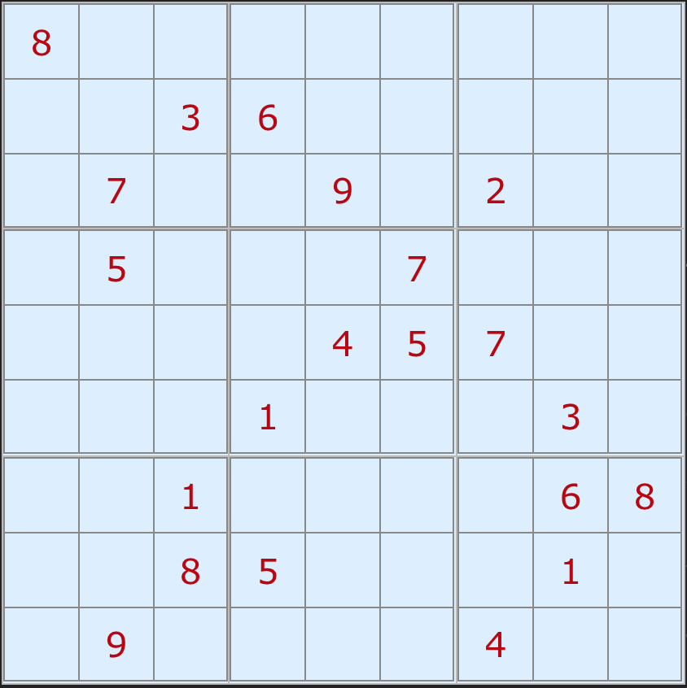
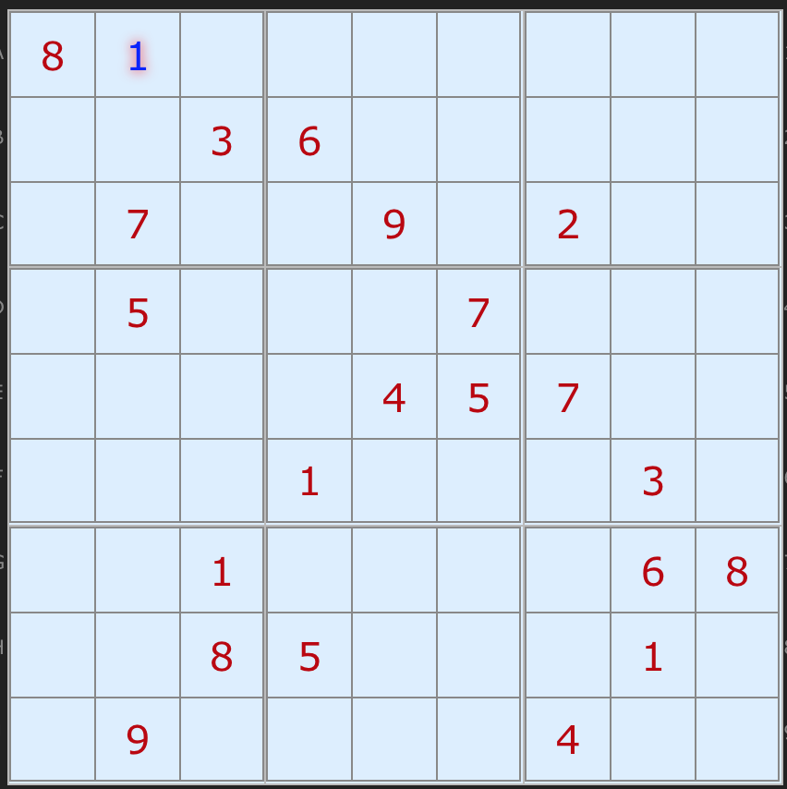
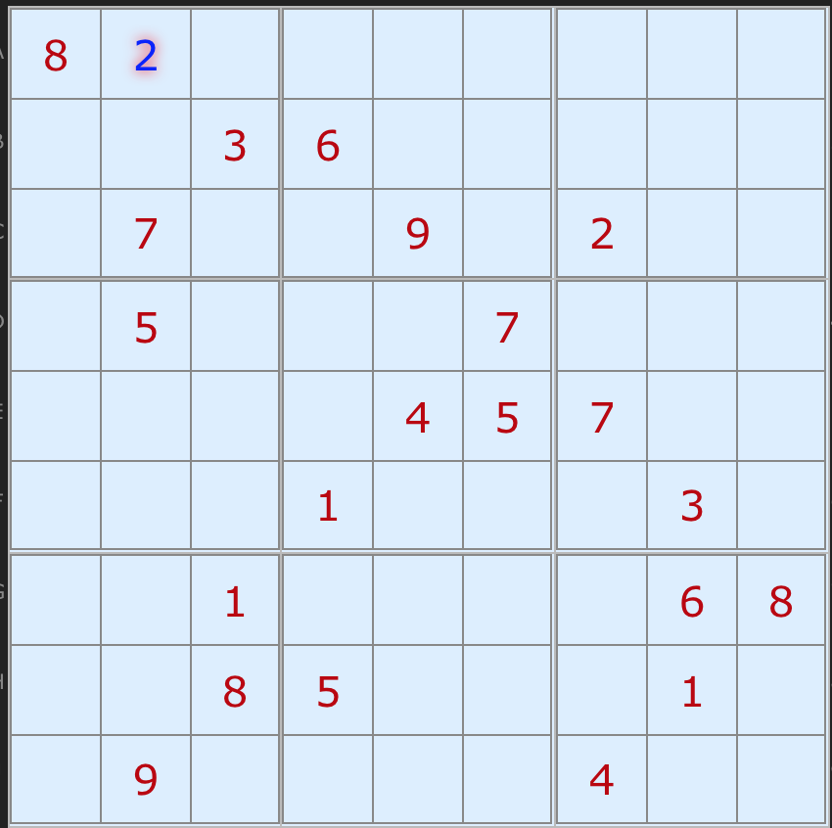
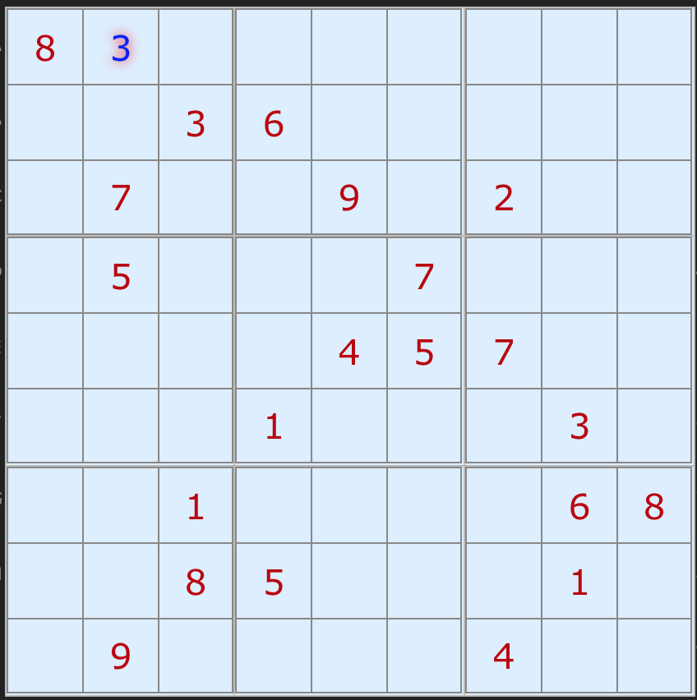
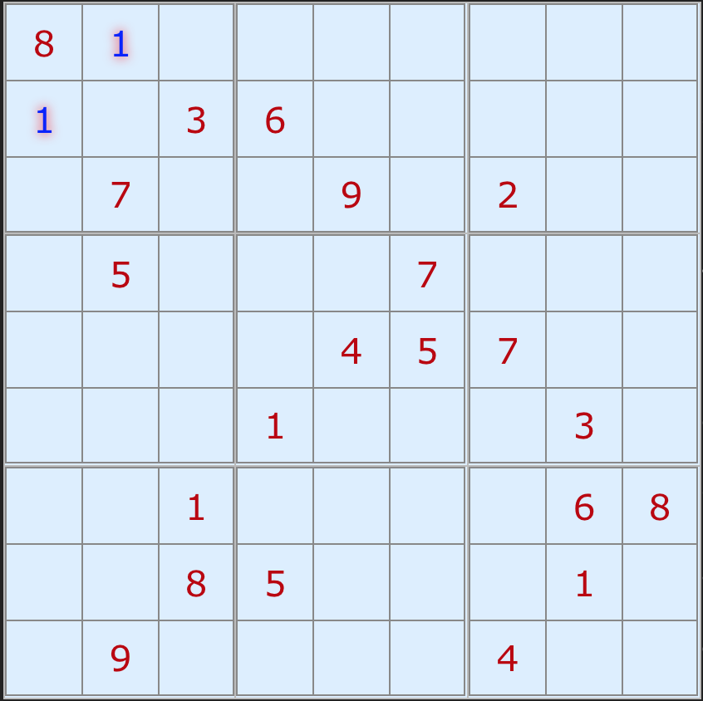
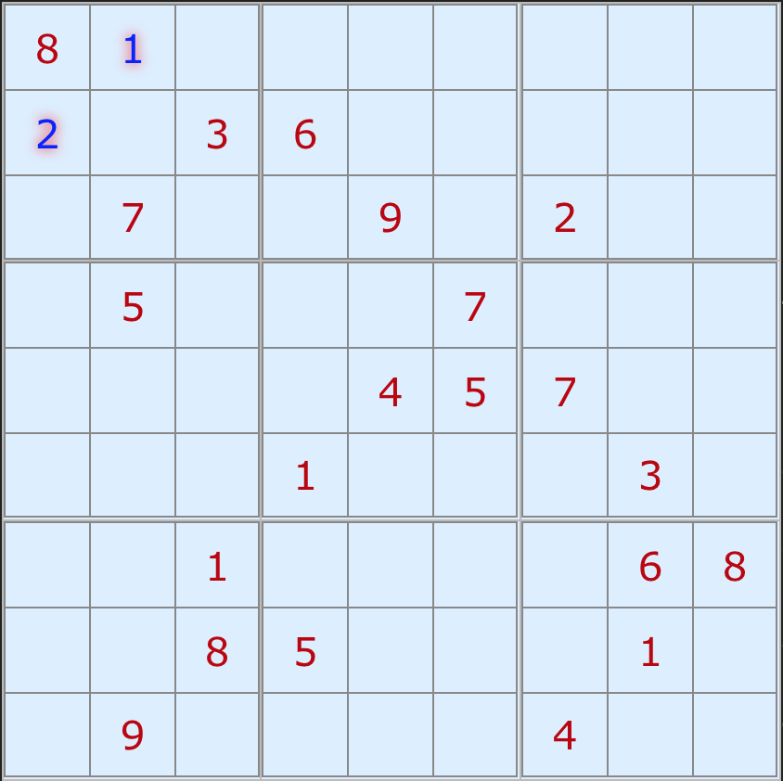
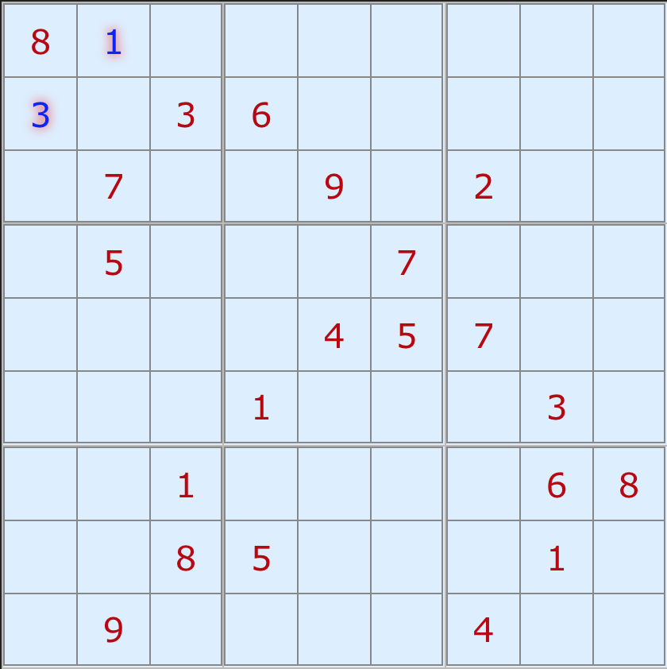
Combinatorial Optimization Problems - CP
CP : Constraint Programming
Example: Sudoku
First ingredient:
Tree search
...
...
Arto Inkala’s grid, 2012
...

Slide 45
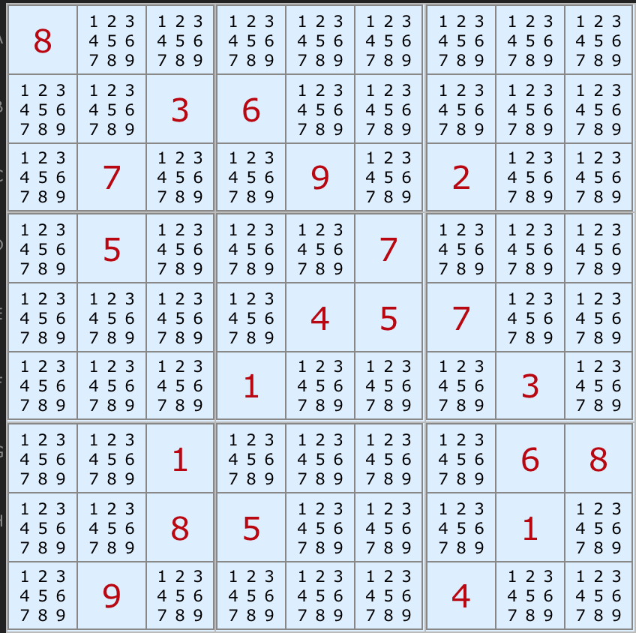
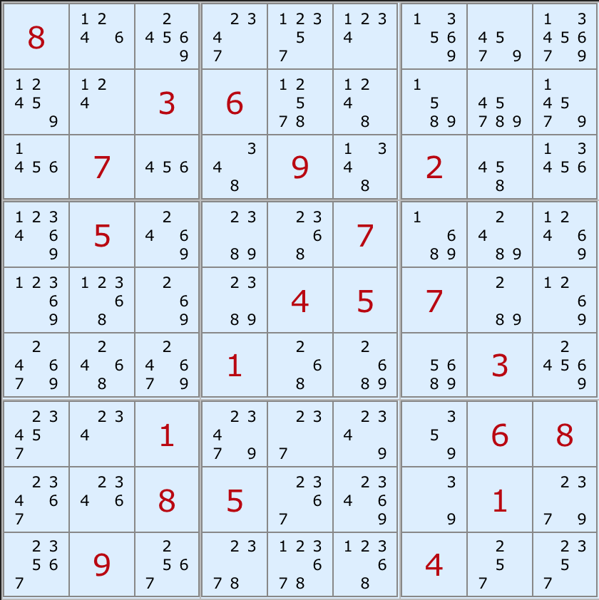
Combinatorial Optimization Problems - CP
CP : Constraint Programming
Example: Sudoku
Second ingredient:
Domain filtering
Arto Inkala’s grid, 2012

Slide 46
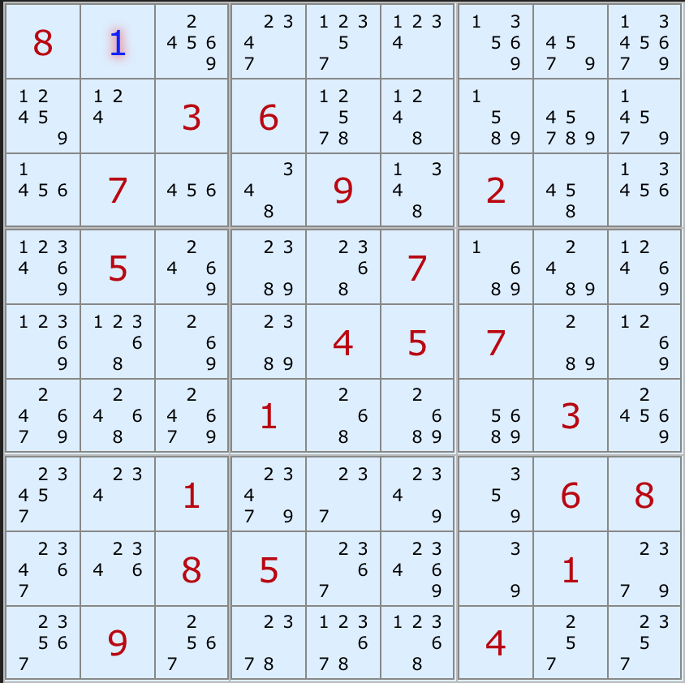
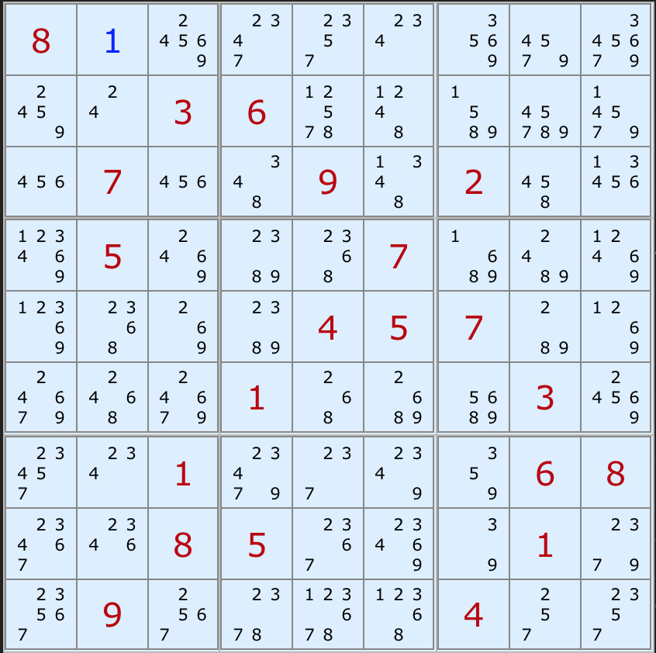
Combinatorial Optimization Problems - CP
CP : Constraint Programming
Example: Sudoku
Second ingredient:
Domain filtering
Arto Inkala’s grid, 2012

Slide 47
Combinatorial Optimization Problems - CP
How Constraint Programming works
  CP is a constructive approach
  Values are assigned to variables one at a time to extend a partial solution to a complete solution
  At a point, it may be useless to further extend a partial solution as at least one constraint is already violated by the partial solution
    The solver backtracks and tries a different value for a previously assigned variable
    All possible assignments of values to variables can be examined in this way

Slide 48
Combinatorial Optimization Problems - CP
How Constraint Programming works
  In CP, the basic search behavior is tree search
  Including search space reduction via domain filtering
  Domain filtering
    Before each value-variable assignment, domain filtering occurs
    Each value of a variable which cannot be used in a solution (given the current partial assignment) can be removed
    Each constraint type has a specialized algorithm which filters domains

Slide 49
Combinatorial Optimization Problems - CP
Domain filtering (specific algorithm for each constraint type)
  x < y
2
3
4
5
1
2
4
5
x y

Slide 50
Combinatorial Optimization Problems - CP
Domain filtering (specific algorithm for each constraint type)
  x < y
2
3
4
5
1
2
4
5
x y

Slide 51
Combinatorial Optimization Problems - CP
Domain filtering (specific algorithm for each constraint type)
  all_different(v,w,x,y,z)
1
2
3
4
5
2
4
2
3
4
4
5
2
4
5
v w x y z

Slide 52
Combinatorial Optimization Problems - CP
Domain filtering (specific algorithm for each constraint type)
  all_different(v,w,x,y,z)
1
2
3
4
5
2
4
2
3
4
4
5
2
4
5
v w x y z
Uses matching theory

Slide 53
Combinatorial Optimization Problems - CP
Domain filtering (specific algorithm for each constraint type)
  all_different(v,w,x,y,z)
1
3
2
4
3
4
5
2
4
5
v w x y z
Uses matching theory

Slide 54
Combinatorial Optimization Problems - CP
Some other ingredients of CP
  Variable selection strategy
  Value selection strategy
  Objective cut

Slide 55
Combinatorial Optimization Problems - CP
Some other ingredients of CP
  Variable selection strategy : select variable with smallest index
  Value selection strategy : select smallest value in domain
  Objective cut
Example:
  minimize x₁+2x₂
  subject to |x₁-x₂|≤2, x₁≠x₂, x₁,x₂ ∈[0,3]

Slide 56
Combinatorial Optimization Problems - CP
Some other ingredients of CP
  Variable selection strategy : select variable with smallest index
  Value selection strategy : select smallest value in domain
  Objective cut
Example:
  minimize x₁+2x₂
  subject to |x₁-x₂|≤2, x₁≠x₂, x₁,x₂ ∈[0,3]
x₁∈[0,3]

Slide 57
Combinatorial Optimization Problems - CP
Some other ingredients of CP
  Variable selection strategy : select variable with smallest index
  Value selection strategy : select smallest value in domain
  Objective cut
Example:
  minimize x₁+2x₂
  subject to |x₁-x₂|≤2, x₁≠x₂, x₁,x₂ ∈[0,3]
x₁∈[0,3]
x₁=0
x₂∈[1,2]

Slide 58
Combinatorial Optimization Problems - CP
Some other ingredients of CP
  Variable selection strategy : select variable with smallest index
  Value selection strategy : select smallest value in domain
  Objective cut
Example:
  minimize x₁+2x₂
  subject to |x₁-x₂|≤2, x₁≠x₂, x₁,x₂ ∈[0,3]
x₁∈[0,3]
x₁=0
x₂∈[1,2]
x₂=1
obj=2

Slide 59
Combinatorial Optimization Problems - CP
Some other ingredients of CP
  Variable selection strategy : select variable with smallest index
  Value selection strategy : select smallest value in domain
  Objective cut
Example:
  minimize x₁+2x₂
  subject to |x₁-x₂|≤2, x₁≠x₂, x₁,x₂ ∈[0,3]
x₁∈[0,3]
x₁=0
x₂∈[1,2]
x₂=1
obj=2
obj<2

Slide 60
Combinatorial Optimization Problems - CP
Some other ingredients of CP
  Variable selection strategy : select variable with smallest index
  Value selection strategy : select smallest value in domain
  Objective cut
Example:
  minimize x₁+2x₂
  subject to |x₁-x₂|≤2, x₁≠x₂, x₁,x₂ ∈[0,3] , obj<2
x₁∈[0,3]
x₁=0
x₂∈[1,2]
x₂=1
obj=2
obj<2

Slide 61
Combinatorial Optimization Problems - CP
Some other ingredients of CP
  Variable selection strategy : select variable with smallest index
  Value selection strategy : select smallest value in domain
  Objective cut
Example:
  minimize x₁+2x₂
  subject to |x₁-x₂|≤2, x₁≠x₂, x₁,x₂ ∈[0,3] , obj<2
x₁∈[0,3]
x₁=0
x₂∈[1]
x₂=1
obj=2
obj<2

Slide 62
Combinatorial Optimization Problems - CP
Some other ingredients of CP
  Variable selection strategy : select variable with smallest index
  Value selection strategy : select smallest value in domain
  Objective cut
Example:
  minimize x₁+2x₂
  subject to |x₁-x₂|≤2, x₁≠x₂, x₁,x₂ ∈[0,3] , obj<2
x₁∈[0,3]
x₁=0
x₂∈[1]
x₂=1
obj=2
obj<2

Slide 63
Combinatorial Optimization Problems - CP
Some other ingredients of CP
  Variable selection strategy : select variable with smallest index
  Value selection strategy : select smallest value in domain
  Objective cut
Example:
  minimize x₁+2x₂
  subject to |x₁-x₂|≤2, x₁≠x₂, x₁,x₂ ∈[0,3] , obj<2
x₁∈[0,1]
x₁=0
x₂∈[1]
x₂=1
obj=2
obj<2

Slide 64
Combinatorial Optimization Problems - CP
Some other ingredients of CP
  Variable selection strategy : select variable with smallest index
  Value selection strategy : select smallest value in domain
  Objective cut
Example:
  minimize x₁+2x₂
  subject to |x₁-x₂|≤2, x₁≠x₂, x₁,x₂ ∈[0,3] , obj<2
x₁∈[0,1]
x₁=0
x₁=1
x₂∈[1]
x₂∈[0]
x₂=1
obj=2
obj<2

Slide 65
Combinatorial Optimization Problems - CP
Some other ingredients of CP
  Variable selection strategy : select variable with smallest index
  Value selection strategy : select smallest value in domain
  Objective cut
Example:
  minimize x₁+2x₂
  subject to |x₁-x₂|≤2, x₁≠x₂, x₁,x₂ ∈[0,3] , obj<2
x₁∈[0,1]
x₁=0
x₁=1
x₂∈[1]
x₂∈[0]
x₂=1
obj=1
obj=2
obj<2

Slide 66
Combinatorial Optimization Problems - CP
Some other ingredients of CP
  Variable selection strategy : select variable with smallest index
  Value selection strategy : select smallest value in domain
  Objective cut
Example:
  minimize x₁+2x₂
  subject to |x₁-x₂|≤2, x₁≠x₂, x₁,x₂ ∈[0,3] , obj<1
x₁∈[0,1]
x₁=0
x₁=1
x₂∈[1]
x₂∈[0]
x₂=1
obj=1
obj<1
obj=2

Slide 67
Combinatorial Optimization Problems - CP
Some other ingredients of CP
  Variable selection strategy : select variable with smallest index
  Value selection strategy : select smallest value in domain
  Objective cut
Example:
  minimize x₁+2x₂
  subject to |x₁-x₂|≤2, x₁≠x₂, x₁,x₂ ∈[0,3] , obj<1
x₁∈[0,1]
x₁=0
x₁=1
x₂∈[1]
x₂∈[0]
x₂=1
obj=1
obj<1
obj=2

Slide 68
Combinatorial Optimization Problems - CP
Some other ingredients of CP
  Variable selection strategy : select variable with smallest index
  Value selection strategy : select smallest value in domain
  Objective cut
Example:
  minimize x₁+2x₂
  subject to |x₁-x₂|≤2, x₁≠x₂, x₁,x₂ ∈[0,3] , obj<1
x₁∈[0], x₂∈[0]
x₁=0
x₁=1
x₂∈[1]
x₂∈[0]
x₂=1
obj=1
obj<1
obj=2

Slide 69
Combinatorial Optimization Problems - CP
Some other ingredients of CP
  Variable selection strategy : select variable with smallest index
  Value selection strategy : select smallest value in domain
  Objective cut
Example:
  minimize x₁+2x₂
  subject to |x₁-x₂|≤2, x₁≠x₂, x₁,x₂ ∈[0,3] , obj<1
x₁∈[0], x₂∈[0]
Optimal solution: x₁=1, x₂=0
Objective value: 1
x₁=0
x₁=1
x₂∈[1]
x₂∈[0]
x₂=1
obj=1
obj<1
obj=2

Slide 70
Combinatorial Optimization Problems - CP
Yet some other ingredients of CP:
  Randomized restarts:
    Add noise to the heuristic branching (variable choice) function
    Cutoff and restart search after a fixed number of backtracks
  No-good learning:
    Learn some redundant constraints to avoid re-exploring the same sub-tree in the sequel of the search
  Large Neighborhood Search (LNS):
    Freeze values of a subset of the variables
    Re-optimize unfrozen variables
  Portfolios of strategies:
    Use a set of different strategies and learn the most efficient ones while solving the problem
Restart
Search tree
No-goods

Slide 71
Combinatorial Optimization Problems - Resolution
Generic Problem specific
Exact
SAT
ILP
CP
Heuristic
Local Search
Large Neighborhood
Search
Genetic
Algorithms
Ant Colonies
Simulated
Annealing
...
Approximation

