Slide 1
Self-Adapting Large Neighborhood Search
Application to single-mode
scheduling problems
P. Laborie and D. Godard
[plaborie,dgodard]@ilog.fr

Slide 2
Objective
A robust search method for solving real-world industrial scheduling problems
Current focus on:
  Non-preemptive scheduling
  Deterministic scheduling
  Single-mode scheduling (no resource allocation)
  Optimization problems for which computing a feasible schedule (even of poor quality) is not too difficult
  Temporal cost functions

Slide 3
Preview of some covered problems
Common due-date
Flowshop
Single-machine E/T
Unary
Jobshop
Flowshop E/T
Jobshop E/T
Openshop
Single proc. tardiness
Unary
w/ setup
Shop setup times
Semicond. testing
Airland
Hybrid flowshop
RCPSP E/T
Discrete
Flowshop w/ buffers
ATFM
Quality RCPSP
Aircraft assembly
Cumul. jobshop
RCPSP
Parallel-machine E/T
State
Jobshop w/ robot
Makespan
E/T
Duration

Slide 4
Model : Activities
Non-preemptive activities with variable duration
Activity A
t
Start time: s(A)
End time: e(A)
Duration: d(A) == e(A)-s(A)
1 activity ≡ 3 integer decision variables

Slide 5
Model : Temporal constraints
Any constraint of one of the forms:
t₁ + d ≤ t₂ or t₁ + d = t₂
where t₁ and t₂ are the start or end time-point of two activities and d an integer variable (or constant)
Expressivity:
  precedence,
  min/max time lags,
  etc.

Slide 6
Model : Resources
Resource typology:
  Unary resource: Resource of capacity 1. Two activities requiring the same unary resource cannot overlap.
  Discrete resource: Resource of capacity Q_{max}. The cumulated resource usage by activities demanding the resource must be kept in the range [Q_{min}, Q_{max}]. Q_{min}, Q_{max} can be some known function of time.
Q_{max}(t)
Q_{min}(t)
t

Slide 7
Model : Resources
Resource typology (cont’d):
  Reservoir: Resource of capacity Q_{max} and initial level L. Activities may consume or produce the reservoir. The level of the reservoir over time must be kept in the range [Q_{min}, Q_{max}], 0≤Q_{min}
  State Resource. Resource with a finite set of possible states. Activities require the resource be in a particular (set of) state s. Activities requiring incompatible states cannot overlap.

Slide 8
Model : Sequence-dependent setup times
On unary resources
end(a_{i}) ≤ start(a_{j}) ⇒
end(a_{i})+setup(a_{i},a_{j}) ≤ start(a_{j})
setup(a_{i},a_{j}) specified by a setup time matrix or a user-defined function

Slide 9
Model : Temporal cost function
Cost function expressed as sum/max aggregation of semi-convex piecewise linear (SCPL) functions on activity start/end/durations
SCPL function:
∀z, {x / f(x)≤z} is a convex interval
cost
cost
cost
cost
cost
z
x
x
x
x
x

Slide 10
Model : Temporal cost function
Why using SCPL functions for cost ?
  Max/Sum of SCPL covers classical temporal costs:
    Minimize makespan, earliness/tardiness cost, weighted number of late jobs, weighted sums of durations (controllable processing times)
    Maximize weighted sums of durations (quality)
  f(x)≤z can be propagated with arc-consistency without creating holes in the variables domains
  They can be convexified without loosing too much information

Slide 11
Search: Self-adapting LNS for scheduling
Principles
  LNS: Iterative improvement method based on sequentially:
    Relaxing a fragment of the current solution and freezing the remaining part
    Re-optimizing the relaxed fragment
  Self-adapting:
    Portfolio of methods for relaxing fragments
    Portfolio of methods for re-optimizing a relaxed fragment
    On-line learning techniques to converge on the most efficient methods on the instance being solved

Slide 12
Search: Self-adapting LNS for scheduling
Relaxation methods
portfolio
Re-optimization methods
portfolio
CS₁ [q₁]
LN₁ [p₁]
CS₁ [q₁]
R₁ [p₁]
O₁ [q₁]
First
solution

Slide 13
Search: Self-adapting LNS for scheduling
Relaxation methods
portfolio
Re-optimization methods
portfolio
CS₁ [q₁]
LN₁ [p₁]
CS₁ [q₁]
R₁ [p₁]
O₁ [q₁]
Selection
First
solution
R_{i} [P_{i}]
O_{j} [Q_{j}]
Relaxation
Re-optimization

Slide 14
Search: Self-adapting LNS for scheduling
Relaxation methods
portfolio
Re-optimization methods
portfolio
CS₁ [q₁]
LN₁ [p₁]
CS₁ [q₁]
R₁ [p₁]
O₁ [q₁]
Reward r
Reinforcement
First
solution
Solution
R_{i} [P_{i}]
R_{i} [P_{i}]
O_{j} [Q_{j}]
O_{j} [Q_{j}]
Relaxation
Re-optimization

Slide 15
Search: Self-adapting LNS for scheduling
Relaxation methods
portfolio
Re-optimization methods
portfolio
LN₁ [p₁]
CS₁ [q₁]
CS₁ [q₁]
R₁ [p₁]
O₁ [q₁]
First
solution
Solution
Relaxation
Re-optimization

Slide 16
Search: Self-adapting LNS for scheduling
Relaxation methods
portfolio
Re-optimization methods
portfolio
LN₁ [p₁]
CS₁ [q₁]
CS₁ [q₁]
R₁ [p₁]
O₁ [q₁]
Selection
Solution
R_{i} [P_{i}]
O_{j} [Q_{j}]
Relaxation
Re-optimization

Slide 17

Search: Relaxation methods portfolio
Partial Order Schedule (POS) definition
  A temporal network that is sufficient to ensure that all its solutions satisfy the temporal and resource constraints of the problem
All relaxation methods in the portfolio start by computing a POS from the solution and then, relax a subset of activities F (fragment) on this temporal network
R_{i} = Relax_{F}i o POS
POS

Slide 18
Search: Relaxation methods portfolio
POS computation on resources
  Unary resource: easy, O(n logn)
  Discrete resource: O(n log(Cn))
t
A
C
B
A
C
B
c
C
E
C
E
F
R
F
D
D
H
H
B
t
B
A
G
A
G

Slide 19
Search: Relaxation methods portfolio
POS computation on resources (cont’d)
  Reservoir: O(n log(Cn))
c
F
F
R
A
B
G
A
B
D
G
t
D
E
E

Slide 20
Search: Relaxation methods portfolio
POS computation on resources (cont’d)
  State resource: O(n²)
R
C
D
B
G
F
C
D
F
t
B
A
E
H
I
G
I
H
A
E

Slide 21
Search: Relaxation methods portfolio
Global POS
  POS = ∪_{R} POS_{R}
  Redundant edges are removed

Slide 22
Search: Relaxation methods portfolio
Partial Order Schedule (POS) definition
  A temporal network that is sufficient to ensure that all its solutions satisfy the temporal and resource constraints of the problem
All relaxation methods in the portfolio start by computing a POS from the solution and then, relax a subset of activities F (fragment) on this temporal network
R_{i} = Relax_{F}i o POS
Relax

Slide 23
Search: Relaxation methods portfolio
Relaxation of a fragment F^{i} of the POS
POS
E
D
H
C
E
Relax_{F}i
C
F
D
F
H
B
B
A
G
A
G
Fragment F^{i}

Slide 24
Search: Relaxation methods portfolio
Portfolio:
  R¹_{α}: Randomized relaxation
  R²_{α,β}: Time-window relaxation
  R³_{α,β}: Topological relaxation
Time-

Slide 25
Search: Relaxation methods portfolio
R²_{α,β}: Time-window relaxation
  Activities are sorted by increasing start time in the solution
  The fragment consists of all the activities with index in [β.n, (β+α).n] in the above array
  α and β are self-adapting parameters of the relaxation method

Slide 26
Search: Relaxation methods portfolio
R²_{α,β}: Time-window relaxation
  Activities are sorted by increasing start time in the solution
  The fragment consists of all the activities with index in [β.n, (β+α).n] in the above array
  α and β are self-adapting parameters of the relaxation method
α=0.25, β=0.5

Slide 27
Search: Relaxation methods portfolio
R²_{α,β}: Time-window relaxation
  Activities are sorted by increasing start time in the solution
  The fragment consists of all the activities with index in [β.n, (β+α).n] in the above array
  α and β are self-adapting parameters of the relaxation method
α=0.25, β=0.5

Slide 28
Search: Re-optimization methods portfolio
Currently, a unique optimization method is used: ScheduleJustInTime_{α}
  Explores a search tree with a limited number of failures α.n
  α is a self-adapting parameter of the optimization method
  At the root node, indicative start and end times for activities are computed using an LP relaxation of the problem

Slide 29
Search: Re-optimization methods portfolio
Temporal relaxation:
  Only consider temporal constraints (including the ones of the relaxed POS) and (convexified) cost function

Slide 30
Search: Re-optimization methods portfolio
Temporal relaxation:
  Only consider temporal constraints (including the ones of the relaxed POS) and (convexified) cost function
E
D
H
C
F
B
A
G

Slide 31
Search: Re-optimization methods portfolio
Temporal relaxation:
  Only consider temporal constraints (including the ones of the relaxed POS) and (convexified) cost function
E
D
H
C
F
B
A
G

Slide 32
Search: Re-optimization methods portfolio
Tree search
  Search considers activities by increasing indicative start times and tries to schedule them as close as possible to their indicative dates
  In case of backtrack, the activity is marked unselectable until constraint propagation removes from the domain of the activity the dates tried on the left branch

Slide 33
Experimental results
The approach was implemented as a black-box (no manual parameter)
Implemented on top of ILOG CP 1.1
  Use constraint propagation of ILOG CP
  Use ILOG CPLEX for temporal relaxation
Experimented on 21 types of scheduling problems
Detailed experimental protocol and results on:
scheduler.ilog.fr

Slide 34
Experimental results: benchmarks
Common due-date
Flowshop
Single-machine E/T
Unary
Jobshop
Flowshop E/T
Jobshop E/T
Openshop
Single proc. tardiness
Unary
w/ setup
Shop setup times
Semicond. testing
Airland
Hybrid flowshop
RCPSP E/T
Discrete
Flowshop w/ buffers
ATFM
Quality RCPSP
Aircraft assembly
Cumul. jobshop
RCPSP
Parallel-machine E/T
State
Jobshop w/ robot
Makespan
E/T
Duration

Slide 35
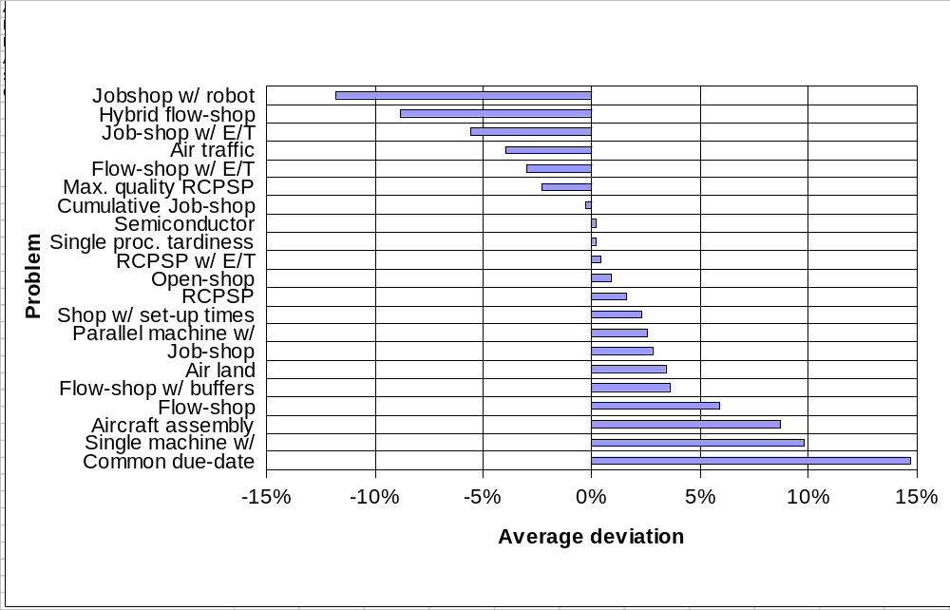
Experimental results: overview
Self-Adapting LNS: results over 21 benchmarks

Slide 36
Conclusion
Ingredients to the robustness of the approach:
  LNS: efficient traversal of the search space
  POS: generality, injects flexibility for re-optimization
  Relaxation methods:
    Randomization allows diversity
    Some methods can exploit problem structure
  Re-optimization methods:
    Global vision provided by temporal relaxation
    (Limited) Tree search allows exploiting CP
  Learning

Slide 37
Current and future work
Extension of the approach to:
  Multi-mode scheduling:
    Optional activities
    Alternative resources
    Alternative routes/recipes
  Resource costs:
    Setup costs
    Resource usage costs
    Inventory costs
  Feasibility problems

