Slide 1
Modeling and Solving
Resource-Constrained Project Scheduling Problems
with IBM ILOG CP Optimizer
Philippe Laborie
ILOG Principal Scientist
IBM Software Group
laborie@fr.ibm.com

Slide 2
What is IBM ILOG CP Optimizer?
A Constraint Programming engine for combinatorial problems (including scheduling problems)
Implements a Model & Run paradigm
  Model: Concise and Expressive modeling language
  Run: Powerful automatic search procedure
Available through the following interfaces:
  OPL (Optimization Programming Language)
  C++ (native interface)
  Java, .NET (wrapping of the C++ engine)

Slide 3
IBM ILOG CP Optimizer for Detailed Scheduling
Modeling
Language
[1,2]
Extension of classical CSP with a new type of decision variable:
optional interval variable :
Domain(a) ⊆ {⊥} ∪ { [s,e) | s,e∈Ζ, s≤e }
Introduction of mathematical notions such as sequences and functions to
capture temporal aspects of scheduling problems
Absent interval
Interval of integers
[1] Reasoning with Conditional Time-intervals. FLAIRS-08.
[2] Reasoning with Conditional Time-intervals, Part II: an Algebraical Model for Resources. FLAIRS-09.

Slide 4
IBM ILOG CP Optimizer for Detailed Scheduling
Problem
Automatic
Search
[3,4]
Fragment
Selection
Problem structure
Randomization
Tree search
LP relaxation
Propagation
Dominance rules
Machine
Learning
Techniques
Self-Adapting
Large Neighborhood
Search
POS generation
Continue
search ?
[3] Randomized Large Neighborhood Search for Cumulative Scheduling. ICAPS-05.
[4] Self-Adapting Large Neighborhood Search: Application to Single-mode Scheduling Problems. MISTA-07.
[1] Reasoning with Conditional Time-intervals. FLAIRS-08.
[2] Reasoning with Conditional Time-intervals, Part II: an Algebraical Model for Resources. FLAIRS-09.

Slide 5

IBM ILOG CP Optimizer for Detailed Scheduling
Modeling
Language
[1,2]
Easy
modeling
Efficient
search
Automatic
Search
[3,4]
Detailed Scheduling
Problems
Resource-Constrained
Project Scheduling
Problems
[3] Randomized Large Neighborhood Search for Cumulative Scheduling. ICAPS-05.
[4] Self-Adapting Large Neighborhood Search: Application to Single-mode Scheduling Problems. MISTA-07.
[1] Reasoning with Conditional Time-intervals. FLAIRS-08.
[2] Reasoning with Conditional Time-intervals, Part II: an Algebraical Model for Resources. FLAIRS-09.

Slide 6
Resource-Constrained Project Scheduling Problems
Resource
Types
Multi-
Modes
Max-
Delays
Resource
Calendars
Optional
Tasks
Work
Breakdown
Structure
Objective
Function
Renewable
No
No
No
No
No
Makespan
Non-Renewable
Yes
Yes
Yes
Yes
Yes
Earliness/
Tardiness
Inventories
Task
Durations
Allocation
Costs
Unperformed
Tasks

Slide 7
Basic RCPSP
Resource
Types
Multi-
Modes
Max-
Delays
Resource
Calendars
Optional
Tasks
Work
Breakdown
Structure
Objective
Function
Renewable
No
No
No
No
No
Makespan
Non-Renewable
Yes
Yes
Yes
Yes
Yes
Earliness/
Tardiness
Inventories
Task
Durations
Allocation
Costs
Basic RCPSP
Unperformed
Tasks

Slide 8
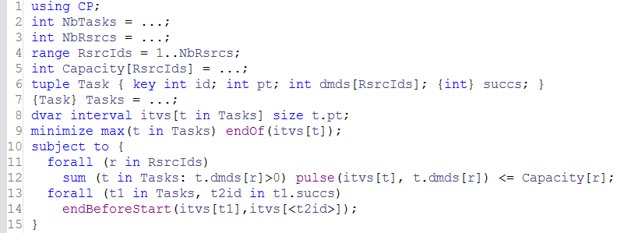
Basic RCPSP
The model is using CP Optimizer engine

Slide 9
Basic RCPSP
Data
Data reading:
  Problem size (number of tasks and resources)
  Resource capacities
  Tasks with their processing time, resource demand and successors

Slide 10
Basic RCPSP
Decisions
Decision variables:
  Tasks: array of interval variables
itvs[t]
t.pt

Slide 11
Basic RCPSP
Objective
Objective:
  Minimize project makespan
max(t in Tasks) endOf(itvs[t])
itvs[t₁]
itvs[t₂]
itvs[t_{n}]

Slide 12
Basic RCPSP
Constraints
Constraints:
  Resource capacity constraints (using cumul functions)
Capacity[r]
t.dmds[r]
pulse
Σ pulse
itvs[t]
itvs[t₂]
itvs[t₁]
itvs[t_{n}]

Slide 13
Basic RCPSP
Constraints
Constraints:
  Precedence constraints between tasks
itvs[t₁]
itvs[t₂]
itvs[t_{n}]

Slide 14
Multi-Mode RCPSP
Resource
Types
Multi-
Modes
Max-
Delays
Resource
Calendars
Optional
Tasks
Work
Breakdown
Structure
Objective
Function
Renewable
No
No
No
No
No
Makespan
Non-Renewable
Yes
Yes
Yes
Yes
Yes
Earliness/
Tardiness
Inventories
Task
Durations
Multi-Mode RCPSP
Each task must be one among several alternative execution modes
Allocation
Costs
task
alternative
Unperformed
Tasks
mode1
mode2
mode3

Slide 15
Multi-Mode RCPSP
Resource
Types
Multi-
Modes
Max-
Delays
Resource
Calendars
Optional
Tasks
Work
Breakdown
Structure
Objective
Function
Renewable
No
No
No
No
No
Makespan
Non-Renewable
Yes
Yes
Yes
Yes
Yes
Earliness/
Tardiness
Inventories
Task
Durations
Multi-Mode RCPSP
Each task must be one among several alternative execution modes
Allocation
Costs
task
alternative
Unperformed
Tasks
mode1
mode2
mode3
R1
R2

Slide 16
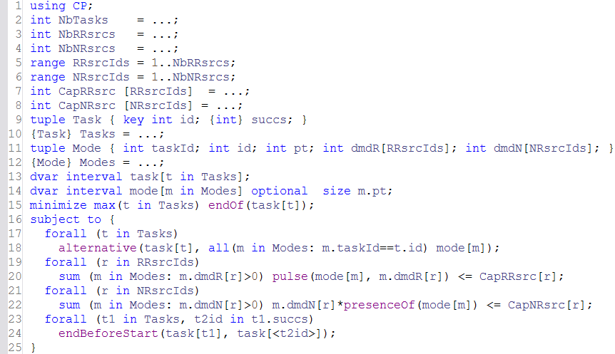
Multi-Mode RCPSP
Alternative constraint:
  Mode selection for each task (using alternative constraints)
  Resource usage for each mode

Slide 17
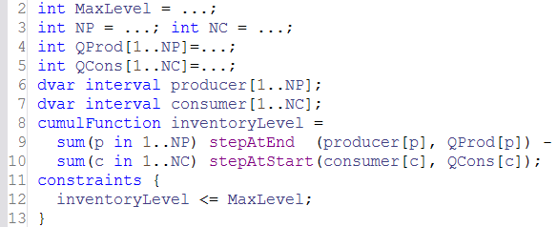
Modeling Inventories
Resource
Types
Multi-
Modes
Max-
Delays
Resource
Calendars
Optional
Tasks
Work
Breakdown
Structure
Objective
Function
Renewable
No
No
No
No
No
Makespan
Non-Renewable
Yes
Yes
Yes
Yes
Yes
Earliness/
Tardiness
Inventories
Task
Durations
Allocation
Costs
Unperformed
Tasks
Inventories
Cumul functions with stepAtStart/stepAtEnd
Σ_{p}
stepAtEnd
QProd[p]
−
Σ_{c}
QCons[c]
stepAtStart
producer[p]
consumer[c]

Slide 18
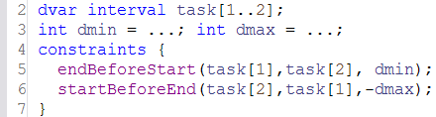
Modeling Maximum Delays
Resource
Types
Multi-
Modes
Max-
Delays
Resource
Calendars
Optional
Tasks
Work
Breakdown
Structure
Objective
Function
Renewable
No
No
No
No
No
Makespan
Non-Renewable
Yes
Yes
Yes
Yes
Yes
Earliness/
Tardiness
Inventories
Task
Durations
Allocation
Costs
Unperformed
Tasks
Max. Delays
Precedence constraints with delays
task[1]
task[2]
[dmin,dmax]

Slide 19
Modeling Resource Calendars
Resource
Types
Multi-
Modes
Max-
Delays
Resource
Calendars
Optional
Tasks
Work
Breakdown
Structure
Objective
Function
Renewable
No
No
No
No
No
Makespan
Non-Renewable
Yes
Yes
Yes
Yes
Yes
Earliness/
Tardiness
Inventories
Task
Durations
Allocation
Costs
Unperformed
Tasks
Calendars
Intensity functions
workingTime
100%
0%
task (size=9)
length=11

Slide 20
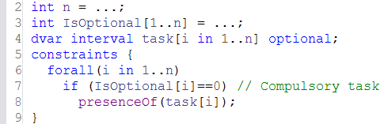
Modeling Optional Tasks
Resource
Types
Multi-
Modes
Max-
Delays
Resource
Calendars
Optional
Tasks
Work
Breakdown
Structure
Objective
Function
Renewable
No
No
No
No
No
Makespan
Non-Renewable
Yes
Yes
Yes
Yes
Yes
Earliness/
Tardiness
Inventories
Task
Durations
Allocation
Costs
Unperformed
Tasks
Opt. Tasks
Optional Interval Variables
  Constraint presenceOf(a) constrains an optional interval variable a to be present in the solution

Slide 21
Modeling Work-Breakdown Structures
Resource
Types
Multi-
Modes
Max-
Delays
Resource
Calendars
Optional
Tasks
Work
Breakdown
Structure
Objective
Function
Renewable
No
No
No
No
No
Makespan
Non-Renewable
Yes
Yes
Yes
Yes
Yes
Earliness/
Tardiness
Inventories
Task
Durations
WBS
Hierarchical description of projects with alternative and optional sub-projects
Allocation
Costs
project1
project2
OR
Unperformed
Tasks
OR
dec11
dec12
dec21
dec22
AND
AND
AND
AND
Optional sub-projects
In the decomposition

Slide 22
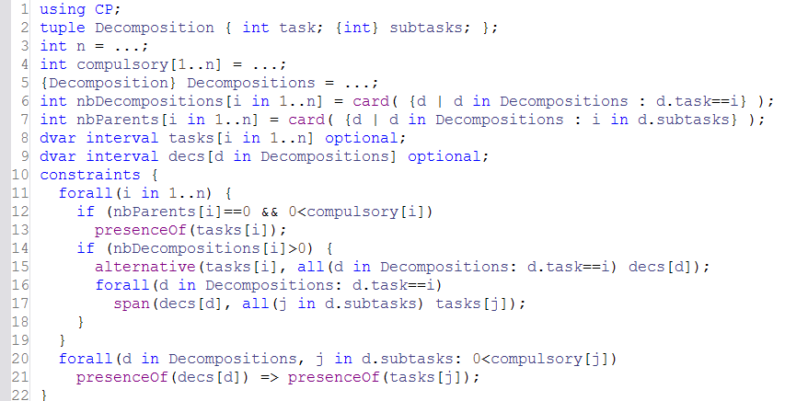
Modeling Work-Breakdown Structures

Slide 23
Modeling Objective Functions
Resource
Types
Multi-
Modes
Max-
Delays
Resource
Calendars
Optional
Tasks
Work
Breakdown
Structure
Objective
Function
Renewable
No
No
No
No
No
Makespan
Non-Renewable
Yes
Yes
Yes
Yes
Yes
Earliness/
Tardiness
Inventories
Task
Durations
Allocation
Costs
Unperformed
Tasks
Objective
Objective functions
  Combinations of startOf, endOf, sizeOf, lengthOf, presenceOf with algebraical expressions

Slide 24
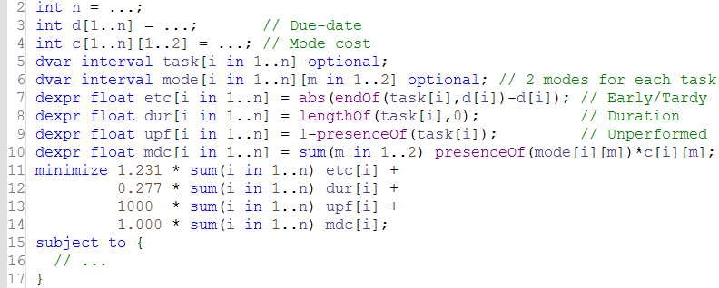
Modeling Objective Functions
Objective
Objective functions
  Combinations of startOf, endOf, sizeOf, lengthOf, presenceOf with algebraical expressions

Slide 25
Experimental Results (excerpts)
Benchmark
Mean relative distance
to best known UB
# Improved UB /
# Instances
RCPSP ⁽¹⁾
1.2%
2/600
MRCPSP/max ⁽²⁾
1.1%
30/270
RCPSP w/ Early/Tardy ⁽³⁾
-2.1%
16/60
Max. quality RCPSP ⁽⁴⁾
-2.7%
NA/3600
Personal Task Scheduling ⁽⁵⁾
-12.5%
60/60
Instances j120* of the PSPLIB
Instances mm50* of the PSPLIB
Random selection of 60 instances from the benchmark proposed in:
M. Vanhoucke, E. Demeulemeester, and W. Herroelen. An exact procedure for the
resource-constrained weighted earliness-tardiness project scheduling problem.
Annals of Operations Research, 102(1-4):179–196, 2001.
Benchmark proposed in:
N. Policella, X. Wang, S.F. Smith, and A. Oddi. Exploiting temporal flexibility to
obtain high quality schedules. In Proc. AAAI-2005, 2005
Benchmark proposed in:
I. Refanidis. Managing Personal Tasks with Time Constraints and Preferences.
Proc. ICAPS-07, 2007.

Slide 26
Finding out More …
http://www.ilog.com/products/oplstudio/trial.cfm
  Trial version of OPL with CP Optimizer support
http://www.ilog.com/products/cpoptimizer
  White papers, Presentations, Data sheet
http://www2.ilog.com/techreports has some technical reports adapted from papers
  TR-07-001: Large neighborhood search (MISTA-07)
  TR-08-001: Reasoning with conditional time intervals (FLAIRS-08)
  TR-09-001: Reasoning with conditional time intervals (II) (FLAIRS-09)
  TR-08-002: Scheduling model exhaustive & formal description
  TR-09-002: CP Optimizer illustrated on 3 scheduling problems (CPAIOR-09)

