Slide 1
Optimization : from mathematical tools to real applications
Illustration on IBM ILOG Optimization technologies and solutions
Philippe Laborie (laborie@fr.ibm.com)

Slide 2
Optimization : from mathematical tools to real applications
IBM ILOG Optimization technologies and solutions
From mathematical tools to real applications

Slide 3
IBM ILOG Optimization technologies and solutions
Optimization
  Let:
    X A vector of decision variables
    f(X) A function
    C(X) Some constraints limiting the possible combinations of values for decision variables
  Optimization problem:
    minimize f(X)
    subject to C(X)

Slide 4
IBM ILOG Optimization technologies and solutions
Optimization: Linear Programming
  Let:
    X A vector of numerical decision variables
    f(X) A linear function
    C(X) Some linear constraints limiting the possible combinations of
    values for decision variables
  Optimization problem:
    minimize f(X)
    subject to C(X)

Slide 5
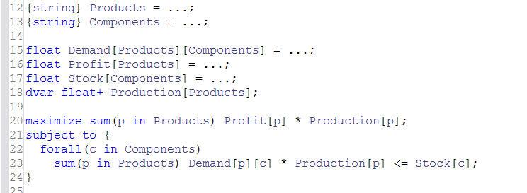
IBM ILOG Optimization technologies and solutions
Optimization: Linear Programming

Slide 6
IBM ILOG Optimization technologies and solutions
Optimization: Mixed Integer Linear Programming
  Let:
    X A vector of numerical or integer decision variables
    f(X) A linear function
    C(X) Some linear constraints limiting the possible combinations of
    values for decision variables
  Optimization problem:
    minimize f(X)
    subject to C(X)

Slide 7
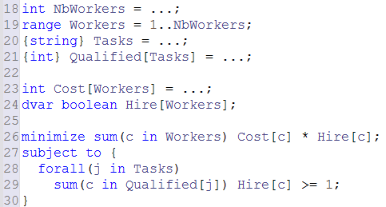
IBM ILOG Optimization technologies and solutions
Optimization: Mixed Integer Linear Programming

Slide 8
IBM ILOG Optimization technologies and solutions
Optimization: Quadratic Programming
  Let:
    X A vector of numerical or integer decision variables
    f(X) A quadratic or linear function
    C(X) Some quadratic or linear constraints limiting the possible
    combinations of values for decision variables
  Optimization problem:
    minimize f(X)
    subject to C(X)

Slide 9
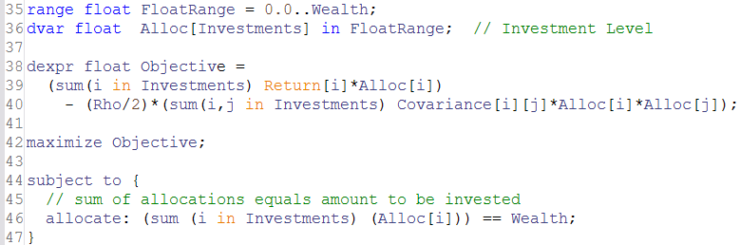
IBM ILOG Optimization technologies and solutions
Optimization: Quadratic Programming

Slide 10
IBM ILOG Optimization technologies and solutions
Optimization: Constraint Programming
  Let:
    X A vector of integer decision variables
    f(X) A general expression
    C(X) Some general constraints limiting the possible combinations of
    values for decision variables
  Optimization problem:
    minimize f(X)
    subject to C(X)

Slide 11
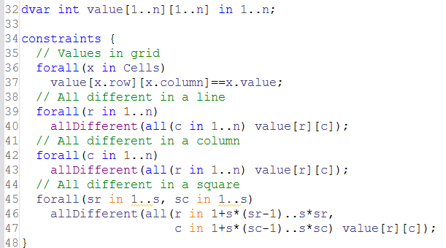
IBM ILOG Optimization technologies and solutions
Optimization: Constraint Programming

Slide 12
IBM ILOG Optimization technologies and solutions
Optimization: Constraint-Based Scheduling
  Let:
    X A vector of integer and interval decision variables (activities)
    f(X) A general expression
    C(X) Some general constraints limiting the possible combinations of
    values for decision variables (temporal constraints,
    resources, …)
  Optimization problem:
    minimize f(X)
    subject to C(X)

Slide 13
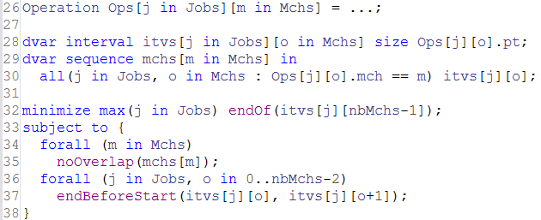
IBM ILOG Optimization technologies and solutions
Optimization: Constraint-Based Scheduling

Slide 14


IBM ILOG Optimization technologies and solutions
  CPLEX Optimization Studio
  OPL Modeling Language & IDE
APIs:
C++
Python
Java
.NET
CPLEX Optimizer
CP Optimizer
LP
MIP
CSP
COP
QP
...
Scheduling

Slide 15
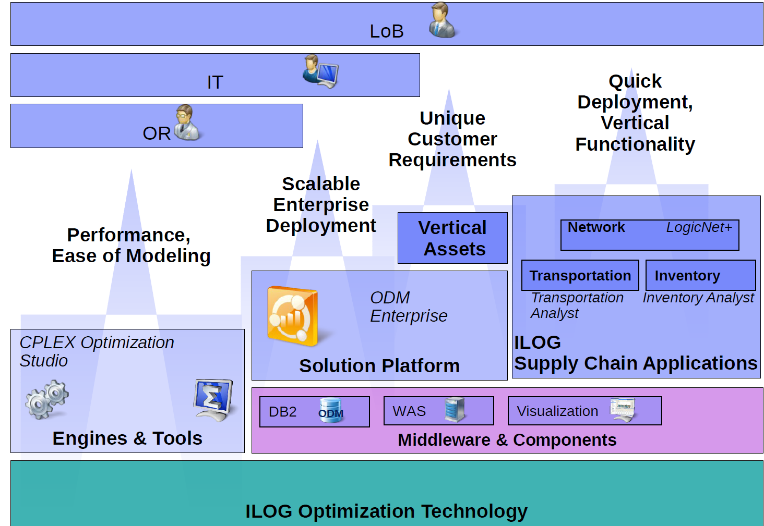
IBM ILOG Optimization technologies and solutions

Slide 16
From mathematical tools to real applications
Some real applications
  Aerospace
    Project scheduling, Aircraft assembly scheduling, Assembly line configuration, …
  Banking, Finance
    Portfolio optimization, Trade matching and timing, Cash management, Loan configuration and lending, …
  Energy & Utilities
    Network planning, Nuclear plant outage scheduling, Maintenance, Production planning, …
  Logistics, Supply Chain
    Routing, Planning and scheduling, Shipment planning and order fulfillment, …
  Manufacturing
    Network optimization, Production planning and scheduling, Factory configuration, …
  Media & Communications
    Advertizing and program scheduling, event and personnel scheduling, …
  Retail
    Inventory optimization, Retail distribution and replenishment planning, Store optimization, …
  Travel and transportation
    Crew scheduling, Timetabling, Airport resources allocation, Container management, …

Slide 17

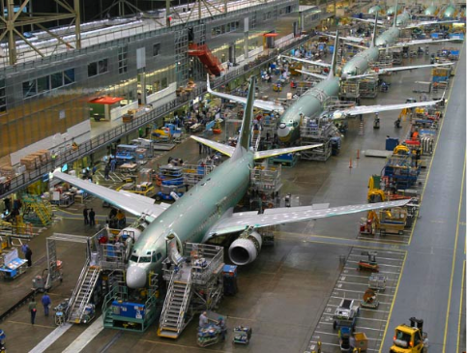

From mathematical tools to real applications
There is a gap between mathematical tools and the real applications
minimize f(X)
subject to C(X)
LP
QP
MIP
CSP
COP
Scheduling
...

Slide 18
From mathematical tools to real applications
There is a gap between mathematical tools and the real applications
This presentation uses material from the excellent blog of JF Puget:
IT Best Kept Secret Is Optimization https://www.ibm.com/developerworks/mydeveloperworks/blogs/jfp/

Slide 19
From mathematical tools to real applications
There is a gap between mathematical tools and the real applications
  Different stakeholders / objectives
  Language, Vocabulary
  Problem definition: which problem(s) do we want to solve?
  Data issues
  Solution definition: what is a solution to the problem(s) ?
  Solution display & User’s interactions
  Customer’s expectations
  Selecting the adequate solving technologies
  Development tools
  Communication channels with customer
  Proof of Concepts (POCs)

Slide 20
From mathematical tools to real applications
> Different stakeholders / objectives
Buyer (management)
  Objectives: maximize ROI, minimize risk
Final users
  Objectives: have the business problem solved, minimize change
Their objective are not necessarily the same, they may even conflict
They do not care about the technology
  They do not understand it, sometimes they do not trust it!
  They will typically expect that the resolution time of their problem scales linearly with its size
They only care about their problem

Slide 21
From mathematical tools to real applications
> Different stakeholders / objectives
Buyer (management)
  Objectives: maximize ROI, minimize risk
Final users
  Objectives: have the business problem solved, minimize change
They only care about their problem
… and the integration of the new solution in their environment
  Can be very hard if it implies process changes
  Can be tough if it implies to move or fire people
  Easier when optimization is used to do more :
    More revenue, better service, new services, etc

Slide 22
From mathematical tools to real applications
> Different stakeholders / objectives
Optimization specialists
Application developers, IT
They deliver the solution to the business problem
Applications developers and IT specialists generally do not know optimization technologies
This is something we are pushing in IBM: make optimization technologies easier so that they are accessible to IT specialists and developers (Model&Run paradigm, ODME)

Slide 23


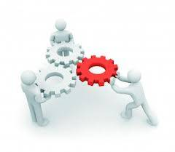


From mathematical tools to real applications
> Different stakeholders / objectives
Buyer
User
Optimization
expert
Developer

Slide 24

From mathematical tools to real applications
> Different stakeholders / objectives
Buyer
User
End User
Optimization
expert
Developer
Partner

Slide 25
From mathematical tools to real applications
> Different stakeholders / objectives
Buyer
User
End User
Optimization
expert
Developer

Slide 26
From mathematical tools to real applications
> Different stakeholders / objectives
Buyer
User
Software
Vendor
Optimization
expert
Developer

Slide 27
From mathematical tools to real applications
> Different stakeholders / objectives
Buyer
User
Software
Vendor
Optimization
expert
Developer

Slide 28
From mathematical tools to real applications
> Different stakeholders / objectives
Buyer
User
Large company
Optimization
expert
Developer

Slide 29
From mathematical tools to real applications
> Different stakeholders / objectives
Buyer
User
Large company
Optimization
expert
Developer

Slide 30
From mathematical tools to real applications
> Different stakeholders / objectives
You need to have a good understanding of the ecosystem of the project

Slide 31
From mathematical tools to real applications
> Language, Vocabulary
Each domain has its own terminology : don’t expect a customer to describe his optimization problems in terms of variables, constraints and objective function
You will hear about: ingot, PSCW, APX, connection, coil, berth, ratability, shelf life, crude distillation unit (CDU), discount rate, reticle, WBS, palonnier (fr), bâti (fr), …
You have to communicate with the customer/prospect using his own business language in order to understand his processes

Slide 32
From mathematical tools to real applications
> Problem definition
What is the problem to be solved?
Usually, many (most of) constraints and objective functions are implicit, they need to be formalized
A good technique for discovering implicit constraints is to iteratively enrich the model and present some solutions of the current model to the user, he will often easily see:
  That something is wrong/infeasible in the solution because some implicit constraint was not modeled
  That the solution is not of good quality because some implicit objective was not considered
A good technique for discovering that some constraints have been overstated in the model is to match a current solution of the customer against the model and analyze which constraints are violated

Slide 33
From mathematical tools to real applications
> Problem definition
You need to solve the right problem
J.F. Puget: “It is better to provide an approximate answer to today's problem than to perfectly solve yesterday's problem.”
J. Tuckey: “An approximate answer to the right problem is worth a good deal more than an exact answer to an approximate problem.”

Slide 34
From mathematical tools to real applications
> Problem definition
But: Optimization will need some model of the real problem
Models cannot fully describe the reality, some aspects of the real problem will have to be:
  Ignored
  Relaxed (e.g. n almost similar machines => 1 resource of capacity n)
  Over-constrained (e.g. increase task duration to account for uncertainty)
  Approximated (e.g. to model an implicit objective function)
There is a trade-off to be found between:
  The complexity/precision of the model
  The capacity of optimization technologies to satisfactorily solve it
  This is the art of optimization modeling

Slide 35

From mathematical tools to real applications
> Problem definition
Be ready to have moving targets
The user may initially have a limited scope in mind:
  Focused on a particular sub-problem
  Think anything large would not be manageable
… as the project advances, the ambitions may change to widen (or restrict) the scope and/or scale of the model
The model should be written in such a way that refactoring is easy (model agility): clean data structures, well-structured code, etc.
For instance, even for complex projects, the OPL language makes it natural to separate data manipulation from the heart of the model itself. Furthermore, the heart of the model is in general quite concise.

Slide 36
From mathematical tools to real applications
> Data issues
Data may be stored on different type of source:
  Data files (txt, csv, excel, …)
  Data bases
  Data streams (web, …)
It can be the result of a computation:
  Statistical analysis
  Current state of an execution system
  …
Connection to data source should be easy
IBM Optimization products integrate easy-to-use connectors with data files, data bases, statistic tools like SPSS, Python API …

Slide 37
From mathematical tools to real applications
> Data issues
Data confidentiality issues : data may contain strategic information for the user about its processes, its customers, …
Customer may not agree to share his data as is
When communicating with the customer, it is useful to have tools / data file formats that encrypt/anonymize the data
CPLEX Optimization Studio 12.6 provides functionalities to save a CP model in an anonymized form (rename variables)

Slide 38
From mathematical tools to real applications
> Data issues
Having data is not enough, you must have good quality data
Data can be:
  Uncertain
  Imprecise
  Incomplete
  Incorrect
Optimization is a GIGO computation (garbage in, garbage out): Wrong data ⇒ Useless solutions
Good practices:
  Check data quality in the model
  Visualize solutions to easily see that something is going wrong

Slide 39
From mathematical tools to real applications
> Data issues : uncertainties
When data is uncertain (activity durations, costs, prices, etc.), think of stochastic optimization techniques but remember:
A prerequisite for solving a stochastic optimization problem is that you are able to solve (efficiently) the deterministic version of the problem
CPLEX Optimization Studio 12.6 provides a new constraint for modeling stochastic/robust scheduling problems on disjunctive resources

Slide 40
From mathematical tools to real applications
> Data issues
Having good quality data is not enough
You must get realistic data early enough in the project
  For developing and testing the data structures and the model
  It helps communication with the customer about his requirements
You must work with many instances, not only one
  Avoid model over-tuning (see later)

Slide 41
From mathematical tools to real applications
> Solution definition
The notion of optimal solution is always relative to a model of the real problem not to the real problem itself
The user only cares about his real problem
If you can convince the customer that the model is close enough to the reality and if you have some guarantees on the solution quality with respect to the model (optimality proof, gap), that can be of course useful but remember: the user does not care about the technology and does not understand it
The user will assess the quality of the solution by:
  Comparing it to the current solutions he gets
  Trying to see if the solution you provide cannot be easily improved

Slide 42
From mathematical tools to real applications
> Solution definition
Minimized
objective
Bad solution
Good solution
Current
user
solution

Slide 43
From mathematical tools to real applications
> Solution definition
Minimized
objective
Bad solution
Good solution
Current
user
solution

Slide 44
From mathematical tools to real applications
> Solution definition
Minimized
objective
Bad solution
Good solution
You are not solving the right problem!
Current
user
solution

Slide 45
From mathematical tools to real applications
> Solution definition
A good solution is a feasible and locally optimal solution that is better than the current solution of the customer
IBM Optimization engines pay special attention to the fact there is no easily improved solution close to the one provided. For instance CPLEX provides the notion of solution polishing for that. CP Optimizer operates on neighborhoods on incumbent solutions.

Slide 46
From mathematical tools to real applications
> Solution definition
Customers like solutions
Instead of one solution, they often prefer to have several ones
  Because there are several objectives (multi-objective, Pareto optimality)
  Because he is the “decider”, not the machine

Slide 47
From mathematical tools to real applications
> Solution definition
Customers like solutions
Even when the problem is infeasible, they like to have one solution!
  Relax constraint in the objective function
CPLEX Optimizer provide the notion of feasopt algorithm to provide a solution that violates the constraints as few as possible
CP Optimizer make it easy to relax constraints as objective terms. Specially for scheduling constraints with the notion of optional interval variable
… or they would like to understand why the problem is infeasible
CPLEX and CP Optimizers provide a conflict refiner functionality to compute a minimal subset of infeasible constraints

Slide 48
From mathematical tools to real applications
> Solution display / User interactions
Optimization is not worth it if the results aren't understood by the business users
The best way to make them understandable is to use nice graphics
It also helps a lot the communication with customer during the development of the model
Solution display and model development should preferably be done in parallel

Slide 49
From mathematical tools to real applications
> Solution display / User interactions
Users often need some “what if analysis” and solve different scenarios to analyze the impact of some decisions
  What happens if I have less trucks available ?
  What happens if this machine breakdowns ?
  What happens if the due date of a task is changed ?
This notion of what if analysis and scenarios is at the heart of ODME
Cooperative problem solving is also a common paradigm
  Configuration problems (e.g. car configuration)

Slide 50
From mathematical tools to real applications
> Customer’s expectations
Requirements on solution architecture & infrastructure (clients, servers, cloud, machines, communication)
Requirements in terms of response time, scalability
  Users will in general expect that response time grows linearly with problem size
  … and decrease linearly with the number of machine cores
Requirements in terms of quality
  No bugs. Bugs in the engine may be killers (it's not like for a research work)
  Solution determinism: two resolutions of the same problem in the same conditions should give the same result

Slide 51
From mathematical tools to real applications
> Selecting the adequate solving technologies
LP, MILP, SAT, CP, Scheduling, ... : not always easy to select the adequate technology
It is a plus if you can easily change from one to the other in case you need to reach a dead-end
IBM Optimization technologies are based on a common modeling layer (called Concert Technology) that makes it easier to change from one optimization technology to another one

Slide 52
From mathematical tools to real applications
> Selecting the adequate solving technologies
Real life problems are often complex:
  Large size
  Mix of different source of complexity
The problem often needs to be split into several optimization models that are solved with different technologies
  Hierarchical decompositions: planning with MIP, then scheduling with CP, …
  Temporal decomposition on time-windows
  Column Generation
  Logical Benders decompositions
  …
Try to understand how the customer is currently solving his problem, it may give some directions for decomposing the problem

Slide 53
From mathematical tools to real applications
> Selecting the adequate solving technologies
Model tuning is good
Model over-tuning is bad (you will only loose time)
  Do not fine tune your model until the model is complete
  Do not fine tune your model on a single problem instance !
  Do not fine tune your model on a single random seed !

Slide 54
From mathematical tools to real applications
> Development tools
Which time are you allowed ?
  Time to compute a solution
    Often time boxed, best solution found in limited time
  Time to develop the software application
    Boxed too by project funding
Trade off
  Fast solver with poor development tool
    Not much time to tune model/data, poor performance in the end
  Slow solver with great development tool
    Lots of time to tune model/data, poor performance in the end
  Great solver with great development tools
    Lots of time to tune model/data, great performance in the end

Slide 55
From mathematical tools to real applications
> Proof of Concepts (POCs)
Often, potential customers will require a POC to convince them that we are the best for solving their problem
A POC is the same thing as the final project except that:
  1. You have much less time for doing it (a few days/weeks)
  2. You are in general not paid for it
  3. It will be an essential element for the success of the deal
The POC is not only about optimization, a good visualization and interaction with the user is crucial already at this point
The POC solves a simpler problem than the actual one. This problem:
  Must be relevant to the customer
  Must convince the customer (and the model developer) that the approach will scale with problem complexity and with problem size: the POC should work with real problem size

Slide 56
From mathematical tools to real applications
> Communication channels with customer
We need to get feedback on the optimization products and help the costumers
Different channels for communication with users:
  Technical sales people
  Training sessions
  Consulting (internal, external) → Partners
  Customer support: L1→ L2→ L3 → R&D
  Discussion forums
  User's meetings/conferences

Slide 57

From mathematical tools to real applications
> Take-home messages
You need to have a good understanding of the ecosystem of the project
You have to understand the vocabulary of the customer
You need to solve the right problem
You need to make sure you access good quality data early enough
A good solution is a feasible and locally optimal solution that is better than the current solution of the customer
Customers like solutions (even when the problem is infeasible)
Nice graphics are necessary and should preferably be developed in parallel with the model

Slide 58
From mathematical tools to real applications
> Take-home messages
Optimization is usually not a one-step process, it often requires interactions with the user (what if analysis, cooperative problem solving)
Be ready to combine several optimization models that are solved with different technologies. Be creative !
Model tuning is good, model over-tuning is bad
You need good model development tools

Slide 59
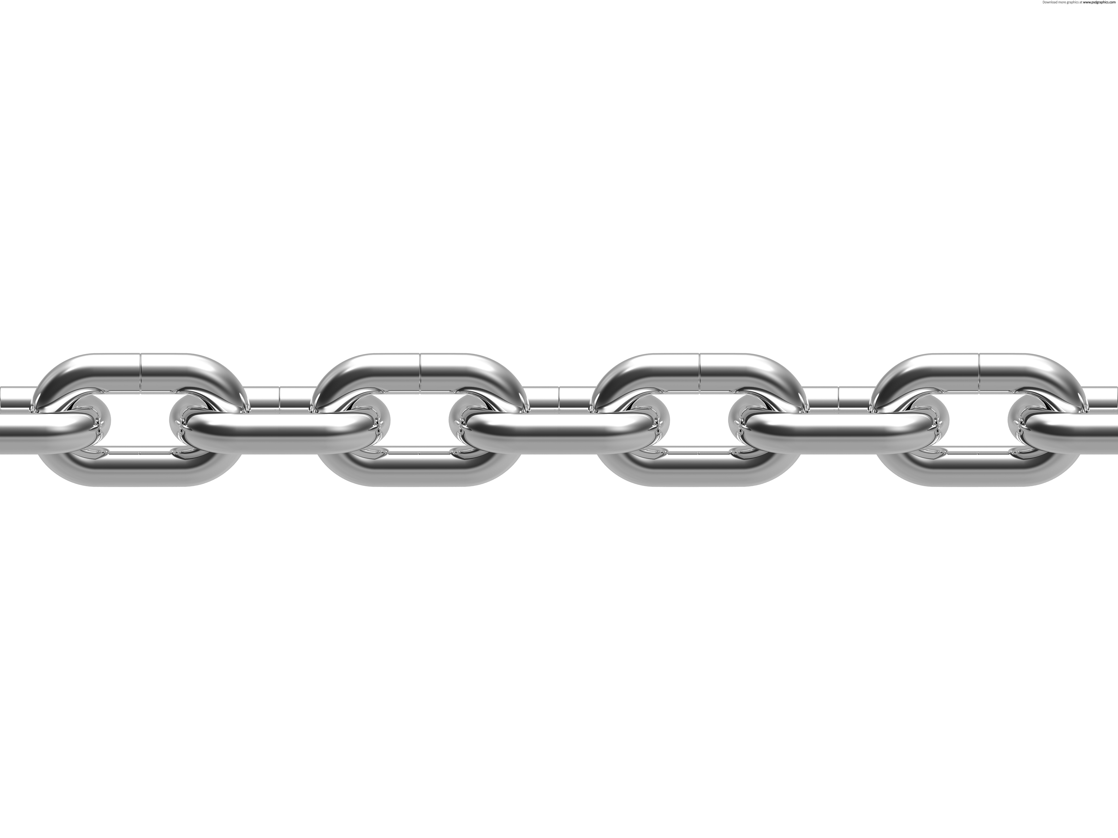

From mathematical tools to real applications
> Take-home messages
Problem
definition
Problem
decomposition
Optimization
technologies
Interactivity
Project
environment
Data
Development
tools
Visualization

