Slide 1
Temporal Linear Relaxation in IBM ILOG CP Optimizer
Philippe Laborie, Jerome Rogerie
Optimization CP Team
IBM ILOG France Lab
laborie@fr.ibm.com , rogerie@fr.ibm.com

Slide 2
Rationale
We present a loose coupling between a linear relaxation and a CP engine Large Neighborhood Iteration.
The relaxation exploits the dominant structures of the problem to provide well informed guidelines for the completion strategy.
We apply this idea for having a robust automatic search for scheduling problems involving irregular costs
  tardiness cost, non convex temporal costs, non execution cost, execution mode cost, or length and workload costs

Slide 3
IBM ILOG CP Optimizer
A constraint programming library
  integer variable and numerical expressions
  Algebraic language and global logical constraints
  Extension interface by encoding your own constraints and search traversal solution generation
Automatic search and optimization
Specific algebraic modeling language for temporal problems

Slide 4
Temporal Model in CPO
Based on the notion of interval as a temporal segment
    [s, e) s ≤ e integers, l = e – s
Interval variables
  Decisions
    Is the interval present in the solution
    Start and end points of a present interval
  Domain
dom(a) ⊆ {⊥} ∪ { [s,e) | s,e∈ℤ, s≤e }
  Ranges
    start, end, and length integer ranges (notation s, e, l), presence Boolean range (notation x)
  Presence Constraint
    presenceOf(a) states ⊥ not in dom(a)

Slide 5
Precedence and Implication graphs
All precedences between interval variables are collected in a precedence graph
  a ends before start of b means:
  if a and b are present then s(a) ≤ e(b)
All implications between interval variables are collected in an implication graph
  The constraint presenceOf(a) ≤ presenceOf(b) adds the arc (a implies b)

Slide 6
Breakdown structure
The breakdown structure of a task is stated thanks to alternative and span constraints on interval variables.
a
a
XOR
b₁
b₄
b₅
b₁
b₂
b₃
b₂
b₃

Slide 7
Resources and objective terms
Resources are structures defined everywhere in time (between origin and horizon)
  Lines (segmented integer functions)
      {([s_{i}, e_{i}), v_{i}) integers, s_{i} ≤ e_{i}, 0 ≤ v_{i}, e_{i} ≤ s_{i+1}}
    Calendar, cumulative, state resources, oven, …
  Sequence of intervals
    permutation of a set of intervals linked by precedences
    Disjunctive resources, transportation systems, batches, campaign, …
Numerical expressions are functions of ranges of the intervals.
  Example startOf(a, v) is the value of the start point of a if present, v if a is absent
  Start, end, length, height of cumul, next or previous values on sequences, …

Slide 8


LNS in CPO temporal problems
Issue is having a robust iterative procedure for scheduling problems including presence (alternative, optional tasks) costs, early tardy costs, and duration (or workload) costs,
  Main hypothesis is the cost is dominated by the time placement.
  The incumbent is relaxed in a Preferred Ordered Set (POS) given by a acyclic precedence network.
  The LNS moves consist in selecting a fragment of the POS
Incumbent
Interval variable assignments
Objective value
Model elements
Lines, sequences, span, alternative, expressions
POS
Acyclic Precedence network of present intervals
Absent Intervals
Move
Model + POS Fragment + better objective constraint

Slide 9
TLR Guideline
The tree search completion procedure generating solutions is essentially a chronological decisions procedure on the interval variables presence and end-points
Eventually a Temporal Linear Relaxation (TLR) is computed at the fix point of the initial propagation of the move and solved by Linear Programming.
  The TLR is used as a guide for date decision selections and presence values.
Tree search
Chronology
TLR Guide
Propagation
Dominance
Fragment
Selection
Structured
Random
Incumbent
POS

Slide 10
Notations for the TLR formulation
Notations in the Linear model
  Interval ranges define the range variables s, e, l in the LP
  Interval range presence: x boolean
A CP numerical range or expression defines a range variable v whose bound are set from the current domain in the propagation engine.
v in [V_{min}, V_{max}]

Slide 11
Principle of the TLR formulations
The implication graph is stated by binary constraints:
x(a) ≤ x(b)
The precedence graph is stated thanks to big-M constraints reified by known implications (y in start or end point) (including e = s + l for an interval variable)
y₁ – y₂ + delay – M₁(1- x₁) - M₂(1 – x₂) ≤ 0
From the set of precedences for each y in s, e and l of an interval variable, we state Y_{o} in [Y_{min}, Y_{max}] as the value of y when the interval is absent (x = 0) and such that Y_{o} tightens the big-M constraints.
The TLR formulation is then calculated from objective terms introspection.
x₁ implies x₂
x₁ implies not x₂
x₁ and x₂ present

Slide 12
Unary constraints or expressions
F
Convex domain
in TLR
y
Current domain of y in CP
The expression is a numerical function of the range y (in s, e, l) of the interval. For example a piecewise linear function.
The value of the expression is v_{a} when the interval is absent. Be v_{p} the linear relaxation of V when the interval is present
v = x*v_{p} + (1-x)*v_{a}
The expression defines a range variable v in the TLR that is initialized from the current bounds of y in the propagation engine [V_{min}, V_{max}]
The idea is to used the absence values in the precedence graph relaxation to state the big-M constraint.
Be V_{o} the value of F for Y_{o}, the formulation is: v = v_{p} + x(v_{a} - V_{o})

Slide 13
Binary constraints and expressions
A full examples is shown in the paper for the overlap length of two intervals.
The general formulation is v = x₁*x₂*v_{p} + (1 –x₁*x₂)*v_{a}
From the implication graph (when possible e.g. x1 is equivalent with x2) we used a similar formulation as for unary expressions:
v = v_{p}(a₁, a₂) + x*(v_{a} – V_{o}(a1, a2))
v_{p} formulation:
  Binary expressions usually expresses some temporal disjunction between the interval variables
  The formulation of v_{p} is improved by cuts computed from
    The current domain of a₁ and a₂ in the propagation engine.
    Eventual precedence graph arcs involving a₁ and a₂.

Slide 14
Other elements of the model
Breakdown structures are composition of temporal constraints and logical constraints
  an alternative is a SOS constraints on presence variables + synchronization of end-points of intervals
Resource constraints are still captured by frozen precedence arcs of the POS
  TLR formulations use rough energetic relaxations
Numerical expression formulations use similar convex relaxations as the piecewise linear function formulations

Slide 15
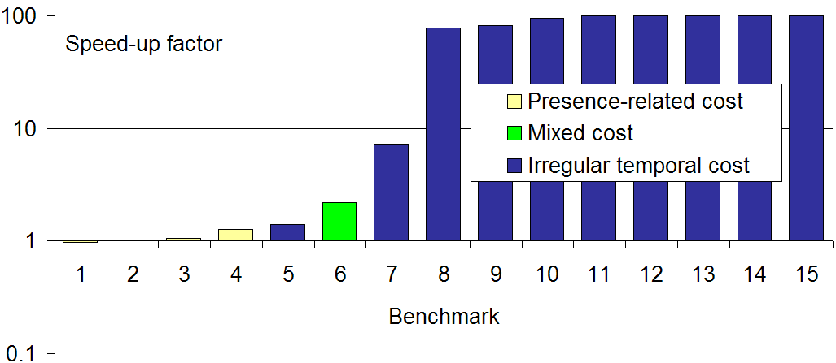
Experimental Results
15 scheduling benchmarks comparing the iterative procedure with against without the TLR guide. The LP is ILOG IBM Cplex.
Speed up is relative to the time at which the compared algorithms reached the same objective value under a global time limit.
A caped 100 factor are problems such that the without TLR procedure never reaches even the first incumbent of the with TLR procedure.

Slide 16
Conclusion
The TLR formulation as a guide is a very effective method for optimizing non regular scheduling costs
  The TLR tends to be very informative as most of the resource constraints are still captured by frozen precedence arcs of the POS.
Future works will concern both the control and the diversification of the temporal relaxation by:
  Controlling the size and the content of the TLR depending on the characteristics of the problem and the current impact on the search,
  Exploring stronger relaxations in the TLR, for instance by solving a MILP enforcing the Boolean presence status of interval variables,
  Considering concurrent relaxations that exploits other dominant structures of the problem like capacity planning or sequencing sub-problems.

