Slide 1
Modeling and Solving Scheduling Problems with CP Optimizer
Philippe Laborie
CPLEX Optimization Studio Team

Slide 2
Agenda
IBM ILOG CP Optimizer for Scheduling
Scheduling concepts in CP Optimizer
Tips and Tools
Q&A

Slide 3
IBM ILOG CP Optimizer for Scheduling
Scheduling consist of assigning starting and completion times to a set of activities while satisfying different types of constraints (resource availability, precedence relationships, … ) and optimizing some criteria (minimizing tardiness, …)
Time is considered as a continuous dimension: domain of possible start/completion times for an activity is potentially very large
Beside start and completion times of activities, other types of decision variables are often involved in real industrial scheduling problems (resource allocation, optional activities …)
start
end
activity
Time

Slide 4
IBM ILOG CP Optimizer for Scheduling
Modeling and solving scheduling problems
Model & run
paradigm
User-implemented
resolution
MIP
(CPLEX)
dispatching rules,
heuristics,
meta-heuristics

Slide 5
IBM ILOG CP Optimizer for Scheduling
Modeling and solving scheduling problems
  Dedicated modeling concepts for scheduling
    Consistent with Optimization paradigm:
new decision variables, expressions and constraints
    Available in OPL and APIs (C++, Java, .NET)
  Automatic search
    Complete
    Combines tree search, large neighborhood search, meta-heuristics, relaxations, learning, ...
Model & run
paradigm
User-implemented
resolution
MIP
(CPLEX)
CP Optimizer
for Scheduling
dispatching rules,
heuristics,
meta-heuristics

Slide 6
Agenda
IBM ILOG CP Optimizer for Scheduling
Scheduling concepts in CP Optimizer
Tips and Tools
Q&A

Slide 7
Concept: interval variable
What for?
  modeling an interval of time during which a particular property holds (an activity executes, a resource is idle, a tank must be non-empty, …)
Example:
dvar interval x in 0..1000 size in 10..20
0
[10,20]
1000
Interval variable
Time

Slide 8
Concept: interval variable
dvar interval x in 0..1000 size in 10..20
Properties:
  The value of an interval variable is an integer interval [start,end)
  Domain of possible values: [0,10), [1,11), [2,12),...[990,1000), [0,11),[1,12),...
  Domain of interval variables is represented compactly in CP Optimizer (a few bounds: smin, smax, emin, emax, szmin, szmax)
0
[10,20]
1000
Interval variable
Time

Slide 9
Concepts: optional interval variable
Interval variables can be defined as being optional that is, it is part of the decisions of the problem to decide whether the interval will be present or absent in the solution
What for?
  Modeling optional activities, alternative execution modes for activities, and … most of the discrete decisions in a schedule
Example:
dvar interval x optional in 0..1000
size in 10..20
Properties:
  An optional interval variable has an additional possible value in its domain (absence value)
  Optionality is a powerful property that you must learn to leverage in your models (more on this later ...)

Slide 10
Concept: precedence constraint
What for ?
  Modeling temporal constraints between interval variables
Example:
a
endBeforeStart(a,b)
startBeforeStart(a,b)
startBeforeEnd(a,b)
endBeforeEnd(a,b)
endAtStart(a,b)
startAtStart(a,b)
startAtEnd(a,b)
endAtEnd(a,b)
b

Slide 11
Concept: precedence constraint
What for ?
  Modeling temporal constraints between interval variables
  Modeling constant or variable minimal delays
Example:
z
endBeforeStart(a,b,z)
startBeforeStart(a,b,z)
startBeforeEnd(a,b,z)
endBeforeEnd(a,b,z)
endAtStart(a,b,z)
startAtStart(a,b,z)
startAtEnd(a,b,z)
endAtEnd(a,b,z)
a
b

Slide 12
Concept: precedence constraint
Properties
  Semantic of the constraints handles optionality (as for all constraints in CP Optimizer). Example of endBeforeStart:
present(a) AND present(b) ⇒ end(a)+z ≤ start(b)
  All precedence constraints are aggregated in a temporal network and handled by dedicated graph algorithms (fast global propagation, negative cycle detection, ...)

Slide 13
Concept: presence constraint
What for:
  Expressing dependency constraints between execution of optional activities or between allocated resources …
Examples:
a
b
presenceOf(a) => presenceOf(b)
presenceOf(a) == presenceOf(b)
presenceOf(a) => !presenceOf(b)
!presenceOf(a) => presenceOf(b)

Slide 14
Concept: presence constraint
Properties:
  All binary constraints between presence status are aggregated in an implication graph
  CP Optimizer maintains hypothetical bounds on interval variables (e.g. start min would the interval be present)
  CP Optimizer exploits the implication graph to perform conditional reasoning between related interval variables

Slide 15
Concept: expressions on interval variables
What for?
  Evaluating a characteristic of an interval variable (start, end, size) for use in the objective function or in a constraint
Example:
  endOf(a, ABSVAL) takes value ABSVAL if interval a is absent otherwise it takes value e if a is present and a=[s,e)
  Typical makespan expression: max(i in 1..n) endOf(a[i])

Slide 16
Concept: expressions on interval variables
What for?
  Evaluating a piecewise linear function at a particular end-point of an interval variable (earliness-tardiness cost, temporal preference)
Example:
  endEval(f,a, ABSVAL) takes value ABSVAL if a is absent otherwise it takes value f(e) if a is present and a=[s,e)
Property:
  f can be any piecewise linear function (non-continuous, non-convex, ...)
f
a

Slide 17
Concept: cumul function
What for?
  Modeling and constraining cumulative quantities over time (cumulative use of a discrete resource, level of an inventory with producing and consuming tasks)
  Restricting the number of intervals that overlap a given date t
  Forcing a minimal number of intervals to overlap a given date t
  Complex synchronization constraints between interval variables: e.g. between activities producing/consuming in a tank and the set of time-intervals during which the tank is non-empty

Slide 18
Concept: cumul function
Cumul functions are built from atomic functions
A cumul function is the sum of atomic functions or their opposite
pulse(a,h)
stepAtStart(a,h)
stepAtEnd(a,h)
h
h
h
a
a
a

Slide 19
Concept: cumul function
Examples:
  cumulFunction f = pulse(a,2)+pulse(b,1)+pulse(c,3)
  Constraint f<=C (global capacity limit)
  Constraint alwaysIn(f,t0,t1,Cmin,Cmax) (capacity profile)
  Constraint alwaysIn(f,x,Cmin,Cmax) (condition holds over an interval variable x)
f
a
b
c

Slide 20
Concept: cumul function
Properties:
  Complexity of cumul functions is independent of the time scale
  CP Optimizer is able to reason globally over cumul functions

Slide 21
Concept: cumul function
Properties:
  Compare:
    Time-indexed MIP model:
    s[i][t]∈{0,1}: s[i][t]=1 iff a[i] starts at date t
    CP Optimizer model:
∀t, sum(i in …, t' in …) Q[i]*s[i][t']≤ C
t
...
sum(i in …) pulse(a[i],Q[i]) ≤ C
t
a[i]

Slide 22
Concept: cumul function
Example: Resource-Constrained Project Scheduling Problem (RCPSP)
Minimization of project makespan
R1
a3
a6
R2
a7
a1
a2
a5
a4
a8

Slide 23
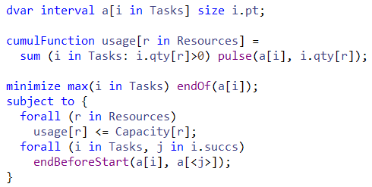
Concept: cumul function
CP Optimizer model for RCPSP:
Comparison of this CP Optimizer model vs a time-indexed MIP model on a set of 300 classical small RCPSP instances (30-120 tasks) + 40 larger ones (900 tasks), time-limit: 2mn, 4 threads

Slide 24
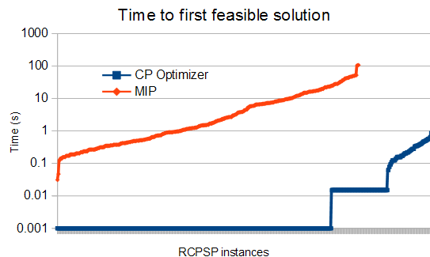
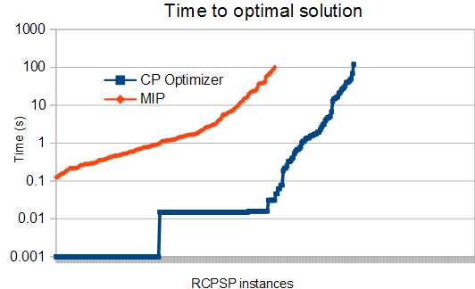
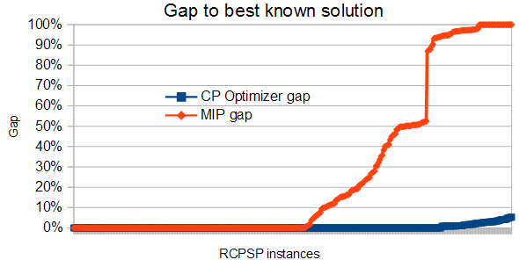
Concept: cumul function
Comparison of CP Optimizer and MIP performance on RCPSP

Slide 25
Concept: sequence variable
What for?
  modeling sequences of events
  constraining the transitions between consecutive events (setup times/costs,...)
Example:
dvar sequence s in all(i in Tasks) a[i]
noOverlap(s)
Properties:
  A value for the sequence variable is a total order on the present interval variables. E.g. a4 → a1 → a3 → a2
  A constraint noOverlap states that intervals of the sequence do not overlap and follows the total order of the sequence
a4
a1
a3
a2
Time

Slide 26
Concept: sequence variable
Properties:
  Complexity is independent of the time scale
  CP Optimizer is able to reason globally over a sequence variable
  Avoid quadratic models over each pair (i,j) of intervals in the sequence
Compare:
  Quadratic disjunctive MIP formulation with big-Ms:
b[i][j]∈{0,1}: b[i][j]=1 iff a[i] before a[j]
end[i] <= start[j] + M*(1-b[i][j])
end[j] <= start[i] + M*b[i][j]
  CP Optimizer model:
noOverlap(all(i in …) a[i])
a[i]
a[j]
…
Time

Slide 27
Concept: sequence variable
Example: Job-shop Scheduling Problem
Minimization of makespan
op11
op12
op13
M1
op21
op22
op23
M2
op31
op32
op33
M3
op41
op42
op43

Slide 28
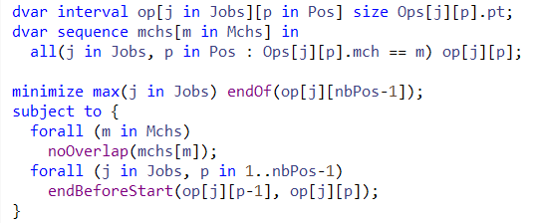
Concept: sequence variable
CP Optimizer model for Job-shop:
Comparison of this CP Optimizer model vs a disjunctive MIP formulation on a set of 140 classical Job-shop instances (50-2000 tasks), time-limit: 2mn, 4 threads

Slide 29
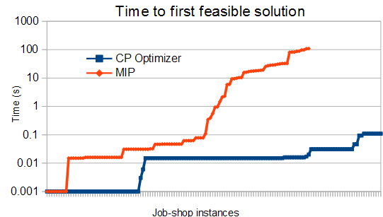
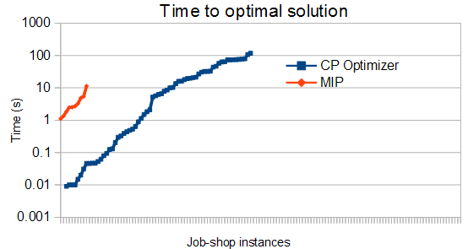
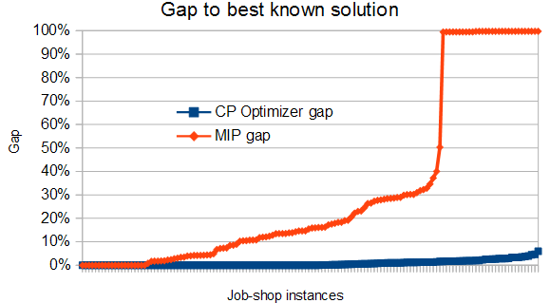
Concept: sequence variable
Comparison of CP Optimizer and MIP performance on Job-Shop

Slide 30
Concept: state function
What for?
  Modeling evolution of a state variable over time
  Modeling incompatibility relations between activities overlapping a given date t
  Synchronizing start/end value of compatible tasks (batching)
Example
Properties
  Complexity is independent of the time scale
  CP Optimizer is able to reason globally over a state function
  Avoid quadratic models over each pair (i,j) of incompatible intervals on the state function
400˚F
500˚F
500˚F
600˚F
Time

Slide 31
Concept: span constraint
What for?
  Modeling task → sub-task decomposition
  Modeling immobilization time of a resource
Example
span(a,[b1,...,bn])
Properties
  The constraint of course handles optional interval variables
a
b3
b1
b4
b2

Slide 32
Concept: alternative constraint
What for?
  Modeling alternative resource/modes/recipes
  In general modeling a discrete selection in the schedule
Example
alternative(a,[b1,...,bn])
Properties
  Conditional reasoning allows a strong pruning on the alternative master interval variable a
  Master interval variable a can of course be optional
a
b1
Absent interval variables
ALT
b2
Selected interval variable
b3

Slide 33
Concept: span/alternative constraint
What for?
  Modeling Work Breakdown Structure
Example
Task
ALT
Recipe 1
Recipe 2
Recipe 3
op1
op2
op3
ALT

Slide 34
Agenda
IBM ILOG CP Optimizer for Scheduling
Scheduling concepts in CP Optimizer
Tips and Tools
Q&A

Slide 35
Tips and Tools
A measure of complexity of a model:
  Number of variables
  Number of groups of variables with different semantics
  Number of variable types (integer variables / interval variables)
Take advantage of the expressiveness of the CP Optimizer modeling language to compact the model by decreasing the above indicators
In particular if in a scheduling model, you are creating 1 decision variable for each time point t you are usually in bad shape
Exploit the scheduling concepts to reason on time-lines (sequence variables, cumul functions, state functions) and avoid an explicit representation of time

Slide 36
Tips and Tools
A measure of complexity of a model is the number of constraints
If the number of constraints grows more than linearly with the number of variables or the size of variables domains, the model will probably not scale well
Furthermore, if a set of many small constraints can be reformulated more compactly, this often leads to stronger inference in the engine
Example: when you need to model activities (and more generally intervals of time) that -under some conditions- cannot overlap, think of using sequence variables, noOverlap constraints and/or state functions

Slide 37

Tips and Tools
Be careful when using composite constraints
In scheduling models, exploit optionality of interval variables
Examples :
  presenceOf(a)*endOf(a)+(1-presenceOf(a))*K USE: endOf(a,K)
  presenceOf(a) => (10<=startOf(a)) USE: 10<=startOf(a,10)
Remarks:
  Exception: Binary logical constraints on presence status (like presenceOf(a) => presenceOf(b)) are handled in a special (and efficient) way in the engine
  Except for constraint “presenceOf”, all constraints on scheduling constructs (interval and sequence variables, cumul and state functions) cannot be used in composite constraints

Slide 38
Tips and Tools
Surrogate constraints may help to reduce the search space
A surrogate constraint is a constraint that does not change the set of solutions (but may be useful for the search by allowing a better pruning of the search space)
Some examples :
  Redundant cumul function for alternative resources

Slide 39
Tips and Tools
Surrogate constraints may help to reduce the search space
A surrogate constraint is a constraint that does not change the set of solutions (but may be useful for the search by allowing a better pruning of the search space)
Some examples :
  Redundant cumul function for alternative resources
  Redundant precedence constraints
min(z11,z12,z21,z22)
a
b
z11
ALT
a1
b1
ALT
z12
z21
a2
z22
b2

Slide 40
Tips and Tools
Some classical patterns in scheduling models
  Chain of optional interval variables
  Optional intervals in paths of precedence constraints
  Multilevel alternatives
  Temporal alternatives
See bonus material at the end of the slide deck

Slide 41
Tips and Tools
Questions:
  Why is my model infeasible ?
  Search does not find any feasible solution, what should I do ?
  Search does not converge fast enough, what should I do ?
  Does my model improvement really help?

Slide 42
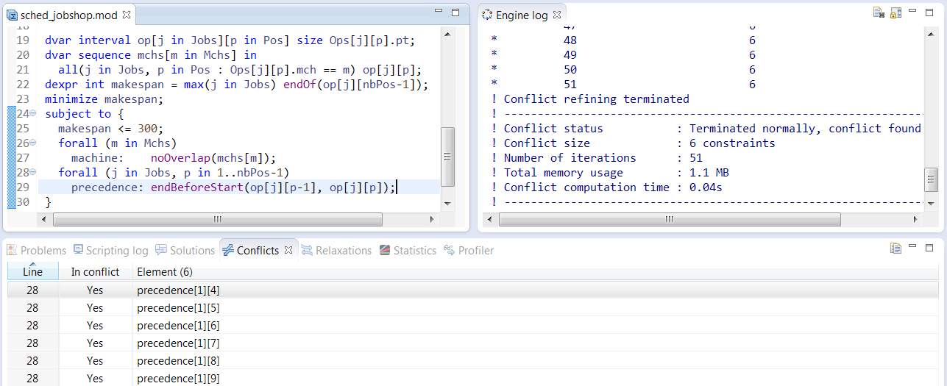
Tips and Tools
Why is my model infeasible ?
  Conflict refiner → Fix/relax model

Slide 43
Tips and Tools
The engine log is an essential tool for understanding how the engine behaves on a given model
! -----------------------------------------------------------------------
! Minimization problem - 110 variables, 100 constraints
! LogPeriod = 100,000
! Workers = 2
! Initial process time : 0.00s (0.00s extraction + 0.00s propagation)
! . Log search space : 664.4 (before), 664.4 (after)
! . Memory usage : 1.1 MB (before), 1.2 MB (after)
! Using parallel search with 2 workers.
! -----------------------------------------------------------------------
! Best Branches Non-fixed W Branch decision
* 1,062 739 0.01s 1 -
...
* 936 136k 3.69s 1 -
936 300k 85 2 F on op#0#9
! Time = 4.05s, Explored branches = 450,928, Memory usage = 7.7 MB
! Best Branches Non-fixed W Branch decision
* 930 166k 4.55s 1 -
930 200k 110 1 F on op#5#1
! -----------------------------------------------------------------------
! Search terminated normally, 17 solutions found.
! Best objective : 930 (optimal - effective tol. is 0)
! Number of branches : 641,352
! Number of fails : 266,640
! Total memory usage : 6.9 MB (6.4 MB CP Optimizer + 0.5 MB Concert)
! Time spent in solve : 5.99s (5.99s engine + 0.00s extraction)
! Search speed (br. / s) : 107,070.5
! -----------------------------------------------------------------------
Problem
characteristics

Slide 44
Tips and Tools
The engine log is an essential tool for understanding how the engine behaves on a given model
! -----------------------------------------------------------------------
! Minimization problem - 110 variables, 100 constraints
! LogPeriod = 100,000
! Workers = 2
! Initial process time : 0.00s (0.00s extraction + 0.00s propagation)
! . Log search space : 664.4 (before), 664.4 (after)
! . Memory usage : 1.1 MB (before), 1.2 MB (after)
! Using parallel search with 2 workers.
! -----------------------------------------------------------------------
! Best Branches Non-fixed W Branch decision
* 1,062 739 0.01s 1 -
...
* 936 136k 3.69s 1 -
936 300k 85 2 F on op#0#9
! Time = 4.05s, Explored branches = 450,928, Memory usage = 7.7 MB
! Best Branches Non-fixed W Branch decision
* 930 166k 4.55s 1 -
930 200k 110 1 F on op#5#1
! -----------------------------------------------------------------------
! Search terminated normally, 17 solutions found.
! Best objective : 930 (optimal - effective tol. is 0)
! Number of branches : 641,352
! Number of fails : 266,640
! Total memory usage : 6.9 MB (6.4 MB CP Optimizer + 0.5 MB Concert)
! Time spent in solve : 5.99s (5.99s engine + 0.00s extraction)
! Search speed (br. / s) : 107,070.5
! -----------------------------------------------------------------------
Modified
parameter values

Slide 45
Tips and Tools
The engine log is an essential tool for understanding how the engine behaves on a given model
! -----------------------------------------------------------------------
! Minimization problem - 110 variables, 100 constraints
! LogPeriod = 100,000
! Workers = 2
! Initial process time : 0.00s (0.00s extraction + 0.00s propagation)
! . Log search space : 664.4 (before), 664.4 (after)
! . Memory usage : 1.1 MB (before), 1.2 MB (after)
! Using parallel search with 2 workers.
! -----------------------------------------------------------------------
! Best Branches Non-fixed W Branch decision
* 1,062 739 0.01s 1 -
...
* 936 136k 3.69s 1 -
936 300k 85 2 F on op#0#9
! Time = 4.05s, Explored branches = 450,928, Memory usage = 7.7 MB
! Best Branches Non-fixed W Branch decision
* 930 166k 4.55s 1 -
930 200k 110 1 F on op#5#1
! -----------------------------------------------------------------------
! Search terminated normally, 17 solutions found.
! Best objective : 930 (optimal - effective tol. is 0)
! Number of branches : 641,352
! Number of fails : 266,640
! Total memory usage : 6.9 MB (6.4 MB CP Optimizer + 0.5 MB Concert)
! Time spent in solve : 5.99s (5.99s engine + 0.00s extraction)
! Search speed (br. / s) : 107,070.5
! -----------------------------------------------------------------------
Root node
information

Slide 46
Tips and Tools
The engine log is an essential tool for understanding how the engine behaves on a given model
! -----------------------------------------------------------------------
! Minimization problem - 110 variables, 100 constraints
! LogPeriod = 100,000
! Workers = 2
! Initial process time : 0.00s (0.00s extraction + 0.00s propagation)
! . Log search space : 664.4 (before), 664.4 (after)
! . Memory usage : 1.1 MB (before), 1.2 MB (after)
! Using parallel search with 2 workers.
! -----------------------------------------------------------------------
! Best Branches Non-fixed W Branch decision
* 1,062 739 0.01s 1 -
...
* 936 136k 3.69s 1 -
936 300k 85 2 F on op#0#9
! Time = 4.05s, Explored branches = 450,928, Memory usage = 7.7 MB
! Best Branches Non-fixed W Branch decision
* 930 166k 4.55s 1 -
930 200k 110 1 F on op#5#1
! -----------------------------------------------------------------------
! Search terminated normally, 17 solutions found.
! Best objective : 930 (optimal - effective tol. is 0)
! Number of branches : 641,352
! Number of fails : 266,640
! Total memory usage : 6.9 MB (6.4 MB CP Optimizer + 0.5 MB Concert)
! Time spent in solve : 5.99s (5.99s engine + 0.00s extraction)
! Search speed (br. / s) : 107,070.5
! -----------------------------------------------------------------------
New incumbent
solutions (time, worker)

Slide 47
Tips and Tools
The engine log is an essential tool for understanding how the engine behaves on a given model
! -----------------------------------------------------------------------
! Minimization problem - 110 variables, 100 constraints
! LogPeriod = 100,000
! Workers = 2
! Initial process time : 0.00s (0.00s extraction + 0.00s propagation)
! . Log search space : 664.4 (before), 664.4 (after)
! . Memory usage : 1.1 MB (before), 1.2 MB (after)
! Using parallel search with 2 workers.
! -----------------------------------------------------------------------
! Best Branches Non-fixed W Branch decision
* 1,062 739 0.01s 1 -
...
* 936 136k 3.69s 1 -
936 300k 85 2 F on op#0#9
! Time = 4.05s, Explored branches = 450,928, Memory usage = 7.7 MB
! Best Branches Non-fixed W Branch decision
* 930 166k 4.55s 1 -
930 200k 110 1 F on op#5#1
! -----------------------------------------------------------------------
! Search terminated normally, 17 solutions found.
! Best objective : 930 (optimal - effective tol. is 0)
! Number of branches : 641,352
! Number of fails : 266,640
! Total memory usage : 6.9 MB (6.4 MB CP Optimizer + 0.5 MB Concert)
! Time spent in solve : 5.99s (5.99s engine + 0.00s extraction)
! Search speed (br. / s) : 107,070.5
! -----------------------------------------------------------------------
Periodical log
with fail information,
number of unfixed
variables, current decision

Slide 48
Tips and Tools
The engine log is an essential tool for understanding how the engine behaves on a given model
! -----------------------------------------------------------------------
! Minimization problem - 110 variables, 100 constraints
! LogPeriod = 100,000
! Workers = 2
! Initial process time : 0.00s (0.00s extraction + 0.00s propagation)
! . Log search space : 664.4 (before), 664.4 (after)
! . Memory usage : 1.1 MB (before), 1.2 MB (after)
! Using parallel search with 2 workers.
! -----------------------------------------------------------------------
! Best Branches Non-fixed W Branch decision
* 1,062 739 0.01s 1 -
...
* 936 136k 3.69s 1 -
936 300k 85 2 F on op#0#9
! Time = 4.05s, Explored branches = 450,928, Memory usage = 7.7 MB
! Best Branches Non-fixed W Branch decision
* 930 166k 4.55s 1 -
930 200k 110 1 F on op#5#1
! -----------------------------------------------------------------------
! Search terminated normally, 17 solutions found.
! Best objective : 930 (optimal - effective tol. is 0)
! Number of branches : 641,352
! Number of fails : 266,640
! Total memory usage : 6.9 MB (6.4 MB CP Optimizer + 0.5 MB Concert)
! Time spent in solve : 5.99s (5.99s engine + 0.00s extraction)
! Search speed (br. / s) : 107,070.5
! -----------------------------------------------------------------------
Final information
with solution status
and search statistics

Slide 49
Tips and Tools
Search does not find any feasible solution, what should I do ?
  Identify which part of the model is hard:
    Simplify problem by removing “easy” constraints
    Search log helps (set LogPeriod=1, look where first fails occur)
  Strengthen the model:
    Be careful with composite constraints
    Add surrogate constraints
    Break symmetries
  Increase inference levels in the engine

Slide 50
Tips and Tools
Search does not find any feasible solution, what should I do ?
  Try using search phases to first focus on the difficult decision variables
  Solve the problem as two sub-problems:
    Finding an initial feasible solution (some difficult constraints can be relaxed and put in the objective function*), then
    Optimize starting from this solution. Consider using starting points.
  Isolate the different sources of complexity in the model by decomposition and sequential resolutions. Consider using starting points
  (*) CP Optimizer's concepts makes it easy to relax part of the model. E.g. make some interval variables optional and maximize number of present intervals, relax deadlines as tardiness costs

Slide 51
Tips and Tools
Search does not converge fast enough, what should I do ?
  Identify and try to isolate the different sources of complexity in your model, first focusing on bottleneck/important parts in a “simplified” model
  Exploit results of previous solve as (1) additional constraints and/or (2) starting point and/or (3) heuristic (search phases)
  Do not hesitate to use MIP models in some steps, exploit strengths of each technology (MIP/CP)
    For instance CP is good at deciding activities start/end times under resource constraints when required resource quantities and activity durations are fixed or mostly depend on activity start/end dates
    For problems with very variable resource quantities or activity durations, it makes sense to consider an initial MIP model that works on these variables (example: lot sizing)

Slide 52
Tips and Tools
Does my model improvement really help?
  CP Optimizer's search relies on a stochastic algorithm initialized by a random seed (parameter IloCP::RandomSeed)
  For a given model, the solution depends on the random seed
  Best solution cost at a given time limit:
  Is model B better than model A ? Yes
cost
cost
seed=1
seed=1
Model A
Model B

Slide 53
Tips and Tools
Does my model improvement really help?
  CP Optimizer's search relies on a stochastic algorithm initialized by a random seed (parameter IloCP::RandomSeed)
  For a given model, the solution depends on the random seed
  Best solution cost at a given time limit:
  Is model B better than model A ? Yes
cost
cost
Never evaluate a
model change on
a single instance/seed !
seed=1
seed=1
Model A
Model B
No!

Slide 54
Conclusion
For scheduling problems, CP Optimizer extends the Model&run paradigm with some (few) general concepts (interval & sequence variables, cumul & state functions, …)
These concepts can be used to model scheduling problems in a compact way that avoids enumeration of time. Typically, the size of a scheduling model in CP Optimizer grows linearly with the size of the data
When combined together these concepts provide an expressive language capable of handling complex and large industrial scheduling problems
The automatic search is complete, it exploits these concepts using an efficient and robust combination of techniques from scheduling theory, meta-heuristics, CP, MP

Slide 55

Agenda
IBM ILOG CP Optimizer for Scheduling
Scheduling concepts in CP Optimizer
Tips and Tools
Q&A

Slide 56
Bonus material
List of most useful parameters for search analysis:
  Workers (=1)
  LogPeriod (=1)
  SearchType (=DepthFirst)
  FailLimit, SolutionLimit (=1)
List of most useful parameters for performance tuning:
  TimeLimit
  TemporalRelaxation (=Off)
  Workers
  SearchType (=Restart|MultiPoint)
  Some inference levels:
    NoOverlapInferenceLevel
    CumulFunctionInferenceLevel

Slide 57
Bonus material: classical patterns in scheduling models
Chain of optional interval variables
  Use cases: any phenomenon that is associated with a set of consecutive time intervals whose number is not known a-priori
  Examples: partially preemptive activities, intervals during which a resource is in use, …
Model is a chain of precedence and implication constraints between optional interval variables
endBeforeStart(a[i],a[i+1]);
presenceOf(a[i+1]) => presenceOf(a[i]);
This ensures that only the first k intervals will be present where k is an implicit decision of the problem
a1
a2
...
ai
ai+1
...
an

Slide 58
Bonus material: classical patterns in scheduling models
Optional intervals in paths of precedence constraints
  Use case: a precedence graph with optional activities such that path of precedence constraints going through absent activities should still be considered
  Example: a → b → c, precedence a → c should be considered even if b is absent
  Direct model using endBeforeStart(a,b), endBeforeStart(b,c) does not work as both constraints are inactive if b is absent
Idea 1: Add endBeforeStart(x,y) constraints of the transitive closure. Issue: may add a quadratic number of constraints
Idea 2: Use additional non-optional interval variables A, B, C of free length synchronized with a, b, c (startAtStart, endAtEnd)
a
b
c
A
B
C

Slide 59
Bonus material: classical patterns in scheduling models
Multi-level alternatives
  Use case: an activity needs to select an element in a Cartesian product
  Example: an activity A needs 1 worker Wi among n to be executed at 1 given position Pj among m. Duration depends both on the worker Wi and the position Pj. Specific constraints need to be posted on all activities executing at a position Pj (e.g. space limitation) while other constraints need to be posted on all activities executed by a given worker Wi (e.g. noOverlap)
Idea: create one optional interval variable AW[i] for activity A executing on worker Wi and one optional interval variable AP[j] for activity A executing a position Pj

Slide 60
Bonus material: classical patterns in scheduling models
Multi-level alternatives
Idea: create one optional interval variable AW[i] for activity A executing on worker Wi and one optional interval variable AP[j] for activity A executing at position Pj
AW[1]
APW[1][1]
APW[1][j]
APW[1][m]
AW[i]
APW[i][1]
APW[i][j]
APW[i][m]
AW[n]
APW[n][1]
APW[n][j]
APW[n][m]
A
AP[1]
AP[j]
AP[m]

Slide 61
Bonus material: classical patterns in scheduling models
Temporal alternatives
  Alternative constraints are not restricted to model disjunctions of resources/modes/recipes, they can also be used to represent temporal disjunction
  Use-case: an activity must execute during a disjunctive set of possible time-windows
Alternative models that directly work on interval variable a are possible (use cumulFunction or forbidExtent). They will be lighter (less variables) but will propagate less.
a1
a2
a3
ALT
a

Slide 62
Bonus material
Technical papers related with scheduling in CP Optimizer
  P. Laborie, J. Rogerie. Temporal Linear Relaxation in IBM ILOG CP Optimizer. Proc. MISTA 2013. Ghent, Belgium. Aug. 2013.
  P. Laborie, J. Rogerie , P. Shaw, P. Vilím. Reasoning with Conditional Time-intervals, Part II: an Algebraical Model for Resources. Proc. FLAIRS 2009.
  P. Vilím. Max Energy Filtering Algorithm for Discrete Cumulative Resources. Proc. CPAIOR 2009. p294-308.
  P. Laborie. IBM ILOG CP Optimizer for Detailed Scheduling Illustrated on Three Problems. Proc. CPAIOR 2009. p148-162.
  P. Vilím. Edge Finding Filtering Algorithm for Discrete Cumulative Resources in O(kn log n). Proc. CP 2009. p802-816.
  P. Laborie, J. Rogerie. Reasoning with Conditional Time-intervals. Proc. FLAIRS 2008, p555-560.
  P. Laborie, D. Godard. Self-Adapting Large Neighborhood Search: Application to single-mode scheduling problems. Proc. MISTA 2007. Paris, France. Aug. 2007.
  D. Godard, P. Laborie, W. Nuijten. Randomized Large Neighborhood Search for Cumulative Scheduling. Proc. ICAPS-05. Monterey, California (USA). June 2005.

