Slide 1
Philippe Laborie
09/03/2015
Solving Scheduling Problems with
CP Optimizer (for CPLEX Users)
Notes:
IBM Big Data & Analytics
© 2014 IBM Corporation

Slide 2
Please Note: This document contains IBM confidential material
IBM’s statements regarding its plans, directions, and intent are subject to change or withdrawal without notice at IBM’s sole discretion.
Information regarding potential future products is intended to outline our general product direction and it should not be relied on in making a purchasing decision.
The information mentioned regarding potential future products is not a commitment, promise, or legal obligation to deliver any material, code or functionality. Information about potential future products may not be incorporated into any contract. The development, release, and timing of any future features or functionality described for our products remains at our sole discretion.
Performance is based on measurements and projections using standard IBM® benchmarks in a controlled environment. The actual throughput or performance that any user will experience will vary depending upon many factors, including considerations such as the amount of multiprogramming in the user's job stream, the I/O configuration, the storage configuration, and the workload processed. Therefore, no assurance can be given that an individual user will achieve results similar to those stated here.

Slide 3
Agenda
Introduction:
  CP Optimizer a component of CPLEX Optimization Studio
  Scheduling
  Example: Resource Constrained Project Scheduling Problem
Scheduling concepts in CP Optimizer
Automatic search in CP Optimizer
Some features for accelerating model development
Q&A

Slide 4


CP Optimizer, a component of CPLEX Optimization Studio
  IBM ILOG CPLEX Optimization Studio
  OPL Modeling Language & IDE
APIs:
C++
Java
.NET
CPLEX Optimizer
CP Optimizer
LP
MIP
CSP
COP
QP
...
Scheduling

Slide 5
Scheduling
Scheduling consist of assigning starting and completion times to a set of activities while satisfying different types of constraints (resource availability, precedence relationships, … ) and optimizing some criteria (minimizing tardiness, …)
Time is considered as a continuous dimension: domain of possible start/completion times for an activity is potentially very large
Beside start and completion times of activities, other types of decision variables are often involved in real industrial scheduling problems (resource allocation, optional activities …)
start
end
activity
Time

Slide 6
Example: Resource Constrained Project Scheduling Problem
RCPSP: a very classical academical scheduling problem
  Tasks a_{i} with fixed processing time P_{i}
  Precedence constraints
  Discrete resources with limited instantaneous capacity R_{k}
  Tasks require some quantity of discrete resources
  Objective is to minimize the schedule makespan
R1
a3
a6
R2
a7
a1
a2
a5
a4
a8

Slide 7
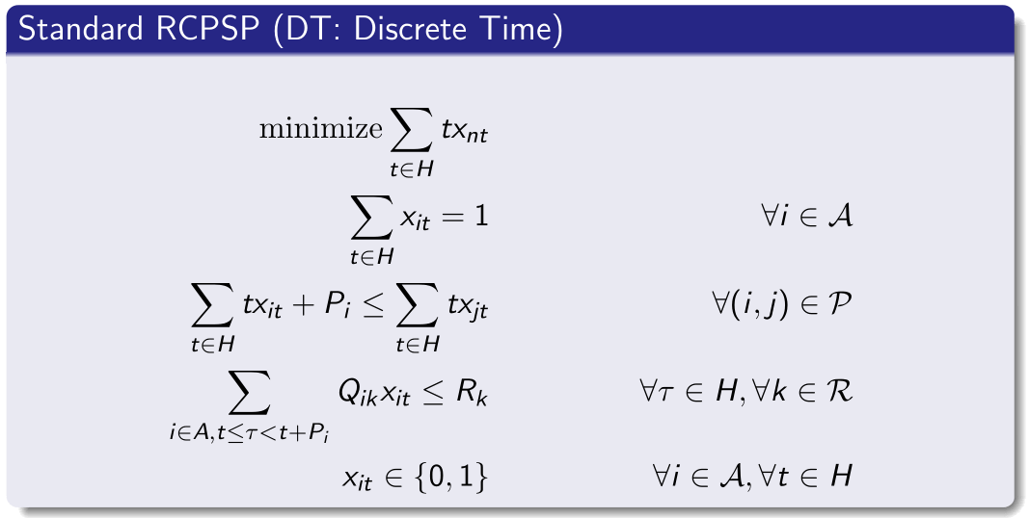
Example: Resource Constrained Project Scheduling Problem
RCPSP: Standard time-indexed MIP formulation
Pi
a_{i}
xit ∈ {0,1}

Slide 8
Example: Resource Constrained Project Scheduling Problem
Comparison of this time-indexed MIP formulation against a simple CP Optimizer model (see later) on a set of:
  300 classical small RCPSP instances (30-120 tasks) +
  40 slightly more realistic larger ones (900 tasks)
  time-limit: 2mn, 4 threads
Note: industrial scheduling problems are often larger, typically several 1.000 tasks (we handled up to 1.000.000 tasks in an RCPSP-like scheduling model)

Slide 9
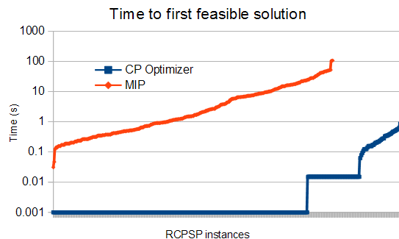
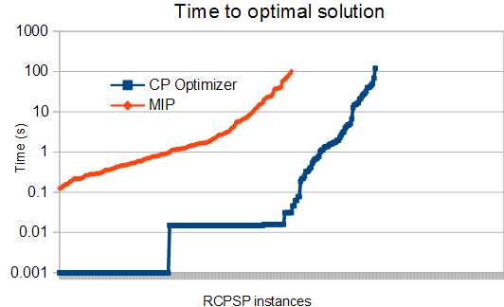
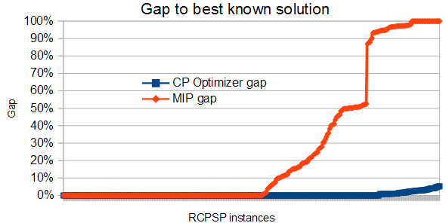
Example: Resource Constrained Project Scheduling Problem
Comparison of CP Optimizer and MIP performance on RCPSP

Slide 10
Example: Resource Constrained Project Scheduling Problem
Some pain points of the MIP approach (also hold for more general scheduling problems) :
  1. Huge number of decision variables:
    Time-indexed formulations grow in O(n.H)
    Other formulations (event-based, precedence-based for disjunctive resources) grow in O(n²)
  2. The time dimension is not exploited. Example: building a first feasible solution by fixing the tasks chronologically is trivial. The MIP engine does not see that.
  3. Global constraints like resource capacities are split into a number of small individual constraints (∀tH) whereas what happens at t+1 is highly correlated with what happens at t.

Slide 11


CP Optimizer for Scheduling
Modeling and solving scheduling problems
Model & run
paradigm
User-implemented
solution
MIP
(CPLEX)
dispatching rules,
heuristics,
meta-heuristics

Slide 12

CP Optimizer for Scheduling
Modeling and solving scheduling problems
  Dedicated modeling concepts for scheduling
    Consistent with Optimization paradigm: new decision variables, expressions and constraints
    Available in OPL and APIs (C++, Java, .NET)
  Automatic search
    Complete (provides optimality proofs)
    Combines tree search, large neighborhood search, meta-heuristics, relaxations, learning, ...
Model & run
paradigm
User-implemented
solution
MIP
(CPLEX)
CP Optimizer
for Scheduling
dispatching rules,
heuristics,
meta-heuristics

Slide 13
Agenda
Introduction:
  CP Optimizer a component of CPLEX Optimization Studio
  Scheduling
  Example: Resource Constrained Project Scheduling Problem
Scheduling concepts in CP Optimizer
Automatic search in CP Optimizer
Some features for accelerating model development
Q&A

Slide 14
Concept: interval variable
What for?
  modeling an interval of time during which a particular property holds (an activity executes, a resource is idle, a tank must be non-empty, …)
Example:
dvar interval x in 0..1000 size in 10..20
0
[10,20]
1000
Interval variable
Time

Slide 15
Concept: interval variable
dvar interval x in 0..1000 size in 10..20
Properties:
  The value of an interval variable is an integer interval [start,end)
  Domain of possible values: [0,10), [1,11), [2,12),...[990,1000), [0,11),[1,12),...
  Domain of interval variables is represented compactly in CP Optimizer (a few bounds: smin, smax, emin, emax, szmin, szmax)
0
[10,20]
1000
Interval variable
Time

Slide 16
Concepts: optional interval variable
Interval variables can be defined as being optional that is, it is part of the decisions of the problem to decide whether the interval will be present or absent in the solution
What for?
  Modeling optional activities, alternative execution modes for activities, and … most of the discrete decisions in a schedule
Example:
dvar interval x optional in 0..1000
size in 10..20
Properties:
  An optional interval variable has an additional possible value in its domain (absence value)
  Optionality is a powerful property that you must learn to leverage in your models (more on this later ...)

Slide 17
Concept: precedence constraint
What for ?
  Modeling temporal constraints between interval variables
Example:
a
endBeforeStart(a,b)
startBeforeStart(a,b)
startBeforeEnd(a,b)
endBeforeEnd(a,b)
endAtStart(a,b)
startAtStart(a,b)
startAtEnd(a,b)
endAtEnd(a,b)
b

Slide 18
Concept: precedence constraint
What for ?
  Modeling temporal constraints between interval variables
  Modeling constant or variable minimal delays
Example:
z
endBeforeStart(a,b,z)
startBeforeStart(a,b,z)
startBeforeEnd(a,b,z)
endBeforeEnd(a,b,z)
endAtStart(a,b,z)
startAtStart(a,b,z)
startAtEnd(a,b,z)
endAtEnd(a,b,z)
a
b

Slide 19
Concept: precedence constraint
Properties
  Semantic of the constraints handles optionality (as for all constraints in CP Optimizer).
Example of endBeforeStart:
present(a) AND present(b) ⇒ end(a)+z ≤ start(b)
  All precedence constraints are aggregated in a temporal network and handled by dedicated graph algorithms (fast global propagation, negative cycle detection, ...)

Slide 20
Concept: presence constraint
What for:
  Expressing dependency constraints between execution of optional activities or between allocated resources …
Examples:
a
b
presenceOf(a) => presenceOf(b)
presenceOf(a) == presenceOf(b)
presenceOf(a) => !presenceOf(b)
!presenceOf(a) => presenceOf(b)

Slide 21
Concept: presence constraint
Properties:
  All binary constraints between presence status (2-SAT) are aggregated in an implication graph
  CP Optimizer maintains hypothetical bounds on interval variables (e.g. start min would the interval be present)
  CP Optimizer exploits the implication graph to perform conditional reasoning between related interval variables

Slide 22
Concept: expressions on interval variables
What for?
  Evaluating a characteristic of an interval variable (start, end, size) for use in the objective function or in a constraint
Example:
  endOf(a, ABSVAL) takes value ABSVAL if interval a is absent otherwise it takes value e if a is present and a=[s,e)
  Typical makespan expression: max(i in 1..n) endOf(a[i])

Slide 23
Concept: cumul function
What for?
  Modeling and constraining cumulative quantities over time (cumulative use of a discrete resource, level of an inventory with producing and consuming tasks)
  Restricting the number of intervals that overlap a given date t
  Forcing a minimal number of intervals to overlap a given date t
  Complex synchronization constraints between interval variables: e.g. between activities producing/consuming in a tank and the set of time-intervals during which the tank is non-empty

Slide 24
Concept: cumul function
Cumul functions are built from atomic functions
A cumul function is the sum of atomic functions or their opposite
pulse(a,h)
stepAtStart(a,h)
stepAtEnd(a,h)
h
h
h
a
a
a

Slide 25
Concept: cumul function
Examples:
  cumulFunction f = pulse(a,2)+pulse(b,1)+pulse(c,3)
  Constraint f<=C (global capacity limit)
  Constraint alwaysIn(f,t0,t1,Cmin,Cmax) (capacity profile)
  Constraint alwaysIn(f,x,Cmin,Cmax) (condition holds over an interval variable x)
f
a
b
c

Slide 26
Concept: cumul function
Properties:
  Complexity of cumul functions is independent of the time scale
  CP Optimizer is able to reason globally over cumul functions

Slide 27
Concept: cumul function
Properties:
  Compare:
    Time-indexed MIP model:
    x[i][t]∈{0,1}: x[i][t]=1 iff a[i] starts at date t
    CP Optimizer model:
∀t, sum(i in …, t' in …) Q[i]*x[i][t']≤ C
t
...
sum(i in …) pulse(a[i],Q[i]) ≤ C
t
a[i]

Slide 28
Concept: cumul function
Example: Resource-Constrained Project Scheduling Problem (RCPSP)
Minimization of project makespan
R1
a3
a6
R2
a7
a1
a2
a5
a4
a8

Slide 29
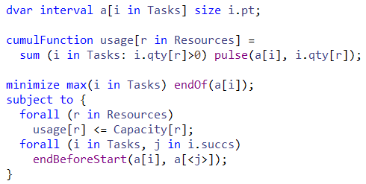
Concept: cumul function
CP Optimizer model for RCPSP:

Slide 30
Concept: sequence variable
What for?
  Modeling sequences of events
  Constraining the transitions between consecutive events (setup times/costs,...)
Example:
dvar sequence s in all(i in Tasks) a[i]
noOverlap(s)
Properties:
  A value for the sequence variable is a total order on the present interval variables. E.g. a4 → a1 → a3 → a2
  A constraint noOverlap states that intervals of the sequence do not overlap and follows the total order of the sequence
a4
a1
a3
a2
Time

Slide 31
Concept: sequence variable
Properties:
  Complexity is independent of the time scale
  CP Optimizer is able to reason globally over a sequence variable
  Avoid quadratic models over each pair (i,j) of intervals in the sequence
Compare:
  Quadratic disjunctive MIP formulation with big-Ms:
b[i][j]{0,1}: b[i][j]=1 iff a[i] before a[j]
end[i] <= start[j] + M*(1-b[i][j])
end[j] <= start[i] + M*b[i][j]
  CP Optimizer model:
noOverlap(all(i in …) a[i])
a[i]
a[j]
…
Time

Slide 32
Concept: sequence variable
Example: Job-shop Scheduling Problem
Minimization of makespan
op11
op12
op13
M1
op21
op22
op23
M2
op31
op32
op33
M3
op41
op42
op43

Slide 33
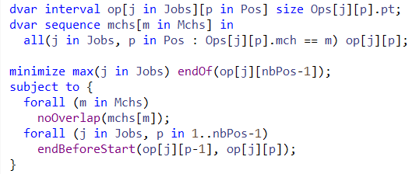
Concept: sequence variable
CP Optimizer model for Job-shop:
Comparison of this CP Optimizer model vs a disjunctive MIP formulation on a set of 140 classical Job-shop instances (50-2000 tasks), time-limit: 2mn, 4 threads

Slide 34
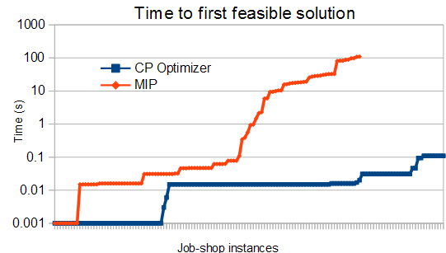
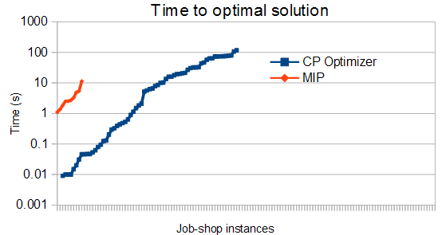
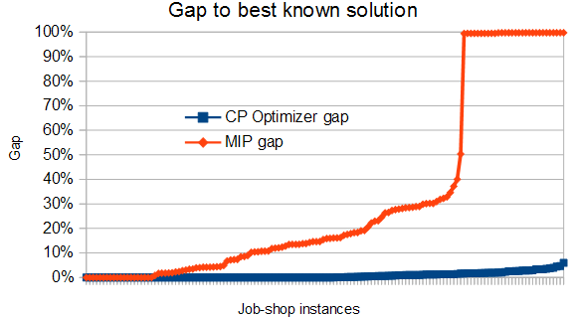
Concept: sequence variable
Comparison of CP Optimizer and MIP performance on Job-Shop

Slide 35
Concept: alternative constraint
What for?
  Modeling alternative resource/modes/recipes
  In general modeling a discrete selection in the schedule
Example
alternative(a,[b1,...,bn])
Properties
  Conditional reasoning allows a strong pruning on the alternative master interval variable a
  Master interval variable a can of course be optional
a
b1
Absent interval variables
ALT
b2
Selected interval variable
b3

Slide 36
Integer variables and expressions in CP Optimizer
CP Optimizer is not only about scheduling !
… and complex scheduling problems may involve other decision variables than interval variables !
CP Optimizer supports integer decision variables and a large panel of expressions/constraints

Slide 37
Variables | Expressions | Constraints
Variables are discrete integer Domains can be specified as a range [1..50] or as a set of values {1, 3, 5, 7, 9} dvar int x in 1..50 | Expressions can be integer or floating-point, for example 0.37 * y is allowed Basic arithmetic and more complex operators (min, max, log, pow etc.) are supported Relational expressions can be treated as 0-1 expressions. e.g. z = (y < t) Special expressions: y == a[x] t == count(b, 3) t == cond ? x : y | Rich set of constraints Standard relational constraints (==, !=, <, >, <=, >=) Logical combinators (&&, ||, !, =>) Specialized (global) constraints allDifferent(b) allowedAssignments(b, tuples) forbiddenAssignments(b, tuples) pack(load, container, size) lexicographic(b, c) inverse(b, c)

Slide 38
Integer variables and expressions in CP Optimizer
Model can mix integer and interval variables
dvar int qty[i in 1..n] in …;
dvar interval task[i in 1..n] in 0..H;
maximize sum(i in 1..n)
qty[i] * pow( H-endOf(task[i]), 1.025 );

Slide 39
Agenda
Introduction:
  CP Optimizer a component of CPLEX Optimization Studio
  Scheduling
  Example: Resource Constrained Project Scheduling Problem
Scheduling concepts in CP Optimizer
Automatic search in CP Optimizer
Some features for accelerating model development
Q&A

Slide 40
Automatic Search
Automatic search is invoked by a single call to:
  IloCP::solve()
Automatic search is complete:
  If the problem is unfeasible, it will prove unfeasibility
  If the problem is feasible, it will find an optimal solution and prove optimality
Note that especially for scheduling problems, proofs are very challenging (some scheduling problems with as few as 50 tasks are still open)
Once a first feasible solution has been found, the search can be interrupted at any time to get the best incumbent solution
Search parameters are available to tune and limit the search (e.g. time limit)

Slide 41
Automatic Search
Core CP techniques used as a building block:
  Tree search (Depth First)
  Constraint propagation
Other techniques used:
  Model presolve
  Restarting techniques
  No-good learning
  Randomization
  Impact-based branching
  Opportunistic probing
  Dominance rules
  LP-assisted heuristics
  Large Neighborhood Search
  Algorithms portfolios and Machine learning
  Evolutionary algorithms

Slide 42
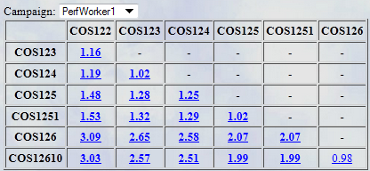
Automatic Search
Performance of the automatic search of CP Optimizer is continuously monitored on a set of more than 90 different scheduling benchmarks (e.g. RCPSP is just one of these benchmarks)
Performance of automatic search has been compared with the problem specific state-of-the-art methods in a number of scheduling benchmarks

Slide 43
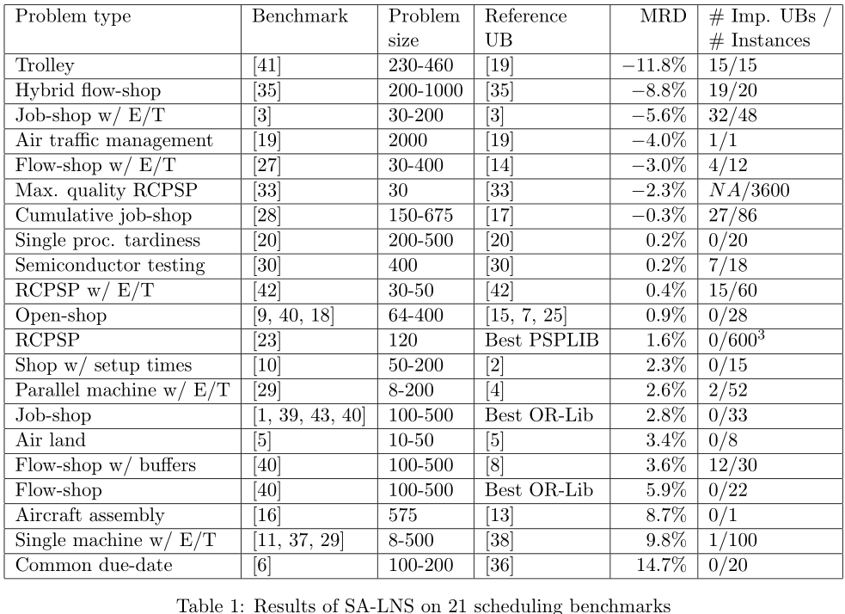
Automatic Search
MISTA 2007
Some results:

Slide 44
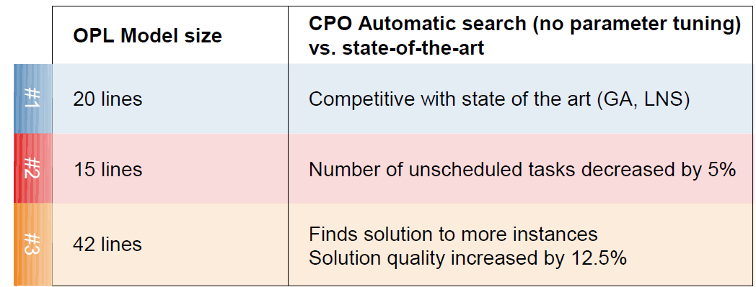
Automatic Search
CP-AI-OR 2009
Some results:
  Problem #1: Flow-shop with earliness/tardiness cost
  Problem #2: Oversubscribed Satellite Scheduling problem
  Problem #3: Personal tasks scheduling

Slide 45
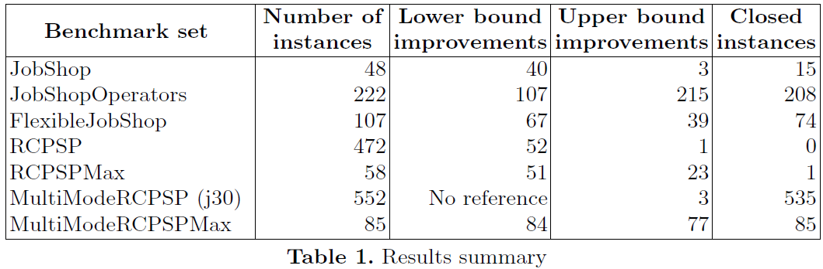
Automatic Search
CP-AI-OR 2015
Some results:

Slide 46
Agenda
Introduction:
  CP Optimizer a component of CPLEX Optimization Studio
  Scheduling
  Example: Resource Constrained Project Scheduling Problem
Scheduling concepts in CP Optimizer
Automatic search in CP Optimizer
Some features for accelerating model development
Q&A

Slide 47
Some features for accelerating model development
CP Optimizer provides similar features as CPLEX:
  Search log
  Conflict refiner
  Warm start
  Human-readable input/output file format (new in 12.6.1)
// --------------------------------------------------------------------------
// IBM ILOG CP Optimizer model export file
// Effective workers: 8
// --------------------------------------------------------------------------
// ------ Interval-related variables: ---------------------------------------
"itvs(0)(5)" = intervalVar(size=2);
"itvs(1)(5)" = intervalVar(size=3);
...
"mchs(0)" = sequenceVar(["itvs(0)(4)", "itvs(1)(1)", "itvs(2)(3)", "itvs(3)(5)", "itvs(4)(4)", "itvs(5)(2)"]);
"mchs(1)" = sequenceVar(["itvs(0)(1)", "itvs(1)(0)", "itvs(2)(2)", "itvs(3)(2)", "itvs(4)(0)", "itvs(5)(4)"]);
...
// ------ Objective: --------------------------------------------------------
minimize(max([endOf("itvs(0)(5)"), endOf("itvs(1)(5)"), ...]));
// ------ Constraints: ------------------------------------------------------
noOverlap("mchs(0)");
noOverlap("mchs(1)");
...
endBeforeStart("itvs(0)(0)", "itvs(0)(1)");
endBeforeStart("itvs(0)(1)", "itvs(0)(2)");
...

Slide 48

Some features for accelerating model development
CPLEX and CP Optimizer engines are available in the same CPLEX Optimization Studio ecosystem and with the same “look&feel”
 |  | CPLEX | CP Optimizer
Interfaces |  | OPL, C++, Java, .NET, C, Python | OPL, C++, Java, .NET
Model | Decision variables | int, float | int, interval
 | Expressions | linear, quadratic | arithmetic, log, pow, … relational, a[x], count,...
 | Constraints | range | relational, logical, specialized, scheduling
Search | Search parameters
 | Warm start
 | Multi-core //
Tools | Search log
 | I/O format | .lp, .mps, ... | .cpo
 | Conflict refiner

Slide 49
Some features for accelerating model development
CPLEX and CP Optimizer engines are available in the same CPLEX Optimization Studio ecosystem and with the same “look&feel”
A few differences still:
  In CP, lower bounds are not directly available. Rationale: CP uses Depth-First instead of Best-First search, LB becomes known only at the very end of the search space traversal.
  CP Optimizer allows for the implementation of user-defined constraints and search tree exploration (in C++ only). This can be compared to CPLEX user cuts and callbacks.
  No feas-opt feature available so far for CP Optimizer. Rationale: due to the large typology of constraint, the violation degree of a constraint is highly dependent on the context. But optionality of interval variables makes it easy to model oversubscribed problems.

Slide 50

Some features for accelerating model development
CPLEX and CP Optimizer engines are available in the same CPLEX Optimization Studio ecosystem and with the same “look&feel”
Real problems are very seldom pure and monolithic

Slide 51

Some features for accelerating model development
CPLEX and CP Optimizer engines are available in the same CPLEX Optimization Studio ecosystem and with the same “look&feel”
Real problems are very seldom pure and monolithic

Slide 52
Some features for accelerating model development
CPLEX and CP Optimizer engines are available in the same CPLEX Optimization Studio ecosystem and with the same “look&feel”
Real problems are very seldom pure and monolithic
CPLEX and CP Optimizer are complementary:
  Sequential models (planning → detailed scheduling)
  Use MIP to compute LB (relaxed model) or guidelines
  Logic-based Benders decomposition, column generation
CPLEX
CP Optimizer

Slide 53

Agenda
Introduction:
  CP Optimizer a component of CPLEX Optimization Studio
  Scheduling
  Example: Resource Constrained Project Scheduling Problem
Scheduling concepts in CP Optimizer
Automatic search in CP Optimizer
Some features for accelerating model development
Q&A

Slide 54

Backup
Notes:
IBM Big Data & Analytics
© 2014 IBM Corporation

Slide 55
Concept: expressions on interval variables
What for?
  Evaluating a piecewise linear function at a particular end-point of an interval variable (earliness-tardiness cost, temporal preference)
Example:
  endEval(f,a, ABSVAL) takes value ABSVAL if a is absent otherwise it takes value f(e) if a is present and a=[s,e)
Property:
  f can be any piecewise linear function (non-continuous, non-convex, ...)
f
a

Slide 56
Concept: state function
What for?
  Modeling evolution of a state variable over time
  Modeling incompatibility relations between activities overlapping a given date t
  Synchronizing start/end value of compatible tasks (batching)
Example
Properties
  Complexity is independent of the time scale
  CP Optimizer is able to reason globally over a state function
  Avoid quadratic models over each pair (i,j) of incompatible intervals on the state function
400˚F
500˚F
500˚F
600˚F
Time

Slide 57
Concept: span constraint
What for?
  Modeling task → sub-task decomposition
  Modeling immobilization time of a resource
Example
span(a,[b1,...,bn])
Properties
  The constraint of course handles optional interval variables
a
b3
b1
b4
b2

Slide 58
Concept: span/alternative constraint
What for?
  Modeling Work Breakdown Structure
Example
Task
ALT
Recipe 1
Recipe 2
Recipe 3
Op1
Op2
Op3
ALT

Slide 59
How Constraint Programming Works
CP is a constructive approach
Values are assigned to variables one at a time to extend a partial solution to a complete solution
At a point, it may be useless to further extend a partial solution as at least one constraint is already violated by the partial solution
  The solver backtracks and tries a different value for a previously assigned variable
  All possible assignments of values to variables can be examined in this way

Slide 60
How Constraint Programming Works
In CP, the basic search behavior is tree search
Including search space reduction via domain filtering
Domain filtering
  Before each value-variable assignment, domain filtering occurs
  Each value of a variable which cannot be used in a solution (given the current partial assignment) can be removed
  Each constraint type has a specialized algorithm which filters domains

Slide 61
Domain filtering
All Different
1
2
3
4
5
1
3
1
3
4
1
4
1
2
4
5
A B C D E

Slide 62
Domain filtering
All Different
1
2
3
4
5
1
3
1
3
4
1
4
1
2
4
5
A B C D E
Uses matching theory

Slide 63
Domain filtering
All Different
Other examples in CP Optimizer
Cardinality (occurrence count)
  Flow theory
Packing
  Subset sum and packing theory
Table (assignments)
  Support structures
Scheduling constraints
  Energetic reasoning
  Timetables
  Edge finding
1
2
3
4
5
1
3
1
3
4
1
4
1
2
4
5
A B C D E
Uses matching theory

Slide 64
Model Presolve
Depending on the input data, models can have redundancies and can contain poorly formulated constraints
Objective: Automatically improve the model in order to make stronger inferences faster
Simplifications
  Constraint compaction
  Redundancy elimination
  Constant propagation
  Common sub-expression factorization
Aggregations
  Count expressions & difference constraints
  Linear constraints over binary {0,1} variables
  Alternative constraint combined with arithmetic expressions

Slide 65
Examples of Model Presolve
Elimination of redundant constraints
  Bound of variables and expressions computed by constraint propagation are used to eliminate redundant constraints before search
Propagation of constant variables and expressions
  1 + 2x + 3y + xy – 3x + 7y ≤ 8x – 7y + 10
  x == 4 → 21y ≤ 45
Variable merge
  x==y, y==z, z==t → merge the domains of x, y, z and t
  and replace y, z, and t by x
  everywhere

Slide 66
Examples of Model Presolve
Aggregation of difference constraints
  Binary ≠ constraints can be lifted to alldiff constraints
A problem with ≠
The associated graph structure
x ≠ y
x ≠ z
x ≠ t
y ≠ z
y ≠ t
z ≠ v
t ≠ z
t ≠ v
u ≠ v
≠
z
x
u
≠
≠
≠
≠
≠
≠
y
t
v
≠
≠
The aggregated model
alldiff(x, y, z, t)
alldiff(z, t, v)
u ≠ v

Slide 67
Examples of Model Presolve
Lifting difference constraints
  Pick up a binary constraint x ≠ y not already in a lifted alldiff
  Find the largest clique containing x ≠ y (in practice we use a greedy algorithm – add vertex one by one to the set starting with vertices having the maximum degree)
  Add a new lifted alldiff
Experimentation on graph coloring
  Color the vertices of a graph such that two adjacent vertices have a different color and the number of colors is minimized
  The model is stated with a set of binary ≠ constraints
  Problems are from the DIMACS challenge (COLOR02 set)
    9 problems over 60 are solved to optimality without presolve
    39 problems over 60 are solved to optimality with presolve

Slide 68
Examples of Model Presolve
Common sub-expression factorization
Eliminate multiple occurrences of the same expression and replace them by a new variable
  example: xy ≠ z + t
  z + xy == a + b
  100 ≤ z + xy
The expressions xy and z + xy appear several times. We introduce two new variables u and v to replace these expressions and add the constraints: u == xy, v == z + u
The model becomes u ≠ z + t
  v == a + b
  100 ≤ v
Communication of bound reduction on newly introduced variables achieves more domain reduction
It also reduces the number of expressions and thus involves less computations

Slide 69
Restart and No-goods
Pure DFS is generally not used
  Thanks to a parameter, you can select pure DFS if you wish
Numerous DFS searches of limited effort are favored
  One element of the CP Optimizer search is the restart
  Effort limit increases over time to ensure completeness
  CP Optimizer's restart limit increases geometrically
  No-good learning helps increase efficiency
  Benefits well documented in numerous papers:
    Selman and Gomes, late 90s, theoretical and practical results

Slide 70
Limited DFS Methods - Classic Restarting
x = 1
x ≠ 1
Clause Generation
x ≠ 1,
x ≠ 2,
x ≠ 3 ∨ y ≠ 1,
x ≠ 3 ∨ y ≠ 2,
x ≠ 3 ∨ y ≠ 3 ∨ z ≠ 1,
x ≠ 3 ∨ y ≠ 3 ∨ z ≠ 2,
x ≠ 3 ∨ y ≠ 3 ∨ z ≠ 3,
x = 2
x ≠ 2
x = 3
y = 1
y ≠ 1
y = 2
y ≠ 2
Restart
y = 3
z = 1
z ≠ 1
Increase limit
z = 2
z ≠ 3

Slide 71
Large Neighborhood Search
In scheduling, a common way of improving solutions is to use Large Neighborhood Search
  Shuffling [A&C, 1991] was the first variant
A number of operations are “relaxed” meaning they can move freely where they want while still obeying problem constraints, such as precedences
The remaining operations stay “rigid” which means that they can shift in time but stay in much the same order as in the current solution
The start times of the free and rigid parts are then decided by a limited DFS search using heuristics. The aim is to find a solution of lower objective value

Slide 72
LNS: simple example
Current solution
C=2
t=0

Slide 73
LNS: simple example
C=2
t=0
Relaxed part

Slide 74
LNS: simple example
Rearrangement
C=2
t=0

Slide 75
LNS: simple example
Shift rigid part
C=2
t=0

Slide 76
Large Neighborhood Search
In a classic form of shuffling for job-shop scheduling, the order of operations on one or more resources is fixed and the order of the others is reoptimized
Problem structure is used to identify the part of the problem to relax and reoptimize. e.g. use resources, alternatives, strongly connected components
Due to the more general forms of resource supported in CP Optimizer, more subtle forms of “fixing” (creating rigidity in the schedule) are required than simple order
Use of partial order schedules
  See [Godard et al., MISTA, 2007], [Pisinger and Ropke, Handbook of Metaheuristics, 2010]

Slide 77
Branching Heuristics – LP-assisted
Traditionally, early/tardy scheduling problems are challenging for CP solvers as the solvers don't have a good global view of the cost function
cost
cost
cost
cost
cost
x
x
x
x
x

Slide 78
Branching Heuristics – LP-assisted
Traditionally, early/tardy scheduling problems are challenging for CP solvers as the solvers don't have a good global view of the cost function
cost
cost
cost
cost
cost
x
x
x
x
x
penalty * (startOf(op) > dueDate)

Slide 79
Branching Heuristics – LP-assisted
Traditionally, early/tardy scheduling problems are challenging for CP solvers as the solvers don't have a good global view of the cost function
cost
cost
cost
cost
cost
x
x
x
x
x
max(0, slope * (startOf(op) - dueDate))

Slide 80
Branching Heuristics – LP-assisted
Since CPLEX and CP Optimizer are both part of CPLEX Optimization studio, CP Optimizer can take advantage of the availability of CPLEX to help on problems where a good global view of the cost function is important
CP Optimizer linearizes scheduling constructs such as:
  Precedences
  Execution / non-execution costs, alternatives
  Cost function terms which are functions of start/end times
  PWL functions can be used to approximate
CPLEX computes cost lower bound and “best” start times using the CPLEX LP Solver: use the LP solution to guide heuristics. Start an operation as close as possible to the time proposed by CPLEX

Slide 81
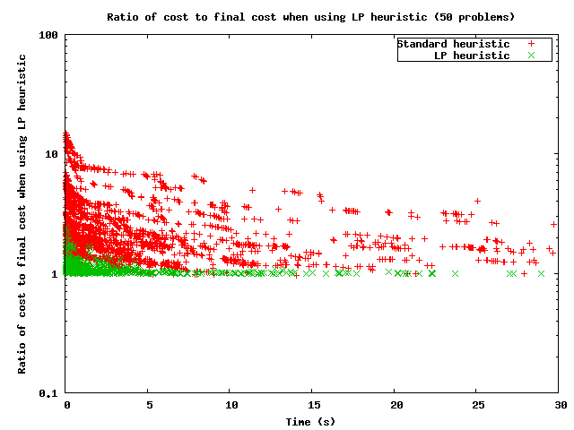
Branching Heuristics – LP-assisted

Slide 82
Probing
Probing is a technique that exploits the fact that in some problems, fixing a variable has a higher than usual probability of causing a failure
  In this case, at a node other variables as well as the branching variable can be tested by fixing them to a value
  If the fixing fails, the fixed value can be filtered from the domain, otherwise the fixing is undone
  Particularly useful for binary and small-domain variables
In CP Optimizer, a dynamic technique is used to adjust how often probing occurs to avoid paying the probe penalty when probing is ineffective

Slide 83

Notes:
IBM Big Data & Analytics
© 2014 IBM Corporation

Slide 84
Legal Disclaimer
  © IBM Corporation 2015. All Rights Reserved.
  The information contained in this publication is provided for informational purposes only. While efforts were made to verify the completeness and accuracy of the information contained in this publication, it is provided AS IS without warranty of any kind, express or implied. In addition, this information is based on IBM’s current product plans and strategy, which are subject to change by IBM without notice. IBM shall not be responsible for any damages arising out of the use of, or otherwise related to, this publication or any other materials. Nothing contained in this publication is intended to, nor shall have the effect of, creating any warranties or representations from IBM or its suppliers or licensors, or altering the terms and conditions of the applicable license agreement governing the use of IBM software.
  References in this presentation to IBM products, programs, or services do not imply that they will be available in all countries in which IBM operates. Product release dates and/or capabilities referenced in this presentation may change at any time at IBM’s sole discretion based on market opportunities or other factors, and are not intended to be a commitment to future product or feature availability in any way. Nothing contained in these materials is intended to, nor shall have the effect of, stating or implying that any activities undertaken by you will result in any specific sales, revenue growth or other results.
  If the text contains performance statistics or references to benchmarks, insert the following language; otherwise delete:
  Performance is based on measurements and projections using standard IBM benchmarks in a controlled environment. The actual throughput or performance that any user will experience will vary depending upon many factors, including considerations such as the amount of multiprogramming in the user's job stream, the I/O configuration, the storage configuration, and the workload processed. Therefore, no assurance can be given that an individual user will achieve results similar to those stated here.
  If the text includes any customer examples, please confirm we have prior written approval from such customer and insert the following language; otherwise delete:
  All customer examples described are presented as illustrations of how those customers have used IBM products and the results they may have achieved. Actual environmental costs and performance characteristics may vary by customer.
  Please review text for proper trademark attribution of IBM products. At first use, each product name must be the full name and include appropriate trademark symbols (e.g., IBM Lotus® Sametime® Unyte™). Subsequent references can drop “IBM” but should include the proper branding (e.g., Lotus Sametime Gateway, or WebSphere Application Server). Please refer to http://www.ibm.com/legal/copytrade.shtml for guidance on which trademarks require the ® or ™ symbol. Do not use abbreviations for IBM product names in your presentation. All product names must be used as adjectives rather than nouns. Please list all of the trademarks that you use in your presentation as follows; delete any not included in your presentation. IBM, the IBM logo, Lotus, Lotus Notes, Notes, Domino, Quickr, Sametime, WebSphere, UC2, PartnerWorld and Lotusphere are trademarks of International Business Machines Corporation in the United States, other countries, or both. Unyte is a trademark of WebDialogs, Inc., in the United States, other countries, or both.
  If you reference Adobe® in the text, please mark the first use and include the following; otherwise delete:
  Adobe, the Adobe logo, PostScript, and the PostScript logo are either registered trademarks or trademarks of Adobe Systems Incorporated in the United States, and/or other countries.
  If you reference Java™ in the text, please mark the first use and include the following; otherwise delete:
  Java and all Java-based trademarks are trademarks of Sun Microsystems, Inc. in the United States, other countries, or both.
  If you reference Microsoft® and/or Windows® in the text, please mark the first use and include the following, as applicable; otherwise delete:
  Microsoft and Windows are trademarks of Microsoft Corporation in the United States, other countries, or both.
  If you reference Intel® and/or any of the following Intel products in the text, please mark the first use and include those that you use as follows; otherwise delete:
  Intel, Intel Centrino, Celeron, Intel Xeon, Intel SpeedStep, Itanium, and Pentium are trademarks or registered trademarks of Intel Corporation or its subsidiaries in the United States and other countries.
  If you reference UNIX® in the text, please mark the first use and include the following; otherwise delete:
  UNIX is a registered trademark of The Open Group in the United States and other countries.
  If you reference Linux® in your presentation, please mark the first use and include the following; otherwise delete:
  Linux is a registered trademark of Linus Torvalds in the United States, other countries, or both. Other company, product, or service names may be trademarks or service marks of others.
  If the text/graphics include screenshots, no actual IBM employee names may be used (even your own), if your screenshots include fictitious company names (e.g., Renovations, Zeta Bank, Acme) please update and insert the following; otherwise delete: All references to [insert fictitious company name] refer to a fictitious company and are used for illustration purposes only.
Notes:
IBM Big Data & Analytics
© 2014 IBM Corporation

