Slide 1
Philippe Laborie
02/04/2015
CP Optimizer updates
Notes:
IBM Big Data & Analytics
© 2014 IBM Corporation

Slide 2
Agenda
CP Optimizer overview
Recent advances
  Modeling
  Tools
  Automatic search
Q&A

Slide 3
CP Optimizer overview
A component of IBM ILOG CPLEX Optimization Studio
A Constraint Programming engine for combinatorial problems (including detailed scheduling problems)
Implements a Model & Run paradigm (like CPLEX)
  Model: Concise yet Expressive modeling language
  Run: Powerful automatic search procedure
Search algorithm is Complete
Available through the following interfaces:
  OPL
  C++ (native interface)
  Java, .NET (wrapping of the C++ engine)

Slide 4
CP Optimizer overview
Two main types of decision variables:
  Integer variables
  Interval variables

Slide 5
CP Optimizer overview : integer variables
Variables | Expressions | Constraints
Variables are discrete integer Domains can be specified as a range [1..50] or as a set of values {1, 3, 5, 7, 9} dvar int x in 1..50 | Expressions can be integer or floating-point, for example 0.37*y is allowed Basic arithmetic (+,-,*,/) and more complex operators (min, max, log, pow etc.) are supported Relational expressions can be treated as 0-1 expressions. e.g. x = (y < z) Special expressions: x == a[y] x == count(Y, 3) y == cond ? y : z | Rich set of constraints Standard relational constraints (==, !=, <, >, <=, >=) Logical combinators (&&, ||, !, =>) Specialized (global) constraints allDifferent(X) allowedAssignments(X, tuples) forbiddenAssignments(X, tuples) pack(load, container, size) lexicographic(X, Y) inverse(X,Y)

Slide 6
Scheduling (our definition of)
Scheduling consist of assigning starting and completion times to a set of activities while satisfying different types of constraints (resource availability, precedence relationships, … ) and optimizing some criteria (minimizing tardiness, …)
Time is considered as a continuous dimension: domain of possible start/completion times for an activity is potentially very large
Beside start and completion times of activities, other types of decision variables are often involved in real industrial scheduling problems (resource allocation, optional activities …)
start
end
activity
Time

Slide 7
CP Optimizer overview : interval variables (for scheduling)
Extension of classical CSP with a new type of decision variable:
optional interval variable :
Domain(x)  {}  { [s,e) | s,e, s≤e }
Introduction of mathematical notions such as sequences and functions to capture temporal aspects of scheduling problems
Absent interval
Interval of integers

Slide 8
CP Optimizer overview : interval variables (for scheduling)
In scheduling models, interval variables usually represent an interval of time whose end-points (start/end) are decision variables of the problem. Examples:
  A production order, a recipe in a production order, an operation in a recipe
  A sub-project in a project, a task in a sub-project
  A batch of operations
  The setup of a tool on a machine
  The moving of an item by a transportation device
  The utilization interval of a machine
  The filling or emptying of a tank
Idea of the model (and search) is to avoid the enumeration of start/end values

Slide 9
CP Optimizer overview : interval variables (for scheduling)
An interval variable can be optional meaning that it is a decision to have it present or absent in a solution.
Examples:
  Unperformed tasks and optional sub-projects
  Alternative resources, modes or recipes for processing an order, each mode specifying a particular combination of operational resources
  Operations that can be processed in different temporal modes (e.g. series or parallel), left unperformed or externalized
  Activities that can be performed in an alternative set of batches or shifts

Slide 10
Example: Resource Constrained Project Scheduling Problem
RCPSP: a very classical academical scheduling problem
  Tasks a_{i} with fixed processing time P_{i}
  Precedence constraints
  Discrete resources with limited instantaneous capacity R_{k}
  Tasks require some quantity of discrete resources
  Objective is to minimize the schedule makespan
R1
a3
a6
R2
a7
a1
a2
a5
a4
a8

Slide 11
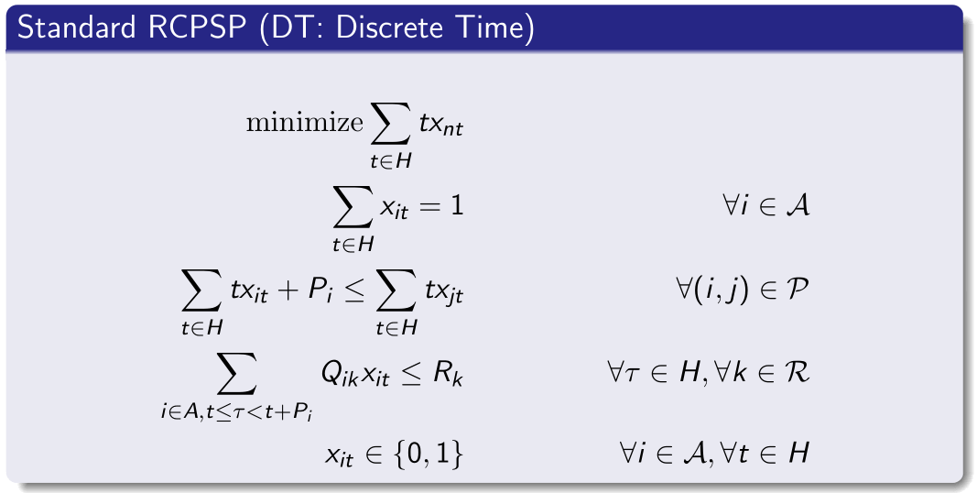
Example: Resource Constrained Project Scheduling Problem
RCPSP: Standard time-indexed MIP formulation
Pi
a_{i}
xit ∈ {0,1}

Slide 12
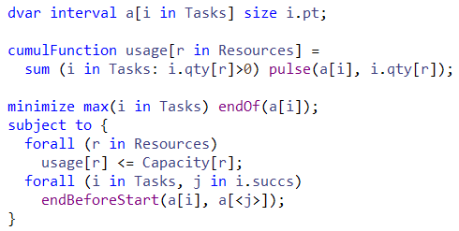
Example: Resource Constrained Project Scheduling Problem
Basic CP Optimizer model for RCPSP:

Slide 13
Example: Resource Constrained Project Scheduling Problem
Comparison of this time-indexed MIP formulation against the CP Optimizer model on a set of:
  300 classical small RCPSP instances (30-120 tasks) +
  40 slightly more realistic larger ones (900 tasks)
  time-limit: 2mn, 4 threads
Note: industrial scheduling problems are often much larger, typically several 1.000 tasks (we handled up to 1.000.000 tasks in an RCPSP-like scheduling application in V12.6)

Slide 14
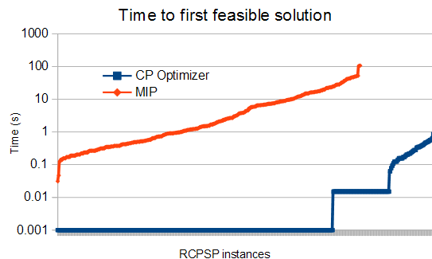
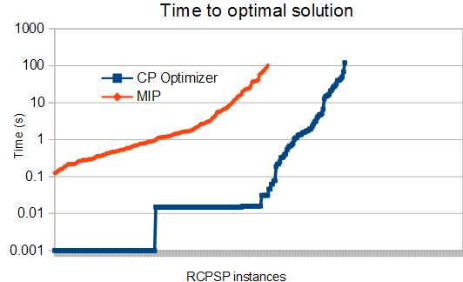
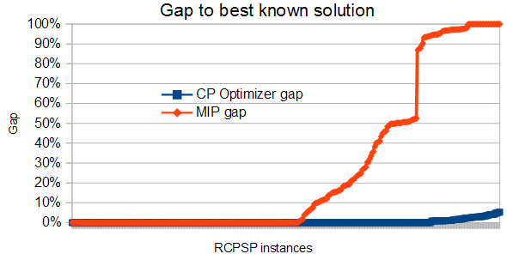
Example: Resource Constrained Project Scheduling Problem
Comparison of CP Optimizer and MIP performance on RCPSP

Slide 15
Example : Job-shop Scheduling Problem
Example: Job-shop Scheduling Problem
Minimization of makespan
op11
op12
op13
M1
op21
op22
op23
M2
op31
op32
op33
M3
op41
op42
op43

Slide 16
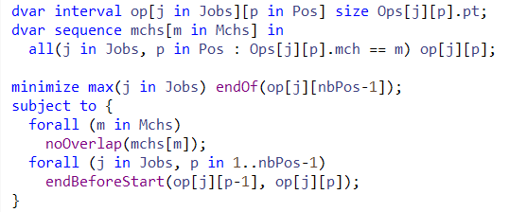
Example : Job-shop Scheduling Problem
CP Optimizer model for Job-shop:

Slide 17
Example : Job-shop Scheduling Problem
Properties:
  Complexity is independent of the time scale
  CP Optimizer is able to reason globally over a sequence variable
  Avoid quadratic models over each pair (i,j) of intervals in the sequence
Compare:
  Quadratic disjunctive MIP formulation with big-Ms:
b[i][j]{0,1}: b[i][j]=1 iff a[i] before a[j]
end[i] <= start[j] + M*(1-b[i][j])
end[j] <= start[i] + M*b[i][j]
  CP Optimizer model:
noOverlap(all(i in …) a[i])
a[i]
a[j]
…
Time

Slide 18
Example : Job-shop Scheduling Problem
Comparison of the CP Optimizer model vs a disjunctive MIP formulation on a set of 140 classical Job-shop instances (50-2000 tasks), time-limit: 2mn, 4 threads

Slide 19
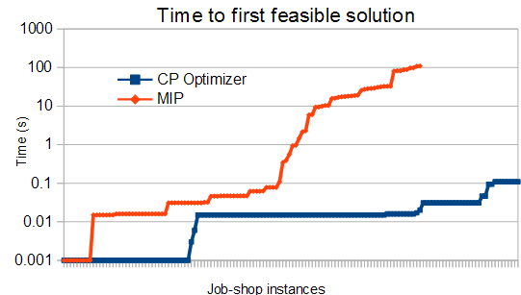
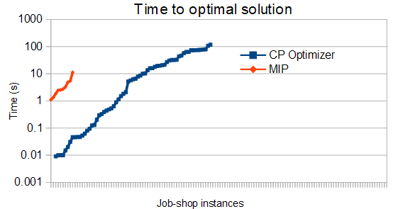
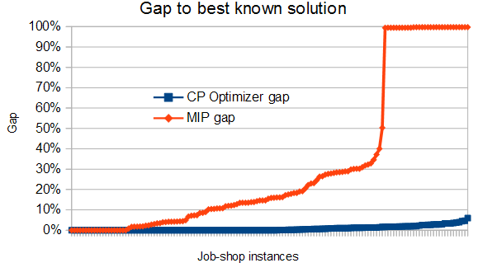
Example : Job-shop Scheduling Problem
Comparison of CP Optimizer and MIP performance on Job-Shop

Slide 20
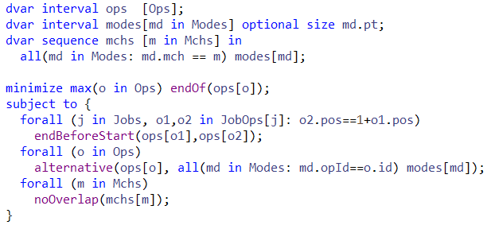
Example : Flexible Job-shop Scheduling Problem
CP Optimizer model

Slide 21
Agenda
CP Optimizer overview
Recent advances
  Modeling
  Tools
  Automatic search
Q&A

Slide 22
Agenda
Lexicographical objectives (12.3)
OverlapLength expressions (12.2)
SameSequence constraints (12.6)
CP Optimizer overview
Recent advances
  Modeling
  Tools
  Automatic search
Q&A
Starting points (old but so useful)
Conflict refiner (12.5)
I/O Format (12.6.1)
Strong annotations (12.6)
Presolve (12.5)
Failure-Directed Search (12.6)

Slide 23
Modeling : Lexicographical objectives
Hierarchical objectives are common in applications
dexpr int crit1 = …;
dexpr int crit1 = …;
minimize staticLex(crit1, crit2, …);
During the search the objective cut eliminates the dominated objective vectors

Slide 24
Modeling : Lexicographical objectives
Example of search log:
! ----------------------------------------------------------------------------
! Minimization problem - 103 variables, 341 constraints, 1 phase
! Initial process time : 0.01s (0.01s extraction + 0.00s propagation)
! . Log search space : 319.3 (before), 319.3 (after)
! . Memory usage : 1.7 MB (before), 1.7 MB (after)
! Using sequential search.
! ----------------------------------------------------------------------------
! Best Branches Non-fixed Branch decision
* 53 38 0.01s 0 = transitionCost(15)
. Multi-criterion values are 53; 11
* 48 3,581 0.09s 0 = transitionCost(15)
...
. Multi-criterion values are 28; 14
* 26 33,375 0.88s 1 = customerOfTruck(15)
. Multi-criterion values are 26; 13
! ----------------------------------------------------------------------------
! Search terminated by limit, 17 solutions found.
! Best objective : 26; 13
! Number of branches : 745,384
! Number of fails : 359,944
! Total memory usage : 3.0 MB (2.4 MB CP Optimizer + 0.6 MB Concert)
! Time spent in solve : 20.01s (19.99s engine + 0.01s extraction)
! Search speed (br. / s) : 37,271.1
! ----------------------------------------------------------------------------

Slide 25
Modeling : OverlapLength expressions
An expression to return the length of the overlap between 2 interval variables
Use cases:
  Time buckets with limited energy:
Σi qi*overlapLength(ai,t1,t2) ≤ W
a
b
dexpr int overlapLength(a,b)
dexpr int overlapLength(a,t1,t2)

Slide 26
Modeling : OverlapLength expressions
Use cases:
  Flexible breaks on a resource
Intensity function of a
a

Slide 27
Modeling : OverlapLength expressions
Use cases:
  Flexible breaks on a resource:
size(a) = sizeMin + Σi overlapLength(a,bi)
maximize Σi presenceOf(bi)
Intensity function of a
b1
b2
bi
a

Slide 28
Modeling : SameSequence constraints
A new constraint to (partially) map two sequence variables
sameSequence(seq1,seq2)
seq1
A1[6]
A1[5]
A1[1]
A1[2]
A1[7]
A1[3]
A1[4]
seq2
A2[6]
A2[5]
A2[1]
A2[2]
A2[7]
A2[3]
A2[4]

Slide 29
Modeling : SameSequence constraints
Use case:
  No-bypass constraint
M1
M2
Conveyor belt
seq1
seq2
sameSequence(seq1,seq2)

Slide 30
Modeling : SameSequence constraints
Use case:
  Stochastic scheduling: sequences as 1st stage variables in 2 stage stochastic programming
Scenario 1 : seq1
→ objective1
Scenario 2 : seq2
→ objective2
seq
objective
sameSequence(seq,seqi)

Slide 31
Modeling : SameSequence constraints
A variant ensuring a partial mapping only on the pairs of present interval variables
Use cases: No-bypass constraints with junctions
sameCommonSequence(seq1,seq2)
M1
M3
M2
M1'
M3'
sameCommonSequence(seq1, seq2)
sameCommonSequence(seq1',seq2)
sameCommonSequence(seq2, seq3)
sameCommonSequence(seq2, seq3')

Slide 32
Tools: Starting points
Objective: Start search from a known (possibly incomplete) solution given by the user (warm start) in order to further improve it or to help to guide the engine towards a first feasible solution
API: IloCP::setStartingPoint(IloSolution warmstart)
Use cases:
  Restart an interrupted search with the current incumbent
  Start from an initial solution found by an available heuristic
  Goal programming for multi-objective problems
  When finding an initial solution is hard, solve an initial problem that maximizes constraint satisfaction and start from its solution
  Successively solving similar problems (e.g. dynamic scheduling)
  Hierarchical problem solving (e.g. planning → scheduling)

Slide 33
Tools: Conflict refiner
Objective: Identify a reason for an inconsistency by providing a minimal infeasible subset of constraints for an infeasible model
API: IloCP::refineConflict()
IloCP::writeConflict(ostream& out)
Use cases:
  Model debugging (errors in model)
  Data debugging (inconsistent data)
  The model and data are correct, but the associated data represents a real-world conflict in the system being modeled
  You create an infeasible model to test properties of (or extract information about) a similar model

Slide 34
Conflict Refiner example: satellite scheduling problem
Satellite Control Network scheduling problem [1]
n communication requests for Earth orbiting satellites must be scheduled on a total of 32 antennas spread across 13 ground-based tracking stations
In the instances, n ranges from to 400 to 1300
[1] Kramer & al.: Understanding Performance Trade-offs in Algorithms for Solving Oversubscribed Scheduling.

Slide 35
Station 1
Station 2
Station 3

Slide 36
Station 1
Station 2
Station 3
Task_{i}
Communication requests

Slide 37
Station 1
Opp_{i,1}
Station 2
Opp_{i,2}
Opp_{i,3}
Station 3
Opp_{i,4}
OR
Alternative assignments
to stations × time windows
(opportunities)
Task_{i}

Slide 38

Station 1
Opp_{i,1}
Station 2
Opp_{i,2}
Opp_{i,3}
Station 3
Opp_{i,4}
Selected opportunity will use
1 antenna for communication
with the satellite
Task_{i}

Slide 39
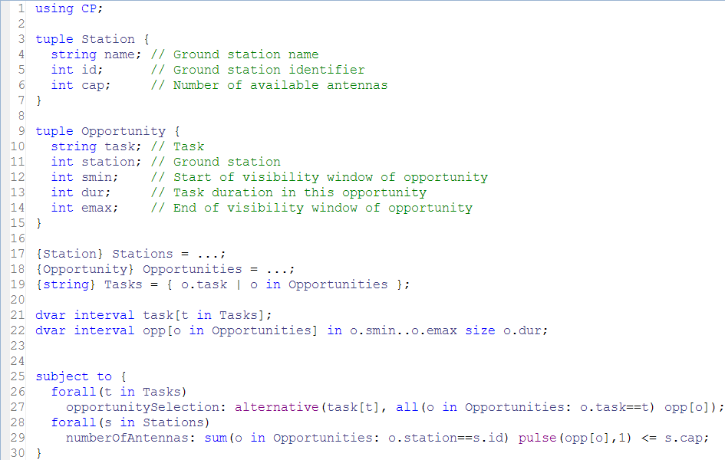
Conflict Refiner example: model 1

Slide 40
Conflict Refiner example: running model 1
! ----------------------------------------------------------------------------
! Satisfiability problem - 2,980 variables, 851 constraints
! Workers = 2
! TimeLimit = 30
! Problem found infeasible at the root node
! ----------------------------------------------------------------------------
...
! ----------------------------------------------------------------------------
! Conflict refining - 851 constraints
! ----------------------------------------------------------------------------
! Iteration Number of constraints
* 1 851
...
* 11 3
* 12 1
* 13 1
! Conflict refining terminated
! ----------------------------------------------------------------------------
! Conflict status : Terminated normally, conflict found
! Conflict size : 1 constraint
! Number of iterations : 13
! Total memory usage : 10.6 MB
! Conflict computation time : 0.04s
! ----------------------------------------------------------------------------

Slide 41

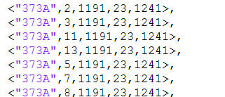
Conflict Refiner example: running model 1
Conflict:
Opportunities for task “373A”:

Slide 42
Conflict Refiner example: model 1

Slide 43

Conflict Refiner example: model 2

Slide 44
Conflict Refiner example: running model 2
! ----------------------------------------------------------------------------
! Satisfiability problem - 2,980 variables, 851 constraints
! Problem found infeasible at the root node
! ----------------------------------------------------------------------------
...
! ----------------------------------------------------------------------------
! Conflict refining - 851 constraints
! ----------------------------------------------------------------------------
! Iteration Number of constraints
* 1 851
* 2 426
...
* 58 5
* 59 5
! Conflict refining terminated
! ----------------------------------------------------------------------------
! Conflict status : Terminated normally, conflict found
! Conflict size : 5 constraints
! Number of iterations : 59
! Total memory usage : 13.3 MB
! Conflict computation time : 0.51s
! ----------------------------------------------------------------------------

Slide 45
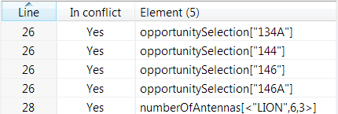
Conflict Refiner example: running model 2
Conflict:
There is not enough antennas to accommodate all 4 tasks on their time-window on ground station “LION” (3 antennas):
<"134A",6,1232,19,1266>
<"144", 6,1238,31,1272>
<"146", 6,1228,22,1260>
<"146A",6,1230,22,1262>
1228
1260
146
1230
1262
146A
1232
1266
134A
1238
1272
144

Slide 46
Conflict Refiner example: model 2

Slide 47
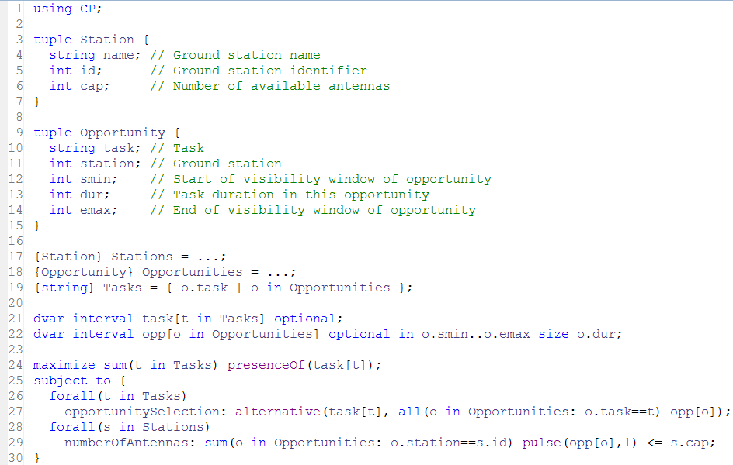
Conflict Refiner example: model 3

Slide 48
Tools: I/O Format
API: IloCP::exportModel(const char* name)
IloCP::importModel(const char* name)
Can be used at top level or during search to dump a partial state of the engine
Human-readable input/output file format
// --------------------------------------------------------------------------
// IBM ILOG CP Optimizer model export file
// Effective workers: 8
// --------------------------------------------------------------------------
// ------ Interval-related variables: ---------------------------------------
"itvs(0)(5)" = intervalVar(size=2);
"itvs(1)(5)" = intervalVar(size=3);
...
"mchs(0)" = sequenceVar(["itvs(0)(4)", "itvs(1)(1)", "itvs(2)(3)", "itvs(3)(5)", "itvs(4)(4)", "itvs(5)(2)"]);
"mchs(1)" = sequenceVar(["itvs(0)(1)", "itvs(1)(0)", "itvs(2)(2)", "itvs(3)(2)", "itvs(4)(0)", "itvs(5)(4)"]);
...
// ------ Objective: --------------------------------------------------------
minimize(max([endOf("itvs(0)(5)"), endOf("itvs(1)(5)"), ...]));
// ------ Constraints: ------------------------------------------------------
noOverlap("mchs(0)");
noOverlap("mchs(1)");
...
endBeforeStart("itvs(0)(0)", "itvs(0)(1)");
endBeforeStart("itvs(0)(1)", "itvs(0)(2)");
...

Slide 49
Tools: Strong annotations
Strong(x1, x2 … xn): automatically generate an allowedAssignment (a.k.a. table) constraint over variables x1, x2 … xn
Benefits:
  Reinforce the model propagation between variables where user know that the domain reduction is weak
  Avoid the enumeration of tuple sets for creating allowedAssignments
  Create stronger allowedAllowed assignments than those obtained by hand
API:
  In C++: IloStrong(IloIntVarArray x)
  In OPL: strong(all …)

Slide 50
Tools: Strong annotations
Basic generation
  Enumerate solutions by performing a search on the variables of the strong using domain reduction with the whole model
  Add an allowedAssignment over the variables with the tupleSet of the generated solutions and remove constraints over these variables that have become redundant
Automatic generation
  After a given number of node explored for solutions, decide if it worths continuing generating
  Criteria 1 : the expected number of solutions (too many solutions gives heavy allowedAssignments).
  Criteria 2 : measure the impact of the constraint by looking at the search space reduction (a weak constraint may not be beneficial)

Slide 51
Tools: Strong annotations : Football tournament example
IloIntTupleSet gha(env, 3);
IloIntArray tuple(env, 3);
for (IloInt i = 0; i < n; i++) {
tuple[0] = i;
for (IloInt j = 0; j < n; j++) {
if (i != j) {
tuple[1] = j;
tuple[2] = Game(i, j, n);
gha.add(tuple);
}
}
}
for (IloInt i = 0; i < nbWeeks; i++) {
for (IloInt j = 0; j < nbGamesPerWeek; j++) {
IloIntVarArray vars(env);
vars.add(home[i][j]);
vars.add(away[i][j]);
vars.add(games[i][j]);
model.add(IloAllowedAssignments(env, vars, gha));
}
}
! Best Branches Non-fixed
* 56 2688 0.53s
* 52 7402 0.99s
* 48 19418 2.38s
* 46 102k 11.87s
* 44 109k 12.81s
* 42 195k 20.22s
* 40 218k 22.43s
* 38 239k 24.47s
for (IloInt i = 0; i < nbWeeks; i++) {
for (IloInt j = 0; j < nbGamesPerWeek; j++) {
model.add(home[i][j] != away[i][j]);
model.add(games[i][j] == Game(home[i][j], away[i][j], n));
IloIntVarArray vars(env);
vars.add(home[i][j]);
vars.add(away[i][j]);
vars.add(games[i][j]);
model.add(IloStrong(env, vars));
}
}
! Best Branches Non-fixed W Branch decision
* 50 520 0.44s 6 -
* 46 2468 0.65s 1 -
* 38 4304 0.88s 1 -
* 36 25689 2.98s 1 -
* 34 86973 8.15s 1 -
The original tuple set has 90 tuples, the generated ones have between 5 and 66 tuples.
Source If Applicable

Slide 52
Automatic Search: Presolve
Depending on the input data, models can have redundancies and can contain poorly formulated constraints
Objective: Automatically improve the model in order to make stronger inferences faster
Simplifications
  Constraint compaction
  Redundancy elimination
  Constant propagation
  Common sub-expression factorization
Aggregations
  Count expressions & difference constraints
  Linear constraints over binary {0,1} variables
  Alternative constraint combined with arithmetic expressions

Slide 53
Automatic Search: Examples of Model Presolve
Elimination of redundant constraints
  Bound of variables and expressions computed by constraint propagation are used to eliminate redundant constraints before search
Propagation of constant variables and expressions
  1 + 2x + 3y + xy – 3x + 7y ≤ 8x – 7y + 10
  x == 4 → 21y ≤ 45
Variable merge
  x==y, y==z, z==t → merge the domains of x, y, z and t
  and replace y, z, and t by x
  everywhere

Slide 54
Automatic Search: Examples of Model Presolve
Aggregation of difference constraints
  Binary ≠ constraints can be lifted to alldiff constraints
A problem with ≠
The associated graph structure
x ≠ y
x ≠ z
x ≠ t
y ≠ z
y ≠ t
z ≠ v
t ≠ z
t ≠ v
u ≠ v
≠
z
x
u
≠
≠
≠
≠
≠
≠
y
t
v
≠
≠
The aggregated model
alldiff(x, y, z, t)
alldiff(z, t, v)
u ≠ v

Slide 55
Automatic Search: Examples of Model Presolve
Common sub-expression factorization
  Eliminate multiple occurrences of the same expression and replace them by a new variable. Example:
xy ≠ z + t
  z + xy == a + b
  100 ≤ z + xy
  The expressions xy and z + xy appear several times. We introduce two new variables u and v to replace these expressions and add the constraints: u == xy, v == z + u
  The model becomes u ≠ z + t
  v == a + b
  100 ≤ v
  Communication of bound reduction on newly introduced variables achieves more domain reduction
  It also reduces the number of expressions and thus involves less computations

Slide 56
Automatic Search: Failure-Directed Search
An additional technique recently added in the automatic search portfolio for scheduling problems
FDS:
  assumes that there is no better solution than the current solution or that such an improving solution is very hard to find
  is based on a systematic exploration of the search tree using a first-fail approach
  uses restarts, no-good learning and some sort form impact measurements
  works on choice points of the form:
    presence/absent of interval
    Start/end of interval <= date value
FDS is used as a “plan B” strategy used once a less systematic « plan A » strategy (LNS) is not able to improve the current solution anymore

Slide 57
Automatic Search
Search algorithm is Complete
Core CP techniques used as a building block:
  Tree search (Depth First)
  Constraint propagation
Other techniques used:
  Model presolve
  Restarting techniques
  No-good learning
  Randomization
  Impact-based branching
  Opportunistic probing
  Dominance rules
  LP-assisted heuristics
  Large Neighborhood Search
  Algorithms portfolios and Machine learning
  Evolutionary algorithms

Slide 58
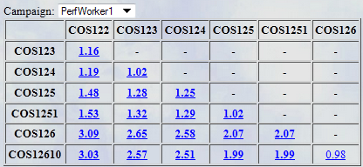
Automatic Search
Performance of the automatic search of CP Optimizer is continuously monitored on a set of more than 90 different scheduling benchmarks (e.g. RCPSP is just one of these benchmarks)
Performance of automatic search has been compared with the problem specific state-of-the-art methods in a number of scheduling benchmarks

Slide 59
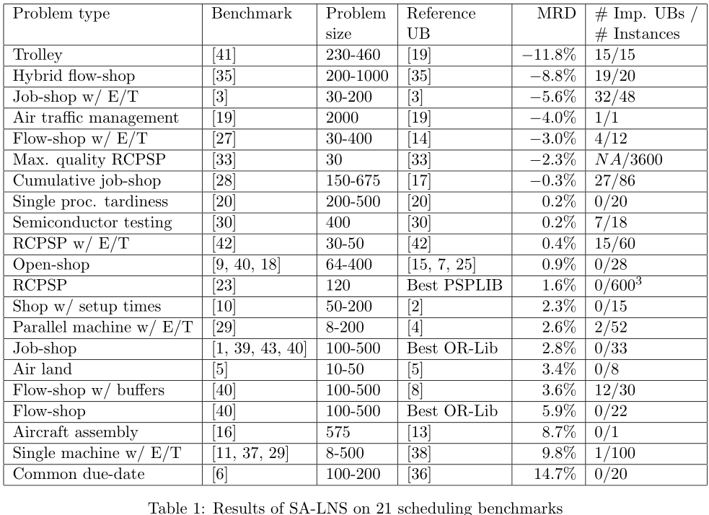
Automatic Search
MISTA 2007
Some old results:

Slide 60
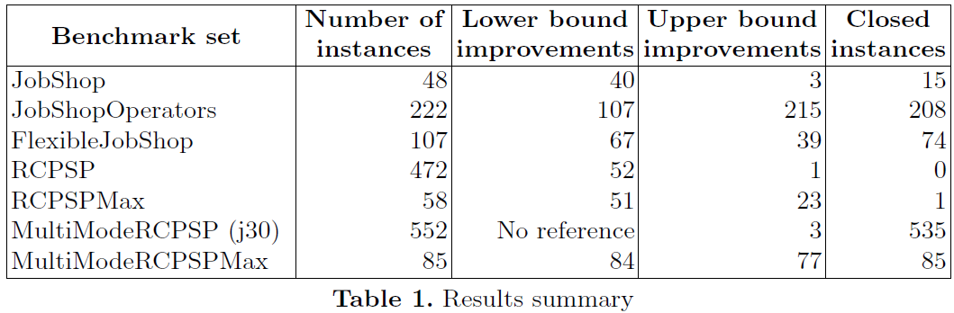
Automatic Search
CP-AI-OR 2015
Some recent results:

Slide 61
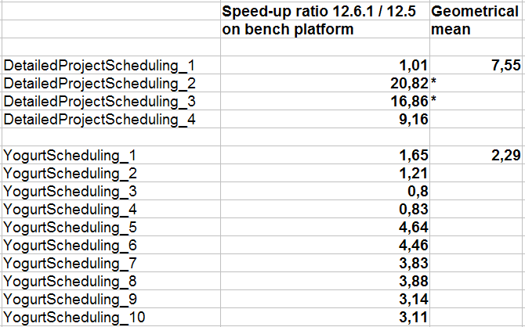
Automatic Search
Average speed-up between V12.5 and V12.6.1 on a couple of models that may ring a bell to some of you:

Slide 62

Comparison CPLEX / CP Optimizer
CPLEX and CP Optimizer engines are available in the same CPLEX Optimization Studio ecosystem and with the same “look&feel”
 |  | CPLEX | CP Optimizer
Interfaces |  | OPL, C++, Java, .NET, C, Python | OPL, C++, Java, .NET
Model | Decision variables | int, float | int, interval
 | Expressions | linear, quadratic | arithmetic, log, pow, … relational, a[x], count,...
 | Constraints | range | relational, logical, specialized, scheduling
Search | Search parameters
 | Warm start
 | Multi-core //
Tools | Search log
 | I/O format | .lp, .mps, ... | .cpo
 | Conflict refiner

Slide 63
Some papers related with CP Optimizer
P. Vilim, P. Laborie and P. Shaw. “Failure-directed Search for Constraint-based Scheduling”. CP-AI-OR 2015.
P. Laborie. “An Optimal Iterative Algorithm for Extracting MUCs in a Black-box Constraint Network”. ECAI 2014.
P. Laborie and J. Rogerie. “Temporal linear relaxation in IBM ILOG CP Optimizer”. Journal of Scheduling, Nov. 2014.
O. Lhomme. “Practical Reformulations With Table Constraints”. ECAI 2012.
P. Vilím. “Timetable Edge Finding Filtering Algorithm for Discrete Cumulative Resources”. CP-AI-OR 2011.
P. Laborie, J. Rogerie, P. Shaw and P. Vilim. "Reasoning with Conditional Time-intervals - Part II: an Algebraical Model for Resources". FLAIRS 2009.
P. Laborie. "IBM ILOG CP Optimizer for Detailed Scheduling Illustrated on Three Problems". CP-AI-OR 2009.
P. Vilim. "Max Energy Filtering Algorithm for Discrete Cumulative Resources". CP-AI-OR 2009.
P. Vilim. "Edge finding filtering algorithm for discrete cumulative resources in O(knlog(n))". CP 2009.
P. Laborie and J. Rogerie. "Reasoning with Conditional Time-intervals". FLAIRS 2008.
P. Laborie and D. Godard. "Self-Adapting Large Neighborhood Search: Application to single-mode scheduling problems". MISTA 2007.
P. Vilim. "Global Constraints in Scheduling". PhD thesis. Charles University, Prague. 2007.
P. Laborie, D. Godard and W. Nuijten. “Randomized Large Neighborhood Search for Cumulative Scheduling”. ICAPS 2005.
P. Refalo: ”Impact-Based Search Strategies for Constraint Programming“. CP 2004.
P. Shaw: "A Constraint for Bin Packing".CP 2004.

Slide 64

Agenda
Lexicographical objectives (12.3)
OverlapLength expressions (12.2)
SameSequence constraints (12.6)
CP Optimizer overview
Recent advances
  Modeling
  Tools
  Automatic search
Q&A
Starting points (old but so useful)
Conflict refiner (12.5)
I/O Format (12.6.1)
Strong annotations (12.6)
Presolve (12.5)
Failure-Directed Search (12.6)

