Slide 1
Accelerating the Development of
Efficient CP Optimizer Models
Philippe Laborie
IBM Analytics, Decision Optimization

Slide 2
Outline
Overview of CP Optimizer
  Model&Run paradigm
  Model
  Automatic search
Tools
  I/O format
  Model warnings
  Model presolve
  Search log
  Warm start
  Conflict refiner
  Failure explainer

Slide 3
Overview of CP Optimizer
A component of IBM ILOG CPLEX Optimization Studio
A Constraint Programming engine for combinatorial problems (including detailed scheduling problems)
Implements a Model & Run paradigm (like CPLEX)
  Model: Concise yet expressive modeling language
  Run: Powerful automatic search procedure
  Search algorithm is complete
Available through the following interfaces:
  OPL
  C++ (native interface)
  Java, .NET (wrapping of the C++ engine)
Set of tools to support the delevopment of efficient models

Slide 4
Overview of CP Optimizer
Model & Run paradigm
Model
User model
OPL, C++, Java, .NET
Solution
Automatic Solve

Slide 5
Model : integer variables
Variables | Expressions | Constraints
Variables are discrete integer Domains can be specified as a range [1..50] or as a set of values {1, 3, 5, 7, 9} dvar int x in 1..50 | Expressions can be integer or floating-point, for example 0.37*y is allowed Arithmetic (+,-,*,/) and more complex operators (min, max, log, pow etc.) are supported Relational expressions can be treated as 0-1 expressions. e.g. x = (y < z) Special expressions: x == a[y] x == count(Y, 3) y == cond ? y : z | Rich set of constraints Standard relational constraints (==, !=, <, >, <=, >=) Logical combinators (&&, ||, !, =>) Specialized (global) constraints allDifferent(X) allowedAssignments(X, tuples) forbiddenAssignments(X, tuples) pack(load, container, size) lexicographic(X, Y) inverse(X,Y)

Slide 6
Model : interval variables
Extension of classical CSP with a new type of decision variable:
optional interval variable :
Domain(x)  {}  { [s,e) | s,e, s≤e }
Introduction of mathematical notions such as sequences and functions to capture temporal dimension of scheduling problems
Absent interval
Interval of integers

Slide 7
Model : interval variables
In scheduling models, interval variables usually represent an interval of time during which some property hold (e.g. an activity executes) and whose end-points (start/end) are decision variables of the problem.
Examples:
  A sub-project in a project, a task in a sub-project (Work Breakdown Structure)
  A batch of operations
  The setup of a tool on a machine
  The moving of an item by a transportation device
  The utilization interval of a resource
Idea of the model (and search) is to avoid the enumeration of start/end values (continuous time)

Slide 8
Model : interval variables
An interval variable can be optional meaning that it is a decision to have it present or absent in a solution.
Examples:
  Unperformed tasks and optional sub-projects
  Alternative resources, modes or recipes for processing an order, each mode specifying a particular combination of operational resources
  Operations that can be processed in different temporal modes (e.g. series or parallel)
  Activities that can be performed in an alternative set of batches or shifts

Slide 9
Model: example
Satellite Control Network scheduling problem [1]
n communication tasks for Earth orbiting satellites must be scheduled on a total of 32 antennas spread across 13 ground-based tracking stations
In the instances, n ranges from to 400 to 1300
Objective: maximize the number of scheduled tasks
[1] Kramer & al.: Understanding Performance Trade-offs in Algorithms for Solving Oversubscribed Scheduling.

Slide 10
Model: example
Station 1
Opp_{i,1}
Station 2
Opp_{i,2}
Opp_{i,3}
Station 3
Opp_{i,4}
OR
Alternative assignments
to stations  time windows
(opportunities)
Task_{i}

Slide 11
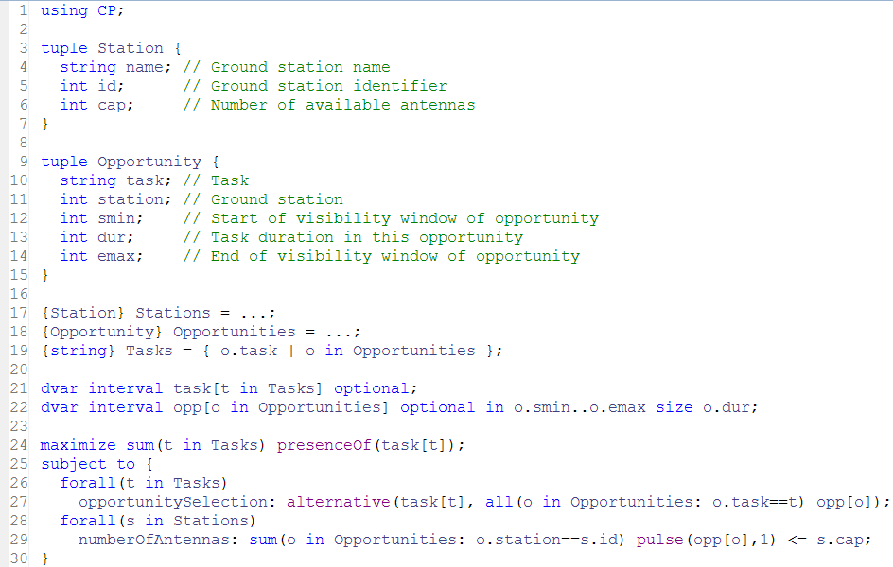
Model: example

Slide 12
Automatic Search
Search algorithm is Complete
Core CP techniques used as a building block:
  Tree search (Depth First)
  Constraint propagation
But also:
  Deterministic multicore parallelism
  Model presolve
  Algorithms portfolios
  Machine learning
  Restarting techniques
  Large Neighborhood Search
  No-good learning
  Impact-based branching
  Opportunistic probing
  Dominance rules
  LP-assisted heuristics
  Randomization
  Evolutionary algorithms

Slide 13
Automatic Search
Search algorithm is Complete
Core CP techniques used as a building block:
  Tree search (Depth First)
  Constraint propagation
But also:
  Deterministic multicore parallelism
  Model presolve
  Algorithms portfolios
  Machine learning
  Restarting techniques
  Large Neighborhood Search
  No-good learning
  Impact-based branching
  Opportunistic probing
  Dominance rules
  LP-assisted heuristics
  Randomization
  Evolutionary algorithms
[2] P. Vilim's talk at this ISMP: “Failure-directed Search for Constraint-based Scheduling”

Slide 14
Tools: I/O format
Objective:
  Make it easier to understand the content of a model
  Communicate a model to IBM support team regardless of the API used to build it (OPL, C++, Java, .NET)
Structure of a .cpo file
  Human readable
  Flat (no cycle, forall statements)
  No user defined data types
  Internal information such as CPO version or platform used
  Includes search parameter values
Facilities
  Export model before/instead of solve
  Export model during solve (with current domains)
  Import model instead of normal modeling

Slide 15
Tools: I/O format
// Interval-related variables:
"task(1)" = intervalVar(optional);
"task(1A)" = intervalVar(optional);
…
"opp({1,1,62})" = intervalVar(optional, start=62..intervalmax, end=0..99, size=25);
"opp({1A,1,32})" = intervalVar(optional, start=32..intervalmax, end=0..69, size=33);
…
// Objective:
maximize(sum([presenceOf("task(1)"), presenceOf("task(1A)"), …]));
…
// Constraints:
alternative("task(1)", ["opp({1,1,62})"], 1);
…
pulse("opp({3,1,58})", 1) + pulse("opp({1,1,62})", 1) + … <= 4;
…
parameters {
LogVerbosity = Quiet;
}

Slide 16
Tools: model warnings
Like a compiler, CP Optimizer can analyze the model and print some warnings
  When there is something suspicious in the model
  Regardless how the model was created (C++, OPL, …)
  Including guilty part of the model in the cpo file format
  Including source code line numbers (if known)
  3 levels of warnings, more than 50 types of warnings
satellite.cpo:2995:1: Warning: Constraint 'alternative': there is only one alternative interval variable.
alternative("task(1)", ["opp({1,1,62})"], 1)
satellite.cpo:2996:1: Warning: Constraint 'alternative': there is only one alternative interval variable.
alternative("task(1A)", ["opp({1A,1,32})"], 1)

Slide 17
Tools: model presolve
Objective: automatically reformulate the model in order to speed-up its resolution
Works on an internal representation of the model
Different types of presolve:
  Aggregation of basic constraints into global constraints
  Constraint strengthening
  Simplifications and factorizations

Slide 18
Tools: model presolve
Model
User model
Model analysis
Model presolve
Warnings
CPO file
Internal model
OPL, C++, Java, .NET
Solution
Automatic Solve

Slide 19
Tools: model presolve
Examples of presolve rules
  Common sub-expression elimination
  Aggregation of x!=y cliques as allDifferent([x,y,...])
  Precedence strengthening
    If a and b cannot overlap and startsBeforeStart(a,b)
    Then endsBeforeStart(a,b)
  Precedence recognition
    If endOf(a,-∞) ≤ startOf(b,+∞)
    Then endsBeforeStart(a,b)
    Precedences are aggregated into a “time net” (STN) for faster and stronger propagation
  2-SAT clauses recognition
    presenceOf(a) ≤ presenceOf(b)
    Such clauses are aggregated into a “logical net” for stronger propagation

Slide 20
Tools: search log
Objective: understand what happens during the automatic search
! -----------------------------------------------------------------------
! Maximization problem - 2980 variables, 853 constraints
! Workers = 2
! TimeLimit = 30
! Initial process time : 0.01s (0.00s extraction + 0.01s propagation)
! . Log search space : 4627.3 (before), 4627.3 (after)
! . Memory usage : 16.9 MB (before), 19.7 MB (after)
! Using parallel search with 2 workers.
! -----------------------------------------------------------------------
! Best Branches Non-fixed W Branch decision
* 746 3945 0.79s 1 -
746 4000 2924 1 on task("8")
746 4000 2908 2 on opp({"186",2,66})
…
! Time = 1.37s, Explored branches = 35832, Memory usage = 55.5 MB
! Best Branches Non-fixed W Branch decision
818 12000 2920 1 on task("184")
…
! -----------------------------------------------------------------------
! Search terminated by limit, 6 solutions found.
! Best objective : 826
! Number of branches : 709092
! Number of fails : 179648
! Total memory usage : 54.5 MB (52.9 MB CP Optimizer + 1.6 MB Concert)
! Time spent in solve : 30.03s (30.01s engine + 0.01s extraction)
! Search speed (br. / s) : 23625.4
! -----------------------------------------------------------------------
Problem
characteristics

Slide 21
Tools: search log
Objective: understand what happens during the automatic search
! -----------------------------------------------------------------------
! Maximization problem - 2980 variables, 853 constraints
! Workers = 2
! TimeLimit = 30
! Initial process time : 0.01s (0.00s extraction + 0.01s propagation)
! . Log search space : 4627.3 (before), 4627.3 (after)
! . Memory usage : 16.9 MB (before), 19.7 MB (after)
! Using parallel search with 2 workers.
! -----------------------------------------------------------------------
! Best Branches Non-fixed W Branch decision
* 746 3945 0.79s 1 -
746 4000 2924 1 on task("8")
746 4000 2908 2 on opp({"186",2,66})
…
! Time = 1.37s, Explored branches = 35832, Memory usage = 55.5 MB
! Best Branches Non-fixed W Branch decision
818 12000 2920 1 on task("184")
…
! -----------------------------------------------------------------------
! Search terminated by limit, 6 solutions found.
! Best objective : 826
! Number of branches : 709092
! Number of fails : 179648
! Total memory usage : 54.5 MB (52.9 MB CP Optimizer + 1.6 MB Concert)
! Time spent in solve : 30.03s (30.01s engine + 0.01s extraction)
! Search speed (br. / s) : 23625.4
! -----------------------------------------------------------------------
Modified
parameter values

Slide 22
Tools: search log
Objective: understand what happens during the automatic search
! -----------------------------------------------------------------------
! Maximization problem - 2980 variables, 853 constraints
! Workers = 2
! TimeLimit = 30
! Initial process time : 0.01s (0.00s extraction + 0.01s propagation)
! . Log search space : 4627.3 (before), 4627.3 (after)
! . Memory usage : 16.9 MB (before), 19.7 MB (after)
! Using parallel search with 2 workers.
! -----------------------------------------------------------------------
! Best Branches Non-fixed W Branch decision
* 746 3945 0.79s 1 -
746 4000 2924 1 on task("8")
746 4000 2908 2 on opp({"186",2,66})
…
! Time = 1.37s, Explored branches = 35832, Memory usage = 55.5 MB
! Best Branches Non-fixed W Branch decision
818 12000 2920 1 on task("184")
…
! -----------------------------------------------------------------------
! Search terminated by limit, 6 solutions found.
! Best objective : 826
! Number of branches : 709092
! Number of fails : 179648
! Total memory usage : 54.5 MB (52.9 MB CP Optimizer + 1.6 MB Concert)
! Time spent in solve : 30.03s (30.01s engine + 0.01s extraction)
! Search speed (br. / s) : 23625.4
! -----------------------------------------------------------------------
Root node
information

Slide 23
Tools: search log
Objective: understand what happens during the automatic search
! -----------------------------------------------------------------------
! Maximization problem - 2980 variables, 853 constraints
! Workers = 2
! TimeLimit = 30
! Initial process time : 0.01s (0.00s extraction + 0.01s propagation)
! . Log search space : 4627.3 (before), 4627.3 (after)
! . Memory usage : 16.9 MB (before), 19.7 MB (after)
! Using parallel search with 2 workers.
! -----------------------------------------------------------------------
! Best Branches Non-fixed W Branch decision
* 746 3945 0.79s 1 -
746 4000 2924 1 on task("8")
746 4000 2908 2 on opp({"186",2,66})
…
! Time = 1.37s, Explored branches = 35832, Memory usage = 55.5 MB
! Best Branches Non-fixed W Branch decision
818 12000 2920 1 on task("184")
…
! -----------------------------------------------------------------------
! Search terminated by limit, 6 solutions found.
! Best objective : 826
! Number of branches : 709092
! Number of fails : 179648
! Total memory usage : 54.5 MB (52.9 MB CP Optimizer + 1.6 MB Concert)
! Time spent in solve : 30.03s (30.01s engine + 0.01s extraction)
! Search speed (br. / s) : 23625.4
! -----------------------------------------------------------------------
New incumbent
solutions (time, worker)

Slide 24
Tools: search log
Objective: understand what happens during the automatic search
! -----------------------------------------------------------------------
! Maximization problem - 2980 variables, 853 constraints
! Workers = 2
! TimeLimit = 30
! Initial process time : 0.01s (0.00s extraction + 0.01s propagation)
! . Log search space : 4627.3 (before), 4627.3 (after)
! . Memory usage : 16.9 MB (before), 19.7 MB (after)
! Using parallel search with 2 workers.
! -----------------------------------------------------------------------
! Best Branches Non-fixed W Branch decision
* 746 3945 0.79s 1 -
746 4000 2924 1 on task("8")
746 4000 2908 2 on opp({"186",2,66})
…
! Time = 1.37s, Explored branches = 35832, Memory usage = 55.5 MB
! Best Branches Non-fixed W Branch decision
818 12000 2920 1 on task("184")
…
! -----------------------------------------------------------------------
! Search terminated by limit, 6 solutions found.
! Best objective : 826
! Number of branches : 709092
! Number of fails : 179648
! Total memory usage : 54.5 MB (52.9 MB CP Optimizer + 1.6 MB Concert)
! Time spent in solve : 30.03s (30.01s engine + 0.01s extraction)
! Search speed (br. / s) : 23625.4
! -----------------------------------------------------------------------
Periodical log
with fail information,
number of unfixed
variables, current decision

Slide 25
Tools: search log
Objective: understand what happens during the automatic search
! -----------------------------------------------------------------------
! Maximization problem - 2980 variables, 853 constraints
! Workers = 2
! TimeLimit = 30
! Initial process time : 0.01s (0.00s extraction + 0.01s propagation)
! . Log search space : 4627.3 (before), 4627.3 (after)
! . Memory usage : 16.9 MB (before), 19.7 MB (after)
! Using parallel search with 2 workers.
! -----------------------------------------------------------------------
! Best Branches Non-fixed W Branch decision
* 746 3945 0.79s 1 -
746 4000 2924 1 on task("8")
746 4000 2908 2 on opp({"186",2,66})
…
! Time = 1.37s, Explored branches = 35832, Memory usage = 55.5 MB
! Best Branches Non-fixed W Branch decision
818 12000 2920 1 on task("184")
…
! -----------------------------------------------------------------------
! Search terminated by limit, 6 solutions found.
! Best objective : 826
! Number of branches : 709092
! Number of fails : 179648
! Total memory usage : 54.5 MB (52.9 MB CP Optimizer + 1.6 MB Concert)
! Time spent in solve : 30.03s (30.01s engine + 0.01s extraction)
! Search speed (br. / s) : 23625.4
! -----------------------------------------------------------------------
Final information
with solution status
and search statistics

Slide 26
Tools: warm start
Objective: Start search from a known (possibly incomplete) solution given by the user (warm start) in order to further improve it or to help to guide the engine towards a first feasible solution
API: IloCP::setStartingPoint(IloSolution warmstart)
Use cases:
  Restart an interrupted search with the current incumbent
  Start from an initial solution found by an available heuristic
  Goal programming for multi-objective problems
  When finding an initial solution is hard, solve an initial problem that maximizes constraint satisfaction and start from its solution
  Successively solving similar problems (e.g. dynamic scheduling)
  Hierarchical problem solving (e.g. planning → scheduling)

Slide 27
Tools: warm start
Satellite Control Network scheduling problem [1]
n communication tasks for Earth orbiting satellites must be scheduled on a total of 32 antennas spread across 13 ground-based tracking stations
In the instances, n ranges from to 400 to 1300
Tasks have priorities: first maximize the number of scheduled high priority tasks, then the number of scheduled low priority tasks
[1] Kramer & al.: Understanding Performance Trade-offs in Algorithms for Solving Oversubscribed Scheduling.

Slide 28
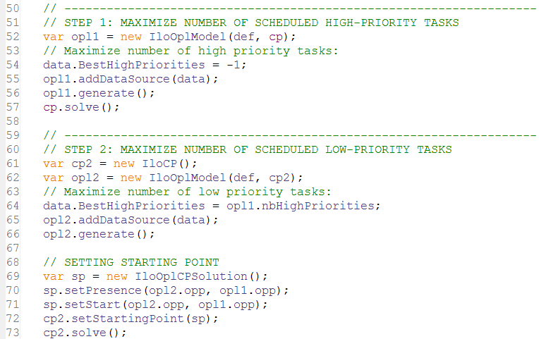
Tools: warm start

Slide 29
Tools: conflict refiner
Objective: identify a reason for an inconsistency by providing a minimal infeasible subset of constraints for an infeasible model
Use cases:
  Model debugging (errors in model)
  Data debugging (inconsistent data)
  The model and data are correct, but the associated data represents a real-world conflict in the system being modeled
  You create an infeasible model to test properties of (or extract information about) a similar model

Slide 30
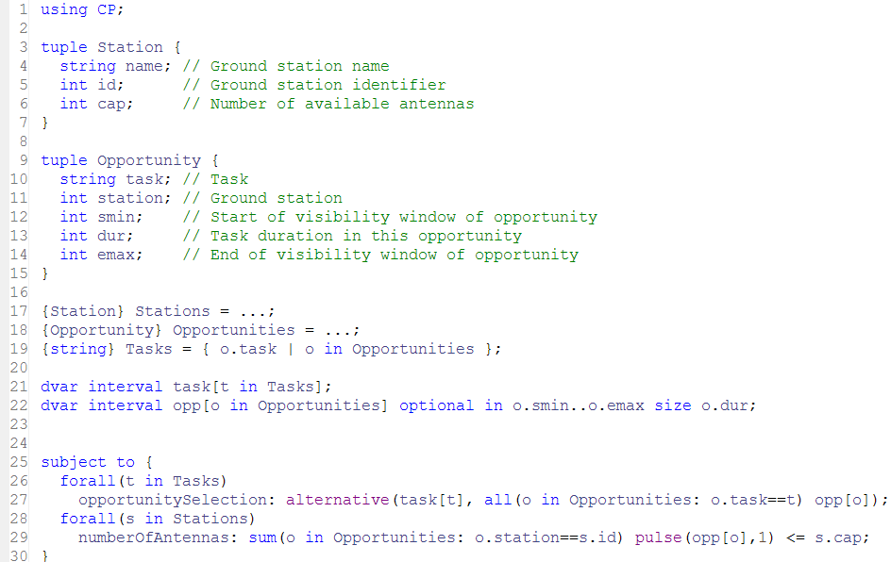
Tools: conflict refiner

Slide 31
Tools: conflict refiner
!----------------------------------------------------------------------------
! Satisfiability problem - 2,980 variables, 851 constraints
! Problem found infeasible at the root node
! ----------------------------------------------------------------------------
...
! ----------------------------------------------------------------------------
! Conflict refining - 851 constraints
! ----------------------------------------------------------------------------
! Iteration Number of constraints
* 1 851
* 2 426
...
* 58 5
* 59 5
! Conflict refining terminated
! ----------------------------------------------------------------------------
! Conflict status : Terminated normally, conflict found
! Conflict size : 5 constraints
! Number of iterations : 59
! Total memory usage : 13.3 MB
! Conflict computation time : 0.51s
! ----------------------------------------------------------------------------

Slide 32
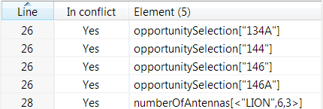
Tools: conflict refiner
Conflict:
There is not enough antennas to accommodate all 4 tasks on their time-window on ground station “LION” (3 antennas):
  <134A,6,1232,19,1266>
  <144, 6,1238,31,1272>
  <146, 6,1228,22,1260>
  <146A,6,1230,22,1262>
1228
1260
146
1230
1262
146A
1232
1266
134A
1238
1272
144

Slide 33
Tools: failure explainer
Objective: explains why the engine backtracks at a given search node
Uses the conflict refiner to find a minimal conflict in the model+decisions at a backtracking node
Currently only available in DepthFirst search mode and only for integer variables

Slide 34
Tools: failure explainer
Example
// Build model:
…
// Create CP object:
IloCP cp(model);
// Use only one thread:
cp.setParameter(IloCP::Workers, 1);
// Simple tree search:
cp.setParameter(IloCP::SearchType, IloCP::DepthFirst);
// Show failure numbers:
cp.setParameter(IloCP::LogSearchTags, IloCP::On);
// Explain particular failures:
cp.explainFailure(IloIntArray(env, 4, 3, 10, 11, 12));
// Solve and explain:
cp.solve();

Slide 35
Tools: failure explainer
- Failure #1
- Failure #2
- Failure #3
-- Possible conflict explaining failure
// Model constraints
element(store1, [location1, location2, location3, location4, location5]) == 1;
element(store2, [location1, location2, location3, location4, location5]) == 1;
element(store3, [location1, location2, location3, location4, location5]) == 1;
element(store4, [location1, location2, location3, location4, location5]) == 1;
element(store5, [location1, location2, location3, location4, location5]) == 1;
element(store6, [location1, location2, location3, location4, location5]) == 1;
element(store7, [location1, location2, location3, location4, location5]) == 1;
element(store8, [location1, location2, location3, location4, location5]) == 1;
count([store1, store2, store3, store4, store5, store6, store7, store8], 0) <= 3;
count([store1, store2, store3, store4, store5, store6, store7, store8], 3) <= 4;
// Branch constraints
location2 == 0;
location3 == 0;
location5 == 0;

Slide 36
The full picture
Model
User model
Warnings
Model analysis
Model presolve
CPO file
Warm start
Internal model
OPL, C++, Java, .NET
Search log
Automatic Solve
Solution
Failure explainer
Conflict refiner
Fail expl.
Conflict

Slide 37
Questions ?
Model
User model
Warnings
Model analysis
Model presolve
CPO file
Warm start
Internal model
OPL, C++, Java, .NET
Search log
Automatic Solve
Solution
Failure explainer
Conflict refiner
Fail expl.
Conflict

