Slide 1
Solving Industrial Scheduling Problems with Constraint Programming
Philippe Laborie
IBM Analytics, Decision Optimization

Slide 2
Outline
Scheduling problems: from theory to practice
CP extensions for scheduling
Simplifying model design & problem resolution

Slide 3
Scheduling problems: from theory to practice
Theory: e.g. RCPSP (Resource Constrained Project Scheduling)
  Problem definition:
    A set of n tasks A1,...,An with specified duration Di for task Ai
    A set of precedence constraints between tasks (precedence graph)
    A set of m resources R1,...,Rm with specified capacity Cj for resource Rj
    Each task Ai requires some resources in a given quantity
    Objective is to minimize project makespan
  Classical benchmark: PSPLib = 30-120 tasks
R1
a3
a6
R2
a1
a7
a2
a5
a4
a8

Slide 4
Scheduling problems: from theory to practice
Theory: e.g. RCPSP (Resource Constrained Project Scheduling)
  From an academical point of view, this is a very generic problem that subsumes many other classical scheduling problems
RCPSP
Job-shop
Hybrid Flow-shop
Open-shop
Flow-shop

Slide 5
Scheduling problems: from theory to practice
Some real scheduling applications
  Aerospace: Project scheduling, Aircraft assembly, Assembly line configuration, Satellite communication & observation, Rover activities …
  Energy & Utilities: Nuclear plant outage scheduling, Maintenance, Production planning …
  Mining: Open pit mining ...
  Logistics, Supply Chain: Vehicle routing, Bikes and car sharing …
  Manufacturing: Production scheduling, Assembly lines, Factory configuration, Test scheduling …
  Media & Communications: Advertizing & program scheduling, Event & personnel scheduling …
  Travel & transportation: Airport scheduling (gates, landing, parking, …), Port scheduling (quay cranes ...), Train scheduling …
  Health: Employee, Patient scheduling, Pharmaceutical products tests …
  Agriculture: Crop scheduling (harvesting ...)
  General audience: Personal schedule organizer, Theme park planner ...

Slide 6
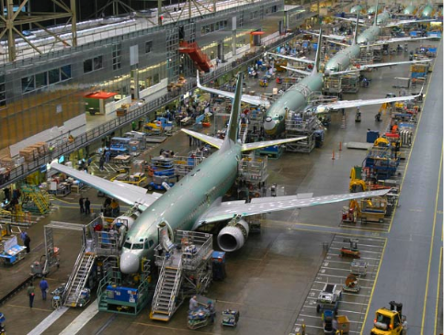

Scheduling problems: from theory to practice
Practice: the problem looks like ...
this ...
or this ...

Slide 7
Scheduling problems: from theory to practice
Practice: the problem is large
  Typical problems are larger than 1000 activities
  E.g. we solved a 1.000.000 tasks RCPSP-like problem for an aircraft manufacturer

Slide 8
Scheduling problems: from theory to practice
Practice: the problem is complex
  Heterogeneous types of decisions: start/end dates, resource allocation, mode selection, activity non-execution, activity durations, activity interruptions, resource quantities, producer/consumer matching, batch configuration, resource overconsumption, resource configuration, …
  Complex resources: inventories, setup times and costs, calendars/shifts, moving resources, spatial constraints, synchronization constraints (e.g. conveyer belt), batch constraints
  Complex activities: optional, interruptible, setups, maintenance, work breakdown structure
  Complex objective function: earliness/tardiness, temporal preferences, resource related costs (many types!), most of the problems are multi-objectives

Slide 9
Scheduling problems: from theory to practice
Practice: the problem is not well defined
  Implicit constraints / objectives
  Some aspects of the problem are critical, others can be:
    Approximated
    Relaxed
    Over-constrained
    Considered in a post-processing step
    …
Practice: the data is:
  Hard to get (different data sources, confidentiality, …)
  Uncertain / Imprecise / Incomplete / Incorrect
Customers are expecting good solutions to their problem, they usually do not care about how the problem is modeled/solved

Slide 10

Scheduling problems: from theory to practice
Practice: mind the real gap
Real world
Model & Data
Modeling
minimize f(X)
subject to C(X)
gapS
Solve
Execution
solution X

Slide 11
Scheduling problems: from theory to practice
Practice: mind the real gap
  “Essentially, all models are wrong, but some are useful” – G. Box
  The real gap you must care about is gapM ⊕ gapS
Real world
Model & Data
Modeling
minimize f(X)
subject to C(X)
gapM
gapS
Solve
Execution
solution X

Slide 12
Scheduling problems: from theory to practice
Expressive modeling language
Robust & efficient
optimization
algorithm
Practice: mind the real gap
  “Essentially, all models are wrong, but some are useful” – G. Box
  The real gap you must care about is gapM ⊕ gapS
Real world
Model & Data
Modeling
minimize f(X)
subject to C(X)
gapM
gapS
Solve
Tools for simplifying model
design and resolution
solution X
Execution

Slide 13
CP extensions for scheduling
Extension of classical CSP with a new type of decision variable:
optional interval variable :
Domain(x)  {}  { [s,e) | s,e, s≤e }
Introduction of mathematical notions such as sequences and functions to capture temporal dimension of scheduling problems
Absent interval
Interval of integers

Slide 14
CP extensions for scheduling
In scheduling models, interval variables usually represent an interval of time during which some property hold (e.g. an activity executes) and whose end-points (start/end) are decision variables of the problem.
Examples:
  A sub-project in a project, a task in a sub-project (Work Breakdown Structure)
  A batch of operations
  The setup of a tool on a machine
  The moving of an item by a transportation device
  The utilization interval of a resource
Idea of the model (and search) is to avoid the enumeration of start/end values (continuous time)

Slide 15
CP extensions for scheduling
An interval variable can be optional meaning that it is a decision to have it present or absent in a solution.
Examples:
  Unperformed tasks and optional sub-projects
  Alternative resources, modes or recipes for processing an order, each mode specifying a particular combination of operational resources
  Operations that can be processed in different temporal modes (e.g. series or parallel)
  Activities that can be performed in an alternative set of batches or shifts

Slide 16
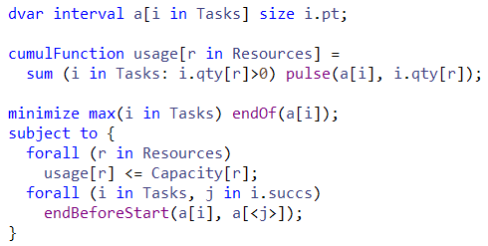
CP extensions for scheduling
Example: RCPSP

Slide 17
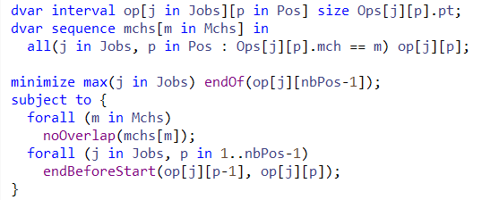
CP extensions for scheduling
Example: Job-shop scheduling problem

Slide 18
CP extensions for scheduling
Satellite Control Network scheduling problem [1]
n communication tasks for Earth orbiting satellites must be scheduled on a total of 32 antennas spread across 13 ground-based tracking stations
In the instances, n ranges from to 400 to 1300
Objective: maximize the number of scheduled tasks
[1] Kramer & al.: Understanding Performance Trade-offs in Algorithms for Solving Oversubscribed Scheduling.

Slide 19
CP extensions for scheduling
Station 1
Opp_{i,1}
Station 2
Opp_{i,2}
Opp_{i,3}
Station 3
Opp_{i,4}
OR
Alternative assignments
to stations  time windows
(opportunities)
Task_{i}

Slide 20
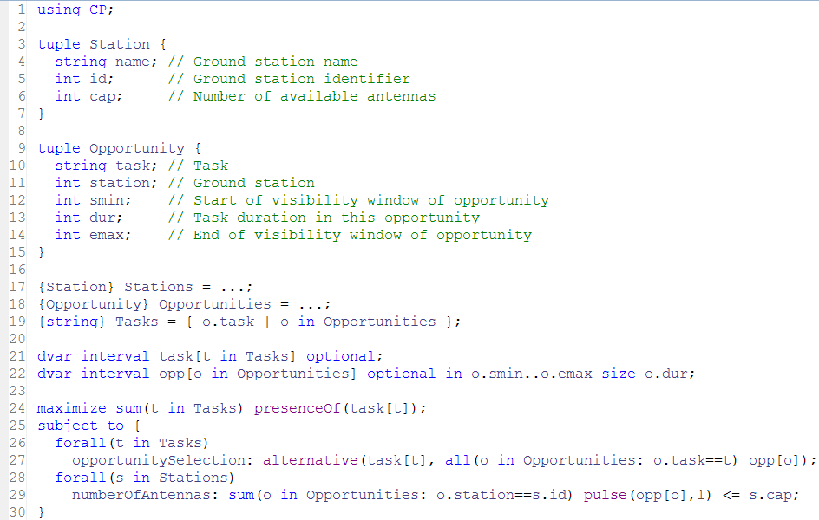
CP extensions for scheduling

Slide 21
Automatic Search
Search algorithm is Complete
Core CP techniques used as a building block:
  Tree search (Depth First)
  Constraint propagation
But also:
  Deterministic multicore parallelism
  Model presolve
  Algorithms portfolios
  Machine learning
  Restarting techniques
  Large Neighborhood Search
  No-good learning
  Impact-based branching
  Opportunistic probing
  Dominance rules
  LP-assisted heuristics
  Randomization
  Evolutionary algorithms

Slide 22
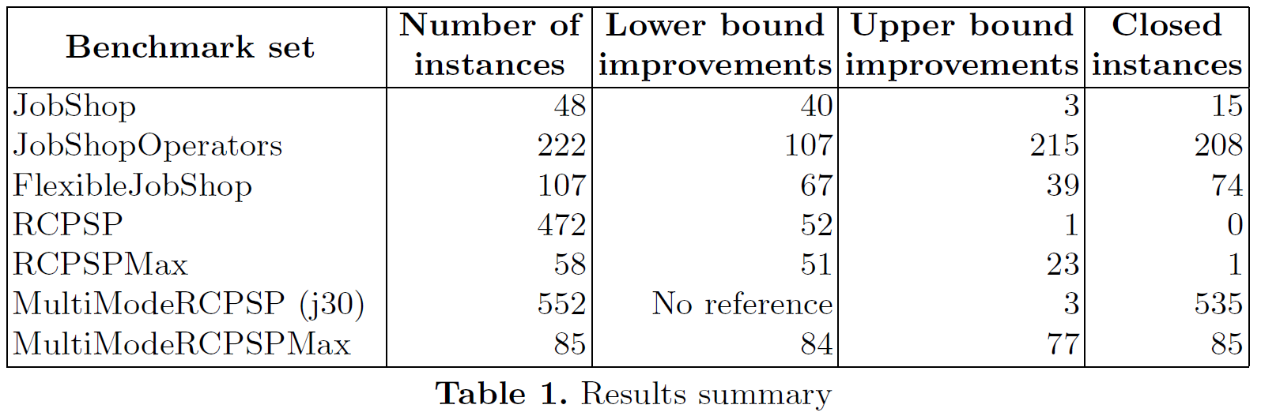
Automatic Search
Very good performance results on academical problems
  CP-AI-OR 2015:
  Winner of the CP-2015 Industrial Modelling Challenge with a very simple model: csplib.org/Problems/prob073/models/model.mod.html
More important: very good performance on industrial problems

Slide 23
Simplifying model design & problem resolution
Model
User model
Warnings
Model analysis
Model presolve
CPO file
Warm start
Internal model
OPL, C++, Java, .NET
Search log
Automatic Solve
Conflict refiner
Solution
Conflict

Slide 24
Tools: I/O format
Objective:
  Make it easier to understand the content of a model
  Communicate a model to IBM support team regardless of the API used to build it (OPL, C++, Java, .NET)
Structure of a .cpo file
  Human readable
  Flat (no cycle, forall statements)
  No user defined data types
  Internal information such as CPO version or platform used
  Includes search parameter values
Facilities
  Export model before/instead of solve
  Export model during solve (with current domains)
  Import model instead of normal modeling

Slide 25
Tools: I/O format
// Interval-related variables:
"task(1)" = intervalVar(optional);
"task(1A)" = intervalVar(optional);
…
"opp({1,1,62})" = intervalVar(optional, start=62..intervalmax, end=0..99, size=25);
"opp({1A,1,32})" = intervalVar(optional, start=32..intervalmax, end=0..69, size=33);
…
// Objective:
maximize(sum([presenceOf("task(1)"), presenceOf("task(1A)"), …]));
…
// Constraints:
alternative("task(1)", ["opp({1,1,62})"], 1);
…
pulse("opp({3,1,58})", 1) + pulse("opp({1,1,62})", 1) + … <= 4;
…
parameters {
LogVerbosity = Quiet;
}

Slide 26
Tools: model warnings
Like a compiler, CP Optimizer can analyze the model and print some warnings
  When there is something suspicious in the model
  Regardless how the model was created (C++, OPL, …)
  Including guilty part of the model in the cpo file format
  Including source code line numbers (if known)
  3 levels of warnings, more than 50 types of warnings
satellite.cpo:2995:1: Warning: Constraint 'alternative': there is only one alternative interval variable.
alternative("task(1)", ["opp({1,1,62})"], 1)
satellite.cpo:2996:1: Warning: Constraint 'alternative': there is only one alternative interval variable.
alternative("task(1A)", ["opp({1A,1,32})"], 1)

Slide 27
Tools: model presolve
Objective: automatically reformulate the model in order to speed-up its resolution
Works on an internal representation of the model
Different types of presolve:
  Aggregation of basic constraints into global constraints
  Constraint strengthening
  Simplifications and factorizations

Slide 28
Tools: model presolve
Examples of presolve rules
  Common sub-expression elimination
  Aggregation of x!=y cliques as allDifferent([x,y,...])
  Precedence strengthening
    If a and b cannot overlap and startsBeforeStart(a,b)
    Then endsBeforeStart(a,b)
  Precedence recognition
    If endOf(a,-∞) ≤ startOf(b,+∞)
    Then endsBeforeStart(a,b)
    Precedences are aggregated into a “time net” (STN) for faster and stronger propagation
  2-SAT clauses recognition
    presenceOf(a) ≤ presenceOf(b)
    Such clauses are aggregated into a “logical net” for stronger propagation

Slide 29
Tools: search log
Objective: understand what happens during the automatic search
! -----------------------------------------------------------------------
! Maximization problem - 2980 variables, 853 constraints
! Workers = 2
! TimeLimit = 30
! Initial process time : 0.01s (0.00s extraction + 0.01s propagation)
! . Log search space : 4627.3 (before), 4627.3 (after)
! . Memory usage : 16.9 MB (before), 19.7 MB (after)
! Using parallel search with 2 workers.
! -----------------------------------------------------------------------
! Best Branches Non-fixed W Branch decision
* 746 3945 0.79s 1 -
746 4000 2924 1 on task("8")
746 4000 2908 2 on opp({"186",2,66})
…
! Time = 1.37s, Explored branches = 35832, Memory usage = 55.5 MB
! Best Branches Non-fixed W Branch decision
818 12000 2920 1 on task("184")
…
! -----------------------------------------------------------------------
! Search terminated by limit, 6 solutions found.
! Best objective : 826
! Number of branches : 709092
! Number of fails : 179648
! Total memory usage : 54.5 MB (52.9 MB CP Optimizer + 1.6 MB Concert)
! Time spent in solve : 30.03s (30.01s engine + 0.01s extraction)
! Search speed (br. / s) : 23625.4
! -----------------------------------------------------------------------
Problem
characteristics

Slide 30
Tools: search log
Objective: understand what happens during the automatic search
! -----------------------------------------------------------------------
! Maximization problem - 2980 variables, 853 constraints
! Workers = 2
! TimeLimit = 30
! Initial process time : 0.01s (0.00s extraction + 0.01s propagation)
! . Log search space : 4627.3 (before), 4627.3 (after)
! . Memory usage : 16.9 MB (before), 19.7 MB (after)
! Using parallel search with 2 workers.
! -----------------------------------------------------------------------
! Best Branches Non-fixed W Branch decision
* 746 3945 0.79s 1 -
746 4000 2924 1 on task("8")
746 4000 2908 2 on opp({"186",2,66})
…
! Time = 1.37s, Explored branches = 35832, Memory usage = 55.5 MB
! Best Branches Non-fixed W Branch decision
818 12000 2920 1 on task("184")
…
! -----------------------------------------------------------------------
! Search terminated by limit, 6 solutions found.
! Best objective : 826
! Number of branches : 709092
! Number of fails : 179648
! Total memory usage : 54.5 MB (52.9 MB CP Optimizer + 1.6 MB Concert)
! Time spent in solve : 30.03s (30.01s engine + 0.01s extraction)
! Search speed (br. / s) : 23625.4
! -----------------------------------------------------------------------
Modified
parameter values

Slide 31
Tools: search log
Objective: understand what happens during the automatic search
! -----------------------------------------------------------------------
! Maximization problem - 2980 variables, 853 constraints
! Workers = 2
! TimeLimit = 30
! Initial process time : 0.01s (0.00s extraction + 0.01s propagation)
! . Log search space : 4627.3 (before), 4627.3 (after)
! . Memory usage : 16.9 MB (before), 19.7 MB (after)
! Using parallel search with 2 workers.
! -----------------------------------------------------------------------
! Best Branches Non-fixed W Branch decision
* 746 3945 0.79s 1 -
746 4000 2924 1 on task("8")
746 4000 2908 2 on opp({"186",2,66})
…
! Time = 1.37s, Explored branches = 35832, Memory usage = 55.5 MB
! Best Branches Non-fixed W Branch decision
818 12000 2920 1 on task("184")
…
! -----------------------------------------------------------------------
! Search terminated by limit, 6 solutions found.
! Best objective : 826
! Number of branches : 709092
! Number of fails : 179648
! Total memory usage : 54.5 MB (52.9 MB CP Optimizer + 1.6 MB Concert)
! Time spent in solve : 30.03s (30.01s engine + 0.01s extraction)
! Search speed (br. / s) : 23625.4
! -----------------------------------------------------------------------
Root node
information

Slide 32
Tools: search log
Objective: understand what happens during the automatic search
! -----------------------------------------------------------------------
! Maximization problem - 2980 variables, 853 constraints
! Workers = 2
! TimeLimit = 30
! Initial process time : 0.01s (0.00s extraction + 0.01s propagation)
! . Log search space : 4627.3 (before), 4627.3 (after)
! . Memory usage : 16.9 MB (before), 19.7 MB (after)
! Using parallel search with 2 workers.
! -----------------------------------------------------------------------
! Best Branches Non-fixed W Branch decision
* 746 3945 0.79s 1 -
746 4000 2924 1 on task("8")
746 4000 2908 2 on opp({"186",2,66})
…
! Time = 1.37s, Explored branches = 35832, Memory usage = 55.5 MB
! Best Branches Non-fixed W Branch decision
818 12000 2920 1 on task("184")
…
! -----------------------------------------------------------------------
! Search terminated by limit, 6 solutions found.
! Best objective : 826
! Number of branches : 709092
! Number of fails : 179648
! Total memory usage : 54.5 MB (52.9 MB CP Optimizer + 1.6 MB Concert)
! Time spent in solve : 30.03s (30.01s engine + 0.01s extraction)
! Search speed (br. / s) : 23625.4
! -----------------------------------------------------------------------
New incumbent
solutions (time, worker)

Slide 33
Tools: search log
Objective: understand what happens during the automatic search
! -----------------------------------------------------------------------
! Maximization problem - 2980 variables, 853 constraints
! Workers = 2
! TimeLimit = 30
! Initial process time : 0.01s (0.00s extraction + 0.01s propagation)
! . Log search space : 4627.3 (before), 4627.3 (after)
! . Memory usage : 16.9 MB (before), 19.7 MB (after)
! Using parallel search with 2 workers.
! -----------------------------------------------------------------------
! Best Branches Non-fixed W Branch decision
* 746 3945 0.79s 1 -
746 4000 2924 1 on task("8")
746 4000 2908 2 on opp({"186",2,66})
…
! Time = 1.37s, Explored branches = 35832, Memory usage = 55.5 MB
! Best Branches Non-fixed W Branch decision
818 12000 2920 1 on task("184")
…
! -----------------------------------------------------------------------
! Search terminated by limit, 6 solutions found.
! Best objective : 826
! Number of branches : 709092
! Number of fails : 179648
! Total memory usage : 54.5 MB (52.9 MB CP Optimizer + 1.6 MB Concert)
! Time spent in solve : 30.03s (30.01s engine + 0.01s extraction)
! Search speed (br. / s) : 23625.4
! -----------------------------------------------------------------------
Periodical log
with fail information,
number of unfixed
variables, current decision

Slide 34
Tools: search log
Objective: understand what happens during the automatic search
! -----------------------------------------------------------------------
! Maximization problem - 2980 variables, 853 constraints
! Workers = 2
! TimeLimit = 30
! Initial process time : 0.01s (0.00s extraction + 0.01s propagation)
! . Log search space : 4627.3 (before), 4627.3 (after)
! . Memory usage : 16.9 MB (before), 19.7 MB (after)
! Using parallel search with 2 workers.
! -----------------------------------------------------------------------
! Best Branches Non-fixed W Branch decision
* 746 3945 0.79s 1 -
746 4000 2924 1 on task("8")
746 4000 2908 2 on opp({"186",2,66})
…
! Time = 1.37s, Explored branches = 35832, Memory usage = 55.5 MB
! Best Branches Non-fixed W Branch decision
818 12000 2920 1 on task("184")
…
! -----------------------------------------------------------------------
! Search terminated by limit, 6 solutions found.
! Best objective : 826
! Number of branches : 709092
! Number of fails : 179648
! Total memory usage : 54.5 MB (52.9 MB CP Optimizer + 1.6 MB Concert)
! Time spent in solve : 30.03s (30.01s engine + 0.01s extraction)
! Search speed (br. / s) : 23625.4
! -----------------------------------------------------------------------
Final information
with solution status
and search statistics

Slide 35
Tools: warm start
Objective: Start search from a known (possibly incomplete) solution given by the user (warm start) in order to further improve it or to help to guide the engine towards a first feasible solution
API: IloCP::setStartingPoint(IloSolution warmstart)
Use cases:
  Restart an interrupted search with the current incumbent
  Start from an initial solution found by an available heuristic
  Goal programming for multi-objective problems
  When finding an initial solution is hard, solve an initial problem that maximizes constraint satisfaction and start from its solution
  Successively solving similar problems (e.g. dynamic scheduling)
  Hierarchical problem solving (e.g. planning → scheduling)

Slide 36
Tools: conflict refiner
Objective: identify a reason for an inconsistency by providing a minimal infeasible subset of constraints for an infeasible model
Use cases:
  Model debugging (errors in model)
  Data debugging (inconsistent data)
  The model and data are correct, but the associated data represents a real-world conflict in the system being modeled
  You create an infeasible model to test properties of (or extract information about) a similar model

Slide 37
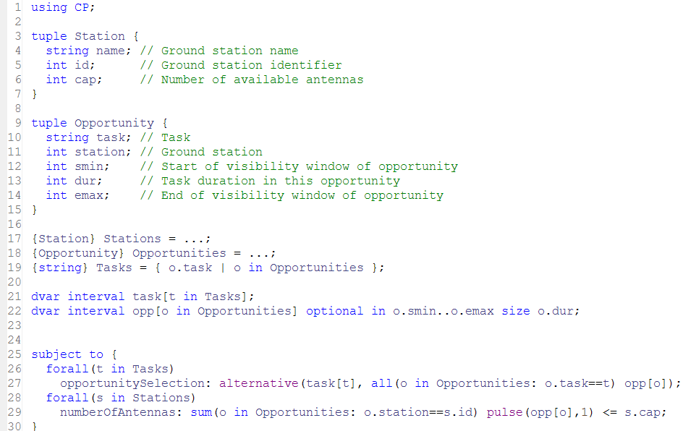
Tools: conflict refiner

Slide 38
Tools: conflict refiner
!----------------------------------------------------------------------------
! Satisfiability problem - 2,980 variables, 851 constraints
! Problem found infeasible at the root node
! ----------------------------------------------------------------------------
...
! ----------------------------------------------------------------------------
! Conflict refining - 851 constraints
! ----------------------------------------------------------------------------
! Iteration Number of constraints
* 1 851
* 2 426
...
* 58 5
* 59 5
! Conflict refining terminated
! ----------------------------------------------------------------------------
! Conflict status : Terminated normally, conflict found
! Conflict size : 5 constraints
! Number of iterations : 59
! Total memory usage : 13.3 MB
! Conflict computation time : 0.51s
! ----------------------------------------------------------------------------

Slide 39
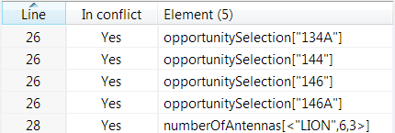
Tools: conflict refiner
Conflict:
There is not enough antennas to accommodate all 4 tasks on their time-window on ground station “LION” (3 antennas):
  <134A,6,1232,19,1266>
  <144, 6,1238,31,1272>
  <146, 6,1228,22,1260>
  <146A,6,1230,22,1262>
1228
1260
146
1230
1262
146A
1232
1266
134A
1238
1272
144

Slide 40
Simplifying model design & problem resolution
Model
User model
Warnings
Model analysis
Model presolve
CPO file
Warm start
Internal model
OPL, C++, Java, .NET
Search log
Automatic Solve
Conflict refiner
Solution
Conflict

Slide 41
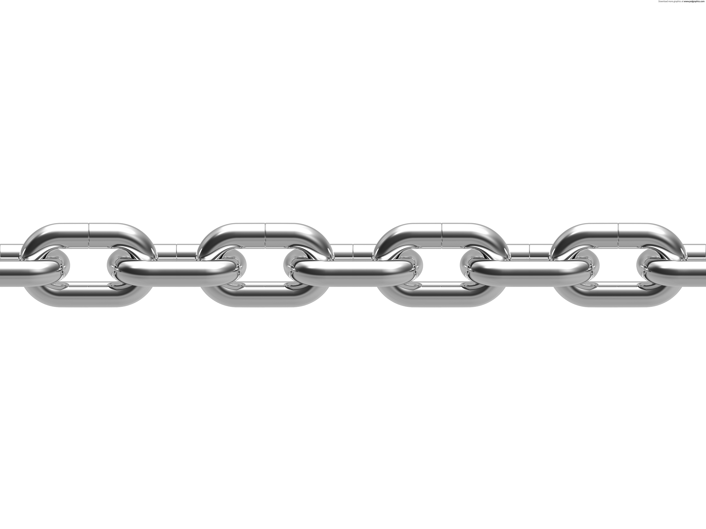

From mathematical tools to real applications
Problem
definition
Problem
decomposition
Optimization
technologies
Interactivity
Project
environment
Data
Development
tools
Visualization

