Slide 1
An introduction to CP Optimizer
Philippe Laborie
IBM Analytics, Decision Optimization

Slide 2
Outline
Overview of CP Optimizer
Modeling concepts
Automatic search
Development tools

Slide 3
Overview of CP Optimizer
A component of IBM ILOG CPLEX Optimization Studio
A Constraint Programming engine for combinatorial problems (including scheduling problems)
Implements a Model & Run paradigm (like CPLEX)
  Model: Concise yet expressive modeling language
  Run: Powerful automatic search procedure
  Search algorithm is complete
Available through the following interfaces:
  OPL
  C++ (native interface)
  Python, Java, .NET (wrapping of the C++ engine)
Set of tools to support the development of efficient models

Slide 4
Overview of CP Optimizer
First version in 2007/2008
Search “CP Optimizer” on Google Scholar to get an idea of how CP Optimizer is being used across academy and industry

Slide 5
Overview of CP Optimizer
Model & Run paradigm
Model
User model
OPL, C++, Python, Java, .NET
Solution
Automatic Solve

Slide 6
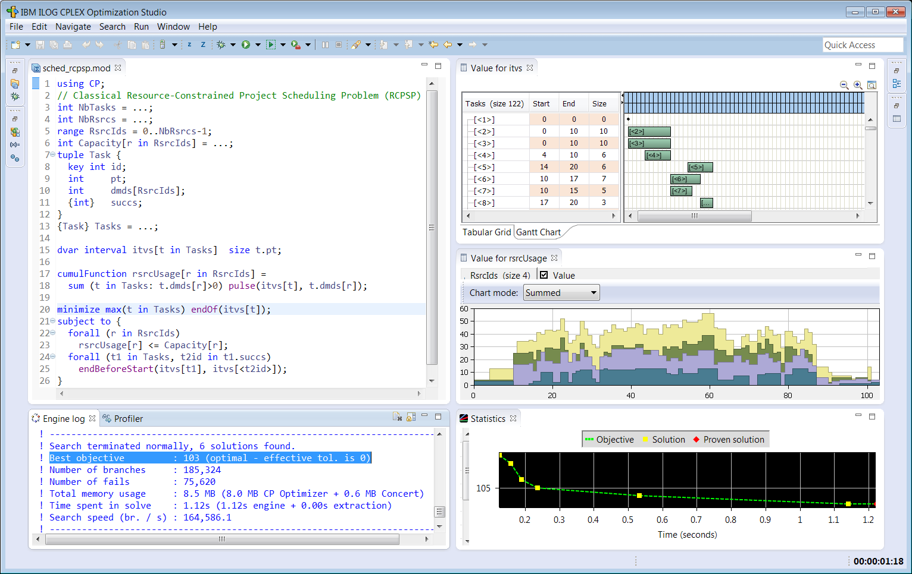
Overview of CP Optimizer

Slide 7
Overview of CP Optimizer
Interval variables

Slide 8
Overview of CP Optimizer
Functions

Slide 9
Modeling concepts
Two main types of decision variables:
  Integer variables
  Interval variables

Slide 10
Modeling concepts (integer variables)
Variables | Expressions | Constraints
Variables are discrete integer Domains can be specified as a range [1..50] or as a set of values {1, 3, 5, 7, 9} dvar int x in 1..50 | Expressions can be integer or floating-point, for example 0.37*y is allowed Basic arithmetic (+,-,*,/) and more complex operators (min, max, log, pow etc.) are supported Relational expressions can be treated as 0-1 expressions. e.g. x = (y < z) Special expressions: x == a[y] x == count(Y, 3) y == cond ? y : z | Rich set of constraints: Standard relational constraints (==, !=, <, >, <=, >=) Logical combinators (&&, ||, !, =>) Specialized (global) constraints allDifferent(X) allowedAssignments(X, tuples) forbiddenAssignments(X, tuples) pack(load, container, size) lexicographic(X, Y) inverse(X,Y)

Slide 11
Modeling concepts (interval variables for scheduling)
Scheduling (our definition of):
  Scheduling consist of assigning starting and completion times to a set of activities while satisfying different types of constraints (resource availability, precedence relationships, … ) and optimizing some criteria (minimizing tardiness, …)
  Time is considered as a continuous dimension: domain of possible start/completion times for an activity is potentially very large
  Beside start and completion times of activities, other types of decision variables are often involved in real industrial scheduling problems (resource allocation, optional activities …)
start
end
activity
Time

Slide 12
Modeling concepts (interval variables for scheduling)
Extension of classical CSP with a new type of decision variable:
optional interval variable :
Domain(x) ⊆ {⊥} ∪ { [s,e) | s,e∈Ζ, s≤e }
Introduction of mathematical notions such as sequences and functions to capture temporal aspects of scheduling problems
Absent interval
Interval of integers

Slide 13
Modeling concepts (interval variables for scheduling)
In scheduling models, interval variables usually represent an interval of time whose end-points (start/end) are decision variables of the problem
Examples:
  A production order, an operation in a production order
  A sub-project in a project, a task in a sub-project
  A batch of operations
  The setup of a tool on a machine
  The moving of an item by a transportation device
  The utilization interval of a machine
  The filling or emptying of a tank
Idea of the model (and search) is to avoid the enumeration of start/end values

Slide 14
Modeling concepts (interval variables for scheduling)
An interval variable can be optional meaning that it is a decision to have it present or absent in a solution.
Examples:
  Unperformed tasks and optional sub-projects
  Alternative resources, modes or recipes for processing an order, each mode specifying a particular combination of operational resources
  Operations that can be processed in different temporal modes (e.g. series or parallel), left unperformed or externalized
  Activities that can be performed in an alternative set of batches or shifts

Slide 15
Example: Resource Constrained Project Scheduling Problem
RCPSP: a very classical academical scheduling problem
  Tasks a_{i} with fixed processing time P_{i}
  Precedence constraints
  Discrete resources with limited instantaneous capacity R_{k}
  Tasks require some quantity of discrete resources
  Objective is to minimize the schedule makespan
R1
a3
a6
R2
a7
a1
a2
a5
a4
a8

Slide 16
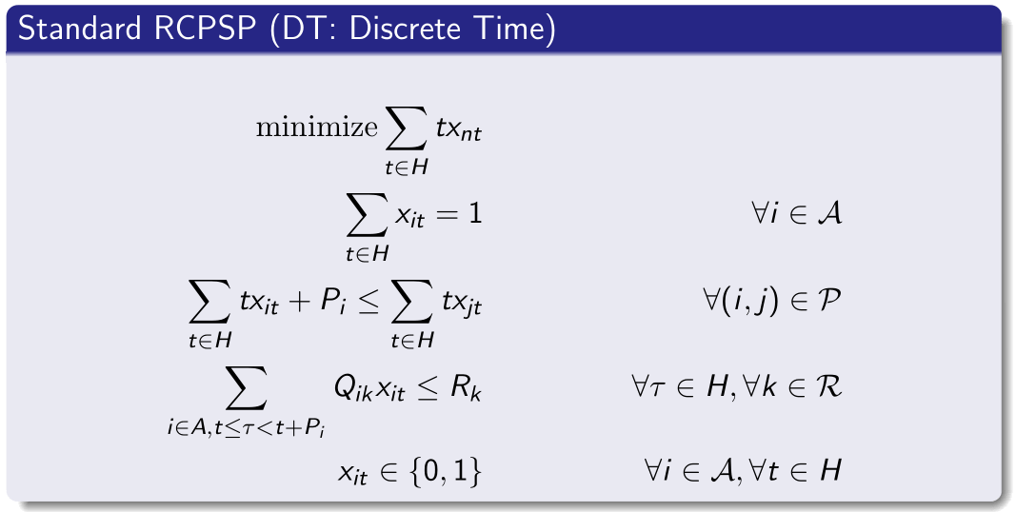
Example: Resource Constrained Project Scheduling Problem
RCPSP: Standard time-indexed MIP formulation
Pi
a_{i}
xit ∈ {0,1}

Slide 17
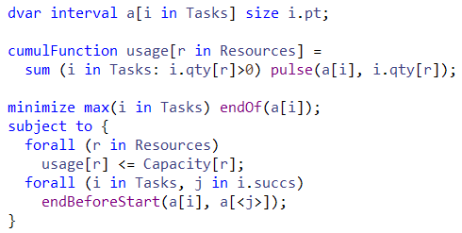
Example: Resource Constrained Project Scheduling Problem
Basic CP Optimizer model for RCPSP:

Slide 18
Example: Resource Constrained Project Scheduling Problem
Comparison of this time-indexed MIP formulation against the CP Optimizer model on a set of:
  300 classical small RCPSP instances (30-120 tasks) +
  40 slightly more realistic larger ones (900 tasks)
  time-limit: 2mn, 4 threads
Note: industrial scheduling problems are often much larger, typically several 1.000 tasks (we handled up to 1.000.000 tasks in an RCPSP-like scheduling application in V12.6)

Slide 19
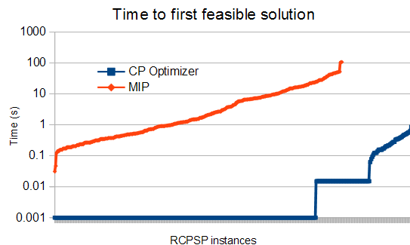
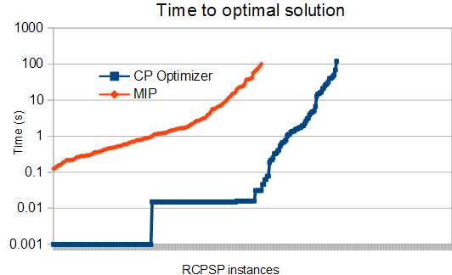
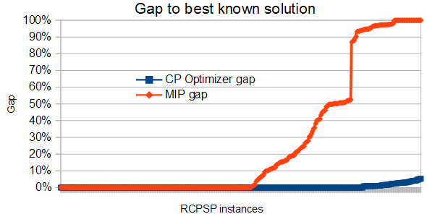
Example: Resource Constrained Project Scheduling Problem
Comparison of CP Optimizer and MIP performance on RCPSP

Slide 20
Example: Job-shop Scheduling Problem
Example: Job-shop Scheduling Problem
Minimization of makespan
op11
op12
op13
M1
op21
op22
op23
M2
op31
op32
op33
M3
op41
op42
op43

Slide 21
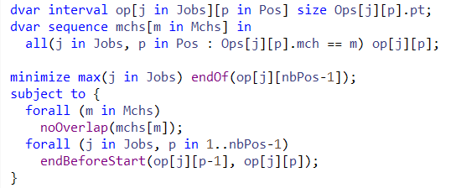
Example: Job-shop Scheduling Problem
CP Optimizer model for Job-shop:

Slide 22
Example: Job-shop Scheduling Problem
Properties:
  Complexity is independent of the time scale
  CP Optimizer is able to reason globally over a sequence variable
  Avoid quadratic models over each pair (i,j) of intervals in the sequence
Compare:
  Quadratic disjunctive MIP formulation with big-Ms:
b[i][j]∈{0,1} // b[i][j]=1 iff a[i] before a[j]
end[i] <= start[j] + M*(1-b[i][j])
end[j] <= start[i] + M*b[i][j]
  CP Optimizer model:
noOverlap(all(i in …) a[i])
a[i]
a[j]
…
Time

Slide 23
Example: Job-shop Scheduling Problem
Comparison of the CP Optimizer model vs a disjunctive MIP formulation on a set of 140 classical Job-shop instances (50-2000 tasks), time-limit: 2mn, 4 threads

Slide 24
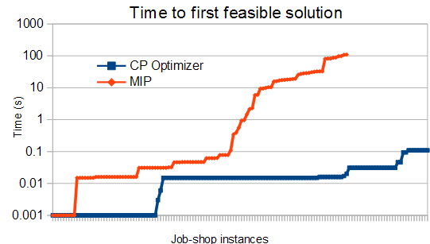
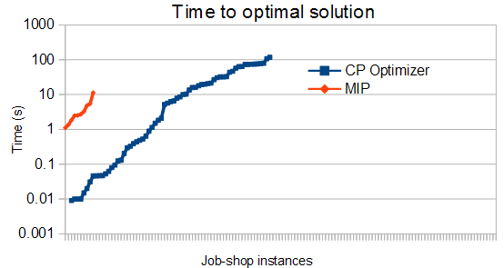
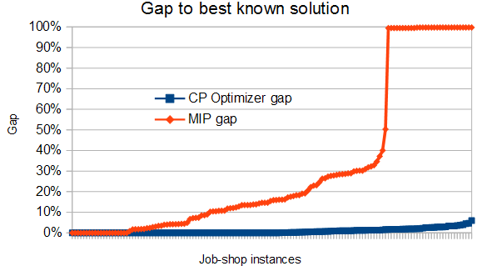
Example: Job-shop Scheduling Problem
Comparison of CP Optimizer and MIP performance on Job-Shop

Slide 25
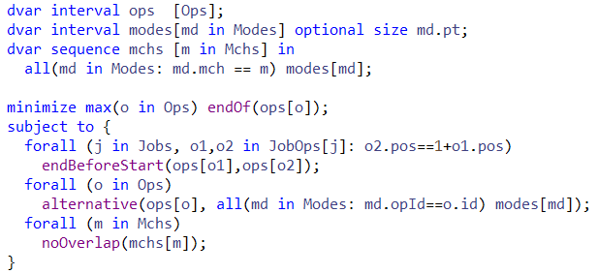
Example: Flexible Job-shop Scheduling Problem
CP Optimizer model

Slide 26
CP Optimizer modeling concepts
CP Optimizer has mathematical concepts that naturally map to features invariably found in industrial scheduling problems
Optional activities
Over-constrained problems
Resource alloc. / alternatives
Work-breakdown structures
Optional interval variables
Cumulative resources
Inventories
Reservoirs
Cumul functions
Parallel batches,
Activity incompatibilities
State functions
Calendars
Resource efficiency
Sequence variables
Unary resources
Setup times/costs
Travel times/costs
Intensity functions
Earliness/tardiness costs
Net Present Value
General arithmetical
expressions

Slide 27
Automatic Search
Search algorithm is Complete
Core CP techniques used as a building block:
  Tree search (Depth First)
  Constraint propagation
But also:
  Deterministic multicore parallelism
  Model presolve
  Algorithms portfolios
  Machine learning
  Restarting techniques
  Large Neighborhood Search
  No-good learning
  Impact-based branching
  Opportunistic probing
  Dominance rules
  LP-assisted heuristics
  Randomization
  Evolutionary algorithms

Slide 28
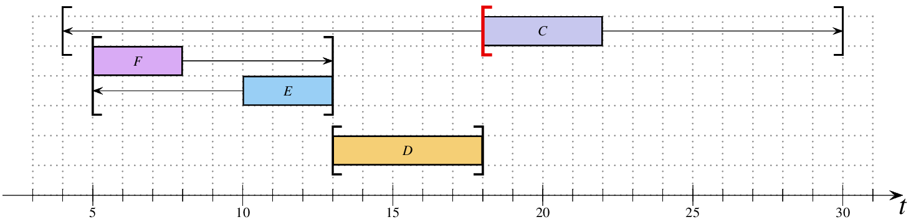
Automatic Search – Constraint propagation
Dedicated Propagation Algorithms for Scheduling
  Edge-Finding
  Not-First/Not-Last
  Detectable Precedences
  Timetable
  Timetable Edge-Finding
  Max Energy Filtering
  etc.
Edge-Finding: C cannot start before 18.

Slide 29
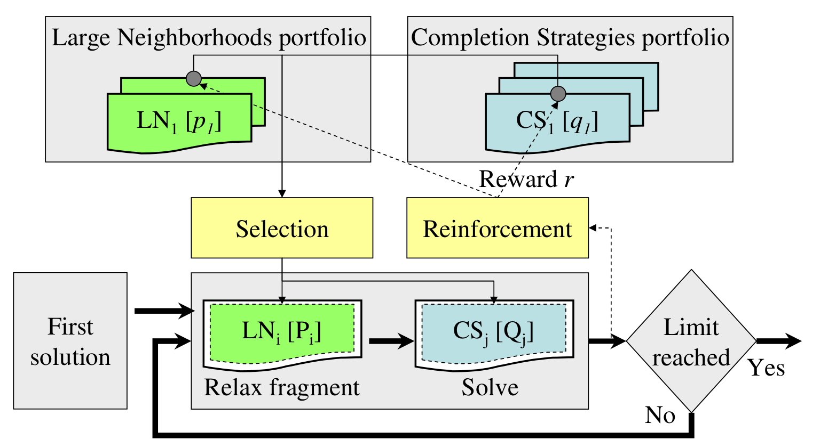
Automatic Search – Large Neighborhood Search (LNS)
LNS is able to converge very quickly to quality solutions
  Start with an existing solution

Slide 30
Automatic Search – Large Neighborhood Search (LNS)
LNS is able to converge very quickly to quality solutions
  Start with an existing solution
  Take part the solution and relax it, fix structure of the rest (but not start/end times)
relax
keep rigid

Slide 31
Automatic Search – Large Neighborhood Search (LNS)
LNS is able to converge very quickly to quality solutions
  Start with an existing solution
  Take part the solution and relax it, fix structure of the rest (but not start/end times)
relax
keep rigid

Slide 32
Automatic Search – Large Neighborhood Search (LNS)
LNS is able to converge very quickly to quality solutions
  Start with an existing solution
  Take part the solution and relax it, fix structure of the rest (but not start/end times)
  Find (improved) solution
improve
kept rigid

Slide 33
Automatic Search – LP-assisted heuristics
Traditionally, early/tardy problems are challenging for CP-based scheduling tools as they miss a good global view of the cost
Approach:
  Automatically use CPLEX's LP solver to provide a solution to a relaxed version of the problem
  Use the LP solution to guide heuristics. Start an operation as close as possible to the time proposed by CPLEX
What is linearized?
  Precedences
  Execution / non-execution costs, logical constraints on optional intervals
  “Alternative” and “Span” constraints
  Cost function terms which are functions of start/end times
cost
cost
cost
cost
cost
x
x
x
x
x

Slide 34
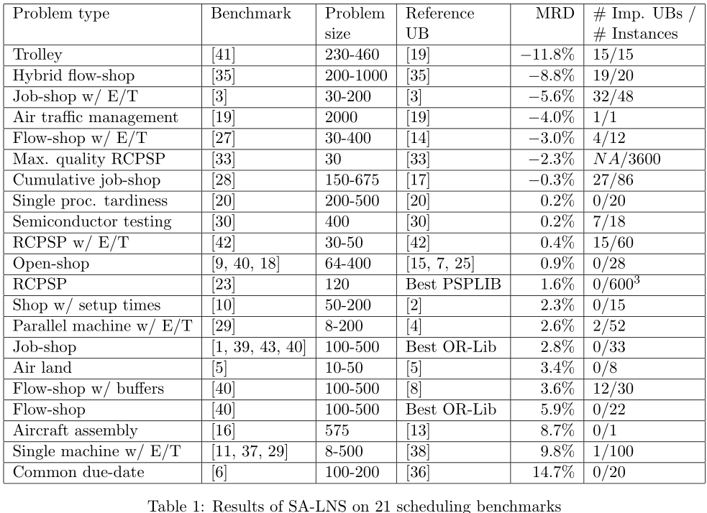
Automatic Search: some results
MISTA 2007

Slide 35
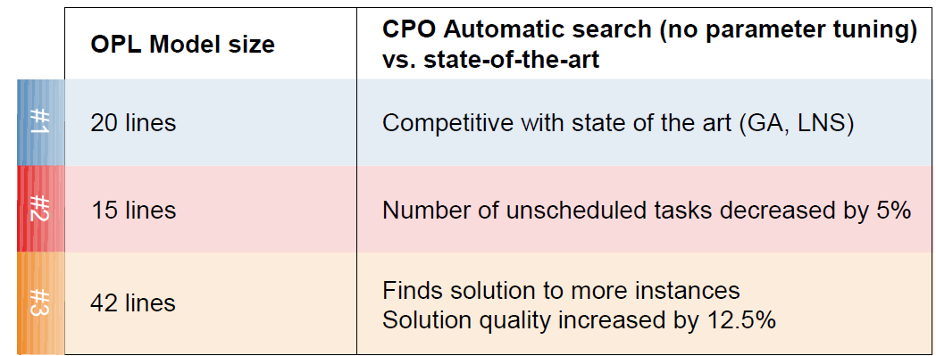
Automatic Search: some results
CP-AI-OR 2009
  Problem #1: Flow-shop with earliness/tardiness cost
  Problem #2: Oversubscribed Satellite Scheduling problem
  Problem #3: Personal tasks scheduling

Slide 36
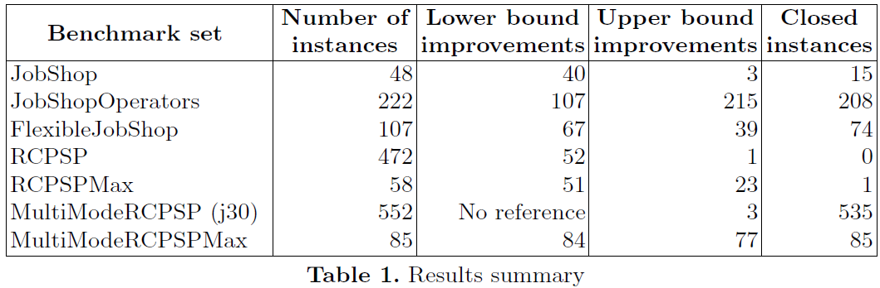
Automatic Search: some results
CP-AI-OR 2015

Slide 37
Automatic Search: some results
CP 2015
Industrial Modelling Competition at CP 2015
http://booleconferences.ucc.ie/indmodellingcomp
CP Optimizer outperformed all the other competitors on all the instances of the challenge

Slide 38
Automatic Search
Some CP Optimizer industrial applications:
  Port Management: Yantian International Container Terminals, Navis
  Manufacturing: Ajover S.A. (plastics), TAL Group (textiles)
  Aviation: Dassault Aviation, another large jet manufacturer
  Workforce scheduling: A world leading IFS (Integrated Facility Services) company

Slide 39
Development tools
Model
User model
Warnings
Model analysis
Model presolve
CPO file
Warm start
Internal model
OPL, C++, Python, Java, .NET
Search log
Automatic Solve
Solution
Failure explainer
Conflict refiner
Fail expl.
Conflict

Slide 40

CPLEX and CP Optimizer are in the same ecosystem
 |  | CPLEX | CP Optimizer
Interfaces |  | OPL, C++, Java, .NET, C, Python | OPL, C++, Java, .NET, Python
Model | Decision variables | int, float | int, interval
 | Expressions | linear, quadratic | arithmetic, log, pow, … relational, a[x], count,...
 | Constraints | range | relational, logical, specialized, scheduling
Search | Search parameters
 | Warm start
 | Multi-core //
Tools | Search log
 | I/O format | .lp, .mps, ... | .cpo
 | Conflict refiner

