Slide 1
Insights into CP Optimizer models:
Using the tools

Slide 2
Outline
Overview of CP Optimizer
Tools providing some insight into models and resolution
  I/O format
  Model warnings
  Search log
  Warm start
  Conflict refiner
  Failure explainer

Slide 3
Overview of CP Optimizer
A component of IBM ILOG CPLEX Optimization Studio
A Constraint Programming engine for combinatorial problems (including detailed scheduling problems)
Implements a Model & Run paradigm (like CPLEX)
  Model: Concise yet expressive modeling language
  Run: Powerful automatic search procedure
  Search algorithm is complete
Available through the following interfaces:
  OPL
  C++ (native interface)
  Python, Java, .NET (wrapping of the C++ engine)
Set of tools to support the delevopment of efficient models

Slide 4
Model: example
Satellite Control Network scheduling problem [1]
n communication tasks for Earth orbiting satellites must be scheduled on a total of 32 antennas spread across 13 ground-based tracking stations
In the instances, n ranges from to 400 to 1300
Objective: maximize the number of scheduled tasks
[1] Kramer & al.: Understanding Performance Trade-offs in Algorithms for Solving Oversubscribed Scheduling.

Slide 5
Model: example
Station 1
Opp_{i,1}
Station 2
Opp_{i,2}
Opp_{i,3}
Station 3
Opp_{i,4}
OR
Alternative assignments
to stations x time windows
(opportunities)
Task_{i}

Slide 6
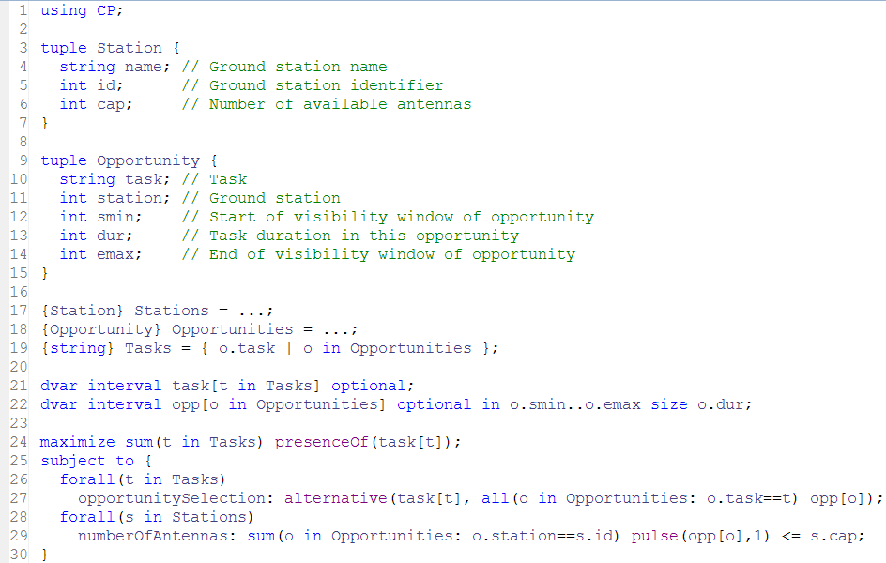
Model: example (OPL)

Slide 7
Automatic Search
Search algorithm is Complete
Core CP techniques used as a building block:
  Tree search (Depth First)
  Constraint propagation
But also:
  Deterministic multicore parallelism
  Model presolve
  Algorithms portfolios
  Machine learning
  Restarting techniques
  Large Neighborhood Search
  No-good learning
  Impact-based branching
  Opportunistic probing
  Dominance rules
  LP-assisted heuristics
  Randomization
  Evolutionary algorithms

Slide 8
Tools: I/O format
Objective:
  Make it easier to understand the content of a model
  Communicate a model to IBM support team regardless of the API used to build it (OPL, C++, Java, .NET)
  Send model to a remote CPO engine (e.g. Cloud)
Structure of a .cpo file
  Human readable
  Flat (no cycle, no forall statements)
  No user defined data types
  Internal information such as CPO version or platform used
  Includes search phases, search parameter values and starting point
Engine Functionality
  Export model before/instead of solve
  Export model during solve (with current domains)
  Import model instead of normal modeling

Slide 9
Tools: I/O format
// Interval-related variables:
"task(1)" = intervalVar(optional);
"task(1A)" = intervalVar(optional);
…
"opp({1,1,62})" = intervalVar(optional, start=62..intervalmax, end=0..99, size=25);
"opp({1A,1,32})" = intervalVar(optional, start=32..intervalmax, end=0..69, size=33);
…
// Objective:
maximize(sum([presenceOf("task(1)"), presenceOf("task(1A)"), …]));
…
// Constraints:
alternative("task(1)", ["opp({1,1,62})"], 1);
…
pulse("opp({3,1,58})", 1) + pulse("opp({1,1,62})", 1) + … <= 4;
…
parameters {
LogVerbosity = Quiet;
}

Slide 10
Tools: model warnings
Like a compiler, CP Optimizer can analyze the model and print some warnings
  When there is something suspicious in the model
  Regardless how the model was created (C++, Java, Python, OPL, …)
  Including guilty part of the model in the cpo file format (optional)
  Including source code line numbers (if known)
  3 levels of warnings, more than 70 types of warnings
cppfile.cpp:24: Warning: Unused interval variable 'x'.
x = intervalVar(start=1..50, size=5..10)
javafile.java:20: Warning: Interval variable 'itv' has empty domain.
itv = intervalVar(start=0..10, length=5, end=100..110)
pythonfile.py:7: Warning: Constraint is always true.
x+y >= 5
pythonfile.py:8: Warning: Constraint is always false, the model is infeasible.
x+y < 5
satellite.cpo:2995:29: Warning: Constraint 'alternative':
there is only one alternative interval variable.
alternative("task(1)", ["opp({1,1,62})"], 1)

Slide 11
Tools: search log
Objective: understand what happens during the automatic search
! -----------------------------------------------------------------------
! Maximization problem - 2980 variables, 853 constraints
! Workers = 2
! TimeLimit = 30
! Initial process time : 0.01s (0.00s extraction + 0.01s propagation)
! . Log search space : 4627.3 (before), 4627.3 (after)
! . Memory usage : 16.9 MB (before), 19.7 MB (after)
! Using parallel search with 2 workers.
! -----------------------------------------------------------------------
! Best Branches Non-fixed W Branch decision
* 746 3945 0.79s 1 -
746 4000 2924 1 on task("8")
746 4000 2908 2 on opp({"186",2,66})
…
! Time = 1.37s, Explored branches = 35832, Memory usage = 55.5 MB
! Best Branches Non-fixed W Branch decision
818 12000 2920 1 on task("184")
…
! -----------------------------------------------------------------------
! Search terminated by limit, 6 solutions found.
! Best objective : 826
! Number of branches : 709092
! Number of fails : 179648
! Total memory usage : 54.5 MB (52.9 MB CP Optimizer + 1.6 MB Concert)
! Time spent in solve : 30.03s (30.01s engine + 0.01s extraction)
! Search speed (br. / s) : 23625.4
! -----------------------------------------------------------------------
Problem
characteristics

Slide 12
Tools: search log
Objective: understand what happens during the automatic search
! -----------------------------------------------------------------------
! Maximization problem - 2980 variables, 853 constraints
! Workers = 2
! TimeLimit = 30
! Initial process time : 0.01s (0.00s extraction + 0.01s propagation)
! . Log search space : 4627.3 (before), 4627.3 (after)
! . Memory usage : 16.9 MB (before), 19.7 MB (after)
! Using parallel search with 2 workers.
! -----------------------------------------------------------------------
! Best Branches Non-fixed W Branch decision
* 746 3945 0.79s 1 -
746 4000 2924 1 on task("8")
746 4000 2908 2 on opp({"186",2,66})
…
! Time = 1.37s, Explored branches = 35832, Memory usage = 55.5 MB
! Best Branches Non-fixed W Branch decision
818 12000 2920 1 on task("184")
…
! -----------------------------------------------------------------------
! Search terminated by limit, 6 solutions found.
! Best objective : 826
! Number of branches : 709092
! Number of fails : 179648
! Total memory usage : 54.5 MB (52.9 MB CP Optimizer + 1.6 MB Concert)
! Time spent in solve : 30.03s (30.01s engine + 0.01s extraction)
! Search speed (br. / s) : 23625.4
! -----------------------------------------------------------------------
Modified
parameter values

Slide 13
Tools: search log
Objective: understand what happens during the automatic search
! -----------------------------------------------------------------------
! Maximization problem - 2980 variables, 853 constraints
! Workers = 2
! TimeLimit = 30
! Initial process time : 0.01s (0.00s extraction + 0.01s propagation)
! . Log search space : 4627.3 (before), 4627.3 (after)
! . Memory usage : 16.9 MB (before), 19.7 MB (after)
! Using parallel search with 2 workers.
! -----------------------------------------------------------------------
! Best Branches Non-fixed W Branch decision
* 746 3945 0.79s 1 -
746 4000 2924 1 on task("8")
746 4000 2908 2 on opp({"186",2,66})
…
! Time = 1.37s, Explored branches = 35832, Memory usage = 55.5 MB
! Best Branches Non-fixed W Branch decision
818 12000 2920 1 on task("184")
…
! -----------------------------------------------------------------------
! Search terminated by limit, 6 solutions found.
! Best objective : 826
! Number of branches : 709092
! Number of fails : 179648
! Total memory usage : 54.5 MB (52.9 MB CP Optimizer + 1.6 MB Concert)
! Time spent in solve : 30.03s (30.01s engine + 0.01s extraction)
! Search speed (br. / s) : 23625.4
! -----------------------------------------------------------------------
Root node
information

Slide 14
Tools: search log
Objective: understand what happens during the automatic search
! -----------------------------------------------------------------------
! Maximization problem - 2980 variables, 853 constraints
! Workers = 2
! TimeLimit = 30
! Initial process time : 0.01s (0.00s extraction + 0.01s propagation)
! . Log search space : 4627.3 (before), 4627.3 (after)
! . Memory usage : 16.9 MB (before), 19.7 MB (after)
! Using parallel search with 2 workers.
! -----------------------------------------------------------------------
! Best Branches Non-fixed W Branch decision
* 746 3945 0.79s 1 -
746 4000 2924 1 on task("8")
746 4000 2908 2 on opp({"186",2,66})
…
! Time = 1.37s, Explored branches = 35832, Memory usage = 55.5 MB
! Best Branches Non-fixed W Branch decision
818 12000 2920 1 on task("184")
…
! -----------------------------------------------------------------------
! Search terminated by limit, 6 solutions found.
! Best objective : 826
! Number of branches : 709092
! Number of fails : 179648
! Total memory usage : 54.5 MB (52.9 MB CP Optimizer + 1.6 MB Concert)
! Time spent in solve : 30.03s (30.01s engine + 0.01s extraction)
! Search speed (br. / s) : 23625.4
! -----------------------------------------------------------------------
New incumbent
solutions (time, worker)

Slide 15
Tools: search log
Objective: understand what happens during the automatic search
! -----------------------------------------------------------------------
! Maximization problem - 2980 variables, 853 constraints
! Workers = 2
! TimeLimit = 30
! Initial process time : 0.01s (0.00s extraction + 0.01s propagation)
! . Log search space : 4627.3 (before), 4627.3 (after)
! . Memory usage : 16.9 MB (before), 19.7 MB (after)
! Using parallel search with 2 workers.
! -----------------------------------------------------------------------
! Best Branches Non-fixed W Branch decision
* 746 3945 0.79s 1 -
746 4000 2924 1 on task("8")
746 4000 2908 2 on opp({"186",2,66})
…
! Time = 1.37s, Explored branches = 35832, Memory usage = 55.5 MB
! Best Branches Non-fixed W Branch decision
818 12000 2920 1 on task("184")
…
! -----------------------------------------------------------------------
! Search terminated by limit, 6 solutions found.
! Best objective : 826
! Number of branches : 709092
! Number of fails : 179648
! Total memory usage : 54.5 MB (52.9 MB CP Optimizer + 1.6 MB Concert)
! Time spent in solve : 30.03s (30.01s engine + 0.01s extraction)
! Search speed (br. / s) : 23625.4
! -----------------------------------------------------------------------
Periodical log
with fail information,
number of unfixed
variables, current decision

Slide 16
Tools: search log
Objective: understand what happens during the automatic search
! -----------------------------------------------------------------------
! Maximization problem - 2980 variables, 853 constraints
! Workers = 2
! TimeLimit = 30
! Initial process time : 0.01s (0.00s extraction + 0.01s propagation)
! . Log search space : 4627.3 (before), 4627.3 (after)
! . Memory usage : 16.9 MB (before), 19.7 MB (after)
! Using parallel search with 2 workers.
! -----------------------------------------------------------------------
! Best Branches Non-fixed W Branch decision
* 746 3945 0.79s 1 -
746 4000 2924 1 on task("8")
746 4000 2908 2 on opp({"186",2,66})
…
! Time = 1.37s, Explored branches = 35832, Memory usage = 55.5 MB
! Best Branches Non-fixed W Branch decision
818 12000 2920 1 on task("184")
…
! -----------------------------------------------------------------------
! Search terminated by limit, 6 solutions found.
! Best objective : 826
! Number of branches : 709092
! Number of fails : 179648
! Total memory usage : 54.5 MB (52.9 MB CP Optimizer + 1.6 MB Concert)
! Time spent in solve : 30.03s (30.01s engine + 0.01s extraction)
! Search speed (br. / s) : 23625.4
! -----------------------------------------------------------------------
Final information
with solution status
and search statistics

Slide 17
Tools: warm start
Objective: Start search from a known (possibly incomplete) solution given by the user (warm start) in order to further improve it or to help to guide the engine towards a first feasible solution
API: IloCP::setStartingPoint(IloSolution warmstart)
Use cases:
  Restart an interrupted search with the current incumbent
  Start from an initial solution found by an available heuristic
  Goal programming for multi-objective problems
  When finding an initial solution is hard, solve an initial problem that maximizes constraint satisfaction and start from its solution
  Successively solving similar problems (e.g. dynamic scheduling)
  Hierarchical problem solving (e.g. planning → scheduling)

Slide 18
Tools: warm start
Satellite Control Network scheduling problem [1]
Communication tasks for Earth orbiting satellites must be scheduled on a total of 32 antennas spread across 13 ground-based tracking stations
In the instances, number of tasks from to 400 to 1300
Tasks are not mandatory but have priorities
Hierarchical objectives:
  first maximize the number of scheduled high priority tasks,
  then the number of scheduled low priority tasks
[1] Kramer & al.: Understanding Performance Trade-offs in Algorithms for Solving Oversubscribed Scheduling.

Slide 19
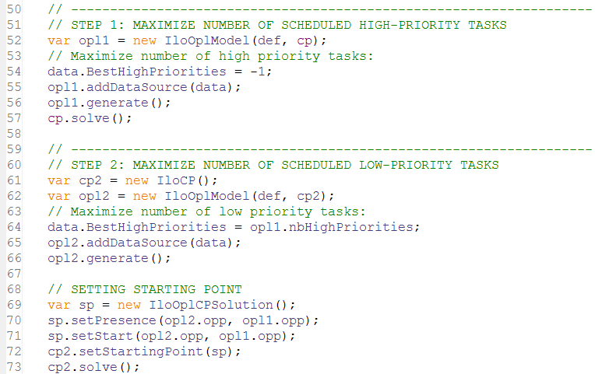
Tools: warm start (OPL sample)

Slide 20
Tools: conflict refiner
Objective: identify a reason for an inconsistency by providing a minimal infeasible subset of constraints for an infeasible model
Use cases:
  Model debugging (errors in model)
  Data debugging (inconsistent data)
  The model and data are correct, but the associated data represents a real-world conflict in the system being modeled
  You create an infeasible model to test properties of (or extract information about) a similar model

Slide 21
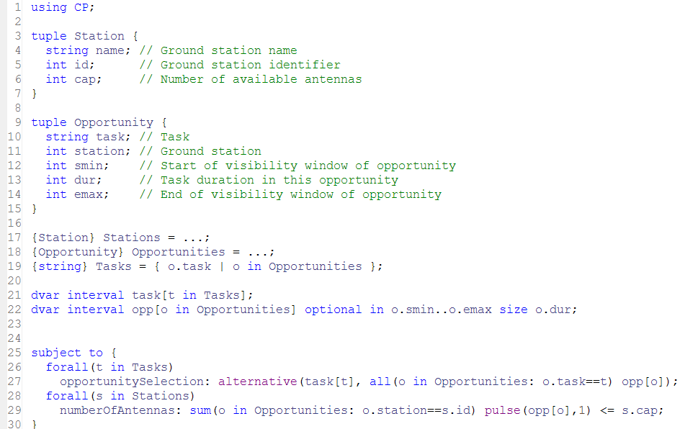
Tools: conflict refiner

Slide 22
Tools: conflict refiner
!----------------------------------------------------------------------------
! Satisfiability problem - 2,980 variables, 851 constraints
! Problem found infeasible at the root node
! ----------------------------------------------------------------------------
...
! ----------------------------------------------------------------------------
! Conflict refining - 851 constraints
! ----------------------------------------------------------------------------
! Iteration Number of constraints
* 1 851
* 2 426
...
* 58 5
* 59 5
! Conflict refining terminated
! ----------------------------------------------------------------------------
! Conflict status : Terminated normally, conflict found
! Conflict size : 5 constraints
! Number of iterations : 59
! Total memory usage : 13.3 MB
! Conflict computation time : 0.51s
! ----------------------------------------------------------------------------

Slide 23
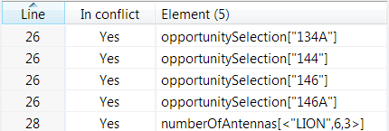
Tools: conflict refiner (OPL display)
Conflict:
There is not enough antennas to accommodate all 4 tasks on their time-window on ground station “LION” (3 antennas):
  <134A,6,1232,19,1266>
  <144, 6,1238,31,1272>
  <146, 6,1228,22,1260>
  <146A,6,1230,22,1262>
1228
1260
146
1230
1262
146A
1232
1266
134A
1238
1272
144

Slide 24
Tools: conflict refiner
Advanced features:
  Control which conflict is selected by assigning some priorities to each constraint
  Run conflict refiner on groups of constraints (one group = one business constraint) instead of individual ones for more informative conflicts
Control parameters :
  ConflictRefinerOnVariables : Off/On
  ConflictRefinerIterationLimit
  ConflictRefinerBranchLimit
  ConflictRefinerFailLimit
  ConflictRefinerTimeLimit

Slide 25
Tools: failure explainer
Objective: explains why the engine backtracks at a given search node
Uses the conflict refiner to find a minimal conflict in the model+decisions at a backtracking node
Currently only available in DepthFirst search mode and only for integer variables

Slide 26
Tools: failure explainer – first step
Solve the model in depth first search in a mode that display failure index and decisions:
// Build model:
…
// Create CP object:
IloCP cp(model);
// Use only one thread:
cp.setParameter(IloCP::Workers, 1);
// Simple tree search:
cp.setParameter(IloCP::SearchType, IloCP::DepthFirst);
// Show failure numbers:
cp.setParameter(IloCP::LogSearchTags, IloCP::On);
// Solve and display the failure:
cp.solve();

Slide 27
Tools: failure explainer – second step
Solve the model in depth first search, specifying the index of the failures to explain :
// Build model:
…
// Create CP object:
IloCP cp(model);
// Use only one thread:
cp.setParameter(IloCP::Workers, 1);
// Simple tree search:
cp.setParameter(IloCP::SearchType, IloCP::DepthFirst);
// Explain particular failures:
cp.explainFailure(IloIntArray(env, 4, 3, 10, 11, 12));
// Solve and explain:
cp.solve();

Slide 28
Tools: failure explainer example: assigning location to store
- Failure #1
- Failure #2
- Failure #3
-- Possible conflict explaining failure
// Model constraints
element(loc_0, [open_0, open_1, open_2, open_3, open_4]) == 1;
element(loc_1, [open_0, open_1, open_2, open_3, open_4]) == 1;
element(loc_2, [open_0, open_1, open_2, open_3, open_4]) == 1;
element(loc_3, [open_0, open_1, open_2, open_3, open_4]) == 1;
element(loc_4, [open_0, open_1, open_2, open_3, open_4]) == 1;
element(loc_6, [open_0, open_1, open_2, open_3, open_4]) == 1;
element(loc_7, [open_0, open_1, open_2, open_3, open_4]) == 1;
element(loc_8, [open_0, open_1, open_2, open_3, open_4]) == 1;
count([loc_0, loc_1, loc_2, loc_3, loc_4, loc_6, loc_7, loc_8], 0) <= 3;
count([loc_0, loc_1, loc_2, loc_3, loc_4, loc_6, loc_7, loc_8], 3) <= 4;
// Branch constraints
open_1 == 0;
open_2 == 0;
open_4 == 0;

Slide 29
Tools: failure explainer example: assigning location to store
loc_x: location of store x, value in <0, 4>
- Failure #1
- Failure #2
- Failure #3
-- Possible conflict explaining failure
// Model constraints
element(loc_0, [open_0, open_1, open_2, open_3, open_4]) == 1;
element(loc_1, [open_0, open_1, open_2, open_3, open_4]) == 1;
element(loc_2, [open_0, open_1, open_2, open_3, open_4]) == 1;
element(loc_3, [open_0, open_1, open_2, open_3, open_4]) == 1;
element(loc_4, [open_0, open_1, open_2, open_3, open_4]) == 1;
element(loc_6, [open_0, open_1, open_2, open_3, open_4]) == 1;
element(loc_7, [open_0, open_1, open_2, open_3, open_4]) == 1;
element(loc_8, [open_0, open_1, open_2, open_3, open_4]) == 1;
count([loc_0, loc_1, loc_2, loc_3, loc_4, loc_6, loc_7, loc_8], 0) <= 3;
count([loc_0, loc_1, loc_2, loc_3, loc_4, loc_6, loc_7, loc_8], 3) <= 4;
// Branch constraints
open_1 == 0;
open_2 == 0;
open_4 == 0;

Slide 30
Tools: failure explainer example: assigning location to store
- Failure #1
- Failure #2
- Failure #3
-- Possible conflict explaining failure
// Model constraints
element(loc_0, [open_0, open_1, open_2, open_3, open_4]) == 1;
element(loc_1, [open_0, open_1, open_2, open_3, open_4]) == 1;
element(loc_2, [open_0, open_1, open_2, open_3, open_4]) == 1;
element(loc_3, [open_0, open_1, open_2, open_3, open_4]) == 1;
element(loc_4, [open_0, open_1, open_2, open_3, open_4]) == 1;
element(loc_6, [open_0, open_1, open_2, open_3, open_4]) == 1;
element(loc_7, [open_0, open_1, open_2, open_3, open_4]) == 1;
element(loc_8, [open_0, open_1, open_2, open_3, open_4]) == 1;
count([loc_0, loc_1, loc_2, loc_3, loc_4, loc_6, loc_7, loc_8], 0) <= 3;
count([loc_0, loc_1, loc_2, loc_3, loc_4, loc_6, loc_7, loc_8], 3) <= 4;
// Branch constraints
open_1 == 0;
open_2 == 0;
open_4 == 0;
open_y: is location y open?, Boolean domain [0,1]

Slide 31
Tools: failure explainer example: assigning location to store
- Failure #1
- Failure #2
- Failure #3
-- Possible conflict explaining failure
// Model constraints
element(loc_0, [open_0, open_1, open_2, open_3, open_4]) == 1;
element(loc_1, [open_0, open_1, open_2, open_3, open_4]) == 1;
element(loc_2, [open_0, open_1, open_2, open_3, open_4]) == 1;
element(loc_3, [open_0, open_1, open_2, open_3, open_4]) == 1;
element(loc_4, [open_0, open_1, open_2, open_3, open_4]) == 1;
element(loc_6, [open_0, open_1, open_2, open_3, open_4]) == 1;
element(loc_7, [open_0, open_1, open_2, open_3, open_4]) == 1;
element(loc_8, [open_0, open_1, open_2, open_3, open_4]) == 1;
count([loc_0, loc_1, loc_2, loc_3, loc_4, loc_6, loc_7, loc_8], 0) <= 3;
count([loc_0, loc_1, loc_2, loc_3, loc_4, loc_6, loc_7, loc_8], 3) <= 4;
// Branch constraints
open_1 == 0;
open_2 == 0;
open_4 == 0;
A store should assigned one location among the open ones

Slide 32
Tools: failure explainer example: assigning location to store
- Failure #1
- Failure #2
- Failure #3
-- Possible conflict explaining failure
// Model constraints
element(loc_0, [open_0, open_1, open_2, open_3, open_4]) == 1;
element(loc_1, [open_0, open_1, open_2, open_3, open_4]) == 1;
element(loc_2, [open_0, open_1, open_2, open_3, open_4]) == 1;
element(loc_3, [open_0, open_1, open_2, open_3, open_4]) == 1;
element(loc_4, [open_0, open_1, open_2, open_3, open_4]) == 1;
element(loc_6, [open_0, open_1, open_2, open_3, open_4]) == 1;
element(loc_7, [open_0, open_1, open_2, open_3, open_4]) == 1;
element(loc_8, [open_0, open_1, open_2, open_3, open_4]) == 1;
count([loc_0, loc_1, loc_2, loc_3, loc_4, loc_6, loc_7, loc_8], 0) <= 3;
count([loc_0, loc_1, loc_2, loc_3, loc_4, loc_6, loc_7, loc_8], 3) <= 4;
// Branch constraints
open_1 == 0;
open_2 == 0;
open_4 == 0;
At most 3 stores at location 0
At most 4 stores at location 3

Slide 33
Tools: failure explainer example: assigning location to store
- Failure #1
- Failure #2
- Failure #3
-- Possible conflict explaining failure
// Model constraints
element(loc_0, [open_0, open_1, open_2, open_3, open_4]) == 1;
element(loc_1, [open_0, open_1, open_2, open_3, open_4]) == 1;
element(loc_2, [open_0, open_1, open_2, open_3, open_4]) == 1;
element(loc_3, [open_0, open_1, open_2, open_3, open_4]) == 1;
element(loc_4, [open_0, open_1, open_2, open_3, open_4]) == 1;
element(loc_6, [open_0, open_1, open_2, open_3, open_4]) == 1;
element(loc_7, [open_0, open_1, open_2, open_3, open_4]) == 1;
element(loc_8, [open_0, open_1, open_2, open_3, open_4]) == 1;
count([loc_0, loc_1, loc_2, loc_3, loc_4, loc_6, loc_7, loc_8], 0) <= 3;
count([loc_0, loc_1, loc_2, loc_3, loc_4, loc_6, loc_7, loc_8], 3) <= 4;
// Branch constraints
open_1 == 0;
open_2 == 0;
open_4 == 0;

Slide 34
Tools: failure explainer example: assigning location to store
- Failure #1
- Failure #2
- Failure #3
-- Possible conflict explaining failure
// Model constraints
element(loc_0, [open_0, open_1, open_2, open_3, open_4]) == 1;
element(loc_1, [open_0, open_1, open_2, open_3, open_4]) == 1;
element(loc_2, [open_0, open_1, open_2, open_3, open_4]) == 1;
element(loc_3, [open_0, open_1, open_2, open_3, open_4]) == 1;
element(loc_4, [open_0, open_1, open_2, open_3, open_4]) == 1;
element(loc_6, [open_0, open_1, open_2, open_3, open_4]) == 1;
element(loc_7, [open_0, open_1, open_2, open_3, open_4]) == 1;
element(loc_8, [open_0, open_1, open_2, open_3, open_4]) == 1;
count([loc_0, loc_1, loc_2, loc_3, loc_4, loc_6, loc_7, loc_8], 0) <= 3;
count([loc_0, loc_1, loc_2, loc_3, loc_4, loc_6, loc_7, loc_8], 3) <= 4;
// Branch constraints
open_1 == 0;
open_2 == 0;
open_4 == 0;
At least 9 stores at location 0 or 3
At most 3 stores at location 0
At most 4 stores at location 3

Slide 35
The full picture
Model
User model
Warnings
Model analysis
CPO file
Warm start
Internal model
OPL, C++, Python,Java, .NET
Search log
Automatic Solve
Solution
Failure explainer
Conflict refiner
Fail expl.
Conflict

