Slide 1
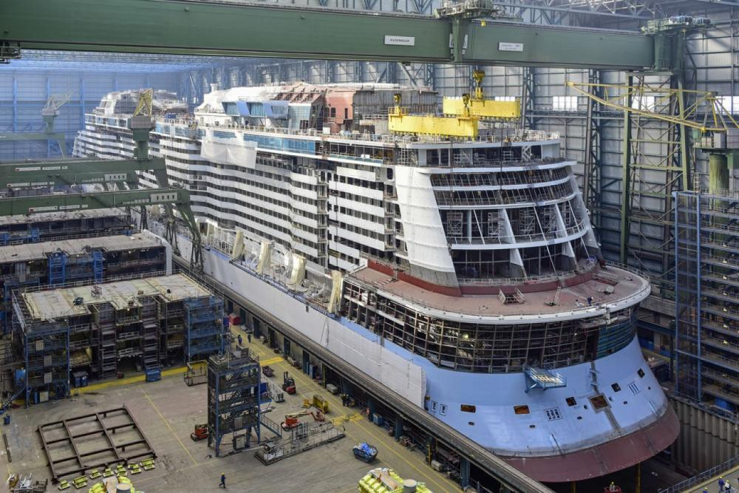
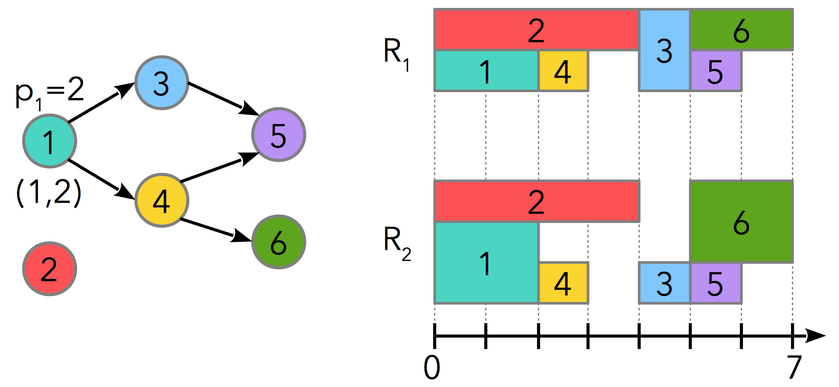
Recent advances on large scheduling problems in CP Optimizer
Philippe Laborie, IBM laborie@fr.ibm.com

Slide 2
In this presentation
1. Recap about IBM CP Optimizer
By the way: if you have CPLEX, you also have
CP Optimizer!
2. Performance improvements on scheduling problems in coming release V12.9

Slide 3
CP Optimizer for scheduling in two sentences
A mathematical modeling language for combinatorial optimization problems that extends ILP (and classical CP) with some algebra on intervals and functions allowing compact and maintainable formulations for complex scheduling problems
A continuously improving automatic search algorithm that is complete, anytime, efficient (e.g. competitive with problem-specific algorithms on classical problems) and scalable
Recent review of CP Optimizer (modeling concepts, applications, examples, tools, performance,…) :
  IBM ILOG CP Optimizer for scheduling. Constraints (2018) 23:210–250. http://ibm.biz/Constraints2018

Slide 4
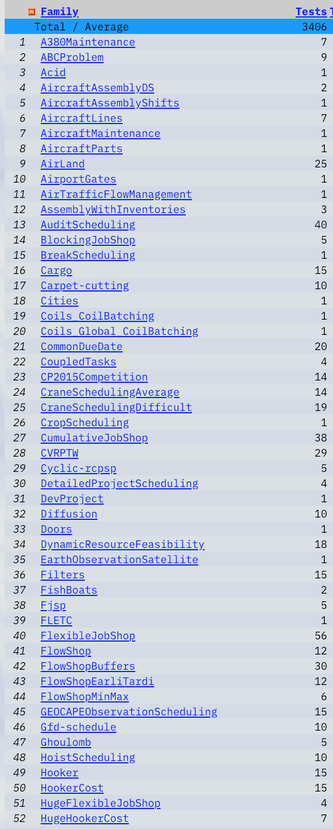
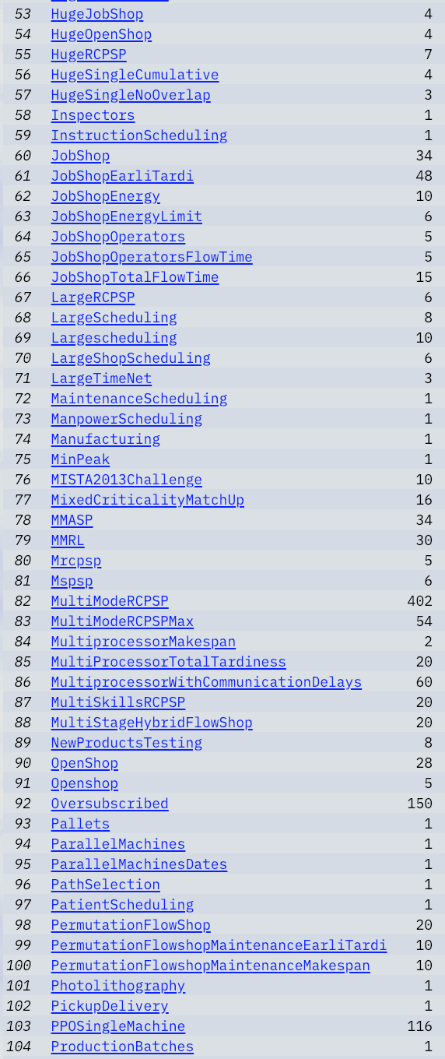
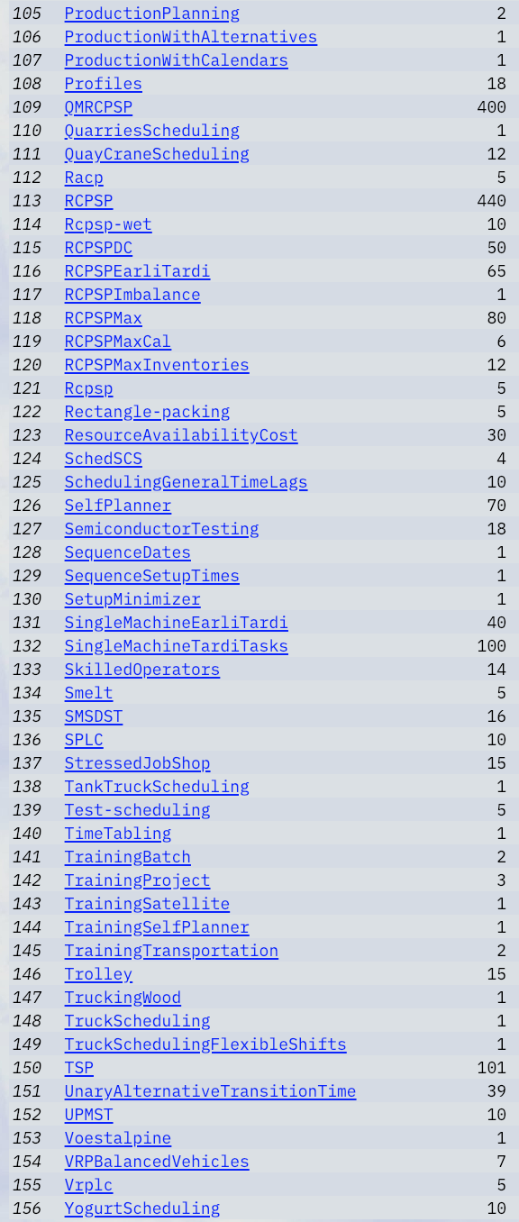

Typical scheduling problems for CP Optimizer

Slide 5
Illustration on an academical scheduling problem
Resource-Constrained Project Scheduling (RCPSP)
  Notorious NP-Hard problem in combinatorial optimization (>5000 references on Google Scholar)
  N tasks with precedence constraints
  M resources of limited capacity
  Minimize project makespan
R₁
2
3
6
C₁=2
p₁=2
3
1
4
5
1
5
(1,2)
4
2
6
6
R₂
1
C₂=3
2
4
3
5
0
7
time

Slide 6
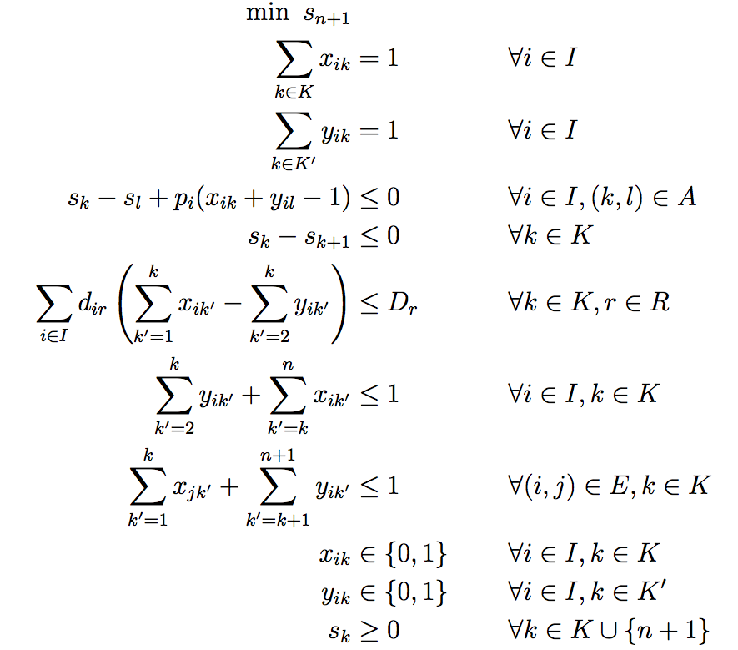

Formulation of the RCPSP in ILP
Example of the Start/End Event-based formulation (SEE)
O(N³)
* A. Tesch. Compact MIP Models for the Resource-Constrained Project Scheduling
Problem. Master's Thesis. Technische Universität Berlin. 2015.

Slide 7
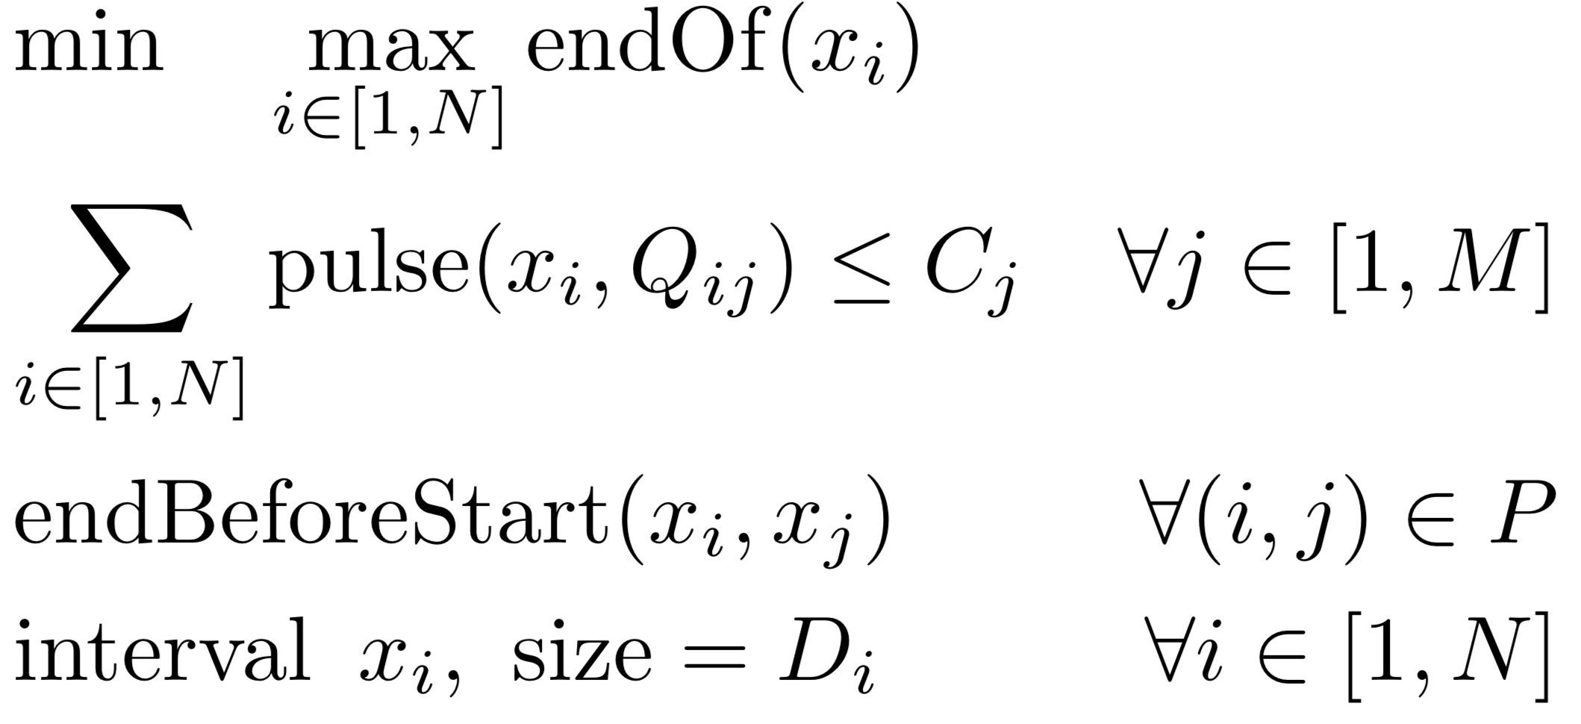
Formulation of the RCPSP in CP Optimizer
Use of interval variables for tasks and cumul functions for resource usage
pulse(x_{i},Q_{ij})
Q_{ij}
x_{i}
D_{i}
x_{j}
O(N)
compact

Slide 8
Formulation of the RCPSP in CP Optimizer
Use of interval variables for tasks and cumul functions for resource usage
from docplex.cp.model import *
model = CpoModel()
# Decision variables: tasks x
x = [interval_var(size=D[i]) for i in N]
# Objective: minimize project makespan
model.add(minimize(max(end_of(x[i]) for i in N)))
# Constraints: resource capacities
for j in M: model.add(sum(pulse(x[i],q) for [i,q] in R[j]) <= C[j])
# Constraints: precedence between tasks
for [i,j] in P: model.add(end_before_start(x[i],x[j]))
# Solve the model
sol = model.solve(TimeLimit=300)
pulse(x_{i},Q_{ij})
Q_{ij}
x_{i}
D_{i}
x_{j}
compact

Slide 9
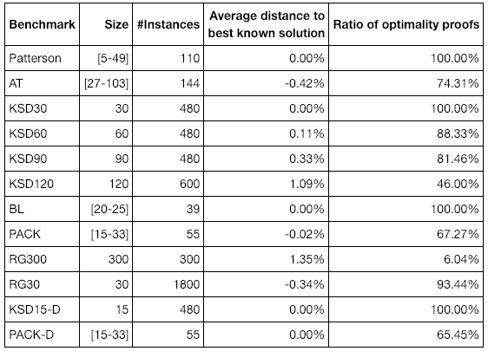
Classical RCPSP benchmarks (5023 instances)
CP Optimizer 12.9 results with automatic search using a time limit of 5mn (code of previous slide)
  Maximal time to first feasible solution: 0.08s
complete
efficient
anytime

Slide 10
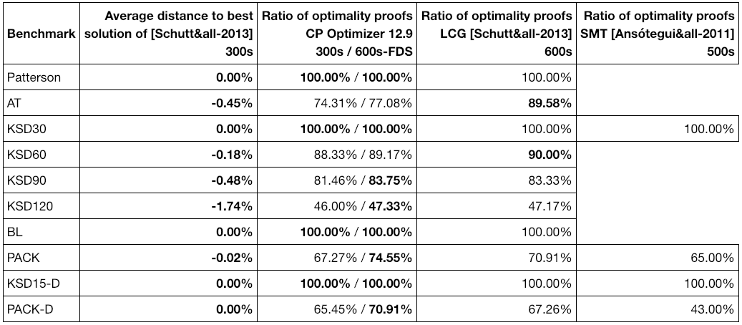
Classical RCPSP benchmarks
CP Optimizer 12.9 results with automatic search
efficient
complete

Slide 11
Classical RCPSP benchmarks
CP Optimizer 12.9 results with automatic search using a time limit of 5mn (code of previous slide)
  These problems are tiny compared to industrial problems !

Slide 12

Automatic Search
Main principle: cooperation between several approaches
CP Optimizer Automatic Search
Failure-Directed Search
Large-Neighborhood Search
Iterative Diving
Existing RCPSP instances
Problem size
(number of
interval
variables)
10⁰
10¹
10²
10³
10⁴
10⁵
10⁶

Slide 13
Iterative diving
By the way: “CP” in “CP Optimizer” means Constraint Programming 
Idea of iterative diving: perform aggressive dives (no backtrack) in the search tree explored by CP
For instance on RCPSP it boils down to some very classical ideas (list scheduling, decoding schemes, …)
The challenge was to generalize these problem-specific ideas to the general modeling concepts of CP Optimizer

Slide 14
CP Optimizer V12.9
New benchmark with RCPSP from 500 to 500.000 tasks
  Largest problem: 500.000 tasks, 79 resources, 4.740.783 precedences, 4.433.550 resource requirements
Time to first feasible solution (V12.8 v.s. V12.9)
scalable

Slide 15
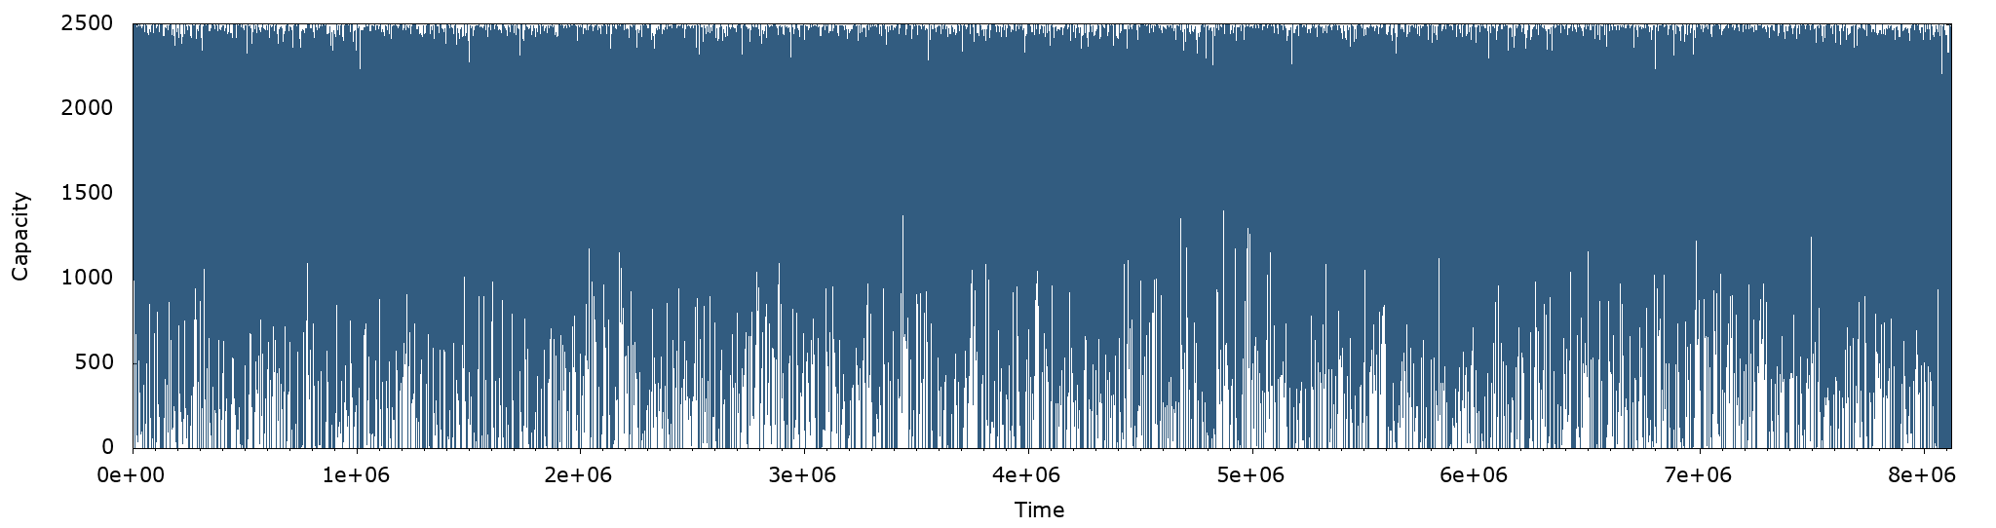
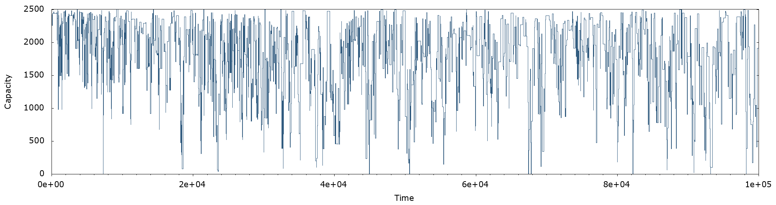
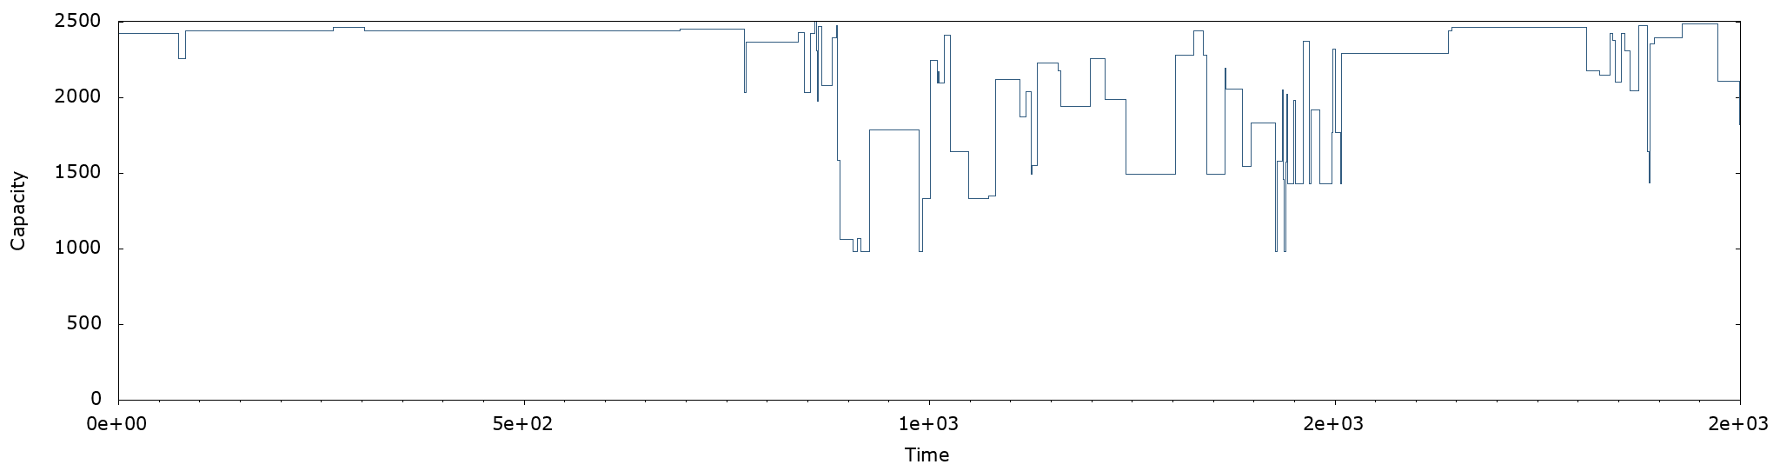
Example of cumul function value
Resource load for one of the resources of a large instance (500.000 tasks)
Resource load
Resource load
Resource load

Slide 16
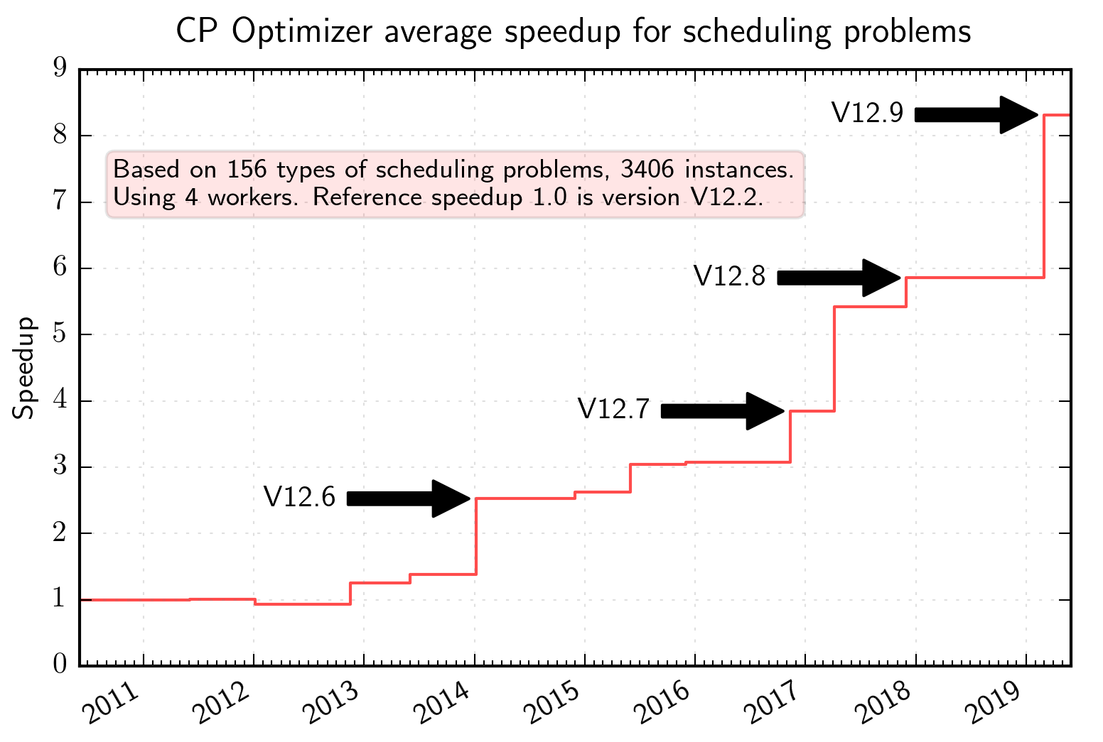
CP Optimizer automatic search
With 4 workers, average speed-up of 42% between 12.8 and coming version 12.9
Iterative
diving
Objective
landscapes
Failure-directed
search

Slide 17
Conclusion
A mathematical modeling language for combinatorial optimization problems that extends ILP (and classical CP) with some algebra on intervals and functions allowing compact and maintainable formulations for complex scheduling problems
A continuously improving automatic search algorithm that is complete, anytime, efficient (e.g. competitive with problem-specific algorithms on classical problems) and scalable
Recent review of CP Optimizer (modeling concepts, applications, examples, tools, performance,…) :
  IBM ILOG CP Optimizer for scheduling. Constraints (2018) 23:210–250. http://ibm.biz/Constraints2018

