Slide 1
CPLEX Optimization Studio
Combinatorial Optimization
Let: X A vector of decision variables
f(X) A function
C(X) Some constraints limiting the possible
combinations of values for decision variables
Problem: minimize f(X)
subject to C(X)
CPLEX engine
X Numerical or Integer variables
f(X) Linear or Quadratic function
C(X) Linear or Quadratic constraints
CP Optimizer engine
X Integer or Interval variables
f(X) General function
C(X) General constraints

Slide 2




CPLEX Optimization Studio
C++
CPLEX or
CP Optimizer
Model
OPL
...
Python
Solve
Java
minimize f(X)
subject to C(X)
C#

Slide 3
Example of a classical scheduling problem (RCPSP)
Given n tasks, m finite capacity resources and precedence constraints …
Find a schedule that minimizes project makespan
R1
a3
a6
R2
a7
a1
a2
a5
a4
a8

Slide 4
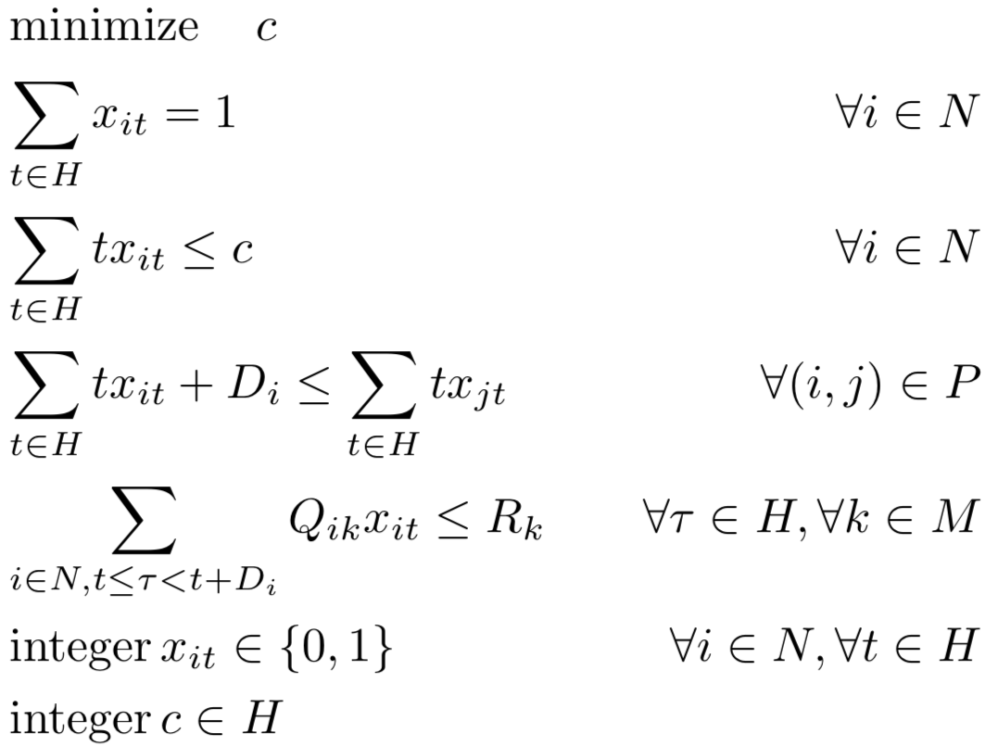
Example of a classical scheduling problem (RCPSP)
A standard CPLEX (MIP) formulation (time-indexed)
Di
a_{i}
xit ∈ {0,1}
H

Slide 5
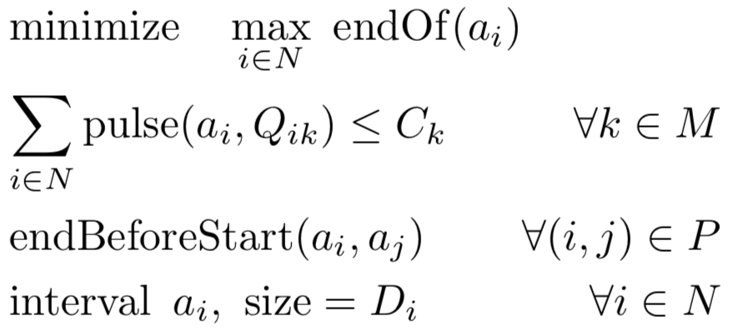
Example of a classical scheduling problem (RCPSP)
A CP Optimizer formulation
pulse(a_{i},Qik)
Qik
a_{i}
Di
a_{j}
No enumeration of time (H)
Formulation size grows linearly
with size of the data
Can find good quality solutions
for problems with several 10.000 tasks

Slide 6
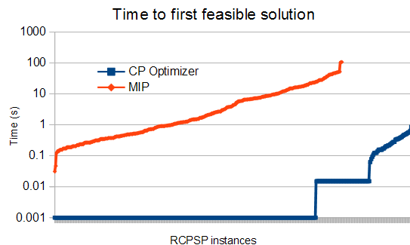
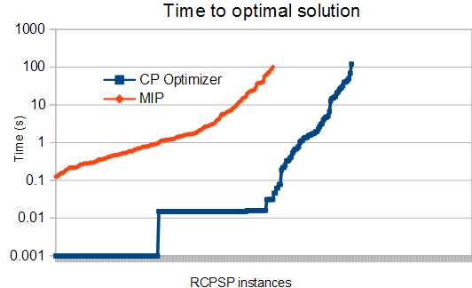
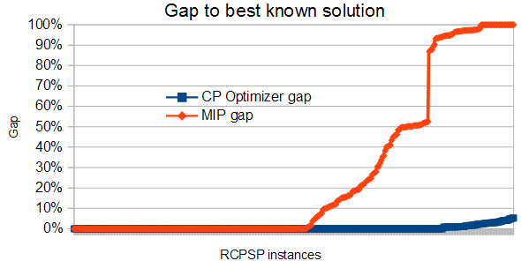
Example of a classical scheduling problem (RCPSP)
Comparison CP Optimizer / MIP performance on RCPSP
Comparison on 300 classical small
RCPSP instances (30-120 tasks) +
40 medium-size ones (900 tasks)
Time-limit: 2 minutes, 4 threads

Slide 7
Beyond RCPSP
CP Optimizer has mathematical concepts that naturally map to features invariably found in industrial scheduling problems
Earliness/tardiness costs
Resource calendars
Resource efficiency
Constant functions
Optional activities
Over-constrained problems
Resource alloc. / alternatives
Work-breakdown structures
Interval variables
Cumulative resources
Inventories
Reservoirs
Cumul functions
Parallel batches,
Activity incompatibilities
State functions
Aggregation of individual
costs (max, weighted sum,
Net Present Value)
Sequence variables
Unary resources
Setup times/costs
Travel times/costs
General arithmetical expressions

Slide 8
CP Optimizer RCPSP formulation in Java
Creation of an instance of CP Optimizer engine:
IloCP cp = new IloCP();
Creation of interval variables and end expressions:
IloIntervalVar[] a = new IloIntervalVar[n];
IloIntExpr[] ends = new IloIntExpr[n];
for (int i = 0; i < n; i++) {
a[i] = cp.intervalVar(D[i]);
ends[i] = cp.endOf(a[i]);
}
Creation of precedence constraints:
cp.add(cp.endBeforeStart(a[i],a[j]));
Etc .
Creation of objective function:
cp.add(cp.minimize(cp.max(ends)));
Problem resolution:
cp.solve();

