Slide 1



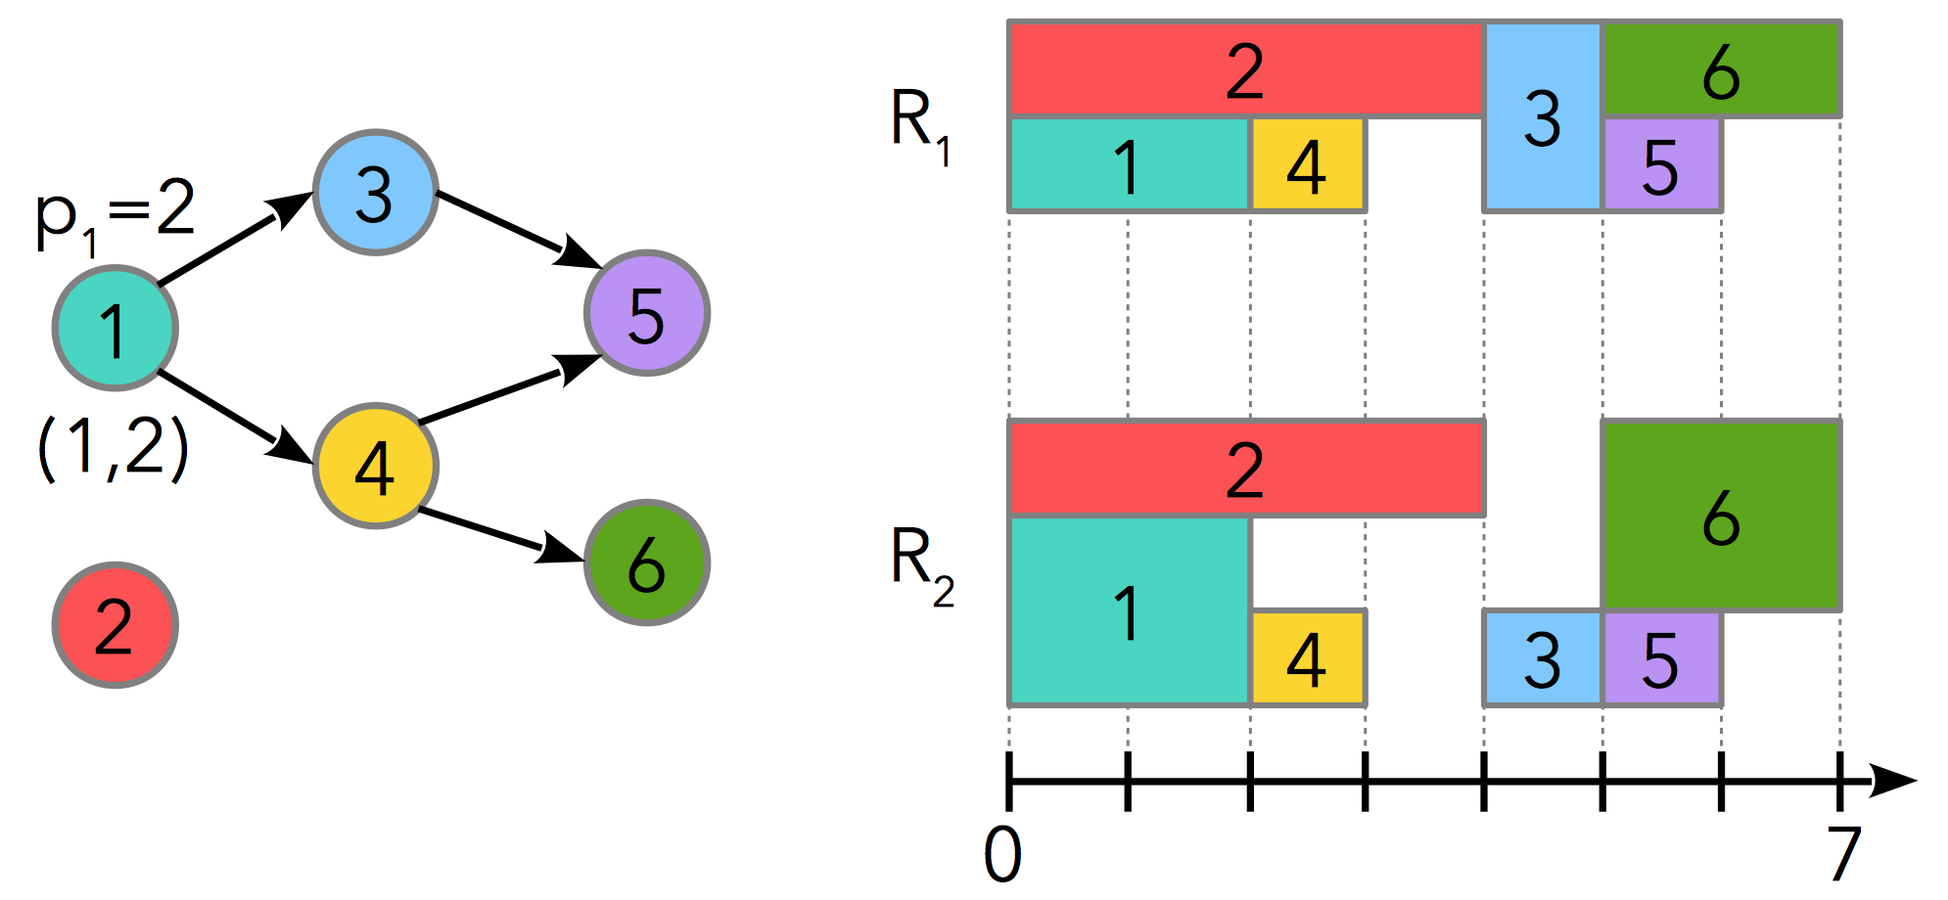
Models and exact algorithms for solving real-world scheduling problems
The CP Optimizer approach
Philippe Laborie, IBM laborie@fr.ibm.com
minimize f(X)
subject to C(X)

Slide 2
ADDITIONAL MATERIAL

Slide 3
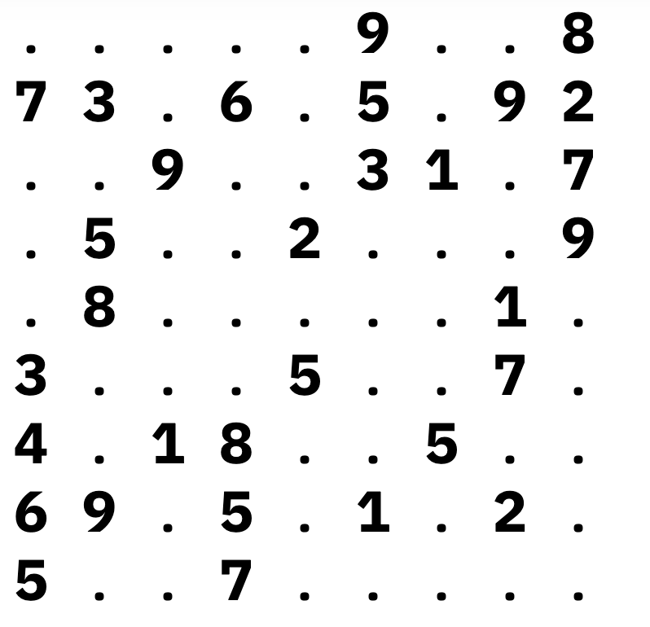
Additional material
An infeasible grid

Slide 4
Additional material
An “explanation” for the infeasibility

