Slide 1

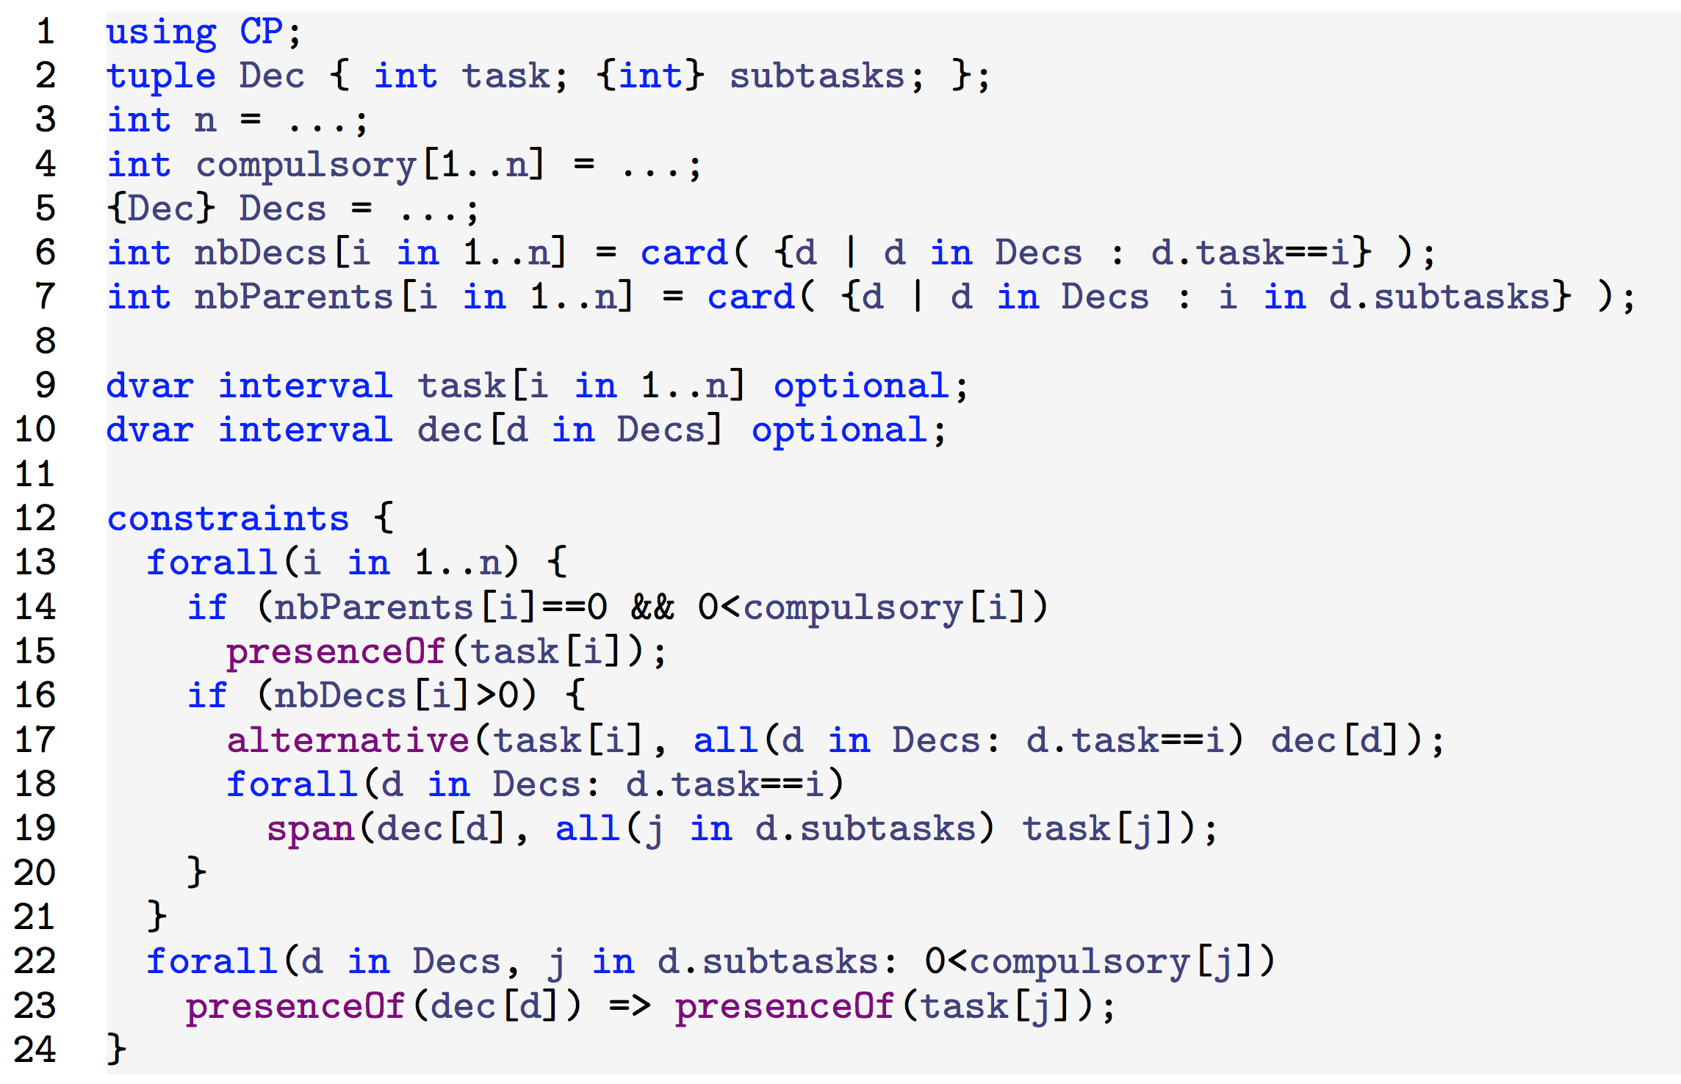
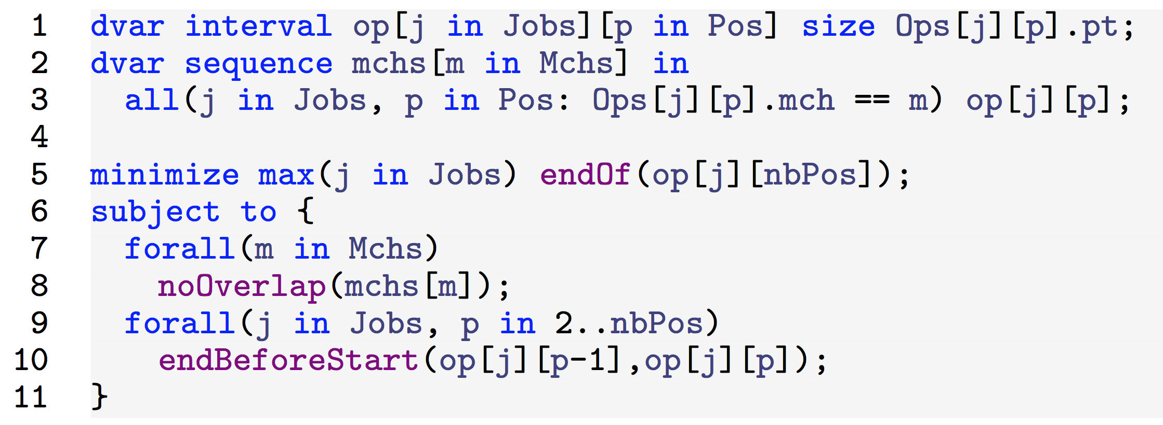
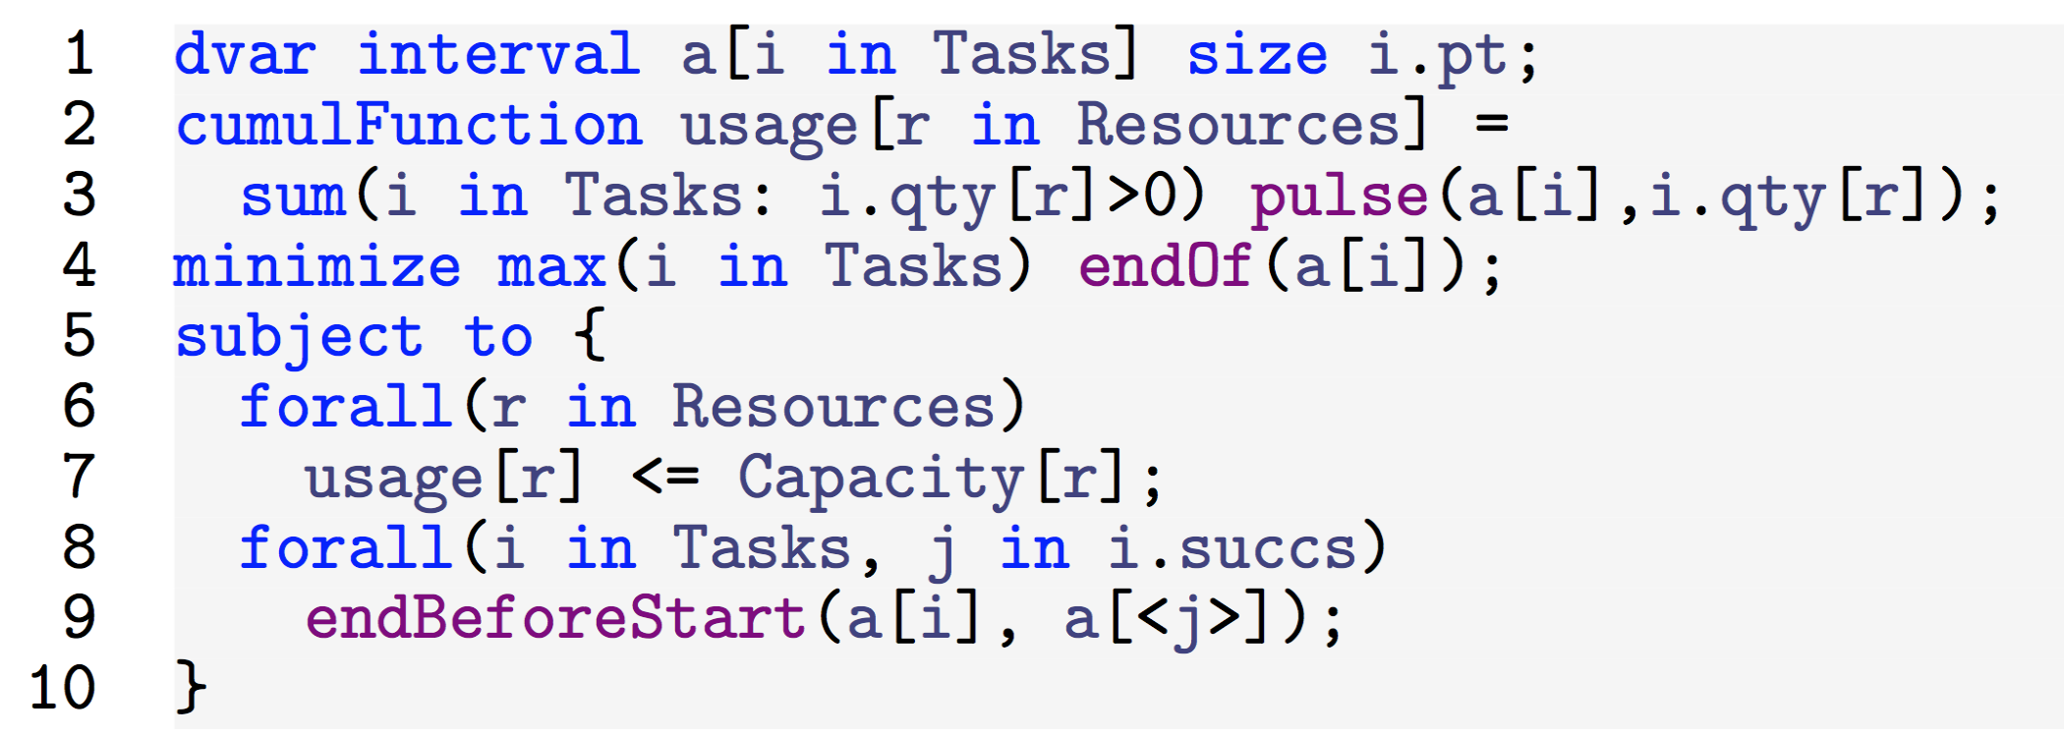
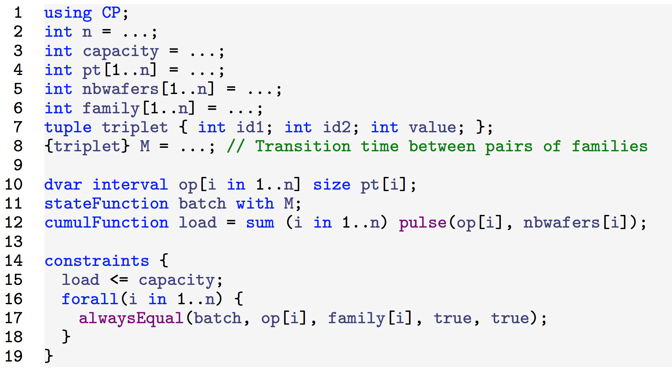




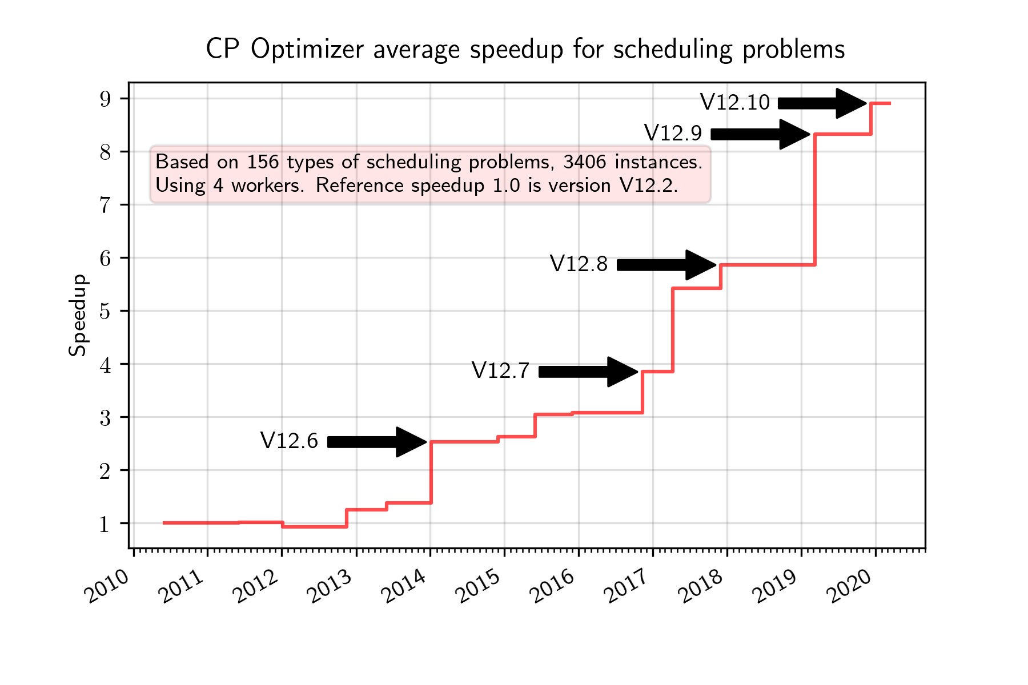

IBM ILOG CP OPTIMIZER FOR SCHEDULING
P. Laborie - IBM - laborie@fr.ibm.com
Interval variables
Structural constraints
What for? Modeling an interval of time during which a particular property holds (an activity executes, a resource is idle, a tank must remain empty, etc.)
If desired, intervals can be optional: that is, whether the interval will be present or absent in a solution is part of the optimization problem [1,2]
Example: dvar interval x optional in 0..1000000 size 100..200;
Logical constraints on interval presence: presenceOf(x) => presenceOf(x)
Precedence constraints: endBeforeStart(x,y, delay)
Step functions for modeling resource time-dependent intensity and breaks
Integer expressions to get interval attributes: startOf(x,ValIfAbsent)
What for? Structure the problem in the form of an AND/OR graph
OR nodes = alternative constraint alternative(x, [y1,…,yn])
AND nodes = span constraint span(x, [y1,…,yn])
Example of a work-breakdown structure:
0
[100,200]
1000000
task
x
Time
dec
MODEL
Sequencing
Cumul functions
State functions
What for? Modeling constraints that enforce a total temporal ordering of a set of interval variables
A sequence variable represents a permutation of interval variables: dvar sequence
Example: Classical Job-Shop Scheduling Problem
Additional features available for modeling sequence-dependent setup times and constraints on transitions (for instance for VRP-like problems)
What for? The value of a cumul function expression represents the time evolution of a quantity (e.g. level of an inventory) that can be incrementally changed (increased or decreased) by interval variables
Examples: number of workers of a given type, level of an inventory, etc.
Example: Classical RCPSP
Levels can be fixed or variable
Constraints are available for limiting the value of a cumul function over some fixed time periods or variable intervals
What for? The value of a state function represents the time evolution of a value that can be changed/required by interval variables
  Two interval requiring different states cannot overlap
  Two interval requiring the same state can (optionally) be batched together (same start and end value)
Example of a photo-lithography machine:
Automatic search
Under the hood
Properties of the automated search
  Complete
  Anytime (usually a first feasible solution is found quickly)
  Parallel (unless stated otherwise)
  Randomized (internally some ties are broken using random numbers)
  Deterministic (solving the same problem twice produces the same result)
The search can be parametrized
  Search parameters (time limit, number of workers, control of inference levels, random generator seed, ...)
  Starting point (injecting a solution)
  Search phases (partition of the decision variables)
You can write your own constraints or search in C++, but this is seldom needed in an industrial context
Two iterative methods are interleaved: LNS for producing good quality solutions and FDS for proving infeasibility
Large-Neighborhood Search (LNS) [4]
Based on a Partial Order Schedule (POS) computed from feasible solutions
A POS is a precedence graph such that the resource constraints (on sequence, cumul and state functions) are necessarily satisfied
At each iteration, a fragment of the POS is relaxed and re-optimized
The completion strategy is guided by a linear relaxation of the problem [7] and by exploiting objective landscapes [8]
Failure-Directed Search (FDS) [5]
Uses strong propagation [1,2,6]
Decisions are rated and the ones that often lead to infeasibility or strong domain reduction in the search are preferred: they are used earlier in the search during the next iterations
FDS uses no-goods to avoid revisiting already explored parts of the search space
cap
C
E
F
C
E
F
B
D
H
B
D
H
FDS
Search Tree
No-goods
A
G
t
A
G
Decisions rating
RUN
Restart
Performance
APIs and Tools
References
Performance is on a par or outperforms state-of-the-art problem specific algorithms for most of classical scheduling problems like different variants / extensions of job-shop and RCPSP problems [3,4,5]
Recent improvements on large problems (1.000.000 tasks)
Performance is continuously improved
APIs
Tools
  Human readable I/O format
  Conflict refiner [9]: tells you why a model has no solution
  Parametrizable search log for understanding the behavior of the search
Reasoning with Conditional Time-Intervals. FLAIRS-2008.
Reasoning with Conditional Time-Intervals, Part II: an
Algebraical Model for Resources. FLAIRS-2009.
IBM ILOG CP Optimizer for Detailed Scheduling Illustrate on
Three Problems. CPAIOR-2009.
Self-Adapting Large Neighborhood Search: Application to
Single-Mode Scheduling Problems. MISTA-2007.
Failure-Directed Search for Constraint-Based Scheduling.
CPAIOR-2015.
Timetable Edge Finding Filtering Algorithm for Discrete
Cumulative Resources. CPAIOR-2011.
Temporal Linear Relaxation in IBM ILOG CP Optimizer.
Journal of Scheduling 19(4), 391-400, 2016.
Objective Landscapes for Constraint Programming.
CPAIOR-2018.
An Optimal Iterative Algorithm for Extracting MUCs in a
Black-box Constraint Network. ECAI-2014.
IBM ILOG CP Optimizer for Scheduling.
Constraints Journal 23(2), 210–250, 2018.
C++
CP Optimizer
model
Local
...
OPL
Python
Solve
Java
On cloud
Iterative
diving
C#
Objective
landscapes
Failure-directed
search

