Slide 1
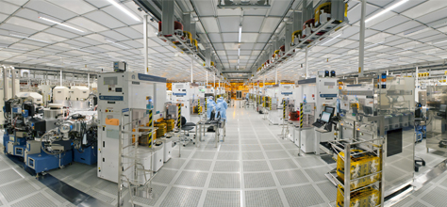
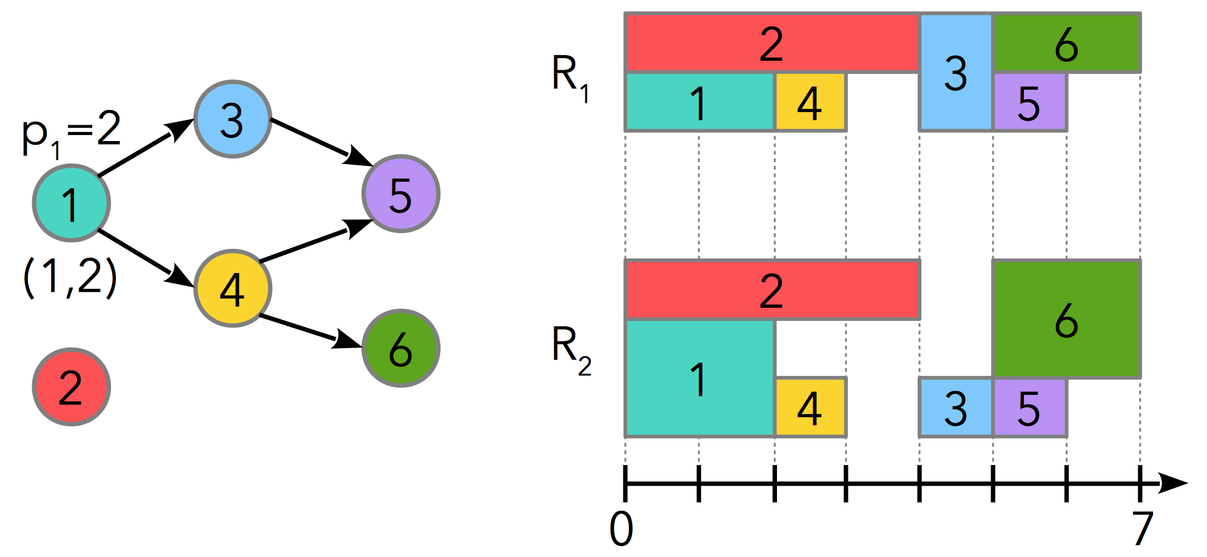
CP Optimizer
A generic optimization engine for solving industrial scheduling problems
Philippe Laborie, IBM laborie@fr.ibm.com

