Slide 1
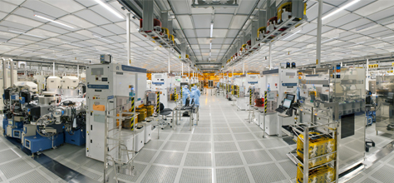
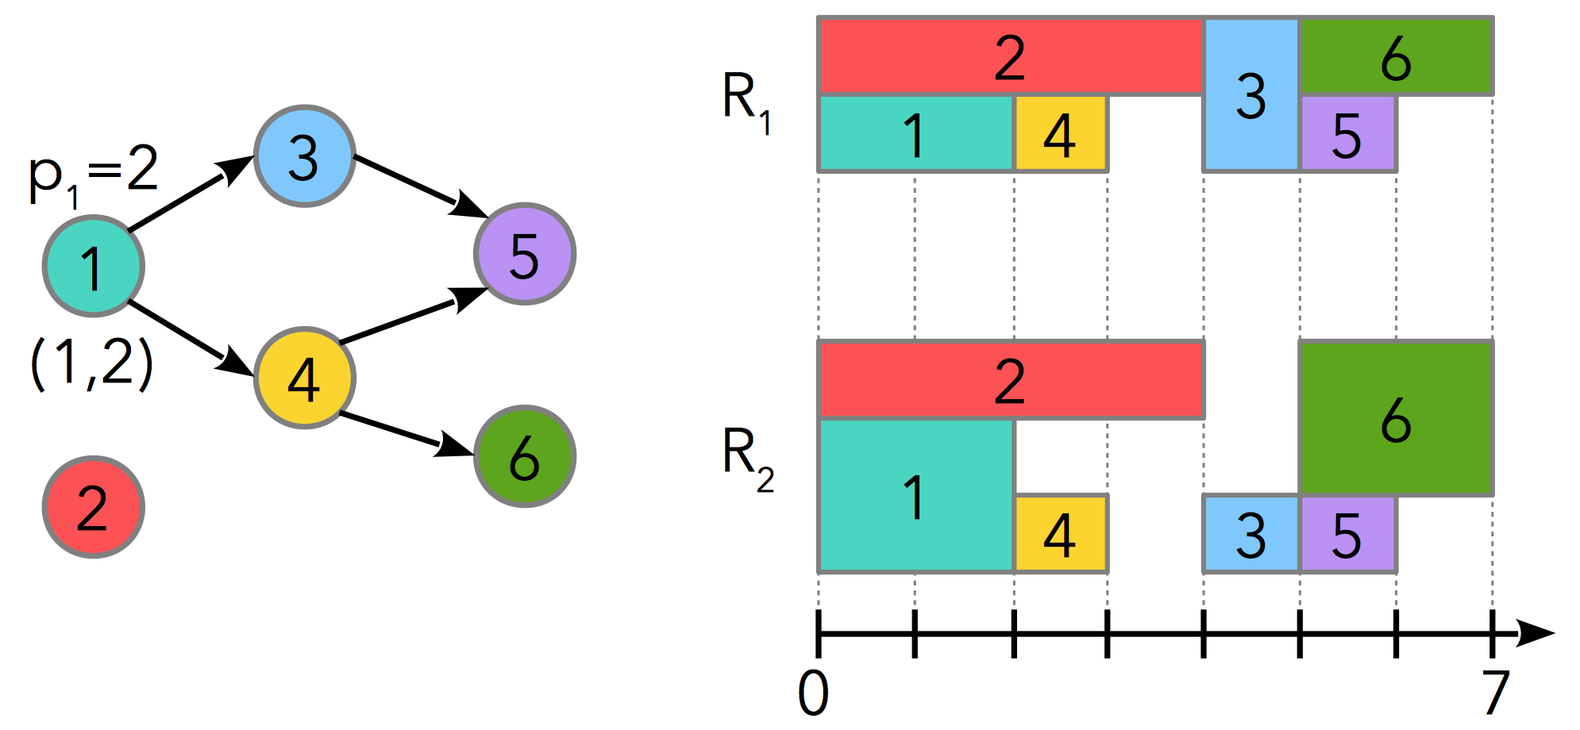
CP Optimizer
A generic optimization engine for solving industrial scheduling problems
Philippe Laborie, IBM laborie@fr.ibm.com

Slide 2
What is CP Optimizer ?
Historically developed since 2007 by ILOG, now IBM
Our team has 20+ years of experience in designing combinatorial optimization tools for real-life industrial problems, and particularly scheduling problems
#1 objective of CP Optimizer : lower the barrier to entry for efficiently solving industrial scheduling problems
In particular, no need to be an OR, AI or algorithmist expert

Slide 3
What is CP Optimizer ?
Model & run approach:
User focuses on a declarative mathematical model of the problem using the classical ingredients of combinatorial optimization: variables, constraints, expressions, objective function
Resolution is performed by an automated search algorithm with the following properties: complete, deterministic, anytime, efficient, robust, continuously improving ...

Slide 4
Scheduling is about time ...
Most existing framework in combinatorial optimization (MILP, classical CP) only deal with numerical values ( x∈ , x∈ )
CP Optimizer introduces a set of other simple mathematical concepts that naturally emerge when dealing with time:
  Intervals : a = [s,e) = { x∈ | s≤x<e }
  Functions : f: →
  Permutations
  Optional interval : occurrence / non-occurrence of an event

Slide 5
What is CP Optimizer ?
What if we integrate these mathematical concepts in the model …
And keep all the good ideas of well established frameworks like MILP:
  Model & run
  Exact algorithm
  Input/output file format
  Language versatility (C++, Python, Java, C#, OPL)
  Modeling assistance (warnings, …)
  Conflict refiner for explaining infeasibility
  Warm-start
  …
That’s exactly what CP Optimizer is about !

Slide 6
Examples of scheduling problems
Resource-Constrained Project Scheduling (RCPSP)
  Notorious NP-Hard problem in combinatorial optimization (>5000 references on Google Scholar)
  N tasks with precedence constraints
  M resources of limited capacity
  Minimize project makespan
R₁
2
3
6
C₁=2
p₁=2
3
1
4
5
1
5
(1,2)
4
2
6
6
R₂
1
C₂=3
2
4
3
5
0
7
time

Slide 7

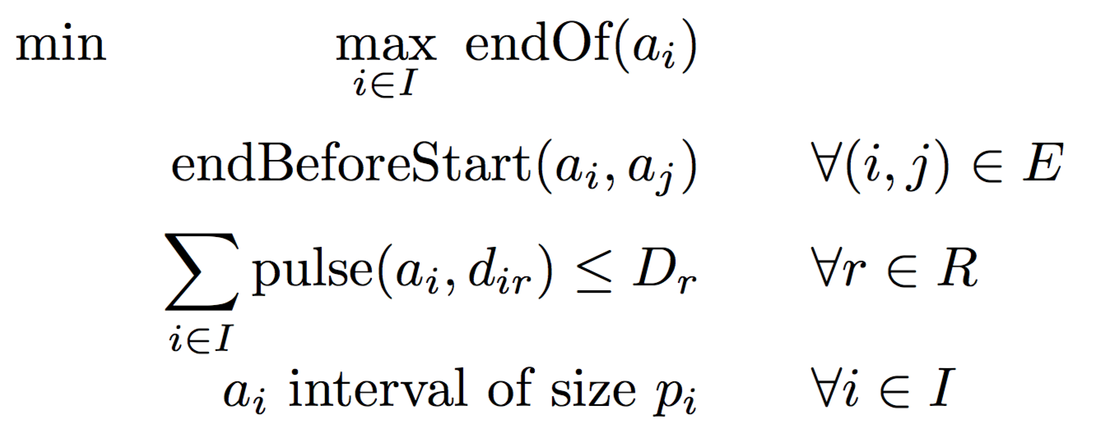
CP Optimizer model for RCPSP

Slide 8
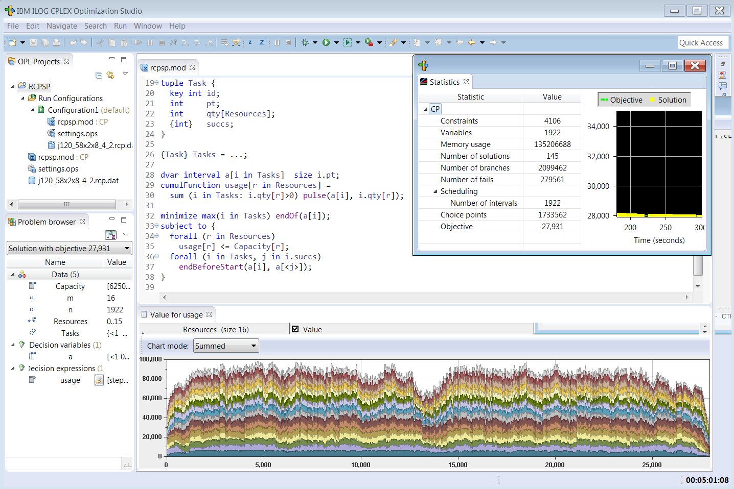
CP Optimizer model for RCPSP

Slide 9
Performance on classical scheduling benchmarks
Results published in CPAIOR-2015 (using V12.6) on classical benchmarks:
  Many instances closed or improved on : Job-shop, Job-shop with operators , Flexible job-shop, RCPSP, RCPSP with maximum delays, Multi-mode RCPSP, Multi-mode RCPSP with maximum delays, ...
  These classical benchmarks are small compared to real industrial problems
New benchmark on RCPSP (from 500 to 500.000 tasks)

Slide 10
Examples of scheduling problems
In the real life, scheduling problems are more complex
  Complex constraints: activities, resources
  Complex objectives: resource costs, tardiness, throughput
  Ill-defined problems
  Over-constrained problems (can’t schedule all activities)
  Heterogeneous decisions (time, resource allocation, batching, …)
  Large (e.g. 1.000.000 tasks)
  Require fast solving time

Slide 11
CP Optimizer modeling concepts
Allows easy modeling of:
  Variable activity duration, partially preemptive tasks
  Optional activities, oversubscribed problems
  Hierarchical problems (Work Breakdown Structures)
  Alternative resources and modes (MM-RCPSP)
  Resource calendars and breaks
  Cumulative resources, inventories, reservoirs
  Parallel batches, activity incompatibilities
  Unary resources with setup times and costs
  Complex objective functions
In CP Optimizer the size of the model in general grows linearly with the size of the problem instance

Slide 12
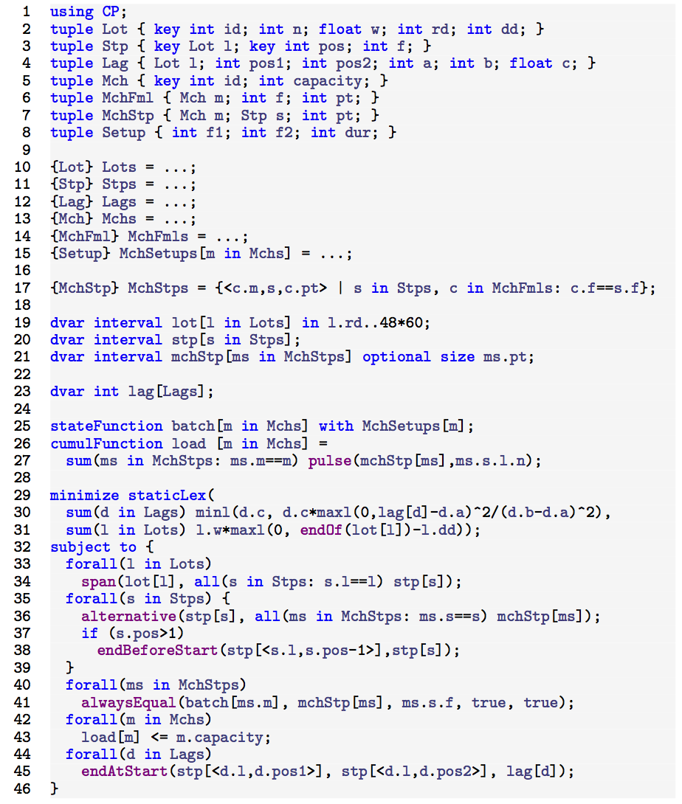

CP Optimizer model for semiconductor manufacturing
Lot 1
Step 1
Step 2
...
Lot 2
...
S. Knopp et al. Modeling Maximum Time Lags in Complex Job-Shops with Batching in Semiconductor Manufacturing. PMS 2016.

Slide 13
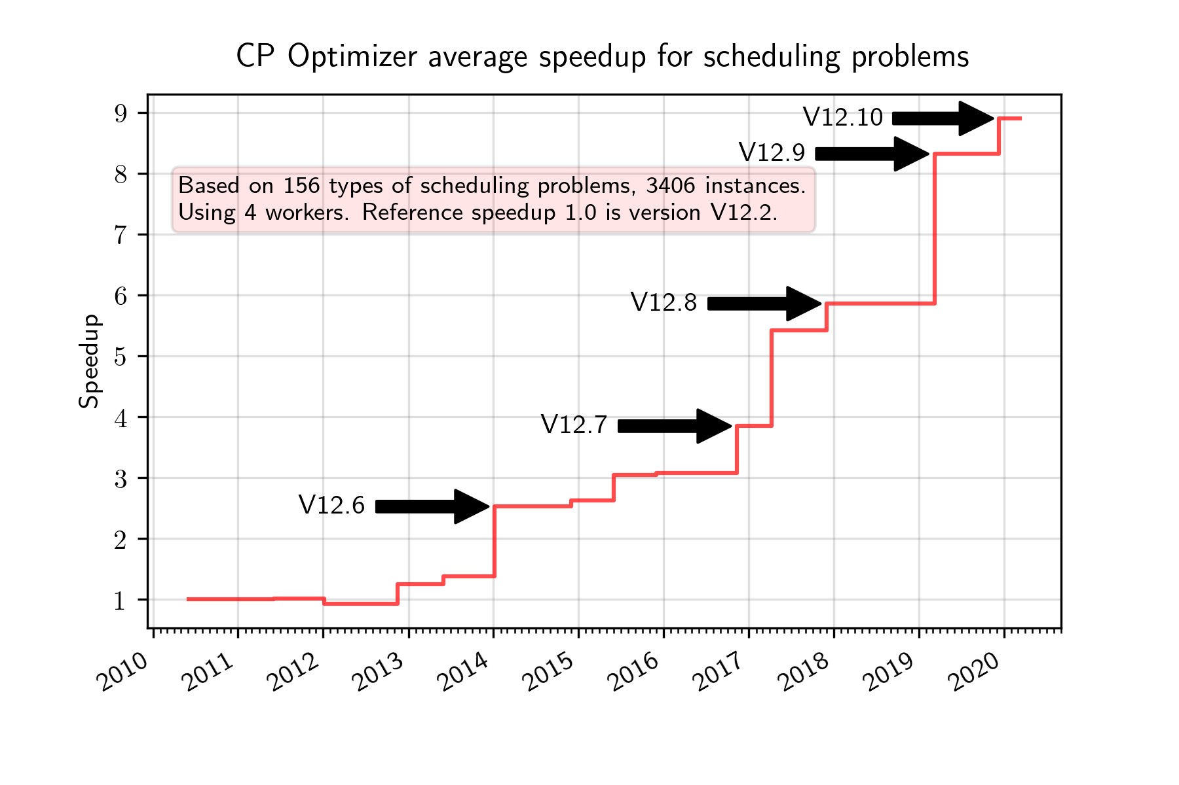
Performance evolution
Iterative
diving
Objective
landscapes
Failure-directed
search

Slide 14
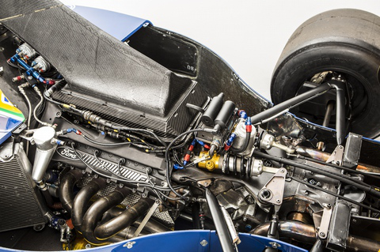
Under the hood
Artificial Intelligence
Operations Research
Constraint
propagation
Heuristics
Model presolve
Linear
relaxations
Learning
Temporal
constraint
networks
Problem
specific
scheduling
algorithms
2-SAT
networks
No-goods
Restarts
Tree search
LNS
Randomization

Slide 15
Some references
P. Laborie, J. Rogerie. Reasoning with Conditional Time-Intervals. In: Proc. FLAIRS-2008, p555-560.
P. Laborie, J. Rogerie, P. Shaw, P. Vilím. Reasoning with Conditional Time-Intervals. Part II: An Algebraical Model for Resources. In: Proc. FLAIRS-2009, p201-206.
P. Laborie. CP Optimizer for detailed scheduling illustrated on three problems. In: Proc. CPAIOR-2009.
P. Laborie, B. Messaoudi. New Results for the GEO-CAPE Observation Scheduling Problem. In Proc. ICAPS-2017.
P. Laborie, D. Godard. Self-Adapting Large Neighborhood Search: Application to Single-Mode Scheduling Problems. In: Proc. MISTA-2007.
P. Laborie, J. Rogerie. Temporal Linear Relaxation in IBM ILOG CP Optimizer. Journal of Scheduling 19(4), 391–400 (2016).
P. Vilím. Timetable Edge Finding Filtering Algorithm for Discrete Cumulative Resources . In: Proc. CPAIOR-2011.
P. Vilím, P. Laborie, P. Shaw. Failure-directed Search for Constraint-based Scheduling. In: Proc. CPAIOR-2015.
P. Laborie, J. Rogerie, P. Shaw, P. Vilím. IBM ILOG CP Optimizer for Scheduling. Constraints Journal (2018).
Modeling
concepts
Examples
Search
algorithm
Overview

Slide 16
Conclusion
Try CP Optimizer !
Full-version of CP Optimizer is free for academics: ibm.com/academic

