Slide 1


Algorithms for Propagating Resource Constraints in AI Planning and Scheduling: Existing Approaches and New Results
Philippe Laborie
ILOG
plaborie@ilog.fr
Notes:
The properties that are sufficient to characterize a solution to a finite capacity scheduling problem fall into two categories: the ones based on the absolute positions of activities along the time axis (resource usage profile) and the ones that rely on the interactions between activities competing for the same resource (precedence between activities start/end times). This talk aims at discussing, classifying and comparing the constraint programming techniques built on this second category of properties.

Slide 2

Overview
Constraint-Based Scheduling
A Framework to compare Resource Propagation Algorithms
Existing Propagation Algorithms
Limitations
New Propagation Algorithms
Experimental Results
Conclusion and Future Works
Notes:
The first part of the presentation is a very brief recap of the principles of constraint-based scheduling: it basically explains what kind of search space is explored and how constraint propagation helps at reducing the size of the explored search space.
Then, we will distinguish between the two main approaches for constraint-based scheduling : the ones based on resource profiling and the ones based on activity interactions. This talk only deals with this second kind of approaches.
Many well-known or less-known propagation techniques rely on activity interaction analyses. We will describe some of them and propose a classification depending on what kind of analyze is performed and what kind of information is deduced.
In a similar way, we will discuss the search procedures based on activity interaction in the last part of the talk. We also give some new results based on very simple search procedures.

Slide 3
Constraint-Based Scheduling
□ Activities
start (s)
end (e)
Processing time (p)
s(A) + p(A) == e(A)
□ Temporal constraints
□ Time bound constraints: e(A) ≤ 100
□ Precedence constraints: e(A) ≤ s(B)
□ Min/Max delay constraints: 5 ≤ s(B)-e(A) ≤ 10
Notes:
Here are the different notions used in constraint-based scheduling (in this talk we only consider non-preemptive scheduling):
Activities are characterized by a start time, a processing time and an end time. All three can be considered as decision variables.
Temporal constraints may be expressed between activities. These temporal constraints include:
Time bound constraints that allow to restrict the domain of a time variable. They are for example useful to represent delivery dates or due dates;
Precedence constraints between activities with possible delays. These are constraints expressing minimal and/or maximal delays between two time-points of the schedule (start or end of an activity). The delay may be a decision variable as well.

Slide 4
Constraint-Based Scheduling
□ Resources
□ Unary Resource
t
□ Discrete Resource
t
□ Reservoir
t
□ Resource usage constraints
Activity A requires (produces) q units of resource R
Notes:
Several types of resources are in general considered:
Unary resources are such that two activity cannot be processed simultaneously on the same unary resources
Discrete resources are resources with a finite capacity. Several activities may be processed simultaneously on that resource provided that the maximal capacity is not exceeded.
Reservoir are finite capacity resources that can be consumed and replenished by some activities.
Note that discrete resources are a special case of reservoir that cannot be replenished and that unary resources are a special case of discrete resource of capacity 1.
Resource constraints allow to express the fact that a given activity requires, consumes or produces a certain quantity of resource. This quantity may be a decision variable of the problem.
[During this presentation, for simplicity reason, we implicitly assume that the only decision variables of the scheduling problem are the start and end time of activities. In other words: the processing time, the resource quantities, the delay variables, etc are constant. But there is no special problem with dealing with variable processing times, resource quantities or delays.]

Slide 5
Constraint-Based Scheduling
Problem:
  Does a solution exist ?
  Find one solution
  Find one good solution (w.r.t. a criterion)
  Find one or all best solutions (w.r.t. a criterion)
Criterion:
  min/max (makespan), linear, piece-wise linear, other
Notes:
A scheduling problem is composed of:
A set of activities
A set of temporal constraints on these activities
A set of resources
A set of resource constraints specifying which activity use which resource and how much quantity of the resource is involved.
Depending on the application, solving the problem may mean different things. For example:
Does a solution exist ?
Find one solution
Find one good solution (w.r.t. a criterion)
Find one or all best solutions (w.r.t. a criterion)
In case an optimization is required, the criterion may be more or less complex.
Constraint-based scheduling offers a very powerful and flexible framework to efficiently solve these scheduling problems.

Slide 6
Constraint-Based Scheduling
Explore a space (search tree) of partial schedules
Root node is the initial problem
At each node: enforce some property (constraints) that characterizes a solution
OR
Solution
Notes:
In constraint-based scheduling, the explored search space is usually a search tree of partial (partially specified) schedules.
The root node is the initial problem formulation. At each node of the search tree, some property that characterizes a solution is enforced (for example on a unary resource, in a solution, activity a must be scheduled before b or b before a). The possible alternatives for enforcing the property are examined in the child nodes.

Slide 7
Constraint-Based Scheduling
Constraint Propagation: Before branching, at a given node in the search, remove from the domain of variables some impossible values.
After propagation
Notes:
At a given search node, a partial schedule can be seen as a set of constraints between activities or between activities and resources.
Constraint propagation is used before branching in order to remove from the domain of decision variables some values that will not participate in any solution reachable from the current search node. Reducing the size of the variable domain allows to avoid some useless search. Whenever the domain of a variable becomes empty, it means that no solution can be reached from this node and thus, the search must backtrack.
We will now examine different constraint propagation techniques used in constrained-based scheduling.

Slide 8





Resource Propagation
Perform deductions that can be expressed as:
C ⇒ E
Tentative classification:
  What’s analyzed on the left side ( C ):
    Time bounds
    Precedence relations
  What kind of reasoning is performed
    Resource Level Reasoning
    Energetic Reasoning
  What is deduced ( E ):
    Time bounds
    Not First/Last among Ω
    Precedence relations
Notes:
At a given search node, a partial schedule can be seen as a set of constraints between activities or between activities and resources.
Constraint propagation is used before branching in order to remove from the domain of decision variables some values that will not participate in any solution reachable from the current search node. Reducing the size of the variable domain allows to avoid some useless search. Whenever the domain of a variable becomes empty, it means that no solution can be reached from this node and thus, the search must backtrack.
We will now examine different constraint propagation techniques used in constrained-based scheduling.

Slide 9




Timetabling
q
Aggregated necessary demand
Q
Q_{MAX}
t
Notes:
Propagation based on resource profiling maintains a time-table that is, basically, two time functions that describe the required and possible aggregated resource demand over time by all the activities in the current partial schedule. This constraint allows to deduce that a given activity cannot overlap a certain time window because there is not enough resource available on that time window.
These propagation techniques are often used in conjunction with some search procedures that try to schedule activities as soon as possible and, in case of failure, postpone the activity. The efficiency as well as the completeness of these search procedures strongly depend on the scheduling problem.
These approaches are often called Cumulative Scheduling approaches as they are mainly used on cumulative resources (discrete resources, reservoir) and consist in cumulating the information about resource usage at each time-point.

Slide 10
Timetabling
Aggregated necessary demand
Q
Q_{MAX}
t
Notes:
Propagation based on resource profiling maintains a time-table that is, basically, two time functions that describe the required and possible aggregated resource demand over time by all the activities in the current partial schedule. This constraint allows to deduce that a given activity cannot overlap a certain time window because there is not enough resource available on that time window.
These propagation techniques are often used in conjunction with some search procedures that try to schedule activities as soon as possible and, in case of failure, postpone the activity. The efficiency as well as the completeness of these search procedures strongly depend on the scheduling problem.
These approaches are often called Cumulative Scheduling approaches as they are mainly used on cumulative resources (discrete resources, reservoir) and consist in cumulating the information about resource usage at each time-point.

Slide 11
Timetabling
C ⇒ E
❑ Time Bounds  Level  Time Bounds
❑ Precedence  Energy  Precedence
❑ Not First/Last



Notes:
Propagation based on resource profiling maintains a time-table that is, basically, two time functions that describe the required and possible aggregated resource demand over time by all the activities in the current partial schedule. This constraint allows to deduce that a given activity cannot overlap a certain time window because there is not enough resource available on that time window.
These propagation techniques are often used in conjunction with some search procedures that try to schedule activities as soon as possible and, in case of failure, postpone the activity. The efficiency as well as the completeness of these search procedures strongly depend on the scheduling problem.
These approaches are often called Cumulative Scheduling approaches as they are mainly used on cumulative resources (discrete resources, reservoir) and consist in cumulating the information about resource usage at each time-point.

Slide 12

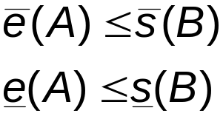
Disjunctive Constraint
Disjunctive constraint on unary resource [Erschler76]
A
A
⇒
B
B
Notes:
The disjunctive constraint on a unary resource states that whenever it is not possible to process activity b before activity a on the resource than, activity a must be processed before activity b.
The disjunctive constraint has a worst case complexity in O(n²).
Note that this is an extended version of the disjunctive constraint. Traditionally the disjunctive constraint is expressed on time bounds of activity variables:
lst(a) < ect(b) ⇒ a ⟨⟨ b
The formulation with precedence between activities on the left side is stronger as it allows to deduce some precedence in some cases where the time bounds would not allow it. This is basically the case when the precedence relation start(a) < end(b) has been deduced by other ways (belong to the problem formulation, added in the search procedure, discovered by some other constraint, etc) than just the fact lst(a) < ect(b).

Slide 13
Disjunctive Constraint
C ⇒ E
❑ Time Bounds  Level  Time Bounds
❑ Precedence  Energy  Precedence
❑ Not First/Last




Notes:
Propagation based on resource profiling maintains a time-table that is, basically, two time functions that describe the required and possible aggregated resource demand over time by all the activities in the current partial schedule. This constraint allows to deduce that a given activity cannot overlap a certain time window because there is not enough resource available on that time window.
These propagation techniques are often used in conjunction with some search procedures that try to schedule activities as soon as possible and, in case of failure, postpone the activity. The efficiency as well as the completeness of these search procedures strongly depend on the scheduling problem.
These approaches are often called Cumulative Scheduling approaches as they are mainly used on cumulative resources (discrete resources, reservoir) and consist in cumulating the information about resource usage at each time-point.

Slide 14
Edge-Finding
Edge-Finding [Carlier&Pinson90, Nuijten94, Baptiste&LePape96] Detecting First Among n Activities on Unary Resource:
B
p=4
B
p=4
6
16
6
16
C
p=5
C
p=5
⇒
7
15
7
15
A
A
p=2
16
7
4
4
Notes:
The disjunctive constraint on a unary resource states that whenever it is not possible to process activity b before activity a on the resource than, activity a must be processed before activity b.
The disjunctive constraint has a worst case complexity in O(n²).
Note that this is an extended version of the disjunctive constraint. Traditionally the disjunctive constraint is expressed on time bounds of activity variables:
lst(a) < ect(b) ⇒ a ⟨⟨ b
The formulation with precedence between activities on the left side is stronger as it allows to deduce some precedence in some cases where the time bounds would not allow it. This is basically the case when the precedence relation start(a) < end(b) has been deduced by other ways (belong to the problem formulation, added in the search procedure, discovered by some other constraint, etc) than just the fact lst(a) < ect(b).

Slide 15
Edge-Finding
Similar reasoning for detecting Last, Not First, Not Last with respect to a set Ω
Edge-Finding can be extended to discrete resources [Nuijten94, Baptiste&LePape96]
C ⇒ E
❑ Time Bounds  Level  Time Bounds
❑ Precedence  Energy  Precedence
❑ Not First/Last





Notes:
The disjunctive constraint on a unary resource states that whenever it is not possible to process activity b before activity a on the resource than, activity a must be processed before activity b.
The disjunctive constraint has a worst case complexity in O(n²).
Note that this is an extended version of the disjunctive constraint. Traditionally the disjunctive constraint is expressed on time bounds of activity variables:
lst(a) < ect(b) ⇒ a ⟨⟨ b
The formulation with precedence between activities on the left side is stronger as it allows to deduce some precedence in some cases where the time bounds would not allow it. This is basically the case when the precedence relation start(a) < end(b) has been deduced by other ways (belong to the problem formulation, added in the search procedure, discovered by some other constraint, etc) than just the fact lst(a) < ect(b).

Slide 16

Energetic Reasoning
Energetic Reasoning [Erschler&al91]
Discrete resource: ∀ {A,B} ⊂ Acts,
1
C₁
p=1
C₁
p=1
6
16
6
16
2
C₂
p=3
C₂
p=3
5
15
5
15
⇒
A
4
A
16
12
4
p=4
4
p=4
4
B
B
6
16
8
16
p=4
p=4
Notes:
As for the Edge-Finding, the energetic constraint propagation analyses the time-bounds of activities and use some kind of energetic reasoning in order to deduce some new precedence relations between activities.
This constraint discovers that a given activity a cannot start after the end of an activity b because, otherwise, there would not be enough energy available on the resource between the EST of b and the LCT of a.

Slide 17
Energetic Reasoning
C ⇒ E
❑ Time Bounds  Level  Time Bounds
❑ Precedence  Energy  Precedence
❑ Not First/Last





Notes:
The disjunctive constraint on a unary resource states that whenever it is not possible to process activity b before activity a on the resource than, activity a must be processed before activity b.
The disjunctive constraint has a worst case complexity in O(n²).
Note that this is an extended version of the disjunctive constraint. Traditionally the disjunctive constraint is expressed on time bounds of activity variables:
lst(a) < ect(b) ⇒ a ⟨⟨ b
The formulation with precedence between activities on the left side is stronger as it allows to deduce some precedence in some cases where the time bounds would not allow it. This is basically the case when the precedence relation start(a) < end(b) has been deduced by other ways (belong to the problem formulation, added in the search procedure, discovered by some other constraint, etc) than just the fact lst(a) < ect(b).

Slide 18
Partial Picture
Level-Based
Time-
tabling
Reservoir
Energy-Based
Edge-
Finding
Energe-
tic
Reason.
Discrete
Disjunc-
tive
Unary
O(n)
O(n²)
O(n²)
O(n²)
Time-Bounds analysis
Notes:
The disjunctive constraint on a unary resource states that whenever it is not possible to process activity b before activity a on the resource than, activity a must be processed before activity b.
The disjunctive constraint has a worst case complexity in O(n²).
Note that this is an extended version of the disjunctive constraint. Traditionally the disjunctive constraint is expressed on time bounds of activity variables:
lst(a) < ect(b) ⇒ a ⟨⟨ b
The formulation with precedence between activities on the left side is stronger as it allows to deduce some precedence in some cases where the time bounds would not allow it. This is basically the case when the precedence relation start(a) < end(b) has been deduced by other ways (belong to the problem formulation, added in the search procedure, discovered by some other constraint, etc) than just the fact lst(a) < ect(b).

Slide 19

Limitations
All these propagation algorithms only analyze the time bounds of activities: they propagate few (or even nothing) when the problem is not tight.
Example: On discrete resources, for the time-table constraint, if for all activity of the schedule:
the time-table constraint propagates nothing
p
Notes:
On a unary resource, an easy way to characterize a solution is that all the activities on the resource must be ordered. It allows to define the notion of rank of an activity in a solution.
Using this notion of rank, we can easily distinguish between the search procedures based on activity interactions on unary resources ;
1. Chronological Ranking selects at each search node an activity to be ranked first (before all the other ones) among the ones that are still unranked. In case of failure, the alternative is to enforce that at least one of the unranked activities executes before the selected one. Of course anti-chronological ranking may also be used.
2. Pair Sequencing selects at each search node a pair of activities to be sequenced one just after the other. In case of failure the alternative consists in enforcing that at least one activity is executed between the two selected ones. This family of goal is useful when dealing with transition costs.
3. Pair Ordering selects at each search node a pair of activities to be ordered. In the left branch it enforces one ordering of the activities and, in case of failure, in the other branch it enforce the other ordering. Note that pair ordering is the only search procedure that ensures that the constraints posted on the left and on the right branch are of the same nature (both are precedence relations).
In the next slides, we will propose two new instances of very simple search procedures based on Pair Ordering.

Slide 20
Limitations
These propagation algorithms do not directly take into account precedence relations (but only through their effect on time bounds)
Example: A reservoir initially empty, 3 activities, 1 precedence
+2
-2
L_{INIT}=0
produces
consumes
requires
-1
+1
Notes:
On a unary resource, an easy way to characterize a solution is that all the activities on the resource must be ordered. It allows to define the notion of rank of an activity in a solution.
Using this notion of rank, we can easily distinguish between the search procedures based on activity interactions on unary resources ;
1. Chronological Ranking selects at each search node an activity to be ranked first (before all the other ones) among the ones that are still unranked. In case of failure, the alternative is to enforce that at least one of the unranked activities executes before the selected one. Of course anti-chronological ranking may also be used.
2. Pair Sequencing selects at each search node a pair of activities to be sequenced one just after the other. In case of failure the alternative consists in enforcing that at least one activity is executed between the two selected ones. This family of goal is useful when dealing with transition costs.
3. Pair Ordering selects at each search node a pair of activities to be ordered. In the left branch it enforces one ordering of the activities and, in case of failure, in the other branch it enforce the other ordering. Note that pair ordering is the only search procedure that ensures that the constraints posted on the left and on the right branch are of the same nature (both are precedence relations).
In the next slides, we will propose two new instances of very simple search procedures based on Pair Ordering.

Slide 21
Limitations
Practical approaches of AI Planning with resources:
PO or HTN Planning
In these approaches:
  Time bounds of operators are loose
  Extensive usage of precedence relations between operators in the partial plan
Traditional resource propagation algorithms do not prune the search space enough
Notes:
On a unary resource, an easy way to characterize a solution is that all the activities on the resource must be ordered. It allows to define the notion of rank of an activity in a solution.
Using this notion of rank, we can easily distinguish between the search procedures based on activity interactions on unary resources ;
1. Chronological Ranking selects at each search node an activity to be ranked first (before all the other ones) among the ones that are still unranked. In case of failure, the alternative is to enforce that at least one of the unranked activities executes before the selected one. Of course anti-chronological ranking may also be used.
2. Pair Sequencing selects at each search node a pair of activities to be sequenced one just after the other. In case of failure the alternative consists in enforcing that at least one activity is executed between the two selected ones. This family of goal is useful when dealing with transition costs.
3. Pair Ordering selects at each search node a pair of activities to be ordered. In the left branch it enforces one ordering of the activities and, in case of failure, in the other branch it enforce the other ordering. Note that pair ordering is the only search procedure that ensures that the constraints posted on the left and on the right branch are of the same nature (both are precedence relations).
In the next slides, we will propose two new instances of very simple search procedures based on Pair Ordering.

Slide 22

New Propagation Algorithms
Analyze precedence relations on the left side of the propagation rule ( C ).
Based on a Precedence Graph that collects and maintains all the precedence relations between activities:
  initial statement of the problem
  precedence constraints inside a planning operator
  search decisions (e.g.: causal link, threat, ordering decision on resources)
  discovered by propagation algorithms (disjunctive constraint, edge-finding, energetic reasoning, )
Notes:
On a unary resource, an easy way to characterize a solution is that all the activities on the resource must be ordered. It allows to define the notion of rank of an activity in a solution.
Using this notion of rank, we can easily distinguish between the search procedures based on activity interactions on unary resources ;
1. Chronological Ranking selects at each search node an activity to be ranked first (before all the other ones) among the ones that are still unranked. In case of failure, the alternative is to enforce that at least one of the unranked activities executes before the selected one. Of course anti-chronological ranking may also be used.
2. Pair Sequencing selects at each search node a pair of activities to be sequenced one just after the other. In case of failure the alternative consists in enforcing that at least one activity is executed between the two selected ones. This family of goal is useful when dealing with transition costs.
3. Pair Ordering selects at each search node a pair of activities to be ordered. In the left branch it enforces one ordering of the activities and, in case of failure, in the other branch it enforce the other ordering. Note that pair ordering is the only search procedure that ensures that the constraints posted on the left and on the right branch are of the same nature (both are precedence relations).
In the next slides, we will propose two new instances of very simple search procedures based on Pair Ordering.

Slide 23
New Propagation Algorithms
Precedence Graph
  Nodes : Events x=(t_{x},Δq_{x}) where the availability of a resource changes
  Edges : Two kind of edges: t_{x}<t_{y} and t_{x}≤ t_{y}
+2
Activity
+2
+2
{
Production
Event
-2
+2
Consumption
[-10,-5]
{
<
-1
Edge
≤
Transitive closure is incrementally maintained
Notes:
On a unary resource, an easy way to characterize a solution is that all the activities on the resource must be ordered. It allows to define the notion of rank of an activity in a solution.
Using this notion of rank, we can easily distinguish between the search procedures based on activity interactions on unary resources ;
1. Chronological Ranking selects at each search node an activity to be ranked first (before all the other ones) among the ones that are still unranked. In case of failure, the alternative is to enforce that at least one of the unranked activities executes before the selected one. Of course anti-chronological ranking may also be used.
2. Pair Sequencing selects at each search node a pair of activities to be sequenced one just after the other. In case of failure the alternative consists in enforcing that at least one activity is executed between the two selected ones. This family of goal is useful when dealing with transition costs.
3. Pair Ordering selects at each search node a pair of activities to be ordered. In the left branch it enforces one ordering of the activities and, in case of failure, in the other branch it enforce the other ordering. Note that pair ordering is the only search procedure that ensures that the constraints posted on the left and on the right branch are of the same nature (both are precedence relations).
In the next slides, we will propose two new instances of very simple search procedures based on Pair Ordering.

Slide 24
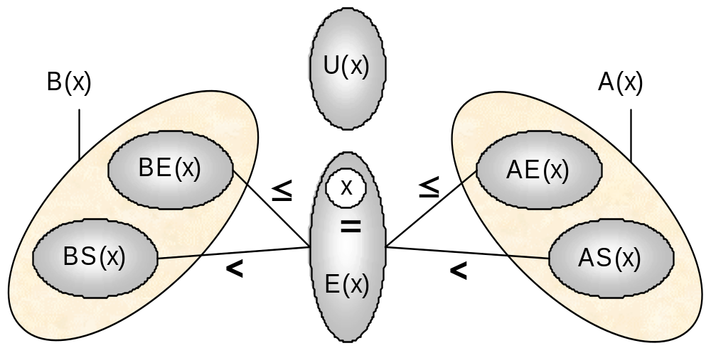
New Propagation Algorithms
Partition for an event x
Traversing a subset Θ(x) has a complexity in ⏐Θ(x)⏐
Notes:
On a unary resource, an easy way to characterize a solution is that all the activities on the resource must be ordered. It allows to define the notion of rank of an activity in a solution.
Using this notion of rank, we can easily distinguish between the search procedures based on activity interactions on unary resources ;
1. Chronological Ranking selects at each search node an activity to be ranked first (before all the other ones) among the ones that are still unranked. In case of failure, the alternative is to enforce that at least one of the unranked activities executes before the selected one. Of course anti-chronological ranking may also be used.
2. Pair Sequencing selects at each search node a pair of activities to be sequenced one just after the other. In case of failure the alternative consists in enforcing that at least one activity is executed between the two selected ones. This family of goal is useful when dealing with transition costs.
3. Pair Ordering selects at each search node a pair of activities to be ordered. In the left branch it enforces one ordering of the activities and, in case of failure, in the other branch it enforce the other ordering. Note that pair ordering is the only search procedure that ensures that the constraints posted on the left and on the right branch are of the same nature (both are precedence relations).
In the next slides, we will propose two new instances of very simple search procedures based on Pair Ordering.

Slide 25
Energy Precedence
Energy Precedence
Discrete resource: ∀ X ∈ Acts,
B
p=4, q=2
Q_{MAX}=2
B
p=4, q=2
9
C
p=4, q=1
X
⇒
C
p=4, q=1
X
E
E
D
D
p=2
q=2
p=2
q=2
p=2
q=1
p=2
q=1
0
0
Notes:
On a unary resource, an easy way to characterize a solution is that all the activities on the resource must be ordered. It allows to define the notion of rank of an activity in a solution.
Using this notion of rank, we can easily distinguish between the search procedures based on activity interactions on unary resources ;
1. Chronological Ranking selects at each search node an activity to be ranked first (before all the other ones) among the ones that are still unranked. In case of failure, the alternative is to enforce that at least one of the unranked activities executes before the selected one. Of course anti-chronological ranking may also be used.
2. Pair Sequencing selects at each search node a pair of activities to be sequenced one just after the other. In case of failure the alternative consists in enforcing that at least one activity is executed between the two selected ones. This family of goal is useful when dealing with transition costs.
3. Pair Ordering selects at each search node a pair of activities to be ordered. In the left branch it enforces one ordering of the activities and, in case of failure, in the other branch it enforce the other ordering. Note that pair ordering is the only search procedure that ensures that the constraints posted on the left and on the right branch are of the same nature (both are precedence relations).
In the next slides, we will propose two new instances of very simple search procedures based on Pair Ordering.

Slide 26
Energy Precedence
C ⇒ E
❑ Time Bounds  Level  Time Bounds
❑ Precedence  Energy  Precedence
❑ Not First/Last



Worst-case complexity: O(n²)
Notes:
Propagation based on resource profiling maintains a time-table that is, basically, two time functions that describe the required and possible aggregated resource demand over time by all the activities in the current partial schedule. This constraint allows to deduce that a given activity cannot overlap a certain time window because there is not enough resource available on that time window.
These propagation techniques are often used in conjunction with some search procedures that try to schedule activities as soon as possible and, in case of failure, postpone the activity. The efficiency as well as the completeness of these search procedures strongly depend on the scheduling problem.
These approaches are often called Cumulative Scheduling approaches as they are mainly used on cumulative resources (discrete resources, reservoir) and consist in cumulating the information about resource usage at each time-point.

Slide 27

Reservoir Balance
Assumption: all producers of the reservoir are known in the current schedule
Idea: Given an event x, using the graph, we can compute an upper bound on the reservoir level at date t(x)-ε assuming:
  All the production events y that may be executed strictly before x are executed strictly before x and produce their maximal quantity q(y);
  All the consumption events y that need to be executed strictly before x are executed strictly before x and consume their minimal quantity q(y);
  All the consumption events that may be executed simultaneously or after x are executed simultaneously or after x
Notes:
On a unary resource, an easy way to characterize a solution is that all the activities on the resource must be ordered. It allows to define the notion of rank of an activity in a solution.
Using this notion of rank, we can easily distinguish between the search procedures based on activity interactions on unary resources ;
1. Chronological Ranking selects at each search node an activity to be ranked first (before all the other ones) among the ones that are still unranked. In case of failure, the alternative is to enforce that at least one of the unranked activities executes before the selected one. Of course anti-chronological ranking may also be used.
2. Pair Sequencing selects at each search node a pair of activities to be sequenced one just after the other. In case of failure the alternative consists in enforcing that at least one activity is executed between the two selected ones. This family of goal is useful when dealing with transition costs.
3. Pair Ordering selects at each search node a pair of activities to be ordered. In the left branch it enforces one ordering of the activities and, in case of failure, in the other branch it enforce the other ordering. Note that pair ordering is the only search procedure that ensures that the constraints posted on the left and on the right branch are of the same nature (both are precedence relations).
In the next slides, we will propose two new instances of very simple search procedures based on Pair Ordering.

Slide 28


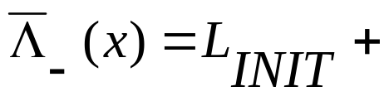
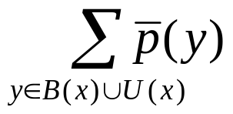
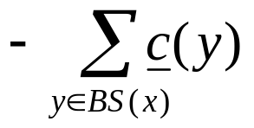
Reservoir Balance
U(x)
BE(x)
AE(x)
≤
≤
<
x
<
☞
BS(x)
E(x)
AS(x)
Notes:
On a unary resource, an easy way to characterize a solution is that all the activities on the resource must be ordered. It allows to define the notion of rank of an activity in a solution.
Using this notion of rank, we can easily distinguish between the search procedures based on activity interactions on unary resources ;
1. Chronological Ranking selects at each search node an activity to be ranked first (before all the other ones) among the ones that are still unranked. In case of failure, the alternative is to enforce that at least one of the unranked activities executes before the selected one. Of course anti-chronological ranking may also be used.
2. Pair Sequencing selects at each search node a pair of activities to be sequenced one just after the other. In case of failure the alternative consists in enforcing that at least one activity is executed between the two selected ones. This family of goal is useful when dealing with transition costs.
3. Pair Ordering selects at each search node a pair of activities to be ordered. In the left branch it enforces one ordering of the activities and, in case of failure, in the other branch it enforce the other ordering. Note that pair ordering is the only search procedure that ensures that the constraints posted on the left and on the right branch are of the same nature (both are precedence relations).
In the next slides, we will propose two new instances of very simple search procedures based on Pair Ordering.

Slide 29
Reservoir Balance
Similar bounds can be computed:
  Upper bound on the reservoir level at date t(x)+ε
  Lower bound on the reservoir level at date t(x)-ε
  Lower bound on the reservoir level at date t(x)+ε
For symmetry reason, we focus on

Given , the reservoir balance algorithm discovers:
  Failures
  New bounds for required quantities of resources q(x)
  New bounds for time variables t(x)
  New precedence relations


Notes:
On a unary resource, an easy way to characterize a solution is that all the activities on the resource must be ordered. It allows to define the notion of rank of an activity in a solution.
Using this notion of rank, we can easily distinguish between the search procedures based on activity interactions on unary resources ;
1. Chronological Ranking selects at each search node an activity to be ranked first (before all the other ones) among the ones that are still unranked. In case of failure, the alternative is to enforce that at least one of the unranked activities executes before the selected one. Of course anti-chronological ranking may also be used.
2. Pair Sequencing selects at each search node a pair of activities to be sequenced one just after the other. In case of failure the alternative consists in enforcing that at least one activity is executed between the two selected ones. This family of goal is useful when dealing with transition costs.
3. Pair Ordering selects at each search node a pair of activities to be ordered. In the left branch it enforces one ordering of the activities and, in case of failure, in the other branch it enforce the other ordering. Note that pair ordering is the only search procedure that ensures that the constraints posted on the left and on the right branch are of the same nature (both are precedence relations).
In the next slides, we will propose two new instances of very simple search procedures based on Pair Ordering.

Slide 30



Reservoir Balance
Discovering failures:
As soon as: , no solution exist that satisfy the precedence relations
Property: the rule is sufficient to ensure the soundness of the search on a reservoir w.r.t. the reservoir underflow.
A symmetrical property exists for reservoir overflow based on .
Notes:
On a unary resource, an easy way to characterize a solution is that all the activities on the resource must be ordered. It allows to define the notion of rank of an activity in a solution.
Using this notion of rank, we can easily distinguish between the search procedures based on activity interactions on unary resources ;
1. Chronological Ranking selects at each search node an activity to be ranked first (before all the other ones) among the ones that are still unranked. In case of failure, the alternative is to enforce that at least one of the unranked activities executes before the selected one. Of course anti-chronological ranking may also be used.
2. Pair Sequencing selects at each search node a pair of activities to be sequenced one just after the other. In case of failure the alternative consists in enforcing that at least one activity is executed between the two selected ones. This family of goal is useful when dealing with transition costs.
3. Pair Ordering selects at each search node a pair of activities to be ordered. In the left branch it enforces one ordering of the activities and, in case of failure, in the other branch it enforce the other ordering. Note that pair ordering is the only search procedure that ensures that the constraints posted on the left and on the right branch are of the same nature (both are precedence relations).
In the next slides, we will propose two new instances of very simple search procedures based on Pair Ordering.

Slide 31
Reservoir Balance
L_{INIT}=0
U(x)
[+1,+2]
[-2,-1]
[-1,-1]
[+1,+1]
E(x)
[+0,+10]
[-5,-5]
[+1,+3]
[-5,-5]
[-5,-4]
BS(x)
BE(x)
[+1,+1]
Λ₋(x)= 0 + (2+1+10+1) - (1+5+5+4) = -1 < 0 !!!
Notes:
On a unary resource, an easy way to characterize a solution is that all the activities on the resource must be ordered. It allows to define the notion of rank of an activity in a solution.
Using this notion of rank, we can easily distinguish between the search procedures based on activity interactions on unary resources ;
1. Chronological Ranking selects at each search node an activity to be ranked first (before all the other ones) among the ones that are still unranked. In case of failure, the alternative is to enforce that at least one of the unranked activities executes before the selected one. Of course anti-chronological ranking may also be used.
2. Pair Sequencing selects at each search node a pair of activities to be sequenced one just after the other. In case of failure the alternative consists in enforcing that at least one activity is executed between the two selected ones. This family of goal is useful when dealing with transition costs.
3. Pair Ordering selects at each search node a pair of activities to be ordered. In the left branch it enforces one ordering of the activities and, in case of failure, in the other branch it enforce the other ordering. Note that pair ordering is the only search procedure that ensures that the constraints posted on the left and on the right branch are of the same nature (both are precedence relations).
In the next slides, we will propose two new instances of very simple search procedures based on Pair Ordering.

Slide 32
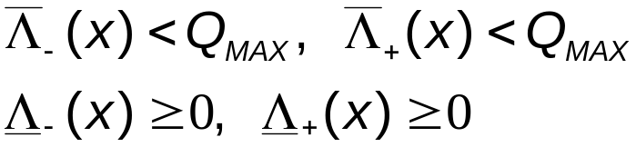
Reservoir Balance
Safe event:
An event x is said to be safe if and only if
Property: If all the events are safe, then any instantiation of the time variable that satisfies the precedence constraints also satisfies the reservoir constraint. In other words, the current partial order is safe and the reservoir is “solved”.
Notes:
On a unary resource, an easy way to characterize a solution is that all the activities on the resource must be ordered. It allows to define the notion of rank of an activity in a solution.
Using this notion of rank, we can easily distinguish between the search procedures based on activity interactions on unary resources ;
1. Chronological Ranking selects at each search node an activity to be ranked first (before all the other ones) among the ones that are still unranked. In case of failure, the alternative is to enforce that at least one of the unranked activities executes before the selected one. Of course anti-chronological ranking may also be used.
2. Pair Sequencing selects at each search node a pair of activities to be sequenced one just after the other. In case of failure the alternative consists in enforcing that at least one activity is executed between the two selected ones. This family of goal is useful when dealing with transition costs.
3. Pair Ordering selects at each search node a pair of activities to be ordered. In the left branch it enforces one ordering of the activities and, in case of failure, in the other branch it enforce the other ordering. Note that pair ordering is the only search procedure that ensures that the constraints posted on the left and on the right branch are of the same nature (both are precedence relations).
In the next slides, we will propose two new instances of very simple search procedures based on Pair Ordering.

Slide 33
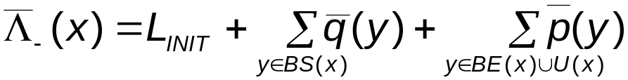
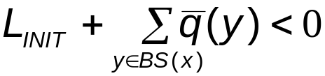

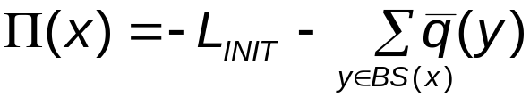
Reservoir Balance
Reservoir balance equation:
In case the first part of the equation is such that:
It means that some events in will have to be executed strictly before x in order to produce at least:
Notes:
On a unary resource, an easy way to characterize a solution is that all the activities on the resource must be ordered. It allows to define the notion of rank of an activity in a solution.
Using this notion of rank, we can easily distinguish between the search procedures based on activity interactions on unary resources ;
1. Chronological Ranking selects at each search node an activity to be ranked first (before all the other ones) among the ones that are still unranked. In case of failure, the alternative is to enforce that at least one of the unranked activities executes before the selected one. Of course anti-chronological ranking may also be used.
2. Pair Sequencing selects at each search node a pair of activities to be sequenced one just after the other. In case of failure the alternative consists in enforcing that at least one activity is executed between the two selected ones. This family of goal is useful when dealing with transition costs.
3. Pair Ordering selects at each search node a pair of activities to be ordered. In the left branch it enforces one ordering of the activities and, in case of failure, in the other branch it enforce the other ordering. Note that pair ordering is the only search procedure that ensures that the constraints posted on the left and on the right branch are of the same nature (both are precedence relations).
In the next slides, we will propose two new instances of very simple search procedures based on Pair Ordering.

Slide 34



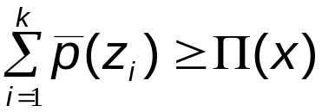

Reservoir Balance
Some events will have to be executed strictly before x in order to produce at least
Let the set of production events in
sorted by increasing minimal time
Let k be the smallest index such that:
Then:
Notes:
On a unary resource, an easy way to characterize a solution is that all the activities on the resource must be ordered. It allows to define the notion of rank of an activity in a solution.
Using this notion of rank, we can easily distinguish between the search procedures based on activity interactions on unary resources ;
1. Chronological Ranking selects at each search node an activity to be ranked first (before all the other ones) among the ones that are still unranked. In case of failure, the alternative is to enforce that at least one of the unranked activities executes before the selected one. Of course anti-chronological ranking may also be used.
2. Pair Sequencing selects at each search node a pair of activities to be sequenced one just after the other. In case of failure the alternative consists in enforcing that at least one activity is executed between the two selected ones. This family of goal is useful when dealing with transition costs.
3. Pair Ordering selects at each search node a pair of activities to be ordered. In the left branch it enforces one ordering of the activities and, in case of failure, in the other branch it enforce the other ordering. Note that pair ordering is the only search procedure that ensures that the constraints posted on the left and on the right branch are of the same nature (both are precedence relations).
In the next slides, we will propose two new instances of very simple search procedures based on Pair Ordering.

Slide 35
Reservoir Balance
L_{INIT}=0
U(x)
[+1,+2]
[-2,-1]
[-2,-2]
[+2,+2]
[+1,+2]
E(x)
[+0,+10]
[-5,-5]
[+1,+3]
[-5,-5]
[-5,-4]
BS(x)
BE(x)
[+1,+2]
Π(x)= 0 - (2+10) + (2+5+5+4) = 4
Notes:
On a unary resource, an easy way to characterize a solution is that all the activities on the resource must be ordered. It allows to define the notion of rank of an activity in a solution.
Using this notion of rank, we can easily distinguish between the search procedures based on activity interactions on unary resources ;
1. Chronological Ranking selects at each search node an activity to be ranked first (before all the other ones) among the ones that are still unranked. In case of failure, the alternative is to enforce that at least one of the unranked activities executes before the selected one. Of course anti-chronological ranking may also be used.
2. Pair Sequencing selects at each search node a pair of activities to be sequenced one just after the other. In case of failure the alternative consists in enforcing that at least one activity is executed between the two selected ones. This family of goal is useful when dealing with transition costs.
3. Pair Ordering selects at each search node a pair of activities to be ordered. In the left branch it enforces one ordering of the activities and, in case of failure, in the other branch it enforce the other ordering. Note that pair ordering is the only search procedure that ensures that the constraints posted on the left and on the right branch are of the same nature (both are precedence relations).
In the next slides, we will propose two new instances of very simple search procedures based on Pair Ordering.

Slide 36
Reservoir Balance
Property: On a unary resource, the balance propagation propagates the same as the disjunctive constraint
A
A
+1
-1
L=1
L_{INIT}=1
≡
B
-1
B
+1
Notes:
On a unary resource, an easy way to characterize a solution is that all the activities on the resource must be ordered. It allows to define the notion of rank of an activity in a solution.
Using this notion of rank, we can easily distinguish between the search procedures based on activity interactions on unary resources ;
1. Chronological Ranking selects at each search node an activity to be ranked first (before all the other ones) among the ones that are still unranked. In case of failure, the alternative is to enforce that at least one of the unranked activities executes before the selected one. Of course anti-chronological ranking may also be used.
2. Pair Sequencing selects at each search node a pair of activities to be sequenced one just after the other. In case of failure the alternative consists in enforcing that at least one activity is executed between the two selected ones. This family of goal is useful when dealing with transition costs.
3. Pair Ordering selects at each search node a pair of activities to be ordered. In the left branch it enforces one ordering of the activities and, in case of failure, in the other branch it enforce the other ordering. Note that pair ordering is the only search procedure that ensures that the constraints posted on the left and on the right branch are of the same nature (both are precedence relations).
In the next slides, we will propose two new instances of very simple search procedures based on Pair Ordering.

Slide 37
Reservoir Balance
In AI Planning applications, if some producers of the reservoir may still be inserted in the partial plan: transform the balance algorithm into a real truth criterion:
  Some events will have to be executed strictly before x in order to produce at least
OR
  Some operator containing a producing event z will have to be inserted such that t(z) < t(x)
Such a “truth criterion” has not been studied yet
Notes:
On a unary resource, an easy way to characterize a solution is that all the activities on the resource must be ordered. It allows to define the notion of rank of an activity in a solution.
Using this notion of rank, we can easily distinguish between the search procedures based on activity interactions on unary resources ;
1. Chronological Ranking selects at each search node an activity to be ranked first (before all the other ones) among the ones that are still unranked. In case of failure, the alternative is to enforce that at least one of the unranked activities executes before the selected one. Of course anti-chronological ranking may also be used.
2. Pair Sequencing selects at each search node a pair of activities to be sequenced one just after the other. In case of failure the alternative consists in enforcing that at least one activity is executed between the two selected ones. This family of goal is useful when dealing with transition costs.
3. Pair Ordering selects at each search node a pair of activities to be ordered. In the left branch it enforces one ordering of the activities and, in case of failure, in the other branch it enforce the other ordering. Note that pair ordering is the only search procedure that ensures that the constraints posted on the left and on the right branch are of the same nature (both are precedence relations).
In the next slides, we will propose two new instances of very simple search procedures based on Pair Ordering.

Slide 38
Reservoir Balance
C ⇒ E
❑ Time Bounds  Level  Time Bounds
❑ Precedence  Energy  Precedence
❑ Not First/Last





Worst-case complexity: O(n²), O(n³)
Notes:
Propagation based on resource profiling maintains a time-table that is, basically, two time functions that describe the required and possible aggregated resource demand over time by all the activities in the current partial schedule. This constraint allows to deduce that a given activity cannot overlap a certain time window because there is not enough resource available on that time window.
These propagation techniques are often used in conjunction with some search procedures that try to schedule activities as soon as possible and, in case of failure, postpone the activity. The efficiency as well as the completeness of these search procedures strongly depend on the scheduling problem.
These approaches are often called Cumulative Scheduling approaches as they are mainly used on cumulative resources (discrete resources, reservoir) and consist in cumulating the information about resource usage at each time-point.

Slide 39
Full Picture
Level-Based
Time-
tabling
Balance
Reservoir
O(n²)
O(n³)
Energy-Based
Edge-
Finding
Energe-
tic
Reason.
Preced.
Energy
Discrete
Disjunc-
tive
Unary
O(n)
O(n²)
O(n²)
O(n²)
O(n²)
Time-Bounds analysis
Precedence analysis
Notes:
The disjunctive constraint on a unary resource states that whenever it is not possible to process activity b before activity a on the resource than, activity a must be processed before activity b.
The disjunctive constraint has a worst case complexity in O(n²).
Note that this is an extended version of the disjunctive constraint. Traditionally the disjunctive constraint is expressed on time bounds of activity variables:
lst(a) < ect(b) ⇒ a ⟨⟨ b
The formulation with precedence between activities on the left side is stronger as it allows to deduce some precedence in some cases where the time bounds would not allow it. This is basically the case when the precedence relation start(a) < end(b) has been deduced by other ways (belong to the problem formulation, added in the search procedure, discovered by some other constraint, etc) than just the fact lst(a) < ect(b).

Slide 40
Experimental Results
Tested on 12 open project scheduling problems
  n activities (n=50 or 100), unit duration, min/max delay between activities
  5 reservoirs, each activity produces/consumes on several reservoirs (1-5)
  Minimize makespan
Search strategy:
  Select a pair of unsafe schedule events (x,y) based on the bounds Λ(x) computed by the balance constraint
  Branch on the precedence relations: t(x)<t(y) or t(x)≥t(y)
  Stop the search when all events are safe
Notes:
The purpose of these search procedures is to find and enforce a partial order between activity time-points (start, end) such that any instantiated schedule that satisfy this partial order will also satisfy the resource constraints.
Once a partial order has been generated, it is in general the case that finding an (optimal) instantiated schedule is easy. For example, if there are only resource and temporal constraints in the initial problem, finding an instantiated schedule is polynomial and if the optimization criterion is linear w.r.t. the start and end dates of activities, the optimal solution associated with a given partial order can easily be computed using LP.
These family of search procedures has been heavily studied for unary resources but less in the more general case of discrete resources and reservoirs (for algorithmic complexity reasons).
The advantages are clear:
The schedules that are produced (partial orders) are more robust (e.g. if an activity lasts longer than its expected processing time, the solution may still be valid).
The approach is a least commitment approach: in the partial order, there is still room to perform optimization and this can be done easily as the generated partial order is linear. These approaches may be seen as a way to produce a set of linearizations of the scheduling problem.

Slide 41
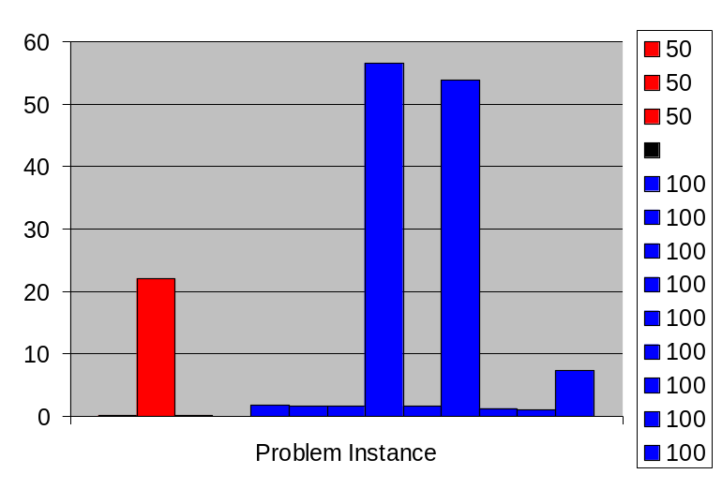
Experimental results
All the 12 open problems were solved to optimality in less than 1mn CPU time
Produce partially ordered solution schedules that are more flexible than completely instantiated ones
Each partial order is linear : if the optimization criterion is linear or piece-wise linear, the optimum corresponding to a partial order can (easily) be computed using LP.
Notes:
All the propagation algorithms [except for MCS based ones on which we are still working on] described in this presentation are available in the commercial release of ILOG Scheduler. Both search procedures whose performances are reported here were implemented using documented features of ILOG Scheduler only.

Slide 42
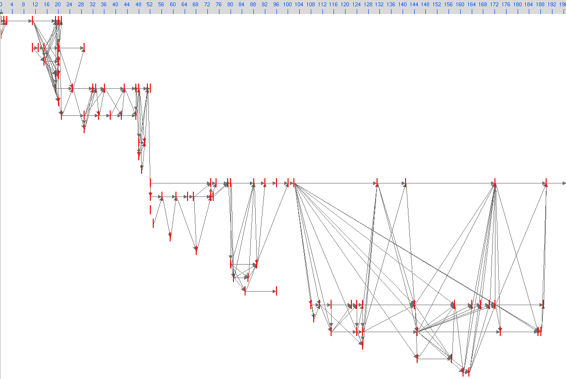
Experimental results
An optimal solution for psp12
Notes:
All the propagation algorithms [except for MCS based ones on which we are still working on] described in this presentation are available in the commercial release of ILOG Scheduler. Both search procedures whose performances are reported here were implemented using documented features of ILOG Scheduler only.

Slide 43
Conclusion
A large panel of algorithms is available to propagate resource constraints in constrained-based scheduling
We present 2 new algorithms that propagate the conjunction of precedence and resource constraints
  Energy Precedence
  Reservoir Balance
The reservoir balance can be considered as an extension of the disjunctive constraint on reservoirs. In particular, it should allow to generalize most of the techniques available for disjunctive scheduling (e.g Job-Shop) to reservoirs:
  Propagation, Shaving
  Search strategies based on activities ordering, Heuristics
  Local search based on precedence, etc.
Notes:
All the propagation algorithms [except for MCS based ones on which we are still working on] described in this presentation are available in the commercial release of ILOG Scheduler. Both search procedures whose performances are reported here were implemented using documented features of ILOG Scheduler only.

Slide 44
Conclusion
All the algorithms (classical as well as new ones) are available in the current version of ILOG Scheduler, a C++ library for Constraint-Based scheduling.
Future work:
  Scheduling: Investigate the systematical generalization of disjunctive scheduling techniques to reservoirs
  AI Planning: Experiment the integration into a PO or HTN planner
Notes:
All the propagation algorithms [except for MCS based ones on which we are still working on] described in this presentation are available in the commercial release of ILOG Scheduler. Both search procedures whose performances are reported here were implemented using documented features of ILOG Scheduler only.

