Slide 1
Self-Adapting Large Neighborhood Search for Scheduling
Extracted from MISTA 2007 presentation
P. Laborie and D. Godard
[plaborie,dgodard]@ilog.fr

Slide 2
Objective
A robust search method for solving real-world industrial scheduling problems

Slide 3
Search: Self-adapting LNS for scheduling
Relaxation methods
portfolio
Re-optimization methods
portfolio
CS₁ [q₁]
LN₁ [p₁]
CS₁ [q₁]
R₁ [p₁]
O₁ [q₁]
First
solution

Slide 4
Search: Self-adapting LNS for scheduling
Relaxation methods
portfolio
Re-optimization methods
portfolio
CS₁ [q₁]
LN₁ [p₁]
CS₁ [q₁]
R₁ [p₁]
O₁ [q₁]
Selection
First
solution
R_{i} [P_{i}]
O_{j} [Q_{j}]
Relaxation
Re-optimization

Slide 5
Search: Self-adapting LNS for scheduling
Relaxation methods
portfolio
Re-optimization methods
portfolio
CS₁ [q₁]
LN₁ [p₁]
CS₁ [q₁]
R₁ [p₁]
O₁ [q₁]
Reward r
Reinforcement
First
solution
Solution
R_{i} [P_{i}]
R_{i} [P_{i}]
O_{j} [Q_{j}]
O_{j} [Q_{j}]
Relaxation
Re-optimization

Slide 6
Search: Self-adapting LNS for scheduling
Relaxation methods
portfolio
Re-optimization methods
portfolio
LN₁ [p₁]
CS₁ [q₁]
CS₁ [q₁]
R₁ [p₁]
O₁ [q₁]
First
solution
Solution
Relaxation
Re-optimization

Slide 7
Search: Self-adapting LNS for scheduling
Relaxation methods
portfolio
Re-optimization methods
portfolio
LN₁ [p₁]
CS₁ [q₁]
CS₁ [q₁]
R₁ [p₁]
O₁ [q₁]
Selection
Solution
R_{i} [P_{i}]
O_{j} [Q_{j}]
Relaxation
Re-optimization

Slide 8

Search: Relaxation methods portfolio
Partial Order Schedule (POS) definition
  A temporal network that is sufficient to ensure that all its solutions satisfy the temporal and resource constraints of the problem
All relaxation methods in the portfolio start by computing a POS from the solution and then, relax a subset of activities F (fragment) on this temporal network
R_{i} = Relax_{F}i o POS
POS

Slide 9
Search: Relaxation methods portfolio
POS computation on resources
  Unary resource: easy, O(n logn)
  Discrete resource: O(n log(Cn))
t
A
C
B
A
C
B
c
C
E
C
E
F
R
F
D
D
H
H
B
t
B
A
G
A
G

Slide 10
Search: Relaxation methods portfolio
POS computation on resources (cont’d)
  Reservoir: O(n log(Cn))
c
F
F
R
A
B
G
A
B
D
G
t
D
E
E

Slide 11
Search: Relaxation methods portfolio
POS computation on resources (cont’d)
  State resource: O(n²)
R
C
D
B
G
F
C
D
F
t
B
A
E
H
I
G
I
H
A
E

Slide 12
Search: Relaxation methods portfolio
Global POS
  POS = ∪_{R} POS_{R}
  Redundant edges are removed

Slide 13
Search: Relaxation methods portfolio
Partial Order Schedule (POS) definition
  A temporal network that is sufficient to ensure that all its solutions satisfy the temporal and resource constraints of the problem
All relaxation methods in the portfolio start by computing a POS from the solution and then, relax a subset of activities F (fragment) on this temporal network
R_{i} = Relax_{F}i o POS
Relax

Slide 14
Search: Relaxation methods portfolio
Relaxation of a fragment F^{i} of the POS
POS
E
D
H
C
E
Relax_{F}i
C
F
D
F
H
B
B
A
G
A
G
Fragment F^{i}

Slide 15
Search: Relaxation methods portfolio
Portfolio:
  R¹_{α}: Randomized relaxation
  R²_{α,β}: Time-window relaxation
  R³_{α,β}: Topological relaxation
Time-

Slide 16
Search: Relaxation methods portfolio
R²_{α,β}: Time-window relaxation
  Activities are sorted by increasing start time in the solution
  The fragment consists of all the activities with index in [β.n, (β+α).n] in the above array
  α and β are self-adapting parameters of the relaxation method

Slide 17
Search: Relaxation methods portfolio
R²_{α,β}: Time-window relaxation
  Activities are sorted by increasing start time in the solution
  The fragment consists of all the activities with index in [β.n, (β+α).n] in the above array
  α and β are self-adapting parameters of the relaxation method
α=0.25, β=0.5

Slide 18
Search: Relaxation methods portfolio
R²_{α,β}: Time-window relaxation
  Activities are sorted by increasing start time in the solution
  The fragment consists of all the activities with index in [β.n, (β+α).n] in the above array
  α and β are self-adapting parameters of the relaxation method
α=0.25, β=0.5

Slide 19
Search: Re-optimization methods portfolio
Main optimization method used: ScheduleJustInTime_{α}
  Explores a search tree with a limited number of failures α.n
  α is a self-adapting parameter of the optimization method
  At the root node, indicative start and end times for activities are computed using an LP relaxation of the problem

Slide 20
Search: Re-optimization methods portfolio
Temporal relaxation:
  Only consider temporal constraints (including the ones of the relaxed POS) and (convexified) cost function

Slide 21
Search: Re-optimization methods portfolio
Temporal relaxation:
  Only consider temporal constraints (including the ones of the relaxed POS) and (convexified) cost function
E
D
H
C
F
B
A
G

Slide 22
Search: Re-optimization methods portfolio
Temporal relaxation:
  Only consider temporal constraints (including the ones of the relaxed POS) and (convexified) cost function
E
D
H
C
F
B
A
G

Slide 23
Search: Re-optimization methods portfolio
Tree search
  Search considers activities by increasing indicative start times and tries to schedule them as close as possible to their indicative dates
  In case of backtrack, the activity is marked unselectable until constraint propagation removes from the domain of the activity the dates tried on the left branch

Slide 24
Experimental results: benchmarks
Common due-date
Flowshop
Single-machine E/T
Unary
Jobshop
Flowshop E/T
Jobshop E/T
Openshop
Single proc. tardiness
Unary
w/ setup
Shop setup times
Semicond. testing
Airland
Hybrid flowshop
RCPSP E/T
Discrete
Flowshop w/ buffers
ATFM
Quality RCPSP
Aircraft assembly
Cumul. jobshop
RCPSP
Parallel-machine E/T
State
Jobshop w/ robot
Makespan
E/T
Duration

Slide 25
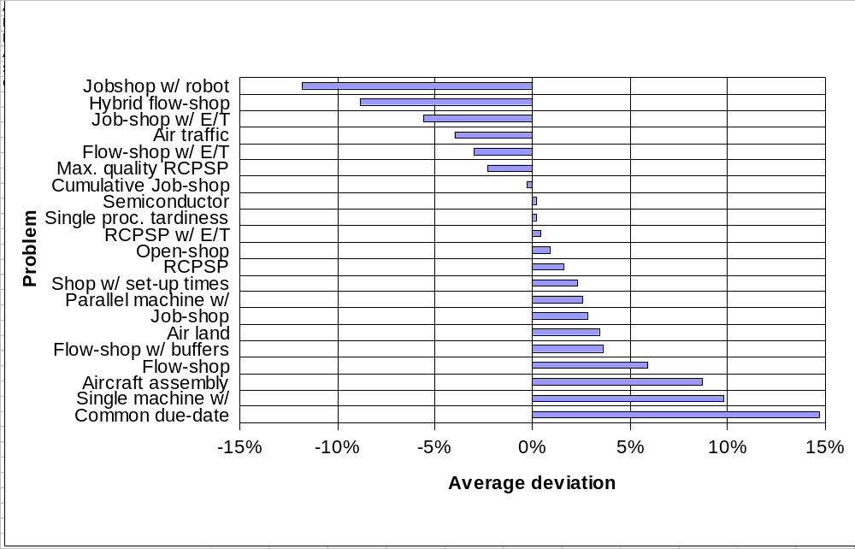
Experimental results: overview
Self-Adapting LNS: results over 21 benchmarks

Slide 26
Conclusion
Ingredients to the robustness of the approach:
  LNS: efficient traversal of the search space
  POS: generality, injects flexibility for re-optimization
  Relaxation methods:
    Randomization allows diversity
    Some methods can exploit problem structure
  Re-optimization methods:
    Global vision provided by temporal relaxation
    (Limited) Tree search allows exploiting CP
  Learning

