Slide 1
Self-Adapting Large Neighborhood Search
Application to single-mode
scheduling problems
5 juin 2007
P. Laborie and D. Godard
[plaborie,dgodard]@ilog.fr
Notes:
ILOG CP: new ILOG product that contains Solver+Scheduler+Dispatcher
ILOG CP for scheduling == ILOG Scheduler

Slide 2
Overview
Objective
Model
Search: self-adapting LNS for scheduling
  Principles
  Relaxation methods portfolio
  Re-optimization methods portfolio
Experimental results
Current and future work

Slide 3
Objective
A robust search method for solving real-world industrial scheduling problems
Current focus on:
  Non-preemptive scheduling
  Deterministic scheduling
  Single-mode scheduling (no resource allocation)
  Optimization problems for which computing a feasible schedule (even of poor quality) is not too difficult
  Temporal cost functions

Slide 4
Model
Activities
Calendar constraints
Temporal constraints
Resources
Sequence-dependent setup times
Temporal cost function

Slide 5
Model : Activities
Non-preemptive activities with variable duration
Activity A
t
Start time: s(A)
End time: e(A)
Duration: d(A) == e(A)-s(A)
1 activity ≡ 3 integer decision variables

Slide 6

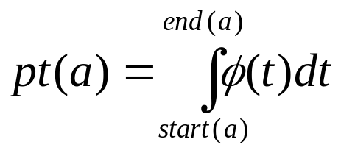
Model : Calendar constraints
Constraint restricting the start/end dates of activities depending on its position in time
  Breaks/Efficiency:
  Forbidden start/end periods:
  Forbidden overlap periods:

Slide 7
Model : Temporal constraints
Any constraint of one of the forms:
t₁ + d ≤ t₂ or t₁ + d = t₂
where t₁ and t₂ are the start or end time-point of two activities and d an integer variable (or constant)
Expressivity: precedence, min/max delays, etc.

Slide 8
Model : Resources
Resource typology:
  Unary resource: Resource of capacity 1. Two activities requiring the same unary resource cannot overlap.
  Discrete resource: Resource of capacity Q_{max}. The cumulated resource usage by activities demanding the resource must be kept in the range [Q_{min}, Q_{max}]. Q_{min}, Q_{max} can be some known function of time.
Q_{max}(t)
Q_{min}(t)
t
Notes:
ILOG CP for scheduling provides a rich typology of resources.

Slide 9
Model : Resources
Resource typology (cont’d):
  Reservoir: Resource of capacity Q_{max} and initial level L. Activities may consume or produce the reservoir. The level of the reservoir over time must be kept in the range [Q_{min}, Q_{max}], 0≤Q_{min}
  State Resource. Resource with a finite set of possible states. Activities require the resource be in a particular (set of) state s. Activities requiring incompatible state may not overlap.
Notes:
ILOG CP for scheduling provides a rich typology of resources.

Slide 10
Model : Sequence-dependent setup times
On unary resources
setup(a_{i},a_{j}) specified by a setup time matrix or a user-defined function

Slide 11
Model : Temporal cost function
Cost function expressed as sum/max aggregation of semi-convex piecewise linear (SCPL) functions on activity start/end/durations
SCPL function:
∀z, {x / f(x)≤z} is a convex interval
cost
cost
cost
cost
cost
z
x
x
x
x
x

Slide 12
Model : Temporal cost function
Why using SCPL functions for cost ?
  They are very expressive (see next slides)
  f(x)≤z can be propagated with arc-consistency without creating holes in the variables domains
  They can be convexified without loosing too much information

Slide 13
Model : Temporal cost function
Some particular SCPL functions:
  I: I(t)=t
  H: H(t)=0 if t<0, H(t)=1 otherwise
  V_{α,β}, 0≤α,β: V(t)=-α.t if t<0, V(t)=β.t otherwise
  -I, -H
  If f and g are SCPL, the following functions are SCPL:
  γ+f, γ.f if 0≤γ, shift(f,γ), max(f,g)
  Note that f+g is not SCPL in general

Slide 14
Model : Temporal cost function
Max/Sum of SCPL covers classical temporal costs:
  Minimize makespan:
  max_{i} { I o end(a_{i}) }
  Minimize earliness/tardiness cost:
  sum/max_{i} { shift(V_{αi,βi},γ_{i}) o end(a_{i}) }
  Minimize weighted number of late jobs:
  sum_{i} { shift(ω_{i}.H,γ_{i}) o end(a_{i}) }
  Minimize weighted sums of activity durations (WIP):
  sum_{i} { ω_{i}.I o duration(a_{i}) }
  Maximize weighted sums of activity durations (quality):
  sum_{i} { ω_{i}.-I o duration(a_{i}) }

Slide 15
Search: Self-adapting LNS for scheduling
Principles
  LNS: Iterative improvement method based on sequentially:
    Relaxing a fragment of the current solution
    Re-optimizing the relaxed fragment
  Self-adapting:
    Portfolio of methods for relaxing fragments
    Portfolio of methods for re-optimizing a relaxed fragment
    On-line learning techniques to converge on the most efficient methods on the instance being solved

Slide 16
Search: Self-adapting LNS for scheduling
Notations:
  s: fully instantiated feasible solution (schedule)
  p: scheduling problem
  R^{i}_{αi}: i^{th} relaxation method parameterized by a parameter vector α_{i}=(α_{i,1},…,α_{i,ni})
  p= R^{i}_{αi}(s)
  O^{j}_{βj}: j^{th} re-optimization method parameterized by a parameter vector β_{j}= (β_{j,1},…,β_{j,mj})
  s= O^{j}_{βj}(p)

Slide 17

Search: Self-adapting LNS for scheduling
One iteration of LNS:
  Input:
    Current best solution: s
    Current probability distributions for methods and parameters: Π
  Select methods according to Π:
    One relaxation method with a set of parameters: R^{i}_{αi}
    One re-optimization method with a set of parameters: O^{j}_{βj}
  Apply selected methods:
    s’= [O^{j}_{βj}o R^{i}_{αi}] (s)
    Δc = max(0, cost(s)-cost(s’))
    Δt = computation time
  Reward selected methods and parameters (i,α_{i},j,β_{j}):
    Π=update(Π,reward, i,α_{i},j,β_{j}) where reward = Δc/Δt
  Update current best solution
    If Δc>0: s=s’
upd

Slide 18
Search: Self-adapting LNS for scheduling
Learning
  Π = update(Π, reward, x)
  Use classical machine learning scheme to update the weight of a parameter value x:
  Π(x) ← (1−α).Π(x) + α.reward
  α is the learning rate (α=0.1 in our experimental settings)

Slide 19
Search: Self-adapting LNS for scheduling
One iteration of LNS:
  Input:
    Current best solution: s
    Current probability distributions for methods and parameters: Π
  Select methods according to Π:
    One relaxation method with a set of parameters: R^{i}_{αi}
    One re-optimization method with a set of parameters: O^{j}_{βj}
  Apply selected methods:
    s’= [O^{j}_{βj}o R^{i}_{αi}] (s)
    Δc = max(0, cost(s)-cost(s’))
    Δt = computation time
  Reward selected methods and parameters (i,α_{i},j,β_{j}):
    Π=update(Π,reward, i,α_{i},j,β_{j}) where reward = Δc/Δt
  Update current best solution
    If Δc>0: s=s’
R^{i}_{αi}

Slide 20
Search: Relaxation methods portfolio
Partial Order Schedule (POS) definition
  A temporal network that is sufficient to ensure that all its solutions satisfy the temporal and resource constraints of the problem
All relaxation methods in the portfolio start by computing a POS from the solution and then, relax a subset of activities F (fragment) on this temporal network
R^{i} = Relax_{F}i o POS
POS

Slide 21
Search: Relaxation methods portfolio
POS computation on resources
  Unary resource: easy, O(n logn)
  Discrete resource: [Godard&al 2005], O(n log(Cn))
t
A
C
B
A
C
B
c
C
E
C
E
F
R
F
D
D
H
H
B
t
B
A
G
A
G

Slide 22
Search: Relaxation methods portfolio
POS computation on resources (cont’d)
  Reservoir: O(n log(Cn))
    Step 1: constraints to prevent reservoir underflow
c
POS_{MIN}
F
F
A
1
B
G
R
A
B
G
2
1
t
1
D
∞
D
1
E
E

Slide 23
Search: Relaxation methods portfolio
POS computation on resources (cont’d)
  Reservoir: O(n log(Cn))
    Step 2: constraints to prevent reservoir overflow
c
F
A
1
B
G
B→ G
R
A→ D
2
1
A→ E
B→ ∞
1
A→ F
t
D
∞
1
E

Slide 24
Search: Relaxation methods portfolio
POS computation on resources (cont’d)
  Reservoir: O(n log(Cn))
    Step 2: constraints to prevent reservoir overflow
POS_{MAX}
c
B→ G
B→ G
A→ D
R
A→ D
A→ E
B→ ∞
A→ E
B→ ∞
A→ F
t
A→ F
Uses algorithm for POS computation on discrete resources

Slide 25
Search: Relaxation methods portfolio
POS computation on resources (cont’d)
  Reservoir: O(n log(Cn))
    Final POS = POS_{MIN} ∪ POS_{MAX}
c
F
F
R
A
B
G
A
B
D
G
t
D
E
E

Slide 26
Search: Relaxation methods portfolio
POS computation on resources (cont’d)
  State resource: O(n²)
R
C
D
B
G
F
C
D
F
t
B
A
E
H
I
G
I
H
A
E

Slide 27
Search: Relaxation methods portfolio
Global POS
  POS = ∪_{R} POS_{R}
  Redundant edges are removed

Slide 28
Search: Relaxation methods portfolio
Partial Order Schedule (POS) definition
  A temporal network that is sufficient to ensure that all its solutions satisfy the temporal and resource constraints of the problem
All relaxation methods in the portfolio start by computing a POS from the solution and then, relax a subset of activities F (fragment) on this temporal network
R^{i} = Relax_{F}i o POS
Relax

Slide 29
Search: Relaxation methods portfolio
Relaxation of a fragment F^{i} of the POS
POS
E
D
H
C
E
Relax_{F}i
C
F
D
F
H
B
B
A
G
A
G
Fragment F^{i}

Slide 30
Search: Relaxation methods portfolio
Portfolio:
  R¹_{α}: Randomized relaxation
  R²_{α,β}: Time-window relaxation
  R³_{α,β}: Topological relaxation

Slide 31
Search: Relaxation methods portfolio
R¹_{α}: Randomized relaxation
  An activity belongs to the relaxed fragment with probability α∈(0,1]
  α is a self-adapting parameter of the relaxation method

Slide 32
Search: Relaxation methods portfolio
R²_{α,β}: Time-window relaxation
  Activities are sorted by increasing start time in the solution
  The fragment consists of all the activities with index in [β.n, (β+α).n] in the above array
  α and β are self-adapting parameters of the relaxation method

Slide 33
Search: Relaxation methods portfolio
R²_{α,β}: Time-window relaxation
  Activities are sorted by increasing start time in the solution
  The fragment consists of all the activities with index in [β.n, (β+α).n] in the above array
  α and β are self-adapting parameters of the relaxation method
α=0.25, β=0.5

Slide 34
Search: Relaxation methods portfolio
R²_{α,β}: Time-window relaxation
  Activities are sorted by increasing start time in the solution
  The fragment consists of all the activities with index in [β.n, (β+α).n] in the above array
  α and β are self-adapting parameters of the relaxation method
α=0.25, β=0.5

Slide 35
Search: Relaxation methods portfolio
R³_{α,β}: Topological relaxation
  Similar principle as for previous relaxation but activities are ordered using a lexicographical comparison:
    Criterion 1: index of strongly connected component of the activity in the initial temporal network
    Criterion 2: index of connected component of the activity in the initial temporal network
    Criterion 3: start time of the activity in the solution
  α and β are self-adapting parameters of the relaxation method

Slide 36
Search: Self-adapting LNS for scheduling
One iteration of LNS:
  Input:
    Current best solution: s
    Current probability distributions for methods and parameters: Π
  Select methods according to Π:
    One relaxation method with a set of parameters: R^{i}_{αi}
    One re-optimization method with a set of parameters: O^{j}_{βj}
  Apply selected methods:
    s’= [O^{j}_{βj}o R^{i}_{αi}] (s)
    Δc = max(0, cost(s)-cost(s’))
    Δt = computation time
  Reward selected methods and parameters (i,α_{i},j,β_{j}):
    Π=update(Π,reward, i,α_{i},j,β_{j}) where reward = Δc/Δt
  Update current best solution
    If Δc>0: s=s’
O^{j}_{βj}

Slide 37
Search: Re-optimization methods portfolio
Currently, a unique optimization method is used: ScheduleJustInTime_{α}
  Explores a search tree with a limited number of failures α.n
  α is a self-adapting parameter of the optimization method
  At the root node, indicative start and end times for activities are computed using an LP relaxation of the problem

Slide 38
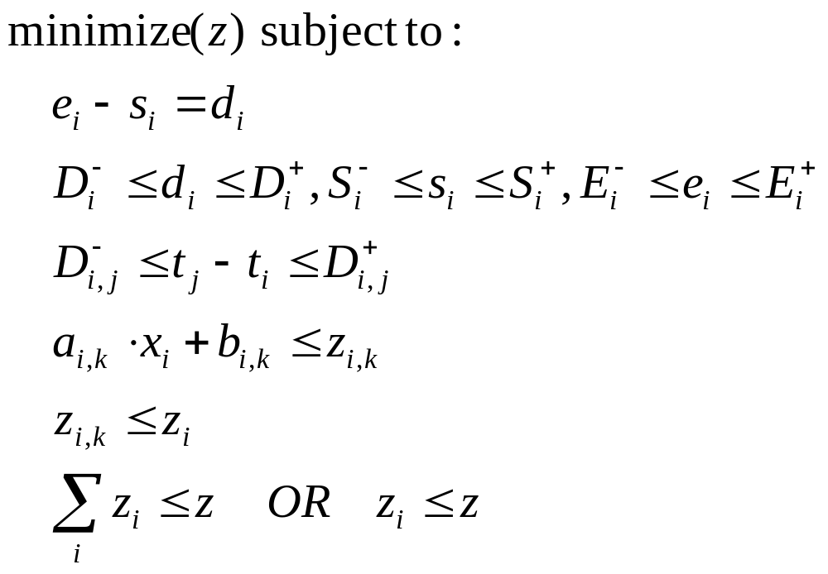
Search: Re-optimization methods portfolio
Temporal relaxation:
  Only consider temporal constraints (including the ones of the relaxed POS) and (convexified) cost function
Duration
Time-bounds
Temporal network
Cost function step
Function cost
Cost aggregation

Slide 39
Search: Re-optimization methods portfolio
Temporal relaxation:
  Only consider temporal constraints (including the ones of the relaxed POS) and (convexified) cost function
E
D
H
C
F
B
A
G

Slide 40
Search: Re-optimization methods portfolio
Temporal relaxation:
  Only consider temporal constraints (including the ones of the relaxed POS) and (convexified) cost function
E
D
H
C
F
B
A
G

Slide 41
Search: Re-optimization methods portfolio
Tree search
  Search considers activities by increasing indicative start times and tries to schedule them as close as possible to their indicative dates
  In case of backtrack, the activity is marked unselectable until constraint propagation removes from the domain of the activity the dates tried on the left branch

Slide 42
Experimental results
The approach was implemented as a black-box (no manual parameter)
Implemented on top of ILOG CP 1.1
  Use constraint propagation of ILOG CP
  Use ILOG CPLEX for temporal relaxation
Experimented on 20 scheduling benchmarks

Slide 43
Experimental results: benchmarks
Common due-date
Flowshop
Single-machine E/T
Unary
Jobshop
Flowshop E/T
Jobshop E/T
Openshop
Single proc. tardiness
Unary+
setup
Shop setup times
Semicond. testing
Airland
Hybrid flowshop
Flowshop w/ buffers
RCPSP E/T
Discrete
Quality RCPSP
Aircraft assembly
ATFM
Cumul. jobshop
RCPSP
State
Trolley
Makespan
E/T
Duration

Slide 44
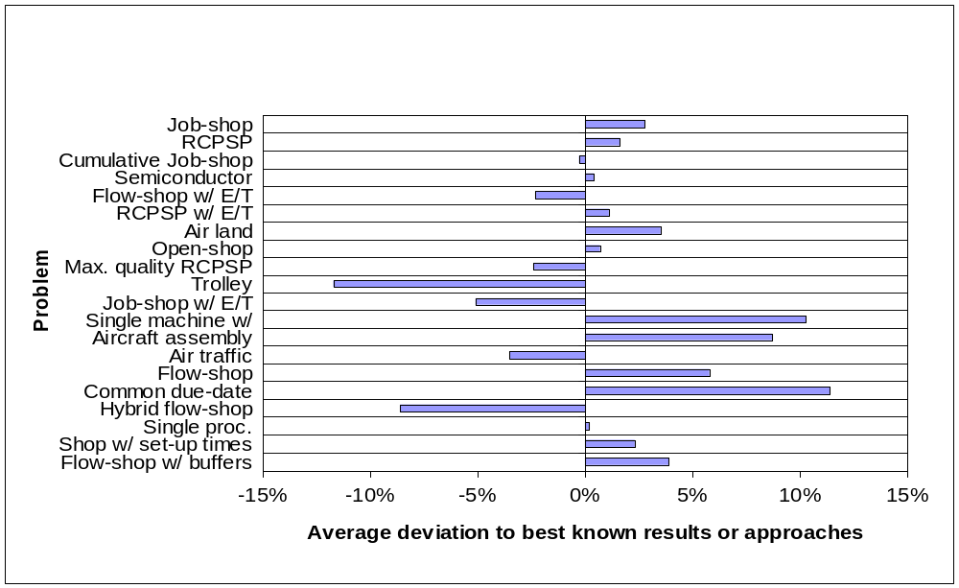
Experimental results: overview
Self-Adapting LNS: results over 20 benchmarks
Details…

Slide 45
Current and future work
Extension of the approach to:
  Multi-mode scheduling:
    Optional activities
    Alternative resources
    Alternative routes/recipes
  Resource costs:
    Setup costs
    Resource usage costs
    Inventory costs
  Feasibility problems

Slide 46
Questions & Answers
Thank You

Slide 47
Experimental results: details
Trolley
Hybrid flow-shop
Job-shop w/ E/T
Air traffic management
Max. quality RCPSP
Flow-shop w/ E/T
Cumulative job-shop
Single proc. Tardiness
Semiconductor testing
Open-shop
RCPSP w/ E/T
RCPSP
Shop w/ setup times
Job-shop
Air land
Flow-shop w/ buffers
Flow-shop
Aircraft assembly
Single machine w/ E/T
Common due-date

Slide 48
Results: Trolley
Generalization of the trolley problem described in [VanHentenryck&al 1999]
  Job-shop + Trolley resource to move items from one machine to the other (limited capacity + transition times)
15 instances
Comparison with OPL 3.7 default search
All 15 instances improved
Mean relative distance: -11.7%

Slide 49
Results: Hybrid flow-shop
20 randomly selected instances among the biggest ones from:
F. Sivrikaya-Serifolu and G. Ulusoy. Multiprocessor task scheduling in multistage hybrid flowshops: a genetic algorithm approach. Journal of the Operational Research Society, 55(5):504–512, 2004.
Sizes: 200, 500 and 1000 operations
Comparison with results of the above paper
Mean relative distance: -8.6%

Slide 50
Results: Job-shop w/ E/T
All 48 instances with 15 and 20 jobs from:
P. Baptiste, M. Flamini, and F. Sourd. Lagrangean bounds and lagrangean heuristics for just in time job-shop scheduling. Tech. report, Universita degli Studi di Roma Tre, 2005.
Comparison with results of the above paper
Mean relative distance: -5.1%

Slide 51
Results: Air traffic management
OPL 3.7 distributed example with about 2000 activities
Comparison with OPL 3.7 default search
Mean relative distance: -3.5%

Slide 52
Results: Max. quality RCPSP
RCPSP with objective to maximize weighted sum of activity duration
3600 instances described in:
N. Policella, X. Wang, S.F. Smith, and A. Oddi. Exploiting temporal flexibility to obtain high quality schedules. In Proc. AAAI-2005, 2005.
Comparison with results of the above paper
Mean relative distance: -2.4%

Slide 53
Results: Max. quality RCPSP
 | Due date = 25 |  | Due date = 30 |  | Due date = 35
 | Solved | Quality | Solved | Quality | Solved | Quality
[Policella-al-2005]
C=3 | 31.2% | 47.21% | 100% | 50.87% | 100% | 52.01%
C=5 | 100% | 81.60% | 100% | 81.37% | 100% | 81.19%
C=7 | 100% | 95.37% | 100% | 95.28% | 100% | 95.19%
[This work]
C=3 | 97.3% | 48.95% | 100% | 52.15% | 100% | 53.53%
C=5 | 100% | 83.84% | 100% | 83.92% | 100% | 83.70%
C=7 | 100% | 96.61% | 100% | 96.49% | 100% | 96.34%

Slide 54
Results: Flow-shop w/ E/T
12 instances of Morton&Pentico textbook
Compared with
E. Danna and L. Perron. Structured vs. unstructured large neighborhood search: A case study on job-shop scheduling problems with earliness and tardiness costs. In Proc. CP 2003, pages 817–821, 2003.
Mean relative distance: -2.3%

Slide 55
Results: Cumulative job-shop
Test on x2 open instances of Nuijten
Comparison with:
D. Godard, P. Laborie, and W. Nuijten. Randomized Large Neighborhood Search for Cumulative Scheduling. In Proc. ICAPS-05, pages 81–89, 2005.
Mean relative distance: -0.3%
The difference is due to parameter learning

Slide 56
Results: Single proc. tardiness
20 randomly selected instances (200-500 activities) from the SMTTP problem library (http://www.bilkent.edu.tr/~bkara/start.html)
Comparison with:
M. Pavlin, H. H. Hoos, and T. Stutzle. Stochastic local search for multiprocessor scheduling for minimimum total tardiness. In Proc. of the 16th Canadian Conference on Artificial Intelligence, pages 96–113, 2003.
Mean relative distance: 0.2%

Slide 57
Results: Semiconductor testing
18 randomly instances among the biggest ones described in:
I.M. Ovacik and R. Uzsoy. Decomposition methods for scheduling semiconductor testing facilities. International Journal of Flexible Manufacturing Systems, 8:357–398, 1996.
Comparison with results of the above paper
Mean relative distance: 0.4%
7 UBs improved out of the 18 instances

Slide 58
Results: Open-shop
Test on the instances of Brucker (j8*), Taillard (tai_20x20_*) and Gueret-Prins (gp10*)
Comparison with optimal solutions or, for open instances with results of:
C. Blum. Beam-ACO - hybridizing ant colony optimization with beam search: an application to open-shop scheduling. Computers and Operations Research, 32(6):1565–1591, 2005.
Mean relative distance: 0.7%
3 UBs improved out of the 28 instances

Slide 59
Results: RCPSP w/ E/T
Selection of 60 instances from the ones of [1]:
M. Vanhoucke, E. Demeulemeester, and W. Herroelen. An exact procedure for the resource constrained weighted earliness tardiness project scheduling problem. Annals of OR, 102(1-4):179–196, 2001.
30 randomly selected instances for which [1] finds optimal solution within 30 s and our approach does not
30 randomly selected instances for which [1] does not prove optimality
Mean relative distance: 1.1%
15 UBs improved out of the 60 instances

Slide 60
Results: RCPSP
Test on the 600 biggest instances of the PSPLIB (j120)
Comparison with best-known UB reported in the PSPLIB
Mean relative distance: 1.6%

Slide 61
Results: RCPSP
Average deviation to path-based lower bound: 32.4%
R. Kolisch and S. Hartmann. Experimental evaluation of state-of-the-art heuristics for the resource-constrained project scheduling problem: An update. European Journal of OR, 2006.

Slide 62
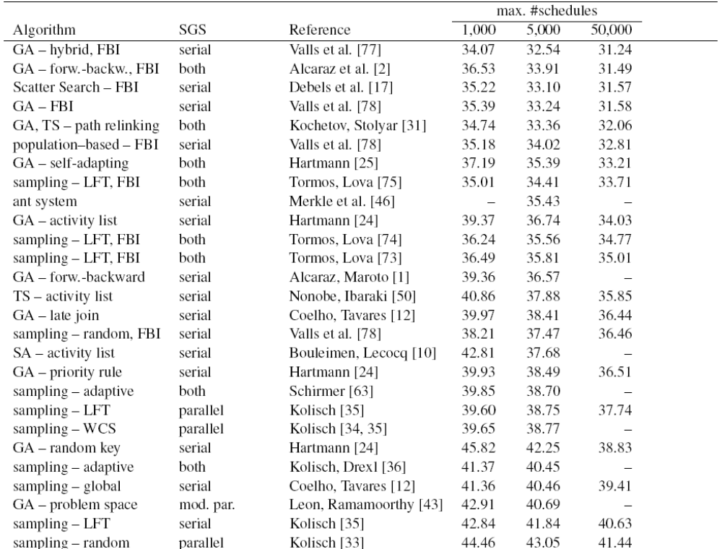
Results: RCPSP
32.4

Slide 63
Results: Shop w/ setup times
Jobshop with sequence-dependent setup times, 15 instances of Brucker and Thielle.
Comparison with:
C. Artigues and D. Feillet. A branch and bound method for the job-shop problem with sequence-dependent setup times. Annals of Operations Research, 2007 [To appear]
Mean relative distance: 2.3%

Slide 64
Results: Job-shop
Test on 33 instances:
  abz5-9
  swv1-20
  tail1-40
  yam1-4
Mean relative distance to best-known UB: 2.8%

Slide 65
Results: Air land
8 instances from:
J.E. Beasley, M. Krishnamoorthy, Y.M. Sharaiha, and D. Abramson. Scheduling aircraft landings - the static case. Transportation Science, 34:180–197, 2000.
Comparison with results of the above paper
Mean relative distance: 3.5%

Slide 66
Results: Flow-shop w/ buffers
Random selection of 30 instances of size 20x5, 20x10, 20x20, 50x5, 50x10 and 100x5, buffer sizes 0, 1 and 2 from Taillard’s benchmark.
Comparison with:
P. Brucker, S. Heitmann, and J. L. Hurink. Flow-shop problems with intermediate buffers. OR Spectrum, 25(4):549–574, 2003.
Mean relative distance: 3.9%
14 UBs improved out of 30 instances

Slide 67
Results: Flow-shop
Random selection of 120 instances of size in range 100-1000 from Taillard’s benchmark.
Comparison with results reported in OR lib.
Mean relative distance: 5.8%

Slide 68
Results: Aircraft assembly
Benchmark www.neosoft.com/ benchmrx/
Comparison with results reported in:
J. Crawford. An approach to resource constrained project scheduling. In Proc. 1996 Artificial Intelligence and Manufacturing Research Planning Workshop, 1996.
Relative distance: 8.7%

Slide 69
Results: Single machine w/ E/T
Comparison with [2]:
F. Sourd and S. Kedad-Sidhoum. An efficient algorithm for the earliness-tardiness scheduling problem. In Optimization Online, 2005.
Selection of 20 instances from BKY benchmark and 20 instances from SKS benchmark
In each benchmark:
  10 instances for which [2] proves optimality
  10 instances for which [2] does not prove optimality (in this case, comparison with heuristics HEURn)
Mean relative distance: 10.3%

Slide 70
Results: Common due-date
20 randomly selected instances of size 100 and 200 activities from:
D. Biskup and M. Feldmann. Benchmarks for scheduling on a single machine against restrictive and unrestrictive common due dates. Computers and OR, 28(8):787–801, 2001.
Comparison with results of the above paper
Mean relative distance: 11.4%

