Slide 1
Reasoning with
Conditional Time-intervals
P. Laborie and J. Rogerie
[plaborie,jrogerie]@ilog.fr

Slide 2
Overview
Motivations
Model
Constraint Propagation
Extensions & Conclusion
Notes:
Purpose:
Conclusion:

Slide 3
Motivations
Optional time-intervals in scheduling:
  Some activities can be left unperformed
A
C
B
Notes:
Purpose:
Conclusion:

Slide 4
Motivations
Optional time-intervals in scheduling:
  Some activities can be left unperformed
A
C
C
B
Notes:
Purpose:
Conclusion:

Slide 5
Motivations
Optional time-intervals in scheduling:
  Some activities can be left unperformed
A
B
Notes:
Purpose:
Conclusion:

Slide 6
Motivations
Optional time-intervals in scheduling:
  Some parts of the schedule can be left unperformed
A
C
E
B
D
Notes:
Purpose:
Conclusion:

Slide 7
Motivations
Optional time-intervals in scheduling:
  Some parts of the schedule can be left unperformed
A
C
C
E
E
B
D
D
Notes:
Purpose:
Conclusion:

Slide 8
Motivations
Optional time-intervals in scheduling:
  Some parts of the schedule can be left unperformed
A
B
Notes:
Purpose:
Conclusion:

Slide 9
Motivations
Optional time-intervals in scheduling:
  Some parts of the schedule can be left unperformed
  Dependencies: exec(E)⇒exec(C)∧exec(D)
A
C
E
B
D
Notes:
Purpose:
Conclusion:

Slide 10


Motivations
Optional time-intervals in scheduling:
  Alternative combination of resources
C
A
XOR
C: Mode 1
B
C: Mode 2
C: Mode 3
Notes:
Purpose:
Conclusion:

Slide 11
Motivations
Optional time-intervals in scheduling:
  Alternative combination of resources
A
C: Mode 1
C: Mode 1
B
Notes:
Purpose:
Conclusion:

Slide 12
Motivations
Optional time-intervals in scheduling:
  Alternative combination of resources
A
B
C: Mode 2
C: Mode 2
Notes:
Purpose:
Conclusion:

Slide 13
Motivations
Optional time-intervals in scheduling:
  Alternative combination of resources
A
B
C: Mode 3
C: Mode 3
Notes:
Purpose:
Conclusion:

Slide 14
Motivations
Optional time-intervals in scheduling:
  Alternative recipes (common in manufacturing)
C
A
XOR
C: Recipe 1
B
Op11
Op12
Op13
C: Recipe 2
Op23
Op21
Op22
Notes:
Purpose:
Conclusion:

Slide 15
Motivations
Optional time-intervals in scheduling:
  Alternative recipes (common in manufacturing)
A
C: recipe 1
C: Recipe 1
B
Op11
Op12
Op13
Op11
Op12
Op13
Notes:
Purpose:
Conclusion:

Slide 16
Motivations
Optional time-intervals in scheduling:
  Alternative recipes (common in manufacturing)
A
B
C: Recipe 2
C: Recipe 2
Op23
Op23
Op21
Op21
Op22
Op22
Notes:
Purpose:
Conclusion:

Slide 17
Motivations
Objective: Make it easier to model and solve scheduling problems involving optional activities/tasks/processes/recipes/…
Constraint Optimization framework
Basic ingredients:
  Optional time-intervals variables (a,b,c,… )
  Logical constraints (exec(a) ⇒ exec(b))
  Precedence constraints (endBeforeStart(a,b))
  Decomposition constraints (span(a,{b₁,…b_{n}}))
  Alternative constraints (alternative(a,{b₁,…b_{n}}))
Notes:
Purpose: Present objective and basic ingredients of the model
Conclusion:

Slide 18
Focus of this talk
MODEL
PROBLEM SOLVING
Basic constraints:
logical, precedence,
span, alternative
Basic constraint
propagation
Time-interval
variables
Notes:
Purpose: Present objective and basic ingredients of the model
Conclusion:

Slide 19
What we won’t talk about here
MODEL
PROBLEM SOLVING
Resource-related
constraints:
sequencing, cumul,
states, calendars
Resource-related
constraint
propagation
Search &
optimization
techniques
Basic constraints:
logical, precedence,
span, alternative
Basic constraint
propagation
Time-interval
variables
Notes:
Purpose: Present objective and basic ingredients of the model
Conclusion:

Slide 20
Model: Time interval variables
Extension of classical CSPs
A new type of first class citizen decision variable: Time-interval variable
Domain of values for a time-interval variable a :
Dom(a) ⊆ {⊥} ∪ { [s,e) | s,e∈ℤ, s≤e }
Non executed
Interval of integers
Notes:
Purpose: Formally define time interval variables
Conclusion:

Slide 21
Model: Time interval variables
Domain of values for a time-interval variable a :
Dom(a) ⊆ {⊥} ∪ { [s,e) | s,e∈ℤ, s≤e }
Notations: Let a be a fixed time-interval variable
  If a={[s,e)} (a is executed), we denote:
  x(a)=1, s(a)=s, e(a)=e, d(a)=e-s
  If a={⊥} (a is non-executed), we denote:
  x(a)=0 (in this case, s(a),e(a),d(a) are meaningless)
Notes:
Purpose: Describe some notations used for defining the semantics of constraints
Conclusion:

Slide 22
Model: Logical constraints
Execution unary constraint exec(a) means that a is executed (x(a)=1)
2-SAT clauses over execution constraints:
[¬]exec(a) ∨ [¬]exec(b)
Expressivity:
  Same execution status: ¬exec(a)∨exec(b),exec(a)∨¬exec(b)
  Incompatibility: ¬exec(a)∨¬exec(b)
  Implication: ¬exec(a)∨exec(b)
Notes:
Purpose: Define logical constraints
Conclusion:

Slide 23
Model: Precedence constraints
Simple Precedence Constraints t_{i}+z≤t_{j} reified by execution statuses
Example: endBeforeStart(a,b,z) means
x(a)∧x(b) ⇒ e(a)+z≤s(b)
startBeforeStart, startBeforeEnd
endBeforeStart, endBeforeEnd
startAtStart, startAtEnd
endAtStart, endAtEnd
Notes:
Purpose: Define precedence constraints
Conclusion:

Slide 24
Model: Span constraint
Span constraint span(a,{b₁,…,b_{n}}) means that if a is executed, it spans all executed intervals from {b₁,…,b_{n}}. Interval a is not executed iff none of intervals {b₁,…,b_{n}} is executed.
a
b₁
b₄
b₅
b₃
b₂
Notes:
Purpose: Define span constraint
Conclusion:

Slide 25
Model: Alternative constraint
Alternative constraint alternative(a,{b₁,…,b_{n}}) means that if a is executed, then exactly one of the {b₁,…,b_{n}} is executed and synchronized with a. Interval a is not executed iff none of intervals {b₁,…,b_{n}} is executed.
a
XOR
b₁
b₂
b₃
Notes:
Purpose: Define alternative constraint
Conclusion:

Slide 26
Model: Simple example
Inspired from [Barták&Čepek 2007]
BuyTube (40)
CollectMaterial (1)
CollectKit (1)
MakeTube
GetTube
SawRod (10)
AssembleKit (5)
XOR
SawTube (30)
ClearRod (2)
ClearTube (20)
WeldTube (15)
WeldRod (15)
AssemblePiston (5)
ShipPiston (0)
Deadline=70
Notes:
Purpose: Give an example of model
Conclusion:

Slide 27
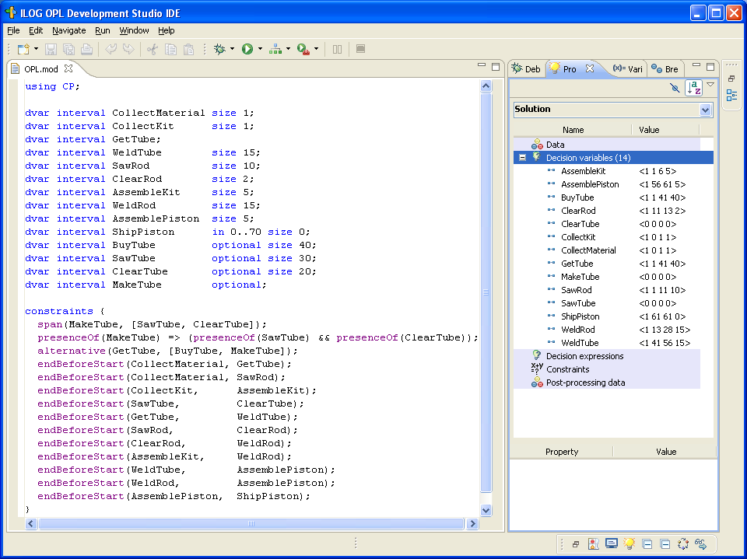
Model: Simple example (ILOG OPL Studio)
Notes:
Purpose: Describe how compactly the previous example is modeled in OPL
Conclusion:

Slide 28
Constraint Propagation: Interval variables
Time interval variable domain representation: tuple of ranges:
  [x_{min},x_{max}]⊆[0,1]: current execution status
  [s_{min},s_{max}]⊆ ℤ: conditional domain of start time would the time-interval be executed
  [e_{min},e_{max}]⊆ ℤ: conditional domain of end time would the time-interval be executed
  [d_{min},d_{max}]⊆ ℤ⁺: conditional domain of duration would the time-interval be executed
Notes:
Purpose: Describe how interval variables are represented in the engine
Conclusion:

Slide 29
Constraint Propagation: Logical network
Logical constraints are aggregated in an implication graph: all 2-SAT logical constraints [¬]exec(a) ∨ [¬]exec(b) are translated as implications ( ¬[¬]exec(a) ⇒ [¬]exec(b) )
Incremental transitive closure of the implication graph allows detecting infeasibilities and querying in O(1) whether exec(a) ⇒ exec(b) for any (a,b)
Notes:
Purpose: Present the logical network
Conclusion:

Slide 30
Constraint Propagation: Temporal network
Precedence constraints are aggregated in a temporal network
Notes:
Purpose: Present the temporal network
Conclusion:

Slide 31
Constraint Propagation: Temporal network
Precedence constraints are aggregated in a temporal network
Conditional reasoning:
From logical network
exec(a)⇒exec(b)
a
b
endBeforeStart(a,b)
Notes:
Purpose: Present the temporal network
Conclusion:

Slide 32
Constraint Propagation: Temporal network
Precedence constraints are aggregated in a temporal network
Conditional reasoning:
Propagation on the conditional bounds of a (would a be executed) can assume that b will be executed too, thus:
e_{max}(a) ← min(e_{max}(a), s_{max}(b))
From logical network
exec(a)⇒exec(b)
a
b
endBeforeStart(a,b)
Notes:
Purpose: Present the temporal network
Conclusion:

Slide 33
Constraint Propagation: Temporal network
Precedence constraints are aggregated in a temporal network
Conditional reasoning:
Propagation on the conditional bounds of a (would a be executed) can assume that b will be executed too, thus:
e_{max}(a) ← min(e_{max}(a), s_{max}(b))
Bounds are propagated even on time intervals with still undecided execution status !
From logical network
exec(a)⇒exec(b)
a
b
endBeforeStart(a,b)
Notes:
Purpose: Present the temporal network
Conclusion:

Slide 34
Model: Simple example
Inspired from [Barták&Čepek 2007]
BuyTube (40)
CollectMaterial (1)
CollectKit (1)
MakeTube
GetTube
SawRod (10)
AssembleKit (5)
XOR
SawTube (30)
ClearRod (2)
ClearTube (20)
WeldTube (15)
WeldRod (15)
AssemblePiston (5)
ShipPiston (0)
Deadline=70
Notes:
Purpose: Give an example of model
Conclusion:

Slide 35
Model: Simple example
Inspired from [Barták&Čepek 2007]
BuyTube (40)
CollectMaterial (1)
CollectKit (1)
BuyTube (40)
BuyTube (40)
MakeTube
GetTube
SawRod (10)
AssembleKit (5)
XOR
SawTube (30)
ClearRod (2)
ClearTube (20)
WeldTube (15)
WeldRod (15)
AssemblePiston (5)
ShipPiston (0)
Deadline=70
Notes:
Purpose: Give an example of model
Conclusion:

Slide 36
Extensions & Conclusion
Conditional time-intervals are the foundation of the new version of ILOG CP Optimizer (2.0) for modeling and solving detailed scheduling problems
Model extensions:
  Resources (sequencing, cumulative, state reasoning)
  Calendars (resource efficiency curves, days off, etc.)
  Expressions to use interval bounds (start, end, etc.) in classical CSP constraints on integer variables
Notes:
Purpose: Summarize model extensions in CPO 2.0
Conclusion:

Slide 37
Extensions & Conclusion
Conditional time-intervals are the foundation of the new version of ILOG CP Optimizer (2.0) for modeling and solving detailed scheduling problems
Search:
  Extension of SA-LNS [Laborie&Godard 2007] to handle optional time-interval variables
Notes:
Purpose: Summarize search approach in CPO 2.0
Conclusion:

Slide 38
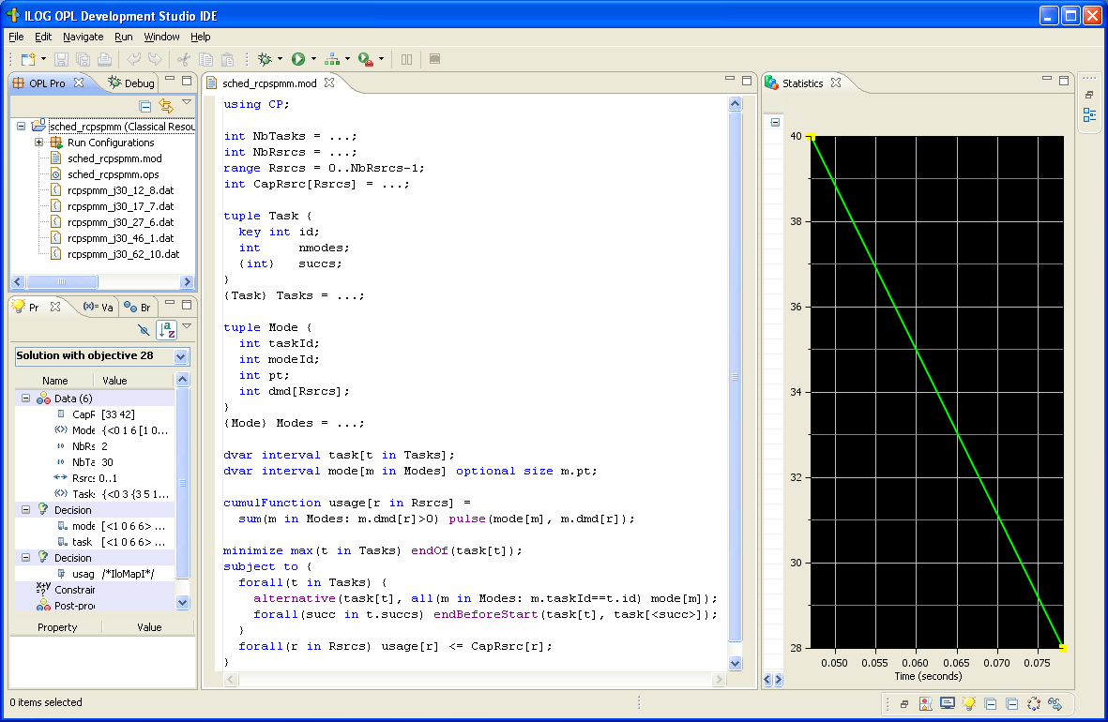
Example: Multi-Mode RCPSP
Notes:
Purpose: Illustrate complete OPL model on Multi-Mode RCPSP
Conclusion:

Slide 39
Example: Multi-Mode RCPSP
Data
Notes:
Purpose: Illustrate complete OPL model on Multi-Mode RCPSP
Conclusion:

Slide 40
Example: Multi-Mode RCPSP
Model
Notes:
Purpose: Illustrate complete OPL model on Multi-Mode RCPSP
Conclusion:

Slide 41
Example: Multi-Mode RCPSP
Trial Version:
http://ilog.com/products/oplstudio/trial.cfm
Notes:
Purpose: Illustrate complete OPL model on Multi-Mode RCPSP and advertise Trial version
Conclusion:

