Slide 1
Reasoning with
Conditional Time-intervals
P. Laborie and J. Rogerie
[plaborie,jrogerie]@ilog.fr

Slide 2
Overview
Motivations
Model
Constraint Propagation
Extensions & Conclusion
Notes:
Purpose:
Conclusion:

Slide 3
Motivations
Optional time-intervals in scheduling:
  Some activities can be left unperformed
A
C
B
Notes:
Purpose:
Conclusion:

Slide 4
Motivations
Optional time-intervals in scheduling:
  Some activities can be left unperformed
A
C
C
B
Notes:
Purpose:
Conclusion:

Slide 5

Motivations
Optional time-intervals in scheduling:
  Some activities can be left unperformed
A
B
Notes:
Purpose:
Conclusion:

Slide 6
Motivations
Optional time-intervals in scheduling:
  Some parts of the schedule can be left unperformed
A
C
E
B
D
Notes:
Purpose:
Conclusion:

Slide 7
Motivations
Optional time-intervals in scheduling:
  Some parts of the schedule can be left unperformed
A
C
C
E
E
B
D
D
Notes:
Purpose:
Conclusion:

Slide 8
Motivations
Optional time-intervals in scheduling:
  Some parts of the schedule can be left unperformed
A
B
Notes:
Purpose:
Conclusion:

Slide 9
Motivations
Optional time-intervals in scheduling:
  Some parts of the schedule can be left unperformed
  Dependencies: exec(E)⇒exec(C)∧exec(D)
A
C
E
B
D
Notes:
Purpose:
Conclusion:

Slide 10



Motivations
Optional time-intervals in scheduling:
  Alternative combination of resources
C
A
XOR
C: Mode 1
B
C: Mode 2
C: Mode 3
Notes:
Purpose:
Conclusion:

Slide 11
Motivations
Optional time-intervals in scheduling:
  Alternative combination of resources
A
C: Mode 1
C: Mode 1
B
Notes:
Purpose:
Conclusion:

Slide 12
Motivations
Optional time-intervals in scheduling:
  Alternative combination of resources
A
B
C: Mode 2
C: Mode 2
Notes:
Purpose:
Conclusion:

Slide 13
Motivations
Optional time-intervals in scheduling:
  Alternative combination of resources
A
B
C: Mode 3
C: Mode 3
Notes:
Purpose:
Conclusion:

Slide 14
Motivations
Optional time-intervals in scheduling:
  Alternative recipes (common in manufacturing)
C
A
XOR
C: Recipe 1
B
Op11
Op12
Op13
C: Recipe 2
Op23
Op21
Op22
Notes:
Purpose:
Conclusion:

Slide 15
Motivations
Optional time-intervals in scheduling:
  Alternative recipes (common in manufacturing)
A
C: recipe 1
C: Recipe 1
B
Op11
Op12
Op13
Op11
Op12
Op13
Notes:
Purpose:
Conclusion:

Slide 16
Motivations
Optional time-intervals in scheduling:
  Alternative recipes (common in manufacturing)
A
B
C: Recipe 2
C: Recipe 2
Op23
Op23
Op21
Op21
Op22
Op22
Notes:
Purpose:
Conclusion:

Slide 17
Motivations
Objective: Make it easier to model and solve scheduling problems involving optional activities/tasks/processes/recipes/…
Constraint Optimization framework
Basic ingredients:
  Optional time-intervals variables (a,b,c,… )
  Logical constraints (exec(a) ⇒ exec(b))
  Precedence constraints (endBeforeStart(a,b))
  Decomposition constraints (span(a,{b₁,…b_{n}}))
  Alternative constraints (alternative(a,{b₁,…b_{n}}))
Notes:
Purpose: Present objective and basic ingredients of the model
Conclusion:

Slide 18
Focus of this talk
MODEL
PROBLEM SOLVING
Basic constraints:
logical, precedence,
span, alternative
Basic constraint
propagation
Time-interval
variables
Notes:
Purpose: Present objective and basic ingredients of the model
Conclusion:

Slide 19
What we won’t talk about here
MODEL
PROBLEM SOLVING
Resource-related
constraints:
sequencing, cumul,
states, calendars
Resource-related
constraint
propagation
Search &
optimization
techniques
Basic constraints:
logical, precedence,
span, alternative
Basic constraint
propagation
Time-interval
variables
Notes:
Purpose: Present objective and basic ingredients of the model
Conclusion:

Slide 20
Model: Time interval variables
Extension of classical CSPs
A new type of first class citizen decision variable: Time-interval variable
Domain of values for a time-interval variable a :
Dom(a) ⊆ {⊥} ∪ { [s,e) | s,e∈ℤ, s≤e }
Non executed
Interval of integers
Notes:
Purpose: Formally define time interval variables
Conclusion:

Slide 21
Model: Time interval variables
Domain of values for a time-interval variable a :
Dom(a) ⊆ {⊥} ∪ { [s,e) | s,e∈ℤ, s≤e }
Notations: Let a be a fixed time-interval variable
  If a={[s,e)} (a is executed), we denote:
  x(a)=1, s(a)=s, e(a)=e, d(a)=e-s
  If a={⊥} (a is non-executed), we denote:
  x(a)=0 (in this case, s(a),e(a),d(a) are meaningless)
Notes:
Purpose: Describe some notations used for defining the semantics of constraints
Conclusion:

Slide 22
Model: Logical constraints
Execution unary constraint exec(a) means that a is executed (x(a)=1)
2-SAT clauses over execution constraints:
[¬]exec(a) ∨ [¬]exec(b)
Expressivity:
  Same execution status: ¬exec(a)∨exec(b),exec(a)∨¬exec(b)
  Incompatibility: ¬exec(a)∨¬exec(b)
  Implication: ¬exec(a)∨exec(b)
Notes:
Purpose: Define logical constraints
Conclusion:

Slide 23
Model: Precedence constraints
Simple Precedence Constraints t_{i}+z≤t_{j} reified by execution statuses
Example: endBeforeStart(a,b,z) means
x(a)∧x(b) ⇒ e(a)+z≤s(b)
startBeforeStart, startBeforeEnd
endBeforeStart, endBeforeEnd
startAtStart, startAtEnd
endAtStart, endAtEnd
Notes:
Purpose: Define precedence constraints
Conclusion:

Slide 24
Model: Span constraint
Span constraint span(a,{b₁,…,b_{n}}) means that if a is executed, it spans all executed intervals from {b₁,…,b_{n}}. Interval a is not executed iff none of intervals {b₁,…,b_{n}} is executed.
a
b₁
b₄
b₅
b₃
b₂
Notes:
Purpose: Define span constraint
Conclusion:

Slide 25
Model: Alternative constraint
Alternative constraint alternative(a,{b₁,…,b_{n}}) means that if a is executed, then exactly one of the {b₁,…,b_{n}} is executed and synchronized with a. Interval a is not executed iff none of intervals {b₁,…,b_{n}} is executed.
a
XOR
b₁
b₂
b₃
Notes:
Purpose: Define alternative constraint
Conclusion:

Slide 26
Model: Simple example
Inspired from [Barták&Čepek 2007]
BuyTube (40)
CollectMaterial (1)
CollectKit (1)
MakeTube
GetTube
SawRod (10)
AssembleKit (5)
XOR
SawTube (30)
ClearRod (2)
ClearTube (20)
WeldTube (15)
WeldRod (15)
AssemblePiston (5)
ShipPiston (0)
Deadline=70
Notes:
Purpose: Give an example of model
Conclusion:

Slide 27
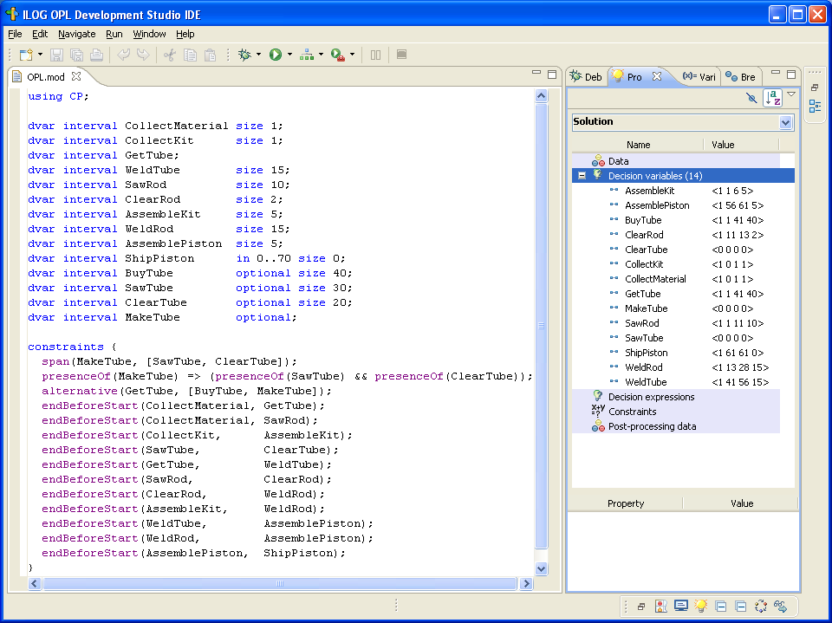
Model: Simple example (ILOG OPL Studio)
Notes:
Purpose: Describe how compactly the previous example is modeled in OPL
Conclusion:

Slide 28
Constraint Propagation: Interval variables
Time interval variable domain representation: tuple of ranges:
  [x_{min},x_{max}]⊆[0,1]: current execution status
  [s_{min},s_{max}]⊆ ℤ: conditional domain of start time would the time-interval be executed
  [e_{min},e_{max}]⊆ ℤ: conditional domain of end time would the time-interval be executed
  [d_{min},d_{max}]⊆ ℤ⁺: conditional domain of duration would the time-interval be executed
Notes:
Purpose: Describe how interval variables are represented in the engine
Conclusion:

Slide 29
Constraint Propagation: Logical network
Logical constraints are aggregated in an implication graph: all 2-SAT logical constraints [¬]exec(a) ∨ [¬]exec(b) are translated as implications ( ¬[¬]exec(a) ⇒ [¬]exec(b) )
Incremental transitive closure of the implication graph allows detecting infeasibilities and querying in O(1) whether exec(a) ⇒ exec(b) for any (a,b)
Notes:
Purpose: Present the logical network
Conclusion:

Slide 30
Constraint Propagation: Temporal network
Precedence constraints are aggregated in a temporal network
Conditional reasoning:
Propagation on the conditional bounds of a (would a be executed) can assume that b will be executed too, thus:
e_{max}(a) ← min(e_{max}(a), s_{max}(b))
Bounds are propagated even on time intervals with still undecided execution status !
From logical network
exec(a)⇒exec(b)
a
b
endBeforeStart(a,b)
Notes:
Purpose: Present the temporal network
Conclusion:

Slide 31
Constraint Propagation: Simple example
Inspired from [Barták&Čepek 2007]
BuyTube (40)
CollectMaterial (1)
CollectKit (1)
MakeTube
GetTube
SawRod (10)
AssembleKit (5)
XOR
SawTube (30)
ClearRod (2)
ClearTube (20)
WeldTube (15)
WeldRod (15)
AssemblePiston (5)
ShipPiston (0)
Deadline=70
Notes:
Purpose: Illustrate propagation on the example
Conclusion:

Slide 32
Constraint Propagation: Simple example
Inspired from [Barták&Čepek 2007]
BuyTube (40)
CollectMaterial (1)
CollectKit (1)
BuyTube (40)
MakeTube
GetTube
SawRod (10)
AssembleKit (5)
XOR
SawTube (30)
ClearRod (2)
ClearTube (20)
WeldTube (15)
WeldRod (15)
AssemblePiston (5)
ShipPiston (0)
Deadline=70
Notes:
Purpose: Illustrate propagation on the example
Conclusion:

Slide 33
Extensions & Conclusion
Conditional time-intervals are the foundation of the new version of ILOG CP Optimizer (2.0) for modeling and solving detailed scheduling problems
Model extensions:
  Resources (sequencing, cumulative, state reasoning)
  Calendars (resource efficiency curves, days off, etc.)
  Expressions to use interval bounds (start, end, etc.) in classical CSP constraints on integer variables
Notes:
Purpose: Summarize model extensions in CPO 2.0
Conclusion:

Slide 34
Extensions & Conclusion
Conditional time-intervals are the foundation of the new version of ILOG CP Optimizer (2.0) for modeling and solving detailed scheduling problems
Search:
  Extension of SA-LNS [Laborie&Godard 2007] to handle optional time-interval variables
Notes:
Purpose: Summarize search approach in CPO 2.0
Conclusion:

Slide 35
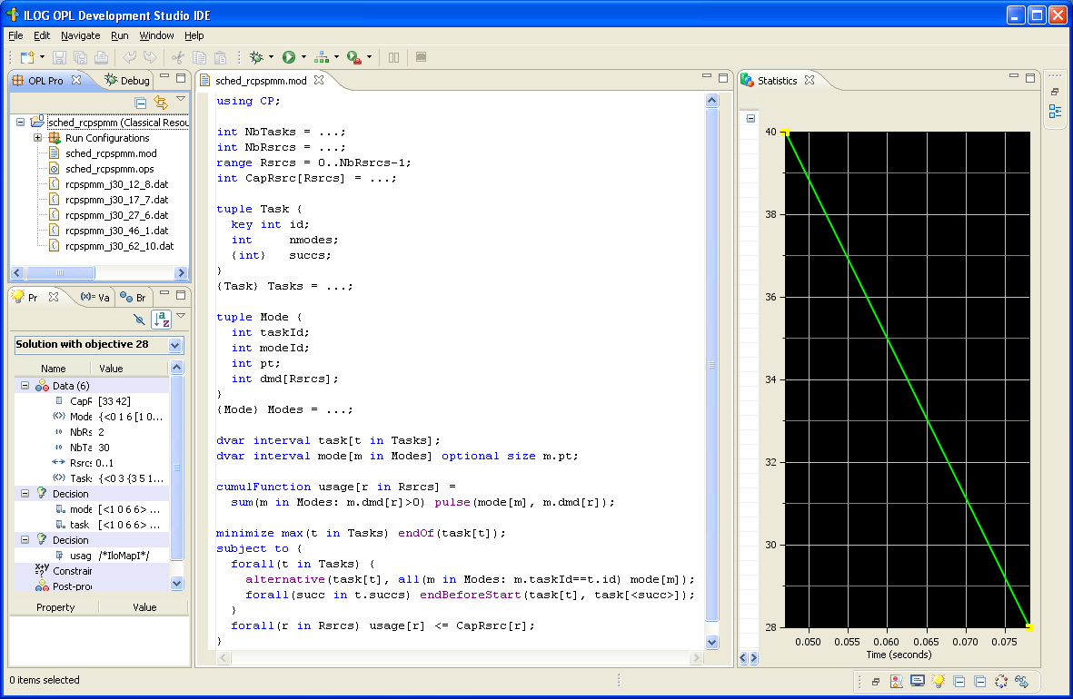
Example: Multi-Mode RCPSP
Data
Model
Notes:
Purpose: Illustrate complete OPL model on Multi-Mode RCPSP
Conclusion:

Slide 36
Example: Multi-Mode RCPSP
Trial Version:
http://ilog.com/products/oplstudio/trial.cfm
Notes:
Purpose: Illustrate complete OPL model on Multi-Mode RCPSP and advertise Trial version
Conclusion:

