Slide 1
IBM ILOG CP Optimizer for Detailed Scheduling
Illustrated on Three Problems
May 30, 2009
Philippe Laborie
Principal Scientist
laborie@fr.ibm.com

Slide 2
What is IBM ILOG CP Optimizer?
A component of IBM ILOG CPLEX Optimization Studio
A Constraint Programming engine for combinatorial problems (including scheduling problems)
Implements a Model & Run paradigm
  Model: Concise and Expressive modeling language
  Run: Powerful automatic search procedure
Available through the following interfaces:
  OPL
  C++ (native interface)
  Java, .NET (wrapping of the C++ engine)

Slide 3
IBM ILOG CP Optimizer for Detailed Scheduling
CP Optimizer provides some specific decision variables and constraints for modeling and solving detailed scheduling problems

Slide 4
IBM ILOG CP Optimizer for Detailed Scheduling
Modeling
Language
[1,2]
Extension of classical CSP with a new type of decision variable:
optional interval variable :
Domain(a) ⊆ {⊥} ∪ { [s,e) | s,e∈Ζ, s≤e }
Introduction of mathematical notions such as sequences and functions to
capture temporal aspects of scheduling problems
Absent interval
Interval of integers
[1] Reasoning with Conditional Time-intervals. FLAIRS-08.
[2] Reasoning with Conditional Time-intervals, Part II: an Algebraical Model for Resources. FLAIRS-09.

Slide 5
IBM ILOG CP Optimizer for Detailed Scheduling
Problem
Automatic
Search
[3,4]
Fragment
Selection
Problem structure
Randomization
Tree search
LP relaxation
Propagation
Dominance rules
Machine
Learning
Techniques
Self-Adapting
Large Neighborhood
Search
POS generation
Continue
search ?
[3] Randomized Large Neighborhood Search for Cumulative Scheduling. ICAPS-05.
[4] Self-Adapting Large Neighborhood Search: Application to Single-mode Scheduling Problems. MISTA-07.
[1] Reasoning with Conditional Time-intervals. FLAIRS-08.
[2] Reasoning with Conditional Time-intervals, Part II: an Algebraical Model for Resources. FLAIRS-09.

Slide 6
IBM ILOG CP Optimizer for Detailed Scheduling
Modeling
Language
[1,2]
Easy
modeling
Efficient
search
Automatic
Search
[3,4]
[3] Randomized Large Neighborhood Search for Cumulative Scheduling. ICAPS-05.
[4] Self-Adapting Large Neighborhood Search: Application to Single-mode Scheduling Problems. MISTA-07.
[1] Reasoning with Conditional Time-intervals. FLAIRS-08.
[2] Reasoning with Conditional Time-intervals, Part II: an Algebraical Model for Resources. FLAIRS-09.

Slide 7
IBM ILOG CP Optimizer for Detailed Scheduling
Modeling
Language
[1,2]
Easy
modeling
Efficient
search
Automatic
Search
[3,4]
Scheduling applications
(Here: [5,6,7])
[5] Danna, Perron: Structured vs. Unstructured Large Neighborhood Search.
[6] Kramer & al.: Understanding Performance Trade-offs in Algorithms for Solving Oversubscribed Scheduling.
[7] Refanidis: Managing Personal Tasks with Time Constraints and Preferences.
[3] Randomized Large Neighborhood Search for Cumulative Scheduling. ICAPS-05.
[4] Self-Adapting Large Neighborhood Search: Application to Single-mode Scheduling Problems. MISTA-07.
[1] Reasoning with Conditional Time-intervals. FLAIRS-08.
[2] Reasoning with Conditional Time-intervals, Part II: an Algebraical Model for Resources. FLAIRS-09.

Slide 8
Problem #1: Flow-shop with Earliness/Tardiness
Classical Flow-Shop Scheduling problem:
  n jobs, m machines
Job release dates ( ), due dates ( ) and weight
op[1,1]
op[1,2]
op[1,3]
op[2,1]
op[2,2]
op[2,3]
op[3,1]
op[3,2]
op[3,3]
op[1,1]
op[1,2]
op[1,3]
op[2,1]
op[2,2]
op[2,3]
op[3,1]
op[3,2]
op[3,3]

Slide 9
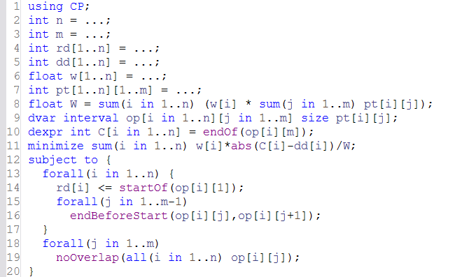
Problem #1: Flow-shop with Earliness/Tardiness
The model is using CP Optimizer engine

Slide 10
Problem #1: Flow-shop with Earliness/Tardiness
Data
Data reading and computation:
  Problem size (n, m)
  Job release date (rd), due-date (dd), weight (w)
  Operation processing time (pt)
  Normalization factor (W)

Slide 11
Problem #1: Flow-shop with Earliness/Tardiness
Decisions
Decision variables and expressions:
  Operations: 2D array of interval variables
  Jobs end time: 1D array of integer expressions

Slide 12
Problem #1: Flow-shop with Earliness/Tardiness
Objective
Objective:
  Weighted sum of earliness/tardiness costs
-w[i]/W
+w[i]/W
dd[i]

Slide 13
Problem #1: Flow-shop with Earliness/Tardiness
Constraints
Constraints:
  Release dates of job i (using startOf integer expression)
  Precedence constraints between operations of job i
  No-overlap of operations on the same machine j

Slide 14
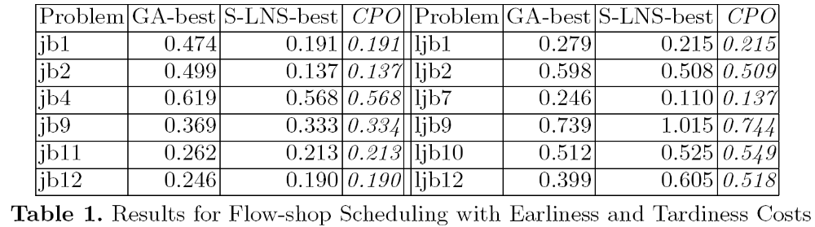
Problem #1: Flow-shop with Earliness/Tardiness
Experimental results
  Average improvement:
    Compared to GA: 25%
    Compared to LNS: 1.7%
[5] Danna, Perron: Structured vs. Unstructured Large Neighborhood Search.

Slide 15
Problem #2: Oversubscribed Scheduling
USAF Satellite Control Network scheduling problem [6]
A set of n communication requests for Earth orbiting satellites must be scheduled on a total of 32 antennas spread across 13 ground-based tracking stations.
Objective is to maximize the number of satisfied requests
In the instances, n ranges from to 400 to 1300
[6] Kramer & al.: Understanding Performance Trade-offs in Algorithms for Solving Oversubscribed Scheduling.

Slide 16


Problem #2: Oversubscribed Scheduling
Station 1
Station 2
Station 3

Slide 17
Problem #2: Oversubscribed Scheduling
Station 1
Station 2
Station 3
Task_{i}
Communication requests

Slide 18
Problem #2: Oversubscribed Scheduling
Station 1
Alt_{i,1}
Station 2
Alt_{i,2}
Alt_{i,3}
Station 3
Alt_{i,4}
OR
Alternative assignments
to stations × time windows
Task_{i}

Slide 19

Problem #2: Oversubscribed Scheduling
Station 1
Alt_{i,1}
Station 2
Alt_{i,2}
Alt_{i,3}
Station 3
Alt_{i,4}
Selected alternative will use
1 antenna for communication
with the satellite
Task_{i}

Slide 20
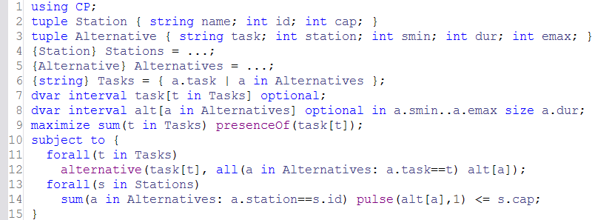
Problem #2: Oversubscribed Scheduling
Data
Data reading and computation:
  Tuple sets of Stations and Alternative assignments
  Tasks: set of tasks of the problem

Slide 21
Problem #2: Oversubscribed Scheduling
Decisions
Decision variables:
  Tasks: array of optional interval variables
  Alternative assignments: array of optional interval variables,
  each possible assignment is defined with a specific time-window ([smin,emax]) and a size

Slide 22
Problem #2: Oversubscribed Scheduling
Objective
Objective:
  Maximize number of executed tasks (modeled with a sum of presenceOf constraints)

Slide 23
Problem #2: Oversubscribed Scheduling
Constraints
Constraints:
  Alternative assignments for a given task t using an alternative constraint
  Maximal capacity of stations (number of antennas) using a constrained cumul function

Slide 24
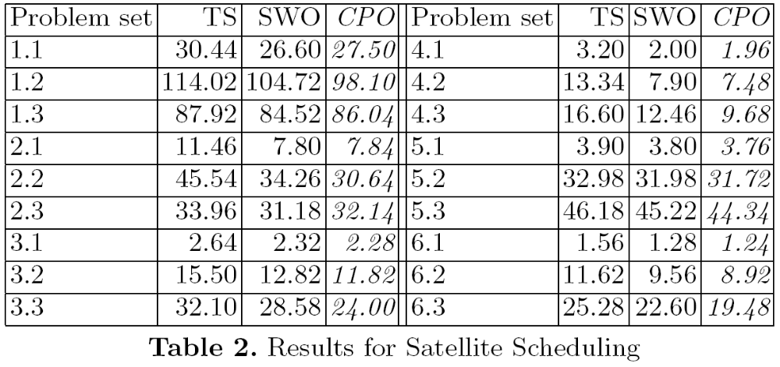
Problem #2: Oversubscribed Scheduling
Experimental Results
  In average, compared with SWO, the number of unscheduled tasks is decreased by 5.3%
[6] Kramer & al.: Understanding Performance Trade-offs in Algorithms for Solving Oversubscribed Scheduling.

Slide 25
Problem #3: Personal Tasks Scheduling
Personal tasks scheduling [7]
Schedule a personal agenda composed of n tasks
Integration with Google Calendar available online: http://selfplanner.uom.gr/
[7] Refanidis: Managing Personal Tasks with Time Constraints and Preferences.

Slide 26
Problem #3: Personal Tasks Scheduling
Tasks are preemptive
  A task specifies a fixed total processing time
  It can be split into one or several parts
  Min/max value for the duration of each individual part
  Minimal delay between consecutive parts of the same task
Task
Part₁
Part₂
Part₃
…
Min/max duration
for each part

Slide 27
Problem #3: Personal Tasks Scheduling
Tasks are preemptive
  A task specifies a fixed total processing time
  It can be split into one or several parts
  Min/max value for the duration of each individual part
  Minimal delay between consecutive parts of the same task
Task
Part₁
Part₂
Part₃
…
Min delay between
Consecutive task parts

Slide 28
Problem #3: Personal Tasks Scheduling
Each task specifies a set of time-windows where it can be executed
Task
Part₁
Part₂
Part₃
…
Task domain

Slide 29

Problem #3: Personal Tasks Scheduling
Precedence constraints
Locations, distances and transition times
Task₁
Task₃
Task₂
1
2
Task₄
Task₅
Task₁
4
3
Task₂
Task₃

Slide 30
Problem #3: Personal Tasks Scheduling
Objective function: maximize task satisfaction
  5 types of task-dependent preference functions:
Part₁
Part₂
Part₃
…
Task

Slide 31
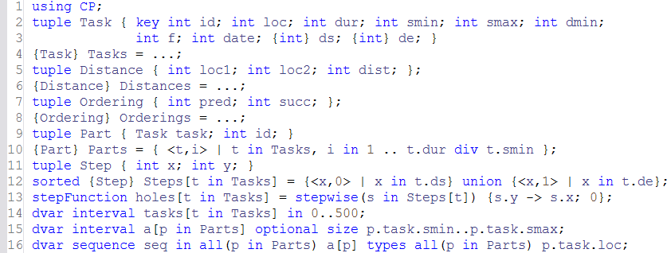
Problem #3: Personal Tasks Scheduling
Data
Data reading:
  Tasks characteristics

Slide 32
Problem #3: Personal Tasks Scheduling
Data
Data reading:
  Distance matrix
1
2
4
3

Slide 33
Problem #3: Personal Tasks Scheduling
Data
Data reading:
  Task ordering
Task₁
Task₃
Task₂

Slide 34
Problem #3: Personal Tasks Scheduling
Data
Data computing:
  Computation of envelope of possible task parts:
  there are at most t.dur / t.smin parts for a task t

Slide 35
Problem #3: Personal Tasks Scheduling
Data
Data computing:
  Step functions for task domains
1
holes
0
Part₁
Part₂
Part₃
…

Slide 36
Problem #3: Personal Tasks Scheduling
Decisions
Decision variables:
  Tasks: array of interval variables
  Task parts: array of optional interval variables
  Sequence variable defined over all task parts

Slide 37
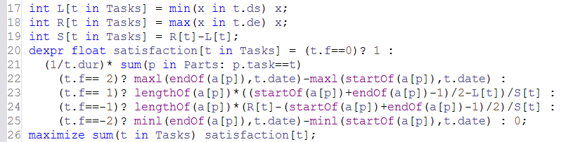
Problem #3: Personal Tasks Scheduling
Objective
Objective function:
  Sum of individual task satisfaction
  5 types of preference functions (note that some are quadratic)
Part₁
Part₂
Part₃
…

Slide 38
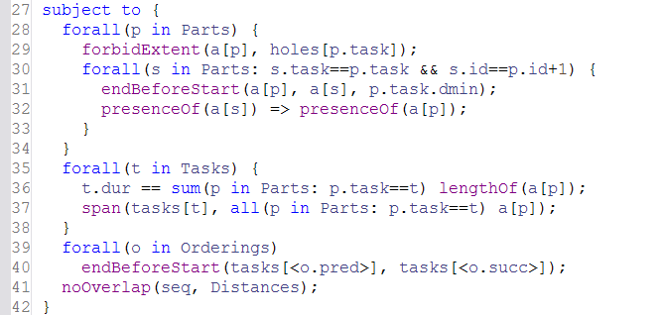
Problem #3: Personal Tasks Scheduling
Constraints
Constraints:
  Task domain
1
holes
0
Part₁
Part₂
Part₃
…

Slide 39
Problem #3: Personal Tasks Scheduling
Constraints
Constraints:
  Task decomposition into parts
Task
Part₁
Part₂
Part₃
…

Slide 40
Problem #3: Personal Tasks Scheduling
Constraints
Constraints:
  Ordering constraints
Task₁
Task₃
Task₂

Slide 41
Problem #3: Personal Tasks Scheduling
Constraints
Constraints:
  No-overlap constraint between task parts using transition distance

Slide 42
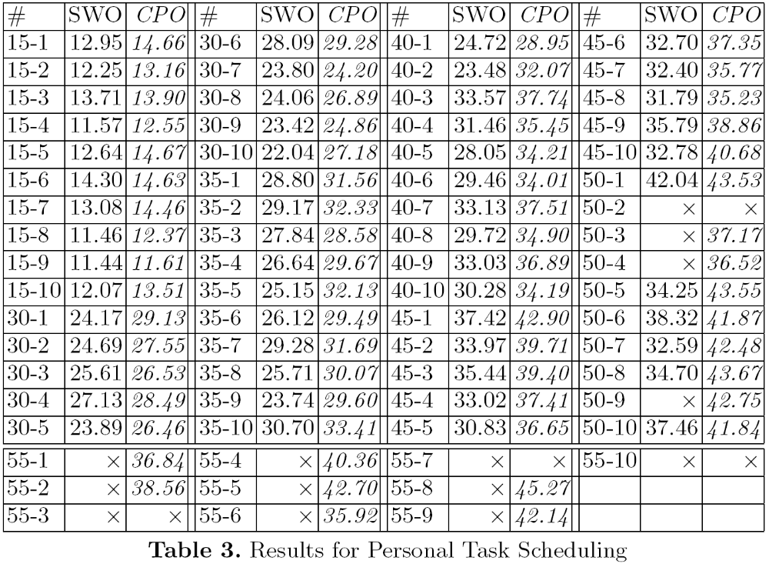

Problem #3: Personal Tasks Scheduling
Experimental Results
  More solutions found for large instances
  Average task satisfaction increases from 78% to 87% in average (12.5% improvement)
[7] Refanidis: Managing Personal Tasks with Time Constraints and Preferences.

Slide 43
Conclusion
These problems cover many aspects of scheduling …
Domain
Activity
type
Resource
type
Temporal
network
Objective
function
#1
Manufacturing
Non-
preemptive
Disjunctive
Structured
(jobs)
Earliness/
tardiness
#2
Aerospace
Non-
preemptive
Cumulative
None
Scheduled
tasks
#3
Project
scheduling
Preemptive
Disjunctive
Unstructured
Complex
temporal
preferences

Slide 44
Conclusion
They can easily be modeled with CP Optimizer …
OPL Model size
#1
20 lines
#2
15 lines
#3
42 lines

Slide 45
Conclusion
They can efficiently be solved by CP Optimizer …
CPO Automatic search (no parameter tuning)
vs. state-of-the-art
OPL Model size
#1
20 lines
Competitive with state of the art (GA, LNS)
#2
15 lines
Number of unscheduled tasks decreased by 5%
#3
42 lines
Finds solution to more instances
Solution quality increased by 12.5%

Slide 46
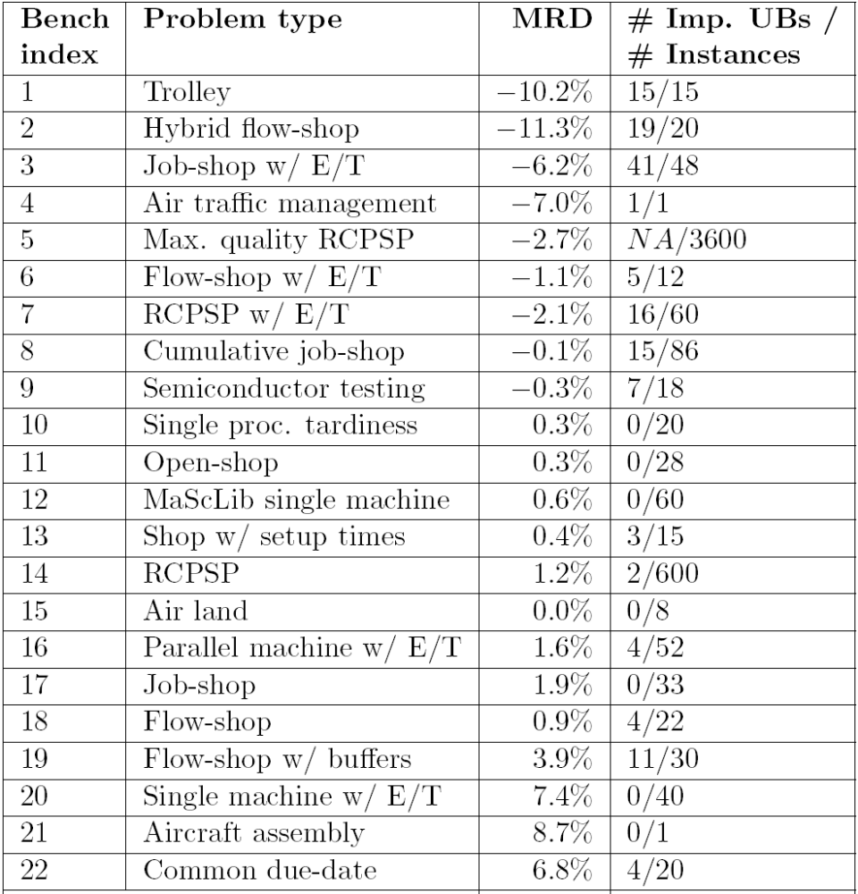
Some more results … (compiled in 2007)

Slide 47
Finding out more …
Product page:
  ibm.com/software/integration/optimization/cplex-optimization-studio
    Trial version
    Product documentation
    White papers
    Presentations
IBM ILOG Optimization Forums / Constraint Programming:
  http://www.ibm.com/developerworks/forums/category.jspa?categoryID=268

Slide 48
Finding out more …
Some papers on CP Optimizer (not limited to scheduling)
P. Laborie, J. Rogerie, P. Shaw and P. Vilim. "Reasoning with Conditional Time-intervals - Part II: an Algebraical Model for Resources". In Proceedings of the Twenty-Second International FLAIRS Conference. 2009.
P. Laborie. "IBM ILOG CP Optimizer for Detailed Scheduling Illustrated on Three Problems". In Proceedings of the 6th International Conference on Integration of AI and OR Techniques in Constraint Programming for Combinatorial Optimization Problems (CP-AI-OR'09). 2009.
P. Vilim. "Max Energy Filtering Algorithm for Discrete Cumulative Resources". In Proceedings of the 6th International Conference on Integration of AI and OR Techniques in Constraint Programming for Combinatorial Optimization Problems (CP-AI-OR'09). 2009.
P. Vilim. "Edge finding filtering algorithm for discrete cumulative resources in O(knlog(n))". In Proceedings of the 15th international conference on Principles and practice of constraint programming (CP'09). 2009.
P. Laborie and J. Rogerie. "Reasoning with Conditional Time-intervals". In Proceedings of the Twenty-First International FLAIRS Conference. pp555-560. 2008.
P. Laborie and D. Godard. "Self-Adapting Large Neighborhood Search: Application to single-mode scheduling problems". In Proceedings of the 3rd Multidisciplinary International Conference on Scheduling: Theory and Applications (MISTA). pp276-284. 2007.
P. Vilim. "Global Constraints in Scheduling". PhD thesis. Charles University, Prague. 2007.
A. Gargani and P. Refalo. "An Efficient Model and Strategy for the Steel Mill Slab Design Problem". In Proceedings of the 13th international conference on Principles and Practice of Constraint Programming (CP'07). 2007.
P. Refalo: ”Impact-Based Search Strategies for Constraint Programming“. In Proceedings of the 10th international conference on Principles and Practice of Constraint Programming (CP'04). 2004.
P. Shaw: "A Constraint for Bin Packing". In Proceedings of the 10th international conference on Principles and Practice of Constraint Programming (CP'04). 2004.

