Slide 1


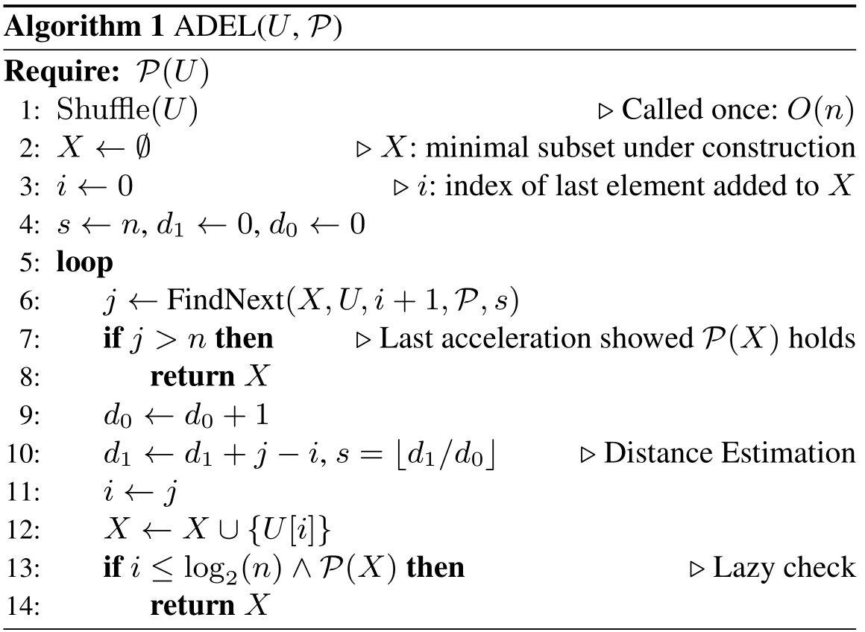
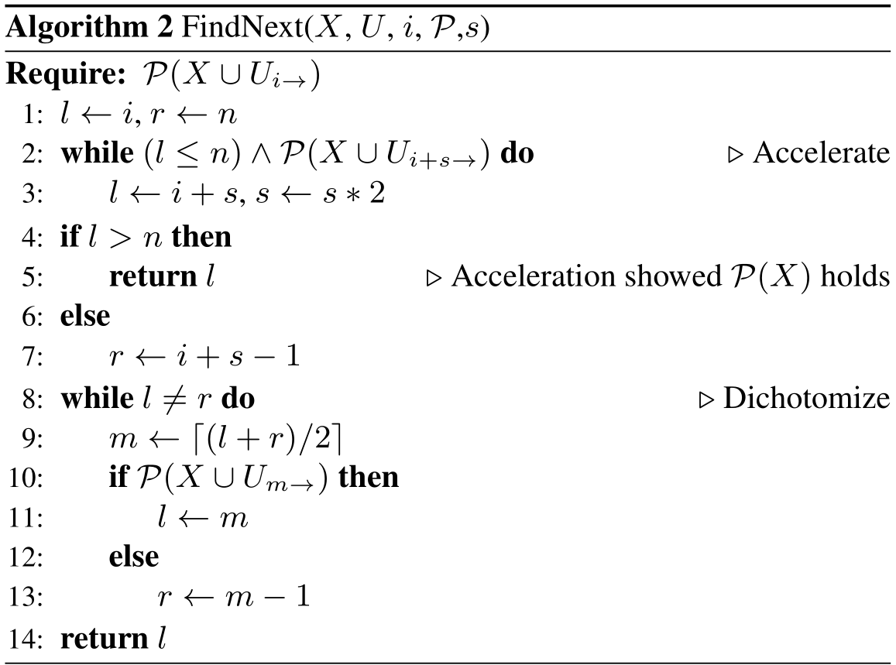
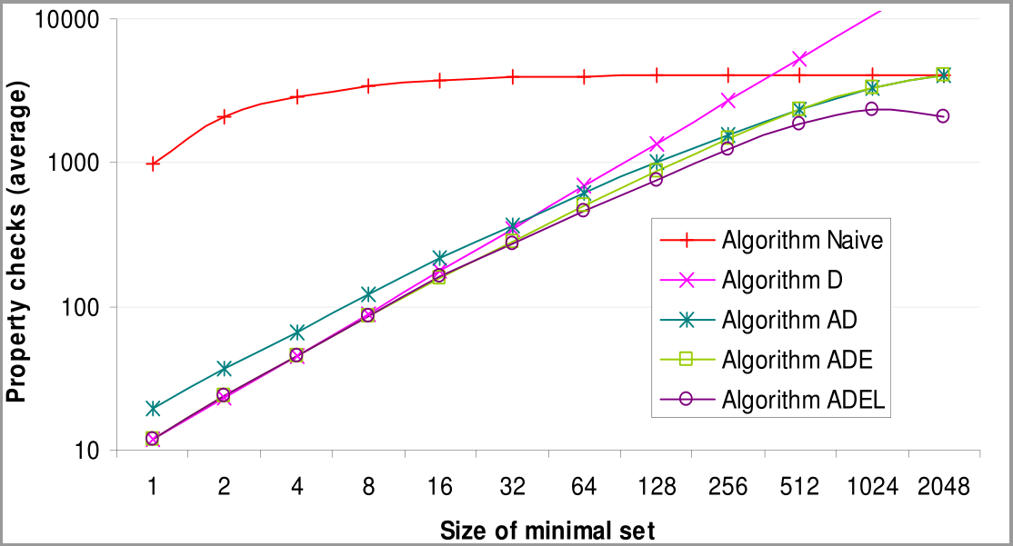
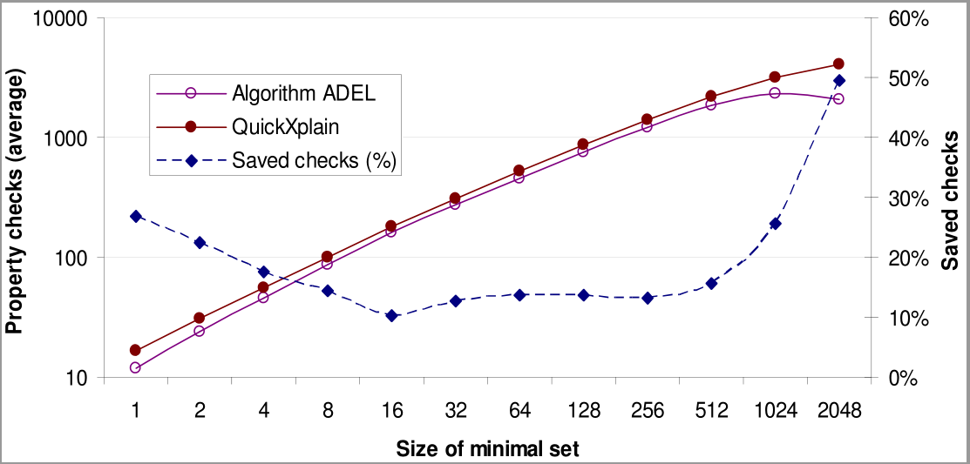
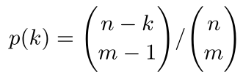
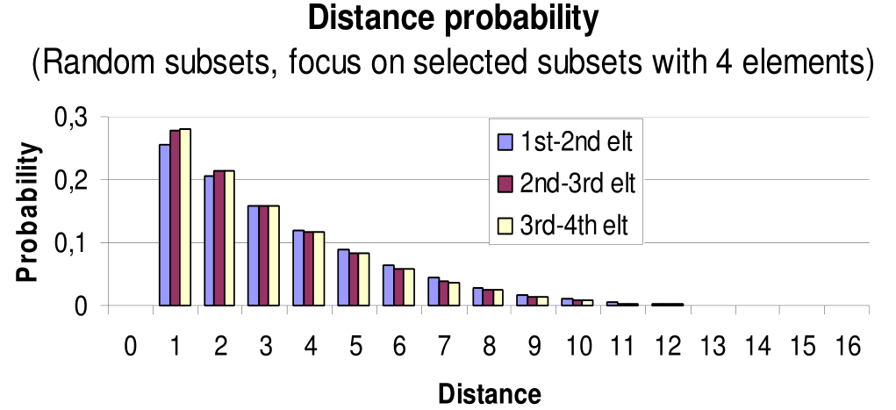
An Optimal Iterative Algorithm for
Extracting MUCs in a Black-box Constraint Network
P. Laborie - IBM Software Group - laborie@fr.ibm.com
Objective
Dichotomy
Detailed ADEL algorithm
Given an unfeasible Constrained Optimization problem M, extract a Minimal Unsatisfiable Core (MUC) that is, a minimal subset (in the sense of set inclusion) of unfeasible constraints X⊆M
Example: x, y, z in { 1, 2, 3 }
constraint C1: AllDifferent(x,y,z)
constraint C2: z == x + 2y
constraint C3: y < x
constraint C4: z == 2x
This problem is unfeasible. A possible MUC is {C1,C2}.
Algorithm developed in the context of providing a Conflict Refiner for CP models in IBM ILOG CPLEX Optimization Studio: when designing optimization models, it is usual to face unfeasible instances (due to errors in the model or the data). Identifying a MUC generally helps to explain the unfeasibility
Given the complexity of the automatic search, we consider the engine as a black-box whose answer is Yes/No for the feasibility of a subset of constraints X⊆M
A dichotomy algorithm DC has been proposed in [2]. It performs a dichotomic search in order to find next element U[i].
This algorithm is efficient for small minimal subsets. It is optimal for minimal subsets of size 1 with a complexity in ∼log₂(n).
On the other side of the spectrum, it is not efficient for large minimal subsets. For a minimal subset of size n it may require O(n log₂(n)) property checks.
Our algorithm uses a dichotomic search:
  To select the first element
  For the following elements: after the acceleration has reduced the scope of the dichotomy
P
¬P
P
P
Abstracted problem
Acceleration / progression
Let U a finite set of cardinality n and P an upward-closed (or monotonous) property on its powerset 2^{U}, that is, such that:
(X⊆Y⊆U) ∧ P(X) ⇒ P(Y)
Minimal subset: X⊆U is a minimal subset satisfying P iff:
P(X) and ∀Y⊂X, ¬P(Y)
In our original problem:
  U ≡ Set of constraints in the model
  P(X) ≡ Subset of constraints X is unfeasible
Problem definition:
  Let U such that P(U), find a minimal subset X satisfying P
  The complexity of the resolution algorithm is measured as the number of property checks. As this is an homogeneous measure we can use a more fine grain complexity comparison than the traditional big O comparison. We use a comparison on the order of :
f(n)∼g(n) means lim_{n→∞} (f(n)/g(n))=1
The probabilistic study of the distance between consecutive elements suggests that it may pay off to look for the next element close to the current one
Starting from last added element at index i, an acceleration algorithm tries i+1,i+2,i+4,...,i+2^{k} until first index j=i+2^{k} such that ¬P(X U U_{j→})
The algorithm then applies a dichotomy on the reduced index segment [i+2^{k-1},i+2^{k})
A similar approach is used in [3]
Main differences of our algorithm compared to [3]:
  The first iteration uses dichotomy, not acceleration
  The initial step in the acceleration is learned (see below), it is not necessarily 1
  Up to a certain size, property is checked on current subset X each time a new element is added
These differences allow showing optimality of the proposed algorithm for small minimal subsets
Results
A family of iterative algorithms
Estimation (of distance)
Elements of U are stored in an array of size n
Array is shuffled so as to rule out any particular structure
Algorithm will select the “rightmost” minimal set in the array
Scan elements from left to right
Grows a current subset X
Next element U[i] to be added to current subset X is the one with the smallest index i such that P(X U U_{i→})
When a new element U[i] is added, property P can be checked on current subset X (if P(X), algorithm can be stopped)
Algorithms in this family differs according to the way to find the next element U[i]
The probabilistic study of the distance between consecutive elements suggests that the distribution of this distance does not depend much on which element is considered
Let s denote the size of the initial acceleration step (acceleration algorithm tries i+s,i+2s,i+4s,...,i+2^{k}s)
For the first element, we take s=n so the search boils down to a pure dichotomic search (line 4 on Algorithm 1)
For the next elements, the initial acceleration step is computed as the average distance between past elements (line 10 on Algorithm 1)
Note that in case of a minimal subset of size n, after first element is found (at position 1), the initial acceleration step is always 1
X
U[i]
U_{i→}
Algorithm ADEL is optimal in both extreme cases:
  For small subsets: ∼log₂(n) for minimal subset of size 1
  For large subsets: ∼n for minimal subset of size n
Compared to QuickXplain [1]:
  For small subsets, it performs 1.5 times less checks
  For large subsets, it performs twice less checks
It behaves continuously in between these extreme cases and outperforms all variants as well as QuickXplain
ADEL algorithm is used as the implementation of the Conflict Refiner functionality for CP models in IBM ILOG CPLEX Optimization Studio since version 12.5
Position of consecutive elements
Lazy checks
In the particular case of a single minimal subset of size m uniformly distributed in U, the probability p(k) that the distance between the i^{th} and i+1th element is k:
  Does not depend on the position i
  Exponentially decreases with k
Experiments in more general cases
  Next element of the subset is often close to the current one
  Estimated distance between consecutive elements can be learned
Property P(X) may be checked when a new element is added to X, this allows stopping the search as soon as X satisfies P
This is efficient for small minimal subsets. Typically, for a minimal subset of size 1, once the initial dichotomy has selected an (the) element, search will be stopped immediately
This is inefficient for large subsets. Typically, for a minimal subset of size n, n-1 useless checks P(X) will be performed
When the last element of the minimal subset is added to X, if we do not check P(X), it will take the acceleration about O(log₂(n)) additional checks to show that X satisfies P(X)
The idea is to check P(X) only for the first log₂(n) elements. For larger subsets, the O(log₂(n)) price to pay for letting the acceleration show the property will not exceed the O(log₂(n)) we already payed to check the first log₂(n) elements so the algorithm can stop checking P(X) (line 13 of Algorithm 1)
References
[1] U. Junker. QuickXplain: Preferred explanations and relaxations for over-constrained problems. In Proc. AAAI-04. 2004.
[2] F. Hemery, C. Lecoutre, L. Sais and F. Boussemart. Extracting MUCs from constraint networks. In Proc. ECAI-06. 2006.
[3] J. Marques-Silva, M. Janota and A. Belov. Minimal Sets over Monotone Predicates in Boolean Formulae. In Proc. CAV-13. 2013.

