Slide 1

New Results for the
GEO-CAPE Observation Scheduling Problem
Philippe Laborie, Bilal Messaoudi
IBM, IBM Analytics laborie@fr.ibm.com

Slide 2
Overview
Problem description
Previous results
Our contributions:
  Providing optimality bounds (MILP model)
  Finding better quality solutions (CP Optimizer model)

Slide 3
Problem description
NASA satellite observation scheduling problem proposed in J. Frank, M. Do and T. T. Tran. Scheduling Ocean Color Observations for a GEO-Stationary Satellite. In Proc. ICAPS-2016.
A set of n scenes to be observed by a satellite instrument during one day
Each scene is observed multiple times during the day
All observations have the same duration (1 time-unit)
Scenes are not always observable (due to sunrise time, cloud coverage, …): each scene is defined as a set of observability time slots
The satellite instrument can only observe one scene at a time

Slide 4
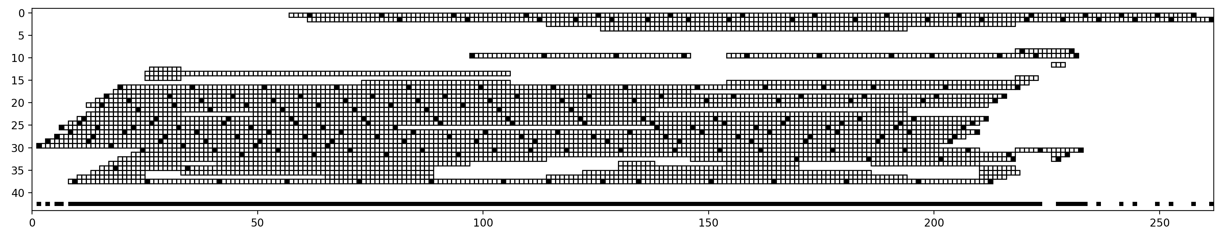
Problem description
Example of a problem instance and a feasible solution
A scene with its possible observability time-slots
Observability time-slots
Scheduled observations
All scheduled observations

Slide 5
Problem description
Schedule quality depends on the separation time d between consecutive observations of each scene
d
Gain
V(d)
Objective: maximize total gain due to separation times
Number of scheduled observations is unknown
V_{T}
V_{B}
d
d
S_{B}
S_{T}

Slide 6
Previous results
Benchmark: 44 realistic instances
  2 types of instruments (COEDI/FR) x
  2 types of science experiments (Survey/Targeted) x
  11 observability scenarios corresponding to weather condition at different period of the year (months)
Best solutions were obtained with a time-indexed MILP formulation
  Main decision variables
o_{ij} ∈ {0,1} s.t. o_{ij}=1 iff scene i is observed at time-slot j
Computation time: 1h
Problems could not be solved to optimality, no optimality bound available

Slide 7
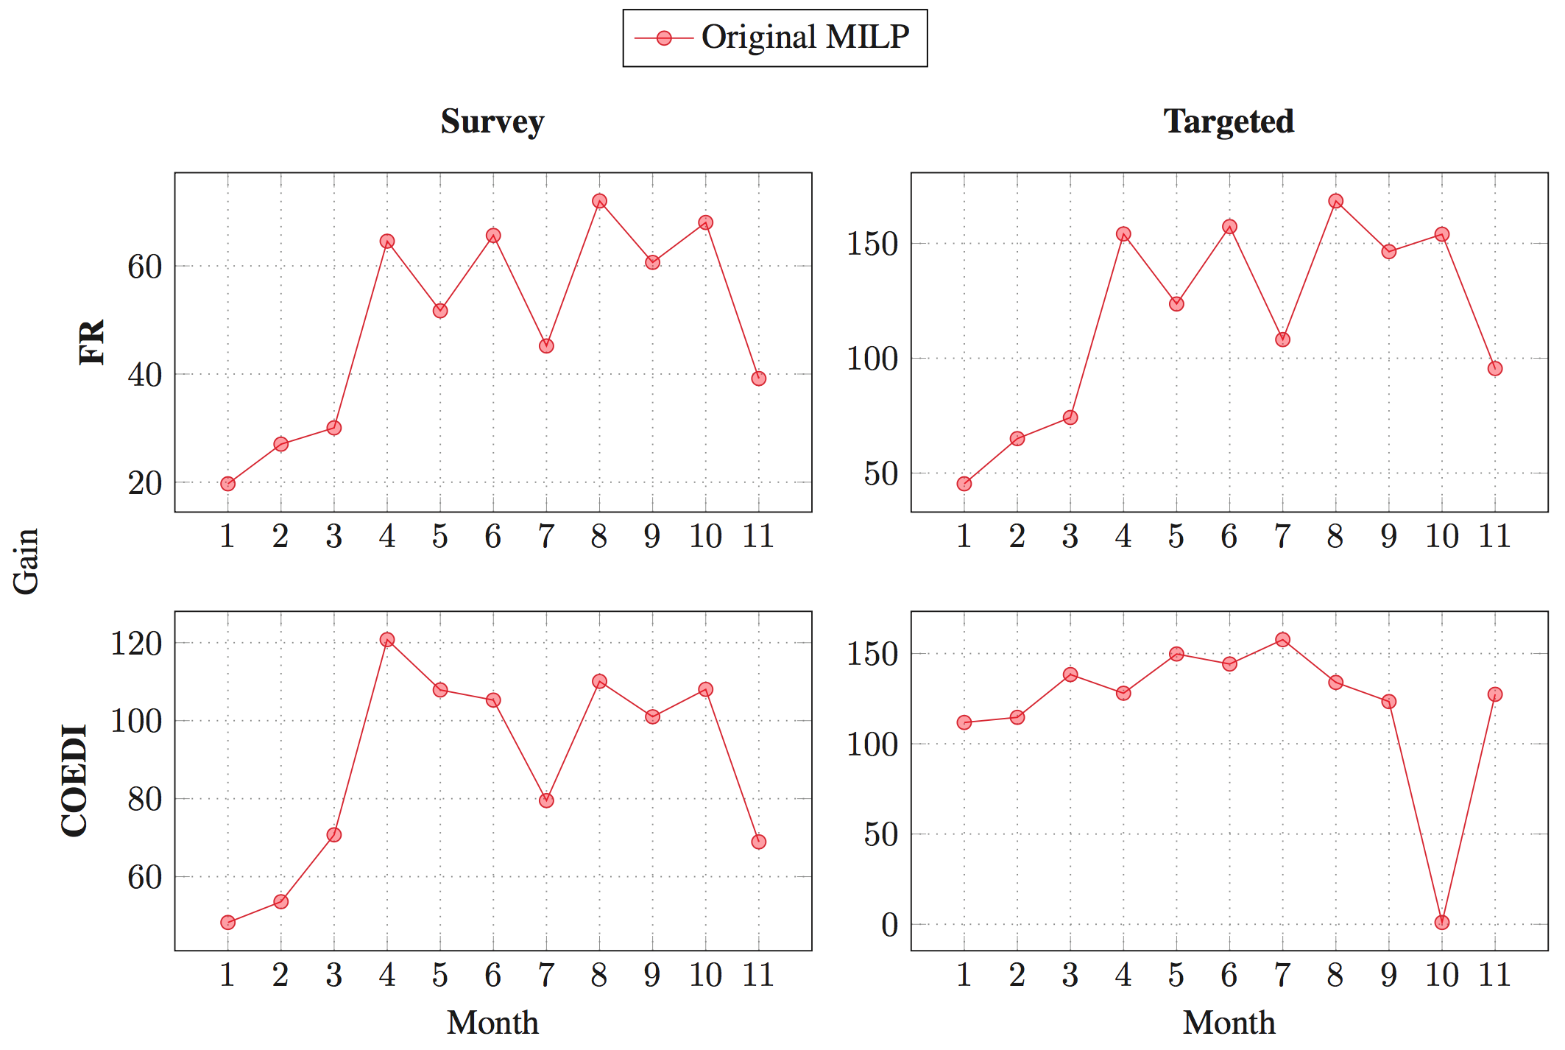
Previous results

Slide 8
Optimality bounds (MILP model)
Disjunctive MILP model (details in the paper)
  Main decision variables:
b_{i1,j1;i2,j2} ∈ {0,1} s.t. b_{i1,j1;i2,j2}=1 iff
the j1th observation of scene i1 is performed before
the j2th observation of scene i2

Slide 9
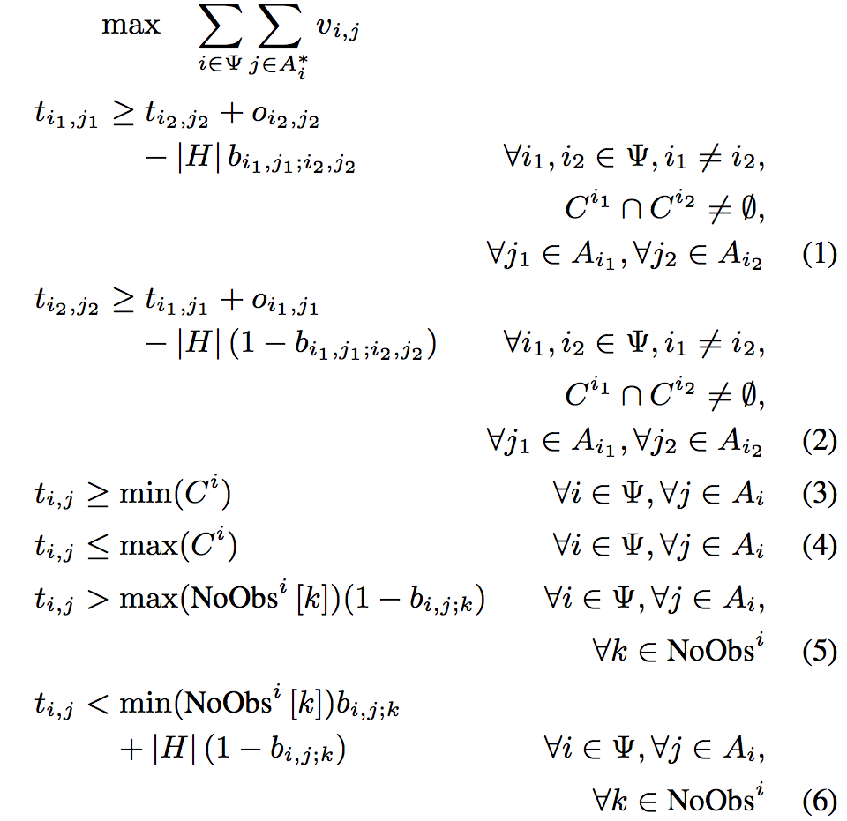
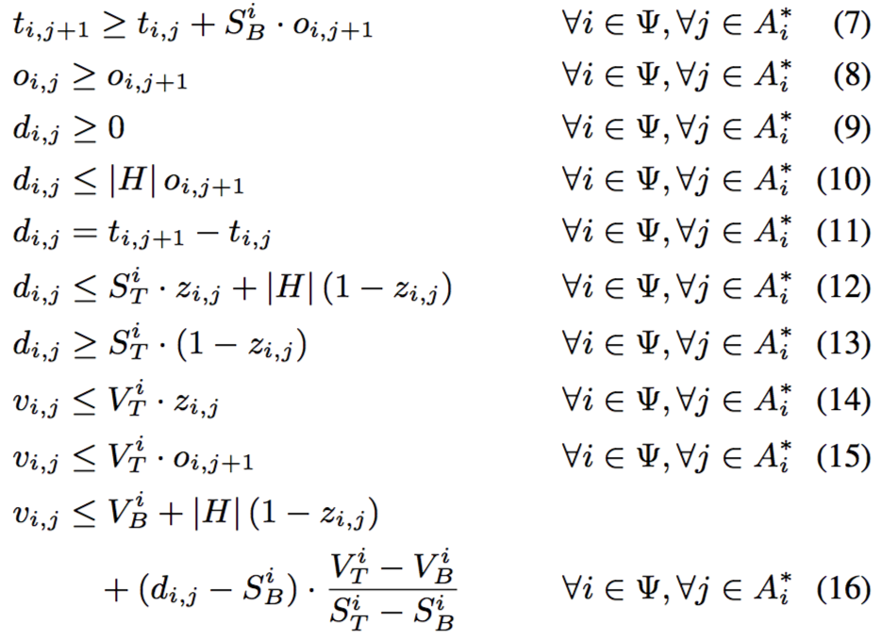
Optimality bounds (MILP model)
Disjunctive MILP model (details in the paper)
  Main decision variables:
b_{i1,j1;i2,j2} ∈ {0,1} s.t. b_{i1,j1;i2,j2}=1 iff
the j1th observation of scene i1 is performed before
the j2th observation of scene i2

Slide 10
Optimality bounds (MILP model)
Disjunctive MILP model (details in the paper)
  Quickly solve easy instances (FR instrument) to optimality
  Bad quality solutions / optimality bounds on the other ones
  The model can be relaxed (energetic relaxation of observations no-overlap) to produce optimality bounds (upper-bounds)

Slide 11
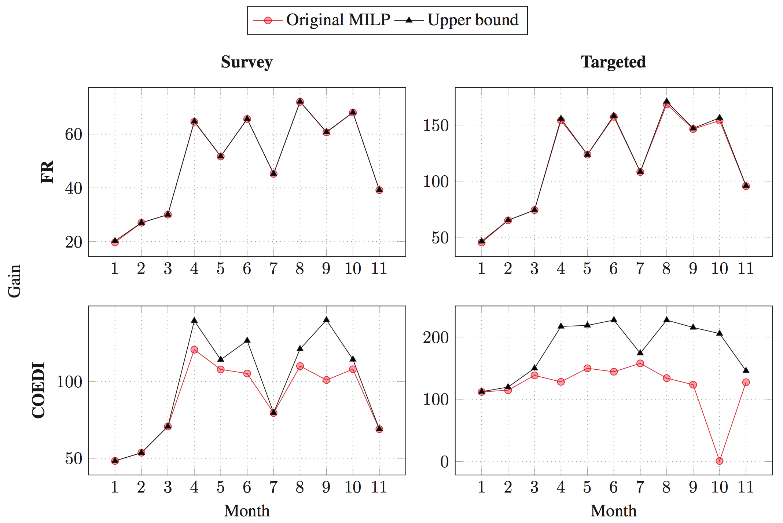
Optimality bounds (MILP model)

Slide 12
Good quality solutions (CP Optimizer model)
What is CP Optimizer?
An optimization engine for solving combinatorial problems (with a particular focus on scheduling problems)
Available in IBM ILOG CPLEX Optimization Studio
Implements a model & run paradigm (like CPLEX):
  Problem is formulated as a declarative model
    Extends classical combinatorial optimization framework with concepts like optional interval variables, functions of time, specialized constraints (e.g. noOverlap), …
    Available in different programming languages (C++, Python, Java, .NET and OPL)
  Powerful automatic search being continuously improved
    Search is complete
    Internally uses many techniques (CP, MP, meta-heuristics,...)

Slide 13
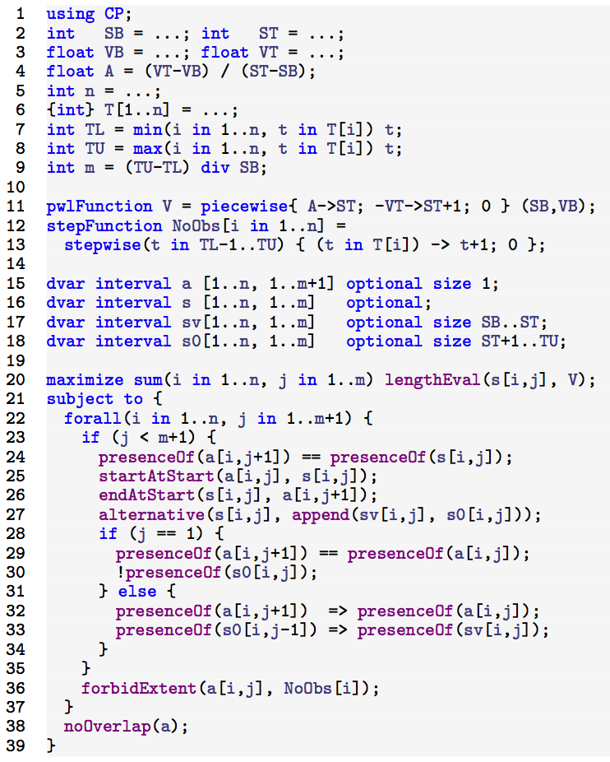
Good quality solutions (CP Optimizer model)

Slide 14
Good quality solutions (CP Optimizer model)
Data reading and
constants
Decision variables
Objective function
Constraints

Slide 15
Good quality solutions (CP Optimizer model)
TL: origin of the schedule
TU: horizon of the schedule
m : upper-bounds on number of
observations of a given scene
V : gain function
NoObs[i]: for observation i,
step function equal to 0 on
time-slots where scene i is not
observable and 1 otherwise
Gain
V_{T}
V_{B}
d
d
S_{B}
S_{T}
1
0

Slide 16
Good quality solutions (CP Optimizer model)
Decision variables
Interval variable: decision variable
x with a domain:
Dom(x) ⊆ {⊥} ∪ { [s,e) | s,e ∈ Z, s≤e }
Absent interval
Interval of integers

Slide 17
Good quality solutions (CP Optimizer model)
a[i,j]: interval variable of size 1
representing the j^{th} observation
of scene i (if i is observed at least
j times), otherwise a[i,j] is absent
s[i,j]: interval variable representing
the separation time between
a[i,j] and a[i,j+1]

Slide 18
Good quality solutions (CP Optimizer model)
a[i,j]: interval variable of size 1
representing the j^{th} observation
of scene i (if i is observed at least
j times), otherwise a[i,j] is absent
s[i,j]: interval variable representing
the separation time between
a[i,j] and a[i,j+1]
...
...
s[i,j]
s[i,j+1]
a[i,j]
a[i,j+1]

Slide 19
Good quality solutions (CP Optimizer model)
a[i,j]: interval variable of size 1
representing the j^{th} observation
of scene i (if i is observed at least
j times), otherwise a[i,j] is absent
s[i,j]: interval variable representing
the separation time between
a[i,j] and a[i,j+1]
...
...
s[i,j]
s[i,j+1]
a[i,j]
a[i,j+1]

Slide 20
Good quality solutions (CP Optimizer model)
a[i,j]: interval variable of size 1
representing the j^{th} observation
of scene i (if i is observed at least
j times), otherwise a[i,j] is absent
s[i,j]: interval variable representing
the separation time between
a[i,j] and a[i,j+1]
Interval variable a[i,j] cannot overlap
a time-slot that is not observable
(NoObs[i](t)=0)
1
0
a[i,j]

Slide 21
Good quality solutions (CP Optimizer model)
a[i,j]: interval variable of size 1
representing the j^{th} observation
of scene i (if i is observed at least
j times), otherwise a[i,j] is absent
s[i,j]: interval variable representing
the separation time between
a[i,j] and a[i,j+1]
Interval variable a[i,j] cannot overlap
a time-slot that is not observable
(NoObs[i](t)=0)
Intervals a[i,j] do not overlap as the
the instrument can observe only one
scene at a time
1
0
a[i,j]

Slide 22
Good quality solutions (CP Optimizer model)
a[i,j]: interval variable of size 1
representing the j^{th} observation
of scene i (if i is observed at least
j times), otherwise a[i,j] is absent
s[i,j]: interval variable representing
the separation time between
a[i,j] and a[i,j+1]
Objective is to maximize the total
gain due to separation time between
observations (length of interval
variables s[i,j]):
∑_{i,j} V(lengthOf(s[i,j]))
Gain
V_{T}
V_{B}
d
d
S_{B}
S_{T}

Slide 23
Good quality solutions (CP Optimizer model)
Notion of an isolated observation a[i,j]:
Property: there exist an optimal
solution that does not contain any
isolated observation
>S_{T}: no gain
>S_{T}: no gain
s[i,j-1]
s[i,j]
a[i,j-1]
a[i,j]
a[i,j+1]
Gain
V_{T}
V_{B}
d
d
S_{B}
S_{T}

Slide 24
Good quality solutions (CP Optimizer model)
Two possibilities are considered for a
separation s[i,j]:
sv[i,j]: length is in [S_{B},S_{T}] and it
brings some value
s0[i,j]: length is >S_{T} and it does not
bring any value
0
S_{B}
S_{T}
sv[i,j-1]
sv[i,j]
Alternatives
s0[i,j-1]
s0[i,j]
Alternatives
s[i,j-1]
s[i,j]
a[i,j-1]
a[i,j]
a[i,j+1]

Slide 25
Good quality solutions (CP Optimizer model)
Two possibilities are considered for a
separation s[i,j]:
sv[i,j]: length is in [S_{B},S_{T}] and it
brings some value
s0[i,j]: length is >S_{T} and it does not
bring any value
0
S_{B}
S_{T}
sv[i,j-1]
sv[i,j]
Alternatives
s0[i,j-1]
s0[i,j]
Alternatives
s[i,j-1]
s[i,j]
a[i,j-1]
a[i,j]
a[i,j+1]

Slide 26
Good quality solutions (CP Optimizer model)

Slide 27
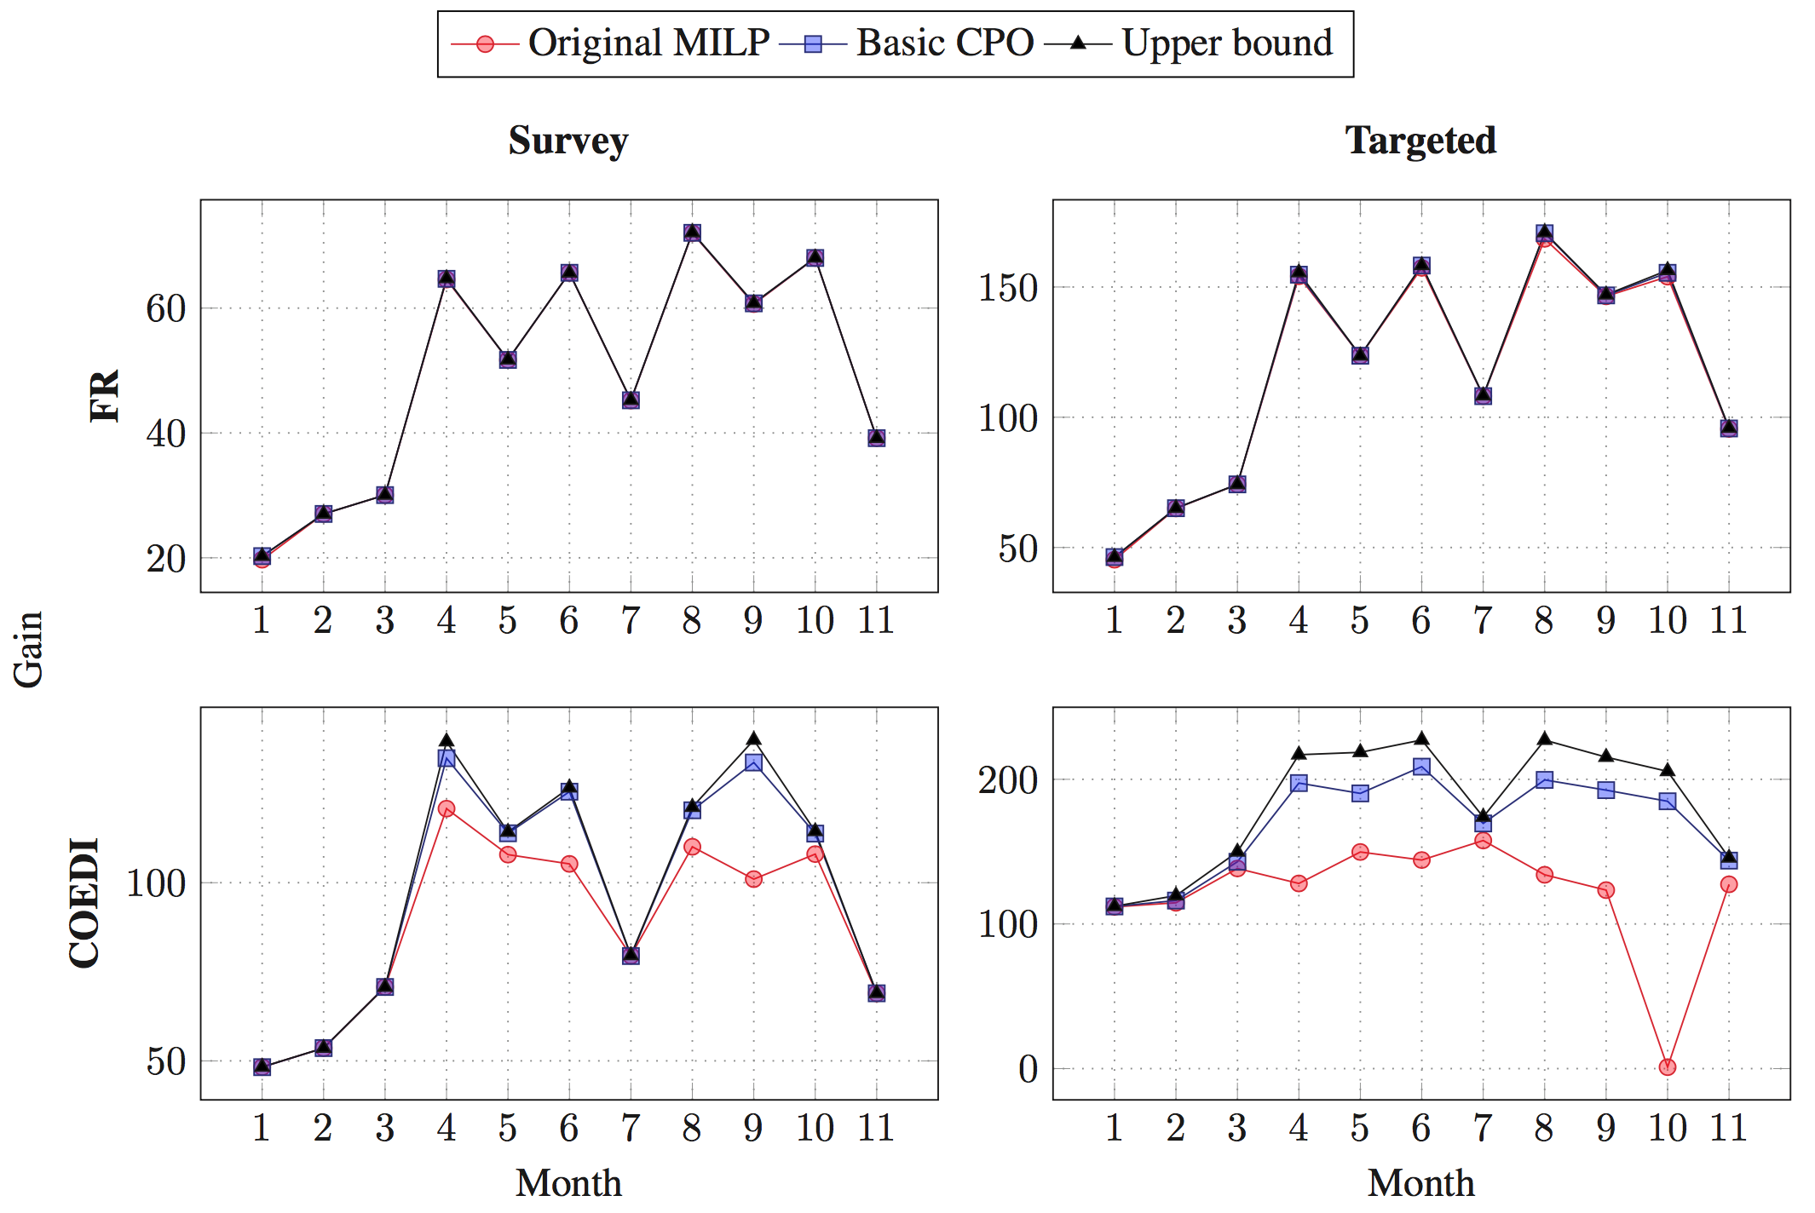
Good quality solutions (CP Optimizer model)

Slide 28
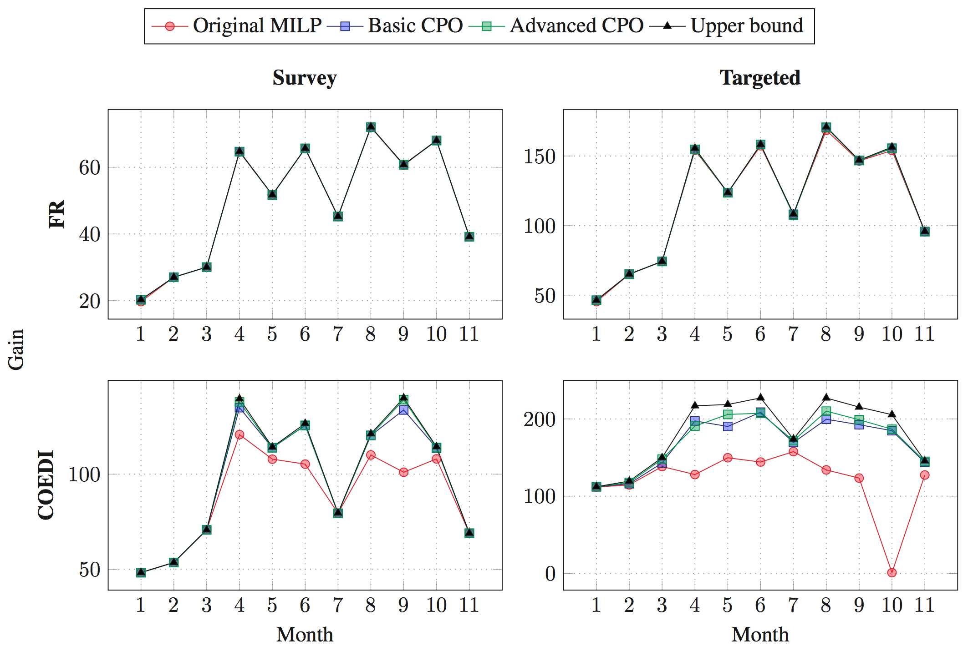
Good quality solutions (CP Optimizer model)

Slide 29
Results and conclusion
Optimal or near optimal solutions (gap≤1%) found for about 80% of the instances
On COEDI instrument, average gap is 2.72% compared to 18.42% for the original MILP
The model is easy to extend to additional features:
  Different observation durations
  Different observation modes
  Sequence-dependent setup times between observations
  Re-scheduling
A good illustration of the versatility of CP Optimizer for solving challenging scheduling problems
  More information in the ICAPS-2017 tutorial “Introduction to CP optimizer for Scheduling” material ...

