Slide 1
An Update on the Comparison of
MIP, CP and Hybrid Approaches for
Mixed Resource Allocation and Scheduling
Philippe Laborie, IBM laborie@fr.ibm.com

Slide 2
The Problem
Described in [1] where a benchmark is provided
n jobs, for each job j:
  Release date rj , Due date dj
m facilities where the jobs can be executed
For each facility i: maximal capacity C_{i}
If a given job j is allocated to facility i:
  Processing time of job j is p_{ij}
  Job j requires c_{ij} units of facility i
  Execution cost of job j is f_{ij}
Decision variables: facility allocation & start time of jobs
Minimize total job execution cost
Job j
r_{j}
d_{j}
[1] J. Hooker. A Hybrid Method for Planning and Scheduling. Proc. CP 2004.

Slide 3
The state-of-the-art
[Hooker-2004]
[Hooker-2007]
[Heinz-2011]
[Heinz-2012]
[Heinz-2013]
[Ciré-2016]
[Mistry-2017]
Mixed Integer Programming (MIP)
Constraint Programming (CP)
Logic-based Benders decomposition (LBBD)
Constraint Integer Programming (CIP)
Satisfiability Modulo Theories (SMT)
The problem is very difficult. Even some problems with only 30 jobs and 2 facilities are still open !

Slide 4
CP Optimizer
A component of IBM ILOG CPLEX Optimization Studio
(so if you have CPLEX, you also have CP Optimizer)
An optimization engine based on a Model & Run approach
(like CPLEX)
… with a particular focus on scheduling problems

Slide 5
CP Optimizer: Model & Run
Declarative mathematical model of the problem
Introduction of adequate mathematical concepts for scheduling problems (intervals, functions, permutations/sequences)
  Modeling is easy
  Modeling is fast
  Models are compact and maintainable
  Models generally scale well (size grows linearly with size of data)
Uses classical ingredients of combinatorial optimization: variables, constraints, expressions, objective function

Slide 6
CP Optimizer: Model & Run
Resolution is performed by an automated search algorithm that is:
  Complete
  Deterministic
  Anytime
  Efficient
  Robust
  Continuously improving

Slide 7
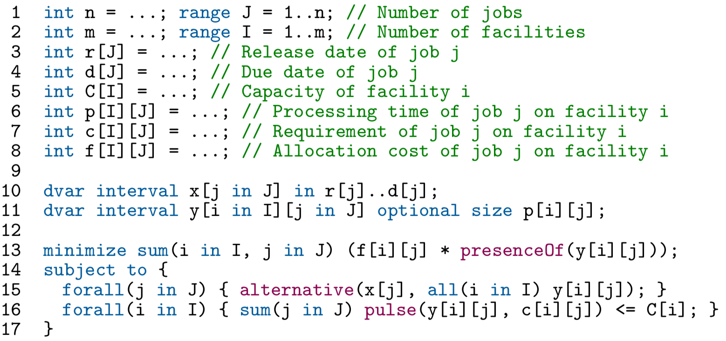
A complete CP Optimizer model for our problem

Slide 8
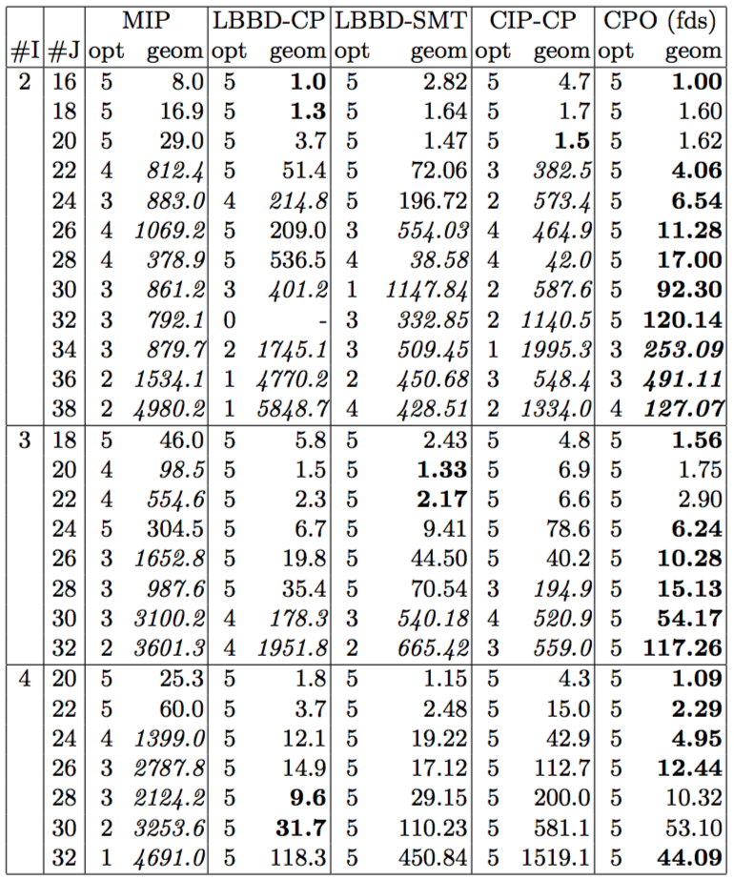
Comparison with state-of-the-art approaches
The tiny CP Optimizer model of previous slide closes the benchmark
Number of solved instances (out of 5)
Average solve time (in s.)
}
The 5 remaining instances were
closed by increasing the time-limit
(up to 160h for the hardest one)

Slide 9
Under the Hood
Search interleaves two complementary approaches:
  Large Neighborhood Search (LNS) finds good solutions C [3]
  Failure-Directed Search (FDS) tries proving infeasibility of obj<C [4]
    Strong constraint propagation algorithms on optional intervals:
      Alternative: constructive disjunction of interval domains [1]
      Cumul functions: Edge-Finding variants [2]
    Restarts, no-goods learning, dynamic rating of decisions
No-goods
Search tree
Decisions rating
Restart
[1] P. Laborie, J. Rogerie. Reasoning with Conditional Time-Intervals. Proc. FLAIRS-2008, p555-560.
[2] P. Vilím: Timetable Edge Finding Filtering Algorithm for Discrete Cumulative Resources. CPAIOR-2011.
[3] P. Laborie, D. Godard. Self-Adapting Large Neighborhood Search: Application to Single-Mode Scheduling Problems. Proc. MISTA-2007.
[4] P. Vilím, P. Laborie, P. Shaw. Failure-Directed Search for Constraint-Based Scheduling. CPAIOR-2015.

Slide 10
Benchmark Extension
Given that the current benchmark is closed we generated more challenging instances (http://ibm.biz/AllocSched)
Larger problems, finer time and capacity granularity
 | Current benchmark | New benchmark
Size: # jobs # facilities | [10,50] [2,10] | [20,1000] [2,20]
Job duration | [5,30] | [100,4500]
Facility capacity Facility requirement | 10 [1,10] | 1000 [1,1000]
Facility requirements depends on task | No | Yes

Slide 11
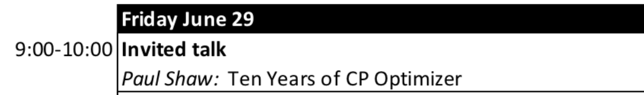
More about CP Optimizer
Recent overview of CP Optimizer for scheduling [1]
Don’t miss tomorrow’s plenary talk by Paul Shaw:
[1] P. Laborie, J. Rogerie, P. Shaw, P. Vilím. IBM ILOG CP Optimizer for Scheduling. Constraints Journal. April 2018, Volume 23, Issue 2, pp 210–250.

