Slide 1
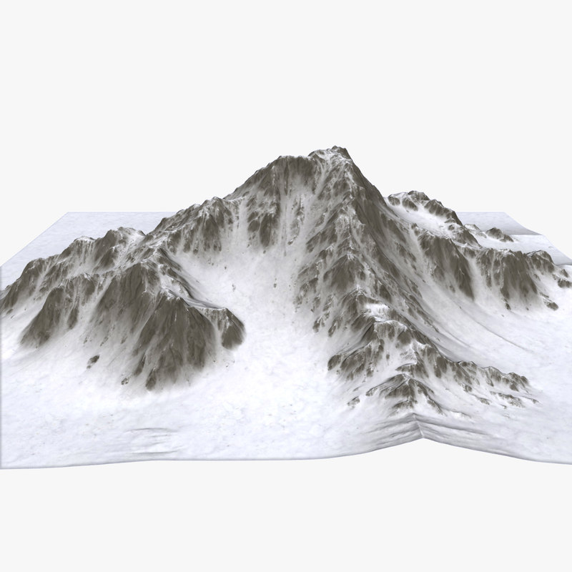
Objective Landscapes for
Constraint Programming
Philippe Laborie, IBM laborie@fr.ibm.com

Slide 2
Goal
Improve performance of a Black-Box CP Solver (in our case IBM ILOG CP Optimizer) by exploiting some information on the relation between decision variables and objective value
This idea is not new !
  Impact-Based Search [Refalo-2014]
  Activity-Based Search [Michel&Van Hentenryck-2012]
  Linear Relaxations [Beck&Refalo-2003, Laborie&Rogerie-2016]
  …, …, ...
But we had specific requirements:
  It should work for variables with huge domains, typically with continuous semantics (start/end times of activities)
  It should scale to large problems with several 1000s of variables

Slide 3
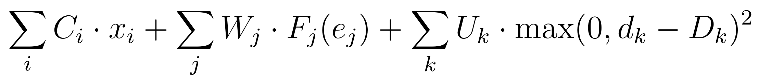
Goal
Typical examples of objective functions in the real-world:
  Scheduling in semiconductor manufacturing:
    x_{i}: Boolean variables (allocations of tasks to machines)
    e_{j}: End time of task j, F_{j}: Earliness/Tardiness cost function
    d_{k}: Delay variable between some particular tasks
  Resource Constrained Project Scheduling with Net Present Value:
    e_{p}: End times of activities producing cash
    e_{c}: End times of activities consuming cash

Slide 4
The Philosophy of Objective Landscapes
“Lazy Programmers for Lazy Machines.”
The new technique should (almost) not add any computational cost to the existing search algorithms
The new technique should reuse existing algorithms as much as possible
→ Use existing algorithms in a different way !

Slide 5
Objective Landscape Definition
Context:
A constrained-optimization problem:
minimize f(x₁,…,x_{n})
subject to c(x₁,…,x_{n},y₁,…,y_{m})
x₁,…, x_{n}, y₁,…, y_{m} are decision variables
A constraint propagation algorithm P that propagates the constraint f(x₁,…,x_{n}) ≤ z for a given value z
Let X_{i}^{L}(z) (resp. X_{i}^{U}(z) ) denote the min (resp. max) value in the domain of x_{i} after propagation of f(x₁,…,x_{n}) ≤ z by P

Slide 6
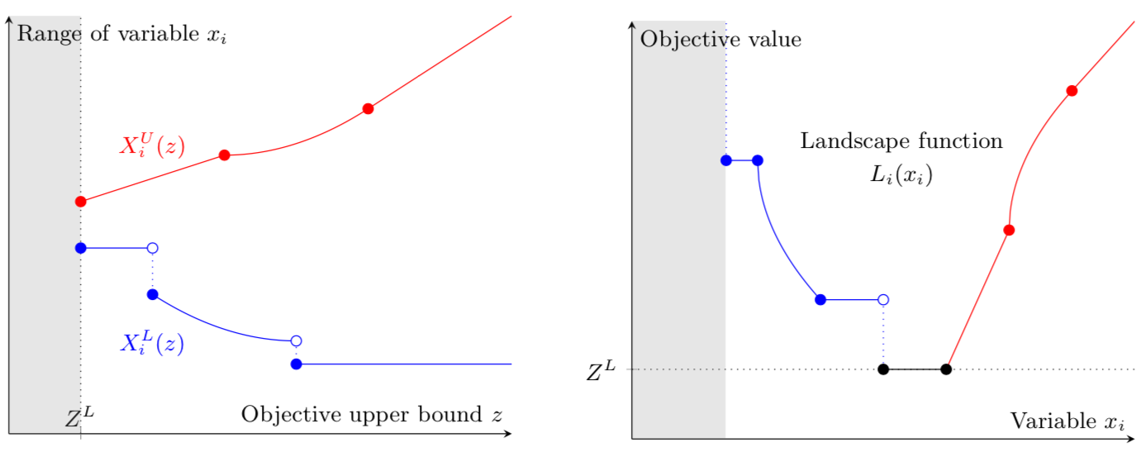
Objective Landscape Definition
Landscape function L_{i} of a variable x_{i}
L_{i}(v) can be interpreted as an optimistic estimation of the objective value when x_{i}=v (more formalization in the paper)
90º

Slide 7
Objective Landscape Computation
Objective Landscape functions can be quickly computed once and for all before entering the search by sampling a discrete set of objective values z and running propagation algorithm P and recording the bounds for all variables x_{i}
They are represented using a light-weight structure (array of pairs variable value/objective value)
Computing the landscape value L_{i}(v) for a value v in the domain of x_{i} is fast: it can be done in O(log(N)) if N is the number of samples (generally only a few tens) by simple binary search

Slide 8
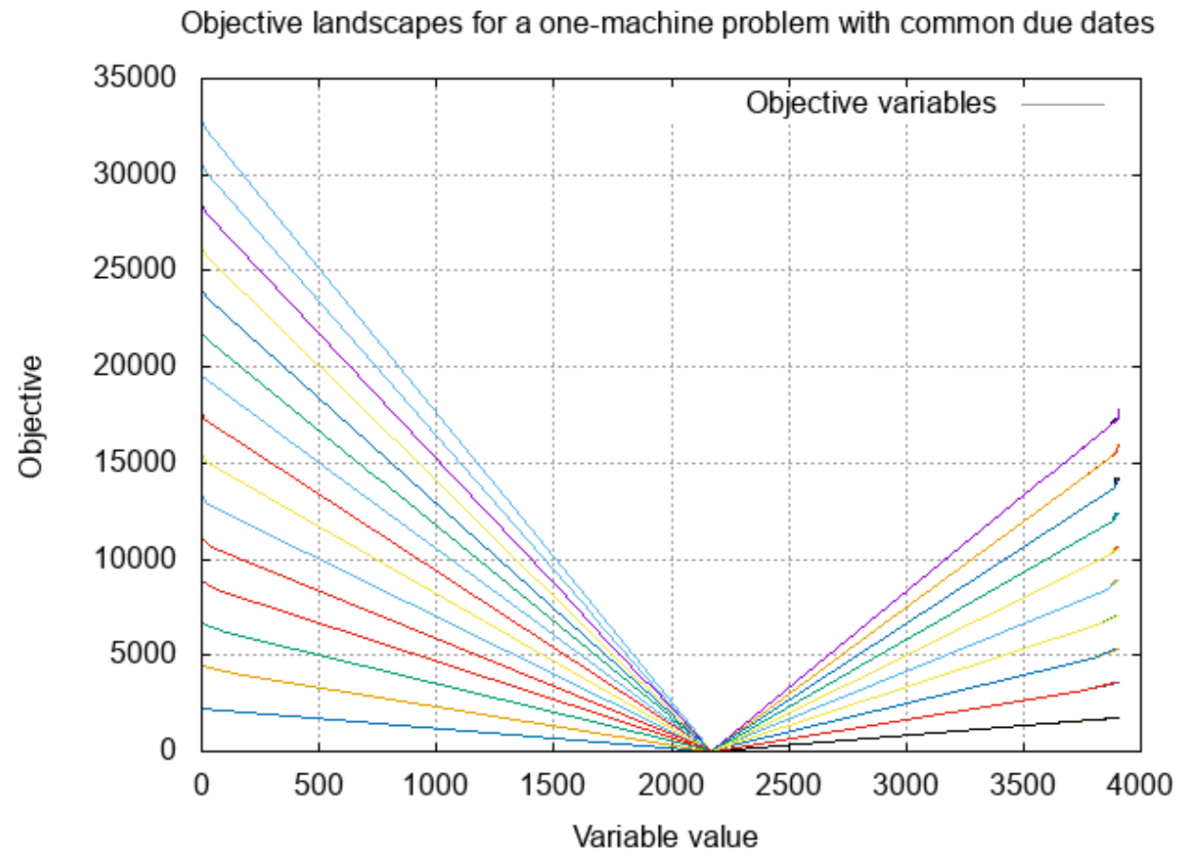
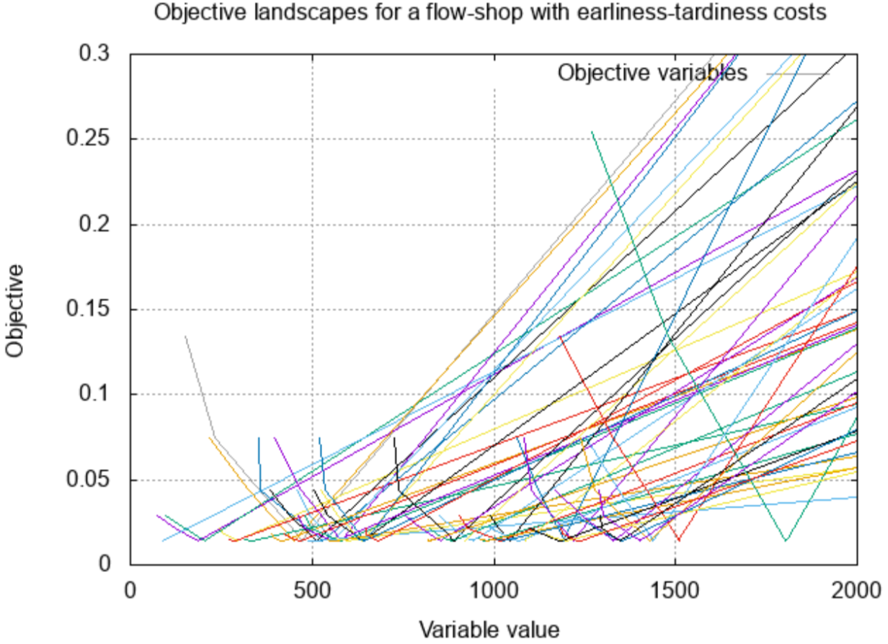
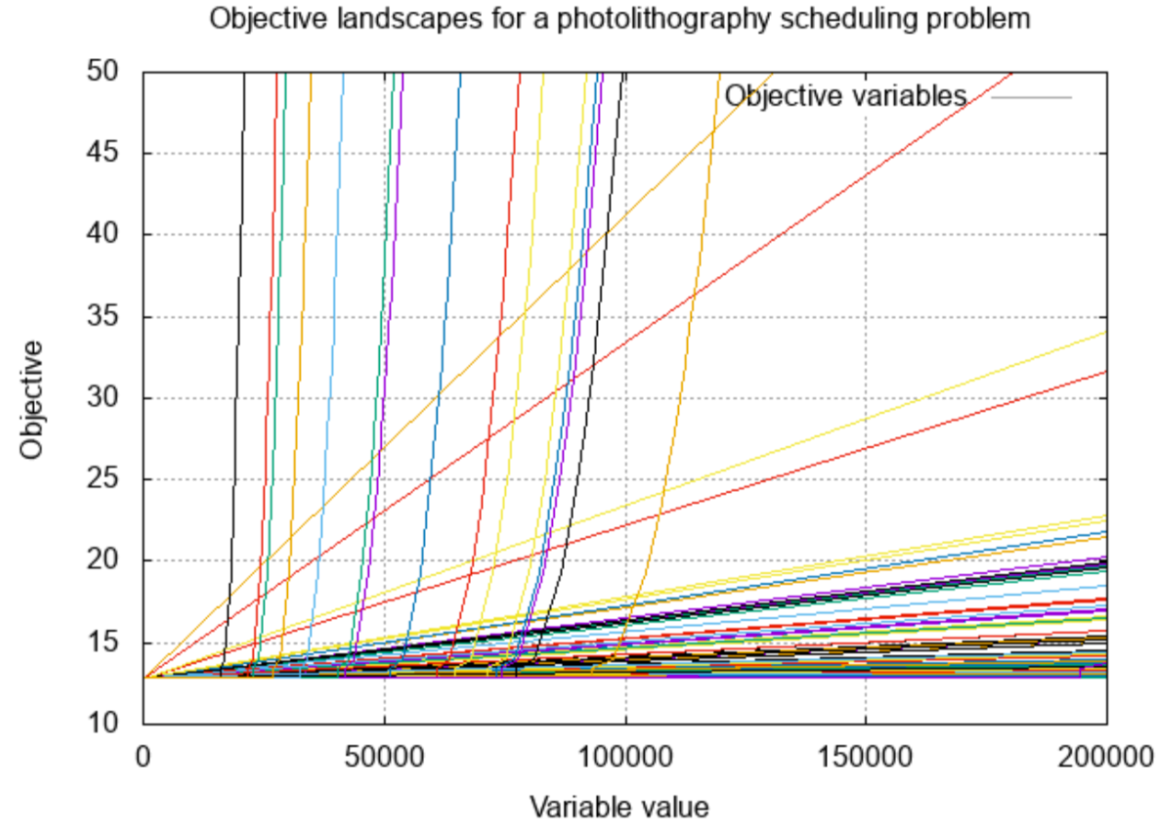
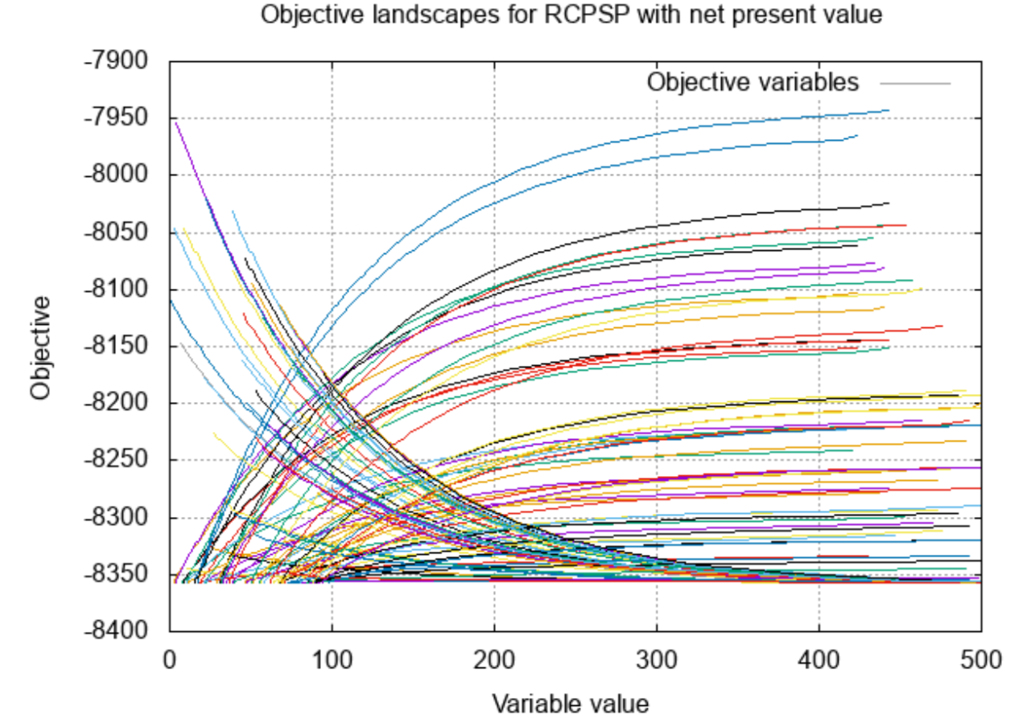
Examples of Landscape Functions

Slide 9
Objective Landscape Exploitation
In CP, landscape functions can be used in many ways during the search:
  Selection of variables
  Selection of values
  In a Large Neighborhood Search (LNS) context:
    Selection of LNS fragment
    Prevent cost degradation for some variables in LNS moves
    Selection of variables and values in LNS completion
We still did not fully explore all these ideas

Slide 10
Objective Landscape Exploitation
Preventing cost degradation for some variables in LNS moves
  At the top level of a move, we have the current solution S and a relaxed model around S that we want to re-optimize
  For a given variable x_{i}, let X_{i}^{S} denote the value of x_{i} in solution S
  For a certain number of variables x_{i} (randomly selected) we just consider the additional constraint L_{i}(x_{i}) ≤ L_{i}(X_{i}^{S})
Landscape function L_{i}
L_{i}(X_{i}^{S})
X_{i}^{S}

Slide 11
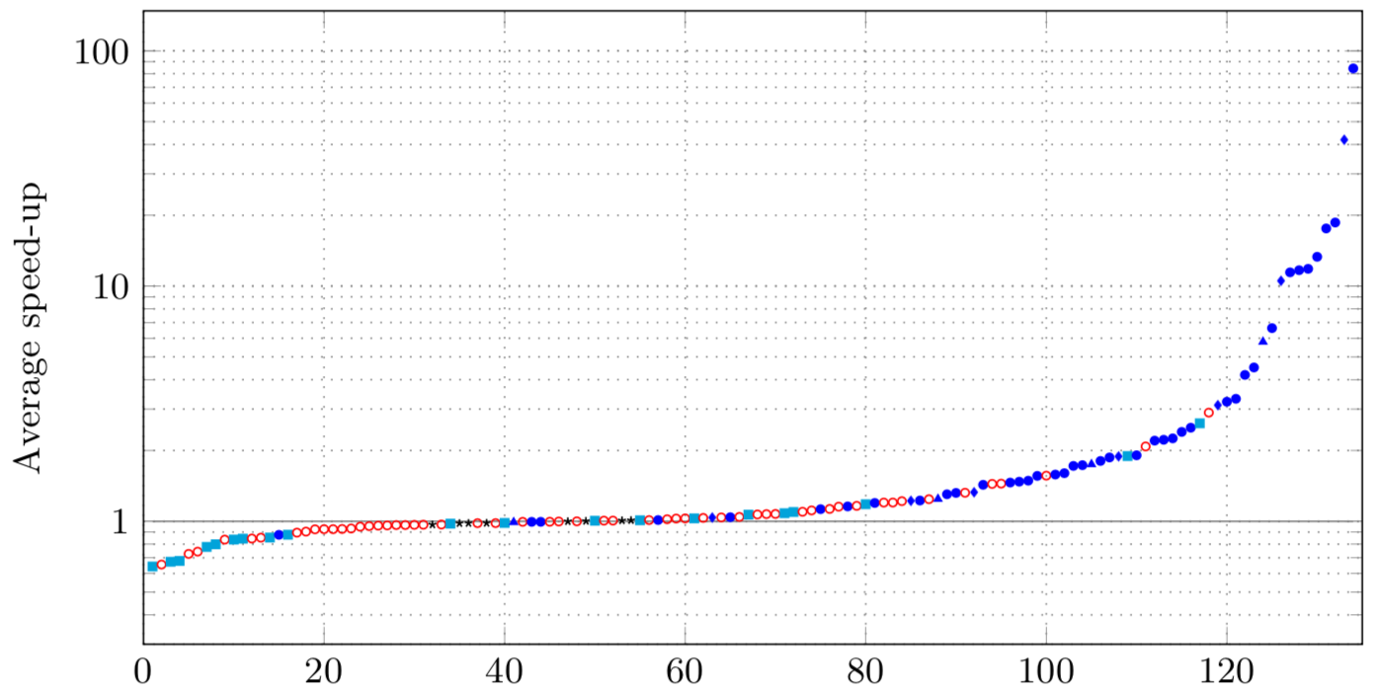
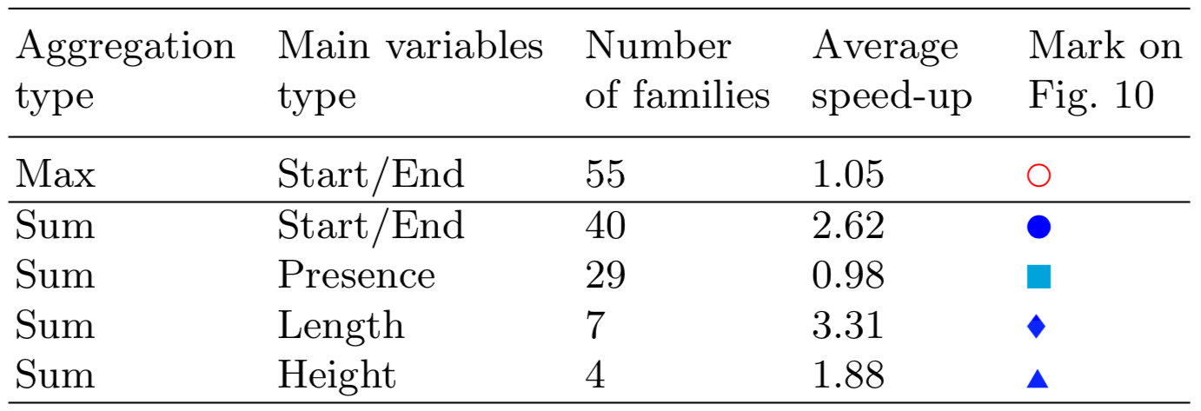
Experimental Results
Average speed-up when using objective landscapes on 135 different families of scheduling problems

Slide 12
Conclusion and Future Work
Implemented in automated search of IBM ILOG CP Optimizer V12.7.1/12.8
Average speed-up x1.5 between 12.7 and 12.8
Up to two orders of magnitude speed-up for some problems with objective expressed as a weighted sum of variables with continuous semantics (very common in real problems)
Future work:
  Investigate other forms of landscape exploitation in the search
  Objective landscapes can be generalized to store holes in the domains
  Constraints of the problem could be exploited too

