Slide 1
Randomized Large Neighborhood Search for Cumulative Scheduling
Daniel Godard
Philippe Laborie
Wim Nuijten

Slide 2
Randomized Large Neighborhood Search for Cumulative Scheduling
Agenda
Introduction
LNS approach
  Searching for solution
  POS generation
  LNS relaxation
Experimental study on Cumulative Job Shop Scheduling Problem
Beyond Cumulative Job Shop Scheduling Problem
Conclusion
Notes:
Searching for a solution

Slide 3
Randomized Large Neighborhood Search for Cumulative Scheduling
Introduction
Cumulative Scheduling : problem where resources may execute more than one activity at a time provided that the resource capacity is not exceeded
Many practical scheduling problems are cumulative scheduling problems
Increasing attention over the past years
Notes:
See work of :
Baptiste, Lepape & Nuijten (1999)
Cesta, Oddi & Smith (2000)
Michel & Van Hentenryck (2004)
Palpant, Artigues & Michelon (2004)

Slide 4
Randomized Large Neighborhood Search for Cumulative Scheduling
LNS approach
Problem
Initial
Solve
Iterative
Solve
Search
algorithm
Search
algorithm
Solution
Limit
reached?
Iterative
Relaxation
No
Solution
Relaxation
Yes
end
Notes:
Our approach is an implementation of the Large Neighborhood
Search (LNS) framework (Shaw 1998) which is based
upon a process of continual relaxation and re-optimization.
It is a generalization of the randomized LNS approach for
the Job Shop Scheduling Problem of (Nuijten & Le Pape
1998). The LNS framework is illustrated above.
A first solution is computed and iteratively improved. Each
iteration consists of a relaxation step followed by a reoptimization
of the relaxed solution. This process continues
until some condition is satisfied (for instance a time limit or
a number of non-improving iterations)

Slide 5
Randomized Large Neighborhood Search for Cumulative Scheduling
Cumulative Scheduling is challenging
Applying LNS approach by only unfreezing start times of some activities provide limited flexibility to re-optimize
[Palpant&al-04] combines LNS with a forward / backward heuristic as a work-around
[MichelVanHentenryck-04] use a different approach : search algorithm generates precedence constraints
Notes:
Drawback of Palpant et al. Approach : their approach gives very good results on Cumulative Scheduling (RCPSP) be their approach cannot be applied on problems with more complex objectives such as earliness / tardiness.
Draw back of Michel & Van Hentenryck approach:highly dependant on the type of search algorithm. Also MCS based type search algorihm leads to very deep search tree : it fits better with disjunctive problems than with cumulative scheduling.

Slide 6
Randomized Large Neighborhood Search for Cumulative Scheduling
LNS approach
Start from a fully instantiated solution
  Any search algorithm can be used
Solution Relaxation made of two parts
  Generation of a Partial Order Schedule (POS)
  Relaxation of the generated POS
Main advantage of this approach is its genericity
  search algorithms and relaxations are orthogonal
Notes:
What is specific in our approach is the building block « Solution relaxation » made of two components and more precisely the step « POS generation ».
Genericity : our approach can be applied to problems with other types of objectives and resources.

Slide 7
Randomized Large Neighborhood Search for Cumulative Scheduling
LNS approach
To select the combination of search algorithms and relaxations, we did various experiments on a subset of the open instances of CJSSP:
  Search algorithms : chronological, based on minimal critical sets, random restart…
  Relaxations : based on critical path, based on jobs, gliding windows, deterministic/non deterministic …
We choose the combination with the best trade-off between simplicity & efficiency :
  SetTimes and Random relaxation
Notes:
Genericity means for instance that our approach can be applied to problems with other types of objectives and resources.

Slide 8
Randomized Large Neighborhood Search for Cumulative Scheduling
Searching for solution : SetTimes
Algorithm described in [LePape&al-94]
Let’s illustrate it on a simple example:
  8 activities
  One discrete resource of capacity 5
  No precedence constraint between activities
Activity | Duration | Requirement
A | 4 | 1
B | 5 | 1
C | 4 | 3
D | 4 | 1
E | 5 | 2
F | 1 | 4
G | 3 | 1
H | 3 | 3

Slide 9
Randomized Large Neighborhood Search for Cumulative Scheduling
Searching for a solution : SetTimes
Select among the selectable activities an activity which has the minimum earliest start time.
Create a choice point (to allow backtracking) and fix the start time of the selected activity
Constraint propagation updates earliest/latest start/end times of activities
c
R
C
E
F
D
H
B
A
G
t
A
B
C
D
E
F
G
=> Solution with makespan 12
H

Slide 10
Randomized Large Neighborhood Search for Cumulative Scheduling
POS Generation
c
C
E
B
H
F
A
G
F
R
D
H
B
C
D
H
F
A
G
E
t
t
B
H
B
H
F
A
G
H
F
G
A
C
D
H
F
D
C
C
E
F
E
t

Slide 11
Randomized Large Neighborhood Search for Cumulative Scheduling
LNS Relaxation
Select m activities with a given probability α
Remove all temporal constraints in POS regarding these activities
Add some temporal constraints to keep the partial order of the remaining activities

Slide 12
Randomized Large Neighborhood Search for Cumulative Scheduling
LNS Relaxation
B
H
B
F
F
G
A
G
A
D
C
C
E
D
H
E

Slide 13
Randomized Large Neighborhood Search for Cumulative Scheduling
Re-Optimize using SetTimes (few backtracks)
c
B
F
B
E
F
A
G
R
C
H
G
C
A
D
t
D
H
=> Solution with makespan 11
E

Slide 14
Randomized Large Neighborhood Search for Cumulative Scheduling
Experimental Study : CJSSP
Example of JSSP 3x2 :
R1
J1R1
J2R1
J3R1
R2
J2R2
J1R2
J3R2
CJSSP derived from JSSP 3x2 : duplicated
J1R1_2
J2R1_2
J3R1_2
R1
J1R1_1
J2R1_1
J3R1_1
t
J2R2_2
J1R2_2
J3R2_2
R2
J2R2_1
J1R2_1
J3R2_1
t
Good UB can be derived from optimal solution of original JSSP

Slide 15
Randomized Large Neighborhood Search for Cumulative Scheduling
Experimental Study : CJSSP
Extension of Jobshop Scheduling
  Same instances as Jobshop Scheduling
  Number of jobs multiplied by a given factor f
  Capacity of the resources multiplied by the same factor f
  Good upper bounds can be derived from Jobshop Scheduling

Slide 16
Randomized Large Neighborhood Search for Cumulative Scheduling
Experimental Study : CJSSP
Instances
  Lawrence : duplicated and triplicated
    Set A : LA01-LA10 100→225 activities
    Set B : LA11-LA20 200→300 activities
    Set C: LA21-LA30 300→600 activities
    Set D: LA30-LA40 450→900 activities
  Fisher & Thomson : duplicated and triplicated
    Set MT : FT06, FT10, FT20 72→300 activities
Notes:
0 <= α <= 1
If Β is null : allow to find solution with a makespan equal ot lower than the previous one. If Β is positive, then the new solution must have a better makespan. If Β is negative, then it is allowed to find a solution with a higher makespan.
Parameter γ is expressed in percentage of the number of activities

Slide 17
Randomized Large Neighborhood Search for Cumulative Scheduling
Experimental Study : CJSSP
STRand : SetTimes + Random relaxation
  α in [10%..30%] : probability to relax an activity
  β in [-∞.. ε]: the improvement step
  γ in [0%..500%]: the maximum number of backtracks allowed
  fc : in {first, cont}; if first, then stops at the first solution found. If cont, then continue the search until γ is reached or optimal solution is found
Notes:
0 <= α <= 1
If Β is null : allow to find solution with a makespan equal ot lower than the previous one. If Β is positive, then the new solution must have a better makespan. If Β is negative, then it is allowed to find a solution with a higher makespan.
Parameter γ is expressed in percentage of the number of activities

Slide 18
Randomized Large Neighborhood Search for Cumulative Scheduling
Experimental Study : CJSSP
Time equivalent test :
  Fair comparisons with previously reported approach
  Fair comparisons with different parameter settings
=> determines for each instance maximum running times:
  STRand (α = 0.2, β = 0., γ = 0., fc = first)
  Number of stable iterations limited to 1000
  Average running times over 10 runs
Notes:
0 <= α <= 1
If Β is null : allow to find solution with a makespan equal ot lower than the previous one. If Β is positive, then the new solution must have a better makespan. If Β is negative, then it is allowed to find a solution with a higher makespan.
Parameter γ is expressed in percentage of the number of activities

Slide 19
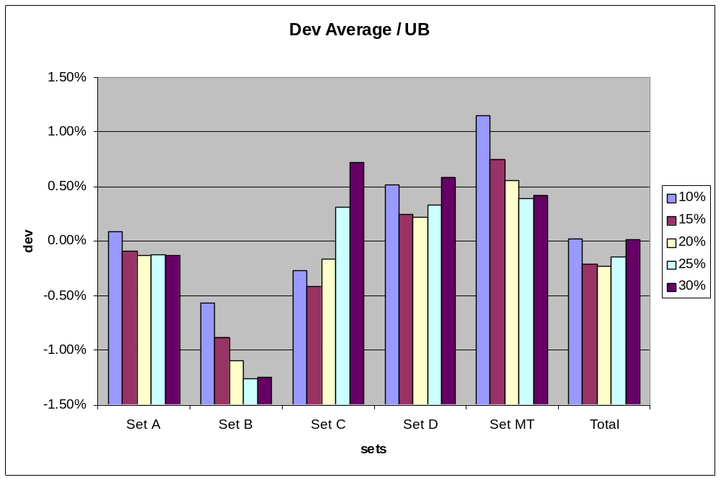
Randomized Large Neighborhood Search for Cumulative Scheduling
Experimental Study : impact of parameter α
other parameters are β = 0, γ = 0.15, and fc = cont
Notes:
Optimal value of alpha depends on problem set
BUT: 20% seems a good compromise
Auto-adaptation could improve the results

Slide 20
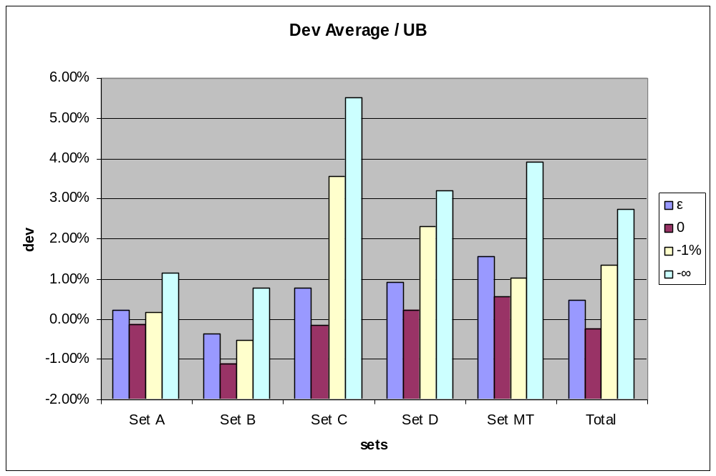
Randomized Large Neighborhood Search for Cumulative Scheduling
Experimental Study : impact of parameter β
other parameters are α = 0.2, γ = 0.15 and fc = cont
Notes:
Enforcing an upper bound clearly pays off
Effect of constraint propagation:
Search space is pruned
Helps heuristics taking better decisions
It’s better to enforce objective<=best known objective rather than <: avoid being trapped in local optimums

Slide 21
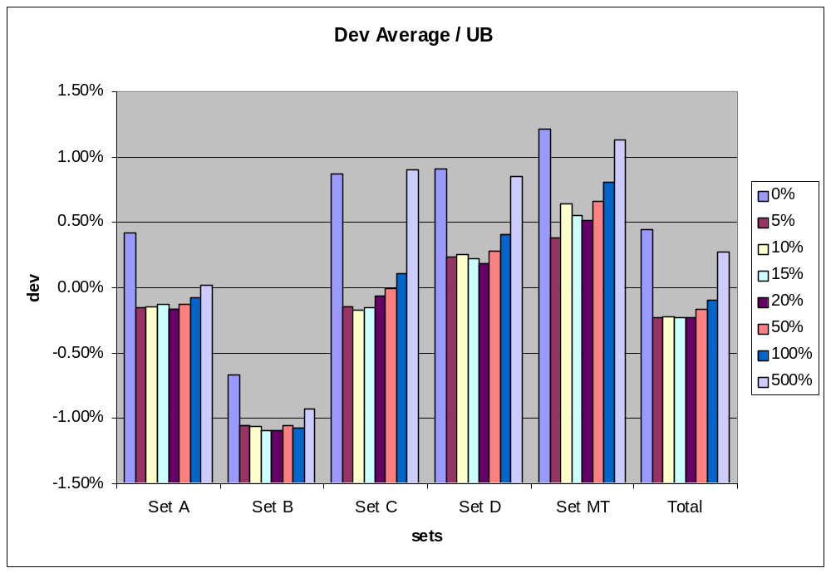
Randomized Large Neighborhood Search for Cumulative Scheduling
Experimental Study : impact of parameter γ
other parameters are α = 0.2, β = 0. and fc = cont
Notes:
It’s always better to allow some backtracks (even if few)
Two many backtracks slow down the iterations
Any value in a range 5-20% lead to comparable results

Slide 22
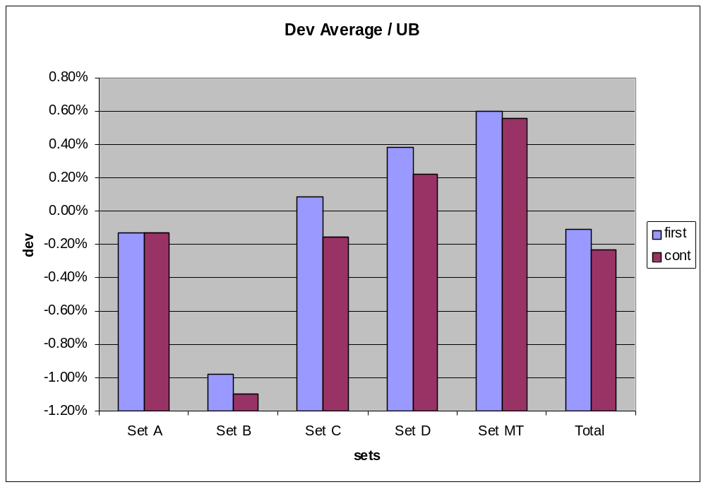
Randomized Large Neighborhood Search for Cumulative Scheduling
Experimental Study : impact of parameter fc
other parameters are α = 0.2, β = 0. and γ =0.15
Notes:
- It’s always better to let the search continue and minimize the makespan until the allowed number of backtrack is reached

Slide 23
Randomized Large Neighborhood Search for Cumulative Scheduling
Experimental Study : resume
Set | Average |  |  | Best
 | IFlat₅ [Cesta&al-00] | IFlatIRelax 4/20/5000 [MichelVanHentenryck-04] | STRand 0.2/0./0.15/cont | STRand
A | 7.76 | 1.07 | -0.13 | -0.34
B | 7.10 | 0.47 | -1.10 | -1.77
C | 13.03 | 4.2 | -0.16 | -1.01
D | 11.92 | 2.4 | 0.22 | -0.40
MT | - | 3.41 | 0.55 | -1.17
Total | - | 2.13 | -0.23 | -0.90
New upper bounds on 33 out of 36 open instances.
LA03D is now closed.
All upper bounds reported in [MichelVanHentenryck-04] have been improved.

Slide 24
Randomized Large Neighborhood Search for Cumulative Scheduling
Beyond CJSSP: RCPSP
 | Dev. Best | Dev. Avg | Avg. CPU | Max. CPU | Rank*
Set J30 | 0.10% | 0.18% | 9.36 | 46.94 | 18
Set J60 | 10.97% | 11.37% | 20.33 | 120.79 | 9
Set J120 | 32.44% | 33.46% | 144.04 | 445.70 | 8
Use same parameters (α= 0.2, β= 0., γ=0.15, fc=cont)
Number of iterations limited to 5000.
*[KolischHartmann-04]

Slide 25
Randomized Large Neighborhood Search for Cumulative Scheduling
Special case of CJSSP : JSSP
Use same parameters (α= 0.2, β= 0., γ=0.15, fc=cont)
Number of iterations limited to 5000
Use of search algorithm IloRankForward instead of IloSetTimesForward
Disjunctive constraint and edge-finder turned on
The job-shop problem topology is not exploited
Notes:
quickly explain (orally) what the IloRankForward search is doing.

Slide 26
Randomized Large Neighborhood Search for Cumulative Scheduling
Beyond CJSSP : JSSP
Set | # instances | Sizes | Dev Best | Dev Avg.
FT & LA | 43 | [6..30]x[5..20] | 0.025% | 0.09%
ABZ | 4 | 10x10;20x15 | 0.7% | 1.23%
CAR | 8 | [7.. 14]x[4..9] | 0.0% | 0.02%
ORB | 10 | 10x10 | 0.06% | 0.40%
SWV | 20 | 20x10;20x15;50x10 | 2.14%* | 3.37%*
YAM | 4 | 20x20 | 1.69%* | 4.71%*
Notes:
All FT and LA instances are closed.
All Carlier instances are closed.
All Applegate & Cook instances are closed.
Fisher & Thomson and Lawrence (LA01-LA40, FT06, FT10, FT20):
On the 13 instances used by Vaessens & al. (1994), average deviation to optimal for the best over 10 runs is 0.9%
Compared to 0.12% Nuijten (1998) and to 0.05% Balas & al (1995)
All optimal solutions found but LA29 & LA 38
Carlier (car1-car8):
Optimal solutions found systematically
Applegate & Cook (orb1-orb10):
All optimal solutions found but one (orb4)
Storer & al. (swv01-swv20):
5 new upper bounds : swv01 (1416), swv02 (1475), swv04 (1477), swv05 (1426), swv06 (1694)
Optimal solutions found on all closed instances (6) but swv14

Slide 27
Randomized Large Neighborhood Search for Cumulative Scheduling
Perspective
Extension to other types of resource and objective
  State resources and reservoirs
  Earliness / tardiness costs, resource allocation costs, setup costs
Auto-adaptative scheme of parameters (α, β, γ, fc)
Flexibility of POS :
  Compare with [Policella&al-04]
  Use temporal interactions between resources
Notes:
Quiclky explain orally what is a state resource and a reservoir

Slide 28
Randomized Large Neighborhood Search for Cumulative Scheduling
Conclusion
POS generation: key element of the generalization of previous randomized LNS work for JSSP to CJSSP
Best known results reported on CJSSP:
  Improve UBs for 33 out of 36 open instances
  Instance LA03x2 now closed
Genericity of the approach:
  POS generation, LNS relaxation and search algorithms are orthogonal
Notes:
Robustness : showed by our experimental study where deviation of average UBs is closed to best UBs
Scheduler.ilog.fr is a temporary website, later on detailed resutls will be available on our public website.

Slide 29
Randomized Large Neighborhood Search for Cumulative Scheduling
Conclusion
Detailed results on CJSSP, JSSP and RCPSP can be found at:
  http://scheduler.ilog.fr
Notes:
Robustness : showed by our experimental study where deviation of average UBs is closed to best UBs
Scheduler.ilog.fr is a temporary website, later on detailed resutls will be available on our public website.

