Slide 2
Complete MCS-Based Search
Overview
Problem description
Model
Search
Experimental evaluation
Conclusion

Slide 3
Problem description
Resource Constrained Project Scheduling (RCPSP)
n activities A_{i} of given duration d(A_{i})
Precedence constraints between activities
A
F
D
C
B
E

Slide 4
Problem description
Resource Constrained Project Scheduling (RCPSP)
m discrete capacity resources R_{j} with given maximal capacity Q(R_{j}).
A
F
R1
R2
R3
D
C
B
E
Notes:
dA=5
dB=7
dC=16
dD=6
dE=10
dF=12
rA1=8
rA2=5
rB2=6
rB3=6
rC2=8
rC3=1
rD1=4
rD3=7
rE1=8
rE2=7
rE3=6
rF1=2
rF3=6

Slide 5
Problem description
Resource Constrained Project Scheduling (RCPSP)
m discrete capacity resources R_{j} with given maximal capacity Q(R_{j}).
Each activity A_{i} may require a quantity q_{ij} of one or several resource R_{j}
A
F
R1
R2
R3
D
C
B
E
Notes:
dA=5
dB=7
dC=16
dD=6
dE=10
dF=12
rA1=8
rA2=5
rB2=6
rB3=6
rC2=8
rC3=1
rD1=4
rD3=7
rE1=8
rE2=7
rE3=6
rF1=2
rF3=6

Slide 6
Problem description
Resource Constrained Project Scheduling (RCPSP)
Find a solution that satisfies precedence and resource capacity constraints and minimizes the schedule makespan
A
F
R1
R2
R3
D
C
B
E

Slide 7
Problem description
Resource Constrained Project Scheduling (RCPSP)
An optimal solution
R3
R2
R1
C
D
B
F
A
E

Slide 8
Model
Model
Constraint-Based Scheduling model
  Decision variables:
    Start/end time of activities: s(A_{i}), e(A_{i})
  Objective function:
    Minimize makespan mk
  Constraints:
    Activity duration: ∀i, e(A_{i})- s(A_{i})=d(A_{i})
    Precedence constraints: ∀(i,j)∈Prec, e(A_{i}) ≤ s(A_{j})
    Resource capacity constraints
    Makespan: ∀i, e(A_{i}) ≤ mk

Slide 9
Search
Constraint propagation
Precedence constraints are propagated by arc-consistency
Resource capacity constraints are propagated using the conjunction of the following classical algorithms:
  Timetabling
  Edge-finding
  Precedence energy
  Balance constraint

Slide 10
Search
Constraint propagation
During the search a temporal network between activity time-points (start, end) using the Point Algebra [Vilain&Kautz-86] is maintained together with its closure
R(t₁,t₂) ∈ { ∅, <, ≤, =, ≥, >, ≠, ? }
<
≤
<
<
A
F
D
≤
<
≤
<
<
C
≤
B
≤
E

Slide 11
Search
Branching scheme
Minimal Critical Set (MCS)
  A subset φ of activities on the same resource R such that:
    activities in φ may globally overlap in time,
    φ over-consumes R, and
    any strict subset of φ does not over-consume R
φ={B,D,F} is a MCS on R
4
10
A
F
4
R
D
3
C
B
E

Slide 12
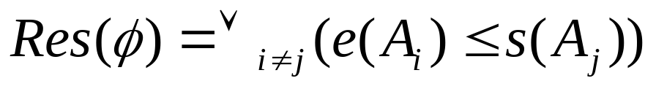
Search
Branching scheme
Resolvers of a MCS φ={A₁,…,A_{p}}
  A precedence constraint between any two of its activity
  Complete set of resolvers:
The set of resolvers can be simplified:
  If s(A_{i}) ≤ s(A_{j}), ∀k≠i,k≠j, (e(A_{k}) ≤ s(A_{i})) ⇒ (e(A_{k}) ≤ s(A_{j})) thus, resolver e(A_{k}) ≤ s(A_{i}) can be removed without sacrifying completeness
  Similar simplification if e(A_{i}) ≤ e(A_{j})

Slide 13
Search
Branching scheme
Branching Scheme:
  Select a MCS φ
  Branch on its different resolvers Res(φ)
  … until there is no more MCS
It results in a complete search
Selected: φ={B,D,F}
B<D
B<F
D<B
D<F
F<B
F<D

Slide 14
Search
Heuristic
At a search node: select an MCS φ that will result in the smallest search space below it
Estimation of the size of the search space below a MCS φ :
Selected: φ
ω(φ) ?

Slide 15
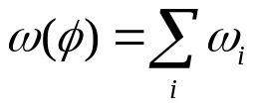
Search
Heuristic
At a search node: select an MCS φ that will result in the smallest search space below it
Estimation of the size of the search space below a MCS φ :
Selected: φ
ρ₁
ρ₂
…
ρ_{i}
…
ρ_{n}
ω₁
ω₂
ω_{i}
ω_{n}

Slide 16
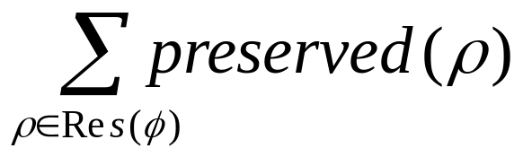
Search
Heuristic
If preserved(ρ_{i}) represents the ratio of the search space that is preserved when adding ρ_{i}, select the MCS φ that minimizes

Slide 17
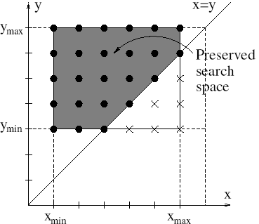
Search
Heuristic
Local estimation: if ρ=(x≤y)
preserved(ρ) = ●/(●+)

Slide 18
Search
Strengthening constraint propagation
Self-adapting shaving approach
Idea:
  If, at a given search node, all the resolvers Res(φ) of a given MCS φ would fail except for one (ρ), this resolver ρ can be inferred and added into the current schedule
  Too expensive to try all the MCSs φ. We only try the ones with a high probability that all resolvers but one will fail
  The probability that a resolver ρ will fail is estimated using preserved(ρ)
Full details in the paper

Slide 19
Experimental evaluation
Experimental evaluation
Start from a valid lower bound T
Look for a solution ≤T within a given time-limit
  If the problem is proven unfeasible:
    LB = T+1
    try with T=T+1
  If a solution is found
    UB = T, stop (optimal solution found)
  If time-limit is exceeded, stop (no optimal solution found)
Implemented on top of ILOG Scheduler 6.1
Machine: Dell Latitude D600 laptop, 1.4 GHz

Slide 20
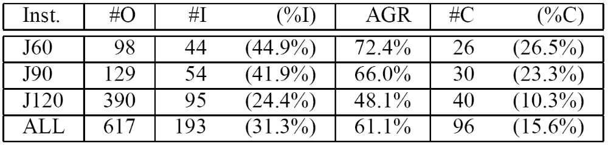
Experimental evaluation
PSPLIB
Experiments on the KSD instances [Kolish&Sprecher-96] with a time limit of 1800s
  #O: number of currently open instances
  #(%)I: number (percentage) of improved instances
  #(%)C: number (percentage) of closed instances

Slide 21
Experimental evaluation
Open-shop problems
Open-shop is a special case of RCPSP
Experiments on instances of [Gueret&Prins-99]:
  All 34 currently open instances closed with a time-limit of 5s CPU time
Experiments on instances of [Brucker&al-97]:
  3 out of 6 currently open instances closed

Slide 22
Experimental evaluation
Cumulative job-shop problems
Cumulative job-shop is a special case of RCPSP
Experiments on instances of [Nuijten-96]
  Improves 12 lower bounds out of 38 open instances
  2 instances were closed

Slide 23
Conclusion
Conclusion
The approach works well on the KSD instances in spite of the fact:
  The number of MCS is exponential
  The maximal number of resolvers for a MCS can be large (|MCS|²)
  In practice, the heuristics focuses on the smallest MCS (quickly detected, few resolvers)
It also proves to be very competitive on pure disjunctive problems like open-shop

Slide 24
Conclusion
Conclusion
Detailed results on RCPSP, open-shop and cumulative job-shop problems are available at:
  http://scheduler.ilog.fr

