Slide 1
Scheduler search
Benchmarks & Results
11/7/2006
Philippe Laborie & Daniel Godard
ILOG
{plaborie,dgodard}@ilog.fr

Slide 2
Benchmarks
Model | Size | Resource types | Temporal network | Objective function
Job-shop |  | Disjunctive | Jobs | Makespan
RCPSP | 120 | Cumulative | Prec graph | Makespan
Cumulative job-shop |  | Cumulative | Jobs | Makespan
Semiconductor testing | 400 | Disjunctive | Jobs | Tardiness max
Flow-shop E/T |  | Disjunctive | Jobs | E/T
RCPSP E/T | 30-50 | Cumulative | Prec graph | E/T
Air land |  | Disjunctive | No | E/T
Open-shop | 64-400 | Disjunctive | No | Makespan
Quality maximization RCPSP | 30 | Cumulative | Prec graph | Durations
Trolley | 230-460 | All | Jobs | Makespan

Slide 3
Benchmarks
Model | Size | Resource types | Temporal network | Objective function
Job-shop E/T | 30-200 | Disjunctive | Jobs | E/T
Single machine E/T | 50-200 | Disjunctive | No | E/T
Aircraft assembly | 575 | Cumulative | Prec graph | Makespan
Air traffic flow management | 2000 | Cumulative | No | Makespan
Flow-shop |  | Disjunctive | Jobs | Makespan
Single machine common due-date | 100-200 | Disjunctive | No | E/T
Multi-stage hybrid flow-shop | 200-1000 | Cumulative | Jobs | Makespan
Single-processor total tardiness | 200-500 | Disjunctive | No | Tardiness sum
Shop set-up times |  | Disjunctive | Jobs | Makespan
Flow-shop buffers | 100-500 | Disj+Cumul | Jobs | Makespan

Slide 4
Results: Job-shop

Slide 5
Results: RCPSP

Slide 6
Results: Cumulative job-shop

Slide 7
Results: Semiconductor testing
Benchmark: 18 instances
Comparison with best known UB:
  Average gap: 0.16%
  Improves 7 UBs (out of 18 instances)

Slide 8
Results: Flow-shop E/T

Slide 9
Results: RCPSP E/T
Benchmark: 60 instances
Comparison with best known UB:
  Average gap: 0.36%
  Improves 15 UBs (out of 60 instances)

Slide 10
Results: Air land

Slide 11
Results: Open-shop
Benchmark: 28 instances
Comparison with best known UB:
  Average gap: 0.9%
Comparison with best known method:
  Average gap: 0.73%
  Improves 3 UBs (out of 28 instances)

Slide 12
Results: Quality maximization RCPSP
Benchmark: 3600 instances
Comparison with [Policella-al-2005]:
  Average gap: -2.43%
 | Due date = 25 |  | Due date = 30 |  | Due date = 35
 | Solved | Quality | Solved | Quality | Solved | Quality
[Policella-al-2005]
C=3 | 31.2% | 47.21% | 100% | 50.87% | 100% | 52.01%
C=5 | 100% | 81.60% | 100% | 81.37% | 100% | 81.19%
C=7 | 100% | 95.37% | 100% | 95.28% | 100% | 95.19%
[This work]
C=3 | 97.3% | 48.95% | 100% | 52.15% | 100% | 53.53%
C=5 | 100% | 83.84% | 100% | 83.92% | 100% | 83.70%
C=7 | 100% | 96.61% | 100% | 96.49% | 100% | 96.34%

Slide 13
Results: Trolley
Benchmark: 15 instances
Comparison with best known UB:
  Average gap: -13.38%
  Improves all 15 UBs

Slide 14
Results: Job-shop E/T
Benchmark: 48 instances
Comparison with best known UB:
  Average gap: -5.89%
  Improves 32 UBs (out of 48 instances)

Slide 15
Results: Single machine E/T
Benchmark: 40 instances
Comparison with best known UB:
  Average gap: 9.30%

Slide 16
Results: Aircraft assembly
Benchmark: 1 instances
Comparison with best known UB:
  Gap: 8.75%

Slide 17
Results: Air traffic flow management
Benchmark: 1 instances
Comparison with best known UB:
  Gap: -2.4%

Slide 18
Results: Flow-shop

Slide 19
Results: Single machine common due-date
Benchmark: 20 instances
Comparison with best known UB:
  Average gap: xx%
  Improves x UBs (out of 20 instances)

Slide 20
Results: Multi-stage hybrid flow-shop
Benchmark: 20 instances
Comparison with best known UB:
  Average gap: -9.60%
  Improves 19 UBs (out of 20 instances)

Slide 21
Results: Single-processor total tardiness
Benchmark: 20 instances
Comparison with best known UB:
  Average gap: 0.25%

Slide 22
Results: Shop set-up times

Slide 23
Results: Flow-shop Buffers
Benchmark: 30 instances
Comparison with best known UB:
  Average gap: 3.51%
  Improves 14 UBs (out of 30 instances)

Slide 24
Results: overview
Model | Size | Results
Job-shop |  | 2.76%
RCPSP |  | 1.61%
Cumulative job-shop |  | 0.42%
Semiconductor testing | 400 | 0.43%
Flow-shop E/T
RCPSP E/T | 30-50 | 1.08%
Air land |  | 3.31%
Open-shop | 64-400 | 0.75%
Quality maximization RCPSP | 30 | -2.43%
Trolley | 230-460 | -11.72%
<0%
[0%,5%]
[5%,10%]
>10%

Slide 25
Results: overview
Model | Size | Results
Job-shop E/T |  | -5.11%
Single machine E/T | 50-200 | 10.61%
Aircraft assembly | 575 | 8.75%
Air traffic flow management | 2000 | -2.40%
Flow-shop |  | 5.80%
Single machine common due-date | 100-200 | 11.41%
Multi-stage hybrid flow-shop | 200-1000 | -8.65%
Single-processor total tardiness | 200-500 | 0.25%
Shop set-up times |  | 2.69%
Flow-shop buffers | 100-500 | 3.90%
<0%
[0%,5%]
[5%,10%]
>10%

Slide 26
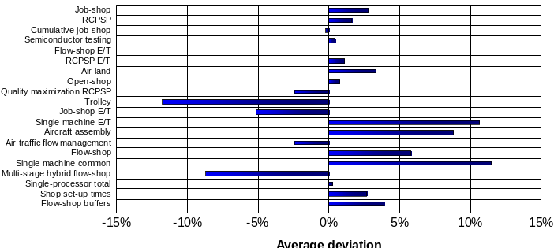
Results: overview

