Slide 1




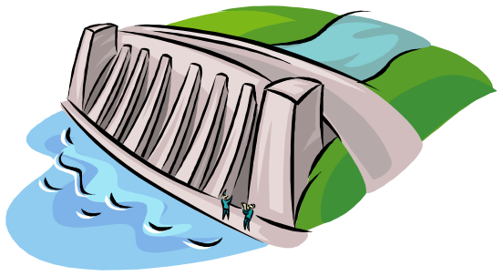
Reservoir Balance Constraint
Philippe Laborie
K=p(x)+c(y)-c(z)
Notes:
The properties that are sufficient to characterize a solution to a finite capacity scheduling problem fall into two categories: the ones based on the absolute positions of activities along the time axis (resource usage profile) and the ones that rely on the interactions between activities competing for the same resource (precedence between activities start/end times). This talk aims at discussing, classifying and comparing the constraint programming techniques built on this second category of properties.

Slide 2

Overview
Motivations
Event Precedence Graph
Reservoir Balance Equations
Constraint Propagation
  Discovering failures
  Reducing domain of reservoir usage variables
  Reducing domain of time variables
  Discovering new precedence relations
Implementation issues
Conclusion
Notes:
On a unary resource, an easy way to characterize a solution is that all the activities on the resource must be ordered. It allows to define the notion of rank of an activity in a solution.
Using this notion of rank, we can easily distinguish between the search procedures based on activity interactions on unary resources ;
1. Chronological Ranking selects at each search node an activity to be ranked first (before all the other ones) among the ones that are still unranked. In case of failure, the alternative is to enforce that at least one of the unranked activities executes before the selected one. Of course anti-chronological ranking may also be used.
2. Pair Sequencing selects at each search node a pair of activities to be sequenced one just after the other. In case of failure the alternative consists in enforcing that at least one activity is executed between the two selected ones. This family of goal is useful when dealing with transition costs.
3. Pair Ordering selects at each search node a pair of activities to be ordered. In the left branch it enforces one ordering of the activities and, in case of failure, in the other branch it enforce the other ordering. Note that pair ordering is the only search procedure that ensures that the constraints posted on the left and on the right branch are of the same nature (both are precedence relations).
In the next slides, we will propose two new instances of very simple search procedures based on Pair Ordering.

Slide 3
Motivations
Limitations of the time-table constraint propagation on discrete resources and reservoirs:
  On discrete resources, the time-table constraint propagates only if the problem is tight: if for all activity of the schedule: lct-est ≥ 2*duration, the time-table constraint propagates nothing
duration
est
ect
lst
lct
Notes:
On a unary resource, an easy way to characterize a solution is that all the activities on the resource must be ordered. It allows to define the notion of rank of an activity in a solution.
Using this notion of rank, we can easily distinguish between the search procedures based on activity interactions on unary resources ;
1. Chronological Ranking selects at each search node an activity to be ranked first (before all the other ones) among the ones that are still unranked. In case of failure, the alternative is to enforce that at least one of the unranked activities executes before the selected one. Of course anti-chronological ranking may also be used.
2. Pair Sequencing selects at each search node a pair of activities to be sequenced one just after the other. In case of failure the alternative consists in enforcing that at least one activity is executed between the two selected ones. This family of goal is useful when dealing with transition costs.
3. Pair Ordering selects at each search node a pair of activities to be ordered. In the left branch it enforces one ordering of the activities and, in case of failure, in the other branch it enforce the other ordering. Note that pair ordering is the only search procedure that ensures that the constraints posted on the left and on the right branch are of the same nature (both are precedence relations).
In the next slides, we will propose two new instances of very simple search procedures based on Pair Ordering.

Slide 4
Motivations
Limitations of the time-table constraint propagation on discrete resources and reservoirs:
  The time-table constraint does not take into account the precedence relations
+2
-2
L_{INIT}=0
produces
consumes
requires
-1
+1
Notes:
On a unary resource, an easy way to characterize a solution is that all the activities on the resource must be ordered. It allows to define the notion of rank of an activity in a solution.
Using this notion of rank, we can easily distinguish between the search procedures based on activity interactions on unary resources ;
1. Chronological Ranking selects at each search node an activity to be ranked first (before all the other ones) among the ones that are still unranked. In case of failure, the alternative is to enforce that at least one of the unranked activities executes before the selected one. Of course anti-chronological ranking may also be used.
2. Pair Sequencing selects at each search node a pair of activities to be sequenced one just after the other. In case of failure the alternative consists in enforcing that at least one activity is executed between the two selected ones. This family of goal is useful when dealing with transition costs.
3. Pair Ordering selects at each search node a pair of activities to be ordered. In the left branch it enforces one ordering of the activities and, in case of failure, in the other branch it enforce the other ordering. Note that pair ordering is the only search procedure that ensures that the constraints posted on the left and on the right branch are of the same nature (both are precedence relations).
In the next slides, we will propose two new instances of very simple search procedures based on Pair Ordering.

Slide 5
Motivations
The time-table constraint does not take into account precedence relations
  Strong drawback in problems where:
    Many precedence relations in the initial problem formulation; or
    Many precedence relations introduced to break the symmetries; or
    Search goals are based on adding precedence relations (solution= a partial order between activity time-points that is sufficient to ensure the resource constraints are satisfied).
  For these problems, the time-table constraint does not propagate enough.
Notes:
On a unary resource, an easy way to characterize a solution is that all the activities on the resource must be ordered. It allows to define the notion of rank of an activity in a solution.
Using this notion of rank, we can easily distinguish between the search procedures based on activity interactions on unary resources ;
1. Chronological Ranking selects at each search node an activity to be ranked first (before all the other ones) among the ones that are still unranked. In case of failure, the alternative is to enforce that at least one of the unranked activities executes before the selected one. Of course anti-chronological ranking may also be used.
2. Pair Sequencing selects at each search node a pair of activities to be sequenced one just after the other. In case of failure the alternative consists in enforcing that at least one activity is executed between the two selected ones. This family of goal is useful when dealing with transition costs.
3. Pair Ordering selects at each search node a pair of activities to be ordered. In the left branch it enforces one ordering of the activities and, in case of failure, in the other branch it enforce the other ordering. Note that pair ordering is the only search procedure that ensures that the constraints posted on the left and on the right branch are of the same nature (both are precedence relations).
In the next slides, we will propose two new instances of very simple search procedures based on Pair Ordering.

Slide 6
Motivations
Develop a global propagation algorithm that :
  Analyzes the precedence relations on the reservoir
  Propagates by discovering :
    Failures
    New bounds for resource usage variables
    New bounds for time variables
    New precedence relations
  Propagates even in case of loose schedule
  Is sufficient to ensure the soundness of the search w.r.t. the reservoir minimal and maximal level constraint
  Is efficient (not worse than O(n²) for a global propagation)
Notes:
On a unary resource, an easy way to characterize a solution is that all the activities on the resource must be ordered. It allows to define the notion of rank of an activity in a solution.
Using this notion of rank, we can easily distinguish between the search procedures based on activity interactions on unary resources ;
1. Chronological Ranking selects at each search node an activity to be ranked first (before all the other ones) among the ones that are still unranked. In case of failure, the alternative is to enforce that at least one of the unranked activities executes before the selected one. Of course anti-chronological ranking may also be used.
2. Pair Sequencing selects at each search node a pair of activities to be sequenced one just after the other. In case of failure the alternative consists in enforcing that at least one activity is executed between the two selected ones. This family of goal is useful when dealing with transition costs.
3. Pair Ordering selects at each search node a pair of activities to be ordered. In the left branch it enforces one ordering of the activities and, in case of failure, in the other branch it enforce the other ordering. Note that pair ordering is the only search procedure that ensures that the constraints posted on the left and on the right branch are of the same nature (both are precedence relations).
In the next slides, we will propose two new instances of very simple search procedures based on Pair Ordering.

Slide 7
Overview
Motivations
Event Precedence Graph
Reservoir Balance Equations
Constraint Propagation
  Discovering failures
  Reducing domain of reservoir usage variables
  Reducing domain of time variables
  Discovering new precedence relations
Implementation issues
Conclusion
Notes:
On a unary resource, an easy way to characterize a solution is that all the activities on the resource must be ordered. It allows to define the notion of rank of an activity in a solution.
Using this notion of rank, we can easily distinguish between the search procedures based on activity interactions on unary resources ;
1. Chronological Ranking selects at each search node an activity to be ranked first (before all the other ones) among the ones that are still unranked. In case of failure, the alternative is to enforce that at least one of the unranked activities executes before the selected one. Of course anti-chronological ranking may also be used.
2. Pair Sequencing selects at each search node a pair of activities to be sequenced one just after the other. In case of failure the alternative consists in enforcing that at least one activity is executed between the two selected ones. This family of goal is useful when dealing with transition costs.
3. Pair Ordering selects at each search node a pair of activities to be ordered. In the left branch it enforces one ordering of the activities and, in case of failure, in the other branch it enforce the other ordering. Note that pair ordering is the only search procedure that ensures that the constraints posted on the left and on the right branch are of the same nature (both are precedence relations).
In the next slides, we will propose two new instances of very simple search procedures based on Pair Ordering.

Slide 8
Event Precedence Graph
Temporary assumption: The maximal level L and minimal level L of a reservoir are constant over time.
Given a resource R (discrete, reservoir), an event on R is any time-point at which the level of the resource is (or maybe) changed.
Any event x is associated
  a time-variable: t(x)
  an algebraical quantity-variable: q(x)
    q(x) > 0 for a production event x
    q(x) < 0 for a consuming event x
Notes:
On a unary resource, an easy way to characterize a solution is that all the activities on the resource must be ordered. It allows to define the notion of rank of an activity in a solution.
Using this notion of rank, we can easily distinguish between the search procedures based on activity interactions on unary resources ;
1. Chronological Ranking selects at each search node an activity to be ranked first (before all the other ones) among the ones that are still unranked. In case of failure, the alternative is to enforce that at least one of the unranked activities executes before the selected one. Of course anti-chronological ranking may also be used.
2. Pair Sequencing selects at each search node a pair of activities to be sequenced one just after the other. In case of failure the alternative consists in enforcing that at least one activity is executed between the two selected ones. This family of goal is useful when dealing with transition costs.
3. Pair Ordering selects at each search node a pair of activities to be ordered. In the left branch it enforces one ordering of the activities and, in case of failure, in the other branch it enforce the other ordering. Note that pair ordering is the only search procedure that ensures that the constraints posted on the left and on the right branch are of the same nature (both are precedence relations).
In the next slides, we will propose two new instances of very simple search procedures based on Pair Ordering.

Slide 9
Event Precedence Graph
From resource constraints to resource events
Activity
Produces
Consumes
-∞
-∞
Before start
Before end
After end
After start
From start to end
Before start and after end
Notes:
On a unary resource, an easy way to characterize a solution is that all the activities on the resource must be ordered. It allows to define the notion of rank of an activity in a solution.
Using this notion of rank, we can easily distinguish between the search procedures based on activity interactions on unary resources ;
1. Chronological Ranking selects at each search node an activity to be ranked first (before all the other ones) among the ones that are still unranked. In case of failure, the alternative is to enforce that at least one of the unranked activities executes before the selected one. Of course anti-chronological ranking may also be used.
2. Pair Sequencing selects at each search node a pair of activities to be sequenced one just after the other. In case of failure the alternative consists in enforcing that at least one activity is executed between the two selected ones. This family of goal is useful when dealing with transition costs.
3. Pair Ordering selects at each search node a pair of activities to be ordered. In the left branch it enforces one ordering of the activities and, in case of failure, in the other branch it enforce the other ordering. Note that pair ordering is the only search procedure that ensures that the constraints posted on the left and on the right branch are of the same nature (both are precedence relations).
In the next slides, we will propose two new instances of very simple search procedures based on Pair Ordering.

Slide 10
Event Precedence Graph
An Event Precedence Graph on a resource is a directed graph
  whose vertices x∈Ω represent the events on the resource
  whose edges represent temporal relation between events:
    t(x) < t(y)
    t(x) ≤ t(y)
Temporal relations on the graph may:
  come from the initial problem (e.g. temporal constraints)
  have been discovered by scheduler global constraints or
  be search decisions
A constraint incrementally maintains the transitive closure of the graph
Notes:
On a unary resource, an easy way to characterize a solution is that all the activities on the resource must be ordered. It allows to define the notion of rank of an activity in a solution.
Using this notion of rank, we can easily distinguish between the search procedures based on activity interactions on unary resources ;
1. Chronological Ranking selects at each search node an activity to be ranked first (before all the other ones) among the ones that are still unranked. In case of failure, the alternative is to enforce that at least one of the unranked activities executes before the selected one. Of course anti-chronological ranking may also be used.
2. Pair Sequencing selects at each search node a pair of activities to be sequenced one just after the other. In case of failure the alternative consists in enforcing that at least one activity is executed between the two selected ones. This family of goal is useful when dealing with transition costs.
3. Pair Ordering selects at each search node a pair of activities to be ordered. In the left branch it enforces one ordering of the activities and, in case of failure, in the other branch it enforce the other ordering. Note that pair ordering is the only search procedure that ensures that the constraints posted on the left and on the right branch are of the same nature (both are precedence relations).
In the next slides, we will propose two new instances of very simple search procedures based on Pair Ordering.

Slide 11
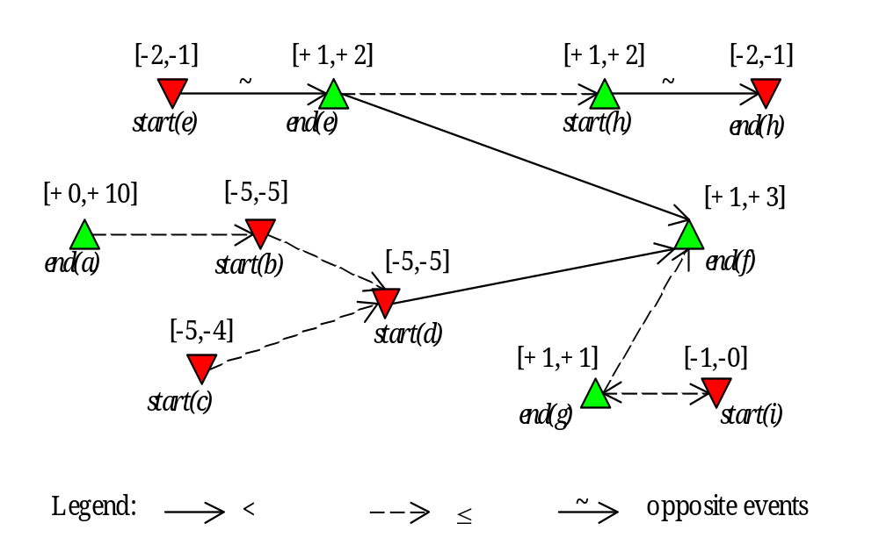
Event Precedence Graph
Example
Notes:
On a unary resource, an easy way to characterize a solution is that all the activities on the resource must be ordered. It allows to define the notion of rank of an activity in a solution.
Using this notion of rank, we can easily distinguish between the search procedures based on activity interactions on unary resources ;
1. Chronological Ranking selects at each search node an activity to be ranked first (before all the other ones) among the ones that are still unranked. In case of failure, the alternative is to enforce that at least one of the unranked activities executes before the selected one. Of course anti-chronological ranking may also be used.
2. Pair Sequencing selects at each search node a pair of activities to be sequenced one just after the other. In case of failure the alternative consists in enforcing that at least one activity is executed between the two selected ones. This family of goal is useful when dealing with transition costs.
3. Pair Ordering selects at each search node a pair of activities to be ordered. In the left branch it enforces one ordering of the activities and, in case of failure, in the other branch it enforce the other ordering. Note that pair ordering is the only search procedure that ensures that the constraints posted on the left and on the right branch are of the same nature (both are precedence relations).
In the next slides, we will propose two new instances of very simple search procedures based on Pair Ordering.

Slide 12
Event Precedence Graph
Notations ( see paper sheet)
  x,y,z: events
  c(x)=Max(0,-q(x)): reservoir consumption
  p(x)=Max(0,q(x)): reservoir production
  x : event opposite to x when it exists
  (E.g. From Start To End)
  v, v resp. minimal and maximal value of variable v
  Δ(v)= v - v : size of the range of variable v
~
Notes:
On a unary resource, an easy way to characterize a solution is that all the activities on the resource must be ordered. It allows to define the notion of rank of an activity in a solution.
Using this notion of rank, we can easily distinguish between the search procedures based on activity interactions on unary resources ;
1. Chronological Ranking selects at each search node an activity to be ranked first (before all the other ones) among the ones that are still unranked. In case of failure, the alternative is to enforce that at least one of the unranked activities executes before the selected one. Of course anti-chronological ranking may also be used.
2. Pair Sequencing selects at each search node a pair of activities to be sequenced one just after the other. In case of failure the alternative consists in enforcing that at least one activity is executed between the two selected ones. This family of goal is useful when dealing with transition costs.
3. Pair Ordering selects at each search node a pair of activities to be ordered. In the left branch it enforces one ordering of the activities and, in case of failure, in the other branch it enforce the other ordering. Note that pair ordering is the only search procedure that ensures that the constraints posted on the left and on the right branch are of the same nature (both are precedence relations).
In the next slides, we will propose two new instances of very simple search procedures based on Pair Ordering.

Slide 13
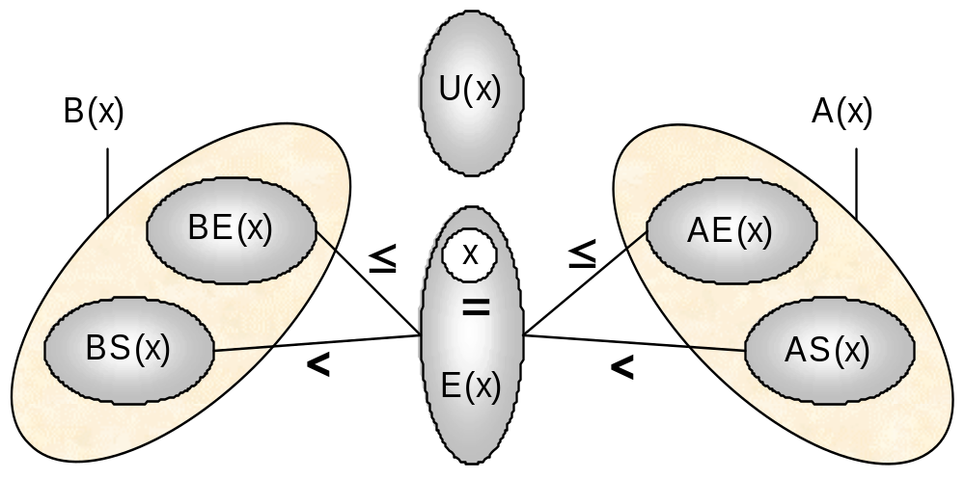
Event Precedence Graph
Notations ( see paper sheet)
Notes:
On a unary resource, an easy way to characterize a solution is that all the activities on the resource must be ordered. It allows to define the notion of rank of an activity in a solution.
Using this notion of rank, we can easily distinguish between the search procedures based on activity interactions on unary resources ;
1. Chronological Ranking selects at each search node an activity to be ranked first (before all the other ones) among the ones that are still unranked. In case of failure, the alternative is to enforce that at least one of the unranked activities executes before the selected one. Of course anti-chronological ranking may also be used.
2. Pair Sequencing selects at each search node a pair of activities to be sequenced one just after the other. In case of failure the alternative consists in enforcing that at least one activity is executed between the two selected ones. This family of goal is useful when dealing with transition costs.
3. Pair Ordering selects at each search node a pair of activities to be ordered. In the left branch it enforces one ordering of the activities and, in case of failure, in the other branch it enforce the other ordering. Note that pair ordering is the only search procedure that ensures that the constraints posted on the left and on the right branch are of the same nature (both are precedence relations).
In the next slides, we will propose two new instances of very simple search procedures based on Pair Ordering.

Slide 14
Overview
Motivations
Event Precedence Graph
Reservoir Balance Equations
Constraint Propagation
  Discovering failures
  Reducing domain of reservoir usage variables
  Reducing domain of time variables
  Discovering new precedence relations
Implementation issues
Conclusion
Notes:
On a unary resource, an easy way to characterize a solution is that all the activities on the resource must be ordered. It allows to define the notion of rank of an activity in a solution.
Using this notion of rank, we can easily distinguish between the search procedures based on activity interactions on unary resources ;
1. Chronological Ranking selects at each search node an activity to be ranked first (before all the other ones) among the ones that are still unranked. In case of failure, the alternative is to enforce that at least one of the unranked activities executes before the selected one. Of course anti-chronological ranking may also be used.
2. Pair Sequencing selects at each search node a pair of activities to be sequenced one just after the other. In case of failure the alternative consists in enforcing that at least one activity is executed between the two selected ones. This family of goal is useful when dealing with transition costs.
3. Pair Ordering selects at each search node a pair of activities to be ordered. In the left branch it enforces one ordering of the activities and, in case of failure, in the other branch it enforce the other ordering. Note that pair ordering is the only search procedure that ensures that the constraints posted on the left and on the right branch are of the same nature (both are precedence relations).
In the next slides, we will propose two new instances of very simple search procedures based on Pair Ordering.

Slide 15
Reservoir Balance Equations
Given an event x, using the graph, we can compute an upper bound on the reservoir level at date t(x)-ε assuming:
  All the production events y that may be executed strictly before x are executed strictly before x and produce their maximal quantity p(y);
  All the consumption events y that need to be executed strictly before x are executed strictly before x and consume their minimal quantity c(y);
  All the consumption events that may be executed simultaneously or after x are executed simultaneously or after x.
Notes:
On a unary resource, an easy way to characterize a solution is that all the activities on the resource must be ordered. It allows to define the notion of rank of an activity in a solution.
Using this notion of rank, we can easily distinguish between the search procedures based on activity interactions on unary resources ;
1. Chronological Ranking selects at each search node an activity to be ranked first (before all the other ones) among the ones that are still unranked. In case of failure, the alternative is to enforce that at least one of the unranked activities executes before the selected one. Of course anti-chronological ranking may also be used.
2. Pair Sequencing selects at each search node a pair of activities to be sequenced one just after the other. In case of failure the alternative consists in enforcing that at least one activity is executed between the two selected ones. This family of goal is useful when dealing with transition costs.
3. Pair Ordering selects at each search node a pair of activities to be ordered. In the left branch it enforces one ordering of the activities and, in case of failure, in the other branch it enforce the other ordering. Note that pair ordering is the only search procedure that ensures that the constraints posted on the left and on the right branch are of the same nature (both are precedence relations).
In the next slides, we will propose two new instances of very simple search procedures based on Pair Ordering.

Slide 16


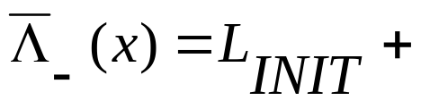
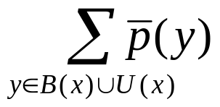
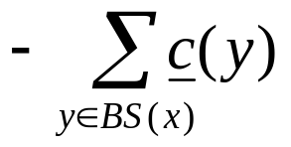
Reservoir Balance Equations
U(x)
BE(x)
AE(x)
≤
≤
<
x
<
☞
BS(x)
E(x)
AS(x)
Notes:
On a unary resource, an easy way to characterize a solution is that all the activities on the resource must be ordered. It allows to define the notion of rank of an activity in a solution.
Using this notion of rank, we can easily distinguish between the search procedures based on activity interactions on unary resources ;
1. Chronological Ranking selects at each search node an activity to be ranked first (before all the other ones) among the ones that are still unranked. In case of failure, the alternative is to enforce that at least one of the unranked activities executes before the selected one. Of course anti-chronological ranking may also be used.
2. Pair Sequencing selects at each search node a pair of activities to be sequenced one just after the other. In case of failure the alternative consists in enforcing that at least one activity is executed between the two selected ones. This family of goal is useful when dealing with transition costs.
3. Pair Ordering selects at each search node a pair of activities to be ordered. In the left branch it enforces one ordering of the activities and, in case of failure, in the other branch it enforce the other ordering. Note that pair ordering is the only search procedure that ensures that the constraints posted on the left and on the right branch are of the same nature (both are precedence relations).
In the next slides, we will propose two new instances of very simple search procedures based on Pair Ordering.

Slide 17
Reservoir Balance Equations
Given an event x, using the graph, we can compute an upper bound on the reservoir level at date t(x)+ε assuming:
  All the production events y that may be executed before or simultaneous with x are executed before or simultaneously with x and produce their maximal quantity p(y);
  All the consumption events y that need to be executed before or simultaneously with x are executed before or simultaneously with x and consume their minimal quantity c(y);
  All the consumption events that may be executed strictly after x are executed strictly after x.
Notes:
On a unary resource, an easy way to characterize a solution is that all the activities on the resource must be ordered. It allows to define the notion of rank of an activity in a solution.
Using this notion of rank, we can easily distinguish between the search procedures based on activity interactions on unary resources ;
1. Chronological Ranking selects at each search node an activity to be ranked first (before all the other ones) among the ones that are still unranked. In case of failure, the alternative is to enforce that at least one of the unranked activities executes before the selected one. Of course anti-chronological ranking may also be used.
2. Pair Sequencing selects at each search node a pair of activities to be sequenced one just after the other. In case of failure the alternative consists in enforcing that at least one activity is executed between the two selected ones. This family of goal is useful when dealing with transition costs.
3. Pair Ordering selects at each search node a pair of activities to be ordered. In the left branch it enforces one ordering of the activities and, in case of failure, in the other branch it enforce the other ordering. Note that pair ordering is the only search procedure that ensures that the constraints posted on the left and on the right branch are of the same nature (both are precedence relations).
In the next slides, we will propose two new instances of very simple search procedures based on Pair Ordering.

Slide 18
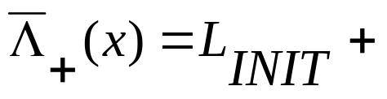
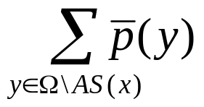
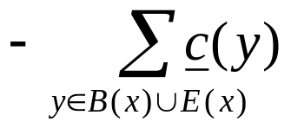
Reservoir Balance Equations
U(x)
BE(x)
AE(x)
≤
≤
<
x
<
☞
BS(x)
E(x)
AS(x)
Notes:
On a unary resource, an easy way to characterize a solution is that all the activities on the resource must be ordered. It allows to define the notion of rank of an activity in a solution.
Using this notion of rank, we can easily distinguish between the search procedures based on activity interactions on unary resources ;
1. Chronological Ranking selects at each search node an activity to be ranked first (before all the other ones) among the ones that are still unranked. In case of failure, the alternative is to enforce that at least one of the unranked activities executes before the selected one. Of course anti-chronological ranking may also be used.
2. Pair Sequencing selects at each search node a pair of activities to be sequenced one just after the other. In case of failure the alternative consists in enforcing that at least one activity is executed between the two selected ones. This family of goal is useful when dealing with transition costs.
3. Pair Ordering selects at each search node a pair of activities to be ordered. In the left branch it enforces one ordering of the activities and, in case of failure, in the other branch it enforce the other ordering. Note that pair ordering is the only search procedure that ensures that the constraints posted on the left and on the right branch are of the same nature (both are precedence relations).
In the next slides, we will propose two new instances of very simple search procedures based on Pair Ordering.

Slide 19
Reservoir Balance Equations
Given an event x, using the graph, we can compute a lower bound on the reservoir level at date t(x)-ε assuming:
  All the consumption events y that may be executed strictly before x are executed strictly before x and consume their maximal quantity c(y);
  All the production events y that need to be executed strictly before x are executed strictly before x and produce their minimal quantity p(y);
  All the production events that may be executed simultaneously or after x are executed simultaneously or after x.
Notes:
On a unary resource, an easy way to characterize a solution is that all the activities on the resource must be ordered. It allows to define the notion of rank of an activity in a solution.
Using this notion of rank, we can easily distinguish between the search procedures based on activity interactions on unary resources ;
1. Chronological Ranking selects at each search node an activity to be ranked first (before all the other ones) among the ones that are still unranked. In case of failure, the alternative is to enforce that at least one of the unranked activities executes before the selected one. Of course anti-chronological ranking may also be used.
2. Pair Sequencing selects at each search node a pair of activities to be sequenced one just after the other. In case of failure the alternative consists in enforcing that at least one activity is executed between the two selected ones. This family of goal is useful when dealing with transition costs.
3. Pair Ordering selects at each search node a pair of activities to be ordered. In the left branch it enforces one ordering of the activities and, in case of failure, in the other branch it enforce the other ordering. Note that pair ordering is the only search procedure that ensures that the constraints posted on the left and on the right branch are of the same nature (both are precedence relations).
In the next slides, we will propose two new instances of very simple search procedures based on Pair Ordering.

Slide 20
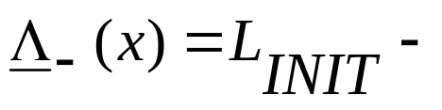
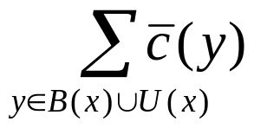
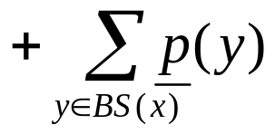
Reservoir Balance Equations
U(x)
BE(x)
AE(x)
≤
≤
<
x
<
☞
BS(x)
E(x)
AS(x)
Notes:
On a unary resource, an easy way to characterize a solution is that all the activities on the resource must be ordered. It allows to define the notion of rank of an activity in a solution.
Using this notion of rank, we can easily distinguish between the search procedures based on activity interactions on unary resources ;
1. Chronological Ranking selects at each search node an activity to be ranked first (before all the other ones) among the ones that are still unranked. In case of failure, the alternative is to enforce that at least one of the unranked activities executes before the selected one. Of course anti-chronological ranking may also be used.
2. Pair Sequencing selects at each search node a pair of activities to be sequenced one just after the other. In case of failure the alternative consists in enforcing that at least one activity is executed between the two selected ones. This family of goal is useful when dealing with transition costs.
3. Pair Ordering selects at each search node a pair of activities to be ordered. In the left branch it enforces one ordering of the activities and, in case of failure, in the other branch it enforce the other ordering. Note that pair ordering is the only search procedure that ensures that the constraints posted on the left and on the right branch are of the same nature (both are precedence relations).
In the next slides, we will propose two new instances of very simple search procedures based on Pair Ordering.

Slide 21
Reservoir Balance Equations
Given an event x, using the graph, we can compute a lower bound on the reservoir level at date t(x)+ε assuming:
  All the consumption events y that may be executed before or simultaneous with x are executed before or simultaneously with x and consume their maximal quantity c(y);
  All the production events y that need to be executed before or simultaneously with x are executed before or simultaneously with x and produce their minimal quantity p(y);
  All the production events that may be executed strictly after x are executed strictly after x.
Notes:
On a unary resource, an easy way to characterize a solution is that all the activities on the resource must be ordered. It allows to define the notion of rank of an activity in a solution.
Using this notion of rank, we can easily distinguish between the search procedures based on activity interactions on unary resources ;
1. Chronological Ranking selects at each search node an activity to be ranked first (before all the other ones) among the ones that are still unranked. In case of failure, the alternative is to enforce that at least one of the unranked activities executes before the selected one. Of course anti-chronological ranking may also be used.
2. Pair Sequencing selects at each search node a pair of activities to be sequenced one just after the other. In case of failure the alternative consists in enforcing that at least one activity is executed between the two selected ones. This family of goal is useful when dealing with transition costs.
3. Pair Ordering selects at each search node a pair of activities to be ordered. In the left branch it enforces one ordering of the activities and, in case of failure, in the other branch it enforce the other ordering. Note that pair ordering is the only search procedure that ensures that the constraints posted on the left and on the right branch are of the same nature (both are precedence relations).
In the next slides, we will propose two new instances of very simple search procedures based on Pair Ordering.

Slide 22
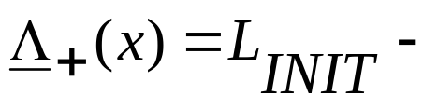
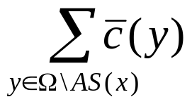
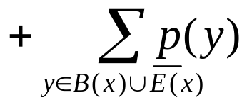
Reservoir Balance Equations
U(x)
BE(x)
AE(x)
≤
≤
<
x
<
☞
BS(x)
E(x)
AS(x)
Notes:
On a unary resource, an easy way to characterize a solution is that all the activities on the resource must be ordered. It allows to define the notion of rank of an activity in a solution.
Using this notion of rank, we can easily distinguish between the search procedures based on activity interactions on unary resources ;
1. Chronological Ranking selects at each search node an activity to be ranked first (before all the other ones) among the ones that are still unranked. In case of failure, the alternative is to enforce that at least one of the unranked activities executes before the selected one. Of course anti-chronological ranking may also be used.
2. Pair Sequencing selects at each search node a pair of activities to be sequenced one just after the other. In case of failure the alternative consists in enforcing that at least one activity is executed between the two selected ones. This family of goal is useful when dealing with transition costs.
3. Pair Ordering selects at each search node a pair of activities to be ordered. In the left branch it enforces one ordering of the activities and, in case of failure, in the other branch it enforce the other ordering. Note that pair ordering is the only search procedure that ensures that the constraints posted on the left and on the right branch are of the same nature (both are precedence relations).
In the next slides, we will propose two new instances of very simple search procedures based on Pair Ordering.

Slide 23
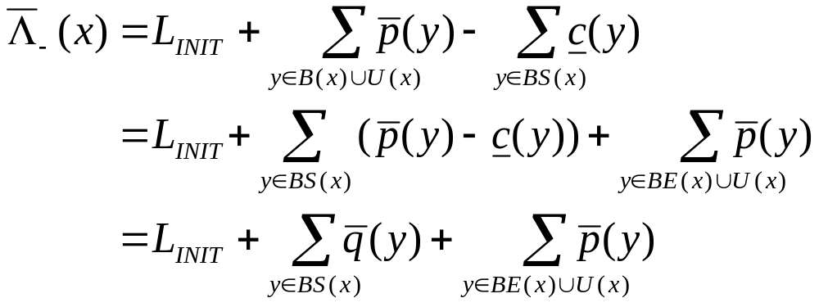
Reservoir Balance Equations
These 4 equations are very symmetrical; we will only focus on the first one :
This upper bound may be improved by considering opposite events ...
Notes:
On a unary resource, an easy way to characterize a solution is that all the activities on the resource must be ordered. It allows to define the notion of rank of an activity in a solution.
Using this notion of rank, we can easily distinguish between the search procedures based on activity interactions on unary resources ;
1. Chronological Ranking selects at each search node an activity to be ranked first (before all the other ones) among the ones that are still unranked. In case of failure, the alternative is to enforce that at least one of the unranked activities executes before the selected one. Of course anti-chronological ranking may also be used.
2. Pair Sequencing selects at each search node a pair of activities to be sequenced one just after the other. In case of failure the alternative consists in enforcing that at least one activity is executed between the two selected ones. This family of goal is useful when dealing with transition costs.
3. Pair Ordering selects at each search node a pair of activities to be ordered. In the left branch it enforces one ordering of the activities and, in case of failure, in the other branch it enforce the other ordering. Note that pair ordering is the only search procedure that ensures that the constraints posted on the left and on the right branch are of the same nature (both are precedence relations).
In the next slides, we will propose two new instances of very simple search procedures based on Pair Ordering.

Slide 24
Reservoir Balance Equations
Considering opposite events :
~
~
The pairs of event (y,y) such that y and y are both strictly before x do not need to be taken into account as their total contribution at date t(x)-ε will be null. This is useful when the reservoir usage of the activity is a variable.
The pairs of event (y,y) that are both in U(x)∪BE(x) and such that y is a reservoir production event and y is to be executed before y do not need to be taken into account. This is the case of a consumption activity with a FromStartToEnd time extent.
~
~
Notes:
On a unary resource, an easy way to characterize a solution is that all the activities on the resource must be ordered. It allows to define the notion of rank of an activity in a solution.
Using this notion of rank, we can easily distinguish between the search procedures based on activity interactions on unary resources ;
1. Chronological Ranking selects at each search node an activity to be ranked first (before all the other ones) among the ones that are still unranked. In case of failure, the alternative is to enforce that at least one of the unranked activities executes before the selected one. Of course anti-chronological ranking may also be used.
2. Pair Sequencing selects at each search node a pair of activities to be sequenced one just after the other. In case of failure the alternative consists in enforcing that at least one activity is executed between the two selected ones. This family of goal is useful when dealing with transition costs.
3. Pair Ordering selects at each search node a pair of activities to be ordered. In the left branch it enforces one ordering of the activities and, in case of failure, in the other branch it enforce the other ordering. Note that pair ordering is the only search procedure that ensures that the constraints posted on the left and on the right branch are of the same nature (both are precedence relations).
In the next slides, we will propose two new instances of very simple search procedures based on Pair Ordering.

Slide 25
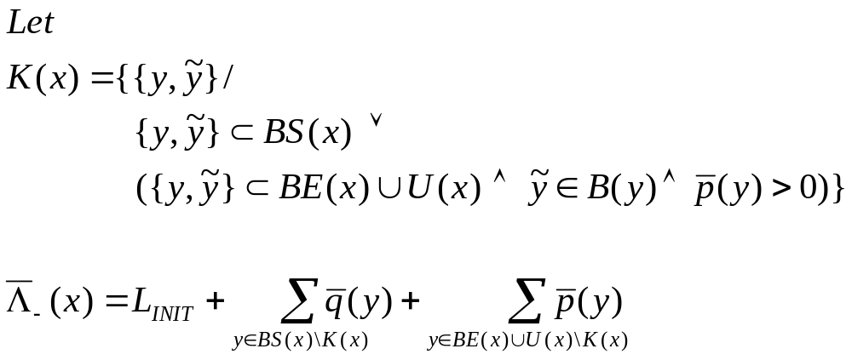
Reservoir Balance Equations
Upper bound on the reservoir level at date t(x)-ε
Notes:
On a unary resource, an easy way to characterize a solution is that all the activities on the resource must be ordered. It allows to define the notion of rank of an activity in a solution.
Using this notion of rank, we can easily distinguish between the search procedures based on activity interactions on unary resources ;
1. Chronological Ranking selects at each search node an activity to be ranked first (before all the other ones) among the ones that are still unranked. In case of failure, the alternative is to enforce that at least one of the unranked activities executes before the selected one. Of course anti-chronological ranking may also be used.
2. Pair Sequencing selects at each search node a pair of activities to be sequenced one just after the other. In case of failure the alternative consists in enforcing that at least one activity is executed between the two selected ones. This family of goal is useful when dealing with transition costs.
3. Pair Ordering selects at each search node a pair of activities to be ordered. In the left branch it enforces one ordering of the activities and, in case of failure, in the other branch it enforce the other ordering. Note that pair ordering is the only search procedure that ensures that the constraints posted on the left and on the right branch are of the same nature (both are precedence relations).
In the next slides, we will propose two new instances of very simple search procedures based on Pair Ordering.

Slide 26
Overview
Motivations
Event Precedence Graph
Reservoir Balance Equations
Constraint Propagation
  Discovering failures
  Reducing domain of reservoir usage variables
  Reducing domain of time variables
  Discovering new precedence relations
Implementation issues
Conclusion
Notes:
On a unary resource, an easy way to characterize a solution is that all the activities on the resource must be ordered. It allows to define the notion of rank of an activity in a solution.
Using this notion of rank, we can easily distinguish between the search procedures based on activity interactions on unary resources ;
1. Chronological Ranking selects at each search node an activity to be ranked first (before all the other ones) among the ones that are still unranked. In case of failure, the alternative is to enforce that at least one of the unranked activities executes before the selected one. Of course anti-chronological ranking may also be used.
2. Pair Sequencing selects at each search node a pair of activities to be sequenced one just after the other. In case of failure the alternative consists in enforcing that at least one activity is executed between the two selected ones. This family of goal is useful when dealing with transition costs.
3. Pair Ordering selects at each search node a pair of activities to be ordered. In the left branch it enforces one ordering of the activities and, in case of failure, in the other branch it enforce the other ordering. Note that pair ordering is the only search procedure that ensures that the constraints posted on the left and on the right branch are of the same nature (both are precedence relations).
In the next slides, we will propose two new instances of very simple search procedures based on Pair Ordering.

Slide 27
Constraint Propagation
Constraint Propagation is a variation around the reservoir balance equations
4 balance equations
For each balance equation, the constraint allows to discover:
  Failures
  New bounds for resource usage variables
  New bounds for time variables of events
  New precedence relations between events
We focus on the first balance equation
Notes:
On a unary resource, an easy way to characterize a solution is that all the activities on the resource must be ordered. It allows to define the notion of rank of an activity in a solution.
Using this notion of rank, we can easily distinguish between the search procedures based on activity interactions on unary resources ;
1. Chronological Ranking selects at each search node an activity to be ranked first (before all the other ones) among the ones that are still unranked. In case of failure, the alternative is to enforce that at least one of the unranked activities executes before the selected one. Of course anti-chronological ranking may also be used.
2. Pair Sequencing selects at each search node a pair of activities to be sequenced one just after the other. In case of failure the alternative consists in enforcing that at least one activity is executed between the two selected ones. This family of goal is useful when dealing with transition costs.
3. Pair Ordering selects at each search node a pair of activities to be ordered. In the left branch it enforces one ordering of the activities and, in case of failure, in the other branch it enforce the other ordering. Note that pair ordering is the only search procedure that ensures that the constraints posted on the left and on the right branch are of the same nature (both are precedence relations).
In the next slides, we will propose two new instances of very simple search procedures based on Pair Ordering.

Slide 28

Discovering Failures
Discovering Failures:
As soon as
No solution exist that satisfy the precedence relations
Notes:
On a unary resource, an easy way to characterize a solution is that all the activities on the resource must be ordered. It allows to define the notion of rank of an activity in a solution.
Using this notion of rank, we can easily distinguish between the search procedures based on activity interactions on unary resources ;
1. Chronological Ranking selects at each search node an activity to be ranked first (before all the other ones) among the ones that are still unranked. In case of failure, the alternative is to enforce that at least one of the unranked activities executes before the selected one. Of course anti-chronological ranking may also be used.
2. Pair Sequencing selects at each search node a pair of activities to be sequenced one just after the other. In case of failure the alternative consists in enforcing that at least one activity is executed between the two selected ones. This family of goal is useful when dealing with transition costs.
3. Pair Ordering selects at each search node a pair of activities to be ordered. In the left branch it enforces one ordering of the activities and, in case of failure, in the other branch it enforce the other ordering. Note that pair ordering is the only search procedure that ensures that the constraints posted on the left and on the right branch are of the same nature (both are precedence relations).
In the next slides, we will propose two new instances of very simple search procedures based on Pair Ordering.

Slide 29
Discovering Failures
L=0; L_{INIT}=0
U(x)
[+1,+2]
[-2,-1]
K(x)
[-2,-1]
[+1,+2]
E(x)
[+0,+10]
[-5,-5]
[+1,+3]
[-5,-5]
[-5,-4]
BS(x)
BE(x)
[+1,+1]
Λ₋(x)= 0 + (10+2+1) - (5+5+4) = -1 < 0 !!!
Notes:
On a unary resource, an easy way to characterize a solution is that all the activities on the resource must be ordered. It allows to define the notion of rank of an activity in a solution.
Using this notion of rank, we can easily distinguish between the search procedures based on activity interactions on unary resources ;
1. Chronological Ranking selects at each search node an activity to be ranked first (before all the other ones) among the ones that are still unranked. In case of failure, the alternative is to enforce that at least one of the unranked activities executes before the selected one. Of course anti-chronological ranking may also be used.
2. Pair Sequencing selects at each search node a pair of activities to be sequenced one just after the other. In case of failure the alternative consists in enforcing that at least one activity is executed between the two selected ones. This family of goal is useful when dealing with transition costs.
3. Pair Ordering selects at each search node a pair of activities to be ordered. In the left branch it enforces one ordering of the activities and, in case of failure, in the other branch it enforce the other ordering. Note that pair ordering is the only search procedure that ensures that the constraints posted on the left and on the right branch are of the same nature (both are precedence relations).
In the next slides, we will propose two new instances of very simple search procedures based on Pair Ordering.

Slide 30

Discovering Failures
Property:
The rule is sufficient to ensure the soundness of the search on a reservoir w.r.t. the reservoir underflow.
A symmetrical property exists for reservoir overflow based on the second reservoir balance equation.
Notes:
On a unary resource, an easy way to characterize a solution is that all the activities on the resource must be ordered. It allows to define the notion of rank of an activity in a solution.
Using this notion of rank, we can easily distinguish between the search procedures based on activity interactions on unary resources ;
1. Chronological Ranking selects at each search node an activity to be ranked first (before all the other ones) among the ones that are still unranked. In case of failure, the alternative is to enforce that at least one of the unranked activities executes before the selected one. Of course anti-chronological ranking may also be used.
2. Pair Sequencing selects at each search node a pair of activities to be sequenced one just after the other. In case of failure the alternative consists in enforcing that at least one activity is executed between the two selected ones. This family of goal is useful when dealing with transition costs.
3. Pair Ordering selects at each search node a pair of activities to be ordered. In the left branch it enforces one ordering of the activities and, in case of failure, in the other branch it enforce the other ordering. Note that pair ordering is the only search procedure that ensures that the constraints posted on the left and on the right branch are of the same nature (both are precedence relations).
In the next slides, we will propose two new instances of very simple search procedures based on Pair Ordering.

Slide 31

Reservoir Usage Variables
Suppose there exists a consumption event y∈BS(x)\K(x) such that:
As the contribution of y to is -c(y), all the values of y that are strictly greater than c(y)+(Λ₋(x)-L) would lead to a new Λ₋(x) that would raise a failure. Thus, we have:
Notes:
On a unary resource, an easy way to characterize a solution is that all the activities on the resource must be ordered. It allows to define the notion of rank of an activity in a solution.
Using this notion of rank, we can easily distinguish between the search procedures based on activity interactions on unary resources ;
1. Chronological Ranking selects at each search node an activity to be ranked first (before all the other ones) among the ones that are still unranked. In case of failure, the alternative is to enforce that at least one of the unranked activities executes before the selected one. Of course anti-chronological ranking may also be used.
2. Pair Sequencing selects at each search node a pair of activities to be sequenced one just after the other. In case of failure the alternative consists in enforcing that at least one activity is executed between the two selected ones. This family of goal is useful when dealing with transition costs.
3. Pair Ordering selects at each search node a pair of activities to be ordered. In the left branch it enforces one ordering of the activities and, in case of failure, in the other branch it enforce the other ordering. Note that pair ordering is the only search procedure that ensures that the constraints posted on the left and on the right branch are of the same nature (both are precedence relations).
In the next slides, we will propose two new instances of very simple search procedures based on Pair Ordering.

Slide 32

Reservoir Usage Variables
Suppose there exists a production event y∈B(x)∪U(x)\K(x) such that:
As the contribution of y to is p(y), all the values of y that are strictly lower than p(y)-(Λ₋(x)-L) would lead to a new Λ₋(x) that would raise a failure. Thus, we have:
Notes:
On a unary resource, an easy way to characterize a solution is that all the activities on the resource must be ordered. It allows to define the notion of rank of an activity in a solution.
Using this notion of rank, we can easily distinguish between the search procedures based on activity interactions on unary resources ;
1. Chronological Ranking selects at each search node an activity to be ranked first (before all the other ones) among the ones that are still unranked. In case of failure, the alternative is to enforce that at least one of the unranked activities executes before the selected one. Of course anti-chronological ranking may also be used.
2. Pair Sequencing selects at each search node a pair of activities to be sequenced one just after the other. In case of failure the alternative consists in enforcing that at least one activity is executed between the two selected ones. This family of goal is useful when dealing with transition costs.
3. Pair Ordering selects at each search node a pair of activities to be ordered. In the left branch it enforces one ordering of the activities and, in case of failure, in the other branch it enforce the other ordering. Note that pair ordering is the only search procedure that ensures that the constraints posted on the left and on the right branch are of the same nature (both are precedence relations).
In the next slides, we will propose two new instances of very simple search procedures based on Pair Ordering.

Slide 33
Reservoir Usage Variables
L=0; L_{INIT}=0
[+2,+2]
U(x)
[+1,+2]
[-2,-1]
K(x)
[-2,-1]
[+1,+2]
E(x)
[+10,+10]
[+0,+10]
[-5,-5]
[+1,+3]
[-5,-5]
[-4,-4]
[-5,-4]
BS(x)
BE(x)
[+1,+2]
[+2,+2]
Λ₋(x)= 0 + (10+2+2) - (5+5+4) = 0
Notes:
On a unary resource, an easy way to characterize a solution is that all the activities on the resource must be ordered. It allows to define the notion of rank of an activity in a solution.
Using this notion of rank, we can easily distinguish between the search procedures based on activity interactions on unary resources ;
1. Chronological Ranking selects at each search node an activity to be ranked first (before all the other ones) among the ones that are still unranked. In case of failure, the alternative is to enforce that at least one of the unranked activities executes before the selected one. Of course anti-chronological ranking may also be used.
2. Pair Sequencing selects at each search node a pair of activities to be sequenced one just after the other. In case of failure the alternative consists in enforcing that at least one activity is executed between the two selected ones. This family of goal is useful when dealing with transition costs.
3. Pair Ordering selects at each search node a pair of activities to be ordered. In the left branch it enforces one ordering of the activities and, in case of failure, in the other branch it enforce the other ordering. Note that pair ordering is the only search procedure that ensures that the constraints posted on the left and on the right branch are of the same nature (both are precedence relations).
In the next slides, we will propose two new instances of very simple search procedures based on Pair Ordering.

Slide 34
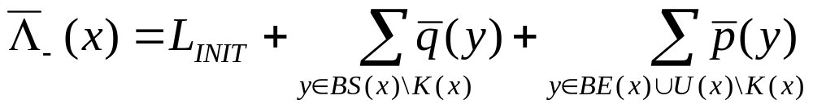
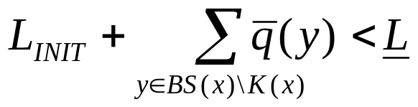
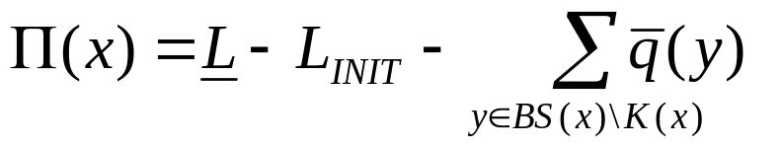
Time Variables (1)
First reservoir balance equation:
In case the first part of the equation is such that:
It means that some events z∈BE(x)∪U(x)\K(x) will have to be executed strictly before x in order to produce at least:
Notes:
On a unary resource, an easy way to characterize a solution is that all the activities on the resource must be ordered. It allows to define the notion of rank of an activity in a solution.
Using this notion of rank, we can easily distinguish between the search procedures based on activity interactions on unary resources ;
1. Chronological Ranking selects at each search node an activity to be ranked first (before all the other ones) among the ones that are still unranked. In case of failure, the alternative is to enforce that at least one of the unranked activities executes before the selected one. Of course anti-chronological ranking may also be used.
2. Pair Sequencing selects at each search node a pair of activities to be sequenced one just after the other. In case of failure the alternative consists in enforcing that at least one activity is executed between the two selected ones. This family of goal is useful when dealing with transition costs.
3. Pair Ordering selects at each search node a pair of activities to be ordered. In the left branch it enforces one ordering of the activities and, in case of failure, in the other branch it enforce the other ordering. Note that pair ordering is the only search procedure that ensures that the constraints posted on the left and on the right branch are of the same nature (both are precedence relations).
In the next slides, we will propose two new instances of very simple search procedures based on Pair Ordering.

Slide 35
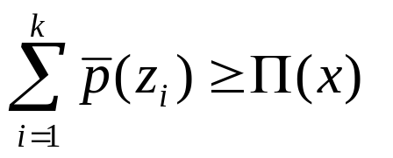
Time Variables (1)
Some events z∈BE(x)∪U(x)\K(x) will have to be executed strictly before x in order to produce at least Π(x).
Let (z₁,…,z_{i},…,z_{n}) the set of production events in BE(x)∪U(x)\K(x) sorted by increasing minimal time.
Let k be the smallest index such that:
Then: t(z_{k}) < t(x)
Notes:
On a unary resource, an easy way to characterize a solution is that all the activities on the resource must be ordered. It allows to define the notion of rank of an activity in a solution.
Using this notion of rank, we can easily distinguish between the search procedures based on activity interactions on unary resources ;
1. Chronological Ranking selects at each search node an activity to be ranked first (before all the other ones) among the ones that are still unranked. In case of failure, the alternative is to enforce that at least one of the unranked activities executes before the selected one. Of course anti-chronological ranking may also be used.
2. Pair Sequencing selects at each search node a pair of activities to be sequenced one just after the other. In case of failure the alternative consists in enforcing that at least one activity is executed between the two selected ones. This family of goal is useful when dealing with transition costs.
3. Pair Ordering selects at each search node a pair of activities to be ordered. In the left branch it enforces one ordering of the activities and, in case of failure, in the other branch it enforce the other ordering. Note that pair ordering is the only search procedure that ensures that the constraints posted on the left and on the right branch are of the same nature (both are precedence relations).
In the next slides, we will propose two new instances of very simple search procedures based on Pair Ordering.

Slide 36
Time Variables (1)
L=0; L_{INIT}=0
U(x)
[+1,+2]
[-2,-1]
K(x)
[-2,-1]
[+1,+2]
[+1,+2]
E(x)
[+0,+10]
[-5,-5]
[+1,+3]
[-5,-5]
[-5,-4]
BS(x)
BE(x)
[+1,+2]
Π(x)= 0 - (10) + (5+5+4) = 4
Notes:
On a unary resource, an easy way to characterize a solution is that all the activities on the resource must be ordered. It allows to define the notion of rank of an activity in a solution.
Using this notion of rank, we can easily distinguish between the search procedures based on activity interactions on unary resources ;
1. Chronological Ranking selects at each search node an activity to be ranked first (before all the other ones) among the ones that are still unranked. In case of failure, the alternative is to enforce that at least one of the unranked activities executes before the selected one. Of course anti-chronological ranking may also be used.
2. Pair Sequencing selects at each search node a pair of activities to be sequenced one just after the other. In case of failure the alternative consists in enforcing that at least one activity is executed between the two selected ones. This family of goal is useful when dealing with transition costs.
3. Pair Ordering selects at each search node a pair of activities to be ordered. In the left branch it enforces one ordering of the activities and, in case of failure, in the other branch it enforce the other ordering. Note that pair ordering is the only search procedure that ensures that the constraints posted on the left and on the right branch are of the same nature (both are precedence relations).
In the next slides, we will propose two new instances of very simple search procedures based on Pair Ordering.

Slide 37
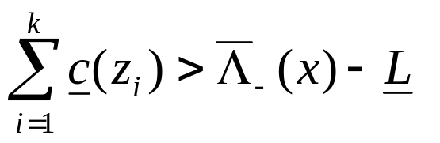
Time Variables (2)
First reservoir balance equation:
Let (z₁,…,z_{i},…,z_{n}) the set of consumption events in BE(x)∪U(x) sorted by increasing maximal time.
Let k, if it exists, be the smallest index such that:
The events in {z₁,…,z_{k} } cannot be all executed before x
It means that: t(x) ≤ t(z_{k})
Notes:
On a unary resource, an easy way to characterize a solution is that all the activities on the resource must be ordered. It allows to define the notion of rank of an activity in a solution.
Using this notion of rank, we can easily distinguish between the search procedures based on activity interactions on unary resources ;
1. Chronological Ranking selects at each search node an activity to be ranked first (before all the other ones) among the ones that are still unranked. In case of failure, the alternative is to enforce that at least one of the unranked activities executes before the selected one. Of course anti-chronological ranking may also be used.
2. Pair Sequencing selects at each search node a pair of activities to be sequenced one just after the other. In case of failure the alternative consists in enforcing that at least one activity is executed between the two selected ones. This family of goal is useful when dealing with transition costs.
3. Pair Ordering selects at each search node a pair of activities to be ordered. In the left branch it enforces one ordering of the activities and, in case of failure, in the other branch it enforce the other ordering. Note that pair ordering is the only search procedure that ensures that the constraints posted on the left and on the right branch are of the same nature (both are precedence relations).
In the next slides, we will propose two new instances of very simple search procedures based on Pair Ordering.

Slide 38
Time Variables (2)
U(x)
L=0; L_{INIT}=0
[-2,-2]
BS(x)
[-2,-2]
E(x)
[+3,+3]
[+1,+1]
BE(x)
[-2,-2]
Λ₋(x)= 0 + ( 3 ) − ( 0 ) = 3
Notes:
On a unary resource, an easy way to characterize a solution is that all the activities on the resource must be ordered. It allows to define the notion of rank of an activity in a solution.
Using this notion of rank, we can easily distinguish between the search procedures based on activity interactions on unary resources ;
1. Chronological Ranking selects at each search node an activity to be ranked first (before all the other ones) among the ones that are still unranked. In case of failure, the alternative is to enforce that at least one of the unranked activities executes before the selected one. Of course anti-chronological ranking may also be used.
2. Pair Sequencing selects at each search node a pair of activities to be sequenced one just after the other. In case of failure the alternative consists in enforcing that at least one activity is executed between the two selected ones. This family of goal is useful when dealing with transition costs.
3. Pair Ordering selects at each search node a pair of activities to be ordered. In the left branch it enforces one ordering of the activities and, in case of failure, in the other branch it enforce the other ordering. Note that pair ordering is the only search procedure that ensures that the constraints posted on the left and on the right branch are of the same nature (both are precedence relations).
In the next slides, we will propose two new instances of very simple search procedures based on Pair Ordering.

Slide 39
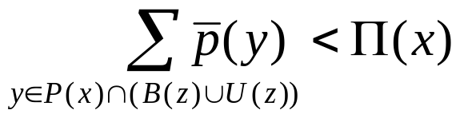
New Precedence Relations (1)
Some events z ∈ P(x)=BE(x)∪U(x)\K(x) will have to be executed strictly before x in order to produce at least Π(x).
Property: If an event z ∈ P(x) is such that:
Then, if z is executed after or simultaneously with x, there will be no way to produce at least Π(x) strictly before x. Thus t(z)<t(x).
Notes:
On a unary resource, an easy way to characterize a solution is that all the activities on the resource must be ordered. It allows to define the notion of rank of an activity in a solution.
Using this notion of rank, we can easily distinguish between the search procedures based on activity interactions on unary resources ;
1. Chronological Ranking selects at each search node an activity to be ranked first (before all the other ones) among the ones that are still unranked. In case of failure, the alternative is to enforce that at least one of the unranked activities executes before the selected one. Of course anti-chronological ranking may also be used.
2. Pair Sequencing selects at each search node a pair of activities to be sequenced one just after the other. In case of failure the alternative consists in enforcing that at least one activity is executed between the two selected ones. This family of goal is useful when dealing with transition costs.
3. Pair Ordering selects at each search node a pair of activities to be ordered. In the left branch it enforces one ordering of the activities and, in case of failure, in the other branch it enforce the other ordering. Note that pair ordering is the only search procedure that ensures that the constraints posted on the left and on the right branch are of the same nature (both are precedence relations).
In the next slides, we will propose two new instances of very simple search procedures based on Pair Ordering.

Slide 40
New Precedence Relations (1)
L=0; L_{INIT}=0
U(x)
[-2,-1]
K(x)
z
[+1,+2]
P(x)
[-2,-1]
[+1,+2]
[+1,+2]
E(x)
[+0,+10]
[-5,-5]
[+1,+3]
[-5,-5]
[-5,-4]
BS(x)
BE(x)
[+1,+2]
Π(x)= 0 - (10) + (5+5+4) = 4
Notes:
On a unary resource, an easy way to characterize a solution is that all the activities on the resource must be ordered. It allows to define the notion of rank of an activity in a solution.
Using this notion of rank, we can easily distinguish between the search procedures based on activity interactions on unary resources ;
1. Chronological Ranking selects at each search node an activity to be ranked first (before all the other ones) among the ones that are still unranked. In case of failure, the alternative is to enforce that at least one of the unranked activities executes before the selected one. Of course anti-chronological ranking may also be used.
2. Pair Sequencing selects at each search node a pair of activities to be sequenced one just after the other. In case of failure the alternative consists in enforcing that at least one activity is executed between the two selected ones. This family of goal is useful when dealing with transition costs.
3. Pair Ordering selects at each search node a pair of activities to be ordered. In the left branch it enforces one ordering of the activities and, in case of failure, in the other branch it enforce the other ordering. Note that pair ordering is the only search procedure that ensures that the constraints posted on the left and on the right branch are of the same nature (both are precedence relations).
In the next slides, we will propose two new instances of very simple search procedures based on Pair Ordering.

Slide 41
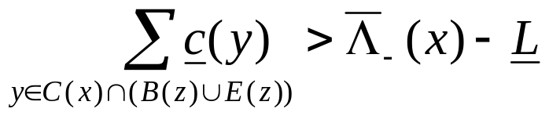
New Precedence Relations (2)
Property: If a consuming event z∈C(x)=BE(x)∪U(x)\K(x) is such that:
Then, if z is executed strictly before x, the first reservoir balance equation will detect a reservoir underflow at t(x)-ε. Thus t(x) ≤ t(z).
Notes:
On a unary resource, an easy way to characterize a solution is that all the activities on the resource must be ordered. It allows to define the notion of rank of an activity in a solution.
Using this notion of rank, we can easily distinguish between the search procedures based on activity interactions on unary resources ;
1. Chronological Ranking selects at each search node an activity to be ranked first (before all the other ones) among the ones that are still unranked. In case of failure, the alternative is to enforce that at least one of the unranked activities executes before the selected one. Of course anti-chronological ranking may also be used.
2. Pair Sequencing selects at each search node a pair of activities to be sequenced one just after the other. In case of failure the alternative consists in enforcing that at least one activity is executed between the two selected ones. This family of goal is useful when dealing with transition costs.
3. Pair Ordering selects at each search node a pair of activities to be ordered. In the left branch it enforces one ordering of the activities and, in case of failure, in the other branch it enforce the other ordering. Note that pair ordering is the only search procedure that ensures that the constraints posted on the left and on the right branch are of the same nature (both are precedence relations).
In the next slides, we will propose two new instances of very simple search procedures based on Pair Ordering.

Slide 42
New Precedence Relations (2)
U(x)
L=0; L_{INIT}=0
[-2,-2]
C(x)
[-2,-2]
z
BS(x)
E(x)
[+3,+3]
[+1,+1]
BE(x)
[-2,-2]
Λ₋(x)= 0 + ( 3 ) − ( 0 ) = 3
Notes:
On a unary resource, an easy way to characterize a solution is that all the activities on the resource must be ordered. It allows to define the notion of rank of an activity in a solution.
Using this notion of rank, we can easily distinguish between the search procedures based on activity interactions on unary resources ;
1. Chronological Ranking selects at each search node an activity to be ranked first (before all the other ones) among the ones that are still unranked. In case of failure, the alternative is to enforce that at least one of the unranked activities executes before the selected one. Of course anti-chronological ranking may also be used.
2. Pair Sequencing selects at each search node a pair of activities to be sequenced one just after the other. In case of failure the alternative consists in enforcing that at least one activity is executed between the two selected ones. This family of goal is useful when dealing with transition costs.
3. Pair Ordering selects at each search node a pair of activities to be ordered. In the left branch it enforces one ordering of the activities and, in case of failure, in the other branch it enforce the other ordering. Note that pair ordering is the only search procedure that ensures that the constraints posted on the left and on the right branch are of the same nature (both are precedence relations).
In the next slides, we will propose two new instances of very simple search procedures based on Pair Ordering.

Slide 43
Overview
Motivations
Event Precedence Graph
Reservoir Balance Equations
Constraint Propagation
  Discovering failures
  Reducing domain of reservoir usage variables
  Reducing domain of time variables
  Discovering new precedence relations
Implementation issues
Conclusion
Notes:
On a unary resource, an easy way to characterize a solution is that all the activities on the resource must be ordered. It allows to define the notion of rank of an activity in a solution.
Using this notion of rank, we can easily distinguish between the search procedures based on activity interactions on unary resources ;
1. Chronological Ranking selects at each search node an activity to be ranked first (before all the other ones) among the ones that are still unranked. In case of failure, the alternative is to enforce that at least one of the unranked activities executes before the selected one. Of course anti-chronological ranking may also be used.
2. Pair Sequencing selects at each search node a pair of activities to be sequenced one just after the other. In case of failure the alternative consists in enforcing that at least one activity is executed between the two selected ones. This family of goal is useful when dealing with transition costs.
3. Pair Ordering selects at each search node a pair of activities to be ordered. In the left branch it enforces one ordering of the activities and, in case of failure, in the other branch it enforce the other ordering. Note that pair ordering is the only search procedure that ensures that the constraints posted on the left and on the right branch are of the same nature (both are precedence relations).
In the next slides, we will propose two new instances of very simple search procedures based on Pair Ordering.

Slide 44
Assumption
If the minimal level of the reservoir is not constant over time, let L=Min(L(t)), the following additional events need to be considered for the two underflow balance equations :
L(t)
L
If the maximal level of the reservoir is not constant over time, similar technique used for two the overflow balance equations.
Notes:
On a unary resource, an easy way to characterize a solution is that all the activities on the resource must be ordered. It allows to define the notion of rank of an activity in a solution.
Using this notion of rank, we can easily distinguish between the search procedures based on activity interactions on unary resources ;
1. Chronological Ranking selects at each search node an activity to be ranked first (before all the other ones) among the ones that are still unranked. In case of failure, the alternative is to enforce that at least one of the unranked activities executes before the selected one. Of course anti-chronological ranking may also be used.
2. Pair Sequencing selects at each search node a pair of activities to be sequenced one just after the other. In case of failure the alternative consists in enforcing that at least one activity is executed between the two selected ones. This family of goal is useful when dealing with transition costs.
3. Pair Ordering selects at each search node a pair of activities to be ordered. In the left branch it enforces one ordering of the activities and, in case of failure, in the other branch it enforce the other ordering. Note that pair ordering is the only search procedure that ensures that the constraints posted on the left and on the right branch are of the same nature (both are precedence relations).
In the next slides, we will propose two new instances of very simple search procedures based on Pair Ordering.

Slide 45
Memory Usage
Event Precedence Graphs requires O(n²) in memory
The Balance constraint doesn’t need other structures
Partition
headers for x_{i}
(11 subsets!)
x_{j}
1 reversible word
x_{i}
...
Relation
Type
Next in
partition
subset
Prev in
partition
subset
Notes:
On a unary resource, an easy way to characterize a solution is that all the activities on the resource must be ordered. It allows to define the notion of rank of an activity in a solution.
Using this notion of rank, we can easily distinguish between the search procedures based on activity interactions on unary resources ;
1. Chronological Ranking selects at each search node an activity to be ranked first (before all the other ones) among the ones that are still unranked. In case of failure, the alternative is to enforce that at least one of the unranked activities executes before the selected one. Of course anti-chronological ranking may also be used.
2. Pair Sequencing selects at each search node a pair of activities to be sequenced one just after the other. In case of failure the alternative consists in enforcing that at least one activity is executed between the two selected ones. This family of goal is useful when dealing with transition costs.
3. Pair Ordering selects at each search node a pair of activities to be ordered. In the left branch it enforces one ordering of the activities and, in case of failure, in the other branch it enforce the other ordering. Note that pair ordering is the only search procedure that ensures that the constraints posted on the left and on the right branch are of the same nature (both are precedence relations).
In the next slides, we will propose two new instances of very simple search procedures based on Pair Ordering.

Slide 46
Time Complexity
Event Precedence Graphs: Let SET(x) denote one of the characteristic subset of events w.r.t. x (B(x), BS(x), BE(x), E(x), U(x), AE(x), AS(x) or A(x))
  Checking y∈SET(x) has time complexity in O(1)
  Iterating over all the elements in SET(x) has a time complexity in O(|SET(x)|)
Discovering all the new precedence relations can be performed in O(n³) in worst case. A limited version of this propagation works in O(n²).
All the other propagation described here (on resource usage variables and time variables) can be completely performed in O(n²) in worst-case.
Notes:
On a unary resource, an easy way to characterize a solution is that all the activities on the resource must be ordered. It allows to define the notion of rank of an activity in a solution.
Using this notion of rank, we can easily distinguish between the search procedures based on activity interactions on unary resources ;
1. Chronological Ranking selects at each search node an activity to be ranked first (before all the other ones) among the ones that are still unranked. In case of failure, the alternative is to enforce that at least one of the unranked activities executes before the selected one. Of course anti-chronological ranking may also be used.
2. Pair Sequencing selects at each search node a pair of activities to be sequenced one just after the other. In case of failure the alternative consists in enforcing that at least one activity is executed between the two selected ones. This family of goal is useful when dealing with transition costs.
3. Pair Ordering selects at each search node a pair of activities to be ordered. In the left branch it enforces one ordering of the activities and, in case of failure, in the other branch it enforce the other ordering. Note that pair ordering is the only search procedure that ensures that the constraints posted on the left and on the right branch are of the same nature (both are precedence relations).
In the next slides, we will propose two new instances of very simple search procedures based on Pair Ordering.

Slide 47
Overview
Motivations
Event Precedence Graph
Reservoir Balance Equations
Constraint Propagation
  Discovering failures
  Reducing domain of reservoir usage variables
  Reducing domain of time variables
  Discovering new precedence relations
Implementation issues
Conclusion
Notes:
On a unary resource, an easy way to characterize a solution is that all the activities on the resource must be ordered. It allows to define the notion of rank of an activity in a solution.
Using this notion of rank, we can easily distinguish between the search procedures based on activity interactions on unary resources ;
1. Chronological Ranking selects at each search node an activity to be ranked first (before all the other ones) among the ones that are still unranked. In case of failure, the alternative is to enforce that at least one of the unranked activities executes before the selected one. Of course anti-chronological ranking may also be used.
2. Pair Sequencing selects at each search node a pair of activities to be sequenced one just after the other. In case of failure the alternative consists in enforcing that at least one activity is executed between the two selected ones. This family of goal is useful when dealing with transition costs.
3. Pair Ordering selects at each search node a pair of activities to be ordered. In the left branch it enforces one ordering of the activities and, in case of failure, in the other branch it enforce the other ordering. Note that pair ordering is the only search procedure that ensures that the constraints posted on the left and on the right branch are of the same nature (both are precedence relations).
In the next slides, we will propose two new instances of very simple search procedures based on Pair Ordering.

Slide 48
Conclusion
The Reservoir Balance Constraint
  Analyzes the precedence relations on the reservoir
  Propagates by discovering :
    Failures
    New bounds for resource usage variables
    New bounds for time variables
    New precedence relations
  Propagates even in case of loose schedule and takes advantage of the precedence relations in the current schedule
  Is sufficient to ensure the soundness of the search w.r.t. the reservoir minimal and maximal level constraint
  Is reasonably efficient for small and middle-size problems (comparable to the edge-finder)
Notes:
On a unary resource, an easy way to characterize a solution is that all the activities on the resource must be ordered. It allows to define the notion of rank of an activity in a solution.
Using this notion of rank, we can easily distinguish between the search procedures based on activity interactions on unary resources ;
1. Chronological Ranking selects at each search node an activity to be ranked first (before all the other ones) among the ones that are still unranked. In case of failure, the alternative is to enforce that at least one of the unranked activities executes before the selected one. Of course anti-chronological ranking may also be used.
2. Pair Sequencing selects at each search node a pair of activities to be sequenced one just after the other. In case of failure the alternative consists in enforcing that at least one activity is executed between the two selected ones. This family of goal is useful when dealing with transition costs.
3. Pair Ordering selects at each search node a pair of activities to be ordered. In the left branch it enforces one ordering of the activities and, in case of failure, in the other branch it enforce the other ordering. Note that pair ordering is the only search procedure that ensures that the constraints posted on the left and on the right branch are of the same nature (both are precedence relations).
In the next slides, we will propose two new instances of very simple search procedures based on Pair Ordering.

Slide 49
Conclusion
The Reservoir Balance Constraint
  Subsumes the disjunctive constraint on unary resources
-1
+1
-1
+1
  Is not strictly stronger than the time-table constraint on discrete resources and reservoir.
Notes:
On a unary resource, an easy way to characterize a solution is that all the activities on the resource must be ordered. It allows to define the notion of rank of an activity in a solution.
Using this notion of rank, we can easily distinguish between the search procedures based on activity interactions on unary resources ;
1. Chronological Ranking selects at each search node an activity to be ranked first (before all the other ones) among the ones that are still unranked. In case of failure, the alternative is to enforce that at least one of the unranked activities executes before the selected one. Of course anti-chronological ranking may also be used.
2. Pair Sequencing selects at each search node a pair of activities to be sequenced one just after the other. In case of failure the alternative consists in enforcing that at least one activity is executed between the two selected ones. This family of goal is useful when dealing with transition costs.
3. Pair Ordering selects at each search node a pair of activities to be ordered. In the left branch it enforces one ordering of the activities and, in case of failure, in the other branch it enforce the other ordering. Note that pair ordering is the only search procedure that ensures that the constraints posted on the left and on the right branch are of the same nature (both are precedence relations).
In the next slides, we will propose two new instances of very simple search procedures based on Pair Ordering.

Slide 50
Appendix 1
The Reservoir Balance Constraint subsumes the disjunctive constraint on unary resources
Sketch of proof
uses 1
-1
+1
L=1
L=0
L_{INIT}=1
-1
+1
uses 1
Notes:
On a unary resource, an easy way to characterize a solution is that all the activities on the resource must be ordered. It allows to define the notion of rank of an activity in a solution.
Using this notion of rank, we can easily distinguish between the search procedures based on activity interactions on unary resources ;
1. Chronological Ranking selects at each search node an activity to be ranked first (before all the other ones) among the ones that are still unranked. In case of failure, the alternative is to enforce that at least one of the unranked activities executes before the selected one. Of course anti-chronological ranking may also be used.
2. Pair Sequencing selects at each search node a pair of activities to be sequenced one just after the other. In case of failure the alternative consists in enforcing that at least one activity is executed between the two selected ones. This family of goal is useful when dealing with transition costs.
3. Pair Ordering selects at each search node a pair of activities to be ordered. In the left branch it enforces one ordering of the activities and, in case of failure, in the other branch it enforce the other ordering. Note that pair ordering is the only search procedure that ensures that the constraints posted on the left and on the right branch are of the same nature (both are precedence relations).
In the next slides, we will propose two new instances of very simple search procedures based on Pair Ordering.

Slide 51
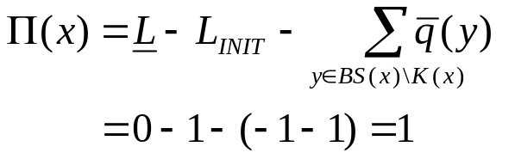
Appendix 1
L=1
L=0
L_{INIT}=1
-1
+1
-1
☞
+1
x
-1
+1
-1
+1
Notes:
On a unary resource, an easy way to characterize a solution is that all the activities on the resource must be ordered. It allows to define the notion of rank of an activity in a solution.
Using this notion of rank, we can easily distinguish between the search procedures based on activity interactions on unary resources ;
1. Chronological Ranking selects at each search node an activity to be ranked first (before all the other ones) among the ones that are still unranked. In case of failure, the alternative is to enforce that at least one of the unranked activities executes before the selected one. Of course anti-chronological ranking may also be used.
2. Pair Sequencing selects at each search node a pair of activities to be sequenced one just after the other. In case of failure the alternative consists in enforcing that at least one activity is executed between the two selected ones. This family of goal is useful when dealing with transition costs.
3. Pair Ordering selects at each search node a pair of activities to be ordered. In the left branch it enforces one ordering of the activities and, in case of failure, in the other branch it enforce the other ordering. Note that pair ordering is the only search procedure that ensures that the constraints posted on the left and on the right branch are of the same nature (both are precedence relations).
In the next slides, we will propose two new instances of very simple search procedures based on Pair Ordering.

Slide 52
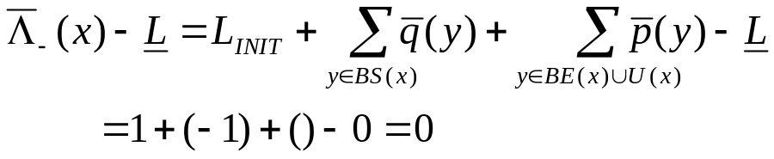
Appendix 1
L=1
L=0
L_{INIT}=1
-1
☞
+1
x
-1
+1
-1
+1
-1
+1
Notes:
On a unary resource, an easy way to characterize a solution is that all the activities on the resource must be ordered. It allows to define the notion of rank of an activity in a solution.
Using this notion of rank, we can easily distinguish between the search procedures based on activity interactions on unary resources ;
1. Chronological Ranking selects at each search node an activity to be ranked first (before all the other ones) among the ones that are still unranked. In case of failure, the alternative is to enforce that at least one of the unranked activities executes before the selected one. Of course anti-chronological ranking may also be used.
2. Pair Sequencing selects at each search node a pair of activities to be sequenced one just after the other. In case of failure the alternative consists in enforcing that at least one activity is executed between the two selected ones. This family of goal is useful when dealing with transition costs.
3. Pair Ordering selects at each search node a pair of activities to be ordered. In the left branch it enforces one ordering of the activities and, in case of failure, in the other branch it enforce the other ordering. Note that pair ordering is the only search procedure that ensures that the constraints posted on the left and on the right branch are of the same nature (both are precedence relations).
In the next slides, we will propose two new instances of very simple search procedures based on Pair Ordering.

Slide 53
Appendix 1
uses 1
uses 1
One can show that events other than the 4 ones involved in the pair of activities does not interfere with this propagation.
Notes:
On a unary resource, an easy way to characterize a solution is that all the activities on the resource must be ordered. It allows to define the notion of rank of an activity in a solution.
Using this notion of rank, we can easily distinguish between the search procedures based on activity interactions on unary resources ;
1. Chronological Ranking selects at each search node an activity to be ranked first (before all the other ones) among the ones that are still unranked. In case of failure, the alternative is to enforce that at least one of the unranked activities executes before the selected one. Of course anti-chronological ranking may also be used.
2. Pair Sequencing selects at each search node a pair of activities to be sequenced one just after the other. In case of failure the alternative consists in enforcing that at least one activity is executed between the two selected ones. This family of goal is useful when dealing with transition costs.
3. Pair Ordering selects at each search node a pair of activities to be ordered. In the left branch it enforces one ordering of the activities and, in case of failure, in the other branch it enforce the other ordering. Note that pair ordering is the only search procedure that ensures that the constraints posted on the left and on the right branch are of the same nature (both are precedence relations).
In the next slides, we will propose two new instances of very simple search procedures based on Pair Ordering.

Slide 54
Appendix 2
The Reservoir Balance Constraint is not strictly stronger than the time-table constraint on discrete resources and reservoir
Example:
L_{INIT}=10
d=20
q=4
q=4
q=4
8
0
10
20
30
100
Notes:
On a unary resource, an easy way to characterize a solution is that all the activities on the resource must be ordered. It allows to define the notion of rank of an activity in a solution.
Using this notion of rank, we can easily distinguish between the search procedures based on activity interactions on unary resources ;
1. Chronological Ranking selects at each search node an activity to be ranked first (before all the other ones) among the ones that are still unranked. In case of failure, the alternative is to enforce that at least one of the unranked activities executes before the selected one. Of course anti-chronological ranking may also be used.
2. Pair Sequencing selects at each search node a pair of activities to be sequenced one just after the other. In case of failure the alternative consists in enforcing that at least one activity is executed between the two selected ones. This family of goal is useful when dealing with transition costs.
3. Pair Ordering selects at each search node a pair of activities to be ordered. In the left branch it enforces one ordering of the activities and, in case of failure, in the other branch it enforce the other ordering. Note that pair ordering is the only search procedure that ensures that the constraints posted on the left and on the right branch are of the same nature (both are precedence relations).
In the next slides, we will propose two new instances of very simple search procedures based on Pair Ordering.

