Slide 1

Resource Temporal Networks:
Definition and Complexity Results
Philippe Laborie
plaborie@ilog.fr

Slide 2

Resource Temporal Network
Definition
Temporal Network:
  Variables:
    Set T of time-points t with domain in Q
  Constraints:
    Min/Max delays: t’ - t∈[A,B], A∈Q, B∈Q, A≤B
    Non-simultaneity: t ≠ t’’
  Graph representation:
[A,B]
t
t’
t’’

Slide 3
Resource Temporal Network
Definition
Temporal Network:
  These temporal networks are called STN≠, they have been proposed in [Gerevini&Cristani97]
  A solution to the temporal network can be found in polynomial time (O(n³))
  Arc- and Path-consistency propagation algorithms are available

Slide 4
Resource Temporal Network
Definition
Resource:
  Time-points of the temporal network are time-points at which something occurs or some condition must be satisfied on a resource
  An RTN is associated a unique resource
  We consider a numerical resource whose level at every date d can be represented by a rational L(d)∈Q
  Initial level of the resource is by convention equal to 0

Slide 5
Resource Temporal Network
Definition
Resource Statements (Resource constraints):
  A(q,t): Absolute change of level at time-point t: at t, the resource level is set to be equal to q
  R(q,t): Relative change of level (if q>0: production, if q<0: consumption) at time-point t.
  For simplicity we assume the quantities q to be constant
=q
t
+=q
t

Slide 6
Resource Temporal Network
Definition
Resource Statements (Resource constraints):
  E(q,t,t’): Equal condition stating that the resource level must be maintained equal to q over the time interval [t,t’)
  L(q,t,t’): Lower-than condition stating that the resource level must be kept lower than or equal to q over the time interval [t,t’)
  For simplicity we assume the quantities q to be constant
t
==q
t’
t
≤q
t’

Slide 7
Resource Temporal Network
Definition
Resource Statements (Resource constraints):
  G(q,t,t’): Greater-than condition stating that the resource level must be kept greater than or equal to q over the time interval [t,t’)
  For simplicity we assume the quantities q to be constant
t
≥q
t’

Slide 8
Resource Temporal Network
Definition
Example of RTN
t₁
[5,10]
t₂
[0,+∞]
t₃
+=1
+=3
-=4
[0,+∞]
t₄
≥3
t₅
=3
[2,+∞]

Slide 9
Resource Temporal Network
Definition
The only decision variables of an RTN are the time-points t∈T
Instantiation of an RTN
  Application σ: T → Q
Time-consistent instantiation
  An instantiation that is a solution to the temporal network

Slide 10
Resource Temporal Network
Definition
Example of RTN
A time-consistent instantiation:
σ(t₁)=0, σ(t₂)=5.5, σ(t₃)=6.4, σ(t₄)=0.8, σ(t₅)=2.8
t₁
[5,10]
t₂
[0,+∞]
t₃
+=1
+=3
-=4
[0,+∞]
t₄
≥3
t₅
=3
[2,+∞]

Slide 11
Resource Temporal Network
Definition
Informal definition of a resource-consistent instantiation
In a resource-consistent instantiation
  Two absolute changes A(q₁,t₁) and A(q₂,t₂) such that q₁≠q₂ cannot be simultaneous (σ(t₁)≠ σ(t₂))
  An absolute change A(q₁,t₁) and a relative change R(q₂,t₂) cannot be simultaneous (σ(t₁)≠ σ(t₂))
  The resource level profile induced by σ must satisfy the resource conditions E,L,G

Slide 12
Resource Temporal Network
Definition
Rationale: two resource statements α and β are allowed to be simultaneous in a resource-consistent instantiation if and only if executing α just before β leads to the same state as executing β just before α
Can be simultaneous
Cannot be simultaneous
=q
=q
α
α→β: q
α
α→β: q’
=q
β→α: q
=q’
β→α: q
β
β
+=q
=q
α
α→β: q+q’
α
α→β: q+q’
+=q’
β→α: q+q’
+=q’
β→α: q
β
β

Slide 13
Resource Temporal Network
Definition
Example of RTN
A resource-consistent instantiation:
σ(t₁)=0, σ(t₂)=2, σ(t₃)=5, σ(t₄)=2, σ(t₅)=3
t₁
[5,10]
t₂
[0,+∞]
t₃
+=1
+=3
-=4
0
2
3
5
[0,+∞]
t₄
≥3
t₅
t₁
t₂
=3
t₃
t₄
≥3
t₅
=3
+=1
+=3
-=4
[2,+∞]

Slide 14
Resource Temporal Network
Definition
A solution to an RTN is an instantiation σ that is both time- and resource-consistent

Slide 15
Resource Temporal Network
Definition
Example of RTN
A solution:
σ(t₁)=0, σ(t₂)=5, σ(t₃)=9, σ(t₄)=6, σ(t₅)=8
t₁
[5,10]
t₂
[0,+∞]
t₃
+=1
+=3
-=4
0
5
6
8
9
[0,+∞]
t₄
≥3
t₅
t₄
t₅
t₁
t₂
=3
t₃
≥3
=3
+=1
+=3
-=4
[2,+∞]

Slide 16
Resource Temporal Network
Definition
An RTN is said to be resource-safe if and only if any time-consistent solution is also resource-consistent (and thus, is a solution)
A solution to a resource-safe RTN can be computed in polynomial time
A resource-safe RTN represents a set of solutions that can be computed in polynomial time

Slide 17
Resource Temporal Network
Definition
Example of RTN
This RTN is not resource-safe:
σ(t₁)=0, σ(t₂)=5, σ(t₃)=6, σ(t₄)=0, σ(t₅)=2
t₁
[5,10]
t₂
[0,+∞]
t₃
+=1
+=3
-=4
0
2
5
6
[0,+∞]
t₄
≥3
t₅
t₄
t₅
t₁
=3
t₂
t₃
≥3
=3
+=1
+=3
-=4
[2,+∞]

Slide 18
Resource Temporal Network
Definition
Example of RTN
This RTN is resource-safe
t₁
[5,10]
t₂
[0,+∞]
t₃
+=1
+=3
-=4
[0,+∞]
[0,+∞]
t₄
t₅
≥3
=3
[2,+∞]

Slide 19
Resource Temporal Network
Definition
Why STN≠ instead of just STN ?
  The conditions for an instantiation to be resource-consistent contain some non-simultaneity constraints (t_{a}≠t_{r}, t_{a1}≠t_{a2} ).
  If the temporal network does not support t ≠ t’, it means that all the statements that cannot be simultaneous need to be totally ordered in a resource-safe solution
  This sounds to be too restrictive, most of all given that STN≠ are not more complex than STN

Slide 20
Resource Temporal Network
Expressivity
A reservoir can be represented as an RTN:
  Production: R(q,t)
  Consumption: R(-q,t)
  Two special time-points: t_{origin}, t_{horizon} (∀t, t_{origin}≤t ≤ t_{horizon})
  A greater-than condition: G(0, t_{origin}, t_{horizon} )
  A lower-than condition: L(Q, t_{origin}, t_{horizon} )
-=q₂
[0,+∞]
[0,+∞]
+=q₁
t₂
[0,+∞]
[0,+∞]
t_{origin}
t₁
t_{horizon}
≥0
≤Q

Slide 21
Resource Temporal Network
Expressivity
A state-resource can be represented as an RTN:
  Mapping μ: S → Q of possible states S
  Activity [t,t’) requires(s) represented as:
  A(μ(s),t), E(μ(s),t,t’)
t
==μ(s)
t’
=μ(s)

Slide 22
Resource Temporal Network
Expressivity
Additional expressivity:
  Activities that empty/fill a reservoir
  Complex conditions for activities: an activity can execute only if resource level stays within a given range [L_{min},L_{max}] during the time interval of an activity
  Gauge variables: variable x is the resource level at the date of a time-point t
  Mixing activities that change the state of a state resource with activities that requires some state to execute: e.g. Temperature: WARM(Oven,T), COOK(Pie,Oven,T)

Slide 23
Notations (1)
Complexity
n number of time points in the RTN
m number of temporal constraints in the temporal network
k number of resource conditions in the RTN (equal, lower-than, greater-than) (k≤n)

Slide 24
Checking a solution
Complexity
Checking if a given instantiation is a solution can be done in polynomial time in O(m+n.(k+log(n)))
  Checking time consistency can be performed in O(m)
  Checking resource consistency can be performed in O(k.n.log(n)):
    Sort all time points : O(n.log(n))
    Chronologically iterate over the sorted time points and check the active conditions at the current time-point (at most k)
A more efficient algorithm in O(m+n.log(n)) exists. Idea: among the k active conditions, only the strongest need to be checked (at most 2)

Slide 25
Checking a solution
Complexity
Result 1
Checking if a given instantiation is a solution can be done in polynomial time in O(m+n.log(n))

Slide 26
Finding a solution
Complexity
Finding a solution is in NP (as checking if an instantiation is a solution is in P)
We now study the complexity of some fragments of the general RTN framework

Slide 27
Notations (2)
Complexity
∅ No temporal constraints
Point algebra of [Vilain&Kautz86]: restriction of STN≠ to qualitative constraints
{ ∅, <, ≤, =, ≥, >, ≠, ? }
General STN≠
P
A
S
T
N
≠

Slide 28
Notations (3)
Complexity
R⁺ Set of relative changes R(q,t) such that q>0
Set of pairs of resource statements (R(+q,t), R(-q,t’)) where q>0 and t<t’
The unique lower-than condition
L(Q, t_{origin}, t_{horizon} )
Set of pairs of resource statements (A(q,t), E(q,t,t’)) where t<t’
E Set of equal conditions
A Set of absolute changes
R
⁺⁻
_{q}
L_{Q}
¹
A
E

Slide 29
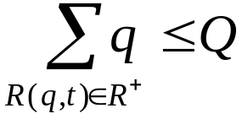
Finding a solution
Complexity
Result 2
Solving (R⁺, | ) can be done in polynomial time in O(n³)
Proof
Temporal and resource constraints are completely separated. There exists a solution iff the temporal network is consistent and
If there exists a solution, then any solution to the temporal network is a solution
L_{Q}
S
T
N
¹
≠

Slide 30
Finding a solution
Complexity
Result 3
Solving ( , | ) can be done in polynomial time in O(n+m)
Proof
This is a one-machine problem submitted to precedence constraints
R
L₁
P
⁺⁻
¹
A
₁
+=1
-=1
+=1
-=1
t_{origin}
+=1
-=1
t_{horizon}
≤1

Slide 31
Finding a solution
Complexity
Result 4
Solving (A | ) can be done in polynomial time in O(n³)
Proof
Resource constraints are equivalent to inserting in the temporal network a constraint t≠t’ for each pair of absolute changes A(q,t), A(q’,t’) such that q≠q’
Thus the complexity is the same as for solving STN≠ which is polynomial
S
T
N
≠

Slide 32
Finding a solution
Complexity
Result 5
Solving ( , | ) is NP-Complete
Proof
The NP-Complete one-machine scheduling problem 1|prec(l_{ij}),p_{j}=1|C_{max}≤T is a special case of it
R
L₁
S
T
N
⁺⁻
¹
₁
≠

Slide 33
Finding a solution
Complexity
Result 6
Solving ( | ) is NP-Complete
Proof
( , | ) which is NP-Complete (c.f. Result 5) can be reformulated as a special case of this problem where all the quantities q_{i} of the pairs (A(q_{i},t), E(q_{i},t,t’)) are different
A
E
S
T
N
≠
R
L₁
S
T
N
⁺⁻
¹
≠
₁

Slide 34
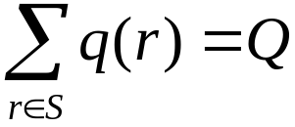
Finding a solution
Complexity
Result 7
Solving (R⁺,E | ∅) is NP-Complete
Proof
The Subset Sum Problem [SP13] can be reduced to it
Subset Sum: Finite set R of size m. For each element r∈R a positive integer size q(r). A positive integer Q. Is there S⊆ R such that ?

Slide 35
Finding a solution
Complexity
Proof (cont’d)
Subset Sum Problem R, q:R→N, Q∈N
Associated RTN:
R
Solution
+=q₁
+=q₂
S ={t / σ(t) ≤ σ(τ)}
+=q_{i}
+=q_{m}
+=q₁
+=q_{i}
τ
==Q
τ’
+=q_{m}
+=q₂
τ
==Q
τ’

Slide 36
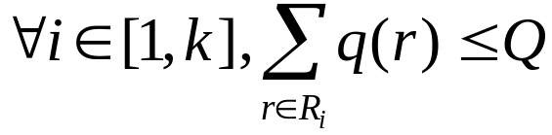
Finding a solution
Complexity
Result 8
Solving (R⁺,A, | ) is NP-Complete
Proof
The Bin Packing Problem [SR1] can be reduced to it
Bin Packing: Finite set R of m item. For each element r∈R a positive integer size q(r). A positive integer Q (bin capacity) and k≤m. Can R be partitioned into k sets R₁,…,R_{k} such that ?
L_{Q}
P
¹
A

Slide 37
Finding a solution
Complexity
Proof (cont’d)
Bin Packing Problem R, q:R→N, Q,k∈N
Associated RTN:
R
+=q₁
+=q₂
+=q_{i}
+=q_{m}
τ₁
τ₂
τ₃
τ_{κ−1}
t_{origin}
=0
=0
=0
=0
t_{horizon}
≤Q

Slide 38
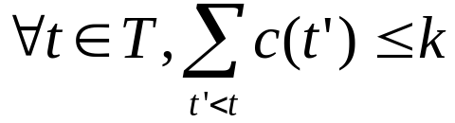
Finding a solution
Complexity
Result 9
Solving ( , | ) is NP-Complete
Proof
The Sequencing to Minimize Maximum Cumulative Cost (SMMCC) [SS7] can be reduced to it
SMMCC: Set of tasks T. Partial order  between tasks. Fixed cost c(t)∈{-1,1} for each task t∈T. Constant k. Find a total order < that obeys  and such that
R
L_{Q}
P
⁺⁻
¹
A
₁

Slide 39
Finding a solution
Complexity
Proof (cont’d)
SMMCC: T,, c:T →{-1,1}, k
Associated RTN: n = card {t / c(t)=-1}
T, 
+=1
-=1
+=1
-=1
{
+=1
+=1
-=1
-=1
n
+=1
-=1
t_{origin}
t_{horizon}
≤k+n

Slide 40
Finding a solution
Complexity
Conclusion
Except for very simple segments, finding a solution to an RTN is NP-Complete

Slide 41
Checking resource-safety
Complexity
Problem: is a given RTN resource-safe or not ?
This question is important because:
  If it is resource-safe, then, exhibiting a solution is polynomial
  If it is not resource-safe, then, with no additional complexity, we can identify a reason why (potential resource conflict) and branch on the different ways to solve it

Slide 42
Checking resource-safety
Complexity
Result 10
Checking resource-safety for (R, | ) can be done in polynomial time in O(n.m.log(n²/m))
Proof
The problem can be reformulated as an Open-Pit Mining Problem [Ahuja&al93]
L_{Q}
P
¹
A

Slide 43
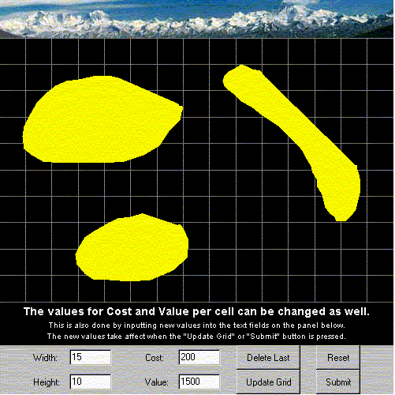

Open-Pit Mining
Complexity
Cost for excavating
a cell: -200
Gain for excavating
an ore cell: +1500
http://riot.ieor.berkeley.edu/riot/Applications/OPM/

Slide 44
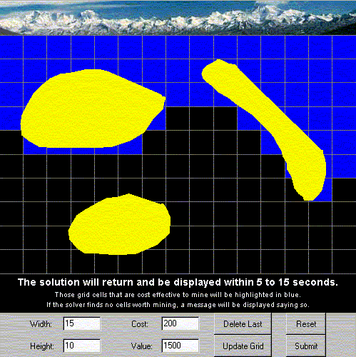
Open-Pit Mining
Complexity
http://riot.ieor.berkeley.edu/riot/Applications/OPM/

Slide 45
Open-Pit Mining
Complexity
A set of cells T
A partial order < between cells
  t<t’ means that a condition for excavating t’ is that cell t has been excavated
A gain g(t) ∈Q for each cell T
  g(t)<0: cost for excavating a cell
  g(t)>0: gain for excavating an ore cell
Problem: find a subset S of cells to be excavated that maximizes the gain

Slide 46
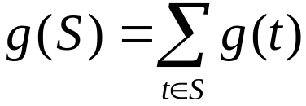

Open-Pit Mining
Complexity
Problem: find a subset S of cells to be excavated that maximizes the gain:
  Maximize
  S⊆T being subject to
T
-9
+8
-4
S*: g(S*)=+2
-1
+7

Slide 47
Open-Pit Mining
Complexity
The Open-Pit Mining Problem can be solved in polynomial time in O(n.m.log(n²/m)) using a min-cut/max-flow algorithm [Hao&Orlin92]

Slide 48
Open-Pit Mining
Complexity
Direct mapping
The RTN is resource safe if and only if g(S*)≤Q
All time-points in S* can be executed before all time points in T\S*. The resource level after S* is g(S*) and is the maximal resource level reachable in a time-consistent instantiation.
-=9
+=8
-9
+8
-=4
-4
S*: g(S*)=+2
-=1
+=7
-1
+7
t_{origin}
t_{horizon}
≤Q

Slide 49
Checking resource-safety
Complexity
Result 11
Checking resource-safety for (A, R⁺, | ) can be done in polynomial time in O(n³.log(n))
Proof
The problem can be reformulated as computing the maximum weighted independent set of a comparability graph [Golumbic80]
L_{Q}
P
¹
A

Slide 50
Checking resource-safety
Complexity
Proof (cont’d)
Example
+=2
+=1
+=1
=0
=0
+=1
=2
t_{origin}
t_{horizon}
≤5

Slide 51

Checking resource-safety
Complexity
Proof (cont’d)
Without lack of generality we assume all the quantities q of absolute changes A(q,t) are such that q>0
Indeed, if this is not true, let
We can transform the RTN into an equivalent RTN as follows:
A(q,t) → A(q+Δ,t)
Q → Q+Δ

Slide 52
Checking resource-safety
Complexity
Proof (cont’d)
Example: Δ=1
+=2
+=1
+=1
=1
=1
+=1
=3
t_{origin}
t_{horizon}
≤6

Slide 53
Checking resource-safety
Complexity
Proof (cont’d)
Problem reformulation
There exists a path containing
an absolute change
Between any pair of
absolute changes
+=2
+=1
+=1
2
1
1
=1
=1
1
1
+=1
=3
1
3
t_{origin}
t_{horizon}
≤6

Slide 54
Checking resource-safety
Complexity
Proof (cont’d)
Problem reformulation
  The graph is a comparability
  graph
  The RTN is resource-safe
  if and only if the weight of the
  maximal weighted independent
  set is lower than Q
  On a comparability graph,
  computing the weight of the
  maximal weighted independent
  set can be done in O(n.m.log(n²/m))
There exists a path containing
an absolute change
Between any pair of
absolute changes
2
1
1
1
1
1
3

Slide 55
Checking resource-safety
Complexity
Result 12
Checking resource-safety for (X,L,E,G| ) is of the same complexity class as (X, | )
Proof
Checking resource-safety of a RTN (X,L,E,G| ) can be done by individually checking each resource condition
S
T
N
≠
L_{Q}
S
T
N
¹
≠
S
T
N
≠

Slide 56
Checking resource-safety
Complexity
Result 13
Checking resource-safety for (X, | ) is of the same complexity class as (X, | )
Proof
This can be easily adapted from a result shown in [Muscetolla02] (notion of separation schedule)
L_{Q}
S
T
N
¹
≠
L_{Q}
P
¹
A

Slide 57
Checking resource-safety
Complexity
Consequence of Result 12 and 13
Checking resource-safety for (R,L,E,G | ) can be done in polynomial time
Checking resource-safety for (A,R⁺,L,E,G | ) can be done in polynomial time
Open question
Complexity for checking resource-safety for the whole framework (A,R,L,E,G | ) ?
S
T
N
≠
S
T
N
≠
S
T
N
≠

Slide 58
Checking resource-safety
Complexity
Complexity for checking resource-safety for (A,R,L,E,G | ) is of the same complexity class as (A,R, | ) (Result 12 and 13)
(A,R, | ) can be seen as an Open Pit Mining with Magical Stones problem
S
T
N
≠
L_{Q}
P
¹
A
L_{Q}
P
¹
A

Slide 59
Open-Pit Mining with Magical Stones
Complexity
A set of cells T, a partial order < between cells
  t<t’ means that a condition for excavating t’ is that cell t has been excavated
A gain g(t) ∈Q for each cell T
  g(t)<0: cost for excavating a cell
  g(t)>0: gain for excavating an ore cell
Some cells contain a magical stone that transforms the current gain (or loss) into a constant q
Problem: find a subset S of cells to be excavated that maximizes the gain

Slide 60

Open-Pit Mining with Magical Stones
Complexity
Example
✰
=1

✰
•
+=1
-=2
•







=3
=1
+=1


-=1
+=1
✰
•





1
2
0
1
3
4
5

Slide 61

Open-Pit Mining with Magical Stones
Complexity
What is the complexity of Open-Pit Mining with Magical Stones ?
Reward offered to anyone showing this problem is polynomial or NP-Complete !

