Slide 1
ILOG CP for scheduling
A developer and user's perspective
May 23, 2007
Philippe Laborie
Principal Scientist
plaborie@ilog.fr

Slide 2
Overview
ILOG CP for Scheduling from inside
  Overview of the tool
  From the perspective of one of its developers
ILOG CP for Scheduling in action
  Using the tool to solve scheduling problems with illustration on some examples
  From the perspective of a CP researcher or engineer using the tool
ILOG CP for Scheduling hereafter
  Current and future developments

Slide 3
ILOG CP for Scheduling from inside
Part of the ILOG Constraint Programming product
A C++ library for modeling and solving scheduling problems
On top of ILOG core-CP

Slide 4
ILOG CP for Scheduling from inside
User-defined
scheduling
constraints
User-defined
scheduling
search goals
User-defined
scheduling
meta-heuristics
Scheduling
constructs
(activity, resource)
Predefined
scheduling
constraints
Predefined
scheduling
search goals
Predefined
scheduling
meta-heuristics
User-defined
constraints
User-defined
search goals
User-defined
meta-heuristics
(LS, LNS, Gas)
Predefined
constraints
Predefined
search goals
Predefined
meta-heuristics
(LS, LNS, Gas)
Variables
Generic
constraints
Generic
search goals
Generic
meta-heuristics
(LS, LNS, Gas)

Slide 5
ILOG CP for Scheduling from inside
User-defined
scheduling
constraints
User-defined
scheduling
search goals
User-defined
scheduling
meta-heuristics
Scheduling
constructs
(activity, resource)
Predefined
scheduling
constraints
Predefined
scheduling
search goals
Predefined
scheduling
meta-heuristics
Scheduling constructs:
Activity
Resource (unary, state, discrete, reservoir, energy)
Alternative resources
Calendar (breaks, shifts, efficiency)
Transition time/cost

Slide 6
ILOG CP for Scheduling from inside
User-defined
scheduling
constraints
User-defined
scheduling
search goals
User-defined
scheduling
meta-heuristics
Scheduling
constructs
(activity, resource)
Predefined
scheduling
constraints
Predefined
scheduling
search goals
Predefined
scheduling
meta-heuristics
Scheduling constraints:
- Temporal constraints
- Resource constraints
Propagation algorithm:
Time-tabling
Disjunctive
Edge-finding
Balance constraint
Precedence energy
Sequencing

Slide 7
ILOG CP for Scheduling from inside
User-defined
scheduling
constraints
User-defined
scheduling
search goals
User-defined
scheduling
meta-heuristics
Scheduling
constructs
(activity, resource)
Predefined
scheduling
constraints
Predefined
scheduling
search goals
Predefined
scheduling
meta-heuristics
Scheduling search goals:
- Resource allocation
- Resource ranking
- Resource sequencing
- Set-Times

Slide 8
ILOG CP for Scheduling from inside
User-defined
scheduling
constraints
User-defined
scheduling
search goals
User-defined
scheduling
meta-heuristics
Scheduling
constructs
(activity, resource)
Predefined
scheduling
constraints
Predefined
scheduling
search goals
Predefined
scheduling
meta-heuristics
Scheduling meta-heuristics:
- Scheduling Large Neighborhood Search
  - Time-window
  - Relocate activity

Slide 9
ILOG CP for Scheduling from inside
Example: Jobshop scheduling problem: Model
IloEnv env;
IloModel model(env);
IloIntVar makespan(env, 0, IloIntMax);
IloInt i, j, k =0;
IloResourceArray machines(env, NumberOfResources);
for (j = 0; j < NumberOfResources; j++)
machines[j] = IloUnaryResource(env);
for (i = 0; i < NumberOfJobs; i++) {
IloActivity prevAct;
for (j = 0; j < NumberOfResources; j++) {
IloActivity act(env, Durations[k]);
model.add(act.requires(machines[ResourceNumbers[k]]));
if (j != 0) model.add(act.startsAfterEnd(prevAct));
prevAct = act; k++;
}
model.add(prevAct.endsBefore(makespan));
}
model.add(IloMinimize(env, makespan));
Resources

Slide 10
ILOG CP for Scheduling from inside
Example: Jobshop scheduling problem: Model
IloEnv env;
IloModel model(env);
IloIntVar makespan(env, 0, IloIntMax);
IloInt i, j, k =0;
IloResourceArray machines(env, NumberOfResources);
for (j = 0; j < NumberOfResources; j++)
machines[j] = IloUnaryResource(env);
for (i = 0; i < NumberOfJobs; i++) {
IloActivity prevAct;
for (j = 0; j < NumberOfResources; j++) {
IloActivity act(env, Durations[k]);
model.add(act.requires(machines[ResourceNumbers[k]]));
if (j != 0) model.add(act.startsAfterEnd(prevAct));
prevAct = act; k++;
}
model.add(prevAct.endsBefore(makespan));
}
model.add(IloMinimize(env, makespan));
Jobs

Slide 11
ILOG CP for Scheduling from inside
Example: Jobshop scheduling problem: Model
IloEnv env;
IloModel model(env);
IloIntVar makespan(env, 0, IloIntMax);
IloInt i, j, k =0;
IloResourceArray machines(env, NumberOfResources);
for (j = 0; j < NumberOfResources; j++)
machines[j] = IloUnaryResource(env);
for (i = 0; i < NumberOfJobs; i++) {
IloActivity prevAct;
for (j = 0; j < NumberOfResources; j++) {
IloActivity act(env, Durations[k]);
model.add(act.requires(machines[ResourceNumbers[k]]));
if (j != 0) model.add(act.startsAfterEnd(prevAct));
prevAct = act; k++;
}
model.add(prevAct.endsBefore(makespan));
}
model.add(IloMinimize(env, makespan));
Objective

Slide 12
ILOG CP for Scheduling from inside
Example: Jobshop scheduling problem: Search
IloSolver cp(model);
cp.solve(IloRankForward(env, makespan));
cout << "Optimal makespan = " << cp.getValue(makespan) << endl;
env.end();

Slide 13
ILOG CP for Scheduling from inside
Activities (non-preemptive)
Activity A
t
Start time: s(A)
End time: e(A)
Duration: d(A) == e(A)-s(A)
1 Activity ≡ 3 numerical Variables

Slide 14
ILOG CP for Scheduling from inside
Activities: notations
Activity A
s_{max}(A)
e_{max}(A)
t
s_{min}(A)
e_{min}(A)

Slide 15
ILOG CP for Scheduling from inside
Calendars:
  When activity duration depends on its execution date
Activity A
p₁
...
p_{i}
t
M
T
W
T
F
S
S
M
T
W
T
F
S
S
M
T
W
T
F
S
S
M
T
W
T
F
S
S
M
T
W
T
Processing time: p(A) = Σ p_{i} = e(A)-s(A) - breaks(A)
1 Activity ≡ 3 numerical Variables

Slide 16
ILOG CP for Scheduling from inside
Temporal constraints:
  Expressed as t_{i} - t_{j} ∈[d_{min}, d_{max}] where:
    t_{i}, t_{j} : start or end time point of some activities
    d_{min}, d_{max}: minimal and maximal delay
  Generic enough to model:
    release dates: start(A) ∈ [r,+∞)
    deadlines: end(A) ∈ (-∞,d]
    precedence: start(B)-end(A) ∈ [0,+∞)
  Propagation by arc-consistency

Slide 17
ILOG CP for Scheduling from inside
Resource typology:
  Unary resource: Resource of capacity 1. Two activities requiring the same unary resource cannot overlap.
  Discrete resource: Resource of capacity Q. Activities requiring the same discrete resource can overlap provided the resource capacity Q is not exceeded.

Slide 18
ILOG CP for Scheduling from inside
Resource typology (cont’d):
  Reservoir: Resource of capacity Q and initial level L; Activities may consume or produce the reservoir. The level of the reservoir over time must be kept in the interval [0,Q].
  State Resource. Resource with a finite set of possible states. Activities require the resource be in a particular state s. Activities requiring incompatible state may not overlap.

Slide 19



ILOG CP for Scheduling from inside
Activities (A)
Demand (D)
Resources (R)
A requires R
Unary resource
A requires(q) R
Discrete resource
A consumes(q) R
A produces(q) R
Reservoir
A requires(q) R

Slide 20
ILOG CP for Scheduling from inside
Unary Resource
Availability
1
0
Time
A requires R
B requires R

Slide 21
ILOG CP for Scheduling from inside
Discrete Resource
Availability
Q
0
Time
A requires(q_{A}) R
B requires (q_{B}) R

Slide 22
ILOG CP for Scheduling from inside
Reservoir
Level
Q
0
Time
A consumes(q_{A}) R
C produces (q_{C}) R
B requires (q_{B}) R

Slide 23
ILOG CP for Scheduling from inside
Resource quantities q(D) are decision variables
The same activity may demand several resources:
D₁: A requires Machine1
A
D₂: A requires(q₂) Power
D₃: A consumes(q₃) Fuel

Slide 24
ILOG CP for Scheduling from inside
Meta-constraints can be used to express logical relations between resource demands:
  [A requires Machine1] ⇒
  [A consumes(q₂) Fuel] ∨ [B requires(q₃) Power]

Slide 25
ILOG CP for Scheduling from inside
Alternative Resource Sets
  n equivalent resources S={R₁,…,R_{n}}
  D = [A requires(q) S] means that
    One resource in the set S needs to be allocated to activity A. The resource r(D)∈S allocated to A (its index 1,..,n) is a decision variable.
    A will require (or: produce, consume) q(D) units of the allocated resource.

Slide 26
ILOG CP for Scheduling from inside
Alternative Resource Sets
  Could be modeled as:
  A requires(q) R₁ ∨ ... ∨ A requires(q) R_{n}
  But alternative resources allow for stronger propagation (global pruning of the disjunction)

Slide 27
ILOG CP for Scheduling from inside
Transition (or setup) times/costs on unary/state resources
  If activity B follows activity A on a unary or state resource R, then at least d_{A,B} units of time are necessary to setup the resource before starting to process B
  Similar to a meta-constraint:

Slide 28
ILOG CP for Scheduling from inside
Resource propagation algorithms:
  Time-tabling, Disjunctive, Edge-finding, Balance constraint, Precedence energy, Sequencing
An overview is available in:
  P. Laborie. Algorithms for Propagating Resource Constraints in AI Planning and Scheduling: Existing Approaches and New Results. A.I. Journal. Vol 143/2 pp151-188. 2003.

Slide 29
ILOG CP for Scheduling from inside
Decision variables:
  Start, end and processing time of activities
  Quantities of resources demands
  Allocated resource in case of alternative resources
From the standpoint of constraint-programming, the limited capacity of resources imposes some global constraint on the decision variables of the problem

Slide 30
ILOG CP for Scheduling from inside
Predefined search strategies:
  Resource Assignment
  Sequence
  Rank First/Not First
  Setting Times
Resource Allocation
Resource Scheduling
Notes:
On a unary resource, an easy way to characterize a solution is that all the activities on the resource must be ordered. It allows to define the notion of rank of an activity in a solution.
Using this notion of rank, we can easily distinguish between the search procedures based on activity interactions on unary resources ;
1. Chronological Ranking selects at each search node an activity to be ranked first (before all the other ones) among the ones that are still unranked. In case of failure, the alternative is to enforce that at least one of the unranked activities executes before the selected one. Of course anti-chronological ranking may also be used.
2. Pair Sequencing selects at each search node a pair of activities to be sequenced one just after the other. In case of failure the alternative consists in enforcing that at least one activity is executed between the two selected ones. This family of goal is useful when dealing with transition costs.
3. Pair Ordering selects at each search node a pair of activities to be ordered. In the left branch it enforces one ordering of the activities and, in case of failure, in the other branch it enforce the other ordering. Note that pair ordering is the only search procedure that ensures that the constraints posted on the left and on the right branch are of the same nature (both are precedence relations).
In the next slides, we will propose two new instances of very simple search procedures based on Pair Ordering.

Slide 31
ILOG CP for Scheduling from inside
Resource Assignment :
  Select an unbound variable r(D)
  Select a value k in the current domain of r(D)
  Branch on : [r(D)=k] ∨ [r(D)≠k]
Notes:
On a unary resource, an easy way to characterize a solution is that all the activities on the resource must be ordered. It allows to define the notion of rank of an activity in a solution.
Using this notion of rank, we can easily distinguish between the search procedures based on activity interactions on unary resources ;
1. Chronological Ranking selects at each search node an activity to be ranked first (before all the other ones) among the ones that are still unranked. In case of failure, the alternative is to enforce that at least one of the unranked activities executes before the selected one. Of course anti-chronological ranking may also be used.
2. Pair Sequencing selects at each search node a pair of activities to be sequenced one just after the other. In case of failure the alternative consists in enforcing that at least one activity is executed between the two selected ones. This family of goal is useful when dealing with transition costs.
3. Pair Ordering selects at each search node a pair of activities to be ordered. In the left branch it enforces one ordering of the activities and, in case of failure, in the other branch it enforce the other ordering. Note that pair ordering is the only search procedure that ensures that the constraints posted on the left and on the right branch are of the same nature (both are precedence relations).
In the next slides, we will propose two new instances of very simple search procedures based on Pair Ordering.

Slide 32
ILOG CP for Scheduling from inside
Property : In any solution on a unary resource, each resource demand - but the last one - has a unique resource demand that is executed next to it (i.e. just after)
Sequence (Unary Resource) :
  Select a not-sequenced pair of resource demand (u,v)
  Branch on : [next(u) = v] ∨ [next(u) ≠ v]
  Needs a sequencing constraint to maintain and propagate the domain of next(x)
  Useful when using transition costs
Notes:
On a unary resource, an easy way to characterize a solution is that all the activities on the resource must be ordered. It allows to define the notion of rank of an activity in a solution.
Using this notion of rank, we can easily distinguish between the search procedures based on activity interactions on unary resources ;
1. Chronological Ranking selects at each search node an activity to be ranked first (before all the other ones) among the ones that are still unranked. In case of failure, the alternative is to enforce that at least one of the unranked activities executes before the selected one. Of course anti-chronological ranking may also be used.
2. Pair Sequencing selects at each search node a pair of activities to be sequenced one just after the other. In case of failure the alternative consists in enforcing that at least one activity is executed between the two selected ones. This family of goal is useful when dealing with transition costs.
3. Pair Ordering selects at each search node a pair of activities to be ordered. In the left branch it enforces one ordering of the activities and, in case of failure, in the other branch it enforce the other ordering. Note that pair ordering is the only search procedure that ensures that the constraints posted on the left and on the right branch are of the same nature (both are precedence relations).
In the next slides, we will propose two new instances of very simple search procedures based on Pair Ordering.

Slide 33
ILOG CP for Scheduling from inside
Property : in a solution for a unary resource, there exists a chronological ordering of the resource demands (u₁,u₂,…,u_{n}) such that for all i, resource demand u_{i} is ranked first among the set of demands {u_{i}, u_{i+1}, …, u_{n}}.
u₁
u₂
u_{i}
u_{i+1}
u_{n}
Notes:
On a unary resource, an easy way to characterize a solution is that all the activities on the resource must be ordered. It allows to define the notion of rank of an activity in a solution.
Using this notion of rank, we can easily distinguish between the search procedures based on activity interactions on unary resources ;
1. Chronological Ranking selects at each search node an activity to be ranked first (before all the other ones) among the ones that are still unranked. In case of failure, the alternative is to enforce that at least one of the unranked activities executes before the selected one. Of course anti-chronological ranking may also be used.
2. Pair Sequencing selects at each search node a pair of activities to be sequenced one just after the other. In case of failure the alternative consists in enforcing that at least one activity is executed between the two selected ones. This family of goal is useful when dealing with transition costs.
3. Pair Ordering selects at each search node a pair of activities to be ordered. In the left branch it enforces one ordering of the activities and, in case of failure, in the other branch it enforce the other ordering. Note that pair ordering is the only search procedure that ensures that the constraints posted on the left and on the right branch are of the same nature (both are precedence relations).
In the next slides, we will propose two new instances of very simple search procedures based on Pair Ordering.

Slide 34
ILOG CP for Scheduling from inside
Rank First/Not First (Unary Resource) :
  Select an unranked resource demand u
  Branch on : [rank first(u)] ∨ [rank not first(u)]
  Needs constraint to propagate rank first/not first
Similar branching scheme with Rank Last/Not Last
u
Unranked
resource
demands
Notes:
On a unary resource, an easy way to characterize a solution is that all the activities on the resource must be ordered. It allows to define the notion of rank of an activity in a solution.
Using this notion of rank, we can easily distinguish between the search procedures based on activity interactions on unary resources ;
1. Chronological Ranking selects at each search node an activity to be ranked first (before all the other ones) among the ones that are still unranked. In case of failure, the alternative is to enforce that at least one of the unranked activities executes before the selected one. Of course anti-chronological ranking may also be used.
2. Pair Sequencing selects at each search node a pair of activities to be sequenced one just after the other. In case of failure the alternative consists in enforcing that at least one activity is executed between the two selected ones. This family of goal is useful when dealing with transition costs.
3. Pair Ordering selects at each search node a pair of activities to be ordered. In the left branch it enforces one ordering of the activities and, in case of failure, in the other branch it enforce the other ordering. Note that pair ordering is the only search procedure that ensures that the constraints posted on the left and on the right branch are of the same nature (both are precedence relations).
In the next slides, we will propose two new instances of very simple search procedures based on Pair Ordering.

Slide 35
ILOG CP for Scheduling from inside
All previous branching schemes are complete
Setting Times (All resources) :
  Select an activity a in the schedule
  Branch on : [s(a) = s_{min}(a)] ∨ [s(a) > s_{min}(a)]
  Dominance rule relying on constraint propagation : instead of posting [s(a) > s_{min}(a)], activity a is marked as non-selectable until its start time has been updated by propagation.
Notes:
On a unary resource, an easy way to characterize a solution is that all the activities on the resource must be ordered. It allows to define the notion of rank of an activity in a solution.
Using this notion of rank, we can easily distinguish between the search procedures based on activity interactions on unary resources ;
1. Chronological Ranking selects at each search node an activity to be ranked first (before all the other ones) among the ones that are still unranked. In case of failure, the alternative is to enforce that at least one of the unranked activities executes before the selected one. Of course anti-chronological ranking may also be used.
2. Pair Sequencing selects at each search node a pair of activities to be sequenced one just after the other. In case of failure the alternative consists in enforcing that at least one activity is executed between the two selected ones. This family of goal is useful when dealing with transition costs.
3. Pair Ordering selects at each search node a pair of activities to be ordered. In the left branch it enforces one ordering of the activities and, in case of failure, in the other branch it enforce the other ordering. Note that pair ordering is the only search procedure that ensures that the constraints posted on the left and on the right branch are of the same nature (both are precedence relations).
In the next slides, we will propose two new instances of very simple search procedures based on Pair Ordering.

Slide 36
ILOG CP for Scheduling from inside
Parameterization of predefined search strategies with evaluators/predicates:
IloEvaluator<IlcActivity> smin = IlcActivityStartMinEvaluator(cp);
IloEvaluator<IlcActivity> emax = IlcActivityEndMaxEvaluator(cp);
IloEvaluator<IlcActivity> d = IlcActivityDurationMinEvaluator(cp);
IloEvaluator<IlcActivity> slack = emax - smin - d;
IloSelector<IlcActivity,IlcSchedule> selector =
IloBestSelector<IlcActivity,IlcSchedule>
(IloComposeLexical(smin, slack));
cp.solve(IlcSetTimes(sched, selector));

Slide 37
ILOG CP for Scheduling from inside
Support for Large Neighborhood Search
S₁: initial solution
LN₁
LN₁: relaxation of some
features of the solution:
activity start/end times
precedence constraints
resource allocation
etc.
S₁

Slide 38
ILOG CP for Scheduling from inside
Support for Large Neighborhood Search
LN₁: relaxation of some
features of the solution:
activity start/end times
precedence constraints
resource allocation
etc.
LN₁
S₂
S₂: new solution after
solving the relaxed problem
with a limited search tree
exploration

Slide 39
ILOG CP for Scheduling from inside
Support for Large Neighborhood Search
Etc …
LN₂
S₂

Slide 40
ILOG CP for Scheduling from inside
Support for Large Neighborhood Search
LN₂
S₃

Slide 41
ILOG CP for Scheduling from inside
Support for Large Neighborhood Search
  IloSchedulerLargeNHood: Allows specifying for each activity/resource demand which elements are restored (start, end, processing time, predecessors, successors, prev, next, allocated resource) depending on the fact the activity/demand belongs to the relaxed fragment or not

Slide 42
ILOG CP for Scheduling from inside
Advanced functionalities
  Accessors on internal global structures (timetable, precedence graph) for writing efficient user-defined constraints: events, domain/delta-domain iterators. E.g.
    IlcIntTimetable::whenRangeInterval(IlcDemon demon)
    IlcResourceConstraint::whenSuccessors(IlcDemon demon)
  Basic decisions for writing user-defined branching schemes and search strategies. E.g.
    IlcGoal IlcScheduleOrPostpone(IlcActivity act)

Slide 43
ILOG CP for Scheduling in action
Scheduling
problem
User’s code
User-defined
constraints
User-defined
search goals
User-defined
meta-heuristics
Scheduling
constructs
(activity, resource)
Predefined
scheduling
constraints
Predefined
scheduling
search goals
Predefined
scheduling
meta-heuristics
ILOG CP
Predefined
constraints
Predefined
search goals
Predefined
meta-heuristics
(LS, LNS, Gas)
Variables
Generic
constraints
Generic
search goals
Generic
meta-heuristics
(LS, LNS, Gas)

Slide 44
ILOG CP for Scheduling in action
Two examples from two papers illustrating how complex search strategies can be built on top of ILOG CP for scheduling:
  P. Laborie, D. Godard. Self-Adapting Large Neighborhood Search: Application to single-mode scheduling problems. MISTA 2007 (to appear).
  P. Laborie. Complete MCS-Based Search: Application to Resource Constrained Project Scheduling. IJCAI'05.

Slide 45
ILOG CP for Scheduling in action ①
Self-Adapting LNS
  Objective:
    Robust search method for computing good solutions
  Current focus: single-mode scheduling problems
    Activities with variable durations and processing times
    Calendars (breaks, efficiency, forbidden time periods)
    All types of temporal constraints
    All types of resources (unary, discrete, reservoir, state)
    Setup times on unary resources
    Cost function expressed as sum/max aggregation of semi-convex piecewise linear functions (SCPL) on start/end/durations

Slide 46
ILOG CP for Scheduling in action ①
Self-Adapting LNS: cost functions
  Semi-convex piecewise linear functions:
  ∀y, {x / f(x)≤y} is a convex interval
cost
cost
cost
y
x
x
x
cost
cost
cost
y
x
x
x

Slide 47
ILOG CP for Scheduling in action ①
Self-Adapting LNS: cost functions
  Covers most of classical scheduling cost functions related with time:
    Makespan
    Sum/Max of earliness/tardiness
    (Weighted) number of late jobs
    (Weighted) sums of activity durations

Slide 48
ILOG CP for Scheduling in action ①
Self-Adapting LNS: whole picture
Large Neighborhoods
portfolio
Completion Strategies
portfolio
CS₁ [q₁]
LN₁ [p₁]
CS₁ [q₁]
LN₁ [p₁]
CS₁ [q₁]
Reward r
Selection
Reinforcement
First
solution
Limit
reached
LN_{i} [P_{i}]
CS_{j} [Q_{j}]
Yes
Relax fragment
Solve
No

Slide 49
ILOG CP for Scheduling in action ①
Self-Adapting LNS: Fragment relaxation
  Fragment relaxation based on the computation of Partial Order Schedule (POS) on each resource
  POS can be generated for all type of resources in ILOG CP (unary, discrete, reservoir, state)
c
B
H
C
E
F
G
F
A
R
D
H
D
B
C
A
G
E
t

Slide 50
ILOG CP for Scheduling in action ①
Self-Adapting LNS: Fragment relaxation
  Activity relaxation in a POS
B
F
B
H
A
G
A
G
C
F
C
D
D
E
E
H

Slide 51
ILOG CP for Scheduling in action ①
Self-Adapting LNS: Fragment relaxation
  Portfolio of neighborhoods:
    Randomized: randomly relax activities with probability α
    Time-window: relax activities belonging to a time window starting at β of length γ
    Topological: correlates the probability to relax activities of the same (strongly) connected component in the temporal constraint network

Slide 52
ILOG CP for Scheduling in action ①
Self-Adapting LNS: Solve fragment
  Explores a search tree with limited number of failures
  At the root: compute indicative start/end dates of activities using a linear relaxation only considering temporal constraints (including the ones of the POS) and (convexified) cost function
F
B
A
G
C
H
E
D

Slide 53
ILOG CP for Scheduling in action ①
Self-Adapting LNS: Solve fragment
  Search considers activities by increasing indicative start times and tries to schedule them as close as possible to their indicative dates
  In case of backtrack, mark the activity unselectable until constraint propagation removes from the domain of the activity the dates tried on the left branch

Slide 54
ILOG CP for Scheduling in action ①
Self-Adapting LNS
  Uses ILOG CP model and propagation algorithms
  Uses the LNS support of ILOG CP
  Uses the goal programming framework of ILOG CP for solving fragments
  Additional code =
  POS computation algorithms +
  Additional large neighborhoods +
  Additional search goal for solving fragments +
  Learning algorithms +
  Temporal relaxation (LP model solved with CPLEX)

Slide 55
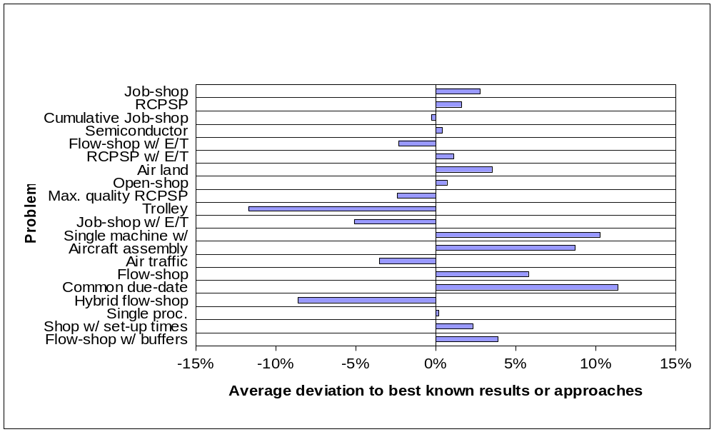
ILOG CP for Scheduling in action ①
Self-Adapting LNS: results

Slide 56
ILOG CP for Scheduling in action ②
Minimal Critical Set (MCS)
  A subset φ of activities on the same resource R such that:
    activities in φ may globally overlap in time,
    φ over-consumes R, and
    any strict subset of φ does not over-consume R
φ={B,D,F} is a MCS on R
4
10
A
F
4
R
D
3
C
B
E

Slide 57
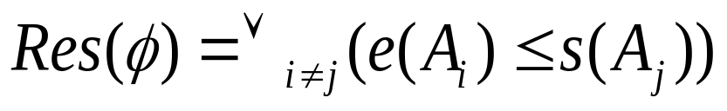
ILOG CP for Scheduling in action ②
Resolvers of a MCS φ={A₁,…,A_{p}}
  A precedence constraint between any two of its activity
  Complete set of resolvers:
  The set of resolvers can be simplified

Slide 58
ILOG CP for Scheduling in action ②
Branching Scheme:
  Select a MCS φ
  Branch on its different resolvers Res(φ)
  … until there is no more MCS
It results in a complete search
Selected: φ={B,D,F}
B<D
B<F
D<B
D<F
F<B
F<D

Slide 59
ILOG CP for Scheduling in action ②
At a search node: select an MCS φ that will result in the smallest search space below it
Estimation of the size of the search space below a MCS φ using some local measurements
Selected: φ
ω(φ) ?

Slide 60
ILOG CP for Scheduling in action ②
Start from a valid lower bound T
Look for a solution ≤T within a given time-limit
  If the problem is proven unfeasible:
    LB = T+1
    try with T=T+1
  If a solution is found
    UB = T, stop (optimal solution found)
  If time-limit is exceeded, stop (no optimal solution found)
Implemented on top of ILOG CP

Slide 61
ILOG CP for Scheduling in action ②
Complete MCS-Based Search
  Uses ILOG CP model and all of the available propagation algorithms on discrete resources
  MCS computation relies on the precedence graph structure of ILOG CP
  New search tree branching scheme based on the computation of MCS written from scratch
  The whole code is about 900 lines long

Slide 62
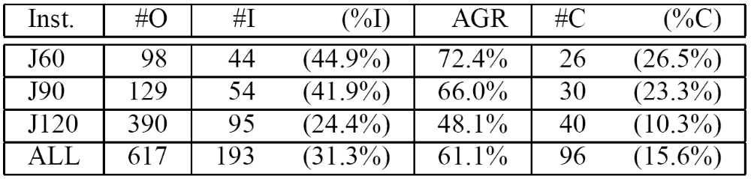
ILOG CP for Scheduling in action ②
Experiments on the KSD instances [Kolish&Sprecher-96] of RCPSP with a time limit of 1800s
  #O: number of currently open instances
  #(%)I: number (percentage) of improved instances
  #(%)C: number (percentage) of closed instances
Good results on open-shop and cumulative job-shop

Slide 63
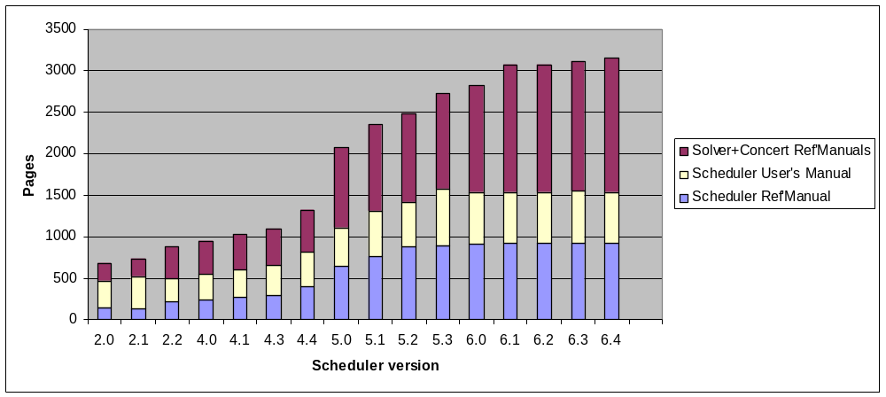
ILOG CP for Scheduling hereafter
Main limitation: ease of use
  The number of concepts is large, the API is large, the documentation is large
  Programming language: limited to C++
  Writing a search strategy is hard … but most of the time is needed as there is no robust default search

Slide 64
ILOG CP for Scheduling hereafter
We are currently completely re-designing the scheduling engine in order to have it integrated into ILOG CP Optimizer
Objectives:
  Less concepts, less API, less documentation
  Similar expressivity
  Cross language: OPL | Java | C# | C++
  Default search (model & solve)
  Stronger & quicker constraint propagation
  Decrease memory usage
  Decrease size of code (currently ≈200000 lines)

Slide 65
Questions & Answers
Thank You

