Slide 1
Modelling & Solving Detailed Scheduling Problems with
IBM ILOG CP Optimizer
Séminaire LAAS
Apr 24, 2009
Philippe Laborie
laborie@fr.ibm.com

Slide 2
CP Optimizer for Detailed Scheduling
Overview:
  Context
  Modelling scheduling problems
  Solving scheduling problems
  Examples

Slide 3


CP at ILOG: an historical overview
1991
1994
1999
2003
2005
May 2007
May 2008
Today
Pecos
CP 1.x
Solver
Scheduler
OPL 2.x, 3.x
MP
CP (num. variables)
CP (scheduling)

Slide 4
CP at ILOG: an historical overview
ILOG Scheduler 1994→2006:
  Many industrial successes, BUT
  The product has become very complex to use: to develop a scheduling application, a customer must master:
    C++
    Constraint Programming (if writing new constraints)
    Non-deterministic programming (search tree exploration)
    Scheduling theory (for writing efficient search, for deciding which propagation algorithm will be useful, …)
    The larger and larger API of Scheduler

Slide 5
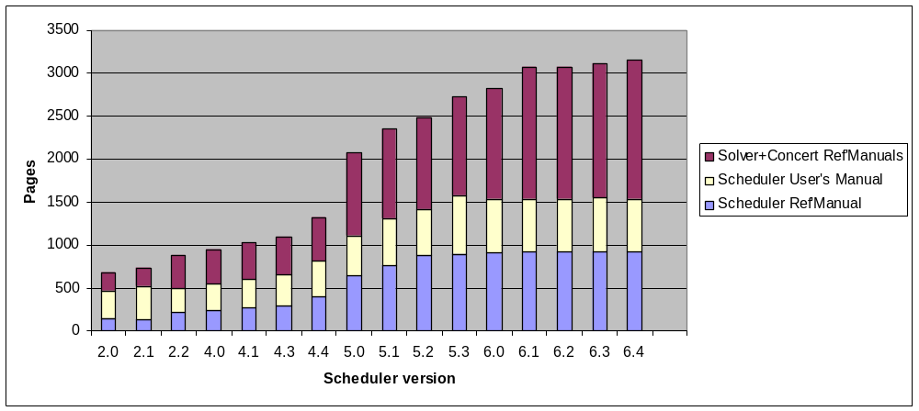
CP at ILOG: an historical overview
ILOG Scheduler 1994→2006:
  Many industrial successes, BUT
  The product has become very complex to use

Slide 6
CP at ILOG: an historical overview
1991
1994
1999
2003
2005
May 2007
May 2008
Today
Pecos
CP 1.x
Solver
“Old CP”
Scheduler
OPL 2.x, 3.x
CPO 1.x
CPO 2.x
MP
“New CP”
CP (num. variables)
OPL 4.x
OPL 5.x
OPL 6.x
CP (scheduling)

Slide 7
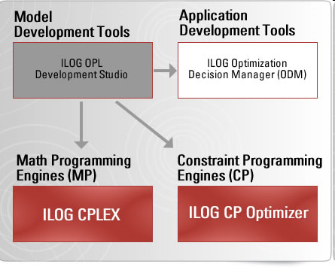
What is IBM ILOG CP Optimizer?
Optimization line

Slide 8
What is IBM ILOG CP Optimizer?
A Constraint Programming engine for combinatorial and detailed scheduling problems
Roughly covers problem classes addressed by Solver & Scheduler
Model&Solve paradigm (a-la CPLEX)
  Flexible modeling language
    But smaller than Solver and Scheduler
  Powerful automatic search procedure
    User can influence search based on their knowledge of the problem

Slide 9
Advantages over ILOG CP
Modeling for scheduling is simplified
  Optional tasks
  Work breakdown structures easily models
  Alternatives and recipes much more powerful
  Constrained time line
No search procedure to write
  Produce prototypes more quickly
  Concentrate on model
  Quickly evaluate CP technology on a problem
Efficiency

Slide 10
Typical use of CP Optimizer
Model problem
in OPL
Model problem
in OPL
Model problem
in OPL
Use “search
phases” to
add some
domain
knowledge
to the search
process
Use “search
phases” to
add some
domain
knowledge
to the search
process
Use “search
phases” to
add some
domain
knowledge
to the search
process
Review
model
(redundant
constraints,
decision
variables etc.)
Review
model
(redundant
constraints,
decision
variables etc.)
Change
parameters
or search
method
Review
model
(redundant
constraints,
decision
variables etc.)
Change
parameters
or search
method
Use CP Optimizer’s
automatic search
Change
parameters
or search
method
Use CP Optimizer’s
automatic search
Use CP Optimizer’s
automatic search
Satisfied?
Satisfied?
Satisfied?
YES
NO
Decompose
model
Decompose
model
Decompose
model

Slide 11
Getting at CP Optimizer
CP Optimizer is available through the following interfaces:
  OPL
  C++: native interface
  Java: wrapping of the C++ engine
  .NET: wrapping of the C++ engine
And on the following platforms:
  32-bit
    Windows, Debian, Solaris, AIX, Darwin (Mac OS X)
  64-bit
    Windows, Debian, Solaris, AIX

Slide 12
Language for detailed scheduling
Data structure
Variable/expression
No-overlap
constraint
Constraints on function value
(alwaysIn, …)
Constraints on function value
(alwaysIn)
Constraint
Sequencing
constraints
Transition
distance
Sequence variable
State function
Cumul function
Piecewise
function
Basic expressions over interval variable (startOf, startEval, …)
Stepwise
function
Interval variable
Unary
constraints
(forbidXXX)
Precedence
constraints
(endBeforeStart, …)
Logical
constraints
(presenceOf)
Composition
constraints
(alternative, span)

Slide 13
Interval-based modeling
A new type of first class citizen decision variable is introduced: interval variable
Models time intervals whose end-points (start/end) are decision variables of the problem
  A production order, a recipe in a production order, an operation in a recipe
  A sub-project in a project, a task in a sub-project
  A batch of operations
  The setup of a tool on a machine
  The moving of an item by a transportation device
  The utilization interval of a machine
  The filling or emptying of a tank

Slide 14
Interval-based modeling
A new type of first class citizen decision variable is introduced: interval variable
An interval variable can be optional meaning that it is a decision to have it present or absent in a solution
  Unperformed tasks and optional sub-projects
  Operations that can be processed in different temporal modes (e.g. series or parallel), left unperformed or externalized
  Activities that can be performed in an alternative set of batches or shifts
  Alternative modes or recipes for processing an order, each mode specifying a particular combination of operational resources

Slide 15
Interval variable
A new type of first class citizen decision variable is introduced: interval variable
Domain of values for an interval variable a:
Dom(a) ⊆ {⊥} ∪ { [s,e) | s,e∈ℤ, s≤e }
*CP Optimizer uses s,e∈[-TMAX,+TMAX] where TMAX = (INTMAX/2)-1
Absent interval
Interval of integers

Slide 16
Interval variable
Notations: let a be a fixed interval variable
  If a=[s,e) (a is present), we denote:
  x(a)=true, s(a)=s, e(a)=e, l(a)=e-s
  s(a) is the start of a
  e(a) is the end of a
  l(a) is the length of a
  If a=⊥ (a is absent), we denote:
  x(a)=false
  In this case s(a), e(a) and l(a) are meaningless

Slide 17
Interval variable
If an interval is declared to be optional, it means its presence status (present or absent) is a decision variable of the problem.

Slide 18
Interval variable
Interval variable declaration in OPL
dvar interval a
[optional] If interval is optional
[in smin..emax] Start min, end max if present
[size szmin..szmax]; Size min, size max if present
For now, we assume size and length are identical concepts
smin, emax: integers
szmin, szmax: non-negative integers
By default: interval is present, smin=0, emax=TMAX, szmin=0, szmax=TMAX

Slide 19
Interval variable
Examples:
dvar interval a;
dvar interval b optional;
dvar interval c in 0..1000 size 10;
Dom(c) = { [0,10), [1,11),…, [990,1000)}
dvar interval d optional in 1..3 size 1..2;
Dom(d) = {⊥} ∪ { [1,2), [2,3), [1,3)}
dvar interval e optional in 0..1 size 0..1;
Dom(e) = {⊥} ∪ { [0,0), [1,1), [0,1)}

Slide 20
Interval variable
Graphical conventions
  Present interval
  Optional interval
Name (szmin..szmax)
smin
emax
Name (szmin..szmax)
smin
emax

Slide 21
Language for detailed scheduling
Data structure
Variable/expression
No-overlap
constraint
Constraints on function value
(alwaysIn, …)
Constraints on function value
(alwaysIn)
Constraint
Sequencing
constraints
Transition
distance
Sequence variable
State function
Cumul function
Piecewise
function
Basic expressions over interval variable (startOf, startEval, …)
Stepwise
function
Interval variable
Unary
constraints
(forbidXXX)
Precedence
constraints
(endBeforeStart, …)
Logical
constraints
(presenceOf)
Composition
constraints
(alternative, span)

Slide 22
Expressions over interval variable
Integer expressions to get the start/end/length/size of an interval variable
OPL syntax:
dexpr int startOf(dvar interval a, int v=0);
dexpr int endOf(dvar interval a, int v=0);
dexpr int sizeOf(dvar interval a, int v=0);
dexpr int lengthOf(dvar interval a, int v=0);
The integer v is the value of the expression if interval a is absent (default: 0)

Slide 23
Expressions over interval variable
Floating point expressions to get the value of a known piecewise linear function at the start/end/length/size of an interval variable
Typical use: earliness/tardiness cost
Piecewise function f
a

Slide 24
Expressions over interval variable
OPL syntax:
dexpr float startEval(dvar interval a, pwlFunction f,
float v=0.0);
dexpr float endEval (dvar interval a, pwlFunction f,
float v=0.0);
dexpr float sizeEval (dvar interval a, pwlFunction f,
float v=0.0);
dexpr float lengthEval(dvar interval a, pwlFunction f,
float v=0.0);
The numerical v is the value of the expression if interval a is absent (default: 0.0)
Piecewise linear function f must be semi-convex

Slide 25
Expressions over interval variable
Semi-convex piecewise linear function (SCPL):
Piecewise linear function with at most one valley
Examples of SCPL functions
f
f
f
x
x
x
f
f
f
x
x
x

Slide 26
Expressions over interval variable
Example: earliness/tardiness/non-execution cost
pwlFunction f = piecewise{-0.5->100;0->250;1}(100,0);
int nexeccost = 20;
dexpr float cost = endEval(a,f,nexeccost);
f
-0.5
1.0
100
250
a

Slide 27
Expressions over interval variable
These expressions can be mixed with other numerical expressions in CP Optimizer:
  General expressions:
  x*y, k*x, x+y, x+k, x-y, abs(x), min(x,y), max(x,y), …
  Integer expressions:
  x div y, x mod y, …
  Floating point expressions:
  ceil(x), floor(x), frac(x), x/y, sqrt(x), exp(x), log(x), pow(x,y), …

Slide 28
Language for detailed scheduling
Data structure
Variable/expression
No-overlap
constraint
Constraints on function value
(alwaysIn, …)
Constraints on function value
(alwaysIn)
Constraint
Sequencing
constraints
Transition
distance
Sequence variable
State function
Cumul function
Piecewise
function
Basic expressions over interval variable (startOf, startEval, …)
Stepwise
function
Interval variable
Unary
constraints
(forbidXXX)
Precedence
constraints
(endBeforeStart, …)
Logical
constraints
(presenceOf)
Composition
constraints
(alternative, span)

Slide 29
Logical constraints
Unary constraint on interval variable presence
OPL Syntax:
presenceOf(dvar interval a);
Can be composed (meta-constraints):
presenceOf(a) => presenceOf(b);
presenceOf(a) => !presenceOf(b);
presenceOf(a) || presenceOf(b);
Can be casted as Boolean expression:
dexpr int nbPres = sum(i in 1..n) presenceOf(a[i]);

Slide 30
Logical constraints
Graphical conventions for binary combinations of presence constraints
a
b
presenceOf(a) => presenceOf(b);
presenceOf(a) == presenceOf(b);
presenceOf(a) => !presenceOf(b);
!presenceOf(a) => presenceOf(b);
presenceOf(a) != presenceOf(b);
a
b
a
b
a
b
a
b

Slide 31
Language for detailed scheduling
Data structure
Variable/expression
No-overlap
constraint
Constraints on function value
(alwaysIn, …)
Constraints on function value
(alwaysIn)
Constraint
Sequencing
constraints
Transition
distance
Sequence variable
State function
Cumul function
Piecewise
function
Basic expressions over interval variable (startOf, startEval, …)
Stepwise
function
Interval variable
Unary
constraints
(forbidXXX)
Precedence
constraints
(endBeforeStart, …)
Logical
constraints
(presenceOf)
Composition
constraints
(alternative, span)

Slide 32
Precedence constraints
Binary constraints on interval variables
Classical precedence constraints of Constraint-Based Scheduling but
Precedence Constraints definition t_{i} + z ≤ t_{j} is reified by optional statuses
Example:
      endBeforeStart(a,b,z) means:
      x(a) ∧ x(b) ⇒ e(a) + z ≤ s(b)
Precedence Constraints cannot be used in logical constraints

Slide 33
Precedence constraints
Graphical conventions
a
b
startBeforeStart
endBeforeStart
startBeforeEnd
endBeforeEnd
startAtStart
endAtStart
startAtEnd
endAtEnd
a
b
a
b
a
b
a
b
a
b
a
b
a
b

Slide 34
Language for detailed scheduling
Data structure
Variable/expression
No-overlap
constraint
Constraints on function value
(alwaysIn, …)
Constraints on function value
(alwaysIn)
Constraint
Sequencing
constraints
Transition
distance
Sequence variable
State function
Cumul function
Piecewise
function
Basic expressions over interval variable (startOf, startEval, …)
Stepwise
function
Interval variable
Unary
constraints
(forbidXXX)
Precedence
constraints
(endBeforeStart, …)
Logical
constraints
(presenceOf)
Composition
constraints
(alternative, span)

Slide 35
Intensity functions and unary constraints
Objective
Model:
  Resources breaks, efficiency or speed
  Forbidden dates for activity start/end
Similar with calendars in ILOG Scheduler
In CP Optimizer, this notion is captured by an integer step function

Slide 36
Language for detailed scheduling
Data structure
Variable/expression
No-overlap
constraint
Constraints on function value
(alwaysIn, …)
Constraints on function value
(alwaysIn)
Constraint
Sequencing
constraints
Transition
distance
Sequence variable
State function
Cumul function
Piecewise
function
Basic expressions over interval variable (startOf, startEval, …)
Stepwise
function
Interval variable
Unary
constraints
(forbidXXX)
Precedence
constraints
(endBeforeStart, …)
Logical
constraints
(presenceOf)
Composition
constraints
(alternative, span)

Slide 37
Composition constraints
Many scheduling problems are hierarchically organized as AND/OR trees:
  AND nodes: a detailed description of how a high-level activity a decomposes into sub-activities {b₁,…,b_{n}}
  OR nodes: a set of alternatives {b₁,…,b_{n}} for executing an activity a
  These nodes may represent optional parts of the schedule

Slide 38
Composition constraints
Order
…
Order
Project
OR
AND
Recipe
…
Recipe
Task
…
Task
AND
OR
Operation
…
Operation
Sub-project
…
Sub-project
AND
Task
…
Task

Slide 39
Composition constraints
Span constraint span(a,{b₁,…,b_{n}}) means that if a is present, it spans all present intervals from {b₁,…,b_{n}} that is, at least one of b_{i} support the start (resp. end) of a. a is absent if and only if all the b_{i} are absent.
a
b₁
b₄
b₅
b₃
b₂

Slide 40
Composition constraints
Alternative constraint alternative(a,{b₁,…,b_{n}}) means that if a is present, then exactly one of the {b₁,…,b_{n}} is present and synchronized with a. a is absent if and only if all the b_{i} are absent.
a
XOR
b₁
b₂
b₃

Slide 41
Composition constraints
OPL Syntax:
  dvar interval a …;
  dvar interval b[i in 1..n] …;
  span( a, all(i in 1..n) b[i] );
  alternative( a, all(i in 1..n) b[i] );
Note that a can be an optional interval variable too …

Slide 42
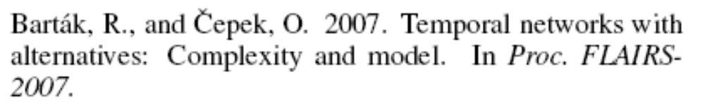
Composition constraints
Inspired from [Barták&Čepek 2007]
BuyTube (40)
CollectMaterial (1)
CollectKit (1)
MakeTube
GetTube
SawRod (10)
AssembleKit (5)
SawTube (30)
XOR
ClearRod (2)
ClearTube (20)
WeldTube (15)
WeldRod (15)
AssemblePiston (5)
ShipPiston (0)

Slide 43
Composition constraints
using CP;
dvar interval CollectMaterial size 1;
dvar interval CollectKit size 1;
dvar interval GetTube;
dvar interval WeldTube size 15;
dvar interval SawRod size 10;
dvar interval ClearRod size 2;
dvar interval AssembleKit size 5;
dvar interval WeldRod size 15;
dvar interval AssemblePiston size 5;
dvar interval ShipPiston in 0..70;
dvar interval BuyTube optional size 40;
dvar interval SawTube optional size 30;
dvar interval ClearTube optional size 20;
dvar interval MakeTube optional;
constraints {
span(MakeTube, append(SawTube,ClearTube));
presenceOf(MakeTube) => presenceOf(SawTube);
presenceOf(MakeTube) => presenceOf(ClearTube);
alternative(GetTube, append(MakeTube,BuyTube));
endBeforeStart(CollectMaterial, GetTube);
endBeforeStart(CollectMaterial, SawRod);
endBeforeStart(CollectKit, AssembleKit);
endBeforeStart(SawTube, ClearTube);
endBeforeStart(GetTube, WeldTube);
endBeforeStart(SawRod, ClearRod);
endBeforeStart(ClearRod, WeldRod);
endBeforeStart(AssembleKit, WeldRod);
endBeforeStart(WeldTube, AssemblePiston);
endBeforeStart(WeldRod, AssemblePiston);
endBeforeStart(AssemblePiston, ShipPiston);
}

Slide 44
Language for detailed scheduling
Data structure
Variable/expression
No-overlap
constraint
Constraints on function value
(alwaysIn, …)
Constraints on function value
(alwaysIn)
Constraint
Sequencing
constraints
Transition
distance
Sequence variable
State function
Cumul function
Piecewise
function
Basic expressions over interval variable (startOf, startEval, …)
Stepwise
function
Interval variable
Unary
constraints
(forbidXXX)
Precedence
constraints
(endBeforeStart, …)
Logical
constraints
(presenceOf)
Composition
constraints
(alternative, span)

Slide 45
Sequence variable
A sequence variable p is defined on a set of interval variables A={a₁,…,a_{n}}
A value of p is a total ordering of the present intervals in A
a₁
a₂
a₃
a₄
a₅
a₆
a₇
a₈
a₂
absent
intervals
a₃
a₆
a₄
a₇
a₁
a₈
a₅

Slide 46
Sequence variable
Sequence variable declaration in OPL
dvar interval a[i in …] …;
dvar sequence p in A;

Slide 47
Sequence variable
What is the domain of p in this model?
dvar interval a[i in 1..3] optional(i%2==1);
dvar sequence p in a;
  { (a2),
  (a2 → a1), (a1 → a2), (a2 → a3), (a3 → a2),
  (a1 → a2 → a3), (a1 → a3 → a2), (a2 → a1 → a3),
  (a2 → a3 → a1), (a3 → a1 → a2), (a3 → a2 → a1) }

Slide 48
Language for detailed scheduling
Data structure
Variable/expression
No-overlap
constraint
Constraints on function value
(alwaysIn, …)
Constraints on function value
(alwaysIn)
Constraint
Sequencing
constraints
Transition
distance
Sequence variable
State function
Cumul function
Piecewise
function
Basic expressions over interval variable (startOf, startEval, …)
Stepwise
function
Interval variable
Unary
constraints
(forbidXXX)
Precedence
constraints
(endBeforeStart, …)
Logical
constraints
(presenceOf)
Composition
constraints
(alternative, span)

Slide 49
Sequencing constraints
Sequencing constraints are unary constraints on sequence variables
  first(p, a): If a is present then p(a) = 1.
  last(p, a): Similar with last position in the sequence.
  prev(p, a, b): If both a and b are present then
  p(b) = p(a) + 1.
  before(p, a, b): If both a and b are present then
  p(a) < p(b).

Slide 50
Language for detailed scheduling
Data structure
Variable/expression
No-overlap
constraint
Constraints on function value
(alwaysIn, …)
Constraints on function value
(alwaysIn)
Constraint
Sequencing
constraints
Transition
distance
Sequence variable
State function
Cumul function
Piecewise
function
Basic expressions over interval variable (startOf, startEval, …)
Stepwise
function
Interval variable
Unary
constraints
(forbidXXX)
Precedence
constraints
(endBeforeStart, …)
Logical
constraints
(presenceOf)
Composition
constraints
(alternative, span)

Slide 51
No-overlap constraint
Let p be a sequence variable. No-overlap constraint noOverlap(p) means that p represents a chain of non overlapping interval variables.
Example:
a₂
absent
intervals
a₃
a₆
a₄
a₇
a₁
a₈
a₅
a₃
a₆
a₄
a₇
a₁

Slide 52
No-overlap constraint
If both a and b are present and a is before b in the sequence p, then a is constrained to end before the start of b
More formally, if p is a sequence on A,
noOverlap(p):
∀a,b ∈A, 0<p(a)≤p(b) ⇔ e(a)≤s(b)

Slide 53
No-overlap constraint
Typically, a no-overlap constraint can be used to model a set of activities requiring a unary resource.
OPL declaration of a no-overlap constraint
dvar interval A[i in …] …;
dvar sequence p in A;
constraints {
noOverlap(p);
}

Slide 54
No-overlap constraint
Transition distance:
  An integer type T(a) can be associated with any interval a in a sequence p.
  A minimal transition distance M between interval variables in the chain can be specified in the no-overlap constraint. It is specified as a matrix indexed by the interval types.

Slide 55
Language for detailed scheduling
Data structure
Variable/expression
No-overlap
constraint
Constraints on function value
(alwaysIn, …)
Constraints on function value
(alwaysIn)
Constraint
Sequencing
constraints
Transition
distance
Sequence variable
State function
Cumul function
Piecewise
function
Basic expressions over interval variable (startOf, startEval, …)
Stepwise
function
Interval variable
Unary
constraints
(forbidXXX)
Precedence
constraints
(endBeforeStart, …)
Logical
constraints
(presenceOf)
Composition
constraints
(alternative, span)

Slide 56
Cumul function
Objective :
  Model discrete capacity resources (ILOG Scheduler: discrete resources, discrete reservoirs)
  and more than that …
The value of a cumul function represents the time evolution of a quantity (e.g. level of a reservoir) that can be incrementally changed (increased or decreased) by interval variables

Slide 57
Cumul function
The individual contribution of an interval to a cumul function is called an elementary cumul function
An elementary cumul function is a cumul function

Slide 58
Cumul function
pulse(u,v,h)
step(u,h)
h
h
0
u
v
u
pulse(a,h)
h_{max}
pulse(a,h_{min},h_{max})
h
h_{min}
0
a
a
stepAtStart(a,h)
h_{max}
stepAtStart(a,h_{min},h_{max})
h
h_{min}
0
a
a
stepAtEnd(a,h)
h_{max}
stepAtEnd(a,h_{min},h_{max})
h
h_{min}
0
a
a

Slide 59
Cumul function
If a is absent, the function is the null function (null contribution)
pulse(a,h)
h_{max}
pulse(a,h_{min},h_{max})
h
h_{min}
0
a
a
stepAtStart(a,h)
h_{max}
stepAtStart(a,h_{min},h_{max})
h
h_{min}
0
a
a
stepAtEnd(a,h)
h_{max}
stepAtEnd(a,h_{min},h_{max})
h
h_{min}
0
a
a

Slide 60
Cumul function
OPL declaration of an elementary cumul function:
dvar interval a …;
int h, hmin, hmax, u, v;
cumulFunction f = pulse(a,h);
cumulFunction f = pulse(a,hmin,hmax);
cumulFunction f = stepAtStart(a,h);
cumulFunction f = stepAtStart(a,hmin,hmax);
cumulFunction f = stepAtEnd(a,h);
cumulFunction f = stepAtEnd(a,hmin,hmax);
cumulFunction f = pulse(u,v,h);
cumulFunction f = step(u,h);

Slide 61
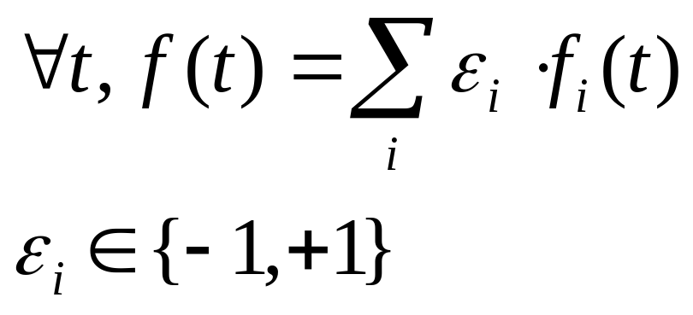
Cumul function
A cumul expression f is the algebraic sum of elementary cumul expressions f_{i} or their negation:

Slide 62
Cumul function
+pulse
-pulse
+pulse
+stepAtStart
-stepAtStart
+stepAtEnd

Slide 63
Cumul function
OPL declaration of a composite cumul function:
dvar interval a[i in …] …;
dvar interval b[j in …] …;
int qa[i in …] = …;
int qb[j in …] = …;
cumulFunction f = sum(i in …) pulse(a[i],qa[i]);
cumulFunction g = sum(i in …) stepAtStart(a[i],qa[i])
– sum(j in …) stepAtEnd(b[j],qb[j];

Slide 64
Language for detailed scheduling
Data structure
Variable/expression
No-overlap
constraint
Constraints on function value
(alwaysIn, …)
Constraints on function value
(alwaysIn)
Constraint
Sequencing
constraints
Transition
distance
Sequence variable
State function
Cumul function
Piecewise
function
Basic expressions over interval variable (startOf, startEval, …)
Stepwise
function
Interval variable
Unary
constraints
(forbidXXX)
Precedence
constraints
(endBeforeStart, …)
Logical
constraints
(presenceOf)
Composition
constraints
(alternative, span)

Slide 65
Constraints on cumul functions
f
+pulse
-pulse
+pulse
+stepAtStart
-stepAtStart
+stepAtEnd

Slide 66
Constraints on cumul functions
f
hmax
hmin
s
e
Constraint: over a fixed interval [s,e), f always takes its value in a fixed range [hmin,hmax]
alwaysIn(f,s,e,hmin,hmax)

Slide 67
Constraints on cumul functions
f
h
Constraint: some shortcut for constraints over the complete horizon [-∞,+ ∞]
f<=h;

Slide 68
Constraints on cumul functions
f
h
Constraint: some shortcut for constraints over the complete horizon [-∞,+ ∞]
h<=f;

Slide 69
Constraints on cumul functions
f
hmax
hmin
a
Constraint: over an interval variable a (if present), f always takes its value in a fixed range [hmin,hmax]
alwaysIn(f,a,hmin,hmax)

Slide 70
Constraints on cumul functions
Example of a discrete (renewable) resource of capacity Q required by n activities (activity i requires q[i] units).
dvar interval a[i in 1..n] …;
int q[i in 1..n] = …;
cumulFunction f = sum(i in 1..n) pulse(a[i],q[i]);
subject to {
f <= Q;
}

Slide 71
Examples
Flowshop with earliness/tardiness costs
Oversubscribed satellite communication scheduling
Personal tasks scheduling with preferences

Slide 72
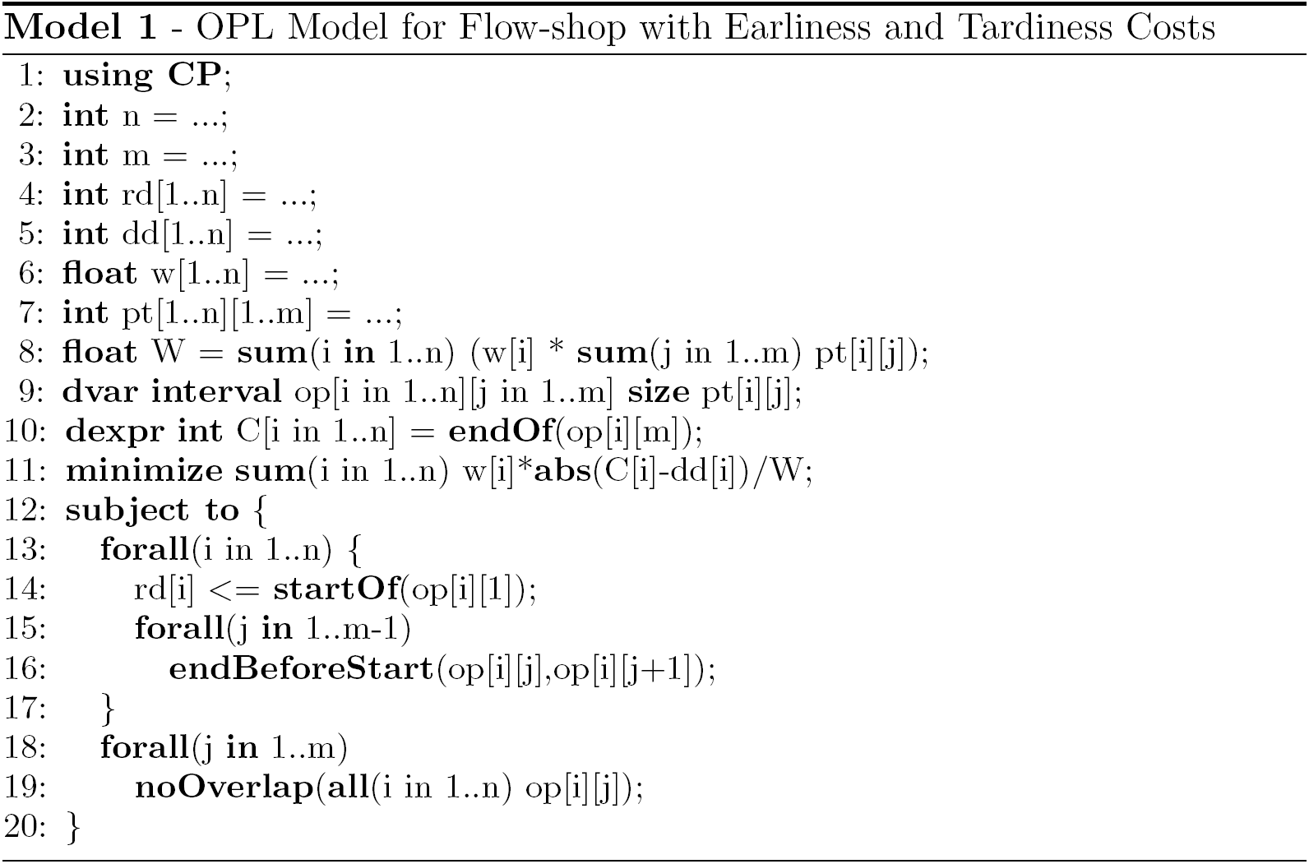
Flowshop with earli/tardi costs

Slide 73
Oversubscribed satellite scheduling
USAF Satellite Control Network scheduling problem [Kramer&al 2007]
A set of n input communication requests for Earth orbiting satellites must be scheduled on a total of 32 antennas spread across 13 ground-based tracking stations.
Objective is to maximize the number of satisfied requests
[Kramer&al 2007] L. Kramer, L. Barbulescu and S. Smith. "Understanding Performance Tradeoffs in Algorithms for Solving Oversubscribed Scheduling". Proc. AAAI-07, July, 2007.

Slide 74
Oversubscribed satellite scheduling
A station S_{j} is associated a number of antennas C_{j}
A request R_{i} is associated:
  A time window [smin_{i}, emax_{i}]
  A set of possible stations where the request can be executed and, for each possible station, a specific duration for the request when executed on this station
  When executed on a station, the request will require 1 antenna of the station
All requests are optional: the objective is to maximize the number of satisfied requests

Slide 75



Oversubscribed satellite scheduling
Station 1
Station 2
Station 3
Duration1
Duration3
Task

Slide 76
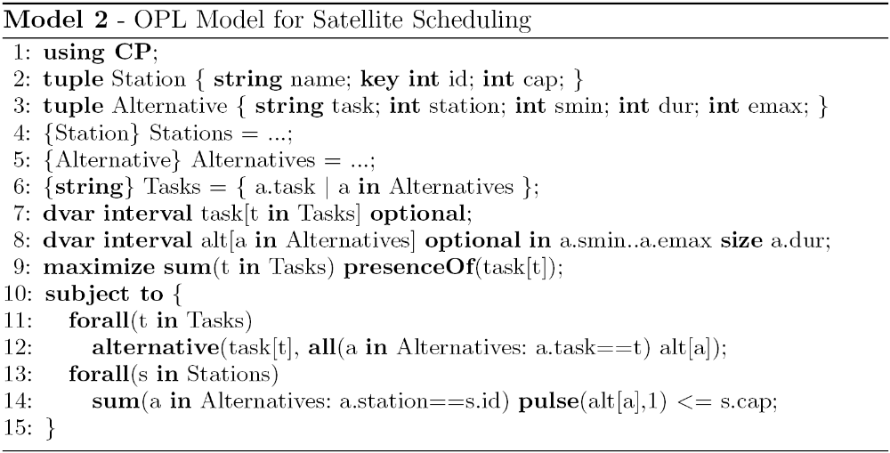
Oversubscribed satellite scheduling

Slide 77
Personal tasks scheduling
Personal tasks scheduling [Refanidis 2007]
Schedule a personal agenda composed of n tasks
Available online: http://selfplanner.uom.gr/
[Refanidis 2007] I. Refanidis. "Managing Personal Tasks with Time Constraints and Preferences". Proc. ICAPS-07, September, 2007.

Slide 78
Personal tasks scheduling
Tasks are preemptive
  A task specifies a fixed total processing time
  It can be split into one or several parts.
  There is a min/max value for the duration of each individual part
  There is a minimal delay between consecutive parts of the same task
Task
Min/max duration
For each part
Part₁
Part₂
Part₃
…
Min delay between
Consecutive task parts

Slide 79
Personal tasks scheduling
Each tasks specifies a set of time-windows where it can be executed
Task
Part₁
Part₂
Part₃
…
Task domain

Slide 80

Personal tasks scheduling
Precedence constraints
Locations, distances and transition times
Task₁
Task₃
Task₂
1
2
Task₄
4
Task₅
Task₁
3
Task₂
Task₃

Slide 81
Personal tasks scheduling
Objective function: maximize task satisfaction
5 types of task-dependent preference functions:
Part₁
Part₂
Part₃
…
Task

Slide 82
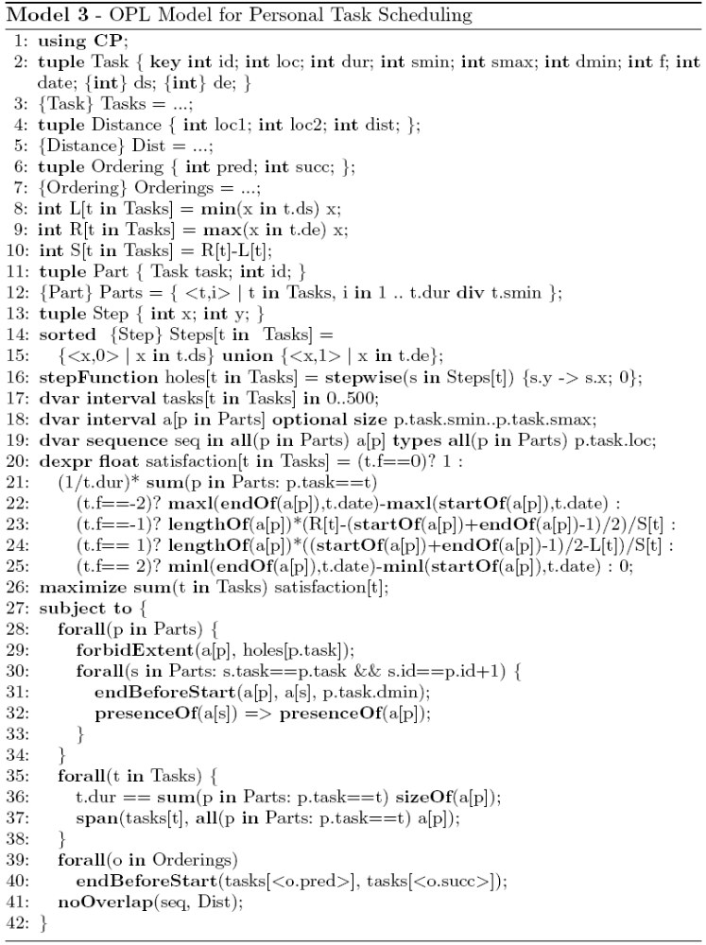
Personal tasks scheduling

Slide 83
Solving scheduling problems
Search types
Search parameters
Search phases

Slide 84
Types of search available
All methods vary according to the presence or not of interval variables
  By default, intervals take priority over integers
Restart
  Method used by default
Multi-point
  Alternative to restart (sometimes superior)
Depth-first
  Useful for debugging or counting solutions

Slide 85
Restart for detailed scheduling
Relaxation methods
portfolio
Re-optimization methods
portfolio
CS₁ [q₁]
LN₁ [p₁]
CS₁ [q₁]
R₁ [p₁]
O₁ [q₁]
First
solution

Slide 86
Restart for detailed scheduling
Relaxation methods
portfolio
Re-optimization methods
portfolio
CS₁ [q₁]
LN₁ [p₁]
CS₁ [q₁]
R₁ [p₁]
O₁ [q₁]
Selection
First
solution
R_{i} [P_{i}]
O_{j} [Q_{j}]
Relaxation
Re-optimization

Slide 87
Restart for detailed scheduling
Relaxation methods
portfolio
Re-optimization methods
portfolio
CS₁ [q₁]
LN₁ [p₁]
CS₁ [q₁]
R₁ [p₁]
O₁ [q₁]
Reward r
Reinforcement
First
solution
Solution
R_{i} [P_{i}]
R_{i} [P_{i}]
O_{j} [Q_{j}]
O_{j} [Q_{j}]
Relaxation
Re-optimization

Slide 88
Restart for detailed scheduling
Relaxation methods
portfolio
Re-optimization methods
portfolio
LN₁ [p₁]
CS₁ [q₁]
CS₁ [q₁]
R₁ [p₁]
O₁ [q₁]
First
solution
Solution
Relaxation
Re-optimization

Slide 89
Restart for detailed scheduling
Relaxation methods
portfolio
Re-optimization methods
portfolio
LN₁ [p₁]
CS₁ [q₁]
CS₁ [q₁]
R₁ [p₁]
O₁ [q₁]
Selection
Solution
R_{i} [P_{i}]
O_{j} [Q_{j}]
Relaxation
Re-optimization

Slide 90

Restart for detailed scheduling
Partial Order Schedule (POS) definition
  A temporal network that is sufficient to ensure that all its solutions satisfy the temporal and “resource” constraints of the problem
All relaxation methods in the portfolio start by computing a POS from the solution and then, relax a subset of activities F (fragment) on this temporal network
R_{i} = Relax_{F}i o POS
POS

Slide 91
Restart for detailed scheduling
POS computation on “resources”
  Sequence/NoOverlap: easy, O(n logn)
  Cumul with pulses only: O(n log(Cn))
A
C
B
t
A
C
B
c
C
E
C
E
F
R
F
D
D
H
H
B
t
B
A
G
A
G

Slide 92
Restart for detailed scheduling
POS computation on “resources” (cont’d)
  General cumul: O(n log(Cn))
c
F
F
R
A
B
G
A
B
D
G
t
D
E
E

Slide 93
Restart for detailed scheduling
Global POS
  POS = ∪_{R} POS_{R}
  Redundant edges are removed

Slide 94
Restart for detailed scheduling
Partial Order Schedule (POS) definition
  A temporal network that is sufficient to ensure that all its solutions satisfy the temporal and resource constraints of the problem
All relaxation methods in the portfolio start by computing a POS from the solution and then, relax a subset of interval variables F (fragment) on this temporal network
R_{i} = Relax_{F}i o POS
Relax

Slide 95
Restart for detailed scheduling
Relaxation of a fragment F^{i} of the POS
POS
E
D
H
C
E
Relax_{F}i
C
F
D
F
H
B
B
A
G
A
G
Fragment F^{i}

Slide 96
Restart for detailed scheduling
Portfolio:
  R¹_{α} : Randomized relaxation
  R²_{α,β} : Time-window relaxation
  R³_{α,β} : Topological relaxation
  R⁴_{α,β} : Slack-based relaxation
Time-

Slide 97
Restart for detailed scheduling
R²_{α,β}: Time-window relaxation
  Interval variables are sorted by increasing start value in the solution
  The fragment consists of all the intervals with index in [β.n, (β+α).n] in the above array
  α and β are self-adapting parameters of the relaxation method

Slide 98
Restart for detailed scheduling
R²_{α,β}: Time-window relaxation
  Interval variables are sorted by increasing start time in the solution
  The fragment consists of all the intervals with index in [β.n, (β+α).n] in the above array
  α and β are self-adapting parameters of the relaxation method
α=0.25, β=0.5

Slide 99
Restart for detailed scheduling
R²_{α,β}: Time-window relaxation
  Interval variables are sorted by increasing start time in the solution
  The fragment consists of all the intervals with index in [β.n, (β+α).n] in the above array
  α and β are self-adapting parameters of the relaxation method
α=0.25, β=0.5

Slide 100
Restart for detailed scheduling
Currently, a unique optimization method is used: ScheduleJustInTime_{α}
  Explores a search tree with a limited number of failures α.n
  α is a self-adapting parameter of the optimization method
  At the root node, indicative start and end values for interval variables are computed using an LP relaxation of the problem

Slide 101
Restart for detailed scheduling
Temporal relaxation:
  Only consider temporal constraints (including the ones of the relaxed POS) and (convexified) cost function

Slide 102
Restart for detailed scheduling
Temporal relaxation:
  Only consider temporal constraints (including the ones of the relaxed POS) and (convexified) cost function
E
D
H
C
F
B
A
G

Slide 103
Restart for detailed scheduling
Temporal relaxation:
  Only consider temporal constraints (including the ones of the relaxed POS) and (convexified) cost function
E
D
H
C
F
B
A
G

Slide 104
Restart for detailed scheduling
Tree search
  Search considers interval variables by increasing indicative start values and tries to schedule them as close as possible to their indicative values
  In case of backtrack, the interval is marked unselectable until constraint propagation removes from the domain of the interval the values tried on the left branch

Slide 105
Multi-Point
Multiple (partial) solutions to the problem are maintained
These are specified via some pre-assignments before a completion method completes the pre-assignment
A population is maintained which balances objective value with the sizes of the partial assignment

Slide 106
Depth-First
Seldom the method to use for solving an optimization problem. Most useful for:
  Debugging or investigating a model
  Producing all solutions to a decision problem
  Proving that there is no solution to a problem

Slide 107
Constraint propagation: Interval Variables
Interval variable domain representation: tuple of ranges:
  [x_{min},x_{max}]⊆[0,1]: current execution status
  [s_{min},s_{max}]⊆ ℤ: conditional domain of start would the interval be present
  [e_{min},e_{max}]⊆ ℤ: conditional domain of end would the interval be present
  [l_{min},l_{max}]⊆ ℤ⁺: conditional domain of length would the interval be present
Notes:
Purpose: Describe how interval variables are represented in the engine
Conclusion:

Slide 108
Constraint propagation: Logical network
Logical constraints are aggregated in an implication graph: all 2-SAT logical constraints [¬]x(a) ∨ [¬]x(b) are translated as implications ( ¬[¬]x(a) ⇒ [¬]x(b) )
Incremental transitive closure of the implication graph allows detecting infeasibilities and querying in O(1) whether x(a) ⇒ x(b) for any (a,b)
Notes:
Purpose: Present the logical network
Conclusion:

Slide 109
Constraint propagation: Temporal network
Precedence constraints are aggregated in a temporal network
Conditional reasoning:
Propagation on the conditional bounds of a (would a be present) can assume that b will be present too, thus:
e_{max}(a) ← min(e_{max}(a), s_{max}(b))
Bounds are propagated even on interval variables with still undecided presence status
From logical network
x(a)⇒x(b)
a
b
endBeforeStart(a,b)
Notes:
Purpose: Present the temporal network
Conclusion:

Slide 110
Constraint Propagation: Simple example
Inspired from [Barták&Čepek 2007]
BuyTube (40)
CollectMaterial (1)
CollectKit (1)
MakeTube
GetTube
SawRod (10)
AssembleKit (5)
XOR
SawTube (30)
ClearRod (2)
ClearTube (20)
WeldTube (15)
WeldRod (15)
AssemblePiston (5)
ShipPiston (0)
Deadline=70
Notes:
Purpose: Illustrate propagation on the example
Conclusion:

Slide 111
Constraint Propagation: Simple example
Inspired from [Barták&Čepek 2007]
BuyTube (40)
CollectMaterial (1)
CollectKit (1)
BuyTube (40)
MakeTube
GetTube
SawRod (10)
AssembleKit (5)
XOR
SawTube (30)
ClearRod (2)
ClearTube (20)
WeldTube (15)
WeldRod (15)
AssemblePiston (5)
ShipPiston (0)
Deadline=70
Notes:
Purpose: Illustrate propagation on the example
Conclusion:

Slide 112
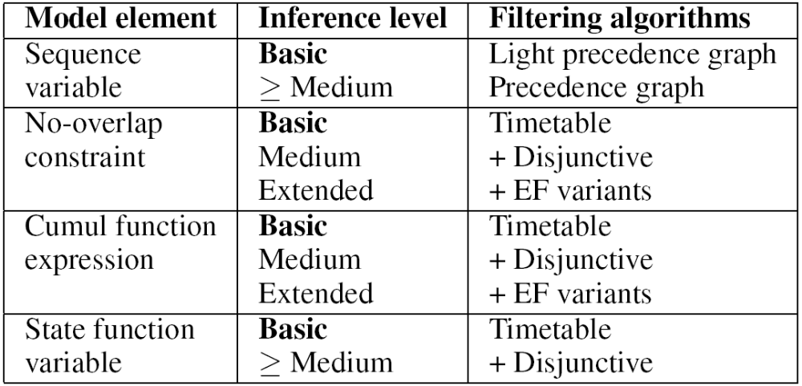
Constraint propagation: Inference Levels

Slide 113
CPO for Detailed Scheduling
Experimental Results
  Flowshop with earliness/tardiness costs
    Similar results (slight improvement of 2.7% in average) as state-of-the-art problem specific algorithms (GAs, LNS)
  Oversubscribed satellite communication scheduling
    CPO assigns 5.3% more tasks in average than state-of-the-art problem specific algorithms (Tabu Search, Squeaky Wheel Optimization)
  Personal tasks scheduling with preferences
    CPO solves more problems than state-of-the-art problem specific algorithms (Squeaky Wheel Optimization) …
    … with better quality (average improvement of 12.5% of task satisfaction)

Slide 114
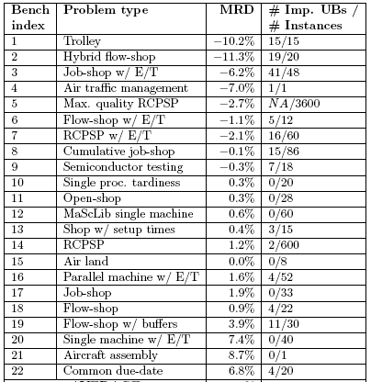
CPO for Detailed Scheduling
Results over 22 benchmarks

Slide 115
Conclusion (Model)
Limited number of concepts
Naturally fit into a CP paradigm with clearly identified decision variables/expressions and constraints
Expressive model
  Optional activities / Oversubscribed problems
  Alternative processes
  Complex synchronization between activities
  Complex cost functions (regular/non-regular, resource costs, etc.)

Slide 116
Conclusion (Search)
Ingredients to the robustness of the approach:
  LNS: efficient traversal of the search space
  POS: generality, injects flexibility for re-optimization
  Relaxation methods:
    Randomization allows diversity
    Some methods can exploit problem structure
  Re-optimization methods:
    Global vision provided by temporal relaxation
    (Limited) Tree search allows exploiting CP
  Learning

Slide 117
Future work
Continual improvement of performances
  Memory
  CPU time
Optimality proofs, gaps
[Parsimonious] extensions of the language
Some additional control of the search
  E.g.: Warm start

Slide 118
Finding out more
http://www.ilog.com/products/cpoptimizer
  White papers
  Presentations
  Data sheet

Slide 119
Finding out more
http://www2.ilog.com/techreports has some technical reports adapted from papers
  TR-07-001: (MISTA-07)
  Large neighborhood search
  TR-08-001: (FLAIRS-08)
  Reasoning with conditional time intervals
  TR-08-002:
  Scheduling model formal description
  TR-09-001: (FLAIRS-09)
  Reasoning with conditional time intervals (II)
  TR-09-002: (CPAIOR-09)
  CP Optimizer illustrated on 3 problems

