Slide 1
Proposal for the BSc. AI, UvA
O. R. Jozefzoon

Slide 2
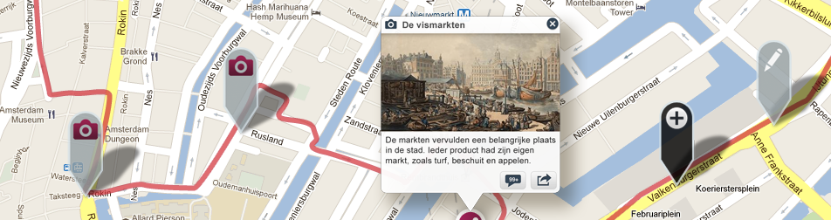
Introduction
Museum App from Amsterdam Museum
Guided touring
Iphone
New feature
Augmented Reality
Textual data -> visual markers
Visual markers -> textual data
Art & Architectural Thesaurus (Getty Research Institute)
(AAT)

Slide 3
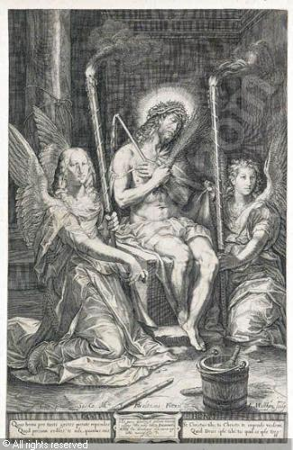
Textual -> Visual
The picture shows Christ in full-figure, sitting on a rock, with a bright aura behind his head. He is wearing the "seamless robe" wrapped around his shoulders and a veil wrapped around his waist, and a crown of thorns. His hands are crossed in gesture of humility and hold the emblematic Instruments of Passion: the whip and the hyssop (depicted as a bundle of twigs). Christ is surrounded by two kneeling angels holding burning torches; Beneath the image appears a cartouche, inscribed in Latin and dated 1603 within the lower part of the frame.

Slide 4
Research question
What is the best method for the transformation of contextualized textual architectural concepts into visual markers to be presented as overlays in AR environments?

Slide 5
Method/Approach
Collecting (pictures of) architectural objects/points
Self made pictures
Linking textual data with architectural collection
Based on the tour
Transforming contextualized textual data to model
Using AAT
Implementing application
Passing transformed data to application
(Testing)
Plaatsen van brackets om herkende object.

Slide 6
Evaluation
Unit tests
In field
Testing by data-expansion
Speed of algorithm

Slide 7
Project Schedule

